Slide 1

Cíle a charakteristiky profesního terciárního vzdělávání v ČR a Evropě
Hodnocení kvality vysokých škol
Telč, 17.-18. března 2014
Michal Karpíšek, EURASHE Vice-President
1

Slide 2
Obsah
EURASHE – reprezentace profesního terciárního vzdělávání v Evropě
Strategický rámec EURASHE
Co je profesní vysokoškolské/terciární vzdělávání? Rozdíly EU a CZ? Projekt HAPHE
  Vnímání a očekávání
  Formální zakotvení
  Návrh definice a charakteristik k diskuzi

Slide 3
MISSION & Role
EURASHE

Slide 4
EURASHE is the European association of European Higher Education Institutions (HEIs) that offer professionally oriented programmes and are engaged in applied and profession-related research within the Bologna cycles
Founded in 1990 in Patras, Greece
EURASHE’s mission is to promote the interests of professional higher education in the EHEA and to contribute to the progressive development of the Area of Higher Education and Research (EHERA)
EURASHE has been an official representation of PHE within the Bologna process since 2001 (member of E4 group)

Slide 5
Role of EURASHE
Representation & promotion of a “widely-comprehended PHE” within the changing environment:
  A variety of institutions with PHE
  Both associations and individual institutions
Policy formulation at EU/EHEA level
  Focus on HE and relevant activities, not wider context (e.g. regional policies, labour market etc.)
  Readiness to promote PHE at national level when required
Influence on decision making and developments at EU/EHEA level
Information on trends & possible solutions

Slide 6
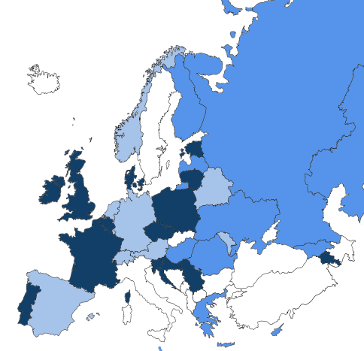
EURASHE members
17 National Associations:
  Armenia, Belgium (2), Croatia, Czech Republic, Denmark, Estonia, France, Ireland, Lithuania, Poland (2), Portugal, Serbia, Slovenia, UK (2)
29 Individual Institutions:
  Armenia, Cyprus (2), Finland (2), Georgia, Greece (3), Hungary (2), Kazakhstan (4), Latvia (3), Malta (2), Poland (2), Romania (3), Russia (3), Ukraine
8 Associate Members (organisations & indirect through sectorial associations):
  Austria, Belarus, Belgium, Cyprus, Estonia, Finland, France, Germany, Greece, Hungary, Ireland, Lithuania, Malta, Moldova, Netherlands, Norway, Portugal, Romania, Russia, Spain, Switzerland, UK, Ukraine
Over 1,400 affiliated higher education institutions in 40 countries within and outside the EHEA

Slide 7

Annual Conference 2014
QUALIFICATIONS FOR THE LABOUR MARKET
Yerevan, Armenia, May 15 – 16, 2014
More at www.eurashe.eu

Slide 8
Strategy development
2014 - 2017
Supported by the operational grant by EU Jean-Monet programme

Slide 9
EURASHE strategy
Reflection of new challenges & opportunities
Clarification of roles
Clarification of priorities
Planning approaches & tools
Communication with members
Effective use of limited resources & looking for resources supporting our objectives

Slide 10
EURASHE strategy framework
PHE Mission
Role & Position
Characteristics
Social Dimension
Education & Learning
Employability
Lifelong Learning
Qualification Frameworks
Recognition of Prior Learning
Student Centred Learning
Methods & Student Assessment
Mobility
Innovation & Development
Applied Research Promotion & Specifics including
Innovation of Professions
Innovation of Teaching/Learning
Regional Development
Sustainability
Quality
Accreditation & Evaluation
Quality Management & Enhancement
Transparency Tools

Slide 11
EURASHE strategy framework
PHE Mission
Role & Position
Characteristics
Social Dimension
Education & Learning
Employability
Lifelong Learning
Qualification Frameworks
Recognition of Prior Learning
Student Centred Learning
Methods & Student Assessment
Mobility
Innovation & Development
Applied Research Promotion & Specifics including
Innovation of Professions
Innovation of Teaching/Learning
Regional Development
Sustainability
Quality
Accreditation & Evaluation
Quality Management & Enhancement
Transparency Tools

Slide 12
Harmonisation of Approaches towards Professional Higher Education
HAPHE Project

Slide 13
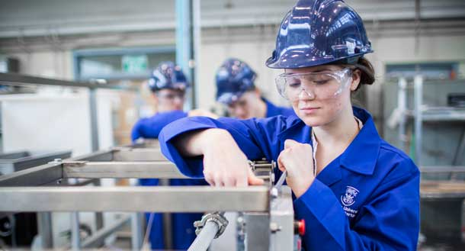
Is this PHE?

Slide 14
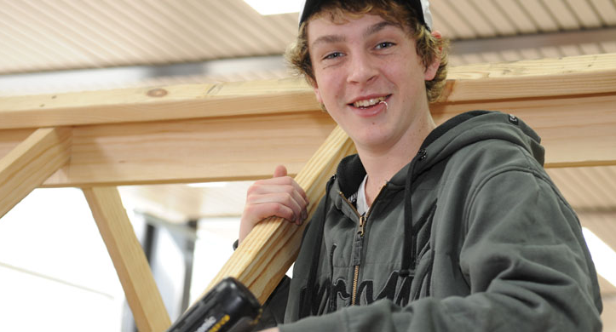
Is this PHE?

Slide 15
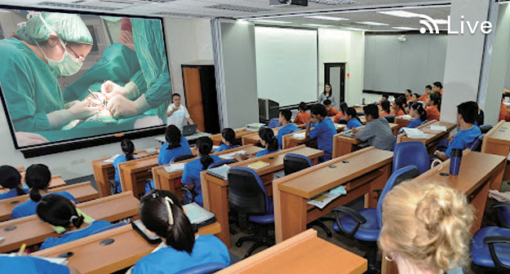
Is this PHE?

Slide 16

Introducing HAPHE
11 partners from 10 countries representing a cross-section of European PHE
0,5 million EUR of funding, over 24 months
activities include research, consultation and piloting
supported by the Lifelong Learning Programme of the European Commission

Slide 17
Methodology
15 Countries surveyed:
BE(FL), CZ, DE, DK, EE, FI, FR, HR, IE, LT, MT, NL, PL, PT SI
‘ID Cards’ built and verified for every country by professionals in PHE Sector
2 Stakeholder surveys covering internal and external stakeholders – 671 responses across 18 countries
Round tables
Drafting group
Verification seminars
Definition & characteristics
⇨ quality & transparency criteria/parameters (PHE Excel project)

Slide 18


First Results
Download Now at:
http://haphe.eurashe.eu

Slide 19
Phe role & potential
HAPHE project

Slide 20
Survey responses

Slide 21
Survey responses
Yellow = < 60 % clarity

Slide 22
What is PHE?

Slide 23
What level?
?
Country |  | PHE | level
 | EQF5 | EQF6 | EQF7 | EQF8
BE(FL)
CZ
DE
DK
EE
FI
FR
HR
IE
LT
MT
NL
PL
PT
SI
EQF 5 = Tertiary Vocational Schools / Colleges
EQF 6 = hybrid
EQF 7 = Universities of Applied Science / Universities

Slide 24
PHE & Research
We observed a trend towards increased research involvement by Institutions
Research focuses on Innovation, Technology Transfer, Applied Research & Development
defining characteristic?

Slide 25
Recognition & transfer between PHE & AHE
Full equivalence of PHE and AHE, with automatic transition between cycles and profiles
Easy transition between profiles and cycles, with bridging programmes used to prepare students for access
Difficult transition between profiles and levels – while bridging programmes exist they are extremely demanding, and form a considerable barrier to access to the next cycle.
No transition possible – in some countries it is not possible to transfer between profile and cycle, particularly from Level 7 to Level 8 of the EQF.

Slide 26
Differences between “PHEI & universities”

Slide 27
HAPHE Survey Results
HAPHE SURVEY Results
Perceptions of PHE
in the Czech Republic
Prepared by Prof. Dr. Nicole Graf, Raimund Hudak
DHBW Stuttgart, Germany
First results – 03-08-2013
EU Level versus Czech Republic HEI All Perspectives

Slide 28
Statistics EU – Czech Republic
Active participation of 18 European countries

Slide 29
Phe potential & governance

Slide 30
Q3: In your understanding:
Is the term “Professional Higher Education” clear?
Meaning and Forms
of
Professional Higher
Education
Notes:
5

Slide 31
Policy: Findings
Educational policies, i.e. from relevant government ministries regarding the scope and scale of PHE are not showing a high evidence in the Czech Republic. The data is lower than the EU average and is showing the highest level of no evidence form all countries
Economical policies from government ministries in Czech Republic are rarely to not evident. The data is showing the lowest evidence level found in the EU data.
The existing regulations, guidelines or policies that define the shape and particular structure of PHE are not explicit at all and are showing the lowest data and a very high variance to the EU data.
The majority of higher-education institutions are not interested in developing and implementing PHE in Czech Republic. The data is the lowest in the EU data set.

Slide 32
Policy: Findings
The demand from employers, professional bodies, organisations or industry representatives are important and the key main driver for PHE in the Czech Republic. The data is low compared to the EU average.
Financial benefits in cooperation with industry, as well as market demands for LLL are less important and lower than the EU average data.
The employability of graduates is a main driver for PHE in Czech Republic, but lower than the EU average.
Only 58% of the survey participants agree that there is a growing demand for well profiled PHE in the Czech Republic. This is the lowest data level in the EU data set

Slide 33
Q9: Do you agree that there is a growing demand for well profiled PHE in your country?
Meaning and Forms
of
Professional Higher
Education
Notes:
5

Slide 34
Q10: IF ANY - What are the main drivers for PHE in your country?
Meaning and Forms
of
Professional Higher
Education
EU HEI-All
Czech Republic HEI-All
Type of Main Drivers
1-Not important
at all
2
3
4
5-Very
important
Economic policies
Educational policies
Demands from employers, professional bodies,
organisations or industry representatives
Student demands for
job-related education
PHE best practices at other institutions
(competitiveness among institutions)

Slide 35
Q10: IF ANY - What are the main drivers for PHE in your country?
Meaning and Forms
of
Professional Higher
Education
EU HEI-All
Czech Republic HEI-All
Type of Main Drivers
1-Not important
at all
2
3
4
5-Very
important
Financial benefits in
cooperation with industry
Skills shortage in the market
Market demands for job profile
upgrading (e.g. health sector)
Market demands for LLL
(Lifelong Learning)
Employability of graduates

Slide 36
Q25. Over the next years, industry demand for employees with qualifications combining practical skills and academic higher education will increase.
Trends and Drivers
for
Professional Higher
Education
Notes:
5

Slide 37
Q19. Are there regulations, guidelines or policies that explicitly define the shape and particular structure of PHE in your country?
Development
of
Professional Higher
Education
Notes:
5

Slide 38
Interaction with the World of Work : Findings
A significant number of participants perceive that the cooperation between higher education and professional sphere is not frequently occurring and used practice. All data from Czech Republic are lower than the EU average data.
There is some involvement of employers in policy development. The data shows a high variance compared to the EU average.
There is a very low level of involvement of companies in the evaluation / accreditation in Czech Republic. The data is the lowest level and shows a high variance to the EU average.
The provision of internships is frequently occurring, but lower than the EU average
The participants state that the importance of PHE in the labour market is not very high in Czech Republic. The data is the lowest compared to other EU countries….
… and the rate of the current offer / fulfilment is seen as low in Czech Republic compared to the EU average.

Slide 39
Meaning and Forms
of
Professional Higher
Education
Q12: One important aspect of PHE should be the cooperation between higher education and professional sphere.
To what extent does it exist in your country?
EU HEI-All
Czech Republic HEI-All
Limkages
1-Not
existent
2
3-Frequently
occuring
4
5-Used
practice
Involvement of employers in
policy development
Involvement of employers in the
QA procedures of higher education institutions
Involvement of employers in setting
learning outcomes / curriculum design
Involvement of companies in
evaluation / accreditation

Slide 40
Meaning and Forms
of
Professional Higher
Education
Q12: One important aspect of PHE should be the cooperation between higher education and professional sphere.
To what extent does it exist in your country?
EU HEI-All
Czech Republic HEI-All
Type of Main Drivers
1-Not
existent
2
3-Frequently
occuring
4
5-Used
practice
Collaboration with employers
in defining new study programs
Collaboration with employers
in delivery of study
programs / teaching
Provision of internships

Slide 41
Quality: Findings
The main drivers in pursuing quality management are accreditation requirements and continuous improvement. The Czech Republic data is lower than the EU average.
Institutions´ internal policies are also seen as a main driver stimulating quality, but less compared to other EU countries
National or regional programmes stimulating quality requirements for HE is no key drivers for quality requirements.
Overall most of data points pursuing quality requirements from the Czech Republic are showing lower ratings compared to the EU data average

Slide 42
Q15: What are the main drivers in pursuing quality requirements for HE in your country?
Quality Delivery
of PHE
EU HEI-All
Czech Republic HEI-All
Type of Main Drivers
1-Completely
disagree
2
3
4
5-Fully
agree
Accreditation requirements and
continuous improvement
Institutions’ internal
developments and policies
Competition for students
Demands from private sector
National or regional programs
stimulating quality

Slide 43
Q21. Are the majority of higher-education institutions interested in developing and implementing PHE in your country?
Development
of
Professional Higher
Education
Notes:
5

Slide 44
Defining phe…
NEXT PRESENTATION

Slide 45
Definition of PHE
Professional Higher Education is a distinct form of Higher Education that offers a particularly intense integration with the world of work in all its aspects (including teaching, learning, research and governance) and at all levels of the overarching Qualifications Framework of the European Higher Education Area.
Its’ function is to diversify learning opportunities, enhance employability, offer qualifications and stimulate innovation, for the benefit of learners and society.
The world of work includes all enterprise, civil society organisations, and the public sector. The intensity of integration with the world of work is manifested by a strong focus on application of learning. This approach involves combining phases of work and study, a concern for employability, cooperation with employers, the use of practice-relevant knowledge and use-inspired research.

Slide 46
PHE Characteristics Framework
Defining
Characteristics
of
Professional Higher
Education
According to the overall aim of the project to harmonise approaches to professional higher education in Europe a set of key characteristics were defined.
In particular the project objectives are to reinforce the role of professional higher education within overall HE provision in order to:
  Better interconnect education, the labour market, research and innovation
  Accelerate the development of professional education
  Improve coordination and collaboration amongst actors in the sector
The following framework defines multidimensional characteristics of Professional Higher Education and quality indicators – the core criteria for each characteristic.

Slide 47
PHE Characteristics Framework
Policy and Strategy :
  How is PHE embedded and represented in the overall strategic framework and policies of higher education institutions?
Teaching and Learning:
  How is teaching and learning influenced through specific characteristics of PHE?
Research
  How is research integrated as part of a sustainable PHE, recognising that it might differ from level to level and has not been implemented in all institutions yet?

Slide 48
PHE Characteristics Framework
Policy and Strategy:
    Policy and Strategy Integration
    Objectives and Outcomes of PHE
    Regional Integration
Teaching and Learning:
    Methods of Curriculum Development
    Learning Methodology
    Content for Teaching and Learning
    Learning Environment
    Programme Team
Research:
    Research Agenda
    Research Process
    Research Outputs and Outcomes

Slide 49
PHE Characteristics Framework
Characteristics | Description | Core Criteria
Policy and Strategy How is PHE embedded and represented in the overall strategic policies and framework of higher education institutions.
Policy and Strategy Integration | Integration of the world of work into policy and strategic frameworks | Institutional policies and strategies are defined in collaboration with the world of work.
Objectives and Outcomes | Main objectives in relation to the outcome of PHE | PHE specifically focuses on enhancing job related skills and competencies with a view to raising employability of students. The emphasis is on learning outcomes and profession-oriented research.
Regional Integration | Engagement with its regions | PHE is strongly embedded in regional partnerships with the world of work.

Slide 50
Characteristics | Description |  | Core Criteria
Teaching and Learning How is teaching and learning influenced through the specific characteristics of PHE?
Methods of Curriculum Development | Curriculum development refers to - methods of learning design and development of curricula learning objectives and outcomes. | Curricula are developed by academia in collaboration with stakeholders, in particular with the world of work. Curricula are aligned to the future needs of the practice and employment context based on evidence.
Learning Methodology The How | The learning methodology comprises the learning design the assessments needed to assess the learning outcomes. | The learning methodology comprises methods of active, collaborative and self-organised learning and while focussing on experience based learning methods including but not limited to simulation based learning (SBL), scenario based learning (SceBL), problem based learning (PBL). Both formative and summative assessments should reflect the nature and methodology of the specific PHE learning environment.
Content for Teaching and Learning The What | The content comprises working methods, practice examples a syllabus and other materials, | The learning content is productively integrating theory and practice through examples, case studies, problem- & project-based learning, latest research or trends and references from both perspectives, the world of work and the academia.

Slide 51
Characteristics | Description | Core Criteria
Teaching and Learning How is teaching and learning influenced through the specific characteristics of PHE.
Learning Outcomes The Why | The learning outcomes refer to what a learner is expected to know, understand and be able to do as the result of a process of learning | The learning outcomes reflect essential knowledge, skills, and attitudes related to the specific professional requirements but should not be limited to this. In addition students acquire professional and life skills which enable them to act successfully and in a self-organised way in a potentially changing work environment.
Learning Environment The Where | The learning environment refers to the surroundings and conditions in which learning takes place | The learning environment includes experience within the Institution as well as outside, in the world of work. Significant practice phases and/or job experiences serve to reflect theory in a practical context.
Programme Team The Who | The programme team refers to all persons involved in the design, delivery and assessment of learning, including visiting lecturers, professionals and support staff | At the programme level, the team shows an appropriate balance of academic background and relevant experience from the world of work.

Slide 52
Characteristics | Description | Core Criteria
Research How is Research integrated as part of a sustainable PHE, recognising that it might differ from level to level and is not implemented in all institutions yet?
Research Agenda | The research agenda is the scope of the research activity | The research agenda is informed by the world of work in order to meet the needs of society and of enterprises.
Research Process | Academic and practical or applied research | Researchers seek input from the world of work and value stakeholders’ requests and contributions. The research process respects the nature of the inputs and can include various types of research activities and scholarship, as appropriate to the EQF level.
Research Outputs and Outcomes | The expected result of research | The research outputs are likely to include licenses, patents, professional masters and professional doctorates. Research outcomes aim to be relevant to the world of work.

Slide 53
Questions for Verification
Is the definition also describing your understanding of PHE?
Do you believe this definition can fit the whole sector of HE?
Do you believe the previously mentioned dimensions and characteristics cover all aspects of PHE when looking for characterisation?
Is there any important dimension missing?
Do you agree with the PHE characteristics?
What would you like to change / add?
Are the PHE framework and characteristics adequate to cover the complexity of PHE?

Slide 54

Acknowledgements
HAPHE Consortium
European Association of Institutions in Higher Education (EURASHE)
Cooperative State University Baden Wurttemberg
Knowledge Innovation Centre
Skupnost Višjih Strokovnih Šol
Czech Association of Schools of Professional Higher Education
Tallinna Tehnikakõrgkool University of Applied Science
Vlaamse Hogescholenraad (Vlhora)
Association of University Institutes of Technology Directors
Conselho Coordenador dos Institutos Superiores Politécnicos
Państwowa Wyższa Szkoła Zawodowa w Tarnowie
Vijeće veleučilišta i visokih škola
Conclusions/presentations
Anthony Camilieri - KIC Malta
Research Leaders
Raimund Hudak – DHBW
Marek Frankowicz – PWSZTAR
Project Leaders
Stefan Delplace
Iva Voldanova, Marko Grdosic, Alexandre Wipf
This project has been funded with support from the European Commission. This publication reflects the views only of the authors, and the Commission cannot be held responsible for any use which may be made of the information contained therein.
Released under a Creative Commons Attribution ShareAlike 3.0 Belgium License
You are free:
to Share — to copy, distribute and transmit the work
to Remix — to adapt the work
Under the following conditions:
Attribution — You must attribute the work in the manner specified by the author or licensor (but not in any way that suggests that they endorse you or your use of the work).
Share Alike — If you alter, transform, or build upon this work, you may distribute the resulting work only under the same or similar license to this one.

Slide 56
Michal Karpíšek
karpisek@ssvs.cz
+420 603 253 392

