Slide 1
Introduction to MS Dynamics NAV (Blanket Orders)
Ing.J.Skorkovský,CSc.
MASARYK UNIVERSITY BRNO, Czech Republic
Faculty of economics and business administration
Department of corporate economy

Slide 2
Blanket Orders
Reasons
One Order frames several partial Order over long period
Customer can get better prices and call of any time deliveries based on instant needs
Vendor knows what have to be purchased/produced in the beforehand specified periods – Blanket Order represents a part of forecasting rules
BO->type of long term contract
Similar to forecast matrix, but with existing customer

Slide 3
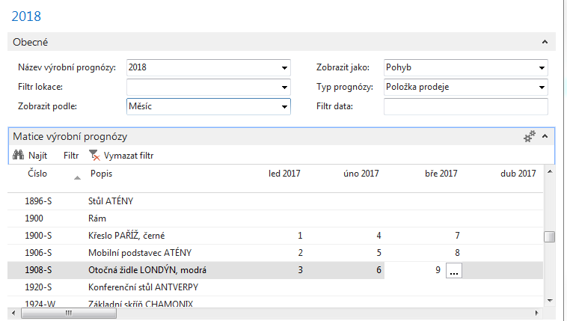
Forecast
We expect to sell these items, but no real customer so far exists !!!

Slide 4
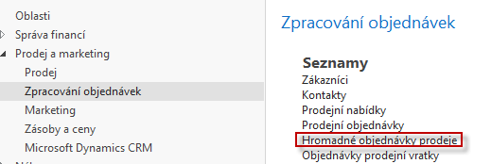
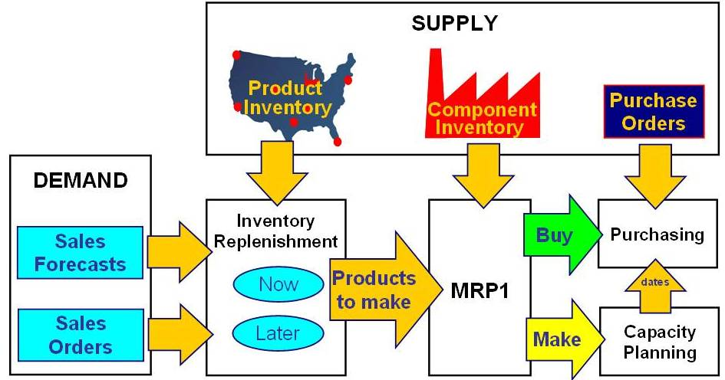
Blanket Orders
Ctrl-N

Slide 5
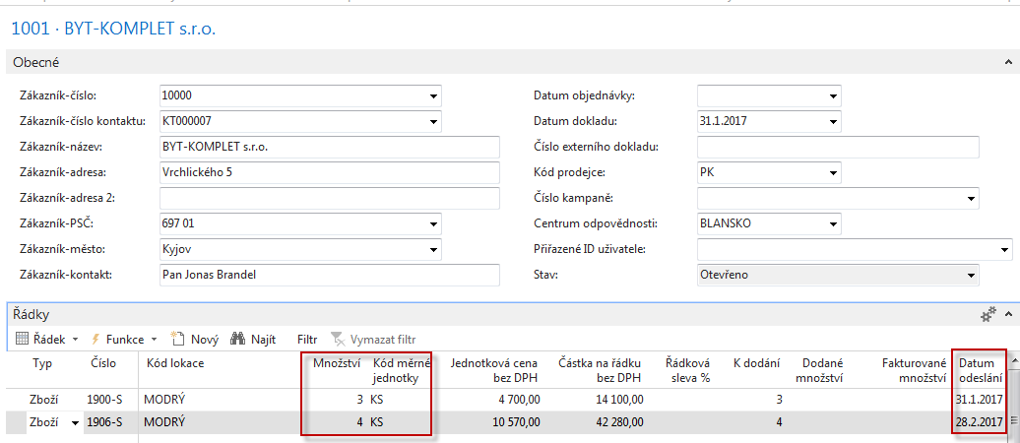
Blanket Orders

Slide 6
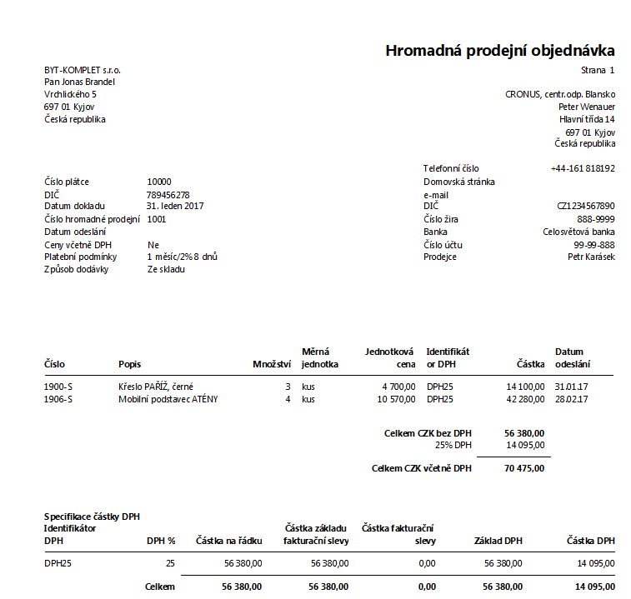
Blanket Order-print (preview)

Slide 7
Partial Sales Order Creation
Blanket Order Header
Customer
3
31.1.17
4
28.2.17
Blanket Order Lines
Item 1
Item 2
Sales Order 1
Sales Order 2
2
31.1.17
3
28.2.17
Time

Slide 8
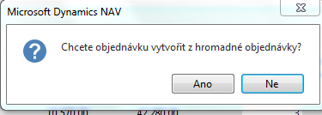
Partial Sales Order Creation
Customer 10000

Slide 9
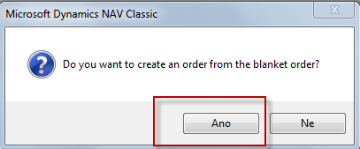
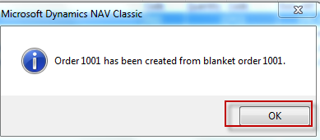
Partial Sales Order Creation

Slide 10
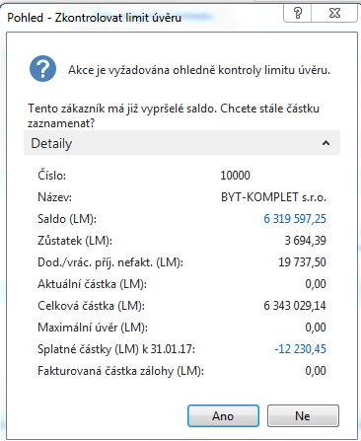
Partial Sales Order Creation

Slide 11
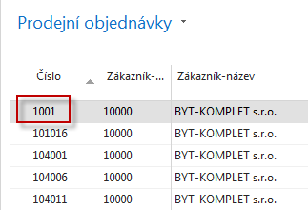
Partial Sales Order Creation
Blanket order is not modified
for the time being !!
Filtered Sales Order List fro customer 10000
Sales Order 1001
31.1.17
28.2.17

Slide 12
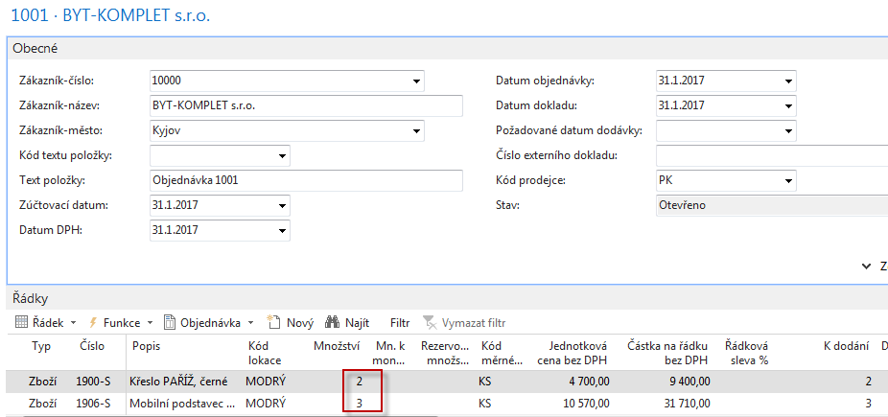
Created Sales Order
Created sales order 1001 for Customer 10000

Slide 13
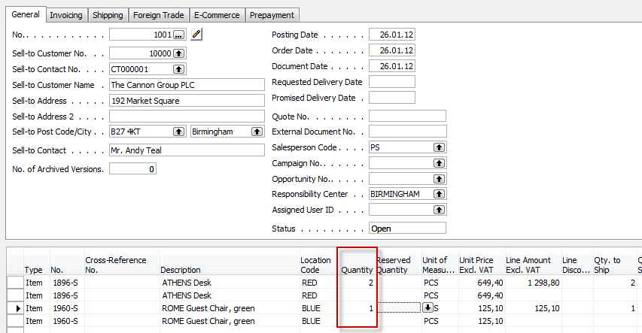
Created Sales Order
New
status
Former
status

Slide 14
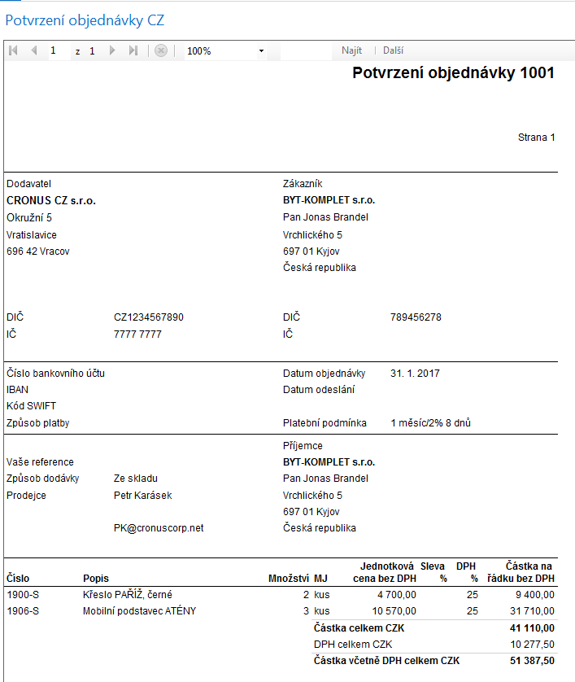
Print of created Sales Order

Slide 15
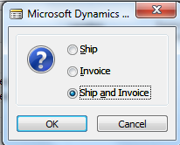
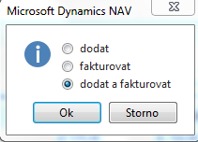
Sales Order - posting
F9
ENG Version
CZE Version

Slide 16
Blanket Order after linked SO was posted
3-2=1 & 4-3=1

Slide 17
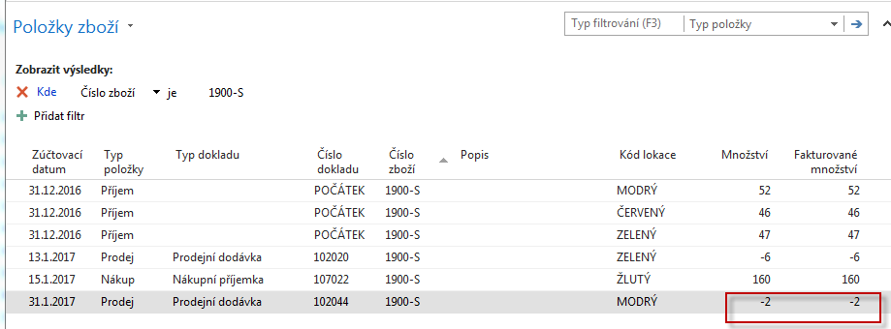
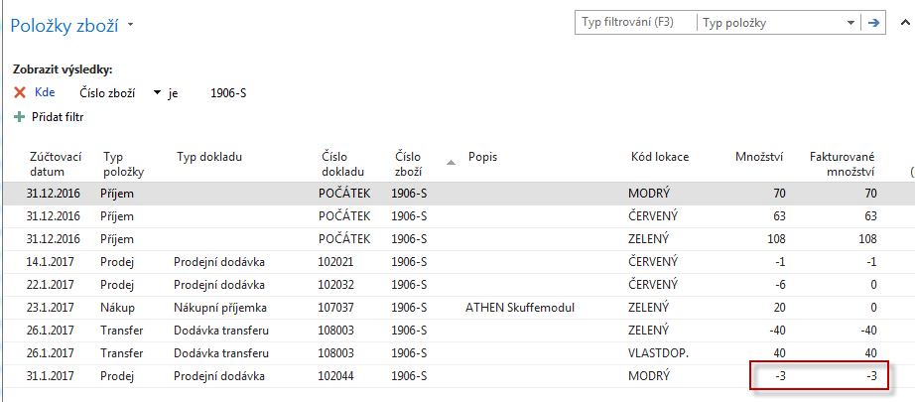
Item Ledger Entries

Slide 18
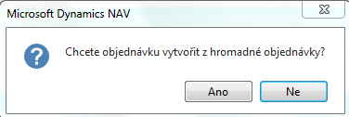
Blanket Order next delivery

Slide 19
After SO 1002 was posted
Lines of the blanket order
Item ledger entries

Slide 20
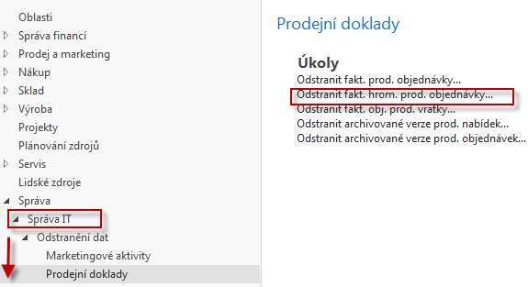
Deleting processed Blank Orders
Used Blanket Order (BO) can be copied to use it again (after modification- if any)

Slide 21
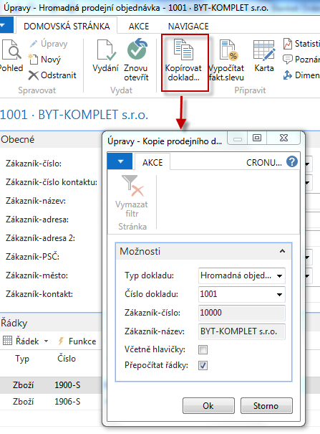
BO copy

Slide 22
BO can be used for replenishment (purchase)

Slide 23
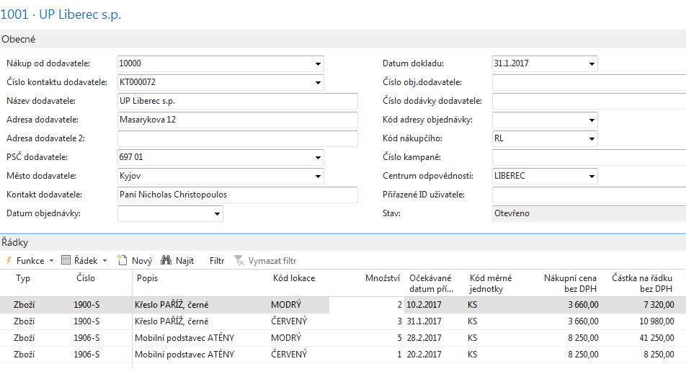
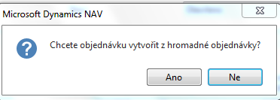
Purchase Blanket order

Slide 24
Purchase order lines (after modification or PBO lines)
Purchase blanket order lines
Purchase order lines

Slide 25
Purchase Blanket order after posting PO

Slide 26
End of the section (Blanket orders)

