Slide 1
Basic production algorithms and its main concepts
Ing.J.Skorkovský,CSc.
and various listed sources
Department of Corporate Economy
Slides 2-18 –basic production theory and 29-48 practical NAV example
Comment : without basic production theory it is useless to model production in ERP

Slide 2
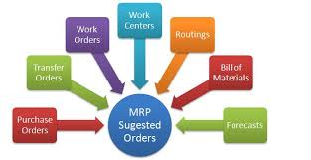
Main concepts
MRP=Material Requirements Planning (push)
MRP_II=Manufacturing Resource Planning (push)
APS = Advanced Planning and Scheduling
JIT = Just In Time (pull)
TOC (Drum-Buffer-Rope) (push-pull->combined) – was presented in another session of this course
Work Order=Production order in MS Dynamics NAV

Slide 3
BOM=Bill Of Material (structure of the product)
Component
0
A
B
Product|Semiproduct
500
1
200
0,1,2,,..Low Level Codes
100
100
600
2
300
300
400
3
300
400
Independent demand for products and semi-products and dependent for components
Planning backward from production schedule (independent) to dependent- demand components -without statistically calculated Reorder Point (ROP)– see next lesson and next slide as well
IF ROP is not taken into consideration – MRP is PUSH system -> it computes the schedule of what should be started (pushed) into a system, that authorizes production as inventory is consumed (ROP will be explained later in this session- only Czech course BPH-PIS2)
HOME STUDY

Slide 4
Push system
Purchase orders
Forecast
MRP|ERP
Operation 1
Operation 2
Operation 3
Operation 4
Supplier1
WIP
WIP
Customer 1
ROUTING
(how to do it)
Supplier 2
Component
warehouse
FG warehouse
Customer 2
Supply
Demand
Take it !
WIP

Slide 5
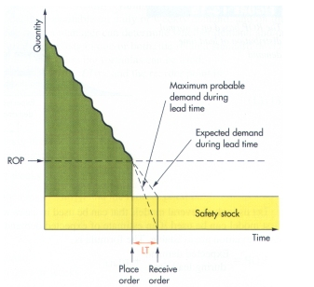
Determination of the Reorder Point (ROP)
ROP=expected demand during lead time + safety stock
Expected demand=30
50-20=30
50=ROP
20
LT =Lead time

Slide 6
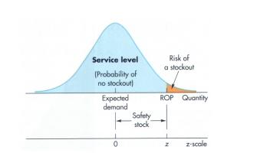
Determination of the Reorder Point (ROP) (home study - AOPR-only for avid readers- will be not discussed during exams)
ROP = expected demand during lead time + z* σ_{dLT}
where z = number of standard deviations and
σ_{dLT =} the standard deviation of lead time demand and z* σ_{dLT} =Safety Stock
aan

Slide 7
Example ( Pareto analysis and ABC model simplified - PWP will be shown later) (home study - AOPR-only for avid readers- will be not discussed during exams)
The manager of a construction supply house determined knows that demand for sand during lead time averages is 50 tons.
The manager knows, that demand during lead time could be described by a normal distribution that has a mean of 50 tons and a Standard Deviation of 5 tons (σ_{dLT )}
The manager is willing to accept a stock out the risk of no more than 3 percent

Slide 8
Example-data (home study - AOPR-only for avid readers- will be not discussed during exams)
Expected lead time averages = 50 tons.
σ_{dLT} = 5 tons
Risk = 3 % max
Questions :
What value of z (number of standard deviations) is appropriate?
How much safety stock should be held?
What reorder point should be used?

Slide 9
Example-solution (home study - AOPR-only for avid readers- will be not discussed during exams)
Service level =1,00-0,03 (risk) =0,97 and from probability tables you will get z= +1,88
See next slide with probability table

Slide 10
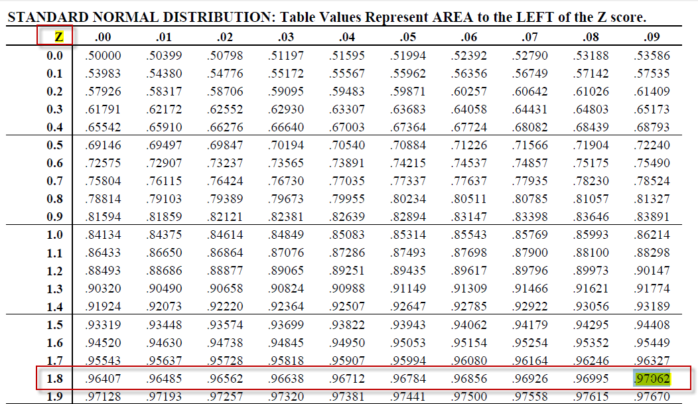
Probability table home study - AOPR-only for avid readers- will be not discussed during exams

Slide 11
Example-solution (home study - AOPR-only for avid readers- will be not discussed during exams)
Service level =1,00-0,03 =0,97 and from probability tables we have got : z= +1,88
Safety stock = z * σ_{dLT} = 1,88 * 5 =9,40 tons
ROP = expected lead time demand + safety stock = 50 + 9.40 = 59.40 tons
For z=1 service level =84,13 %
For z=2 service level= 97,72 %
For z=3 service level = 99,87% (see six sigma)

Slide 12
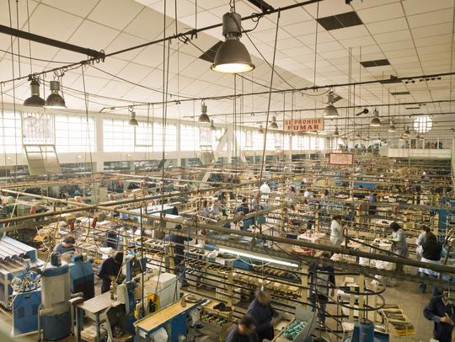
MRP_II =MRP + resource capacity planning
Rough-cut capacity planning
MPS
Demand
management
BOM
MRP
Intermediate-range
planning
Scheduled
receipts
Job
Pool (planned)
Capacity requirement planning
Job Release
Routings
(operations)
Short term
control
(Shop floor)
Job
Dispatch

Slide 13
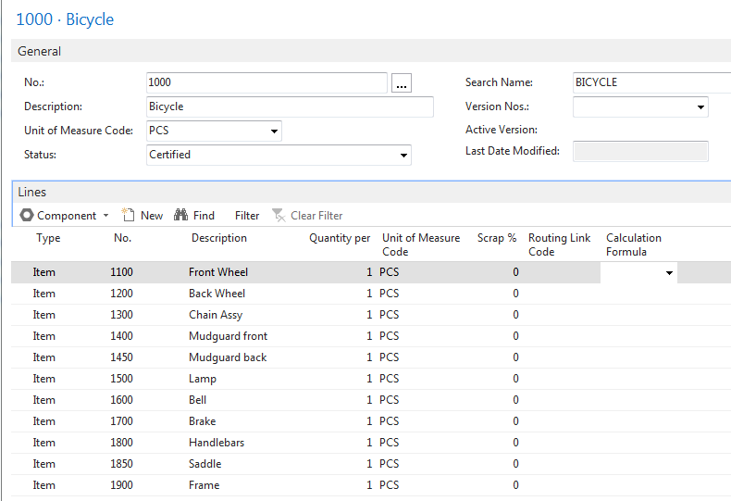
BOM in MS Dynamics NAV
7
6
5
4
3
2
1
B OM = Bill of Material

Slide 14
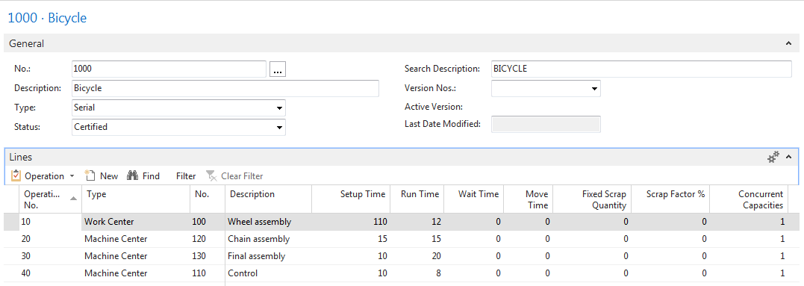
Routings in MS Dynamics NAV

Slide 15
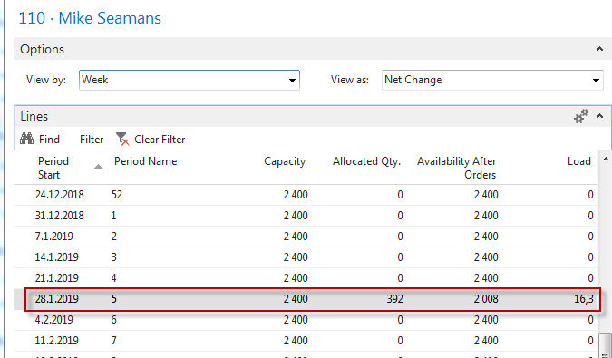
Capacity of resources in MS Dynamics NAV

Slide 16
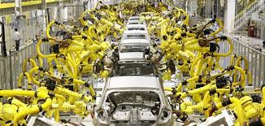
JIT=Just In Time
Toyota Motors and Taiichi Ohno
Production based only on demand
Lower inventory costs
The concept behind it is that a company can save money on parts and components---by not have having to store them--- if they are delivered to the assembly line just in time to be installed on the car as it is being built.

Slide 17
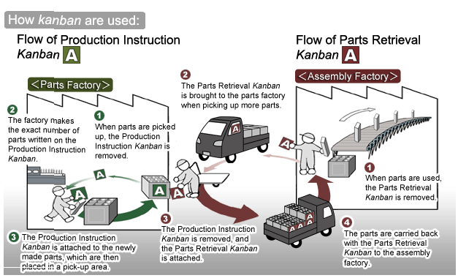
Kanban principle
(home study not fro AOPR-AOMA)
Resource :

Slide 18
Orders Tracking
Customer
Vendor
Sales Order
Tracking
Planning production (MRP-II )
Requisition Worksheet (MRP)
Tracking
Sales Order Line
Tracking
Production Order
Purchase Order
Tracking
Bill of Material
Stock
Supply
Demand
Routing (OP1-OP4)
Supply
Tracking

Slide 19
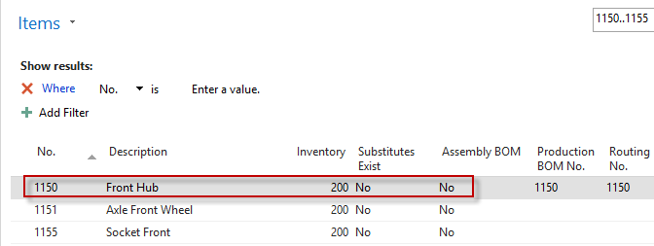
Product and two components
1150
Product
1151
1155
Components
Bill of material

Slide 20
Requirement=Demand
Request=Demand (Sales Order) will be for Front Hub 1150 (200), whose BOM consists of two 1151 components (200 in stock) and 1155 (200 in stock).
Preparing data for example: Change both components (1151 and 1155) the following parameters :
Reordering policy: Lot-for-Lot. Furthermore, with the help of an Item Journal, sell 200 pieces of 1150 and its components 1151 and 1155.
Attention: components and product are not stored at any location. Next, change on the Replenishment tab for both components the Vendor number to 10000. The result of the demand (request) will be the production order planning and subsequent consumption registration of components and resources and put-away of the final product
Set Scrap%=0 on all involved items !!!! Lot size parameter on all involved items=0!

Slide 21
Item (Final) 1150
Set Scrap%->0 !!!

Slide 22
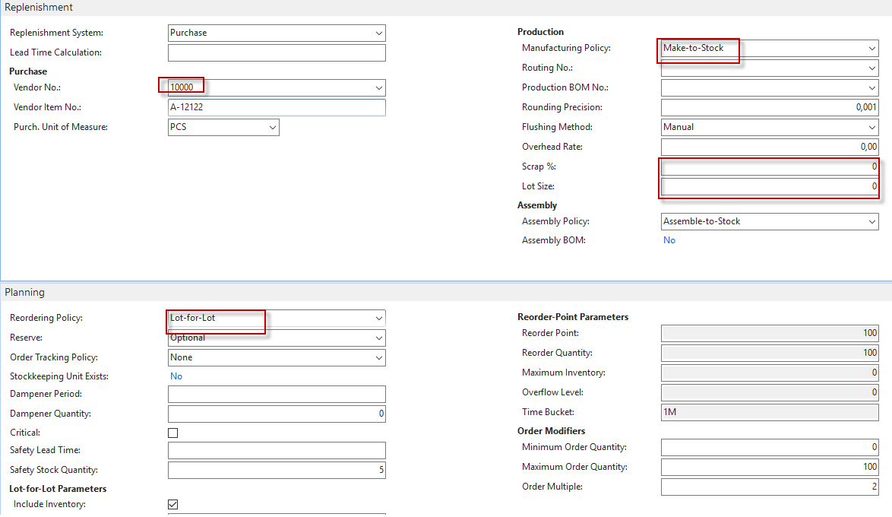
Partial setup of components (both)
Safety stock value set to 0

Slide 23
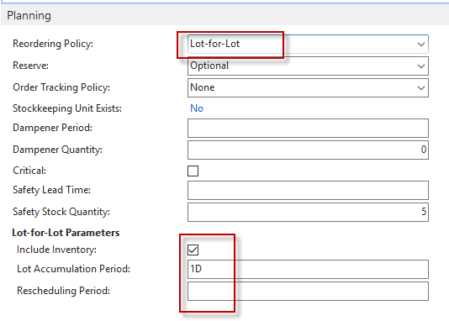
Item (Final) 1150
0
Safety stock value
set to 0

Slide 24
Items (components) 1151 ( 1155 has the same setup)
Safety stock value set to 0

Slide 25
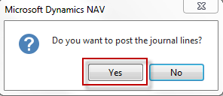
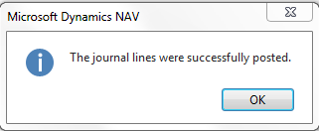
Use of Item Journal to „clean“ inventory How to go there ->Warehouse ->Inventory->Tasks->Item Journals
Post it by F9
See related item ledger entries !!!

Slide 26
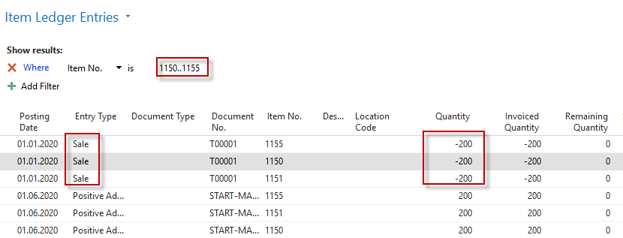
Item ledger entries Use Ctrl-F7 and filters

Slide 27
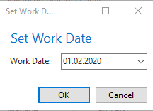
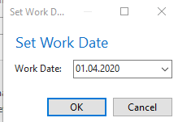
Working date setup
1.4.2020

Slide 28
Sales Order for 100 pcs Demand creation- reason for production planning
You might be notified that item 1150 is not in stock !! Our reaction to warning should be YES (if warning message generated)
Next, change the Scheduled Delivery Date in the sales line to 20.4. 2020, well away from the working date (1.4.2020)
Reason: that the scheduling algorithm does not schedule the start of production to date before the working date
Part of the sales line

Slide 29
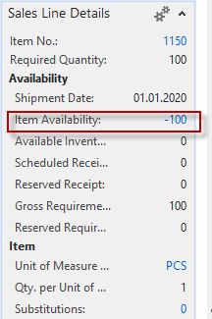
Sales Order lines for 100 pcs
Demand
created

Slide 30
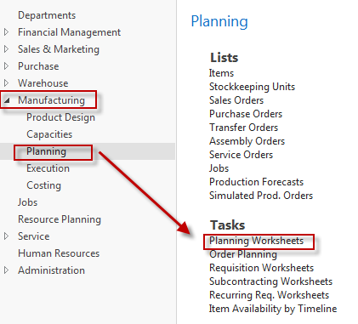
Planning worksheets (MRP)
MRP = Material Requirement Planning

Slide 31
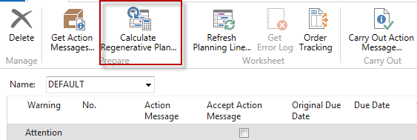
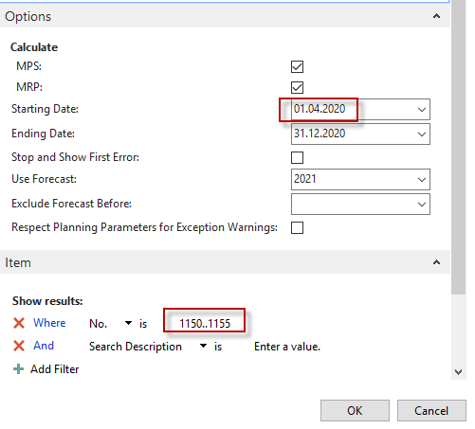
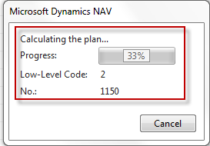
Planning worksheets
Planning Batch job is running…

Slide 32
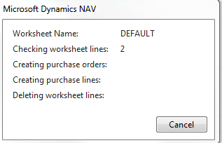
Planning worksheets
Creation of Purchase order and
Production order
Planning worksheet
Production
order
Purchase
order
Diagram of the pocess
1150
1151
1155

Slide 33
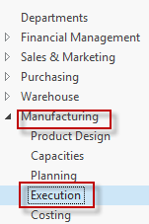
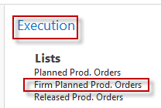
Firm Planned Production Orders

Slide 34
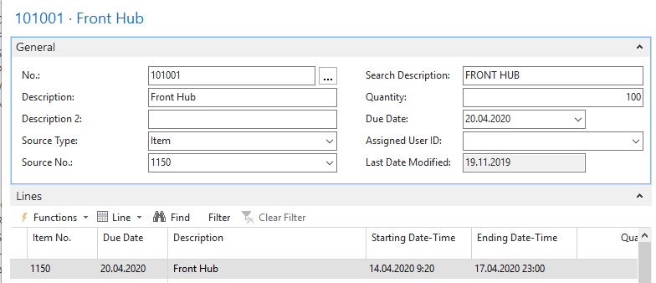
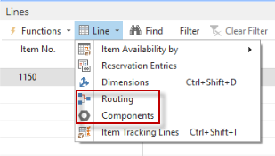
Firm Planned Production Order
See next slide

Slide 35
Bill of Material (BOM) & Routing
To go to Routing and Components (BOM) use ikon Line ) see previous slide
To go to Demand use Icon Function and Order Tracking

Slide 36
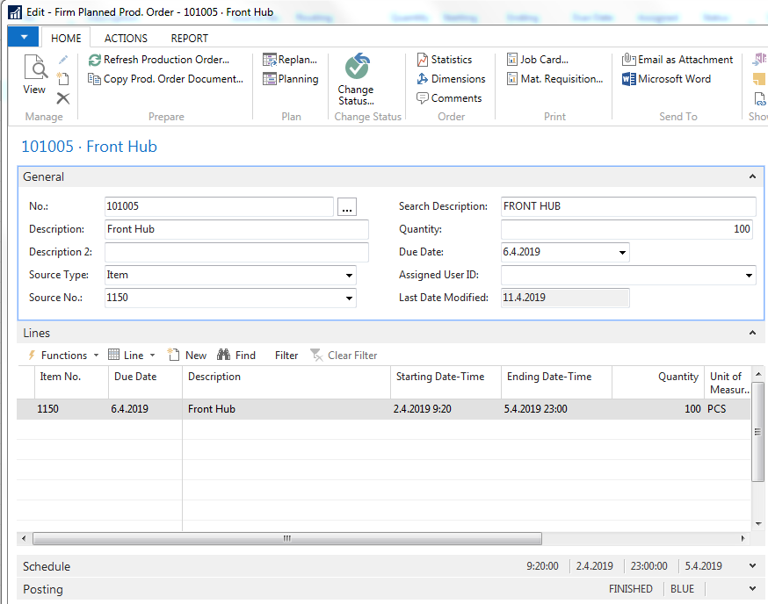
Firm Planned Production (animated)
To go to Routing and Components use ikon Line
To go to Demand use Icon Function and Order tracking

Slide 37
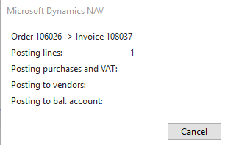
Created Purchase Order lines (Purchasing->Order PROcessing->Purchase Orders)
Lines of the Purchase order
Post it by F9 and then
see related item ledger entries !!!
See next slide

Slide 38
Item ledger entries (only components)
Used filter to see only entry type=Purchase

Slide 39
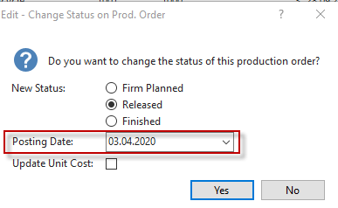
Change the status of Production Order
From status Firm Planned to status Relesed
Before planning we have changed working day to 3.4.2020

Slide 40
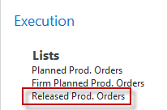
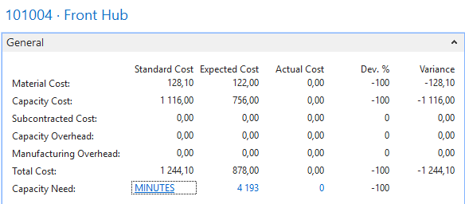
Statistics from Relesed Production Order (F7)
Click and edit->Released Production Order->F7

Slide 41
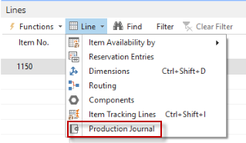
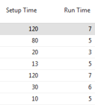
Production Journal (from icon Lines)
Released
Production Order
We need to register time of manchines
and consumption of components
Manually
Data such as Setup times and Run Times was entered manually. We have used exact data from original Routing
Post it by F9 and then

Slide 42
Item entries after registering (F9)

Slide 43
End of the English section
This is the end Beautiful friend This is the end My only friend, the end…
So why worry now ……

Slide 44
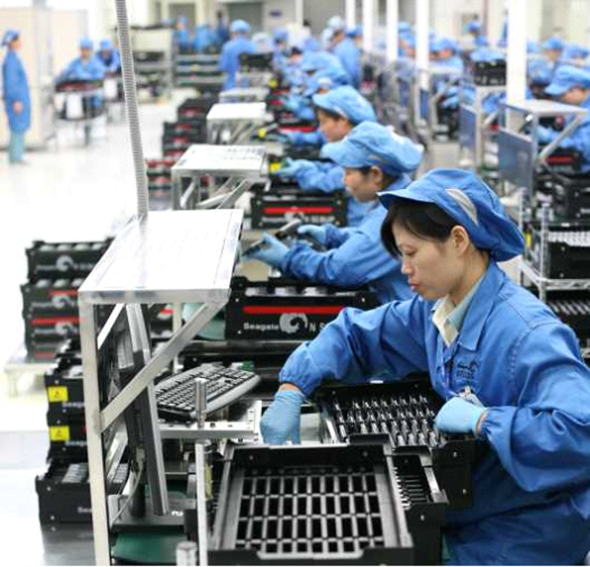
Czech version of the example Česká verze příkladu na výrobu
Určeno pro kurzy BPH_PIS- BPH_PIS2

Slide 45
Požadavek
Požadavek (Prodejní objednávka) bude na prodej Předního náboje 1150 (na skladě 200),
jehož kusovník se skládá ze dvou komponent 1151 (200 na skladě)
a 1155 (200 na skladě).
Příprava dat pro příklad : Změňte u obou komponent (1151 a 1155)
Způsob přiobjednání na Dávka-pro- dávku. Dále s pomocí deníku zboží prodejte 200 ks
výrobku 1150 a jeho komponent 1151 a 1155. Pozor: komponenty i výrobek
nejsou uloženy na žádné lokaci. Dále změňte na záložkách Doplnění
u obou komponent dodavatel na 10000. Dále vynulujte pole zmetky a pole
Bezpečnostní zásoba
Výsledkem požadavku bude naplánování Výrobní zakázky a její následné odhlášení
(komponenty do spotřeby a výrobek na sklad)

Slide 46
Vynulování počtů 1150..1155 na skladě
Deník zboží ->F9

Slide 47
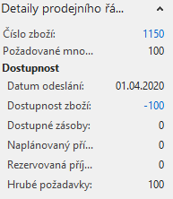
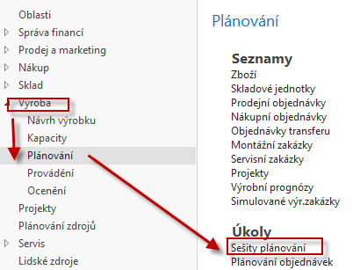
Prodejní objednávka na 100 ks 1150
Dostaneme upozornění, že podsestava kola 1150 není na skladě !! Reakce->ANO
Dále změňte Plánované datum dodávky na datum 20.4. , tedy dostatečně daleko od pracovního data – Důvod : aby plánovací algoritmus neplánoval počátek výroby na data před pracovním datem.
Prodejní řádek
Další krok procesu plánování
Viz další snímek

Slide 48
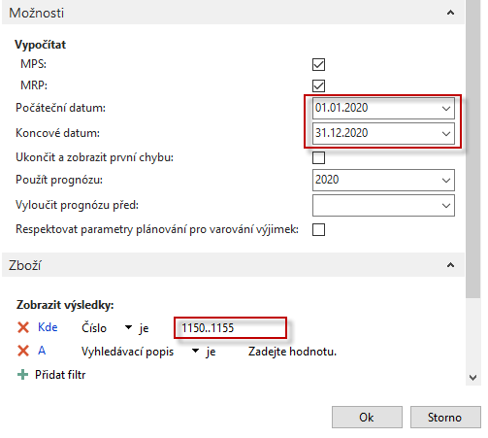
Plánovací sešit
Plánované datum dodávky (viz prodejní řádek)
je pro tuto databázi 4.5.2017. Do Čísla zboží zavedeme ručně Jak číslo výrobku tak i čísla komponent ->1150|1151|1155
Viz další snímek

Slide 49
Sledování zakázky

Slide 50
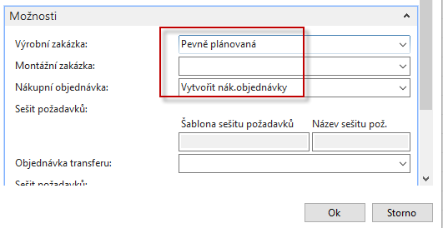
Seši plánování po naplánování
Plánovací sešit
Výrobní
objednávka
Nákupní objednávka
1150
1151
1155

Slide 51
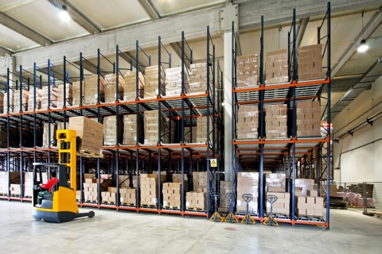
Řádky nákupní objednávky
Doplňte číslo faktury dodavatele a zaúčtuje F9->podívejte se na položky zboží

Slide 52
Položky zboží po zaúčtování příjmu komponent

Slide 53
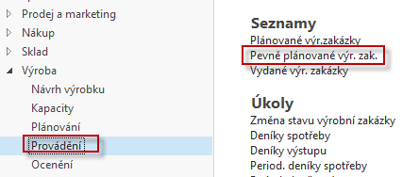
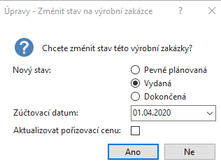
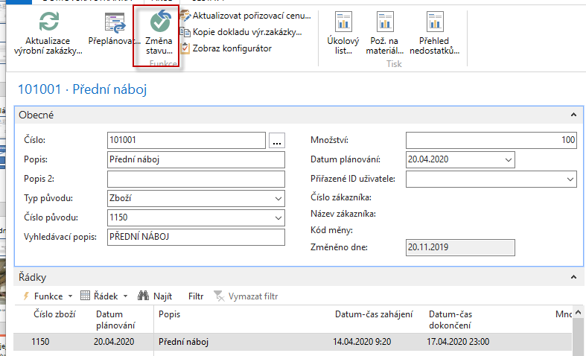
Výrobní zakázka a změna jejího stavu (Pevně plánovaná VZ ->Vydaná VZ)

Slide 54
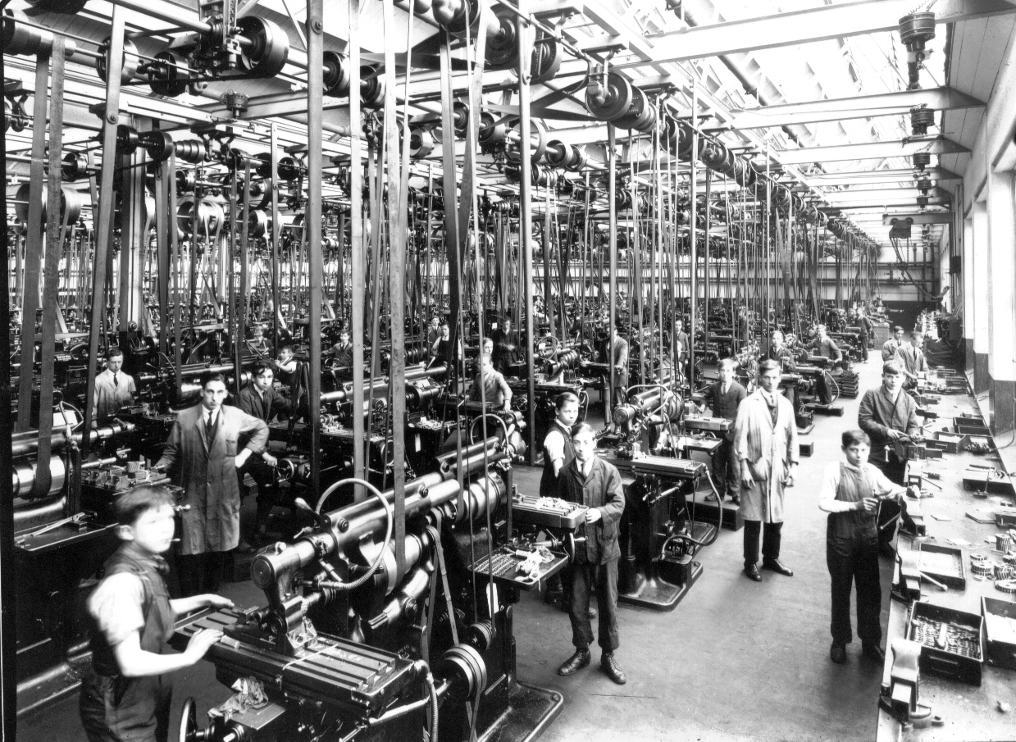
VZ je v dílně

Slide 55
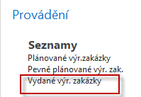
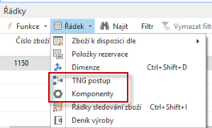
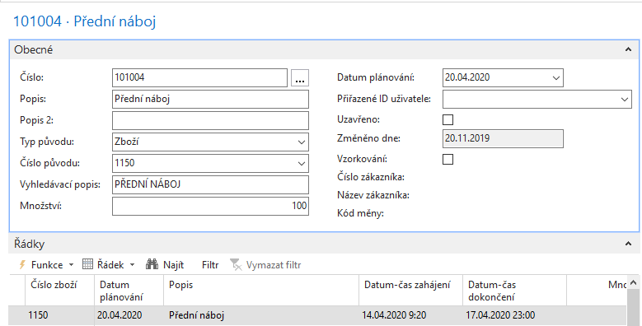
Vydaná VZ a její komponenty
Viz další snímek

Slide 56
Kusovník a technologický postup
Řádek VZ->Komponenty
Řádek VZ->TNG postup

Slide 57
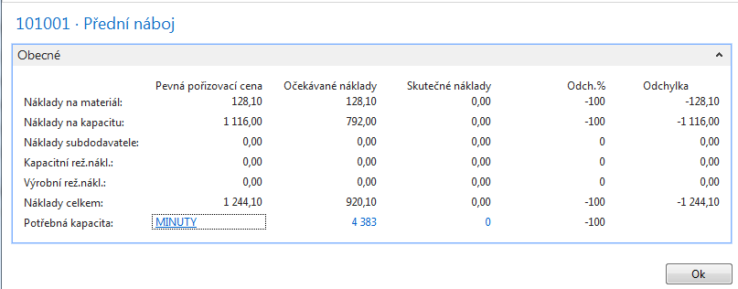
Statistika VZ (s pomocí F7)

Slide 58
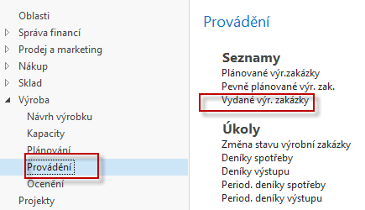
Odhlášení spotřeby a zdrojů
V řádku VZ vydané, kde je ikona Funkce najdete Deník výroby
Zadejte ručně odhadnutou dobu seřízení a zpracování včetně spotřeby materiálu.
Zadané hodnoty by se neměly lišit od TNG postupu uvedeného pře několika snímky.
Na dalším obrázku to zobrazíme ještě jednou pro ulehčení zadávání hodnot do
Výrobního deníku. Zde se často používají dotykové obrazovky a BAR čtečky

Slide 59
Deník výroby po vyplnění
Záměrně je množné některé časy změnit- reálné časy nemusí přesně odpovídat plánu.

Slide 60
Statistika VZ po zaúčtování deníku

Slide 61
Položky VZ po zaúčtování (VZ->Ctrl-F7)

Slide 62
Dokončená VZ

Slide 63
VZ- kalkulace

Slide 64
Konec CZ sekce výroba
Děkuji za pozornost !!

