Slide 1
Introduction to MS Dynamics NAV (Basic of payments)
Ing.J.Skorkovský,CSc.
MASARYK UNIVERSITY BRNO, Czech Republic
Faculty of economics and business administration
Department of corporate economy

Slide 2
General Journals and its use in G/L
It enables to post and apply payment to „open“ invoices
It enables to post an amount from one account to another
Recurring operations (periodic posting of similar transactions) are much more easier

Slide 3
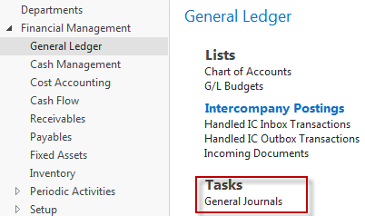
General Journals and its use in G/L
You use the General Journal window to post transactions to G/L, bank, customer, vendor and fixed assets accounts. In a General Journal (GJ), you enter the relevant information for the planned transaction, such as the posting date, amount and the accounts you want to post to. The information you enter in a Journal is temporary and can be changed as long as it is in the General Journal.
If you often use the General Journal to post the same or similar journal lines, for example, in connection with payroll expenses you can you periodic one call Recurring Journals.
How to access GJ in G/L

Slide 4
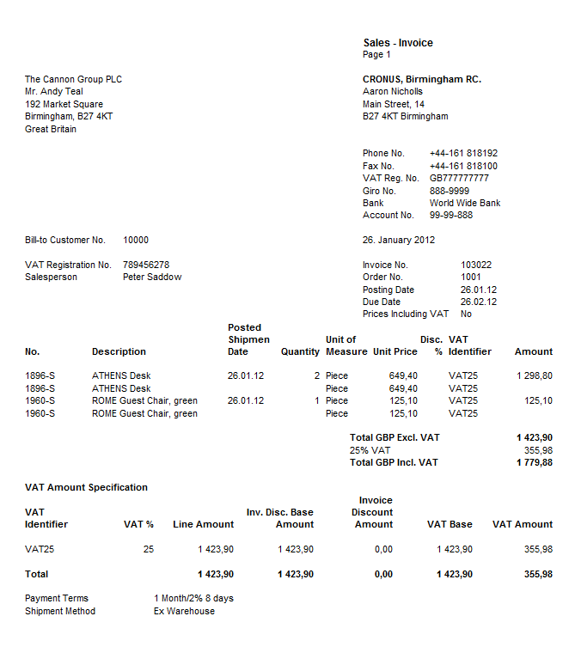
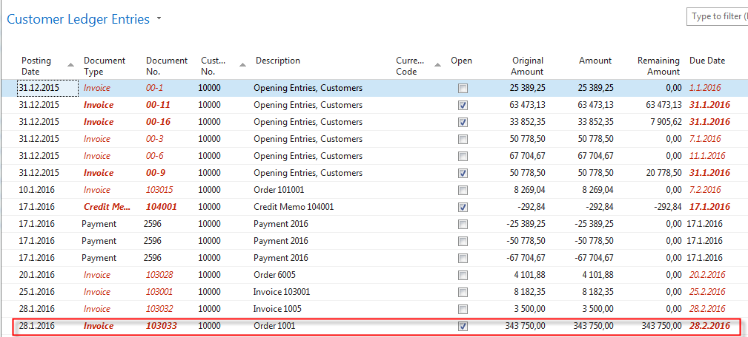
Applying principles
Invoice
Apply
From customer 10000 by Ctrl-F7

Slide 5
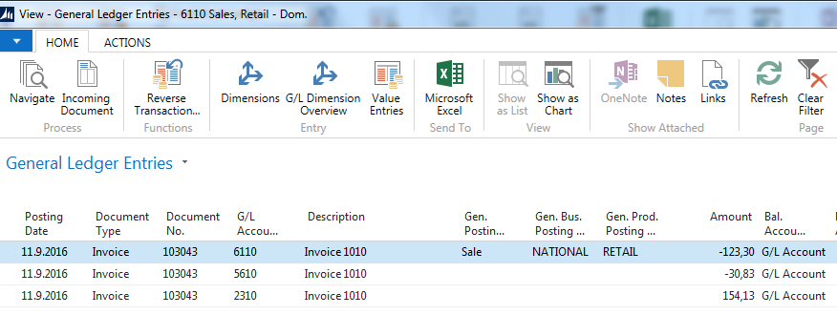
Impacts to G/L (General Ledger Entries)
5610 Sales VAT 25%
2920 Bank Account
2310 Customer Domestic
30,83
6110 Sales Retail Domestic
154,13
154,13
154,13
123,30
Applied payment
154,13=123,30+30,83

Slide 6
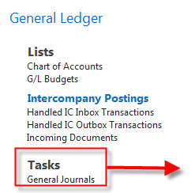
General Journal Structure
GJ structure
Code NBL represents through Bank Account Posting Group G/L Account 2920
Code 10000 represents through Customer Posting Group G/L Account 2310
F4 or mouse cursor to access list of open documents (Invoices and Credit Memos)
See list of open documents on the next slide
Firstly you must display a new field that is not yet shown so far.
It is necessary to find the Select column option with the right mouse button
and to find the required field in the left segment - Apply to Doc.
The number and move it to the right of the screen.

Slide 7
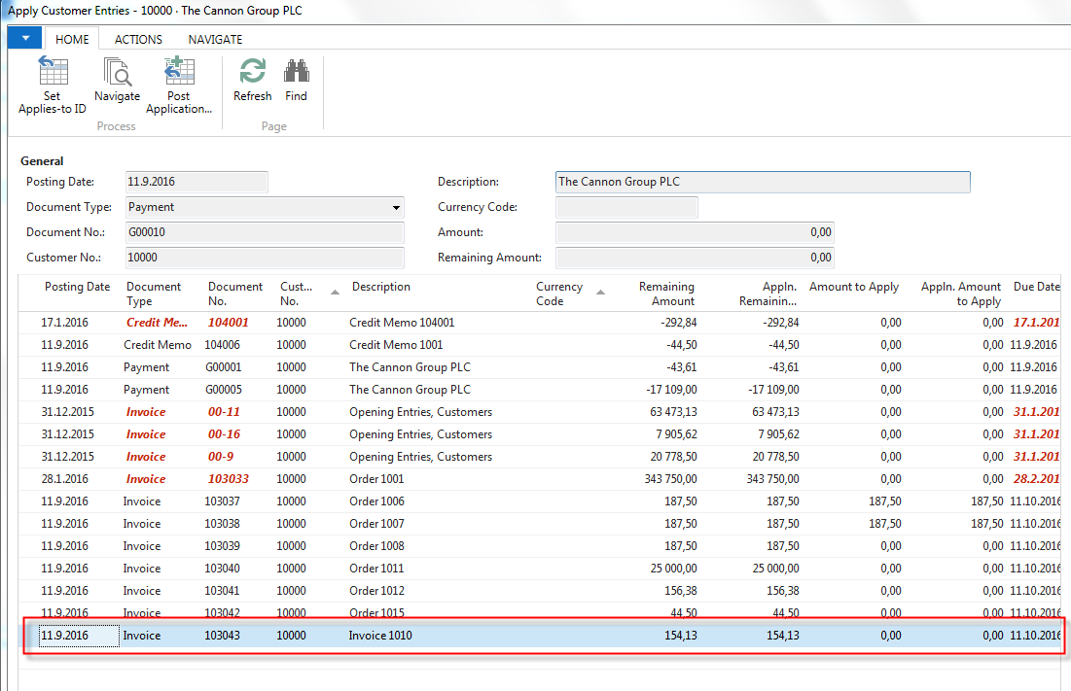
Posted Entries of different types( Customer Entries, Payment Entries, Credit Memo Entries,…..)
Posted Customer Ledger Entries
Select document and click on the OK button to see it (or use Navigate icon)

Slide 8
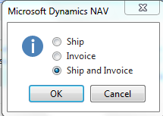
NewsSale Order creation
Preparing data for simple example
Customer 10000
Change manually Unit price to 150 to get more simple data later!
F9

Slide 9
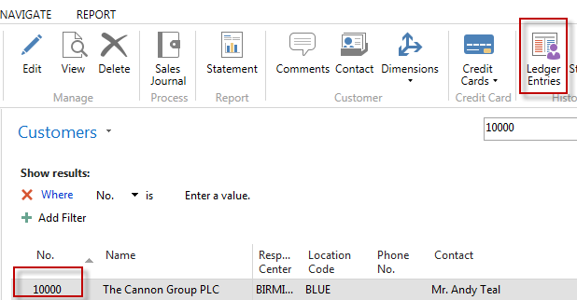
Customer Ledger Entries (CLE) – see our PWP show about SO
Customer Ledger Entries
Author modified columns of CLE to see fields
Open and Entry number as well!
Checked Open field means, that this invoice was
not paid yet (applied by payment)

Slide 10
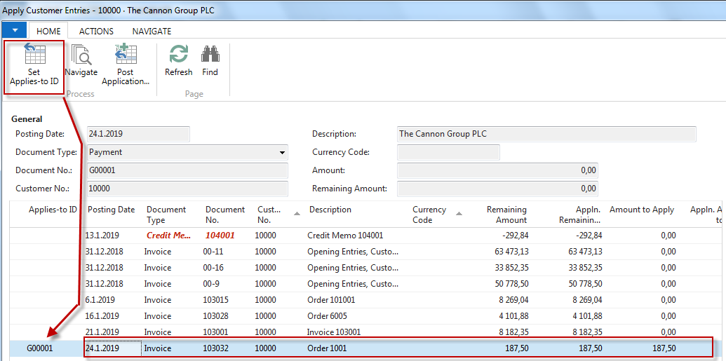
G/L Journal is prepared to be posted
G/L Journal prepared to be posted

Slide 11
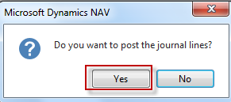
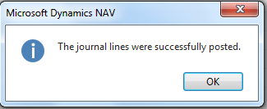
GJ after application entry for setup payment
GJ after application entry
F9

Slide 12
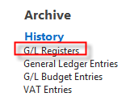
How to find out what we have done so far
In NAV 2018w1 go to the first line please!

Slide 13
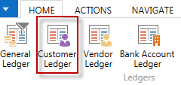
How to find out what we have done so far
Debit side = plus sign and Credit side=minus sign - syntax rule

Slide 14
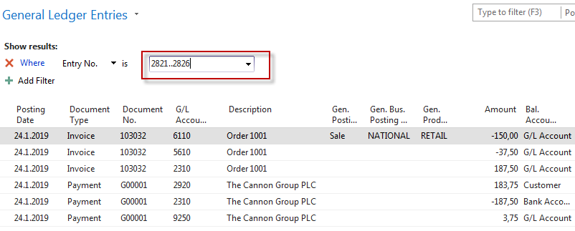
9250 Payment discount granted
5610 Sales VAT 25%
2920 Bank Account
3,75
2310 Customer Domestic
37,50
6110 Sales Retail Domestic
183,75
187,50
187,50
150,00
Applied payment

Slide 15
Additional tasks
Prepare Purchase order and post it by F9
Enter data to General Journal (Vendor and Bank Account)
Find unapplied Vendor entry related to just posted PO (by us of Appl. To doc. No filed)
Post GJ (General Journal)
See Vendor entries to see application
Use icon Applied entries to see applied pair !!
Can we unapply entries for Customer (Vendor) entry window?

Slide 16
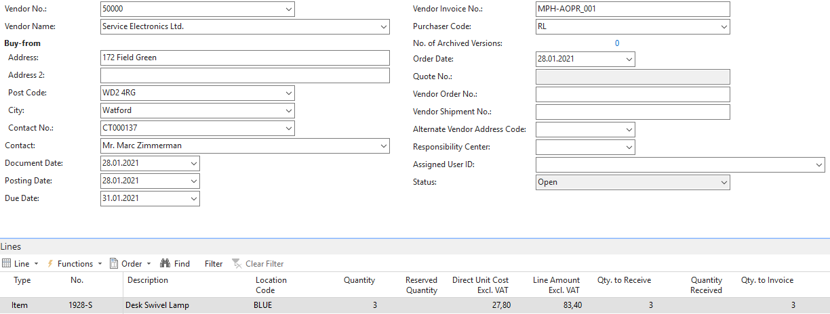
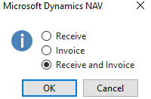
Purchase Order
Purchase Oorder
F9-Post

Slide 17
Vendor entries
Vendor Entries

Slide 18
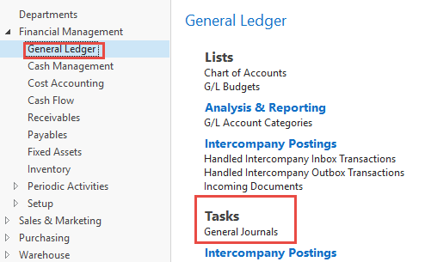
General Journal I.
General Journal I

Slide 19
General Journal II
General Journal III.
When changing the value in the Batch field from Cash to Default, it is necessary to delete a possible system design (about ten lines) with the help of the selection and the Delete icon

Slide 20
General Journal III.
General Journal II.
Completion of the required field. Firstly you must display a new field that
is not yet shown so far. It is necessary to find the Select column option
with the right mouse button and to see the required field
in the left segment - Apply to Doc.
The number and move it to the right of the screen.

Slide 21
General Journal IV.
General Journal IV.
F9

Slide 22
Vendor Entries and access to General Ledger entries
Vendor Entries and acces to GL Ledger entries

Slide 23
General Ledger entries
G/L Entries

Slide 24
End of the section (Basic of Payments)

