Slide 1
Introduction to MS Dynamics NAV 2018w1
Ing.J.Skorkovský,CSc.
MASARYK UNIVERSITY BRNO, Czech Republic
Faculty of economics and business administration
Department of corporate economy

Slide 2
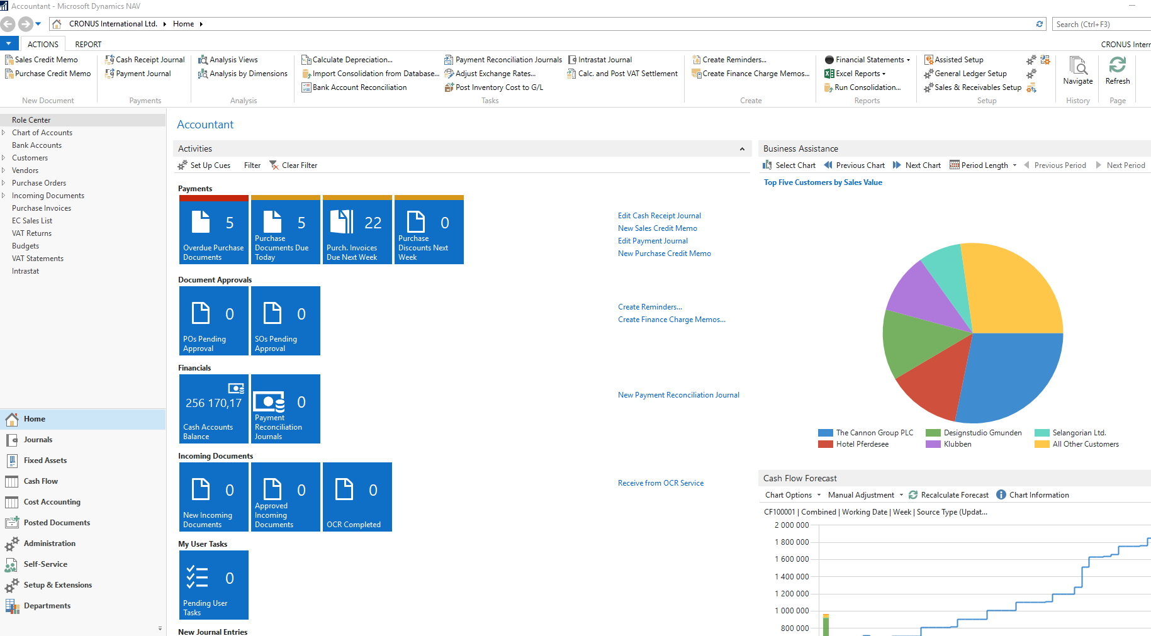
Introduction
Relation to the file and the questions asked in this file
Simple scenario of the first and second ERP Microsoft Dynamics NAV session I.

Slide 3
Questions I
What we need every day when running the business?
What is data?
Data + Structure = Information
What is the data field?
What is a record?
What is the table?
How can we see data?
What is the form (window)?
What types of forms does ERP use?
What is ERP?
What is the working area?
What is the menu?
How to see only one record?
How to see a list of records?
What is the relation between fields (F4)?

Slide 4
Questions II
16. What is customer balance?
17. What is the calculated field?
18. What is the customer credit limit?
19. Name are four main tables (Customer, Vendor, Item and G/L Account)
20. Where can you find help to see a list of used function keys combinations to control ERP?
21. Name essential economic documents used to control business!
22. Quote, order, invoice, credit note, shipment list, delivery list, good receive note
23. Explain the structure of these documents! (header and lines)
24. Find Customer or Vendor
25. Find Item card
26. Find Chart of account
27. Find help related to Customer (Vendor, Item) card

Slide 5
Questions III
28. Find help to one chosen field (F1)
29. What is an entry (created transaction)?
30. To which objects belong entries?
31. How to display entries (Ctrl-F7)?
32: Name essential professions of ERP users
33. How to post a document (order, invoice, credit memo,..) (F9)

Slide 6
What we need every day when running the business?
Perfect overview of processes
Accounting
Reports (Profit and loss account, Balance sheet, Vat reports)
Budgets
Cash flow
Cost
Purchases
Availability
Delivery times
Costs
Sales
Availability
Timing
Unit prices, discounts,..
Inventory and warehouse management
Production

Slide 7
What we need every day when running the business?
Perfect overview of processes
Inventory and warehouse management
Positions of stored items (location)
Transfers o items
Costs
Production
Bill of material – structure of the product
Routings – how the product is made, which machines they use, what the capacities of the machines are
Production times

Slide 8
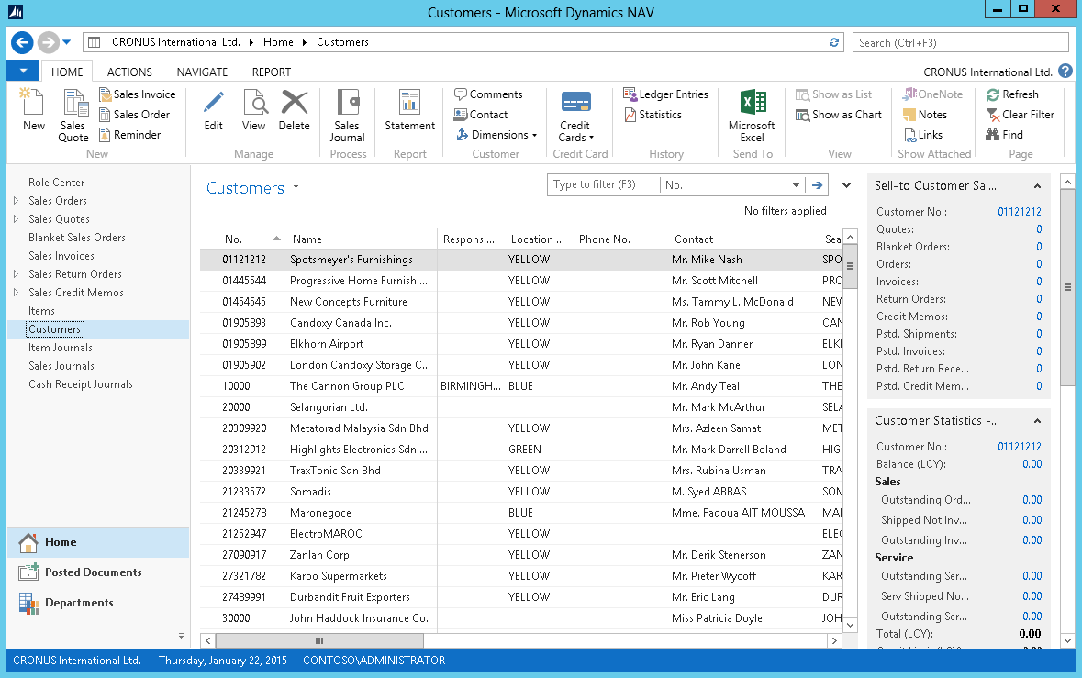
The main screen of our ERP MS Dynamics system
Ribbon
Filter pane
List
FactBox pane
1
2
4
3
Notes:
After showing this slide and explaining the different components of a list page, go to the application and show some examples of list pages.
Remember to only focus on the interface. Topics such as personalization, filter, search, … are covered in other modules.

Slide 9
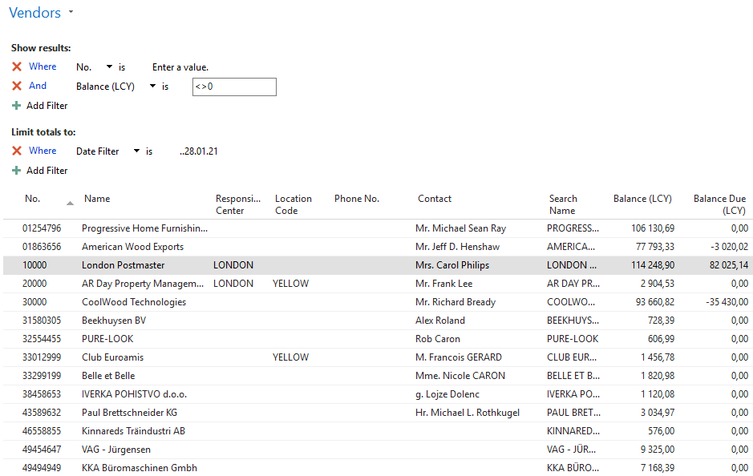
What is data?
List of our vendors

Slide 10
Information
Information =Data + Structure of the data
Information
Sum of partial posted amounts
DATA
The balance is the sum of all sub-amounts in Customer ledger entries.
This number is a so-called floating or calculated field, and this field is not stored in the database. Each time the window (s) is opened, it is always recalculated.
Each entry(not only the customer but also supplier entries, item ledger entries, etc.) is associated with the posted document.
2771,84
Sum of partial posted amounts
Calculated field

Slide 11
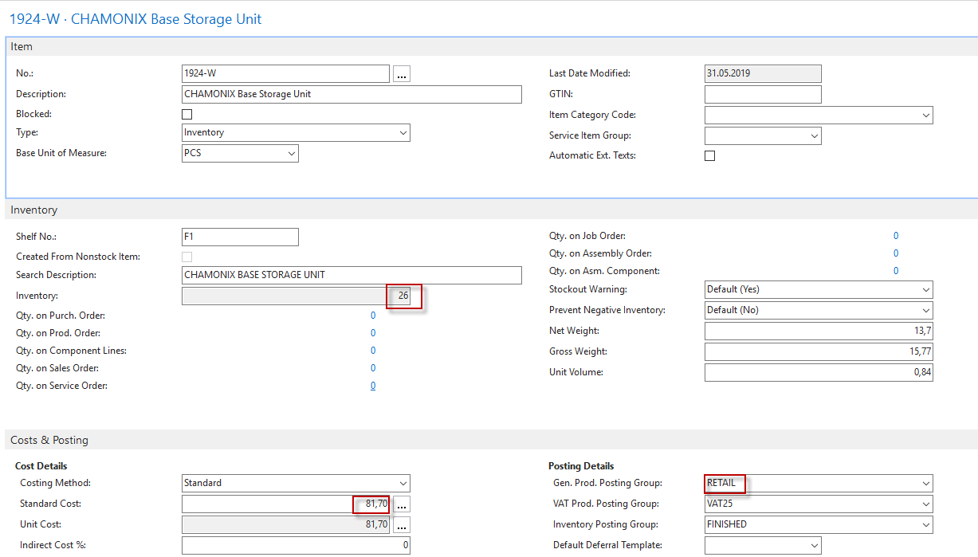
What is the data field?
One item card in our warehouse.
There are many data fields
on the card.
The card is divided into tabs .
You can see data fields that belong
to every tab.
The grouping of the data fields
relates to the logic of warehouse
processes on each tab.
Different types of data in data fields, which are fields that are part of data tables. It can be, for example, numbers, selected options represented by text strings, Boolean variables, time, date, ...

Slide 12
What is the data record
4 data records
(list of inventory
items in the stock)
CTRL-F7
From List or Card to Item ledger entries
5 inventory
transactions.
Item ledger
entries.

Slide 13
What is the table?

Slide 14
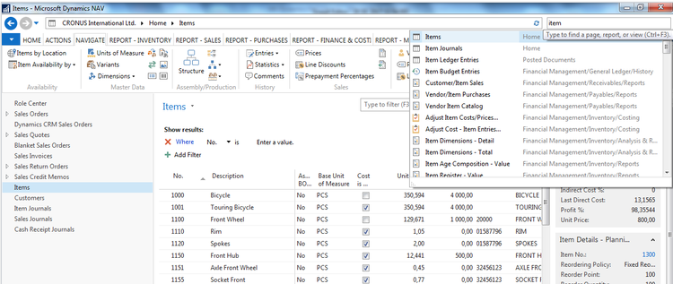
How to access data (use of searching window)?
Will be shown by tutor and examined on demo student databases by them
(Find Vendor, Item, Customer, General Ledger Account, Profile and so on)

Slide 15
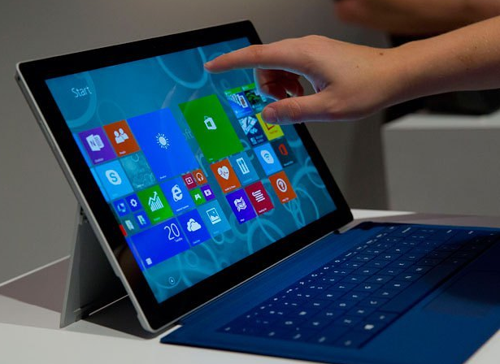
How can we see data?
Customer number | Customer name | Balance | Payment condition | Currency
10000 | SW Kings | 20000 | 1M | USD
20000 | China computers | 432444 | 21D | USD
30000 | Navertica | 902 | 14D | CZK
40000 | Berlin Experts | 20002 | 1W | EUR
Data
How to
see
data
(Windows - forms)

Slide 16
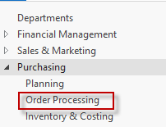
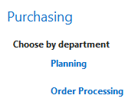
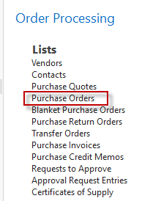
How can we see data?
From the different window structures accessed by use of menu of Hot keys combination
Card
List (many cards)
Matrix
Form and Sub-form (Documents – header and lines)
MENU
SUB_MENU

Slide 17
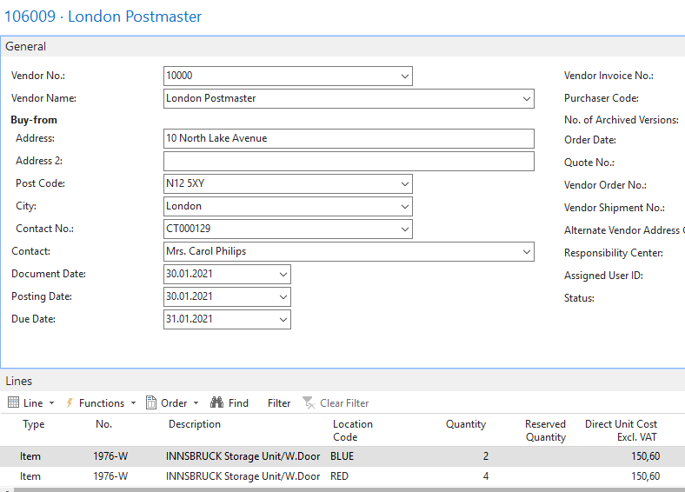
How can we see data?
MENU
SUB_MENU

Slide 18
What is the form?
LIST
CARD

Slide 19
What is the form related to documents?
HEADER
LINES

Slide 20
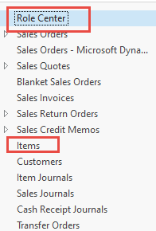
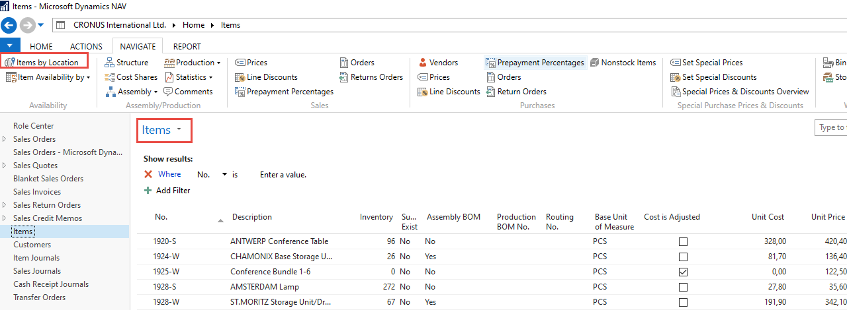
Matrix type form
Double click

Slide 21
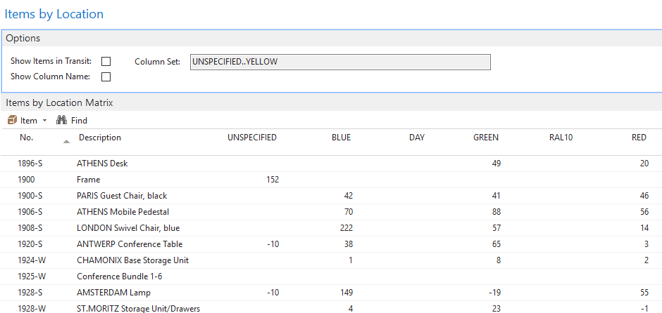
What is the form (matrix type form)?
MATRIX

Slide 22
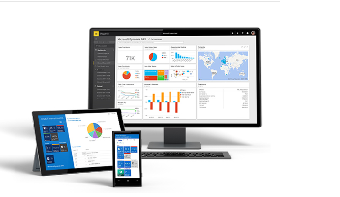
What is MS Dynamics NAV (home study) ?
If your business is growing and ready to take on more opportunities, MS Dynamics NAV can help. An easily adaptable enterprise resource planning (ERP) solution, it helps your business automate and connect your sales, purchasing, operations, accounting, and inventory management
Microsoft Dynamics NAV enables every individual in your company to turn hunches (intuitions, feelings) into genuine insight, and insight into decisions. With access to real-time data and a wide range of analytical and reporting tools—including graphical displays, online analytical processing (OLAP) cubes, and Web-based delivery options—people can make informed, confident decisions that help drive business success.

Slide 23
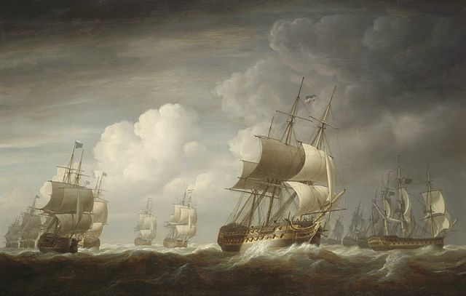
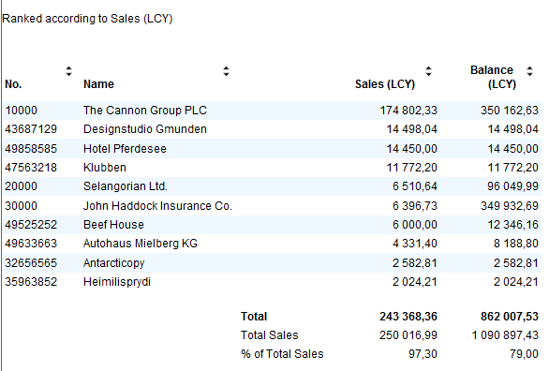
Navigation (NAV) - tool
To find the way in the see of big data and to get important information
Information = data + structure (see slide 6)

Slide 24
Navigation- explanation (home study)
The navigation tool traces the cause-effect relations.
Let's have a look at the posting of a sales order. It represents, in our example, the cause.
This action's consequences are two created documents, such as a delivery note and a sales invoice.
Furthermore, the system creates a Customer ledger entry for the customer and an item ledger entry for the item sold. Eventually, system creates other records in the General ledger area on predefined accounts. It will all take place in the background.

Slide 25
Posting of Sales Order - process diagram
Ctrl-N
Customer
Customer
Delivery
Note header
Customer Ledger Entry
Post
3
Sales order
Sales Invioce
header
12,30
3
Item quantity
to be sold
12,30
Item
3
Item
Item Ledger Entry
Post

Slide 26
What is an entry (created transaction)
The entry represents created transaction
You create for example a document called Sales Order
When you have completed all the lines and entered all the information on the sales order, you can post it. Posting creates a shipment and an invoice.
When a sales order is posted, the customer's account, the general ledger, and the item ledger entries are updated.
For each sales order, a sales entry is created in the G/L Entry table. An entry is also created in the customer's account in the Customer Ledger Entry table and a general ledger entry is created in the relevant receivables account. Besides, posting the order may result in a VAT entry and a general ledger entry for the discount amount.

Slide 27
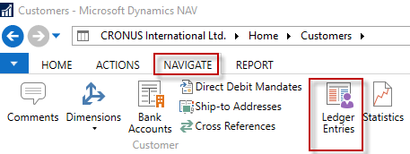
Navigation (NAV)

Slide 28
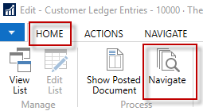
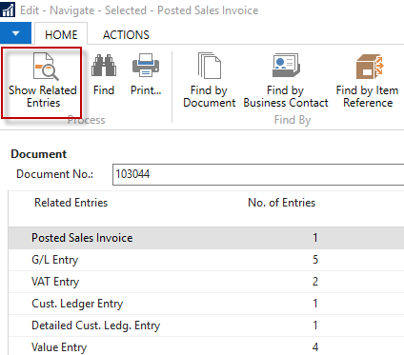
Navigation (NAV)

Slide 29
Feedback to control all processes

Slide 30
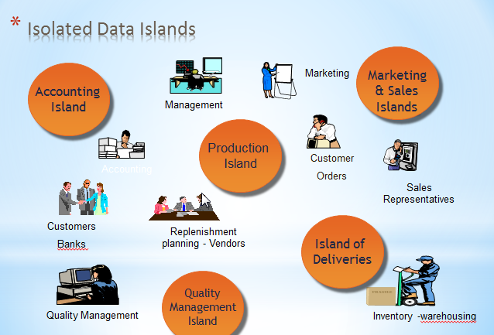
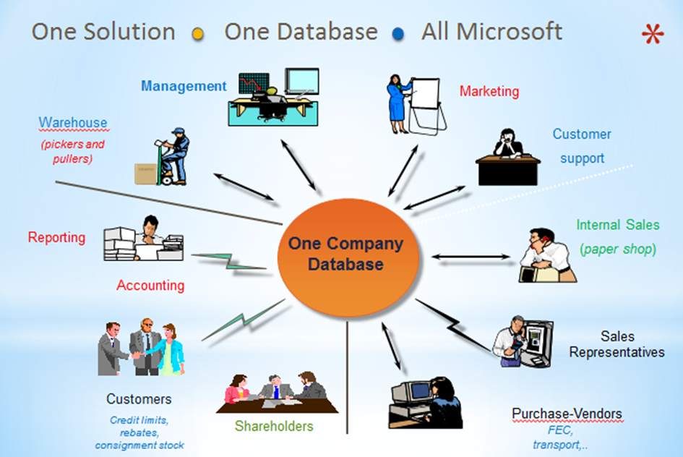
What is ERP = Enterprise Resource Planning System ?
Microsoft Dynamics NAV 2018 is an ERP system. But why is it an ERP system? What are the main features of an ERP system, and how do we recognize these in Microsoft Dynamics NAV?
Let's have a look at the overview slide. So one of the challenges that some companies might have to address is one of island systems.

Slide 31
What is ERP (home study)?
So everyone working with the system, for example, the bookkeeper in financial management, the sales representative in sales and marketing, the warehouse worker in the warehouse management, the HR manager in human resources and so on, so they all work with the system in their specific application department but with a shared database. And that's very, very important. That's one of the main features of an ERP system which stands as Enterprise Resource Planning System

Slide 32
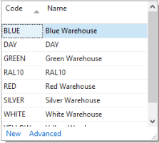
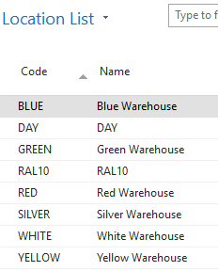
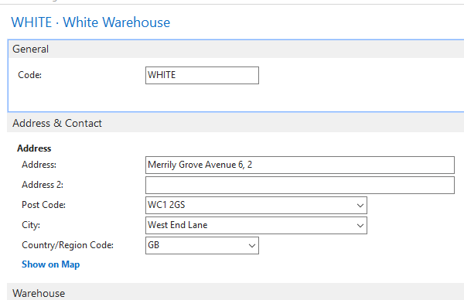
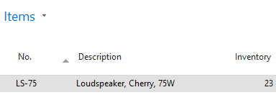
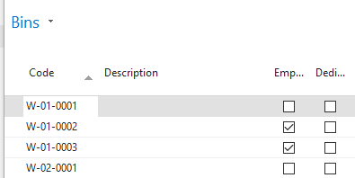
What is the relation between fields (key F4 or mouse click)?
How many relations are shown in this slide ?

Slide 33
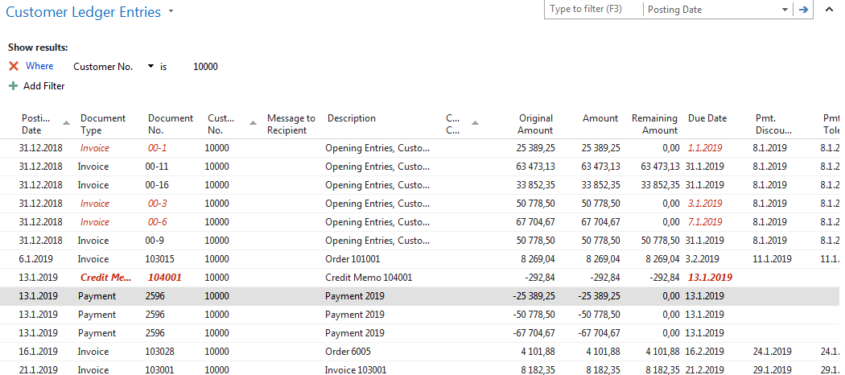
What is the Customer (Vendor) balance ?
It is Calculated field.
This figure (amount ) is not stored in database !
What has been posted in the past

Slide 34
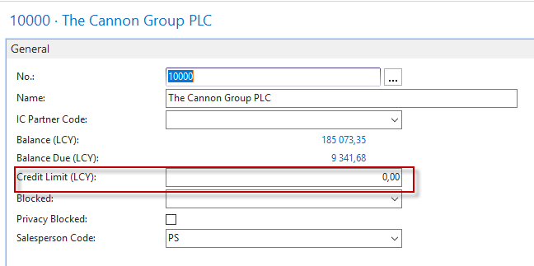
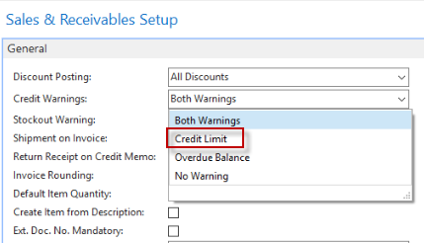
What is the meaning of Customer credit limit (one of many examples) ?
If the amount on already invoiced and not yet paid invoices exceeds this credit limit, the user will receive a message that the limit has been exceeded, and no other invoices are issued.

Slide 35
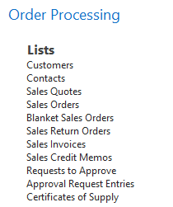
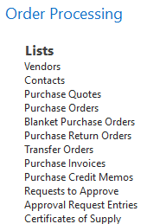
Name essential economic documents used to control enterprise
Purchase
Quotes
Sales and Purchase Orders
Invoices
Delivery lists
Credit memos
Transfer orders
Production orders
Sales

Slide 36
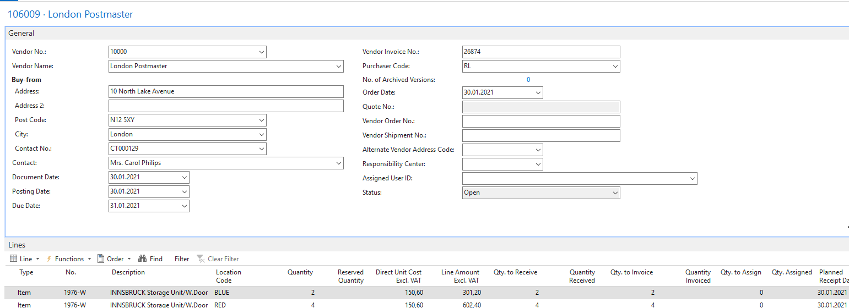
Explain the structure of standard documents generated in ERP
Header
Lines

Slide 37
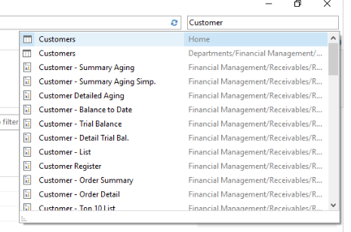
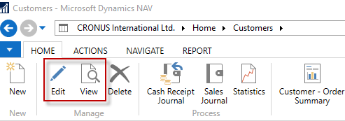
Find Customer or Vendor or Item card (any card)
Use of the searching window
See next sllide

Slide 38
Customer Card
Each card has a number of tabs, where there are different fields according to their similar meaning.

Slide 39
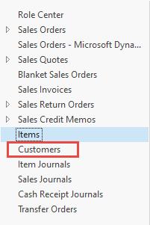
Customer Card – another important tab
For example, if we post a sales order where it will be on March 10, 2020, a sales invoice will be entered, the due date of which will be according to Payment Term code = 14D is 24.3.2020.
Code 14D means fourteen days in the MS Dynamics NAV syntax, as in another example 1M = one month and so on.

Slide 40
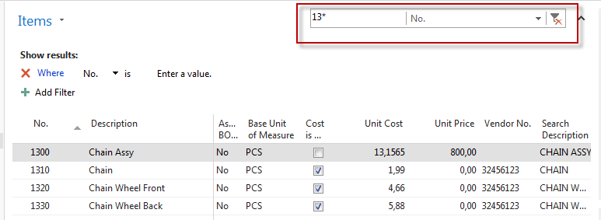
Filters – how to display only chosen part of the data (simple filter)

Slide 41
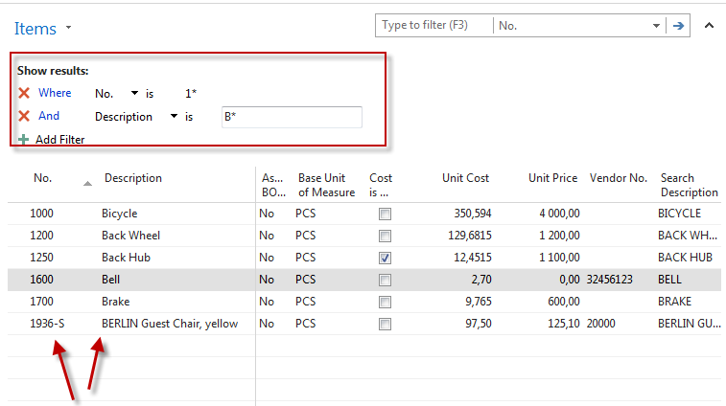
Filters – how to display only chosen part of the data (multiple filter)

Slide 42
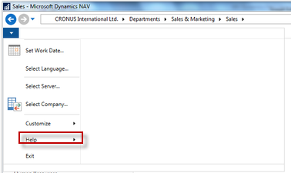
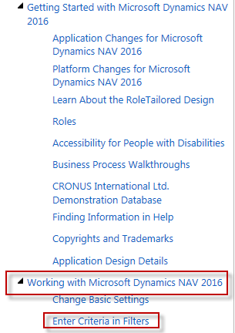
Example of using help _filter criteria

Slide 43
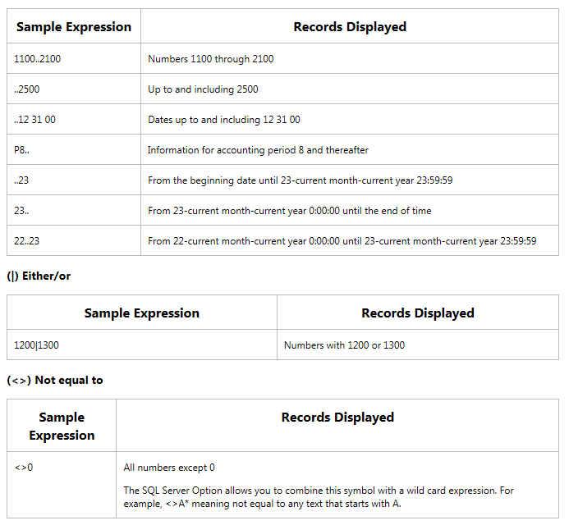
Example of using help _filter criteria
Only part of it! Will be presented
by the tutor and experienced by
students.

Slide 44
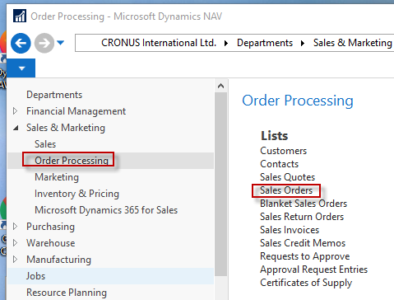
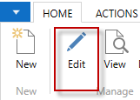
Sales Order (SO)
You can edit one SO chosen from the list of already created documents
See next slide

Slide 45
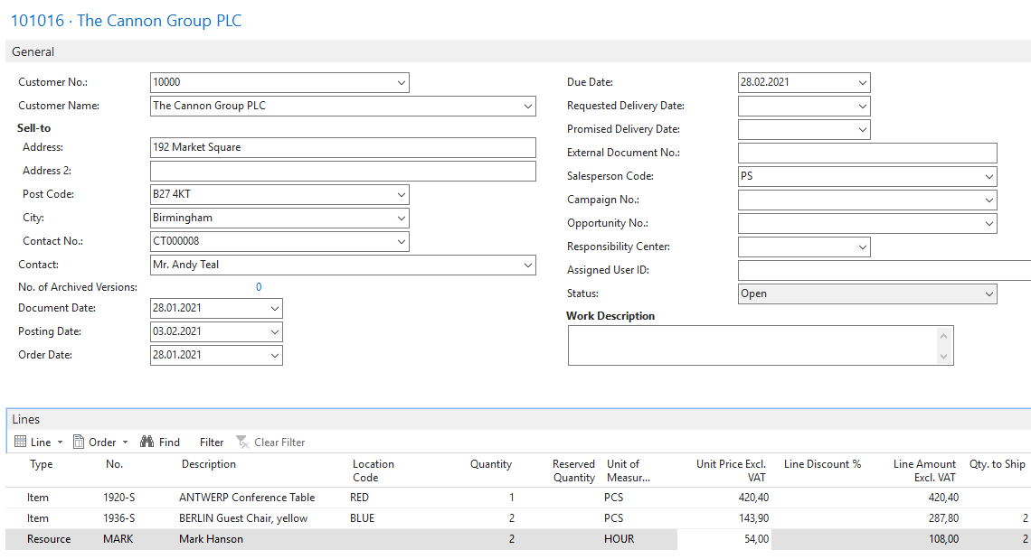
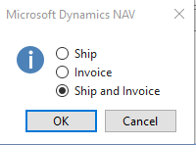
Sales Order (SO)

Slide 46
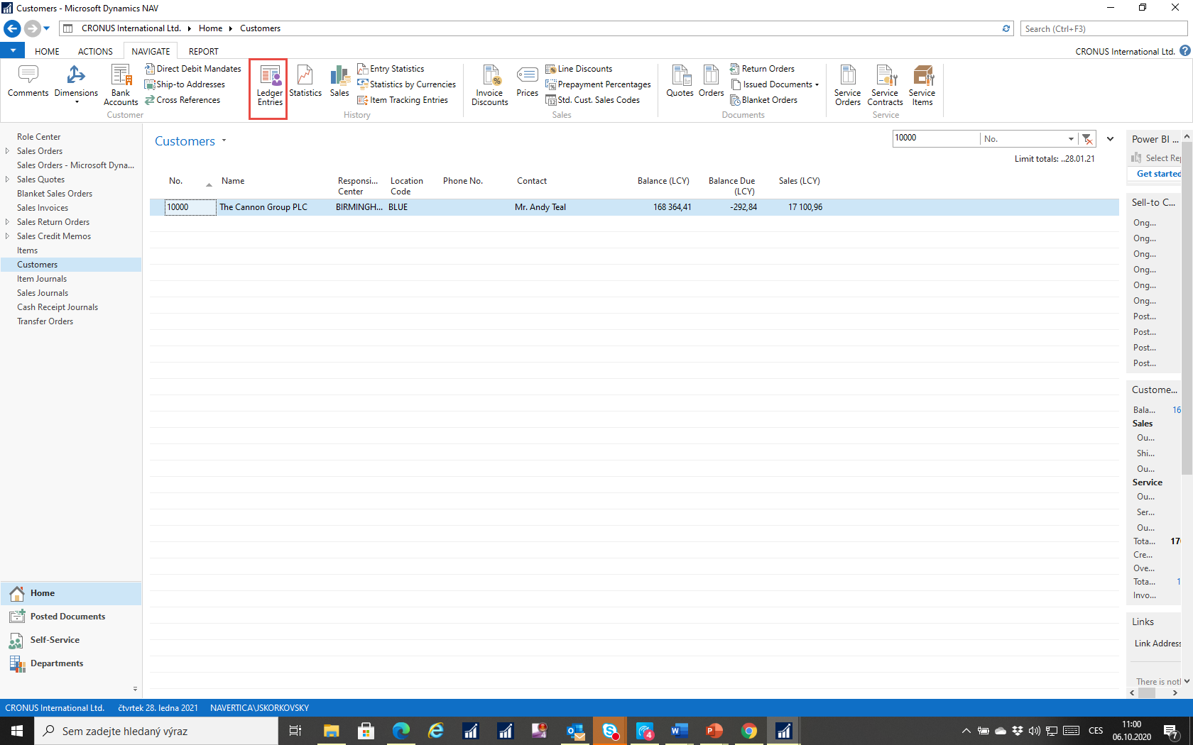
How to access created Customer Ledger Entries
We always have two options for displaying items in NAV2018. One using the item icon and the other using Ctrl-F7

Slide 47
Created entries (Customer Ledger Entry and Item Ledger Entry)
Related to created invoice
Related to one of the sold items (inventory level is decreased)

Slide 48
Created General Ledger Entries
Related to the chart of account
These General Ledger Entries serve as source data used by the MS Dynamics NAV 201 8 system.
System uses this data to create all key reports used in the management of the company.
It can be, for example, a profit and loss account, balance sheet, or cash flow reports

Slide 49
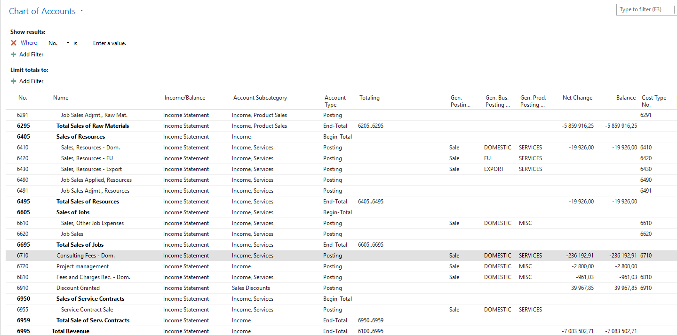
Chart of account
The chart of accounts shows the ledger accounts that store your financial data. Microsoft Dynamics NAV includes a standard chart of accounts that is ready to support your business. However, you can change the default accounts, and you can add new accounts.

Slide 50
Entries and their use

Slide 51
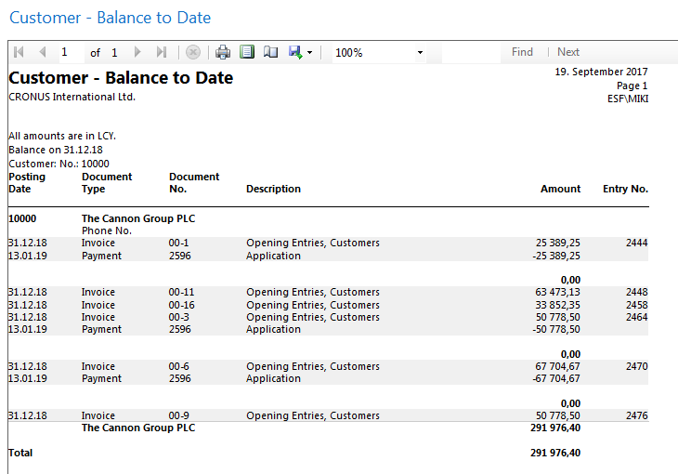
One of many reports generated from entries

Slide 52
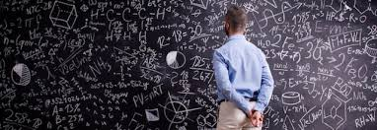
Thank you for your attention and patience

