Slide 1
Local finances management
Public Finance 2

Slide 2
Theory of Fiscal Federalism
Many authors – Tiebout, Oates and others
Tiebout model/hypothesis (1956):
„model yields a solution for the level of expenditures for local public goods which reflects the preferences of the population more adequately than they can be reflected at the national level“
individuals will move from one local community to another which maximizes their personal utility.

Slide 3
Oates „theorem“
Oates' Decentralization Theorem (Oates, 1972) „stating that in the absence of cost savings from centralization and interjurisdictional externalities, fiscal responsibilities should be decentralized. This argument implicitly assumes that the center is unresponsive to preference heterogeneity and thereby is only able to implement uniform policies“ (Koethenbuerger, 2007)

Slide 4
Decentralization
The process of redistributing functions or powers from center to localities in term of hierarchy.
Dentralization concept is widely used in public administration, economics, law, but also in private sector.
Decentralization of state power (public administration):
Central government
Regional government
Local government

Slide 5
Fiscal Federalism (FF)
division of responsibilities: finance, tasks, policy
(central government-localities)
important questions:
Who makes the decisions about the programs?
Who pays for these programs?
examples
Government rule – Localities administer
Government pays – Localities carry out

Slide 6
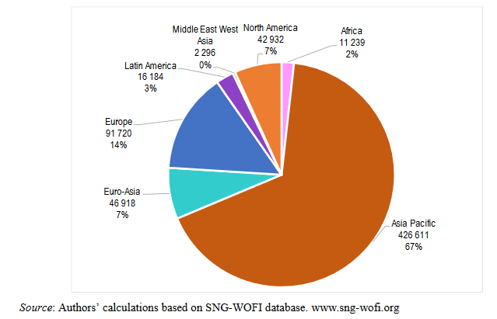
Number of subnational governments by geographical areas (2018)
Source: OECD/UCLG (2019),2019 Report of the World Observatory on Subnational Government Finance and Investment –Key Findings

Slide 7
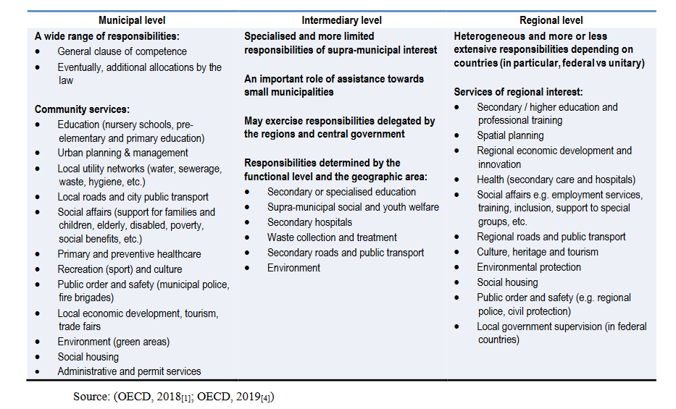
Breakdown of responsibilities across SNG levels: a general scheme
Source: OECD/UCLG (2019),2019 Report of the World Observatory on Subnational Government Finance and Investment –Key Findings

Slide 8
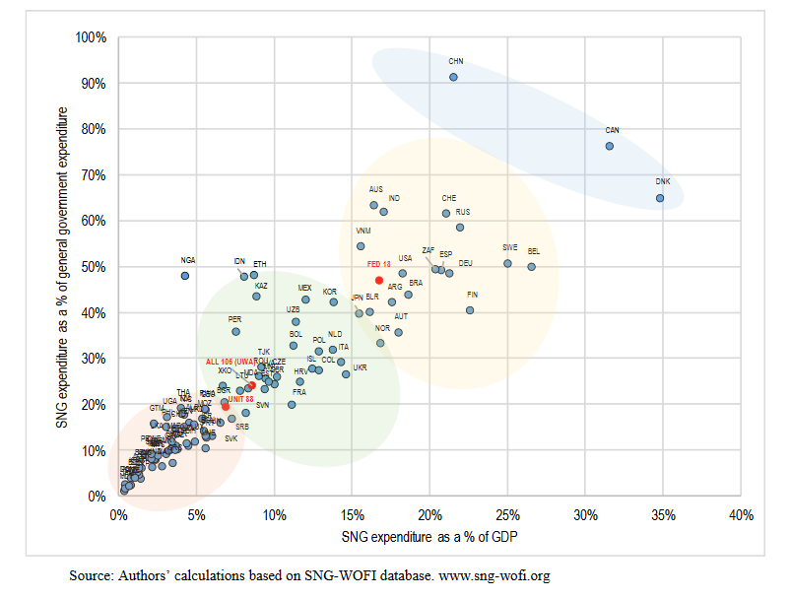
Subnational government expenditure as a percentage of GDP and general government expenditure (2016)
Source: OECD/UCLG (2019),2019 Report of the World Observatory on Subnational Government Finance and Investment –Key Findings

Slide 9
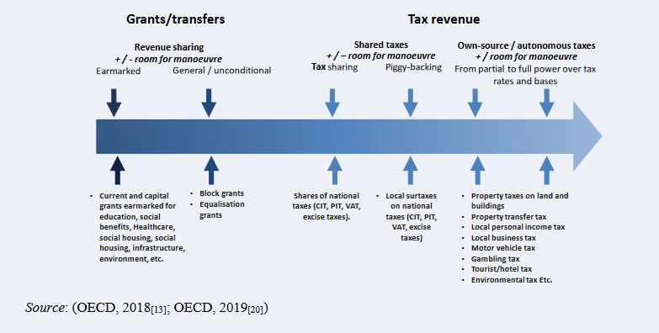
Subnational resources and autonomy: no clear cut frontiers
Source: OECD/UCLG (2019),2019 Report of the World Observatory on Subnational Government Finance and Investment –Key Findings

Slide 10
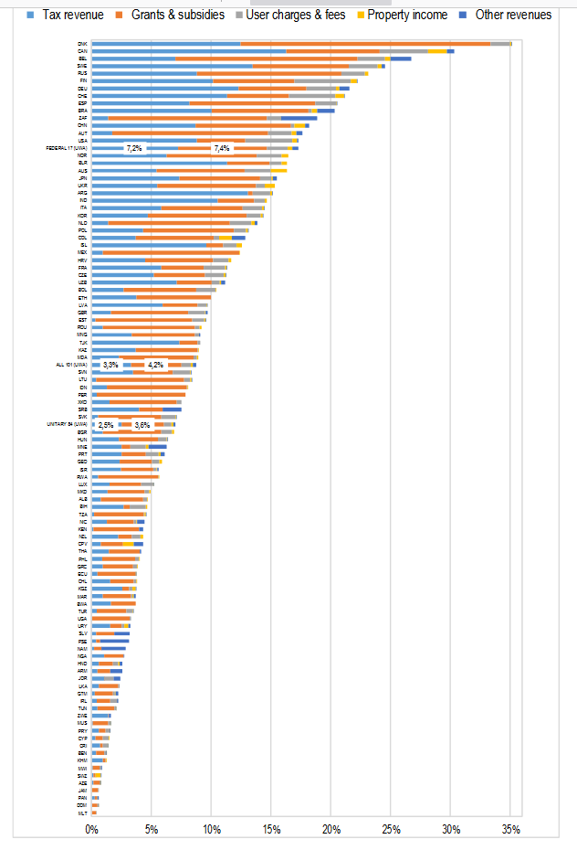
Subnational government revenue by category as a percentage of GDP (2016)
Source: OECD/UCLG (2019),2019 Report of the World Observatory on Subnational Government Finance and Investment –Key Findings

Slide 11
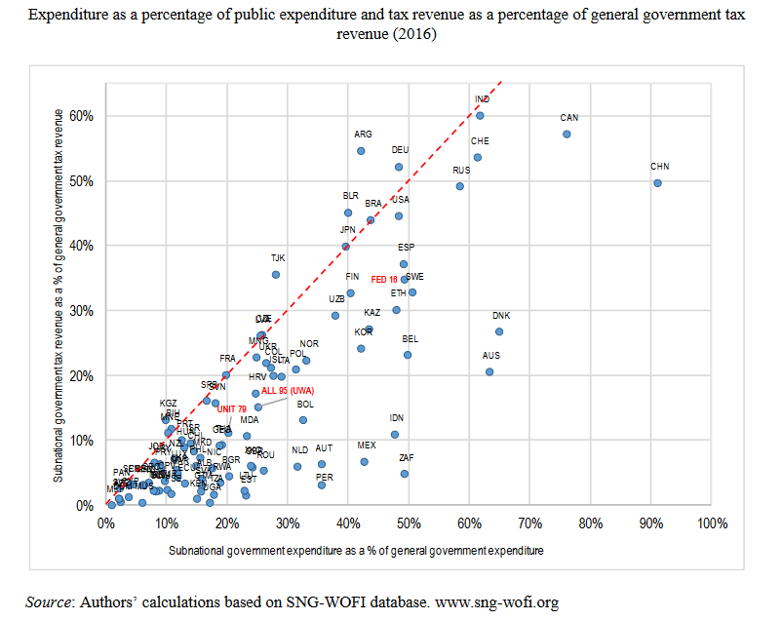
The gap between subnational government expenditure and tax revenue is often large
Source: OECD/UCLG (2019),2019 Report of the World Observatory on Subnational Government Finance and Investment –Key Findings

Slide 12
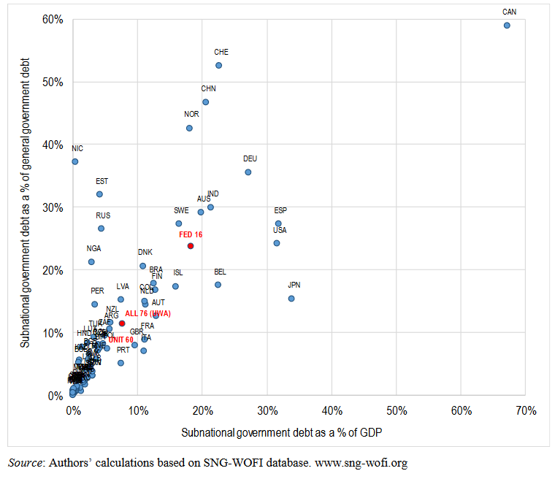
Subnational government debt as a percentage of GDP and general government debt (2016)

Slide 13
Czech republic and fiscal federalism
Inhabitants 10 532 770
14 regions (Prague-municipality and region)
6 253 municipalities
Special case- NUTS II. (created for monitoring EU statistic)
Fiscal decentralization involves the transfer of taxing and spending powers to sub-national levels of government

Slide 14
Q & A

