Slide 1
Functional structure of the skull

Slide 2
Functional structure of the skull​
According to forces acting on the skull bones we have thickened and thinner parts
of the skull
Thinner parts of the skull are predilection sites for fractures

Slide 3
Functional structure of the skull - Facial buttresses system
thin (fragile) segments of bone are encased and supported by more rigid framework of "buttresses" ​
the midface is anchored to the cranium through this framework ​
formed by thickened parts of frontal, maxillary, zygomatic and sphenoid bones and their attachments to one another
the buttresses support against the force of mastication, which sends force from the mandible all the way through the maxilla to the skullbase and calvaria
vertical x horizontal buttresses

Slide 4
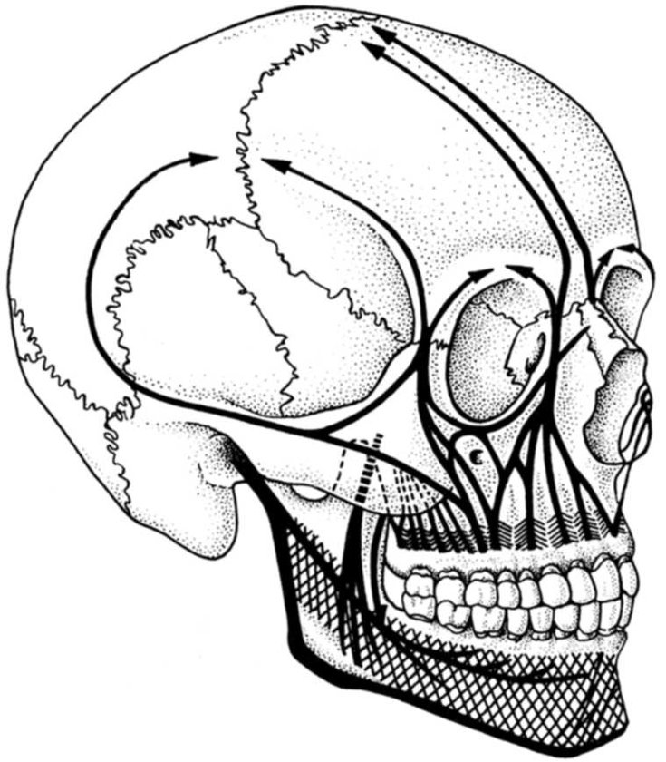
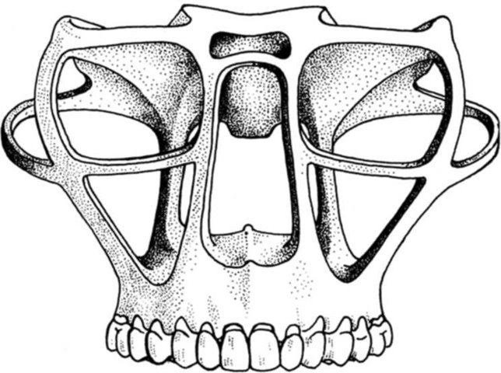
Vertical buttreesses
Medial maxillary buttress
from the maxilla in the region of the canines accros the nasofrontal junction to the frontal bone
runs cranially along the medial border of the maxillary sinus

Slide 5
Vertical buttreesses
Lateral maxillary buttress
from the maxilla across the zygomatocomaxillary suture and body of the zygoma, extending superiorly along the lateral orbital rim to the frontal bone and
Second branch runs horizontally towards the zygomatic arch and radiates to the squamous part of the temporal bone

Slide 6
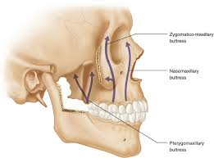
Vertical buttreesses
Posterior maxillary buttress
formed by the fusion of the posterior and medial surfaces of the maxilla with the lower half of the pterygoid process
originates from the region of the posterior alveoli M2-M3 and transmits pressure from the posterior teeth to the body of the sphenoid bone
runs along the posterior wall of the maxillary sinus

Slide 7
Horizontal buttresses
Upper transverse (maxillary)
zygomatic arch along the floor of the orbit/roof maxillary sinus/ going posterior through the orbital floor

Slide 8
Horizontal buttresses
Lower transverse (maxillary)
along the maxillary alveolar ridge (base of the maxillary sinus) extending posteriorly along the hard palate

Slide 9
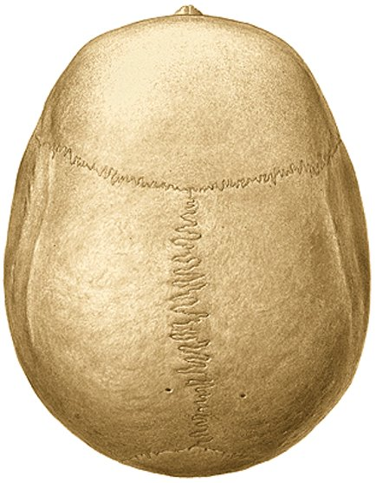
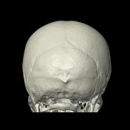
Calvaria (the top of the skull)
thick parts:​
tubera frontalia​ (the frontal eminence)
tubera parietalia​ (the parietal eminence)
external occipital protuberance (the
highest point of which is referred to as the inion)
linea temporalis​ (temporal line)
(marks the attachment of the temporalis muscle)
margin of sulcus sinus sagitalis sup.​
et transversus

Slide 10
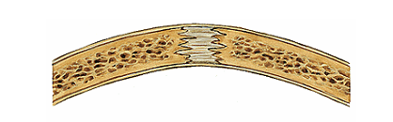
Calvaria (the top of the skull)
The calvaria consist of three layers
external table (lamina externa) – formed by thick compact bone
diploe – medullary space of cancellous bone
internal table (lamina interna)
The bones of the calvaria are joined by sutures (fibrous joints)

Slide 11
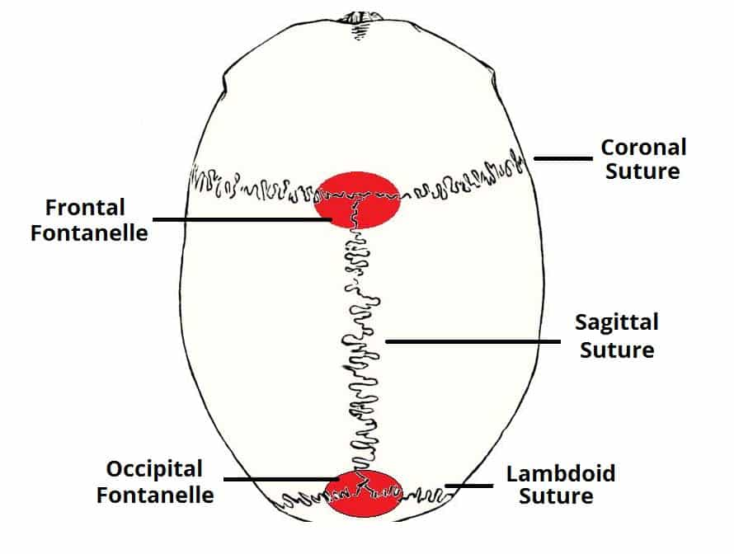
Calvaria (the top of the skull)
Sutures of the skull - fibrous tissue
fuse completely around the age of 20
represent weakness points in the skull
Coronal suture - fuses the frontal bone with the two parietal bones
Sagittal suture - fuses both parietal bones to each other
Lambdoid suture - fuses the occipital bone to the two parietal bones
In neonates, the incompletely fused suture joints give rise to membranous gaps between the bones, known as fontanelles
Frontal fontanelle – located at the junction of the coronal and sagittal sutures (disappears within 2 years of life)
Occipital fontanelle – located at the junction of the sagittal and lambdoid sutures (disappears in 2-3 months after birth)

Slide 12
Craniosynostosis
Craniosynostosis -condition in which one or more of the fibrous sutures prematurely fuses by turning into bone
skull cannot expand perpendicular to the fused suture
compensatory growth in the direction parallel to the closed sutures
complications – elevated intracranial pressure, cosmetic impact

Slide 13
Craniosynostosis
Scaphocephaly
premature sagittal suture closure which restricts growth in a perpendicular plane
the head will not grow sideways and will remain narrow
compensatory growth occurs forward at the coronal suture and backward at the lambdoid suture

Slide 14
Craniosynostosis
Brachycephaly or a 'short head'
the result of a closure of both the coronal sutures
restriction of growth in the forward direction
compensatory growth will occur sideways, due to the sagittal suture

Slide 15
Craniosynostosis
Trigonocephaly
a result from the premature closure of the metopic suture (divides the frontal bone into two halves, it should fuse by around 9 monthos of age)
fusion of the metopic suture will result in a narrow forehead,
compensatory growth occurs at both the coronal sutures
the resulting shape appears triangular from above

Slide 16
Craniosynostosis
The primary goal of surgical intervention is to correct an abnormal head shape and allow the growing brain room to expand normaly
excision of the fused suture – bone will grow in the cut places

Slide 17
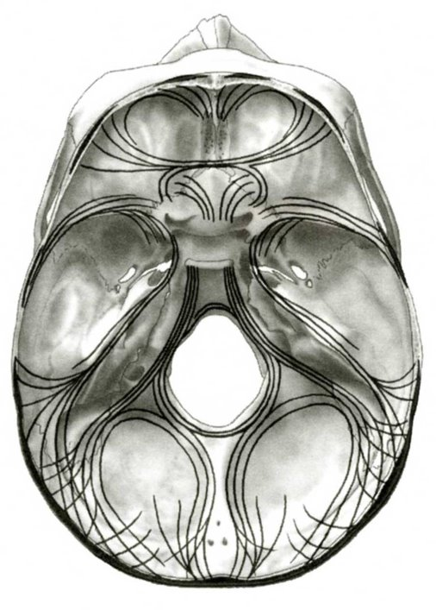
Cranial base - thickened parts:​
​
the most solid part - pars basilaris ossis occipit.​
​
Craial base - thinner parts of skull base​
​
sphenoid sinus
cribriform plate​
foramina, canals, external auditory canal etc…
Thin parts of the base of the skull are predilection sites for fractures !!!

Slide 18
Head injuries

Slide 19
Skull fracturess
Skull fractures can be broadly divided in a variety of ways:
associated with overlying skin injury
open (the injury broke the skin over the fracture)
closed
degree of displacement
undisplaced
depressed
number of fracture lines/fragments
linear
comminuted

Slide 20
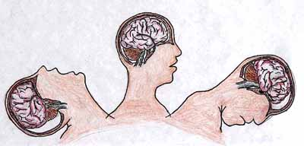
Etiology o head injuries
hitting the head with a hard object X the impact of the head on a hard object​
compression effect (between 2 objects) ​
pulse mechanism without direct mechanism of action on the skull (alternation of acceleration and deceleration - traffic accidents) - brain injury
During an injury, alteration of tensile and compressive forces leads to the brain damage!!!

Slide 21
skull fractures are best imaged with CT of the brain as discontinuities in the bone and may or may not be displaced
uncomplicated skull fractures themselves rarely produce neurologic deficit
Skull fractures associated with brain injury may have serious neurologic consequences !​

Slide 22
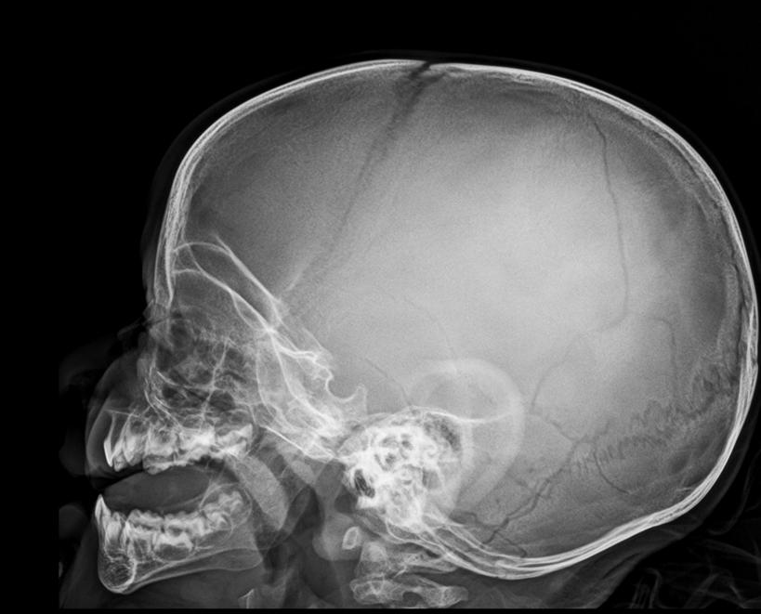
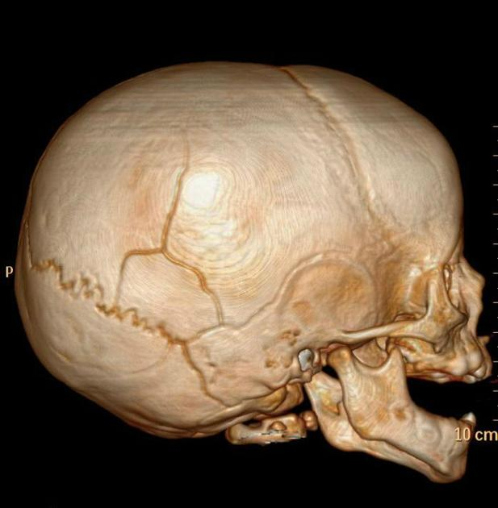
Linear skull fracture
Most common​
involve a break in the bone​ but no displacement​
usually the result of low-energy transfer​
​
caused by blunt trauma over a wide surface area of the skull​
​
these fractures often have little clinical significance
break line

Slide 23
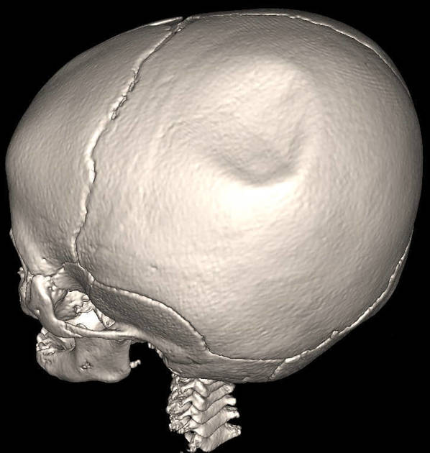
'ping pong' fracture
there is no visible fracture line
no fracture but skull bone deformation
children - elastic bones

Slide 24
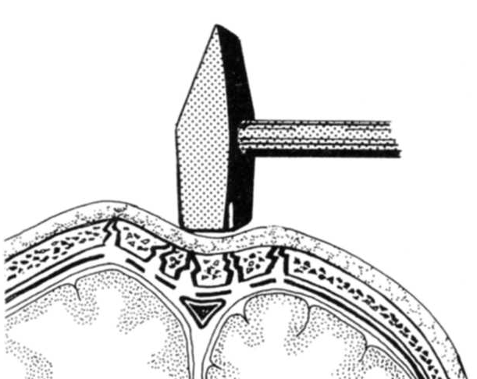
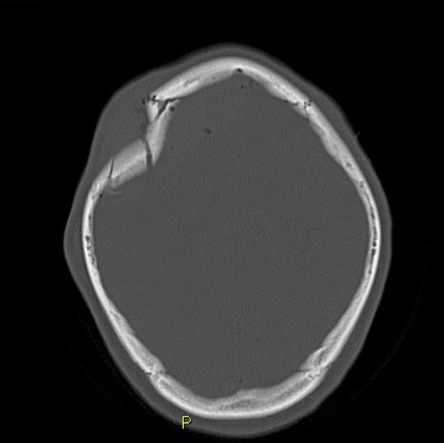
Depressed skull fractures​
in case of applying a force to a small area, typically hit with a hammer or ax
usually associated with brain damage
dislocation of fragments into the cranial cavity, with damage to soft tissues – open
CT scan of the head to rule out brain damage and intracranial bleeding and reveal the extent of the skull damage
clinically significant and requires surgical
elevation of the fragments

Slide 25
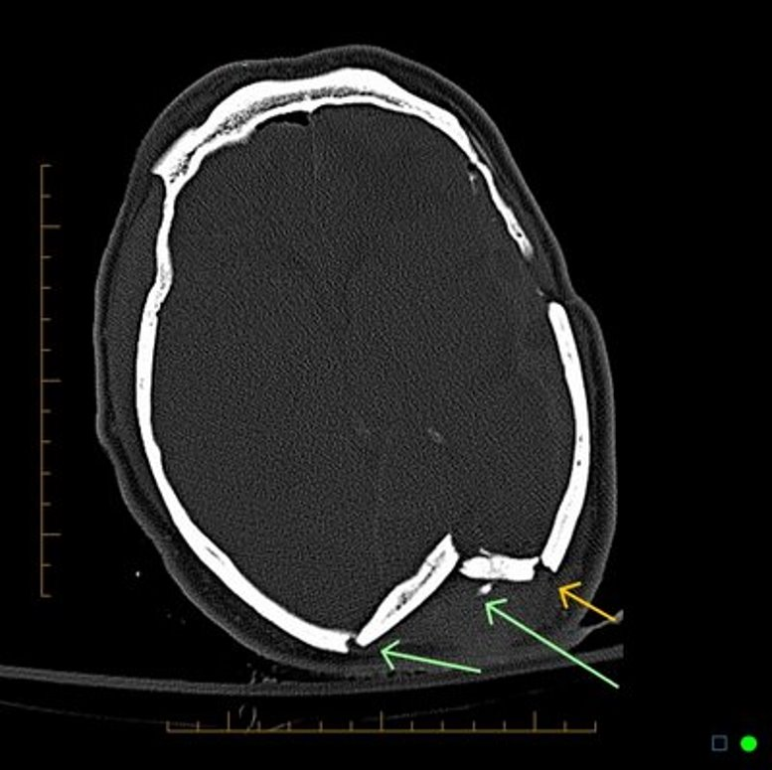
Depressed skull fractures​
Depressed fractures are usually comminuted, bone fragments are displaced inward - and often require surgical intervention to repair underlying tissue damage

Slide 26
Basilar skull fractures​
A basilar skull fracture is a break of a bone in the base of the skull
Usually indirect force (a punch to the face) - transmission at the base of the skull
Basilar fractures are the most serious! (dmage of brainstem or basal ganglia)
Can be isolated or together with fractures of bones of calvaria
Fracture lines often occur at predilection sites​

Slide 27
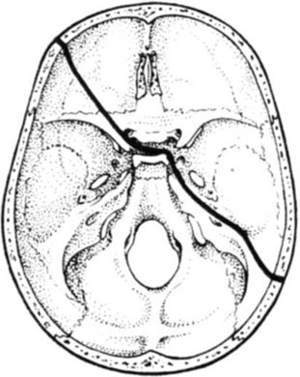
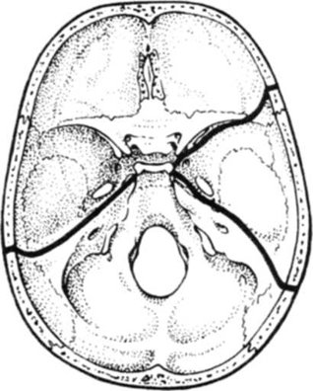
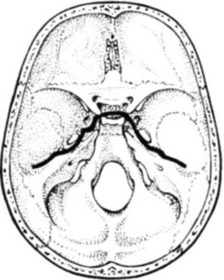
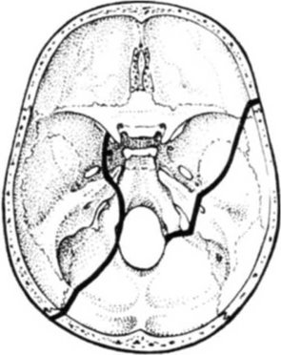
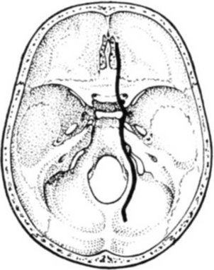
Spreading of the fracture lines​
predilection sites
sphenoid sinus
cribriform plate​
foramina, canals etc.

Slide 28
Basilar fractures
characteristic signs: ​
- blood in the sinuses ​
- a clear fluid - cerebrospinal fluid (CSF) leaking ​
from the nose (rhinorrhea) or ears (otorrhea) - tearing of the dura mater over the
fracture​
- periorbital ecchymosis often called 'raccoon eyes​
- retroauricular ecchymosis known as ”battle's sign„​
- pneumocephalus – air bubles around the brain
- intracranial hemorrhage: epidural, subdural and intracerebral hematoma
- damage of the brain, brain oedema, hypoxy, posttraumatic epilepsy, meningitis …​

Slide 29
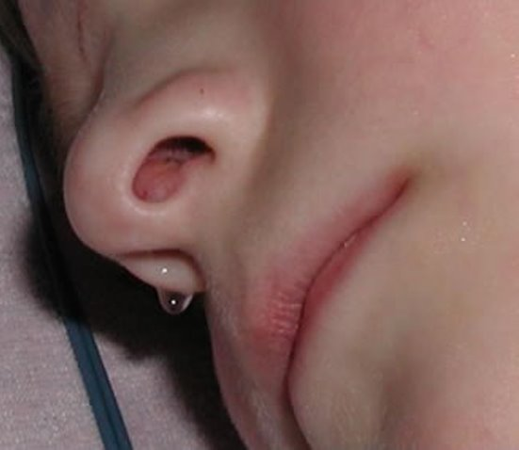
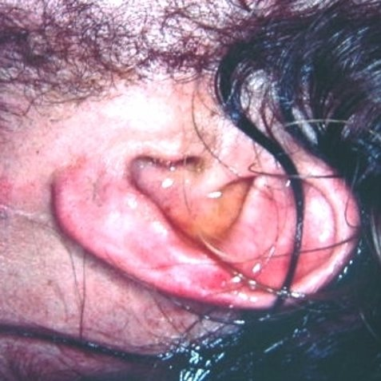
Rhinorrhea
Otorrhea​
A cerebrospinal fluid (CSF) leak can result in fluid leaking from the nose or ear​
High risk of infection!

Slide 30
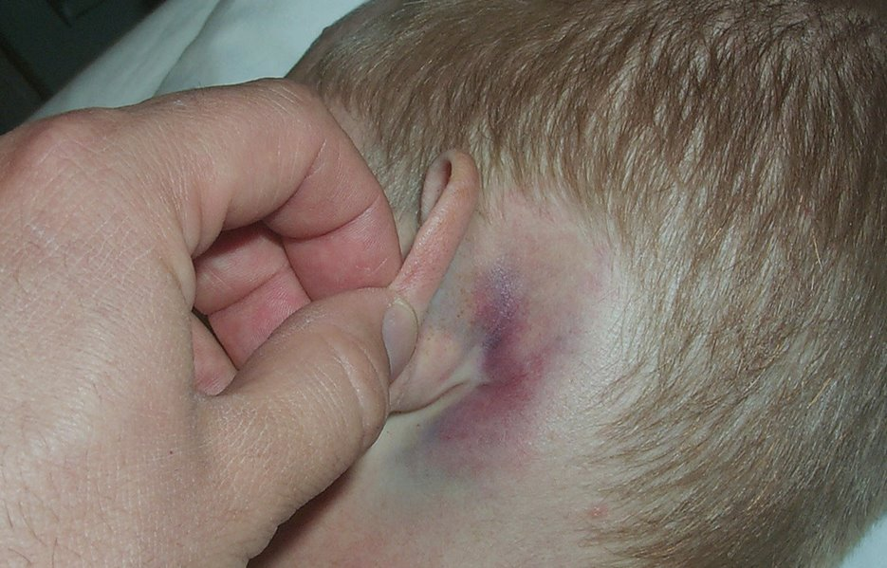
Battle´s sign
Battle's sign, also known as mastoid ecchymosis, is an indication of fracture of middle cranial fossa of the skull. These fractures may be associated with underlying brain trauma. ​
Battle's sign consists of bruising over the mastoid process as a result of extravasation of blood along the path of the posterior auricular artery

Slide 31
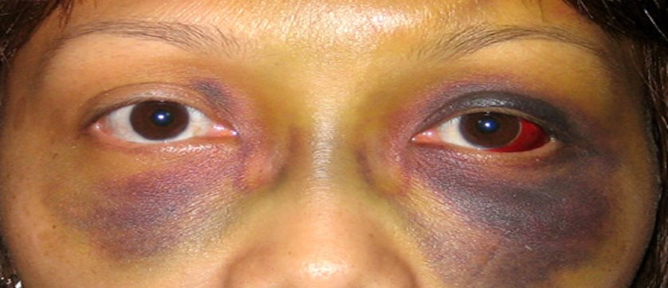
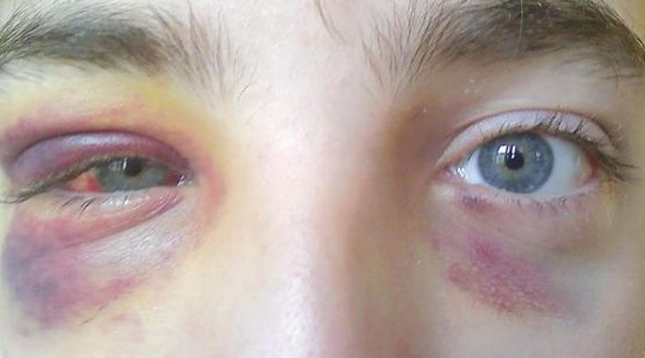
Raccoon eyes – periorbital ecchymosis​
They are most often associated with fractures of the anterior cranial fossa​

Slide 32
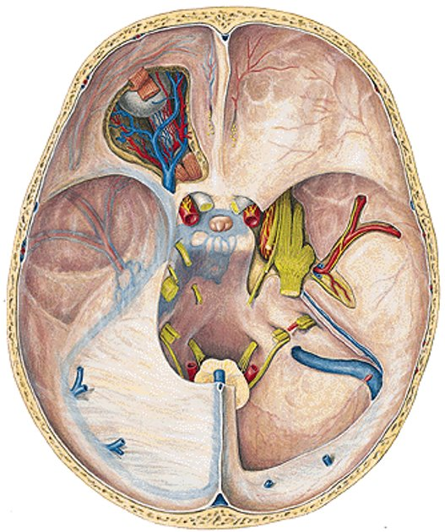
Cranial nerve lesion​
I. (Olfactory n.) - loss of smell (anosomia)​
II. (Optic n.) - loss of vision, abnormal pupillary reflex​
III. (Oculomotor n.) -loss of accommodation, lateral strabism​
VI. (Abducens n.) - medial strabism​, double vision
VII. (Facial n.) - paralysis of facial mimic muscles ​
VIII. (Auditory n.) - hearing loss

Slide 33
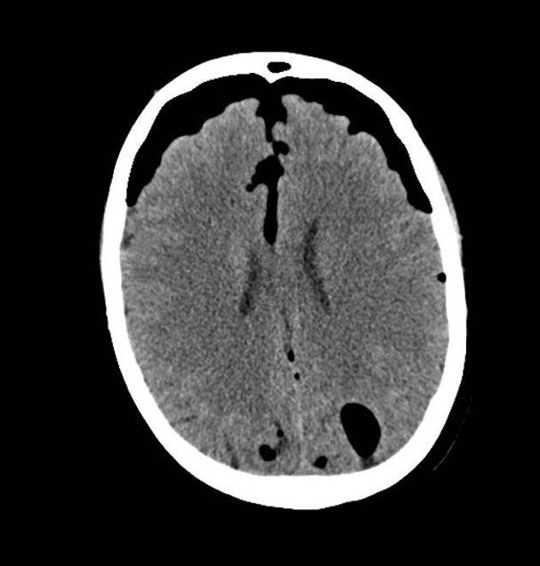
Pneumocephalus
presence of intracranial air​
most often occurs
following trauma or surgery
headache (forehead area)
air is spontaneously absorbed in a few days

Slide 34
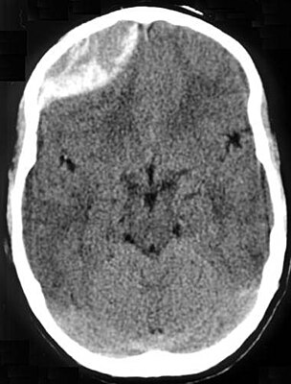
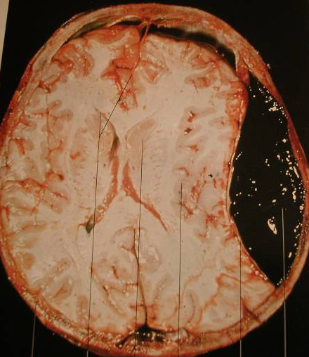
Epidural hemorrhage
The cause is usually a fracture of the temporal bone and bleeding from the middle meningeal artery
Between the inner skull table and dura matter​
The temporal bone is usually the thinnest part of the skull
- fractures are common
Epidural hematomas usually appear convex in shape

Slide 35
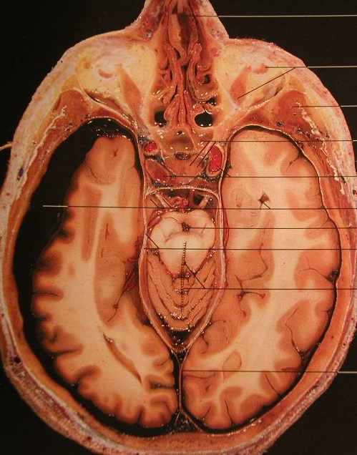
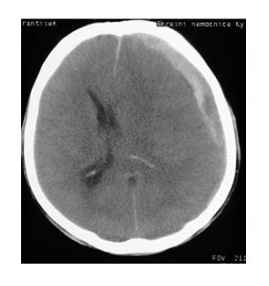
Subdural hemorrhage
usually results from tears of the small veins that bridge the gap between the dura and the cortical surface of the brain
collection of blood between the dura matter and arachnoid
life-threatening condition
subdural hematomas are classically crescent-shaped on CT scan, with a concave surface away from the skull

Slide 36
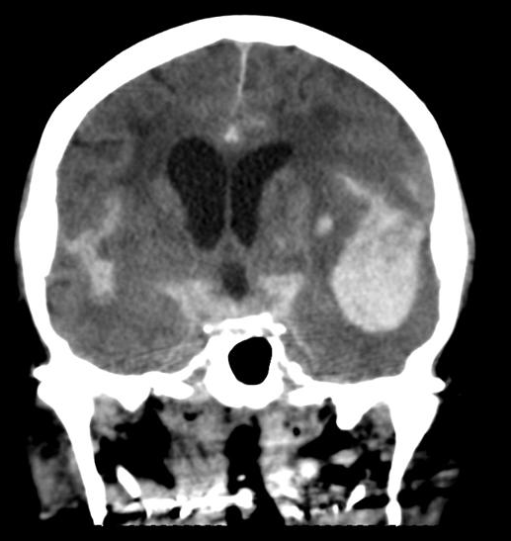
Intracerebral hemorrhage
Traumatic intracerebral hemorrhage is usually due to extension of hemorrhage from surface contusions deep into the substance of the brain
- not frequent

Slide 37
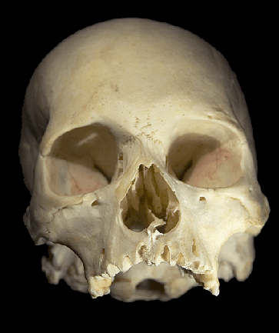
Craniofacial fractures
Upper midfacial fractures
Lower midfacial fractures

Slide 38
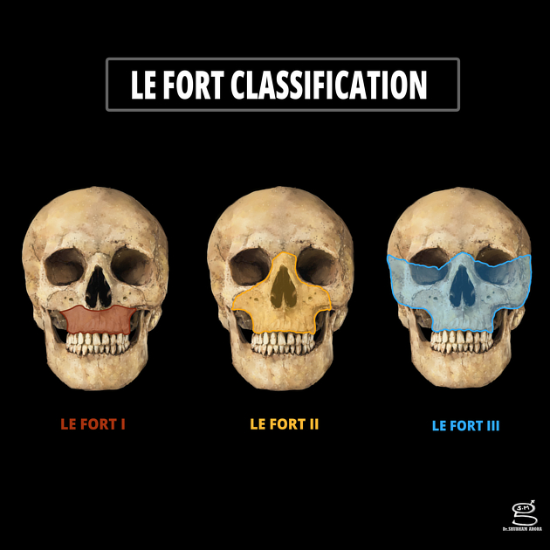
Le Fort fractures
Le Fort fractures are fractures of the midface, which involve separation of all or a portion of the midface from the skull base
The commonly used classification is as follows:
Le Fort type I
Le Fort type II
Le Fort type III

Slide 39
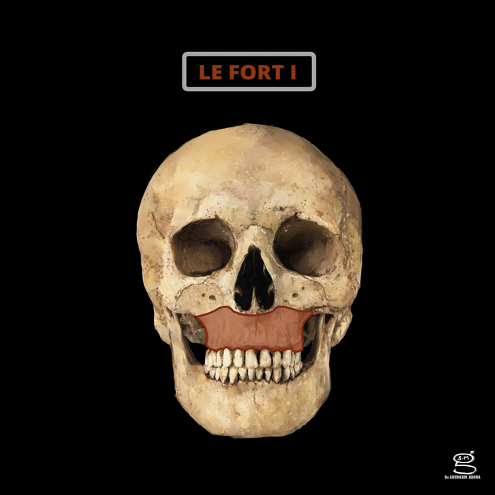
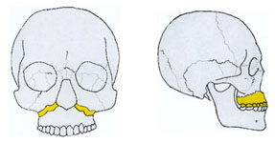
Lower midfacial fracture
Le Fort type I or low horizontal fractures
horizontal maxillary fracture, separating the teeth from the upper face
fracture line passes through the alveolar ridge, lateral nose and inferior wall of the maxillary sinus
traumatic changes of occlusion

Slide 40
Upper midfacial fracture
Naso-orbitoethmoid fractures
zygomaticomaxillary complex
orbital fractures
Le Fort II
Le Fort III

Slide 41
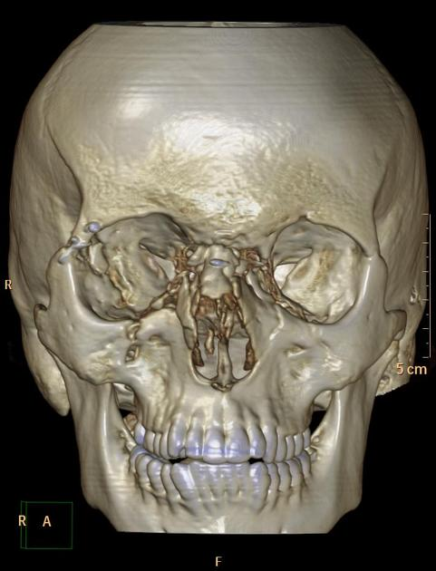
Naso-orbitoethmoid fractures
naso-orbitoethmoid fractures are caused by a high-impact force applied anteriorly to the nose and transmitted posteriorly through the ethmoid bone
comminution of both nasomaxillary buttresses involving the nasal bones and septum,
ethmoid sinuses, and medial orbital walls.

Slide 42
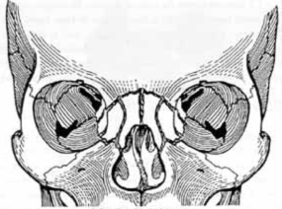
Naso-orbitoethmoid fractures
In patients with comminution, the bony segments may spread medially into the nasal cavity, superiorly to the anterior cranial fossa, and laterally into the orbit

Slide 43
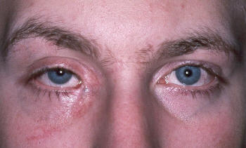
Naso-orbitoethmoid fractures
damage of the inner corner of the eye -> enlargement of the interorbital distance
= telecanthus

Slide 44
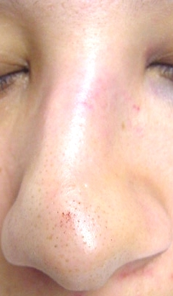
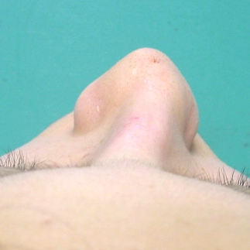
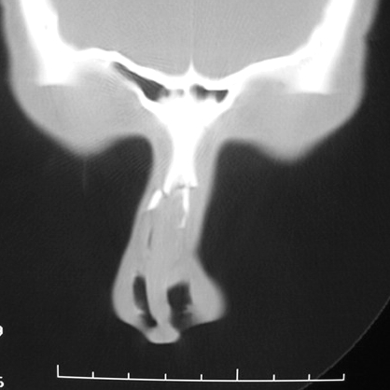
Isolated fractures of nasal bones
It usually results from a blunt injury and is one of the most common facial fracture
(cosmetically serious)
deviation of the nose to the side

Slide 45
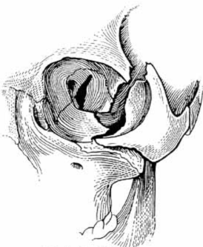
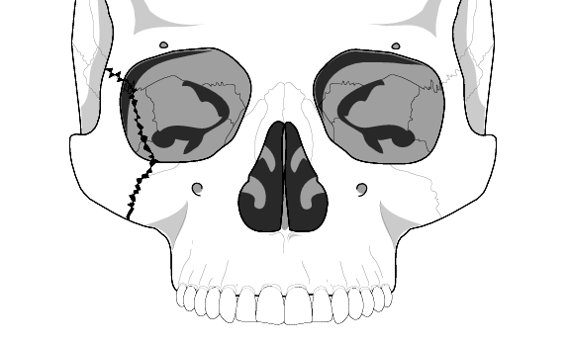
Zygomaticomaxillary Complex
fracture lines usually run through the infraorbital rim, and extend to the inferior orbital fissure
all zygomatic complex fractures involve the orbit, making visual complications
the affected eye may have impaired motility, resulting in double vision

Slide 46
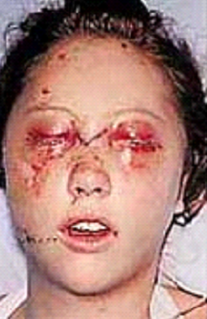
Zygomaticomaxillary Complex
SYMPTOMS:
Periocular (bruises) and oedema
Epistaxis, cerebrospinal fluid leakage, lacrimal
drainage problems
Diplopia (double vission)
Enopthalmus X Exopthalmus (posterior X anterior displacement of the globe within the orbit.

Slide 47
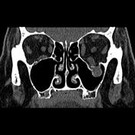
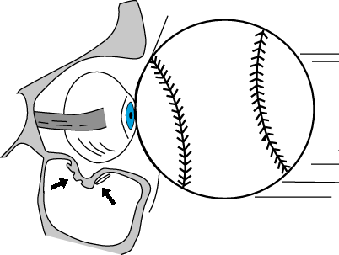
Orbital blow-out fractures
the fractures of orbital skeleton
occur when there is a fracture of one of the walls of orbit but the orbital rim remains intact
typically caused by a direct blow to the central orbit from a fist or ball.
fracture of the floor ot the orbit

Slide 48
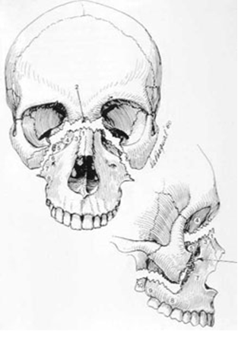
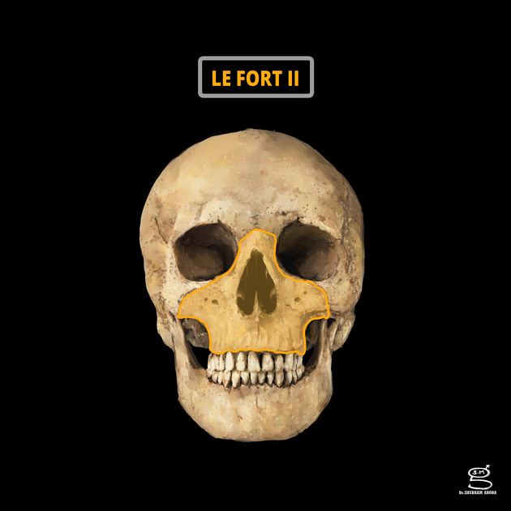
Le Fort type II (pyramidal)
pyramidal fracture, with the teeth at the pyramid base, and nasofrontal suture at its apex
fracture line passes through the posterior alveolar ridge, lateral walls of maxillary sinuses, inferior orbital rim and nasal bones
uppermost fracture line can pass through the nasofrontal junction or the frontal process of the maxilla
traumatic changes of occlusion

Slide 49
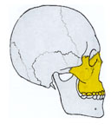

Le Fort type III (transverse)
craniofacial disjunction - because of the involvement of the zygomatic arch
transverse fracture line passes through nasofrontal suture, maxillo-frontal suture, orbital wall, and zygomatic arch/zygomaticofrontal suture
unsurprisingly type III fractures have the highest rate of CSF leak
traumatic changes of occlusion

Slide 50
Thank you for your attention

