Slide 1
Cranial nerves

Slide 2
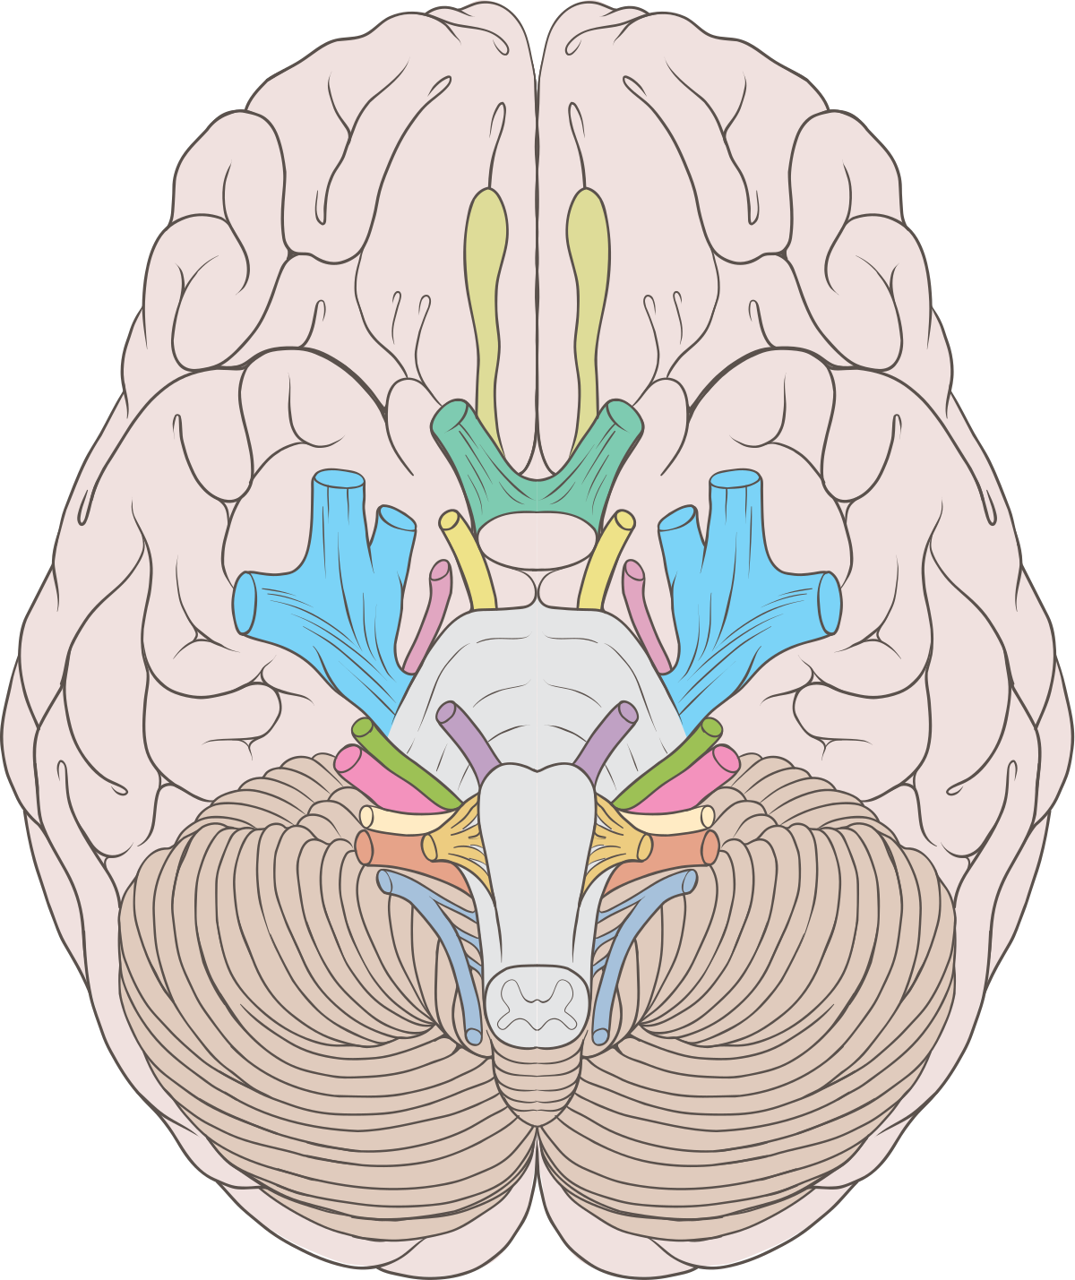
Cranial nerves
twelve pairs of cranial nerves
the exception is I. and II. cranial nerve, which are the protruding parts of the telencephalon and diencephalon
generally named according to their structure or function
numbered based on their position (rostral-caudal)
the innervation area, as the name suggests, is the head and neck
the exception is the X. cranial nerve, which extends into the abdominal cavity

Slide 3
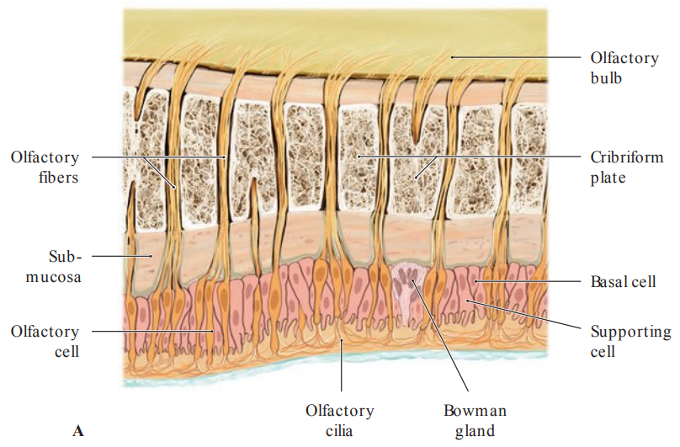
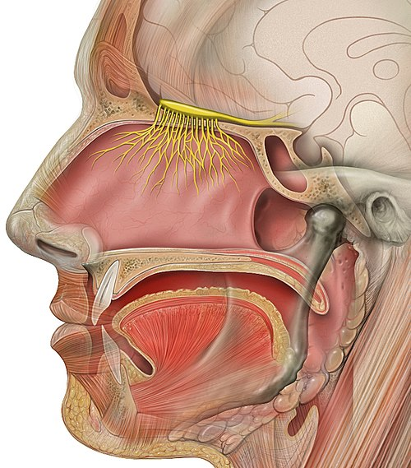
Olfactory nerve (n. I)
part of the telencephalon, not really a cranial nerve in the conventional sense
humans have a poor sense of smell compared to animals (dogs)
olfactory area is approximately 5 cm² (10⁷ olfactory cells)
(olfactory area in dogs up to 170 cm² )
humans can distinguish around 10 000 smells
the olfactory neurons can regenerate
The specialized olfactory receptor neurons of the olfactory nerve are located in the olfactory mucosa of the upper parts of the nasal cavity.
sensory nerve fibers extend from the olfactory epithelium through the many openings of the cribriform plate to reach the olfactory bulb

Slide 4
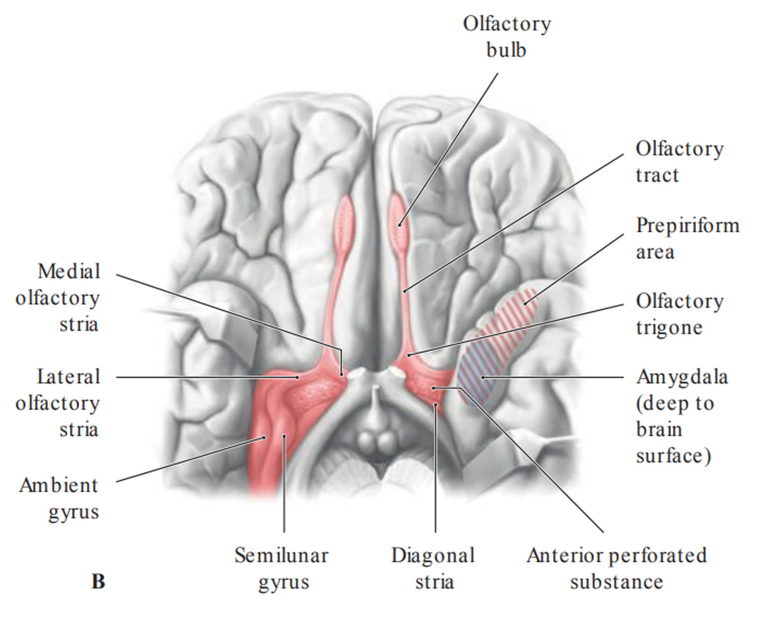
Olfactory pathway
1st. neuron - neuroepithelial cell of the olfactory epithelium of the upper parts of the nasal cavity (pars olfactoria cavitatis nasi)
2nd. neuron - mitral cell in the olfactory bulb
- axons continue further along the olfactory tract to the trigonum olfactorium
- the olfactory tract on both sides divides into medial and lateral olfactory striae
- the medial stria projects to the to contralateral olfactory structures
-the lateral stria continues on to structures associated with the olfactory cortex in the temporal lobe
The olfactory pathway connects to parts of the brain that control emotional responses - associating different smells with our feelings, sexual attraction and also serves asthe warning system that provides us with information about the outside world (if something stinks its probably dangerous for the body)

Slide 5
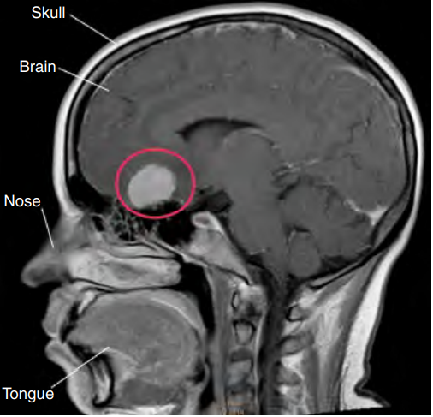
SYMPTOMS OF OLFACTORY NERVE
LESIONS
hyposmia/mikrosmia (impaired sense of smell)
Anosmia (loss of sense of smell)
parosmia (cacosmia) (normal fragrances stink, the fragrance of the flowers stink)
uncinate seizure (a form of epileptic seizure with olfactory hallucinations, evoked from the area of ​​the hippocampal gyrus)
- seizures often originates from temporal lobe

Slide 6
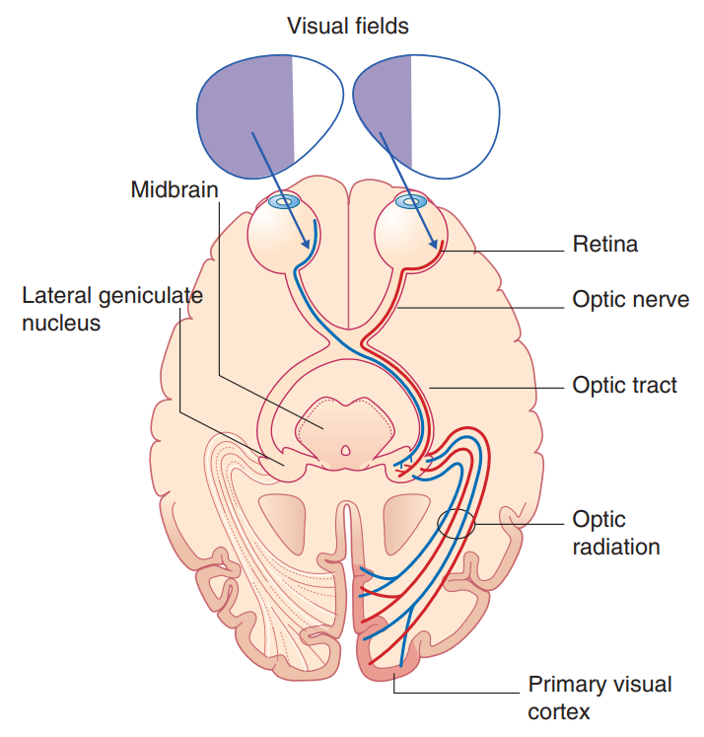
Optic nerve (n.II)
- part of the diencephalon, not really a cranial nerve in the conventional sense
- doesn´t regenerate after injury
- formed from the central processes of the ganglionic cells (3th neuron of the optic pathway)
- contains approximately 1,2 milions of the afferent fibers
- 80% fibers ends in the lateral geniculate nucleus, remain fibers leads to the mesencephalon and hypothalamus
- 4th neurons are the cells of the lateral geniculate nucleus, their axons constitutes the optic radiation that ends in the occipital cortex
- neurons of the occipital cortex create a so-called cortical image of the external world
loss of left visual field

Slide 7
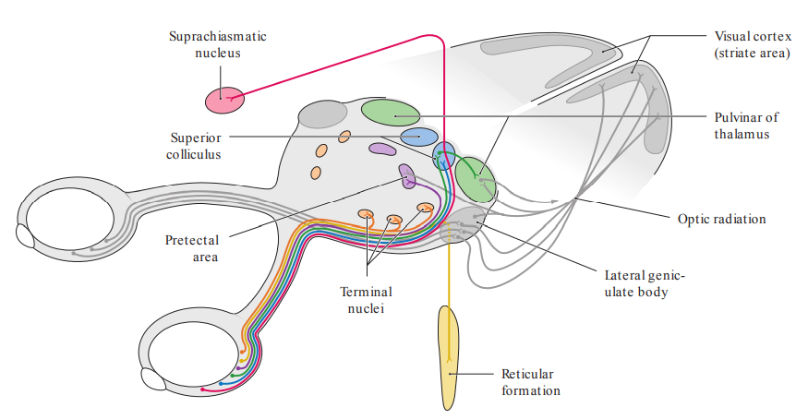
Branches of the optic tract
- composed of approximately 10-20% fibers
- branch to area pretectalis - pupillary reflex
-branch to the hypothalamus - control of vegetative functions and control of circadian rhythms (the sleep-wake cycle).

Slide 8
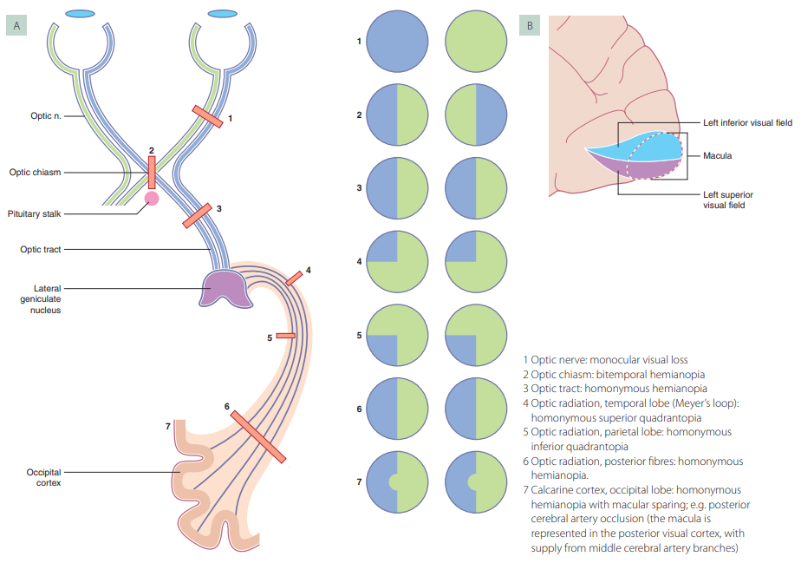
SYMPTOMS OF OPTIC NERVE LESIONS
amaurosis – vision loss
hemianopsia – loss of vision or blindness (anopsia) in half of the field of vision, usually on one side of the vertical midline (cannoot see the right or left side of the field of vision)
quadrantopsia - loss of vision in one quarter (one-fourth) of the field of vision
scotoma - blind spot in your field of vision (temporary or permanent)
phosphene - images of light or color that you can see while your eye is closed

Slide 9
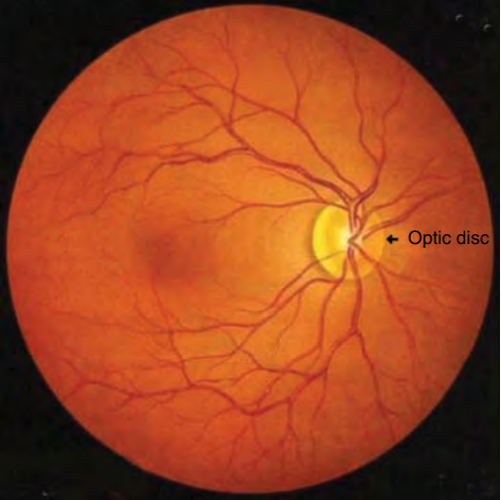
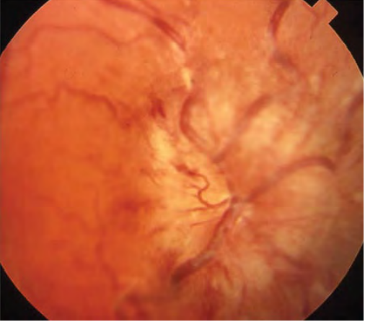
suspicion of increased intracranial pressure - fundoscopic examination is a visualization of the retina using an ophthalmoscop
edema of the eye papilla - occurs when intracranial pressure rises, which leads to compression of nerve fibers due to increased intracranial pressure in the subarachnoid space around the optic nerve

Slide 10
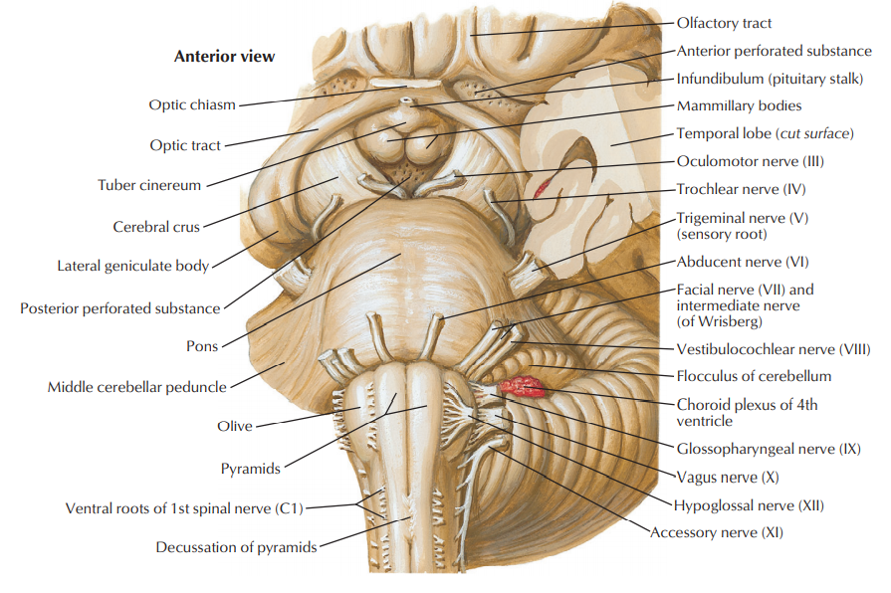
Oculomotor nerve (n.III)
- arises from the interpeduncular fossa (sulcus nervi oculomotorii) of the midbrain
- innervates all of the extraocular muscles except superior obliquus muscle and lateral rectus muscle
- brings preganglionic parasympathetic fibers from the parasympathetic nucleus III (Edinger-Westphali), which, after interpolation in the ciliary ganglion, innervate the pupillary sphincter muscle (miosis, constriction of the pupil) and ciliary muscle (accommodation – increasing the curvature of the lens)

Slide 11
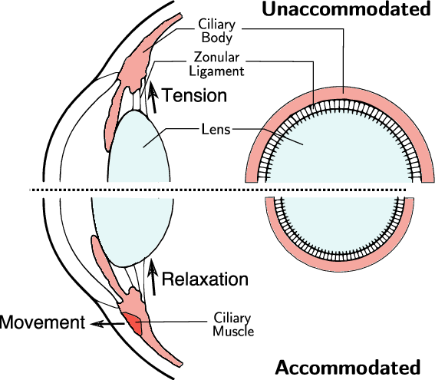
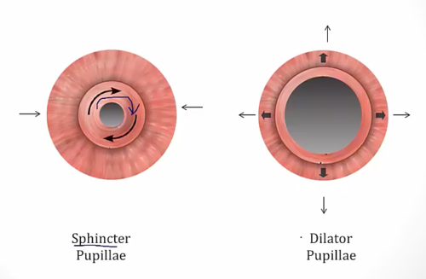
accommodation – increasing the curvature of the lens
when the ciliary muscle is contracted, the lens becomes more spherical – and has increased focussing power
miosis (narrowed pupil) mydriasis (dilated pupil)

Slide 12
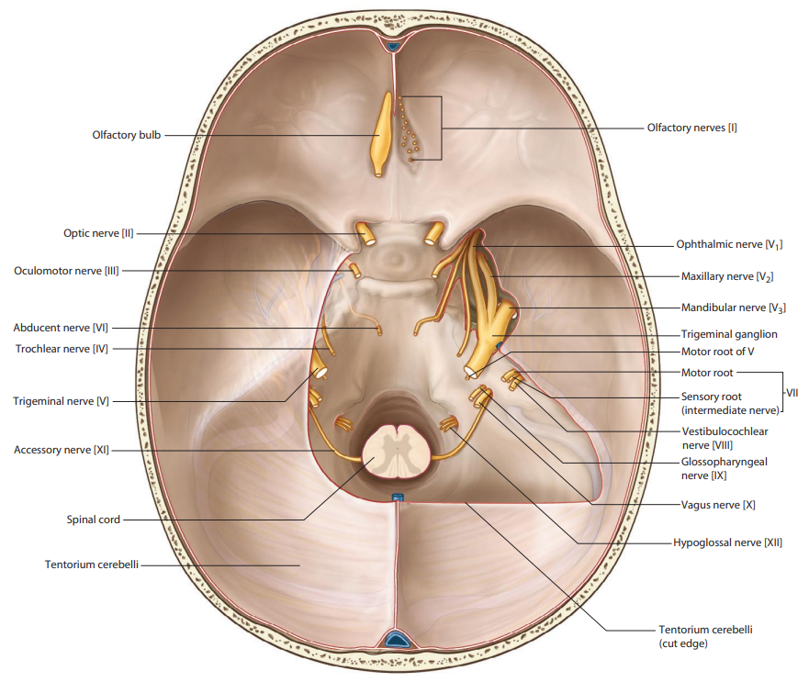
Oculomotor nerve
passes through subarachnoid space (interpeduncular cistern) lateral to the posterior communicating artery
pierces dura mater lateral from the posterior clinoid process a enters the cavernous sinus
CAVE: oculomotor nerve palsy caused by posterior communicating artery aneurysm!

Slide 13
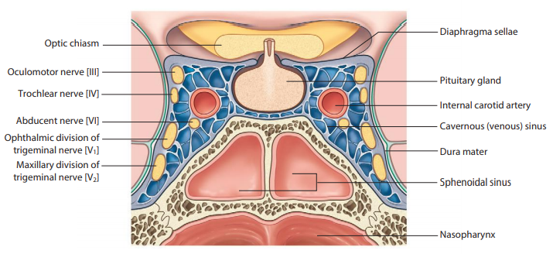
- oculomotor nerve is located uppermost, above the trochlear nerve in the lateral wall of the cavernous
- In the cavernous sinus:
receives sympathetic branches from internal carotid plexus for innervation of superior tarsal muscle
(ncl. intermediolateralis Th1-Th5 → ganglion cervicale superius → n. caroticus internus → plexus caroticus internus)

Slide 14
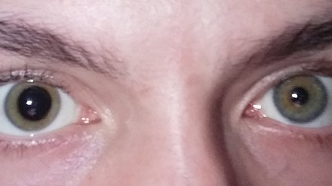
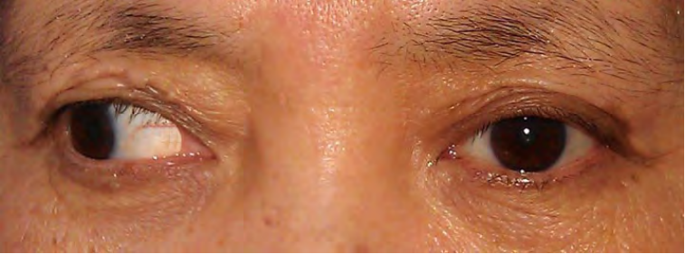
SYMPTOMS OF OCULOMOTOR NERVE LESION
- ptosis (drooping or falling of the upper eyelid, weakening of the levator palpebrae superioris muscle)
- strabismus (eyes do not line up in the same direction)
- diplopia (double vision)
- miosis (constriction of the pupil)
- mydriasis (dilation of the pupil)

Slide 15
Trochlear nerve (n.IV)
- the trochlear motor nucleus in the midbrain
- fibers decussate within the brainstem
- arises as only cranial nerve from the dorsal
aspect of the brainstem
- innervates the superior oblique muscle

Slide 16
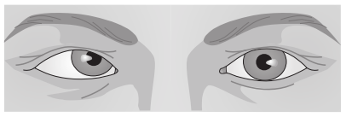
SYMPTOMS OF TROCHLEAR NERVE LESION
- inability to move the eye down and laterally – paresis of the superior oblique muscle (the eye is moved medially)
- diplopia (double vision)

Slide 17
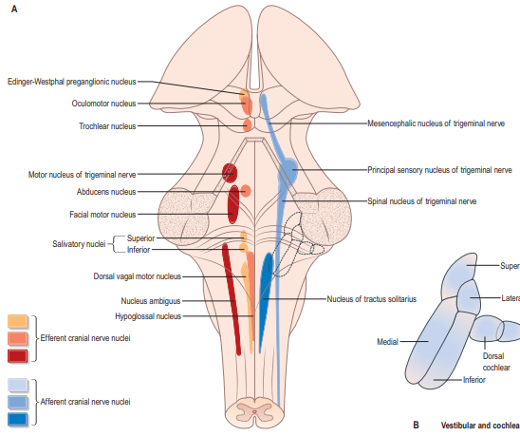
Trigeminal nerve (n.V)
- the biggest cranial nerve
- mixed nerve with large nuclear complex
1. Motor nucleus of trigeminal nerve (masticatory)
branchiomotor nucleus supplies muscules derived
from 1th pharyngeal arch (muscles of mastication,
m. mylohyoideus, venter anterior m. digastrici,
m. tensor tympani, m. tensor veli palatini)
2. Principal sensory nucleus of trigeminal nerve (pontine)
somatosensory nucleus, receives discriminative sensations,
proprioception, light touch and vibration in areas of face and mouth
3. Spinal nucleus of trigeminal nerve
somatosensory nucleus for perception of cold, heat, pain (pain in or around your teeth and jaws)
and partial proprioception from n. V, VII, IX, X
4. Mesencephalic nucleus of trigeminal nerve
ganglion with pseudounipolar neurons, receives proprioception (the sense that lets us perceive the location, movement, and action of parts of the body)
from periodontium - group of tissues that together facilitate the anchorage of teeth in jaws, hard
palate, temporomandibular joint and
from extraocular, masticatory, mimic and lingual muscles too

Slide 18
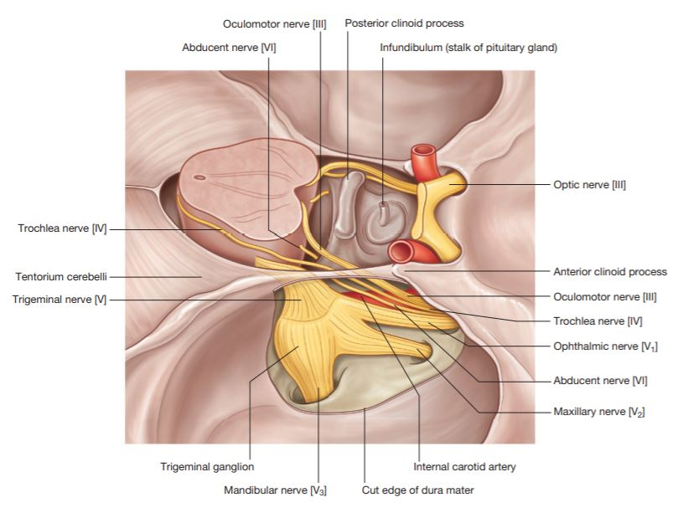
Trigeminal nerve
arises from the middle part of pons
enters the trigeminal cave (Meckel´s cave), a dura mater
pouch containing trigeminal ganglion (semilunare, Gasseri)
motor root (portio minor trigemini) underruns the ganglion
and joins the mandibular nerve directly

Slide 19
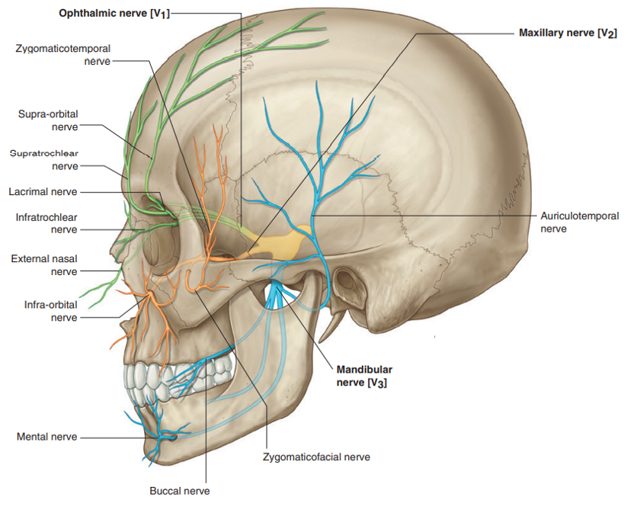
Ophthalmic nerve
1th branch of the trigeminal nerve
counts approx. 26 000 myelinated fibers
the most medial branch of the trigeminal ganglion
passes through the lateral wall of cavernous sinus
supplies (somatosensory):
orbit with periosteum, ocular bulb, lacrimal gland
conjunctiva of the upper eyelid
skin of nasal dorsum and tip, upper eyelid and
forehead to the interauricular line
ethmoidal cells mucosa, sphenoid sinus
and ventral part of nasal cavity

Slide 20
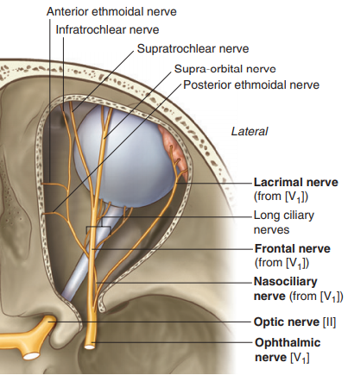
Ophthalmic nerve
divides in superior ophthalmic fissure to:
nervus frontalis
nervus lacrimalis
nervus nasociliaris
Nervus frontalis
n. supraorbitalis
→ r. medialis
→ r. lateralis
n. supratrochlearis
Nervus lacrimalis
r. communicans cum nervo zygomatico
Nervus nasociliaris
r. communicans cum ganglio ciliari
nn. ciliares longi
n. ethmoidalis posterior
n. ethmoidalis anterior
→ rr. nasales
→ r. nasalis externus
Innervates the mucosa of the upper part of the
nasal cavity

Slide 21
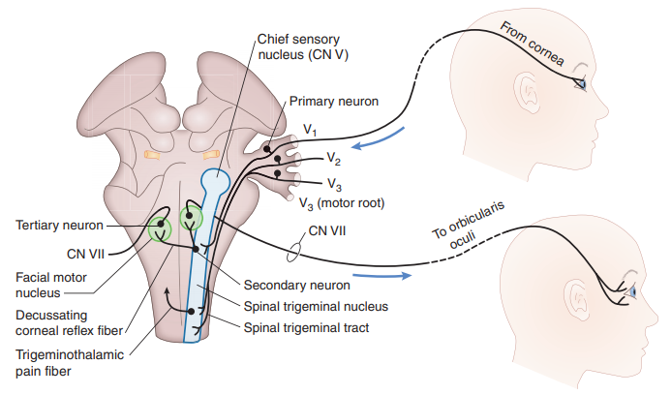
The corneal reflex
also known as the blink reflex or eyelid reflex - blinking of the eyelids elicited by stimulation of the cornea (such as by touching
The corneal reflex is mediated by the reflex arc, which consists of corneal roreceptors, the afferent ophthalmic nerve (1st branch of the nerve) and the efferent VII nerve innervating the orbicularis oculi muscle (leads to tighteninig of the eyelids)
hypo/areflexia (loss of reflex): indicated mesencephalon or pons damage

Slide 22
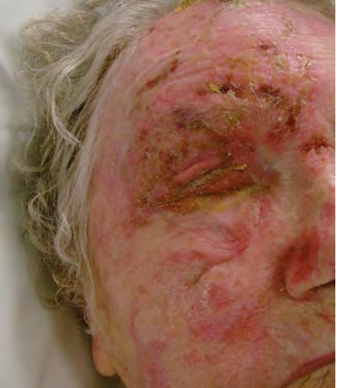
Herpes Zoster Ophthalmicus
- a viral disease characterized by a unilateral painful skin rash or blisters in distributions of the fifth cranial nerve (opthalmic nerve) - travel along neurons to the sensory axons of the skin to form vesicular lesions
- occurs after reactivation of latent varicella-zoster virus (VZV) present within the cerebral ganglia
antiviral drugs, corticoids, ATB for bacterial infection….
the risk of brain damage in patients with weakened immunity !!!

Slide 23
Maxillary nerve
- 2nd branch of the trigeminal nerve
- supplies (somatosensory):
dura mater in the middle cranial fossa
cheek skin between the palpebral and oral fissure
mucosa of the upper cheeks
mucosa of the maxillary sinus and posterior
2/3 of the nasal cavity
mucosa of the palate, nasopharynx and adjacent part of the Eustachian tube, maxilla and upper teeth

Slide 24
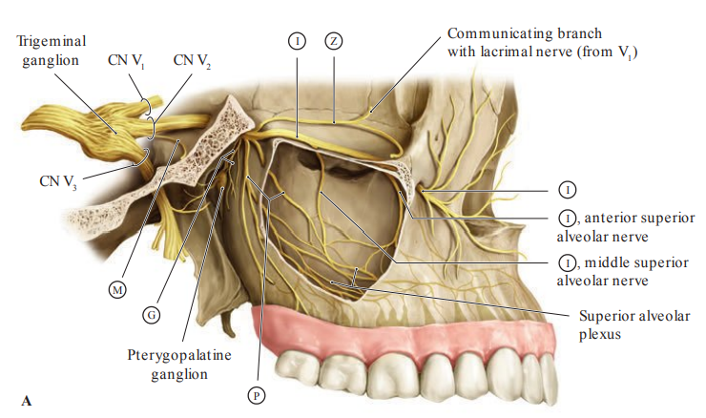
Maxillary nerve
- passes through the lateral wall of cavernous sinus,
- enters pterygopalatine fossa through the foramen rotundum
- enters the orbit through the inferior orbital fissure and runs forward on the floor of the orbit
- emerges on the face through the infraorbital foramen
- terminates by dividing into inferior palpebral, lateral nasal and superior labial branches

Slide 25
Mandibular nerve
3th branch of the trigeminal nerve
counts approx. 26 000 myelinated fibers
supplies (somatosensory):
dura mater near the posterior branches of
middle meningeal artery
skin of temporal region and around mandibula
mucosa of the lower cheeks, isthmus faucium,
palatine tonsil and the floor of the oral cavity
mandible and lower teeth
innervates (branchiomotor):
masticatory muscles (m. masseter, m. temporalis,
m. pterygoideus medialis et lateralis)
m. mylohyoideus, venter anterior m. digastrici
m. tensor tympani, m. tensor veli palatini

Slide 26
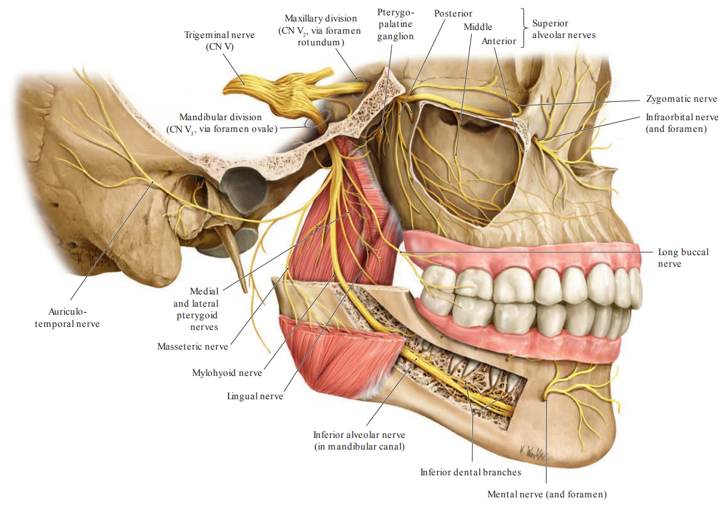
Mandibular nerve
the most lateral branch of the trigeminal ganglion
receives motor root
enters to the infratemporal fossa through the foramen ovale
enter the mandibular canal, a narrow tunnel running through the mandible, within this canal, the nerve provides branches to the mandibular teeth and emerges as the mental nerve (provides feeling of lower lip, the front of your chin, and a portion of your gums)

Slide 27
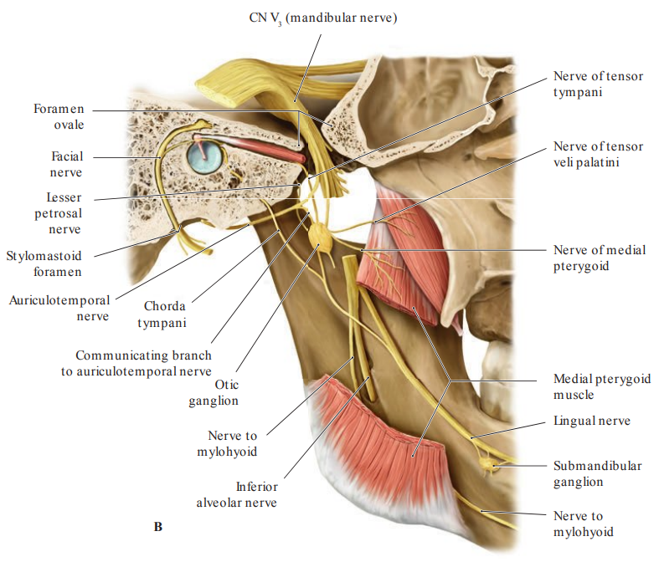
Chorda tympani
Chorda tympani branches off the facial nerve (within the facial canal) and enters the lateral wall of the tympanic cavity
- exits the skull by descending through the petrotympanic fissure into the infratemporal fossa and joins the lingual nerve,
a branch of the mandibular nerve
- fibers of chorda tympani enter the sublingual space to reach the anterior 2/3 of the tongue and submandibular ganglion which innervate the submandibular and sublingual salivary glands

Slide 28
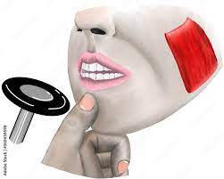
Jaw jerk (masseter) reflex
The mandible (lower jaw) is tapped at a downward angle just below the lips at the chin while the mouth is held slightly open
In a healthy patient, the answer is the closing of the lower jaw, which is caused by the contraction of the masseter muscle
we can test for damage to the trigeminal nerve using the masseter reflex

Slide 29
Trigeminal neuralgia
type of chronic pain disorder that involves sudden attacks of severe facial pain similar to an electric shock on one side of the face
- most commonly affects the 2nd and 3rd branches of the trigeminal nerve
- usually the pain is triggered by touching the trigger zone (trigger point) for example touching the face, gums, chewing, brushing teeth, talking, cold or touch stimulus of the face
Inflammation in the oral cavity can mimic the trigeminal neuralgia by irritation of the mandibular nerve!

Slide 30
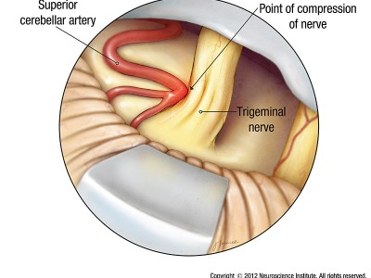
Trigeminal neuralgia
the most common cause of trigeminal neuralgia is compression of the trigeminal nerve at the point of exit from the brainstem by a vessel
exit point of the nerve from the brainstem

Slide 31
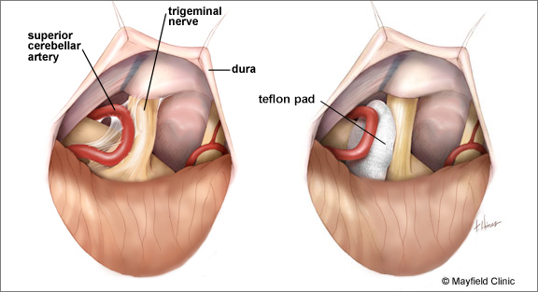
Trigeminal neuralgia
treatment – surgical
- microvascular decompression and inserting a special material between the vessel and the nerve
- the goal is to reduce the transmission of pulsations from the vessel to the nerve

Slide 32
Abducens nerve (n.VI)
the abducens motor nucleus in the pons
arises from the bulbopontine groove medial to the n. VII
innervates the lateral rectus muscle

Slide 33
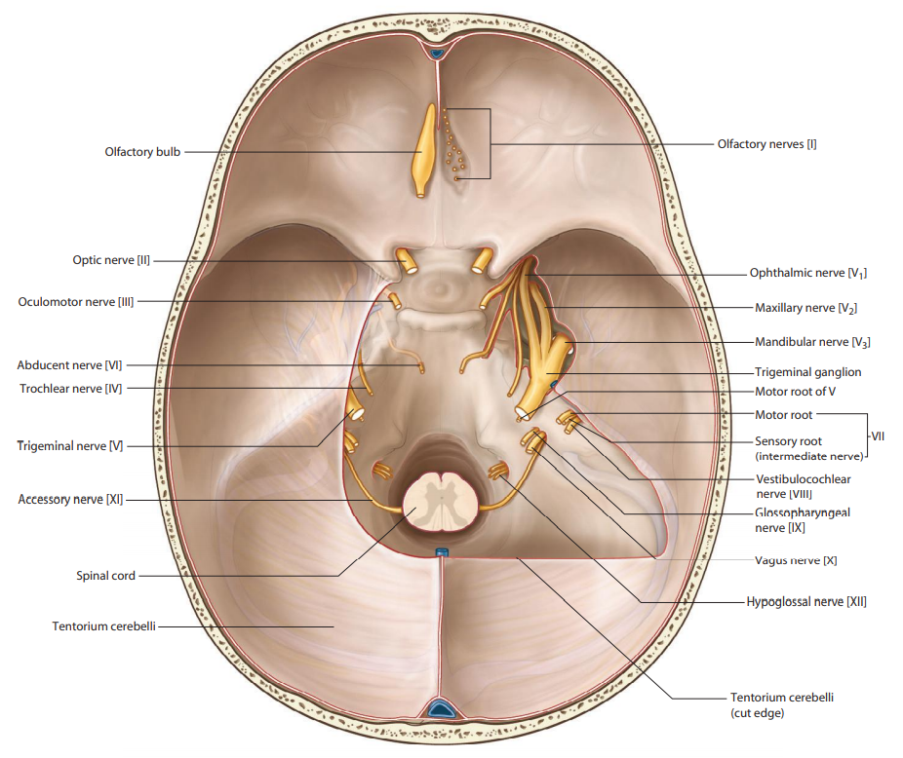
Abducens nerve (n.VI)
- runs along the clivus forward and laterally
- in the cavernous sinus runs laterocaudally from the internal carotid artery – mobile and more vulnerrable
- through the superior orbital fissure into the orbit
thin and mobile -can be injured by stretching or compression

Slide 34
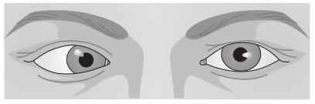
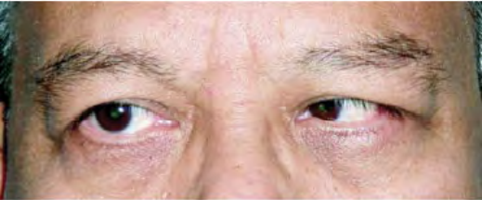
SYMPTOMS OF ABDUCENS NERVE LESION
- lateral limitation of eye movement (the lateral rectus muscle does not work)
- diplopia (double vision)
Etiology:
- trauma
- compression by the tumor
- arteriovenous fistula of the
sinus cavernosus
- intracranial hypertension

Slide 35
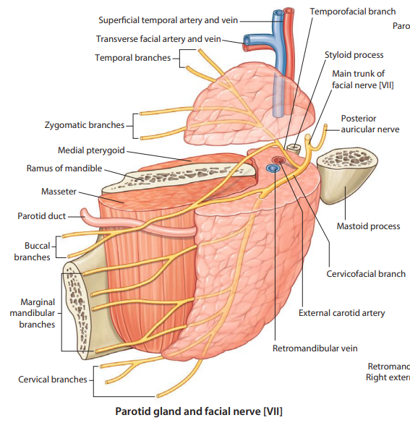
Facial nerve (n.VII)
Arising of the n. VII
arises from the bulbopontine groove
lateral from the abducent nerve)
- travels from the pons through the facial canal in
the temporal bone
- exits the skull at the stylomastoid foramen
- enters the parotid gland posteriorly and forms the
parotid plexus
- branches for facial muscles arise from the
parotid plexus

Slide 36
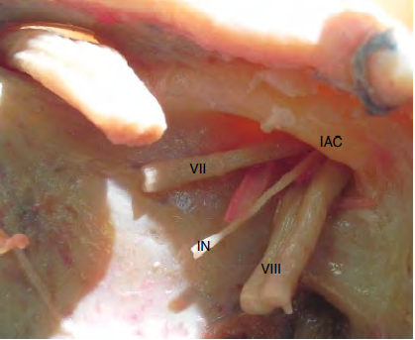
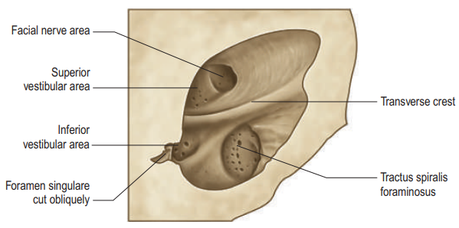
Facial nerve (n.VII)
- enters the pyramid through the fundus of internal acustic meatus (area nervi facialis, ventrocranial part)
- before entering the pyramid, it connects with the n. intermedius, part of the facial nerve - contains the sensory fibers for taste from the front two-thirds of the tongue and parasympathetic fibers for the sublingual and submandibular salivary gland

Slide 37
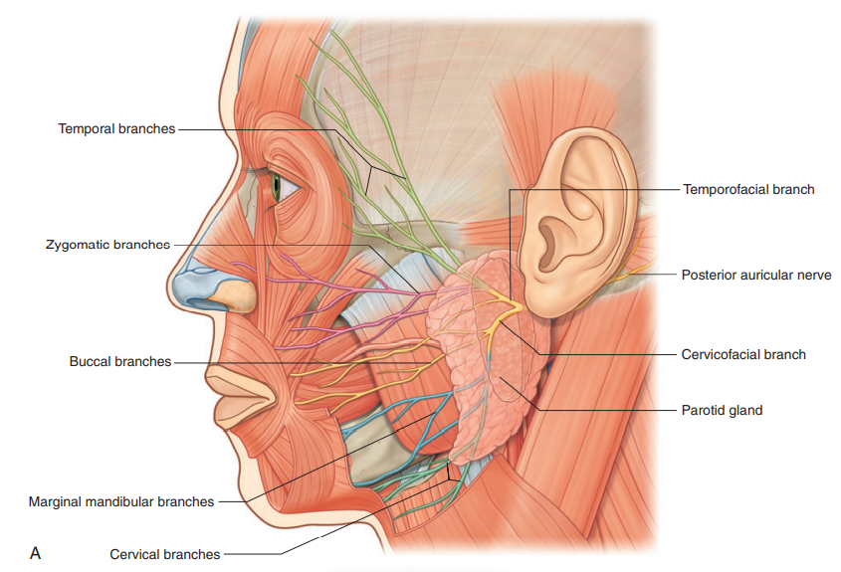
after exiting the parotid plexus it has 5 branches for mimic muscles…
1. Temporal branches
- muscles of the frontal and temporal region
2. Zygomatic branches
- m. orbicularis oculi, mm. zygomatici and
muscles of the nose
3. Buccal branches
- muscles of the upper lip and buccal region
4. Marginal mandibular branches
- muscles of the chin and lower lip
5. Cervical branches
- m. platysma

Slide 38



Symptoms of facial nerve lesion
mimic muscles palsy (drooping of the corner of the mouth)
lagophthalmos (inability to close the eyelids completely - leads to corneal drying and ulceration)
ageusia (loss of taste functions of the tongue)
hyposecretion of saliva

Slide 39
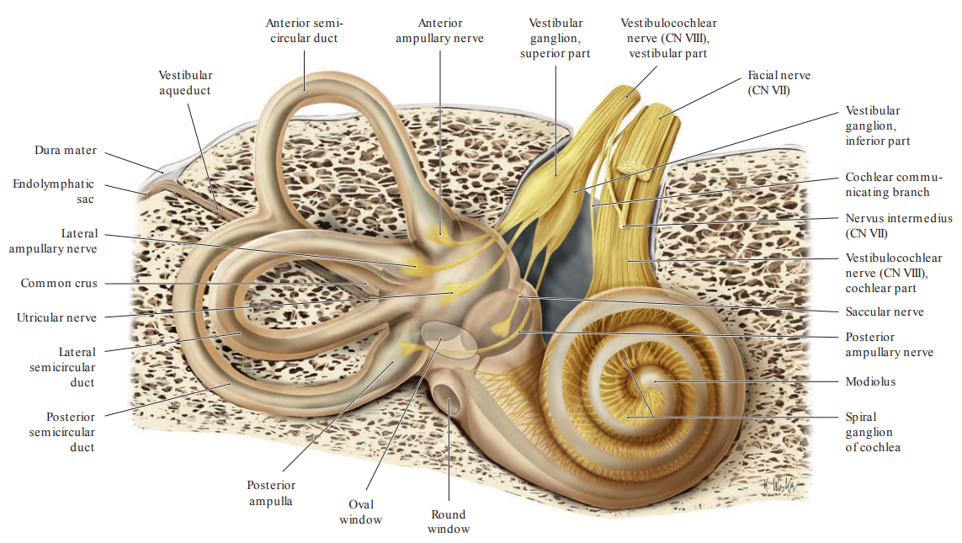
Vestibulocochlear nerve (n.VIII)
- emerges from the brain at the cerebellopontine angle and exits the cranium via the internal acoustic meatus of the temporal bone
- splits to form the vestibular nerve and the cochlear nerve
- vestibular nerve innervates the vestibular system of the inner ear, which is responsible for detecting balance
- cochlear nerve travels to cochlea of the inner ear, forming the spiral ganglion which serve the sense of hearing
arises from the bulbopontine groove
medial to the n. VII

Slide 40
Symptoms from damage to the vestibular system
- vertigo (the feeling of spinning)
- nystagmus (rhythmic, abnormal eye movements)
- nausea (the feeling that you are going to vomit)
- vomitus (vomiting)

Slide 41
Symptoms from damage to the auditory system
- hypacsis (partial hearing loss)
- anacusis (the total loss of hearing)
- tinnitus (the sensation of hearing, commonly described as a ringing sound, noise in the aer)

Slide 42
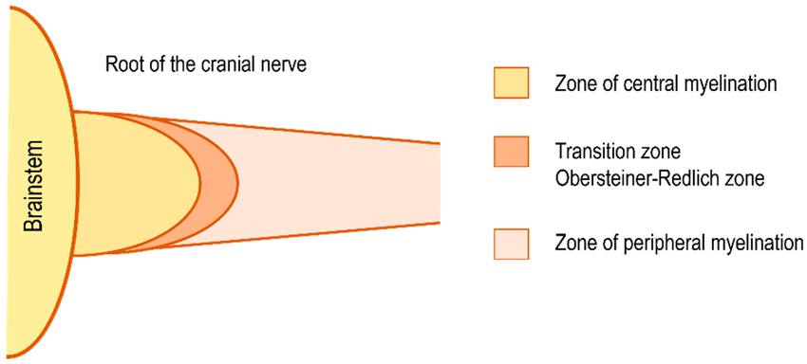
Vestibular schwannoma
- benign tumor from the Schwann´s cells
- develops on the vestibular nerve
- arise at the junction of central myelin produced by oligodendrocytes and peripheral myelin from Schwann cells (Obersteiner-Redlich zone)

Slide 43
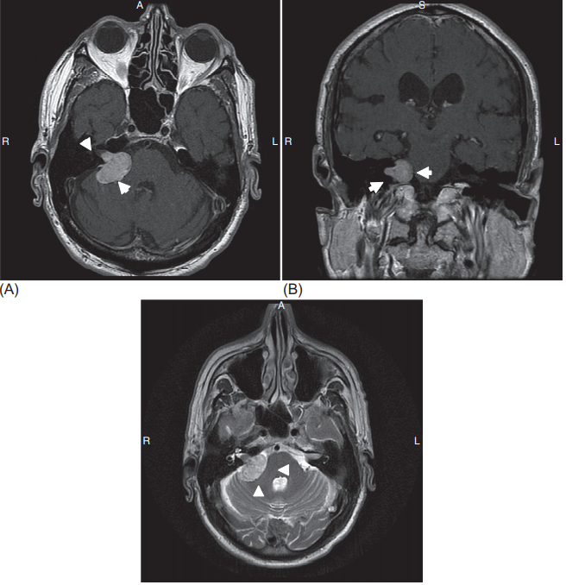
Vestibular schwannoma
Symptoms from vestibulocochlear nerve compression:
- one-sided hearing loss
- noise in the ear (Tinnitus)
- balance problems and vertigo
Treatment
observations
radiation
surgical removal

Slide 44
Glossopharyngeal nerve (n.IX)
- nerve with motor, sensitive and parasympathetic (gl. parotis, parotid salivary gland) component
- sensory function - for taste perception from dorsal 1/3 of the tongue (n.VII - taste perception from the front two thirds of the tongue)
- leaves the brainstem in a form of the several rootlets from the posterolateral sulcus

Slide 45
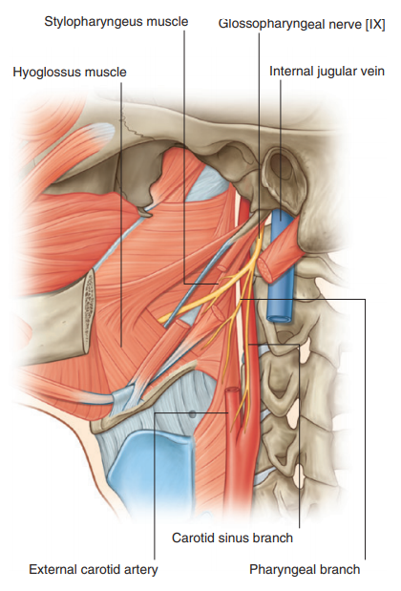
Glossopharyngeal nerve
- leaves the cranium through the jugular foramen
- descends forward and inferiorly, aiming to the root of the tongue
innervation of the muscles - muscles of the pharynx, soft palate except of m. tensor veli palatini
parasympathetic innervation of the parotide gland
taste perception from dorsal 1/3 of the tongue
somatosensory information (pain, temperature, touch) from the pharynx, palatine tonsil, dorsal 1/3 of the tongue, tympanic cavity and adjacent part of the Eustachian tube

Slide 46
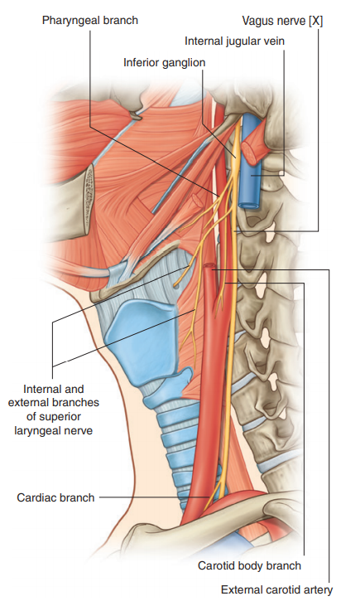
Vagus nerve (n.X)
- contains parasympathetic fibres to control heart, lungs, and digestive tract
- extends through the jugular foramen, then passes into the carotid sheath between the internal carotid artery and the internal jugular vein down to the neck, chest, and abdomen

Slide 47
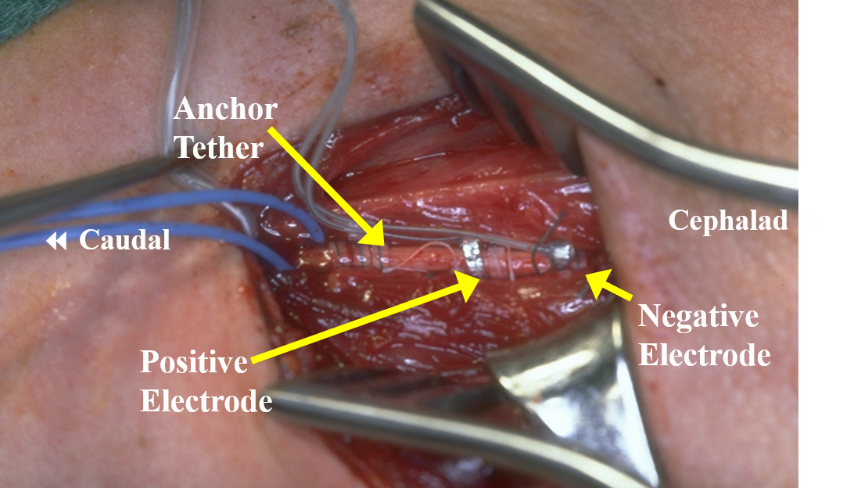
Drug-resistant epilepsy
Treatment of drug-resistant epilepsy
- implantation of electrodes to stimulate the vagus nerve with electrical impulses
connection of subcutaneous electrodes to a generator implanted below the clavicle

Slide 48
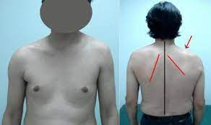
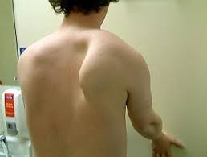
Accessory nerv (n.XI)
- essential for neck and shoulder movement
- innervation of the sternocleidomastoid and
trapezius muscles
- palsy of the accessory nerve is most often
manifested as the inability to rotate the head to
the healthy side
- the arm on the affected side is lowered

Slide 49
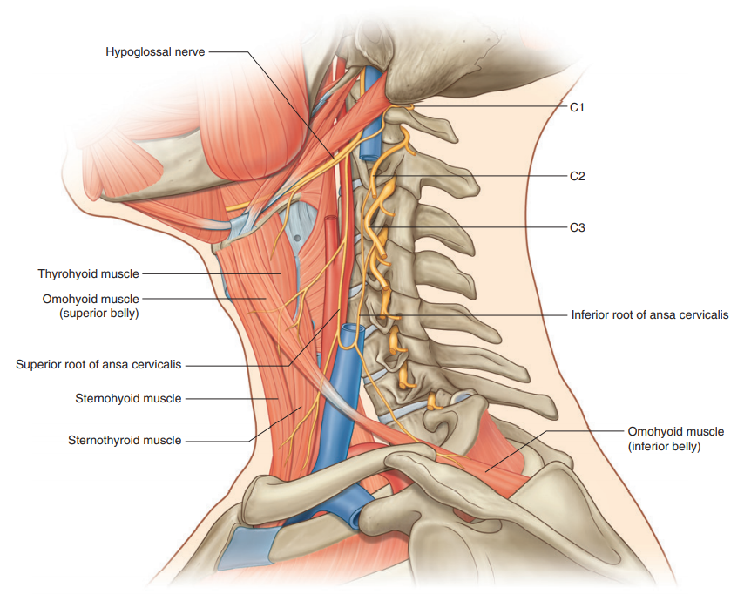
Hypoglossal nerve (n.XII)
innervates all muscles of the tongue, except for the palatoglossus which is innervated by the vagus nerve
- exits the cranium via the hypoglossal canal of the occipital bone
- passes inferiorly to the angle of the mandible and moving in an anterior direction to enter the tongue

Slide 50
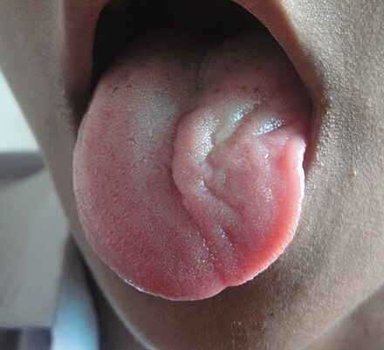
Symptom of hypoglossal nerve lesion
Unilateral damage to the hypoglossal nerve
hemiglossoplegia (paralysis of half of the tongue)
- the affected side of the tongue is atrophic, fasciculations (muscle twitching) appear
- the tongue rolls on affected side
Bilateral damage to the hypoglossal nerve
- paralysis of both halves of the tongue, (glossoplegia) – cannot crawl out, speech is impaired (dysarthria)

Slide 51
References:
HOMBACH-KLONISCH, S., T. KLONISCH and J. PEELER. Sobotta: Clinical Atlas of Human Anatomy. Munich, Germany: Elsevier Science, 2019, 680 s. ISBN 978-0-7020-5273-6.
STANDRING, S, et al. Gray's Anatomy: The Anatomical Basis of Clinical Practice. 41st. Philadelphia: Elsevier, 2016, 1562 s. ISBN 978-0-7020-5230-9.
DRAKE, R. L., A. WAYNE VOGL and A. W. M. MITCHELL. Gray's Anatomy for Students. 4th. Philadelphia: Elsevier, 2020. ISBN 978-0-323-39304-1.
DRAKE, R. L., A. WAYNE VOGL, A. W. M. MITCHELL, R. M. TIBBITTS and P. E. RICHARDSON. Gray's Atlas of Anatomy. 2. Philadelphia: Churchill Livingstone, 2015,
648 s. ISBN 978-1-4557-4802-0.
VILENSKY, J. A., W. M. ROBERTSON and C. A. SUÁREZ-QUIAN. The Clinical Anatomy of the Cranial Nerves: The Nerves of "On Old Olympus Towering Top.
Wiley-Blackwell, 2015, 336 s. ISBN 978-1-1184-9201-7.
NETTER, F. H. Atlas of Human Anatomy. 6. Philadelphia: Saunders, 2014, 624 s. ISBN 978-1-4557-0418-7.
ELLIS, H. and V. MAHADEVAN. Clinical anatomy: applied anatomy for students and junior doctors. Fourteenth edition. Hoboken, USA: Wiley-Blackwell, 2019.
ISBN 978-111-9325-536.
GOULD, D. J. and J. D. FIX. Neuroanatomy (Board Review Series). 5. Baltimore: Lippincott Williams & Wilkins, 2014, 368 s. ISBN 978-1-4511-7609-4.
ROPPER, A. H., M. A. SAMUELS, J. P. KLEIN, S. PRASAD, et al. Adams and Victor's Principles of Neurology. 11. New York: McGraw-Hill Education Medical, 2019,
1664 s. ISBN 978-0-07-184262-4.
GOSLING, J. A., P. F. HARRIS, J. R. HUMPHERSON, I. WHITMORE, P. L. T. WILLAN et al. Human Anatomy, Color Atlas and Textbook. 6. Philadelphia: Elsevier,
2017, 456 s. ISBN 978-0-7234-3827-4.
BAKER, E. W., M. SCHUENKE, E. SCHULTE, U. SCHUMACHER, et al. Anatomy for Dental Medicine. Second Edition. Thieme Medical Publishers, 2015. ISBN 978-1-62623-085-9.
GLEESON, M. J., R. C. CLARKE, et al. Scott-Brown’s Otorhinolaryngology: Head and Neck Surgery (3 volume set). 7th edition. CRC Press, 2008. ISBN 978-0-340-808-931.
CHROBOK, V., J. DRŠATA, M. JANOUCH, P. KOMÍNEK, et al. Příručka pro praxi: Screening sluchu novorozenců [online]. Praha:
Česká společnost otorinolaryngologie a chirurgie hlavy a krku ČLS JEP, 2019 [cit. 2022-03-21].
Dostupné z: https://www.otorinolaryngologie.cz/content/uploads/2020/02/ppp-screening-sluchu-novorozencu.pdf
ČIHÁK, Radomír. Anatomie 3. Třetí, upravené a doplněné vydání. Praha: Grada, 2016, 832 s. ISBN 978-802-4756-363.
PARENT, A. and M. B. CARPENTER. Carpenter's Human Neuroanatomy. 9th Edition. Providence: Williams & Wilkins, 1996. ISBN 0-683-06752-4.
AUGUSTINE, J. R. Human Neuroanatomy. 2nd Edition. New Jersey: Wiley-Blackwell, 2017. ISBN 978‐0‐4709‐6161‐2.
STRASSMAN, A. M., Y. MINETA and B. P. VOS. Distribution of fos-like immunoreactivity in the medullary and upper cervical dorsal horn produced by stimulation of dural blood vessels in the rat.
The Journal of Neuroscience. 1994, 14(6), 3725-3735. ISSN 0270-6474. DOI:10.1523/JNEUROSCI.14-06-03725.1994
BURSTEIN, R., P. BLAKE, A. SCHAIN and C. PERRY. Extracranial origin of headache. Current Opinion in Neurology. 2017, 30(3), 263-271. ISSN 1350-7540. DOI:10.1097/WCO.0000000000000437

Slide 52
Thank you for your attentioon

