Slide 1
Delivering Serious News

Slide 2
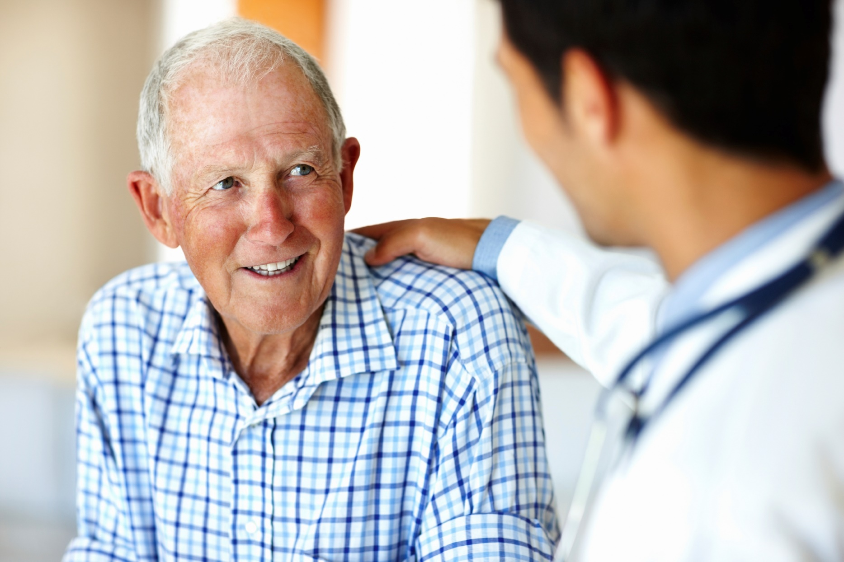
Delivering
Serious News

Slide 3
Serious Illness Communication Skills Training
Delivering Serious News
GUIDE
Conducting Goals of Care Conversations
Part 1 - Reframing: We’re in a Different Place
Part 2 - Mapping the Future: Clarifying Priorities
Part 3 - Aligning with Patient Values
Part 4 - Discussing Life-Sustaining Treatments
Notes:
FACILITATOR NOTES:
“Today’s session is the first in a series of training sessions that we will do over the next XX weeks (months).” (Modify if you are doing all the training sessions at once.)
“We’re going to start by focusing on how to deliver serious news to patients and their families.”
Raise the question to the group (and facilitate a few responses):
“Why do we call it serious news?”
After the responses, emphasize the following point:
To call it “bad news” implies only one outcome and one way of looking at it. There is lots of different kinds of news that patients receive, and it is not always perceived as universally bad.
Serious news is a more global term for any news that has important repercussions, one way or the other.

Slide 4
Why is Delivering Serious News Hard?
We feel sad ourselves
We don’t know the right words to say
Emotions are strong and we don’t know how to respond
Notes:
FACILITATOR NOTES:
One of the hard parts about any difficult conversation is not knowing how to get from “here” to “there.” We will provide you with a step by step “Talking Map” that provides you a guide to get there. It’s called GUIDE, which is an acronym for the five steps.
One of the other tough parts is responding to the inevitable emotion that emerges in these conversations. So, we will also learn two tools that will help you respond.

Slide 5
What We Will Learn
GUIDE: A ‘Talking Map’
Tools for responding to patient emotion
Notes:
FACILITATOR NOTES:
One of the hard parts about any difficult conversation is not knowing how to get from “here” to “there.” We will provide you with a step by step “Talking Map” that provides you a guide to get there. It’s called GUIDE, which is an acronym for the five steps.
One of the other tough parts is responding to the inevitable emotion that emerges in these conversations. So, we will also learn two tools that will help you respond.

Slide 6
How We Will Learn
Define skills (lecture)
Observe skills in action (videos)
Practice
Notes:
FACILITATOR NOTES:
This session will take less than an hour (MAKE SURE TO FINISH ON TIME!)
We will start with a brief “mini-lecture” in which I define and outline the skills that we’ll learn.
I’ll then show you several videos that give you examples of what these look like in action.
However, learning communication is like learning to improve at a sport, or a musical instrument. You only get better with practice, and we’ll have a chance to do that, in a very easy and not-scary way.

Slide 7
GUIDE: A Talking Map for Serious News
Get Ready
Understand what the patient knows
Inform starting with a headline
Demonstrate empathy
Equip the patient for the next step.
Notes:
Changed title to GUIDE from SPIKES
FACILITATOR NOTES:
GUIDE is a talking map for delivering serious news. It is comprised of 5 steps, each named with the first letter of this acronym. These are get ready, understand, inform, demonstrate empathy, and equip the patient. We’ll go through each of these steps one by one in the next few slides.

Slide 8
GUIDE: Get Ready
Have a plan in mind
Who should be in the room
Conducive setting
Find a private space
Sign out pager or set to vibrate
Tissue
Allot adequate time
Notes:
FACILITATOR NOTES:
Walk the audience through each of these bullets.

Slide 9
GUIDE: Understand
Ask current understanding
“Tell me what you understand is going on with your illness?”
“What have the other doctors told you?”
When you give serious news, your patient is learning. Start from what they know already.
Notes:
FACILITATOR NOTES:
Emphasize to the audience that they should ALWAYS learn what the patient knows before giving information.
You may want to run through some of the reasons why this is useful.
For example, if they already know what you’re going to tell them, you can save a lot of time.
Or, if you find out that they have a VERY different understanding of things, what you are sharing will be more of a shock.

Slide 10
GUIDE: Inform
How much information does the patient want?
Ask permission
“Is now a good time to talk?”
Use a soft start
“The test did not come back as we were hoping”
Notes:
FACILITATOR NOTES:
It is also helpful to find out how much (or what kind) of information a patient wants.
Asking for permission before moving forward always make a patient feel like they have more control over the conversation and is very helpful.

Slide 11
GUIDE: Inform
Get to the point with a one - sentence headline.
Short, discrete chunks
“The CT scan shows that the cancer has gotten worse”
Leave silence so your patient can take it in
Pause after giving information
You may need to give more details, but first make sure your patient takes in the headline.
Notes:
FACILITATOR NOTES:
Walk through these bullets. A few key points to share:
When sharing serious news, do not give a long lecture or huge amounts of detail. Information should be provided in short, digestible chunks.
A rule of thumb is not to give more than two or three pieces of information at a time.
Use sixth grade English in communicating. Avoid medical jargon.
If delivering bad news, it can be quite useful to just pause after the news for as long as the patient needs. If they are silent for over a minute or two, you may want to say something like:
“I think I just dropped some pretty big news on you – would you like to share what you’re thinking?”

Slide 12
GUIDE: Demonstrate Empathy
Expect the patient’s first response to be emotion.
Attend to that emotion BEFORE moving on
Tools to show that you see the emotion:
Naming
Acknowledging
Notes:
FACILITATOR NOTES:
This is the most important point of GUIDE.
If the learners walk away with nothing else, we want them to understand that emotional reactions are normal and common, and MUST be attended to by the clinician communicating the serious news.
Key point: It’s much better to only attend to the emotion, than to miss it and cover lots of other “facts.”

Slide 13
Naming Emotion
Naming emotions helps patients…
Know they’ve been heard
Identify what they are feeling
Best done as a suggestion or humble question
“Some people would be angry”
“I’m wondering if you’re feeling sad.“
Notes:
FACILITATOR NOTES:
There are two ways to respond to patients’ emotional reactions: Naming and Acknowledging.
Naming is when you state what emotion you think the patient may be experiencing.

Slide 14
Notes:
FACILITATOR NOTES:
Set up the video carefully:
“Here is an example of a doctor responding to an angry patient.”
“Pay close attention to the words used, and we’ll discuss what you saw at the end.”
After the video, turn to the audience and ask:
What specifically did the doctor do that you liked?
Or…
What did the doctor say?
Make sure that they catch all the things that happen here:
Ask for specific words that were used
Doctor names the emotion, including patient’s lack of trust
Doctor does not get defensive, but rolls with the pushback
You may also want to ask: “What was the effect of what the doctor said on the patient?”

Slide 15
Acknowledging Emotion
A statement that conveys the clinician is trying to understand what the patient is going through
“It must be hard”
You can’t truly understand patient experience, but you can show that you’re trying
Don’t say:
“I understand exactly what you’re feeling”
Notes:
FACILITATOR NOTES:
Acknowledging is anything you say that makes it clear you recognize the patient is having an emotional reaction.

Slide 16
Notes:
FACILITATOR NOTES:
Set up the video briefly (e.g, “In this video, the doctor is talking to a mother of a teenager who’s been in a critical bicycle accident. It presents an example of a doctor acknowledging the mother’s emotion. Pay close attention to the words said, and we’ll discuss what you saw at the end”).
After the video, turn to the audience and ask:
What specifically did the doctor do that you liked?
or
What words did the doctor say?
Make sure that they catch all the things that happen here:
Doctor says “I can’t even imagine…”
Doctor does not engage in the miracle talk. Just empathizes with mother’s pain.
Video attribute:
Emanuel LL, von Gunten CF, Ferris FD, Hauser, J. eds. The Education in Palliative and End-of-life Care (EPEC) Curriculum: © The EPEC Program, 1999-2011.

Slide 17
GUIDE: Equip
Make a plan for next steps
Be as concrete as possible
“We’ll get a CT scan on Tuesday, and I’ll see you the next day so we can discuss options”
Confirm that you and patient are on same page
“To make sure I explained things well, could you tell me in your own words what you now understand?”
Notes:
FACILITATOR NOTES:
Note the language used in the last bullet point. Instead of asking patient to repeat back what you said (which can sound patronizing), the language on the slide can be more effective. It puts the onus on the clinician if the patient doesn’t understand.

Slide 18
Notes:
FACILITATOR NOTES:
Set up the video briefly (e.g., “Here is an example of a doctor telling a prostate cancer patient that his PSA has increased. You’ll see him start out the conversation by assessing understanding before giving the news, and then checking in later. The middle part of the conversation is left out of the clip. Pay close attention and we’ll discuss what you saw after we’ve watched.”)
After the video, turn to the audience and ask:
What specifically did the doctor do that you liked?
Or…
What words did the doctor use?
Make sure that they catch all the things that happen here:
Doctor asks understanding
Doctor gives information and at end of discussion, checks understanding

Slide 19
Time to Practice!!
Notes:
FACILITATOR NOTES:
Tell the group: “Now that you’ve heard and seen what these skills look like, let’s practice them”
Ask the group, “How do athletes or musicians practice?”
Facilitate the responses, and then (if they haven’t gotten there on their own), talk about drills. Something like,
“Even the world’s best athletes or musicians do drills every day. Basketball players practice shot after shot and pass after pass. Professional musicians play 30-60 minutes of scales every day – even though they know them by heart. Drills build and retain muscle memory, and also allow us to learn new things”
We’re going to practice using the words we’ve been talking about, and we’re going to make it really easy for you by giving you exact words to say.
It may seem easy, or even silly, but it’s just like a great basketball player practicing layups” (or choose another similar analogy that you’re comfortable with).

Slide 20
Drill Instructions
Review drill as a group
Divide into pairs to practice the drill
Practice two drill scripts (person with bigger feet is the clinician first, small feet is the patient)
Switch roles
Debrief with one another
How did it feel to say the words?
Notes:
FACILITATOR NOTES:
Walk the group through the drill instructions. At the end, ask if there are any questions and make sure there is complete clarity in the room about how to do this.
Ask the group to divide into pairs.
Read the first two drills out loud – or, better yet – have two learners in the audience read them out loud for you using the slides.
Then, have the people that just demonstrated, switch roles and do the two drills again.
Then, explain that after these two drills, you’ll debrief.
Hand out the drill sheets and have the pairs practice together using their drill sheets, reminding them to switch roles after they complete one round.

Slide 21
Drill A: Understand what the patient knows
Clinician
Patient
What’s your understanding of what’s going on with your illness?
Would you like me to share what I know?
No one’s really told me anything.
Yes, that would be really helpful.
Notes:
FACILITATOR NOTES:
These first two drills are for the Understand and Inform of GUIDE.
Read the drill out loud. Or, better yet, ask two people in the group to read it out loud for the group.

Slide 22
Drill A: Give a headline
Clinician
Patient
Is now an okay time to talk about the tests?
I’m afraid I have serious news. The cancer has come back in your liver and lung.
I know this is quite a shock.
I suppose as good as any. What is it?
In my liver AND my lung? How can that be?
I just can’t believe this.
Notes:
FACILITATOR NOTES:
Either read or have the two learners read out loud this drill as well.

Slide 23
Drill Instructions: Swap Roles
Patient
Clinician
Notes:
FACILITATOR NOTES:
Ask them to switch roles and show again.
When done demonstrating the drill…..go back to slide 21 (drill instructions) and ask everyone to do the two drills in their groups of two using the drill sheets.
Walk around the room and observe how they are doing, and when it looks like everyone has completed both drills, call for the switch.

Slide 24
Drill: Debrief
How did it feel to say the words?
One thing clinician noticed
One thing patient noticed
Notes:
FACILITATOR NOTES:
Once the pairs have run through the drills, ask each of the dyads to answer these questions just to each other. Give them 2-3 minutes to run through this exercise.

Slide 25
Drill B: Demonstrate empathy (naming statement)
Patient
Clinician
I’ve just been going to all these doctors appointments and getting all these tests, and I don’t know…
Yes, exactly, so much is going on and I don’t know what to do…
It sounds like you’re feeling overwhelmed.
Notes:
FACILITATOR NOTES:
Now demonstrate the next two drills by reading them out loud, or having two learners read them out loud.
Both drills are for responding to emotion – one by using Naming, the other by Acknowledging.

Slide 26
Drill B: Demonstrate empathy (acknowledge)
Patient
Clinician
No one’s really telling me what’s going on. Is this treatment working or not?
It’s just so scary. I’m really worried.
I can’t even imagine what it’s like for you to be going through this.
Notes:
FACILITATOR NOTES:
Demonstrate this drill, or have two audience members demonstrate.

Slide 27
Drill Instructions: Swap Roles
Clinician
Patient
Notes:
FACILITATOR NOTES:
Ask demonstrators to switch roles, after the demonstration, have the pairs practice together using the drill sheets, reminding them to switch roles.

Slide 28
Drill: Debrief 2
How did it feel to say the words?
One thing clinician noticed
One thing patient noticed
Notes:
FACILITATOR NOTES:
Once the pairs have run through the drills, Ask them to talk with their partners and answer the three questions:
How did it feel to say the words?
One thing the clinician noticed
One thing the patient noticed
Then lead a group discussion about their reactions to practicing these words.

Slide 29
What surprised you? What do you want to take forward? Anywhere you might get stuck?
Notes:
FACILITATOR NOTES:
This is the debrief where deeper learning takes place.
Ask everyone to write about each of these questions for 1-2 minutes.
Then, lead a group discussion asking people to volunteer something they wrote in response to one of these questions.

Slide 30
Summary
GUIDE: A ‘Talking Map’ for delivering serious news
Responding to patient emotion
Name
Acknowledge
What’s one thing you’re going to try this week?
Notes:
FACILITATOR NOTES:
Summarize very quickly and then ask everyone to write down on a piece of paper the one thing they’re going to try out this week, and keep that paper in their wallet/purse/pocket.
Then thank the group, express appreciation for their willingness to practice and engage, and close the session.

Slide 31
Goals of Care Conversations
Delivering Serious News and Goals of Care Conversations training materials were developed and made available for public use through U.S. Department of Veterans Affairs contracts with VitalTalk
[Orders VA777-14-P-0400 and VA777-16-C-0015].

