Slide 1
The General American Dialect
An Introduction

Slide 2
What is GenAm?
- Network English, Standard American English
Few native speakers, usually acquired.
Minor differences in realization depending on speaker.
Regionally intermediate, different from the regional accents of both the Southern states, the midwest and the US Northeast
One of the 2 globally preferred dialects of English, next to RP.

Slide 3
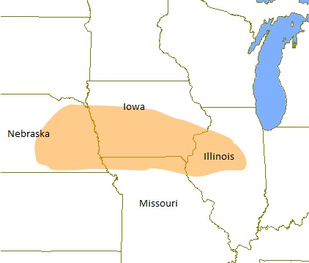
The ‘Regional Home’ of GenAm

Slide 4
History
Prior to WWII, a variety based on RP considered standard for stage and screen in anglophone North America
1944 John Kenyon & Thomas Knott – Pronouncing Dictionary Of American English – set the standard for GenAm pronunciation.
1940’s -Mid-Atlantic English – halfway between RP and GenAm, used on stage and in films.

Slide 5
Signature Sounds
Rhoticity (r-coloration)
Absence of intrusive /r/
Glottal stop /ˀ/
/ɛ/ slightly more open than RP /e/
Difference between short lax /ɪ/ and long /i:/
BATH and TRAP lexical sets both pronounced with /æ/
No diphtongization of /o/ in GOAT, unlike RP /əʊ/
/t/ in middle position before vowels realized as tapped of flapped, similar to /r/ or /d/

Slide 6
BATH raising
the front near-open /æ/ in words such as half, cab, bad, man or lash is raised (Eastern New England)
THOUGHT-LOT merger
words from both lexical sets pronounced with back open-mid /ɑ/ (i.e. lawn, on, frog, and John share the same vowel) (Northwest and North-central areas)
Threefold homophonization in marry-merry-Mary typical of most GenAm Speakers
(for more see Wells 1982, vol. 3. section 6.1.2-6)

Slide 7
Consonants
 | Bilabial | Labio-dental | Dental | Alveolar | Post –alveolar | Palatal | Velar | Glottal
Plosive | p b |  |  | t d |  |  | k g
Affricate |  |  |  |  | tʃ dʒ
Fricative |  | f v | θ ð | s z | ʃ ʒ |  |  | h
Nasal | m |  |  | n |  |  | ŋ
Lateral |  |  |  | l
Approximant |  |  |  | ɹ |  | j | (ʍ) w

Slide 8
Vowels
Monophtongs | Front | Central |  | Back
 |  | plain | rhotacized
Close | i |  |  | u
Near-close | ɪ |  |  | ʊ
Close-mid | e (eɪ)¹ |  |  | o
Mid |  | ə | ɚ
Open-mid | ɛ | ʌ² (ɜ) | ɝ | ɔ~ɑ³
Near-open | æ |  |  | ɑ
close-mid /e/ occurs in open syllables only, also occurs as a diphtong in the FACE set
always has a centralized back quality preceding /ɫ/, in some speakers may be more front, in OH realized as a central /ɜ/
depends on whether speaker is from an area affected by the THOUGHT-LOT merger

Slide 9
Lexical Sets
Lexical Sets representing GenAm vowel pronunciation.
FLEECE |  | GOOSE
KIT |  | FOOT
FACE |  | GOAT
 | NURSE
DRESS | STRUT | THOUGHT
TRAP |  | PALM
Note In the CLOTH lexical set either /ɑ/ or /ɔ/ are used depending on the speaker. GenAm naturally lacks the open back rounded RP vowel /ɒ/.

Slide 10
Diphtongs
Diphtong | Lexical Set
eɪ | FACE
aɪ | PRICE
ɔɪ | CHOICE
o | GOAT
aʊ | MOUTH

Slide 11
Merging of vowels before /r/
Vowel in /____r/ | Merge as… | Example words
/ir ~ ɪr/ | /ɪr/ | near, spirit
/eɪr ~ ɛr ~ ær/ | /ɛr/ | fairy, ferry, marry
/ɑr/ (START, LOT) |  | bar, sorry
/ɔr ~ or/ | /ɔr/ | war, bore, orange
/ur ~ ʊr/ | /ʊr/ | you’re, poor
/ʌr ~ ɛr/ | /ɝ/ | current, furry

Slide 12
Rhythm, Tempo, Tone & Pitch
PITCH: Sentence emphasis added by increasing volume rather than pitch. Higher pitches typically avoided in GenAm
RHYTHM: Emphasis is spread more evenly throughout the utterance than in RP
TEMPO: of GenAm is usually lower than in RP
SENTENCE STRESS: The beginning of the utterance spoken more loudly, volume decreases towards the end
TONE: Harder tone, more emphasis on vowels than in RP

Slide 13
References
Meier, P. Accents for Stage and Screen
Wells, J.C. Accents of English, vol. 3
The Telsur Project by William Labov et al. http://www.ling.upenn.edu/phono_atlas/home.html

