Slide 1
Application Individualization and Differentiation in Czech Primary Schools - One of the Characteristic Features of Inclusion
Research project Special Needs of Pupils in the Context of the Framework Educational Programme for Basic Education
Jana Kratochvílová, Jiří Havel,
Department of Primary Education
Faculty of Education, Masaryk University

Slide 2
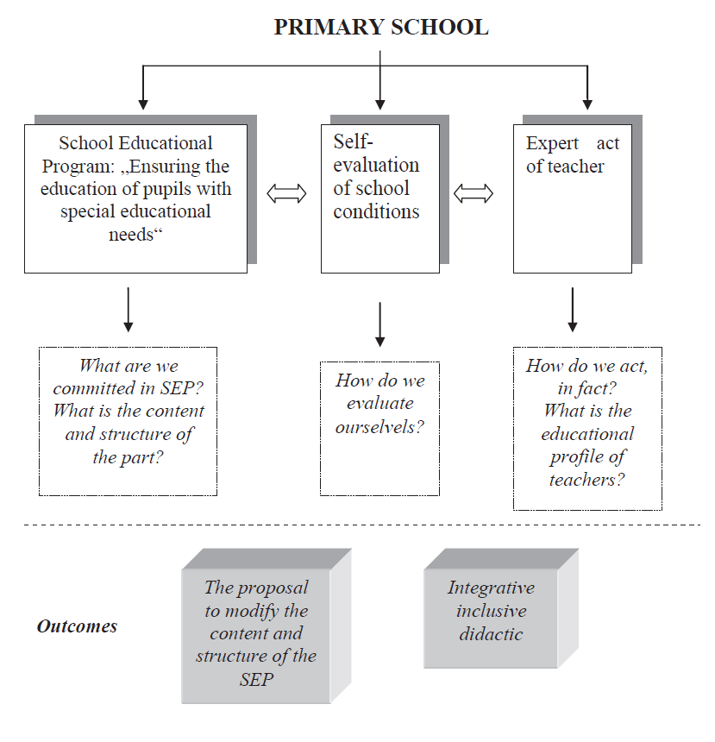

Slide 3
II. phase + III. phase
Key issues:
How do teachers evaluate the level of individualization and differentiation? (Quantitative approach)
What arguments do teachers choose for advocacy of their evaluation? (Qualitative approach).
What arguments do teachers use for improving the situation? (Qualitative approach)
How, individualization and differentiation is seen in the school in fact?

Slide 4
Research sample
Eight schools (60 teachers)
Equitable representation of rural and urban schools
The urban schools | The rural schools:
mostly fully organized | 1 fully organized, 3 small schools
217 - 649 students | 45 -165 students
16 - 41 teachers | 3 – 13 teachers
wide range of social and cultural background | cultural background much more homogenous

Slide 5
Research tool
The Czech version of the questioner Framework for self-evaluation of conditions of education 2007 modified from the British original Index for inclusion (Booth, T. & Ainscow, M. 2002).
Czech version 2002 included 42 criteria and the guidance questions were greatly reduced in the number 195.

Slide 6
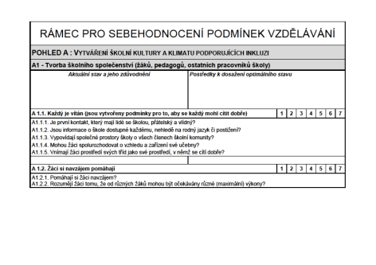
Qualitative and quantitative approach
Qualitative and quantitative analysis of data obtained seven selected indicators.
Quantitative data - the seven-point scale (1 - not at all, 7 - completely).
Qualitative data (content analysis of arguments for sub-criteria) which are very important for evaluation the objectivity of the chosen degree.

Slide 7
Features of inclusion
Respect
Communication
Cooperation
Maximum expectation
Individualization and Differentiation

Slide 8
Individualization and differentiation
Criterion | Average 2009 | Average 2011
Employees of school create optimal conditions for education of each pupil | 6,0 | 6,1
Education respects the diversity of pupils | 6,0 | 6,3
Way of identification and evaluation of SEN leads to the elimination of barriers to learning and active participation of all pupils | 5,7 | 5,8
Self-evaluation and evaluation support the performance of each pupil | 5,4 | 5,9
The access to homework contributes to learning of all pupils | 5,3 | 5,0

Slide 9
Employees of school create optimal conditions for education of each pupil
Diagnostic activities of teachers (SEN)
Close cooperation with experts (particularly in developing IP)
No argument to the indicator: Teachers included in the reflection of the lesson pupils too.
Continuous diagnostic activities: Was there a word, which didn´t you understand? What was for you easy, difficult?
Content differentiation in reading, respect for the individual pace of writing, the choice of a suitable size, writing instrument
The using of specific equipment
Completely missing work with the goals – objectives of teaching and assessment
Arguments
Observation

Slide 10
Self-evaluation and evaluation support the performance of each pupil
For this item is characterized a really high dispersion of value between schools:
Pupils regularly evaluate not only the results of their activities, but also the learning process and the causes of success or failure.
Regularly used self-evaluation of pupils allows them to reflect their knowledge, skills, level of key competencies.
At the end of group work we perform evaluations (writing - a questionnaire, or oral).
Information books are based on weekly and monthly self-evaluation.
Frequent immediate feedback - motivating, but usually not specific enough: great
Teachers judge knowledge mainly, rarely competencies or process
The corrective function of evaluation is missing
Self-assessment is implemented more as summative
Working with the evaluation criteria is exceptional
Prevails the summative assessment
Arguments
Observation

Slide 11
The access to homework contributes to learning of all pupils
Generally teachers don`t make differentiation and individualization of homeworks. An example of a good argument is:
We differentiate homework, enter optional tasks, use the class library, internet classroom.
Some tasks are awarded on a voluntary basis; sometimes pupils have the opportunity of their choice
Mostly prevail collective tasks in which students didn´t have the choice of task or cooperation
Typically it was a task specified from a textbook or workbook
Homework with aim to practice curriculum
Rarely acquire new information
Arguments
Observation

Slide 12
Education respects the diversity of pupils
Despite the high average 6, it is clear that the arguments on this item was often general or did not apply to a given indicator.
More specific statements
Lessons include activities that can be done individually, in pairs, groups and with the whole class
There are various activities including discussion, interpretation, writing, drawing, problem solving, using of library, audio-visual technology, practical activities and information technology
An important attribute is the choice (order of tasks, individually, in groups, use of tools and techniques), consideration of the individual pace of students
Teachers often transfer knowledge
They frequently connect the school with life (theory – practice)
Respecting of individual pace
Various activities: writing, reading, drawing, problem solving, use of libraries, computers, practical activities
Less experiments, but more mutual peer learning
Unique leadership on the various records of work, oftenly worksheets
Arguments
Observation

Slide 13
Conclusions
Teams of teachers for their argumentation often used the irrelevant answers that were too wide, general and unspecified or did not respond to the question and to the results of observation.
One school was significantly different by its specific and factual argumentation. This school also excelled in the content analysis of the school curriculum.
Most schools are on the way to individualization and differentiation.

Slide 14
Thank you for your attention!
Brussels, WCLTA
22.–25. 10. 2012

