Slide 1
Academic Writing Workshop for EAP Tutors
Friday 4th April 2014
Katie Mansfield
ksmansfield@hotmail.com

Slide 2
4th April – Agenda
Current key issues in teaching writing in an EAP context & possible solutions
Successful classroom activities / materials (sharing concept)
Process vs product writing activities
Useful online websites for students & tutors
Giving feedback in academic writing
Approaches & strategies
Consideration for the mark scheme
The usefulness of writing check-lists

Slide 3
1. Current key issues in teaching writing (i)
We are going to focus on some of the current key issues in academic writing classrooms found at HE institutions throughout the UK and in your country.
Before we begin
Write a list of some of the key issues that you have in your own academic writing classrooms.
How do you overcome these issues? Discuss with a partner.

Slide 4
1. Current key issues in teaching writing (ii)
Here are the 10 most common key issues in teaching writing in HE institutions throughout the UK:
Students have different linguistic levels
Learners are studying different disciplines
Deciding which approach to academic writing to follow (different learning preferences)
Students don’t use enough academic vocabulary
Students write in an informal way (looks more like spoken English)

Slide 5
1. Current key issues in teaching writing (iii)
Students don’t plan before they write, therefore, their writing is not structured and confusing to read
Students don’t use the correct punctuation
Students make lots of spelling mistakes
Their writing is littered with grammar mistakes
Students don’t reference other author’s ideas (not something they are used to doing)

Slide 6
1. Current key issues in teaching writing (iv)
With a partner:
Look through each problem and discuss how serious it is.
Do your students have the same issues?
How do you overcome these issues? Or How could you overcome these issues?

Slide 7
1. Possible solutions (i)
Choosing the right approach to academic writing for your students.
With a partner, discuss:
What are the current approaches used to teach academic writing in your country?
Can you name any other approaches which you have read about?
Which approach do you use and why?

Slide 8
1. Possible solutions (ii)
Most popular approaches to teaching Academic Writing used in the UK:
General EAP
Focus: general linguistic & cognitive needs of non-native speakers (Benesch 2001, Leki & Carson 2004).
Aim: what is taught & learnt helps ss with writing across the curriculum (Leki & Carson 1994).
Materials: study skills.
Issue: Pre-determined, non-discipline specific materials.

Slide 9
1. Possible solutions (iii)
Academic Literacies
Focus: diverse writing practices in HE (Lea & Street 1998).
Aim: address literacy from cultural & social perspective and contemplate issue of identity & power relationships.
Materials: Limited availability & time for preparation.
Issue: No practical suggestions of integration (Wingate & Tribble 2012).

Slide 10
1. Possible solutions (iv)
Genre-based approaches
Focus: Explore genres students are required to write. Awareness that variations exist in different contexts of writing.
Aim: to provide a contextual framework.
Pedagogic approach: Genre-informed pedagogic framework (Tribble & Wingate forthcoming).
Role of teacher: guide & support the learners (Vygotskian scaffolding).

Slide 11
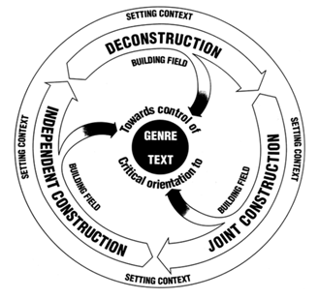
1. Possible solutions (v)
The Teaching-Learning Model
(Rothery and Stenglin 1994:8 cited in Martin 2000:19)

Slide 12
1. Possible solutions (vi)
Introduce students to the Academic Word List (AWL).
With a partner, discuss:
What is the AWL?
How could it benefit your students?
Do you make your students aware of it in your classrooms?
How could you/do you incorporate it into your materials?

Slide 13
Introduction to the Academic Word List (AWL) (i)
Compiled from corpus of 3.5 million words of written academic texts
570 word families (10% of total words in academic texts)
Arranged into 10 sublists
Reflect word frequency & range
(Coxhead 2000)
Notes:
Texts used: journals, textbooks, coursebooks, lab manuals and course notes.
Sublists 1-9 each have 60 word families whereas 10 has 30 word families.

Slide 14
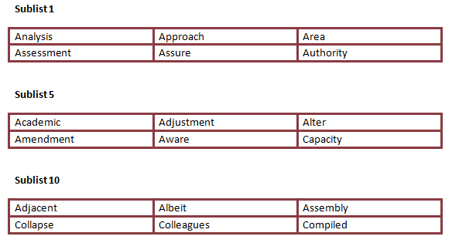
Academic Word List (AWL) (ii)
Sublists

Slide 15
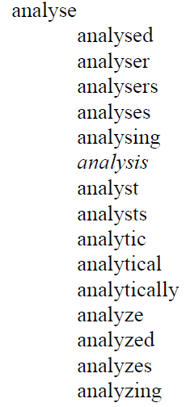
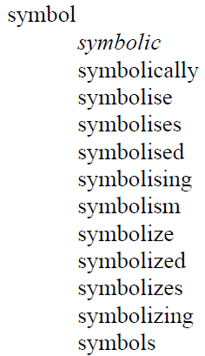
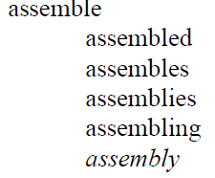
Academic Word List (AWL) (iii)
Word families
(Sublist 1) (Sublist 5) (Sublist 10)

Slide 16
AWL – Advantages
Words students need in wide range of academic texts
Free online sources available (PC & Smartphone):
Flashcard maker
http://orangeorapple.com/Flashcards/Default.aspx
Exercises
http://www.englishvocabularyexercises.com/AWL/index.htm
Test maker
http://www.phonetain.com/Phonetain_Software/Products.htm
AWL highlighter
http://www.nottingham.ac.uk/alzsh3/acvocab/awlhighlighter.htm

Slide 17
AWL – Disadvantages
No focus on collocations (Durrant 2009)
Does not address discipline-specific vocabulary (Martinez et al 2009)
How can we overcome this problem? Discuss with your partner.

Slide 18
Practical suggestions (i)
Problem: Does not address discipline-specific vocabulary
Solution: Create a discipline – specific wordlist.
What needed?
Discipline-specific texts.
Concordance software programme e.g. Antconc (free), Sketch engine, Wordsmith Tools.
Time!

Slide 19
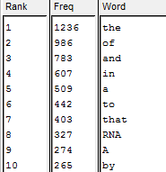
Practical suggestions (ii)
6 Steps
Save discipline-specific journal articles as .txt docs.
Open the txt docs in Antconc. http://www.antlab.sci.waseda.ac.jp/software.html
Click on create ‘Word List’.
From top 100 most frequent words, make a list of discipline-specific vocab.

Slide 20
Future consideration
Future consideration
The key is to anticipate the problems and address the possible solutions before they come up. You should always factor reoccurring problems into the scheme of work or your lesson plans.

Slide 21
2. Successful classroom materials
Product vs process writing
Let’s discuss:
What are the differences between process and product writing?
Which approach do you tend to use in your classroom?
Can you think of some advantages and disadvantages of each approach?
As a learner, which approach would/do you prefer?

Slide 22
2. Successful classroom materials
Process writing
Do any of you have any classroom activities that focus on process writing?
Do you use any course books which emphasize process writing? If yes, what types of activities do they encourage?
Share your ideas with your group and then with the class.

Slide 23
2. Successful classroom materials
Product writing
Read through the following activities to see how they break down the product.
Discuss the following questions with your partner/group:
Do you use this type of activity in your classroom?
Do you use different types of activities to carry out the same task? Share your ideas/activities.
Would your students benefit from carrying out this activity? If no, why not? If yes, how?

Slide 24
2. Successful classroom materials
Time to share…
Now that you have looked through some of the ways in which I break down the product, it’s time for you to share some of the materials that you find work well with your students.
Tell your partner/group about the task.
What your students like about the task
What it teaches them
How you incorporate it into the class

Slide 25
3. Useful online websites (i)
Before we look at some useful online tools, discuss the following:
Which online tools/websites do you use in the classroom?
Which online tools/websites do you direct your students to use outside the classroom?
Would it be more useful to hand your students a list of useful websites or demonstrate how to use them in class?

Slide 26
3. Useful online websites (ii)
General Academic English
The following websites can help students with their grammar, listening, developing academic skills and presentations.
http://www.prepareforsuccess.org.uk/ (Introduction to life at university – main differences between school and HE)
http://elc.polyu.edu.hk/cill/eap/ (General EAP skills + presentation skills)
http://www.uefap.com/ (General EAP skills)
http://www.bristol.ac.uk/arts/exercises/grammar/grammar_tutorial/page_41.htm (Grammar)
http://aeo.sllf.qmul.ac.uk/ (General Academic skills)

Slide 27
5. 3. Useful online websites (iii)
2. Focus on vocabulary
2.1 Academic Word List (AWL)
Numerous exercises which focus on the Academic Word List can be found on the following websites:
http://www.englishvocabularyexercises.com/AWL/index.htm
http://www.uefap.com/vocab/exercise/exercise.htm
http://www.nottingham.ac.uk/alzsh3/acvocab/

Slide 28
5. 3. Useful online websites (iv)
2.2 AWL Highlighter
With this tool, students can upload their written work and see how academic their vocabulary is as the tool highlights all of the words in the text from the AWL.
http://www.nottingham.ac.uk/alzsh3/acvocab/awlhighlighter.htm
2.3 Academic phrases & expressions
Often students use the same expressions and phrases in their writing. This site introduces postgraduates and undergraduates to a whole range of phrases used in introductions, methodology sections, etc.
http://www.phrasebank.manchester.ac.uk/

Slide 29
5. 3. Useful online websites (v)
2.4 Understanding key words in context
The following Corpus can be used by teachers and students alike to see how words work in context: http://corpus.byu.edu/bnc/
2.5 Word collocations
If students are struggling with collocations (words that come before or after the target word), they can access the site below:
http://wordtree.coventry.ac.uk/?BAWE

Slide 30
5. 3. Useful online websites (vi)
3. Common mistakes in written work
3.1 Common Errors Detector
With this programme, you can upload any written text and the program will output the text with the errors highlighted, give comments and explanations to help you solve the problems.
http://www2.elc.polyu.edu.hk/CILL/errordetector.htm
4. Referencing (Using the Harvard Referencing System)
4.1 Online reference guide
For help writing in-text references of a list of references using the Harvard referencing system, students can go to: https://libweb.anglia.ac.uk/referencing/harvard.htm
4.2 Mobile phone (iphone) app:
ReferenceME (Students can scan the barcode of the book they want to include in their list of references and it will write it in the Harvard Referencing Style).

Slide 31
3. Useful online websites (vii)
Discuss the following questions.
What are your student’s main weaknesses?
Which websites do you think your students would benefit most from?
Do you use others that are not on this list? If yes, which ones?
How could you incorporate the new websites into your classroom?

Slide 32
3. Useful online websites (viii)
Now that you have seen some useful tools.
Discuss the following questions.
Which websites do you think your students would benefit most from?
How could you incorporate the new websites into your classroom?

Slide 33
4. Giving feedback in academic writing (i)
Before we begin thinking about feedback, discuss the following:
What is the purpose of feedback?
How and when do you typically give feedback?
What do you comment on?
How much time do you spend giving feedback?
Do you pick up on general mistakes and feedback in class?
Do you think students take on board your feedback?
Can you think of any better ways of giving feedback? (time dependent)

Slide 34
4. Giving feedback in academic writing (ii)
Approaches & strategies
There are many different ways and levels of giving feedback. If students are able to submit draft copies of their essays/writing then the feedback that you give them at this stage is vital for the students to improve their work.
Let’s look at your pre-workshop task to see how you have chosen to give the student feedback.

Slide 35
4. Giving feedback in academic writing (iii)
Draft feedback
Here are a number of ways to give feedback on draft essays/writing:
1. Overall comment at the end of the essay
Discuss with a partner:
What are the advantages of this approach?
What are the disadvantages of this approach?
Would the students benefit from the feedback given?

Slide 36
4. Giving feedback in academic writing (iv)
2. In-text feedback (using track changes & comments)
Discuss the following:
Do you feel the student would benefit from this level of comments? If yes, how? If not, why not?
Do you have the time to give this level of comments?

Slide 37
4. Giving feedback in academic writing (iii)
3. Reformulation
Discuss with your partner/group:
As a learner, how would you feel about carrying out this type of activity?
Do you think your students could benefit from this type of activity?
What are some of the advantages and disadvantages of carrying out this type of task?
Think about how you could reformulate the first paragraph of the pre-worksheet task. What changes would you make?

Slide 38
4. Giving feedback in academic writing (iv)
Final draft feedback
The same type and level of feedback can be given for the final draft. But at this stage, it can be important to consider the mark scheme.
Discuss with a partner/group:
If your students have continued to make the same errors in their final draft, how could you prevent them in the future?

Slide 39
Consideration for the mark scheme
Discuss with a partner/group:
How important is it to show the students the mark scheme before they submit their work?
How can the students benefit from seeing it?

Slide 40
The usefulness of writing check-lists
Before we look at the essay checklist that I often give to my students, discuss the questions with a partner/group:
Do you ever give your students checklists before they submit their written work? Why? Why not?
What are some of the advantages of using checklists?

