Slide 1
CEITEC at Masaryk University
Notes:
Hello and welcome
My name is xxx and I am xxx of CEITEC.
It is my great pleasure to welcome you today and to introduce CEITEC – Central European Institute of Technology.
The story of CEITEC is much like science itself – exciting and in some ways unpredictable. So let me share with you some key moments of CEITEC’s history, its key achievements of the present and the outlook for its future.

Slide 2
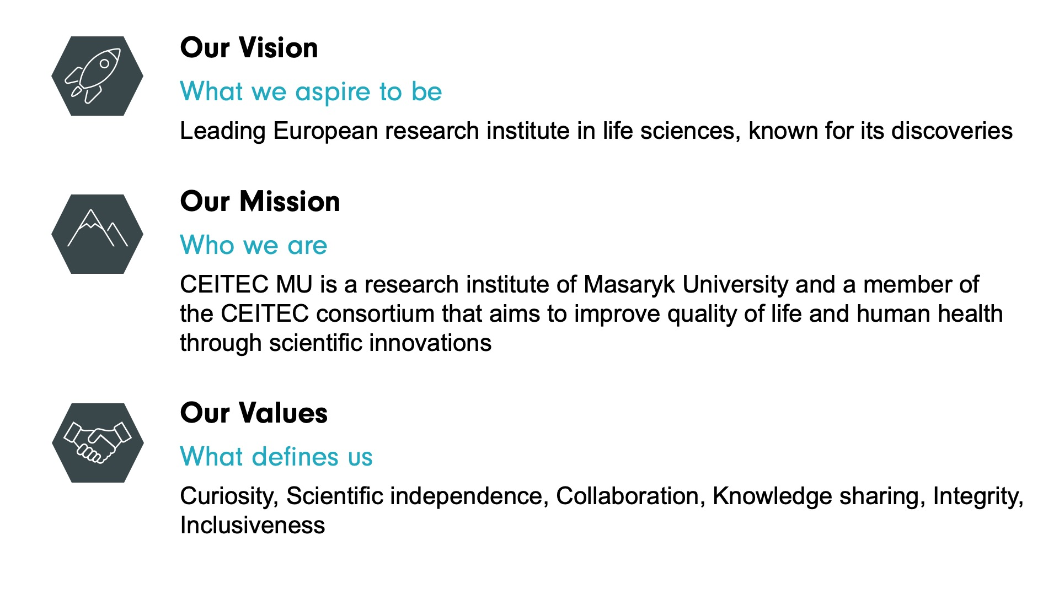

Slide 3
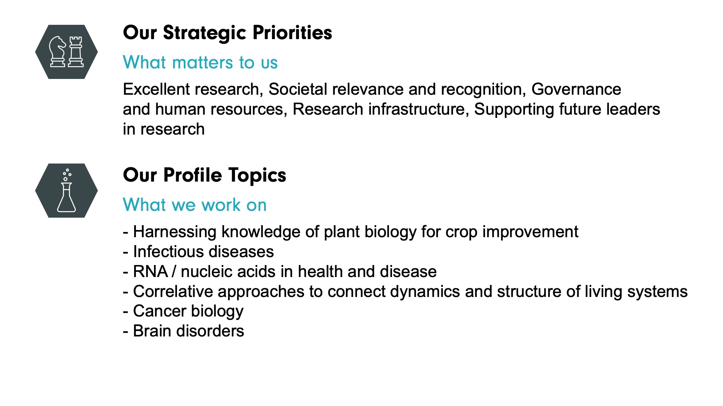

Slide 4
Discoveries of Science
PENICILLIN
ROENTGEN
INSULIN
Notes:
Let’s start the journey with a look back.
As you may know, many breakthrough scientific discoveries have rested in equal parts on the genius work of its discoverers as well as on an element of surprise, of the unexpected. Perhaps the most famous example of such accidental discovery is Alexander Fleming and his discovery of penicillin. But the same element of surprise was involved in the invention of Xrays and insulin as well.
I have pulled out these examples to demonstrate that often times, you can find a truly exceptional thing in the most unlikely of places.
Had the same element of surprise was unexpected in Breakthrough scientific discoveries often have an element of the unexpected in them.
Fleming, Roentgen, insulin

Slide 5
Notes:
And perhaps it may seem just as unlikely to some to find an internationally acclaimed research center in Brno, in the heart of Europe. But much like the discoveries we have seen earlier – CEITEC is no accident.

Slide 6
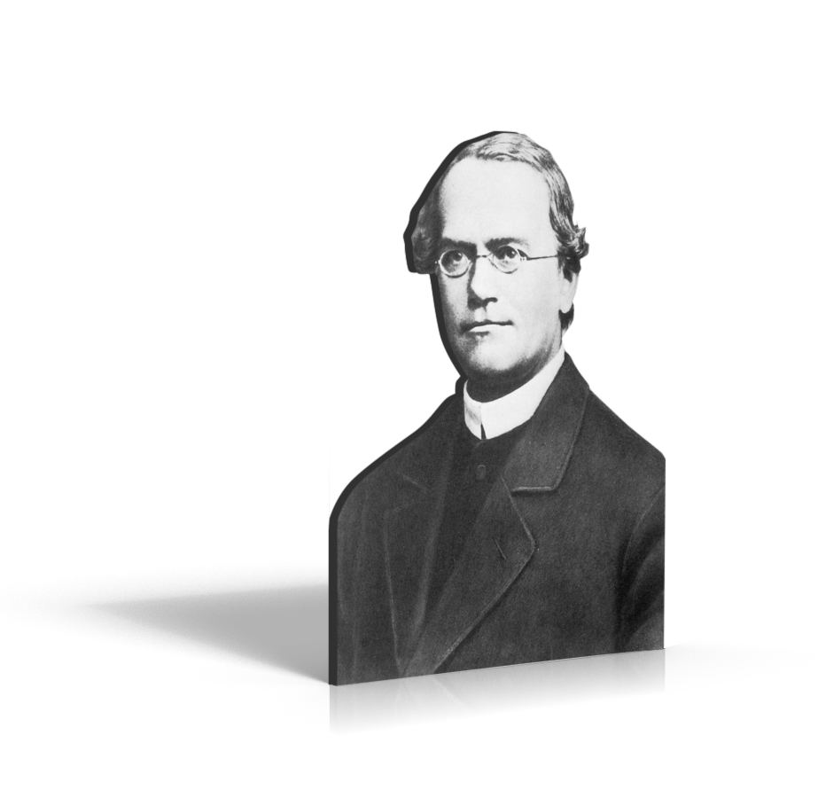
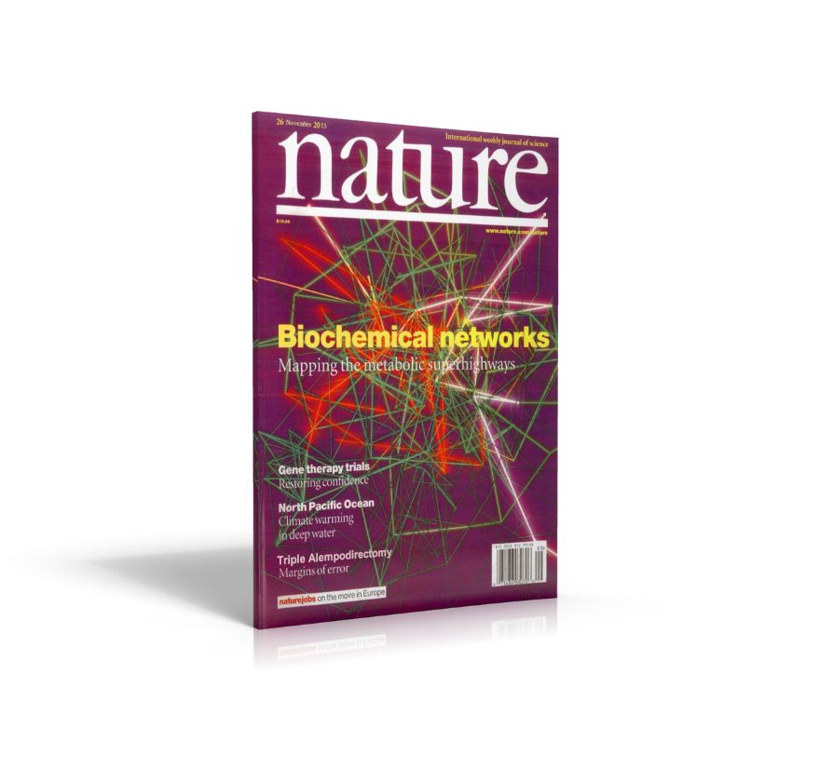

Built on Tradition, Leading the Future
Historical Legacy
Scientific Results
CEE Leadership
Notes:
It is built on a long lasting tradition of discoveries in genetics. The foundation for one of today’s key scientific disciplines was actually laid here in Brno, which was a home to Georg Mendel, the world famous father of genetics
Despite it’s young age, CEITEC has already managed to deliver impressive scientific results and become a worthwile partner for talented professionals as well as strategic partner institutions
It has also become a leader in the CEE space in how modern scientific institutions should be managed

Slide 7
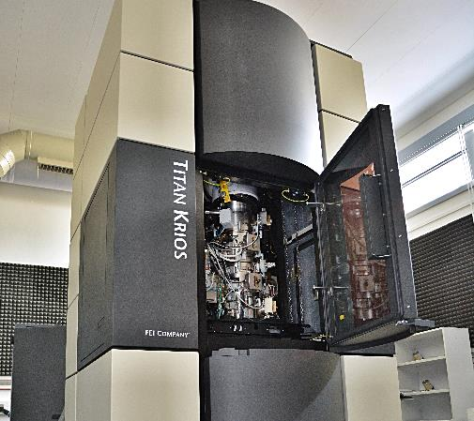
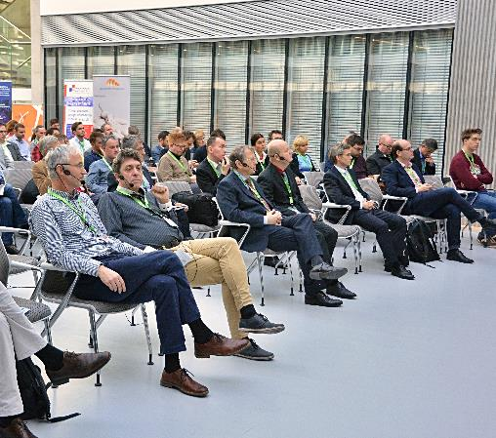
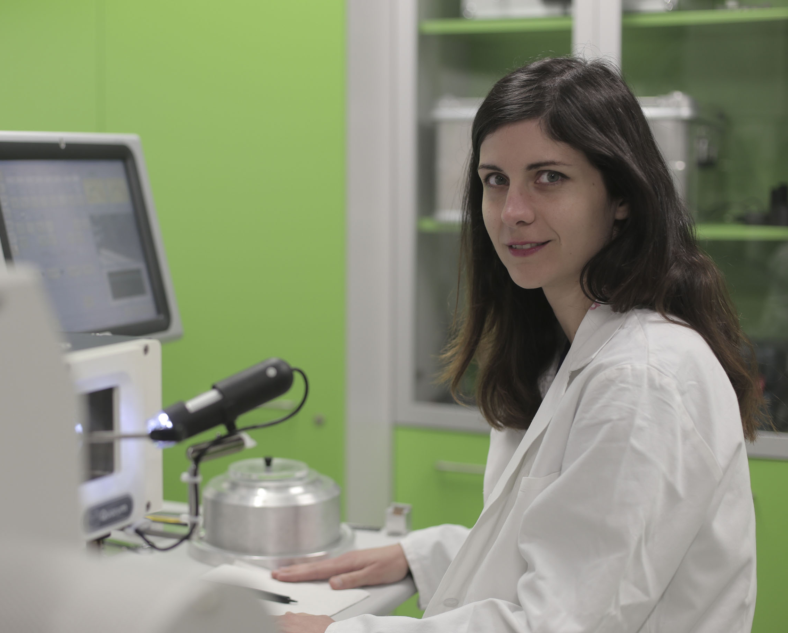
Improving Quality of Life Through Scientific Research
State of the Art Infrastructure
Vibrant Scientific Community
People
Notes:
And how have we accomplished that?
CEITEC’s success stands on three pillars:
First, our institution offers state of the art infrastructure which facilitates high-level research projects
Second, its our people. We are lucky to have a great number of professionals who cooperate across disciplines to deliver results. This is a strength very unique to CEITEC.
Third we facilitate a strong connection between these two that allows us to create a vibrant, lively scientific community
This gives us a solid foundation to pursue our mission of improving quality of life through Scientific research

Slide 8
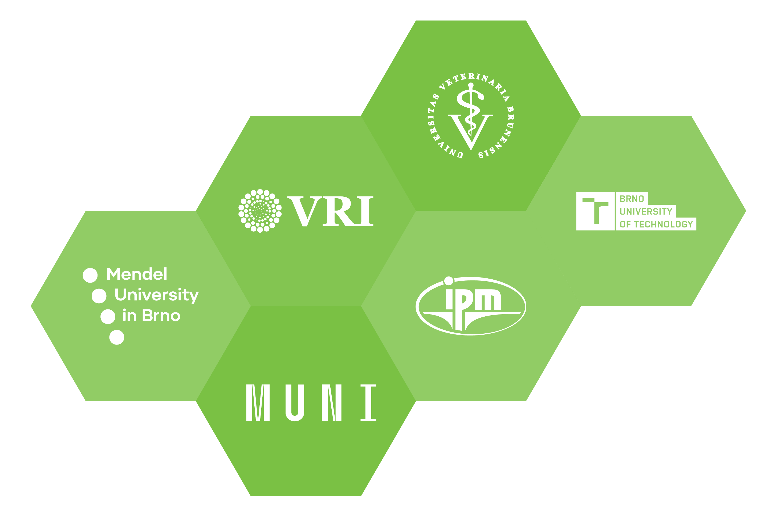

Built on a Foundation of 6 Core Institutions
Notes:
CEITEC was established in 2011 on the strong foundation of six prominent universities and research institutes. The combined knowledge and resources have allowed us to create synergies across departments facilitate interdisciplinary collaboration and promote cross-pollination of opinions and ideas which is so important for quality research. It also ensures higher levels of involvement from the application sphere.
In the rest of the presentation we will focus specifically on CEITEC Masaryk University as the leading member of the CEITEC consortium.

Slide 9
CEITEC MU Highlights (2022)
32
Mil. EUR
Total Budget
28 12
Research Core
Groups Facilities
Notes:
Lets’ take a look at CEITEC MU through some numbers:
We operate with a total budget of more than 32 mil. EUR, most of which originates in competitive sourcing.
In 2022, our research professionals were split into 28 research groups and 12 core facilities.

Slide 10
CEITEC MU Highlights in Detail (2022)
48 %
Women
(FTE)
52 %
International PhD
Candidates
42 %
International
Researchers
(FTE)
261
Scientific
Employees
(FTE)
212
PhD
Candidates
Notes:
Lets’ take a look at CEITEC MU through some numbers:
Our multinational, scientific staff counts 261 (FTE), 48 % women and 42 % international researchers.
At CEITEC MU, there are 212 PhD candidates and 52 % are international.

Slide 11
CEITEC MU Highlights (2021)
44
New
Projects
108
Q1
24
T5
33
International Projects
39,3 %
Publications with
Corresponding
Author
174
Ongoing
Projects
241
Publications
Notes:
We have here 174 ongoing projects, 44 new and 33 international.
Total number of publications in 2022 is 241, 108Q1 and 24 T5.

Slide 12
Management Excellence
COORDINATION
BOARD
INTERNATIONAL SCIENTIFIC ADVISORY BOARD
EVALUATION
Notes:
I have mentioned earlier that CEITEC is a leader in the CEE context in how the institution is managed. Our experience reflects the management practices of the best research institutions worldwide.
We work with an established international scientific advisory board, which is comprised exclusively of important international research institutions.
The quality of our research work and result is attested by independent evaluations conducted by global experts in their respective fields
We collaborate with other significant institutions in Europe through our membership in the EU-Life alliance and Alliance4Life to foster excellence, share knowledge and influence research policy on the European level.

Slide 13
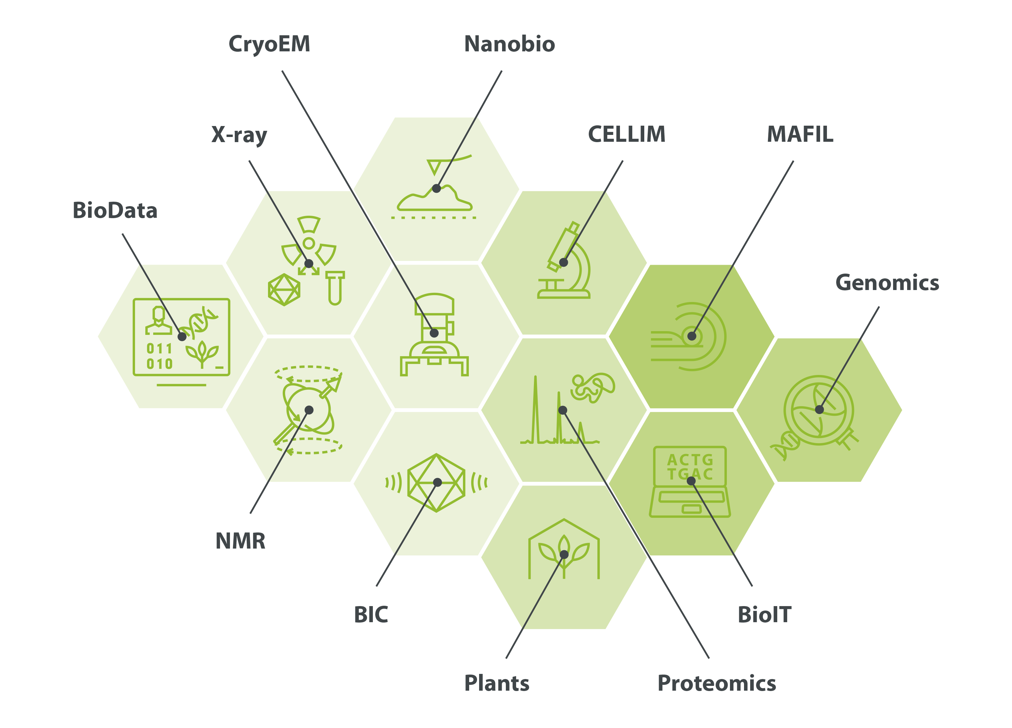
Core Facilities
BIC Biomolecular Interactions an Crystallization
BioData Biological Data Management and Analysis
BioIT Bioinformatics
CELLIM Cellular Imagining
CryoEM Cryo-electron Microscopy and Tomography
Genomics Genomics
MAFIL Multimodal and Functional Imaging Laboratory
NMR Josef Dadok National NMR Centre
Plants Plant Sciences
Proteomics Proteomics
X-ray X-ray Diffraction and Bio-SAXS
Notes:
State of the art reserach facilities are the first pillar of CEITEC and a key to high quality research.
The CEITEC core facilities are spread on more than 25000 square meters and offer the research community access to cutting edge equipment. These resources are shared and provide our scientific investigators the opportunity to leverage the instrumentation and access to technology development and services.

Slide 14
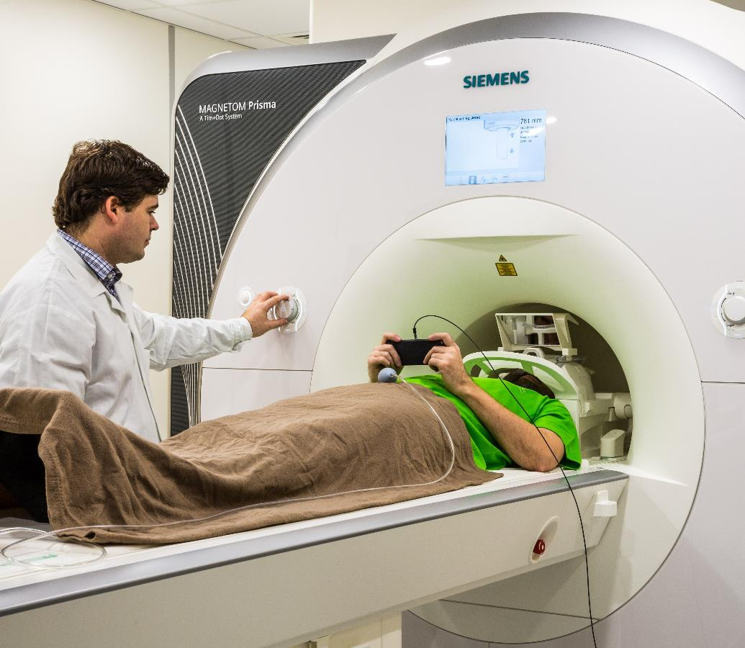
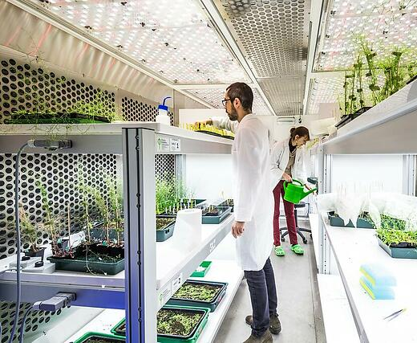
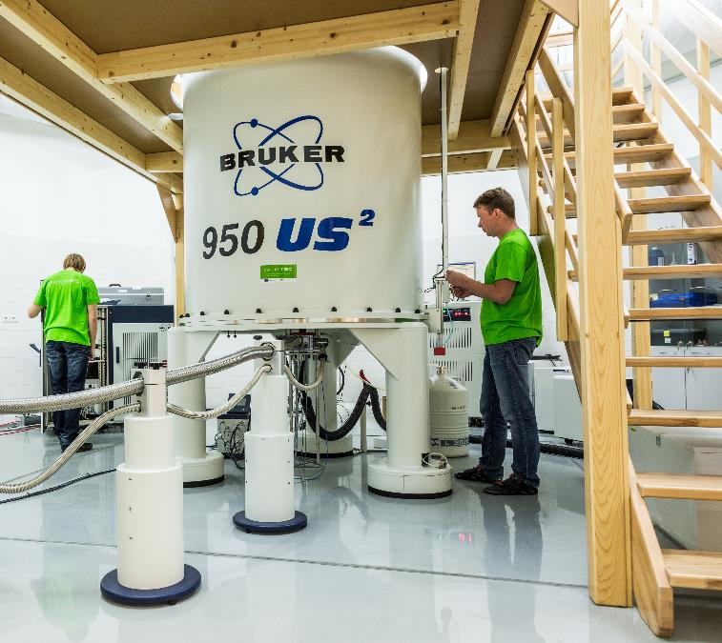

Slide 15
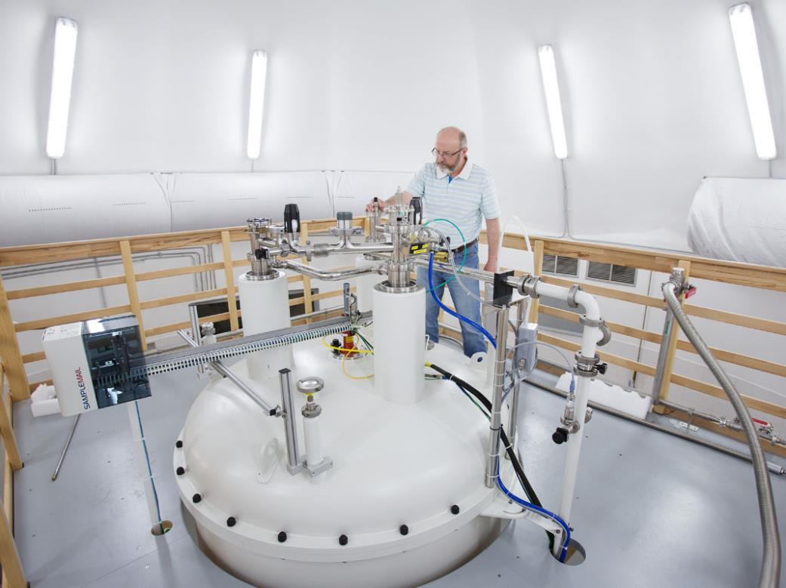
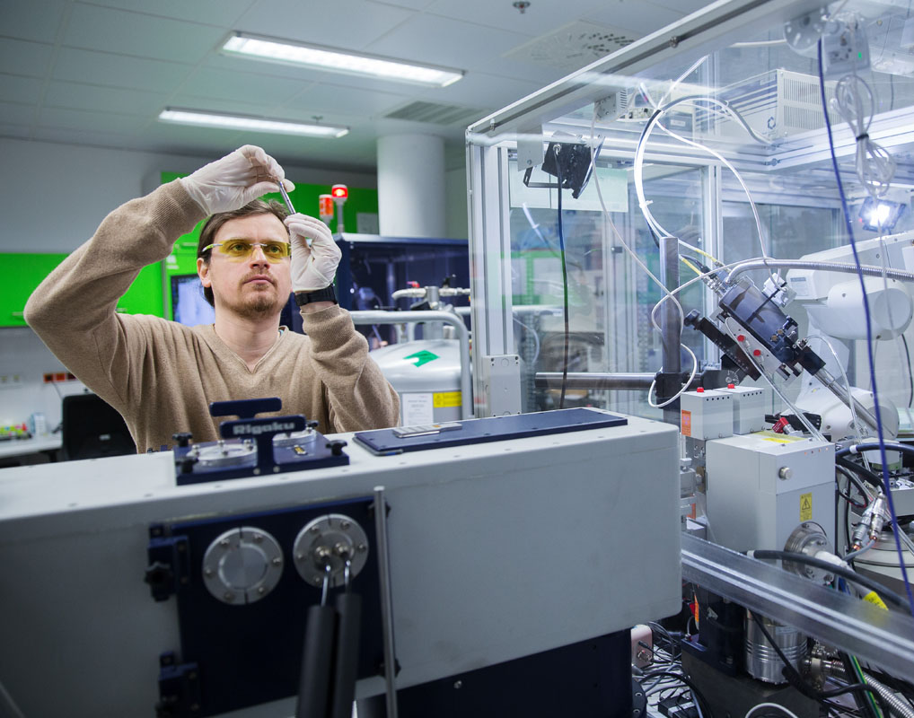
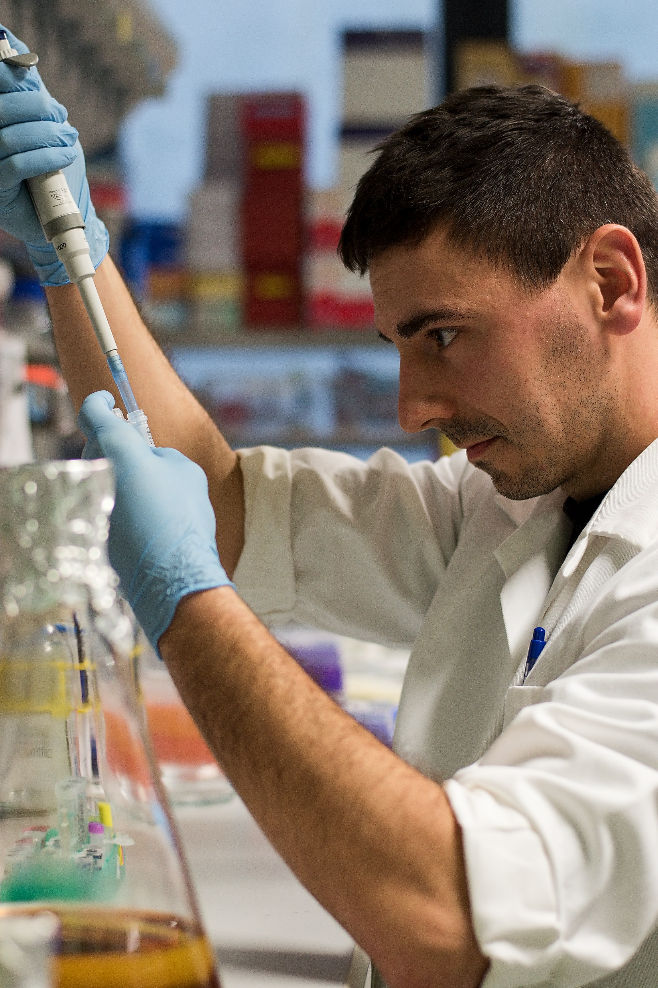
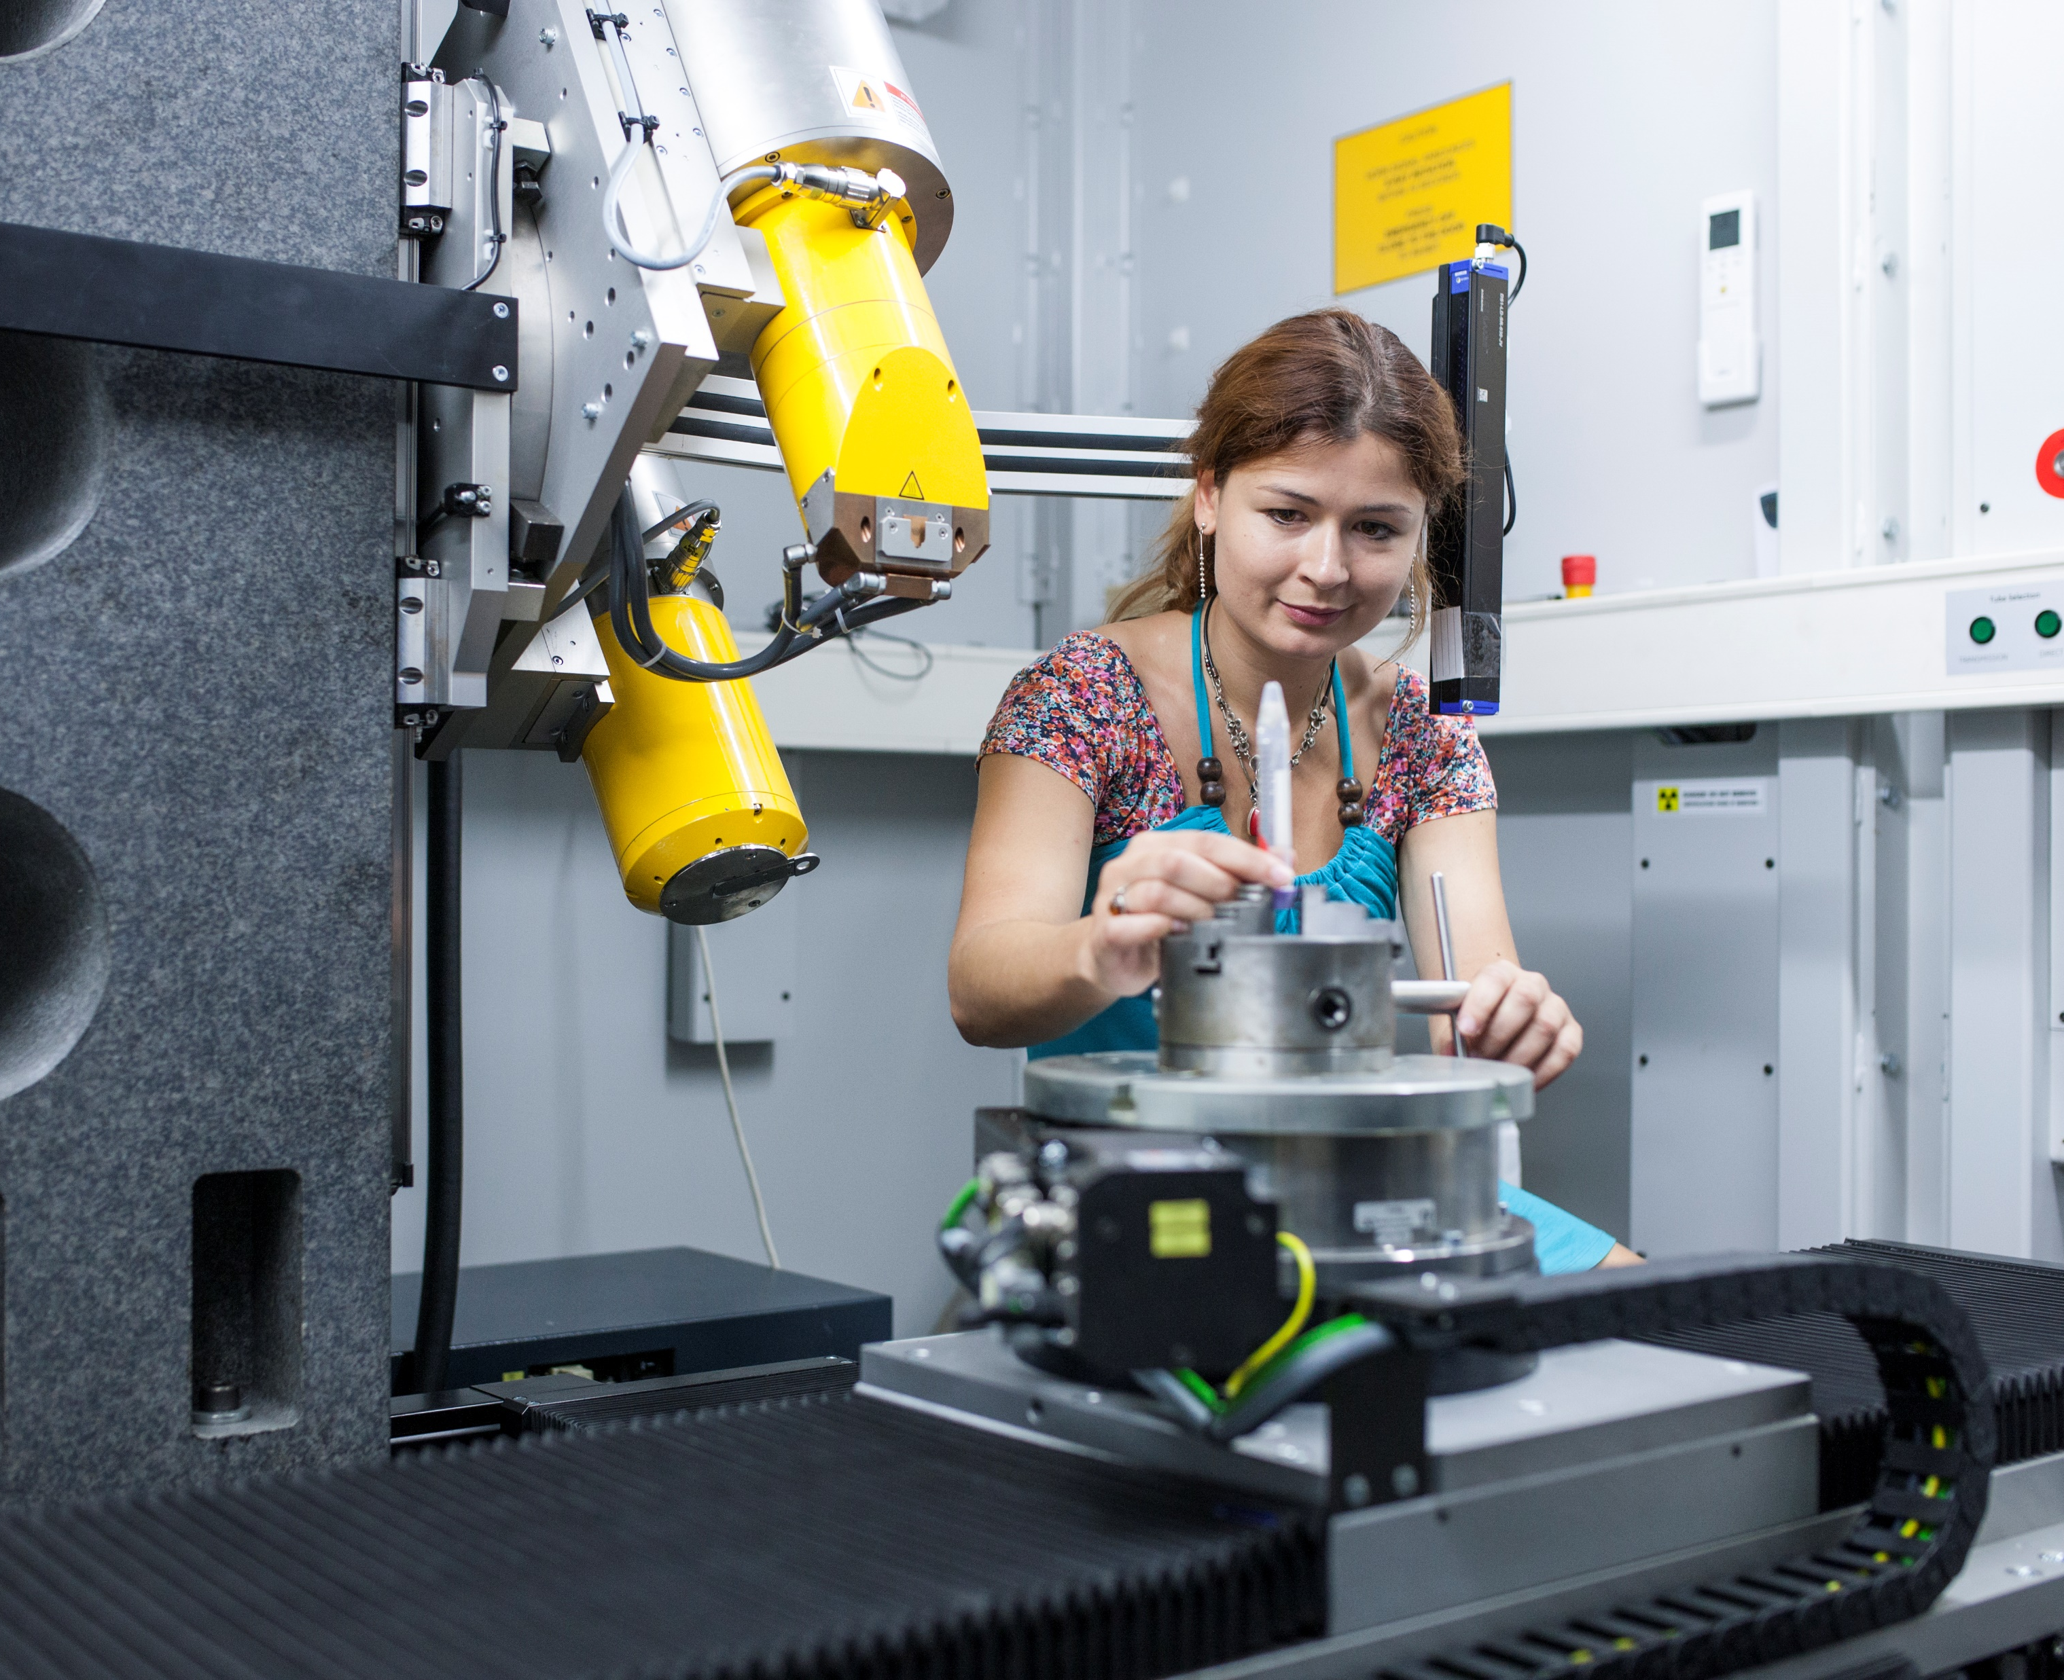
Our People
Notes:
While we are very proud of the technologies and equipment available at CEITEC, it is our people that make the research facilities come alive.
The great number of technological equipment allows collaboration across different specialties and fields of study and facilitates synergies between them. Our research teams inspire each other, ask the right questions and offer their own, different perspective in the topics under discussion – and this creates a special force of creativity and scientific inquiry which is very unique to CEITEC.

Slide 16
Addressing Global Challenges
CEITEC Agricultural
Sustainability
9
Billion People
in 2040
CEITEC Biomedicine
Notes:
Our research teams that I have just talked about are on an important mission. Our purpose at CEITEC MUS is to help address global challenges in two key areas of our everyday lives / sustainable agriculture and new generation of medicine.
What does this mean in the context of our everyday lives? How does the science we conduct here at CEITEC apply to real life problems?
First, let’s look at agricultural sustainability. It is estimated that by 2040 there will be 9 billion people on Earth, which is more than triple from 100 years ago. How will we be able to feed such great number of people without destroying the natural resources of our planet? Our research teams help provide answers to these questions.
Our second focus is on the field of new generation biomedicine, which applies biological and physiological principles to clinical practice. Our researches facilitate developments of the next-generation diagnostic and therapeutic strategies for the treatment of human diseases, many of which have a genetic background.

Slide 17
Main Research Areas
Structural Biology
Plant Biology
Molecular Medicine
Neurosciences
Notes:
To address these global challenges, our teams conduct research in these four key areas:

Slide 18
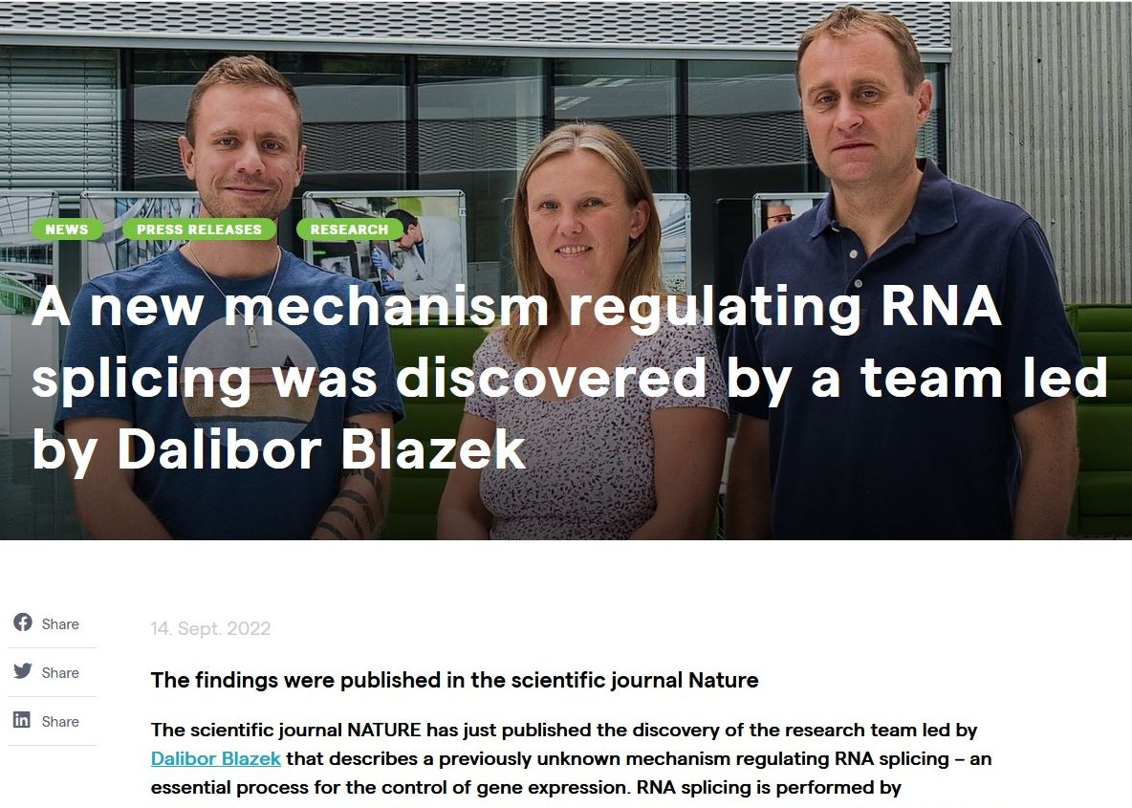
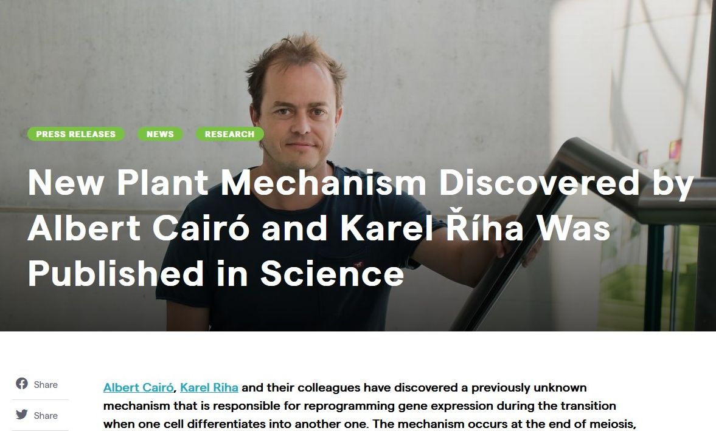

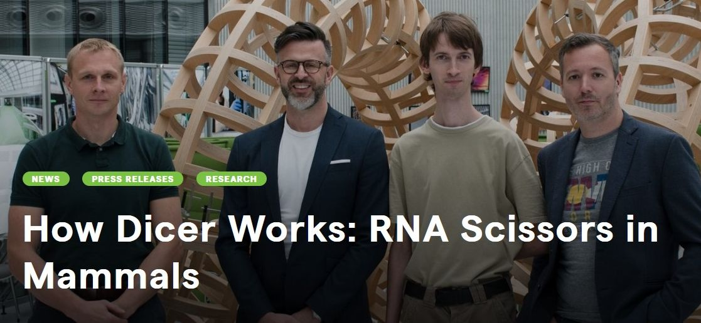


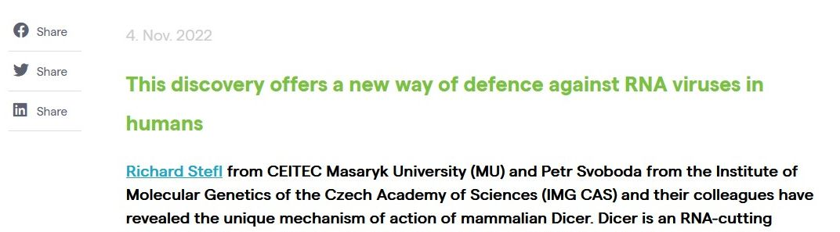
“The triumph“ of 2022

Slide 19
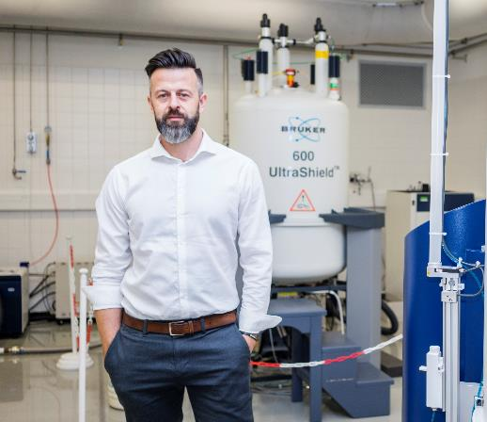
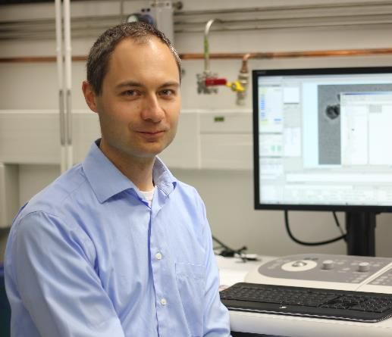
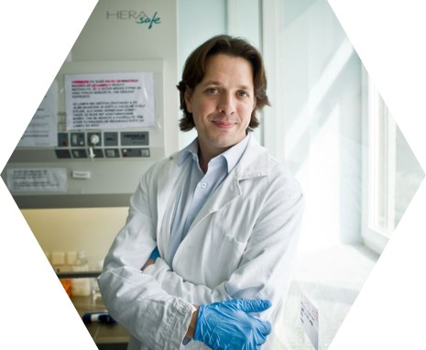
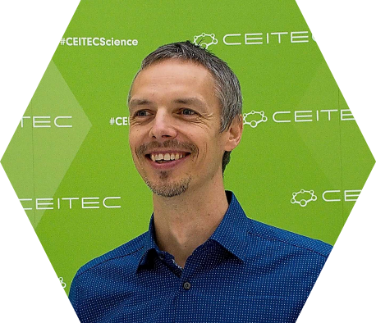
CEITEC MU ERC Grant Holders
Richard Štefl
ERC Consolidator Grant
Dynamic Assembly and Exchange of RNA Polymerase II CTD Factors
Pavel Plevka
ERC Starting Grant
Structural Study of Human Picornaviruses
ERC Consolidator Grant
BioPhage
Robert Vácha
ERC Consolidator Grant
PeptideKillers
Marek Mráz
ERC Starting Grant
Signaling Propensity in the Microenvironment of B Cell Chronic Lymphocytic Leukemia
Notes:
We are proud to say that in these areas we have already been able to accomplish some impressive results and will continue to do so in the future.

Slide 20
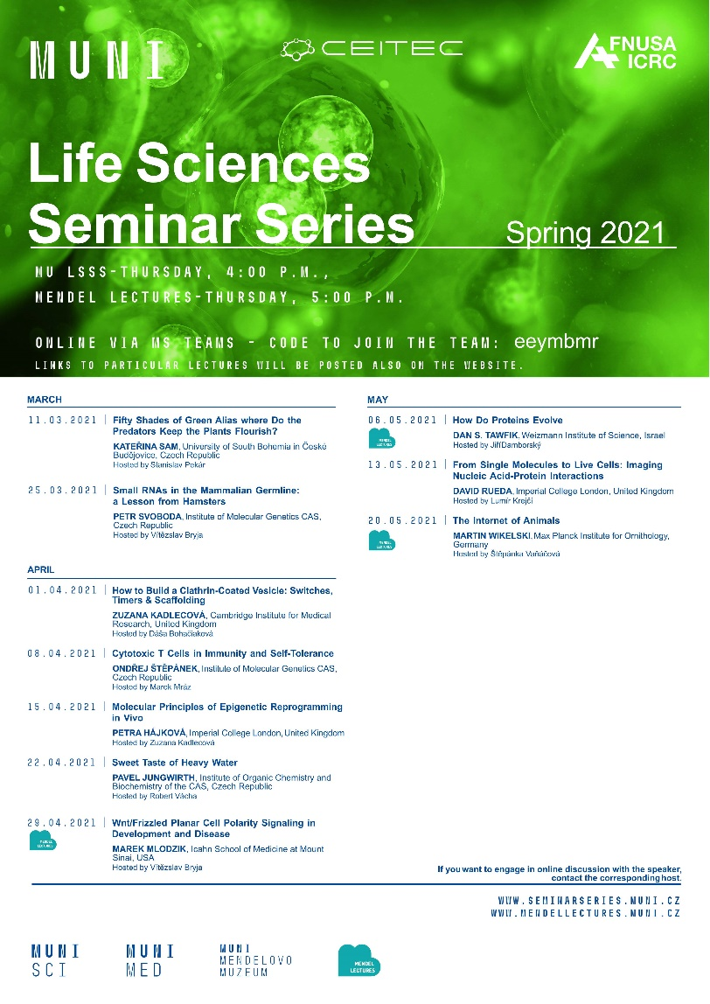
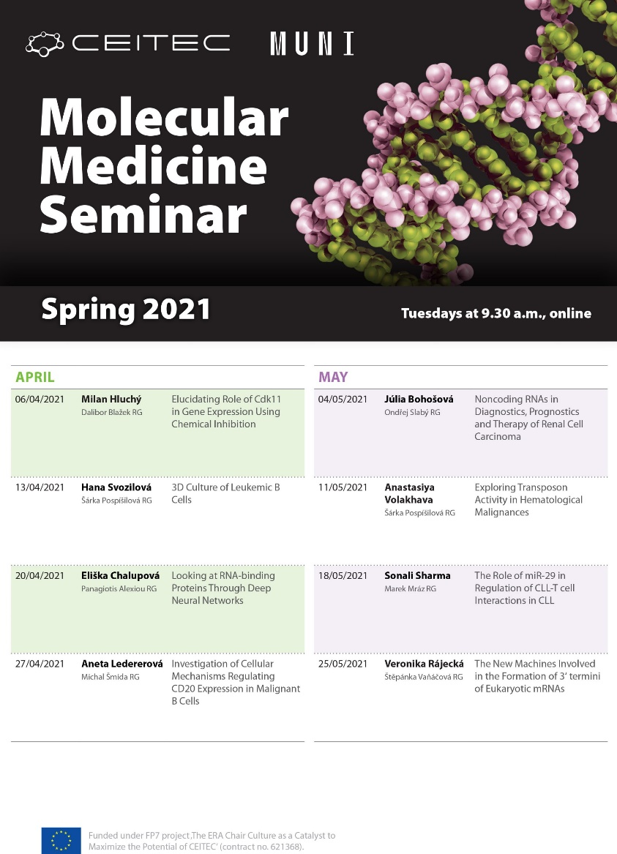
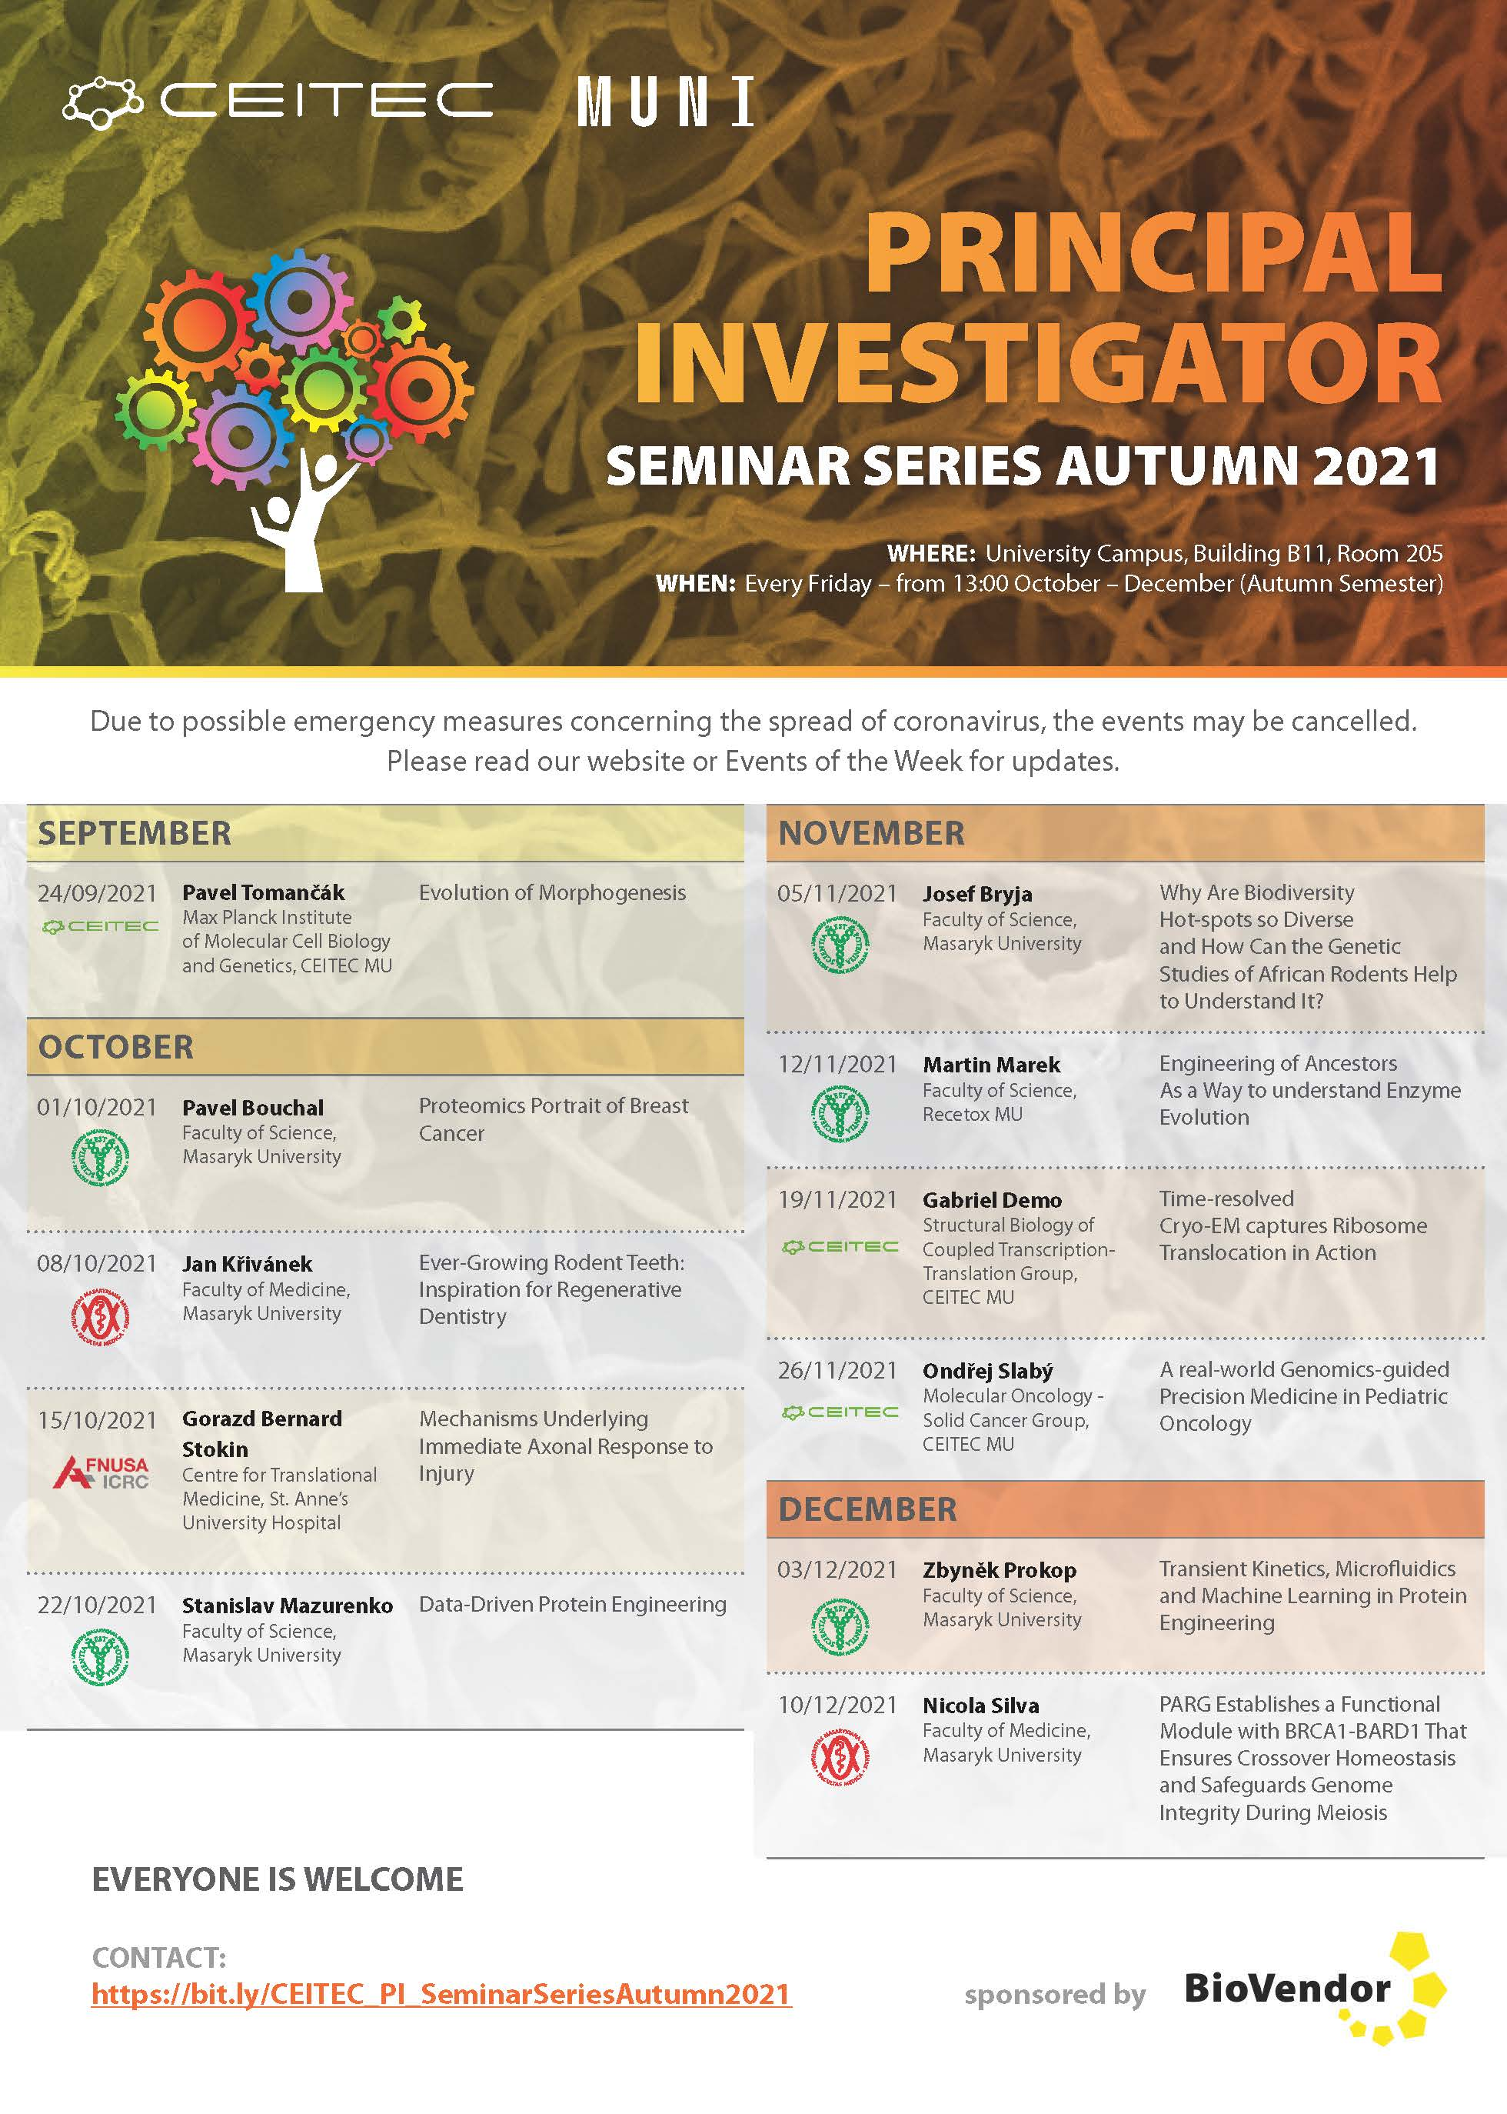
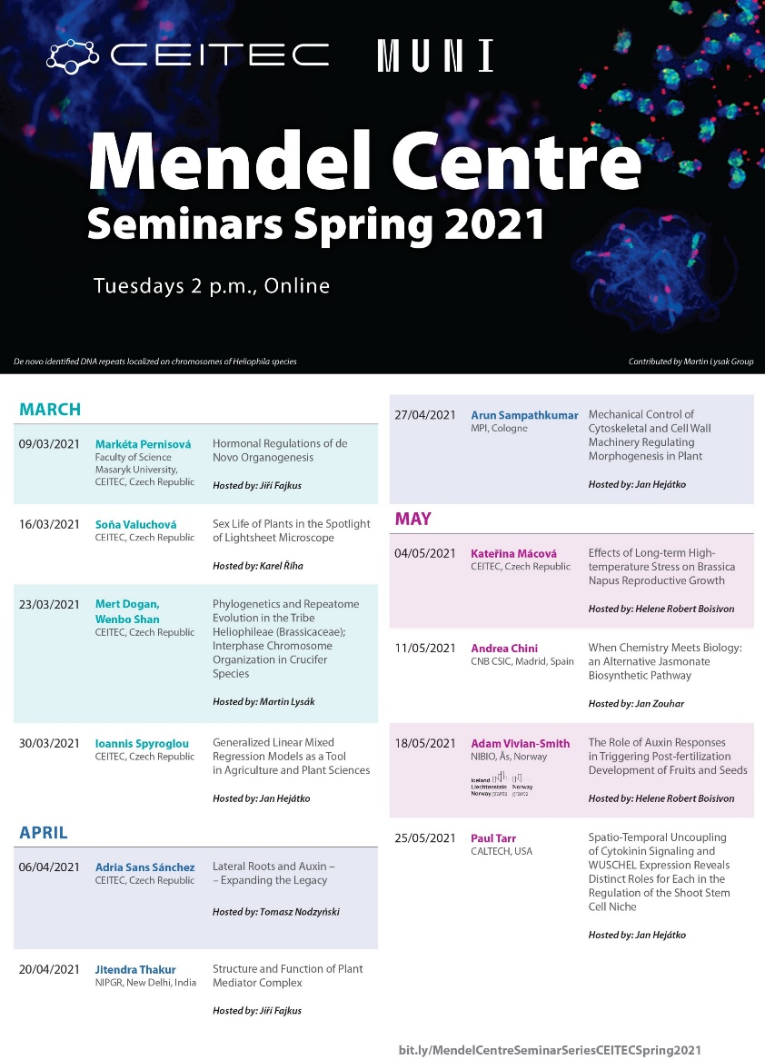
Vibrant Scientific Community at CEITEC
Scientific Events
Notes:
We realize that the only way to fulfill our promise and our mission and to fully exploit the potential of our state of the art technologies is to create an environment in which a vibrant scientific community will thrive.
At CEITEC we take this very seriously and are proud of making our facilities literally come alive.
Every year we organize a great number of quality scientific events in various fields of study attended with researches from all over the world.
We foster collaboration with important partner institutions and exchange of ideas among our teams.
And last but certainly not least, we offer an acclaimed International PhD program to entice researches from other parts of the world to come to CEITEC and conduct their research here.
So far, we have talked about CEITEC’s scientific heritage, about its state of the art facilities, its pool of talented research professionals and the fields of study that allows
Vibrant, international scientific community
Collaboration / departmental , with partners, etc. / internationally, FN Bohunice
PhD program

Slide 21













Vibrant Scientific Community at CEITEC
Collaboration & Partnerships
Notes:
We realize that the only way to fulfill our promise and our mission and to fully exploit the potential of our state of the art technologies is to create an environment in which a vibrant scientific community will thrive.
At CEITEC we take this very seriously and are proud of making our facilities literally come alive.
Every year we organize a great number of quality scientific events in various fields of study attended with researches from all over the world.
We foster collaboration with important partner institutions and exchange of ideas among our teams.
And last but certainly not least, we offer an acclaimed International PhD program to entice researches from other parts of the world to come to CEITEC and conduct their research here.
So far, we have talked about CEITEC’s scientific heritage, about its state of the art facilities, its pool of talented research professionals and the fields of study that allows
Vibrant, international scientific community
Collaboration / departmental , with partners, etc. / internationally, FN Bohunice
PhD program

Slide 22
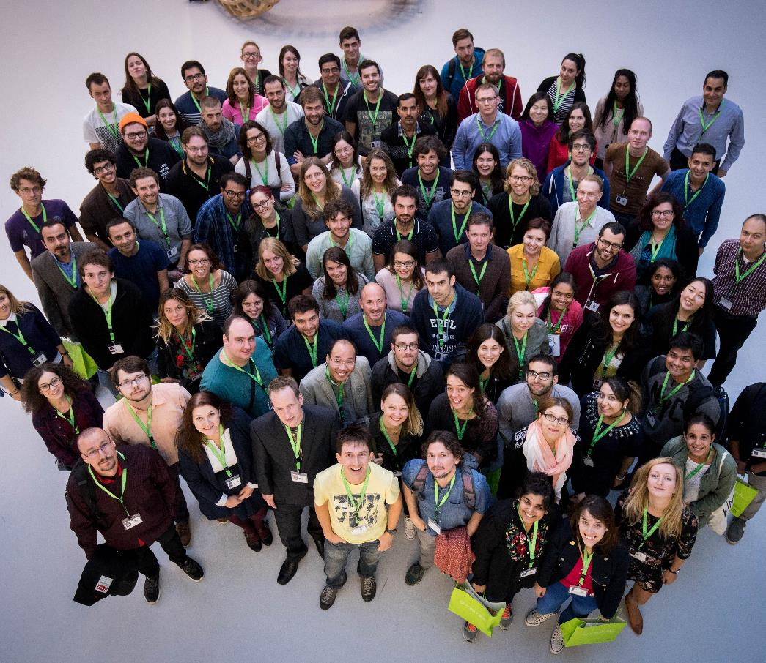
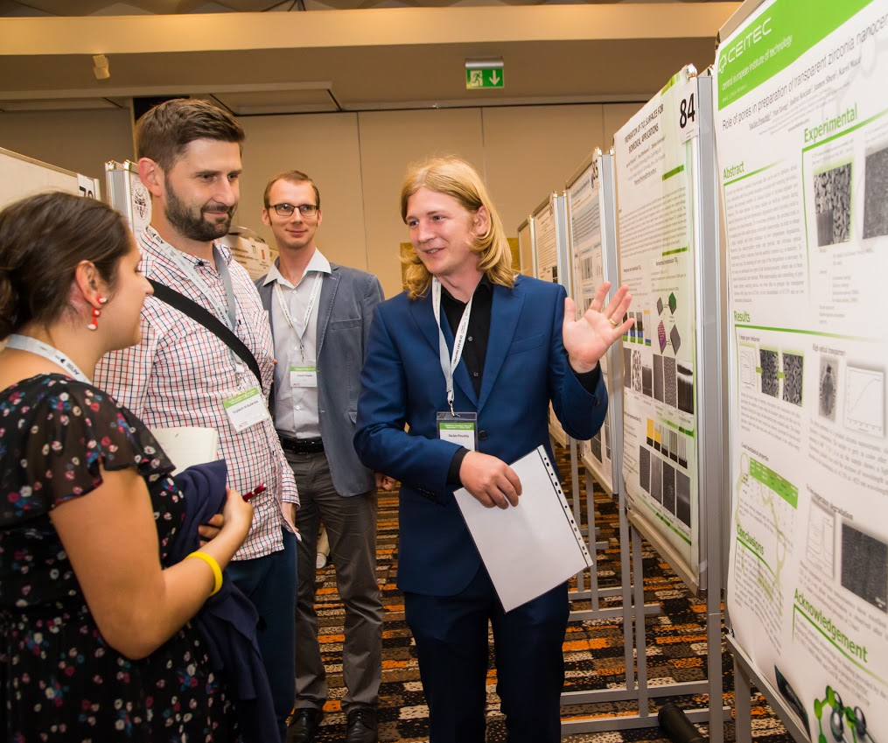
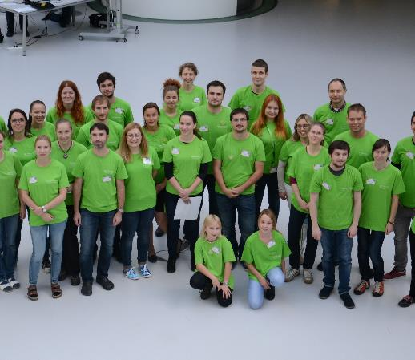
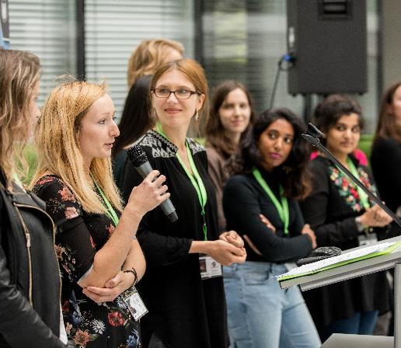
Vibrant Scientific Community at CEITEC
International Staff & PhD Program
Notes:
We realize that the only way to fulfill our promise and our mission and to fully exploit the potential of our state of the art technologies is to create an environment in which a vibrant scientific community will thrive.
At CEITEC we take this very seriously and are proud of making our facilities literally come alive.
Every year we organize a great number of quality scientific events in various fields of study attended with researches from all over the world.
We foster collaboration with important partner institutions and exchange of ideas among our teams.
And last but certainly not least, we offer an acclaimed International PhD program to entice researches from other parts of the world to come to CEITEC and conduct their research here.
So far, we have talked about CEITEC’s scientific heritage, about its state of the art facilities, its pool of talented research professionals and the fields of study that allows
Vibrant, international scientific community
Collaboration / departmental , with partners, etc. / internationally, FN Bohunice
PhD program

Slide 23
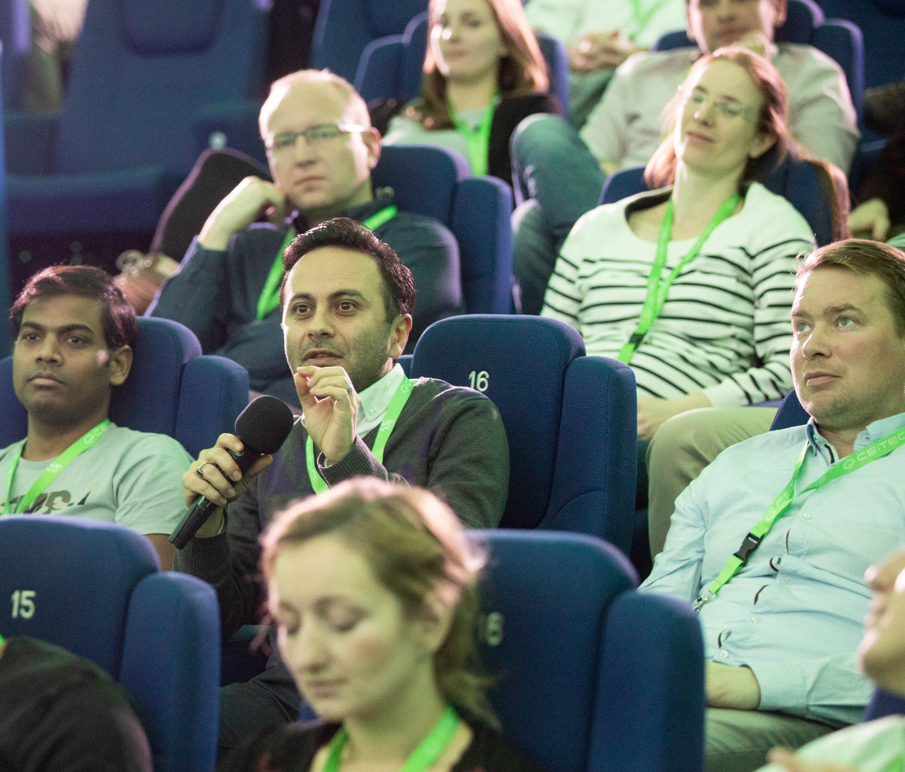
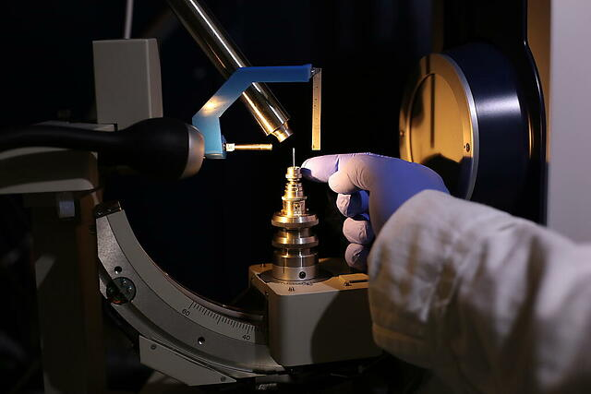
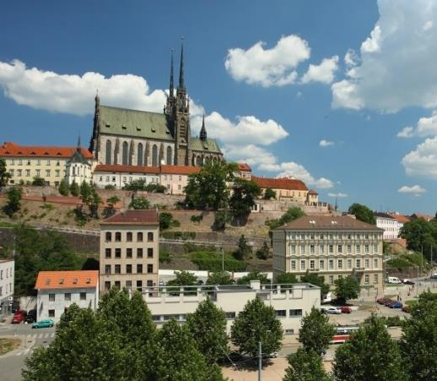
Reasons to Choose CEITEC
International Scientific Community
Breakthrough Technologies
High Quality of Life
Notes:
There are good reasons why so many research talents choose CEITEC for their chosen field of study.
We already talked about the state of the art technologies available.
We have just talked about the vibrant, international scientific community of researches that conduct their research at CEITEC.
But we should also mention the excellent quality of life in Brno and the Czech republic, because it is a big draw not only to our employees but their families as well, who often join them for this important career move.

Slide 24

Notes:
In the beginning of 2019, CEITEC MU was awarded the HR Excellence in Research Award, known as the HR Award, as the first research institute in the Czech Republic. This quality label is granted by the European Commission to research institutions that aim to create an international and transparent work environment consistent with international scientific trends.
The HR Award is a long-term commitment, and implementation of the HR Strategy is regularly monitored by the European Commission. The year 2023 will be crucial because representatives of the European Commission will visit CEITEC MU in person and decide whether the institution can continue to have the HR Award.

Slide 25
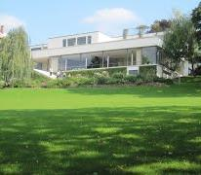
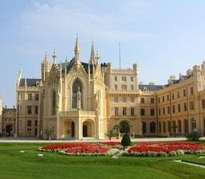
Brno for Living – Safe, Vibrant & Convenient
#4 Most Popular City in the World for Students
(topuniversities.com)
#6 Safest Country in EU
(European Commission)
Prague
#1 Best City for EXPAT Support
(Financial Times)
Excellent Health-Care Coverage
BRNO
Bratislava
3.8% of GDP for Sciences and Research
Mild Climate
EU, Schengen,
NATO, OECD Member
Vienna

Slide 26
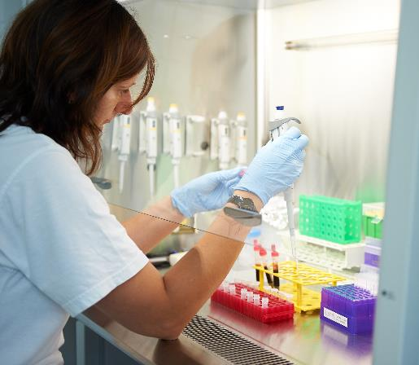
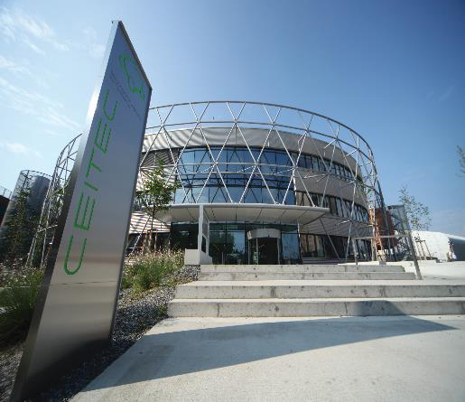
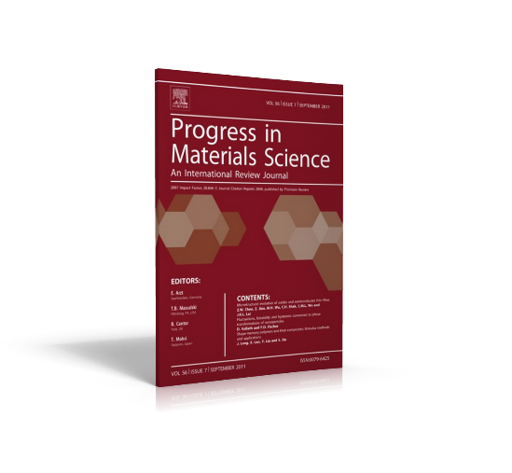
Improving Quality of Life and Human Health
Through Scientific Research
Legacy of Great Science
Worthy Partner
Excellent Scientific Results
Notes:
The story of CEITEC is coming to an end.
You have heard about a young institute built on legacy of great science in the heart of Europe.
We have shared with you our „formula“ for delivering great scientific results – the combination of state of the art facilities, dedicated people and an environment of open communication in a vibrant, international community.
And hopefully we have been able to show you how and why CEITEC is a worthwile partner of choice for scientific institutions and individual researches alike and why so many have joined us already on our mission to improve quality of human health and life.

Slide 27
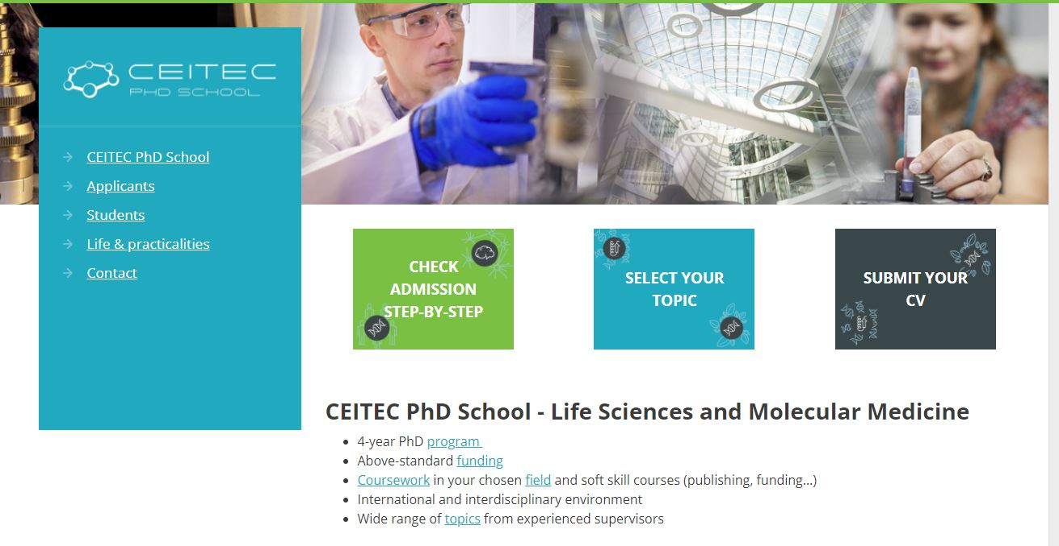
CEITEC PhD School
Life Sciences and Molecular Medicine PhD Programmes
  4-year PhD program
  Above-standard funding
  State-of-the-art core facilities
  Coursework in your chosen field and soft skill courses
  International and interdisciplinary environment
  Wide range of topics from experienced supervisors
  Support of mentoring and career development activities
More information: www.ls-phd.ceitec.cz
Overview of CEITEC research groups: www.ceitec.eu/research-groups

Slide 28

Training and Career Development
Support of career development and well-being of our researchers
Well-balanced portfolio of courses in soft skills and transferable skills
Relevant and competitive skill set for successful life science career
  with regard to global standards and reflect the needs of the scientific community CEITEC
Examples:
  Academic Writing/Presentation Skills in English
  Science Communication Course:
  Present Your Research Results with Confidence
  From Idea to Start-Up
  Open Science and Your Research

Slide 29
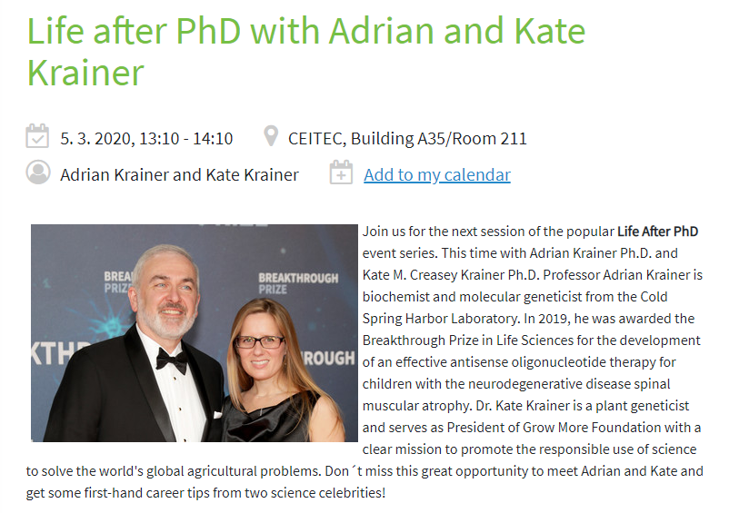
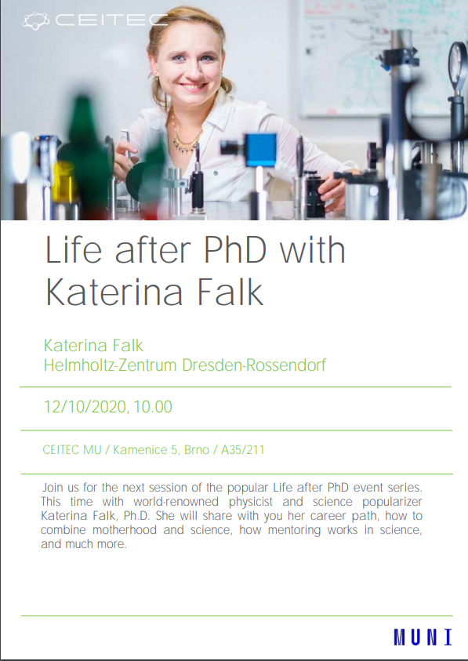
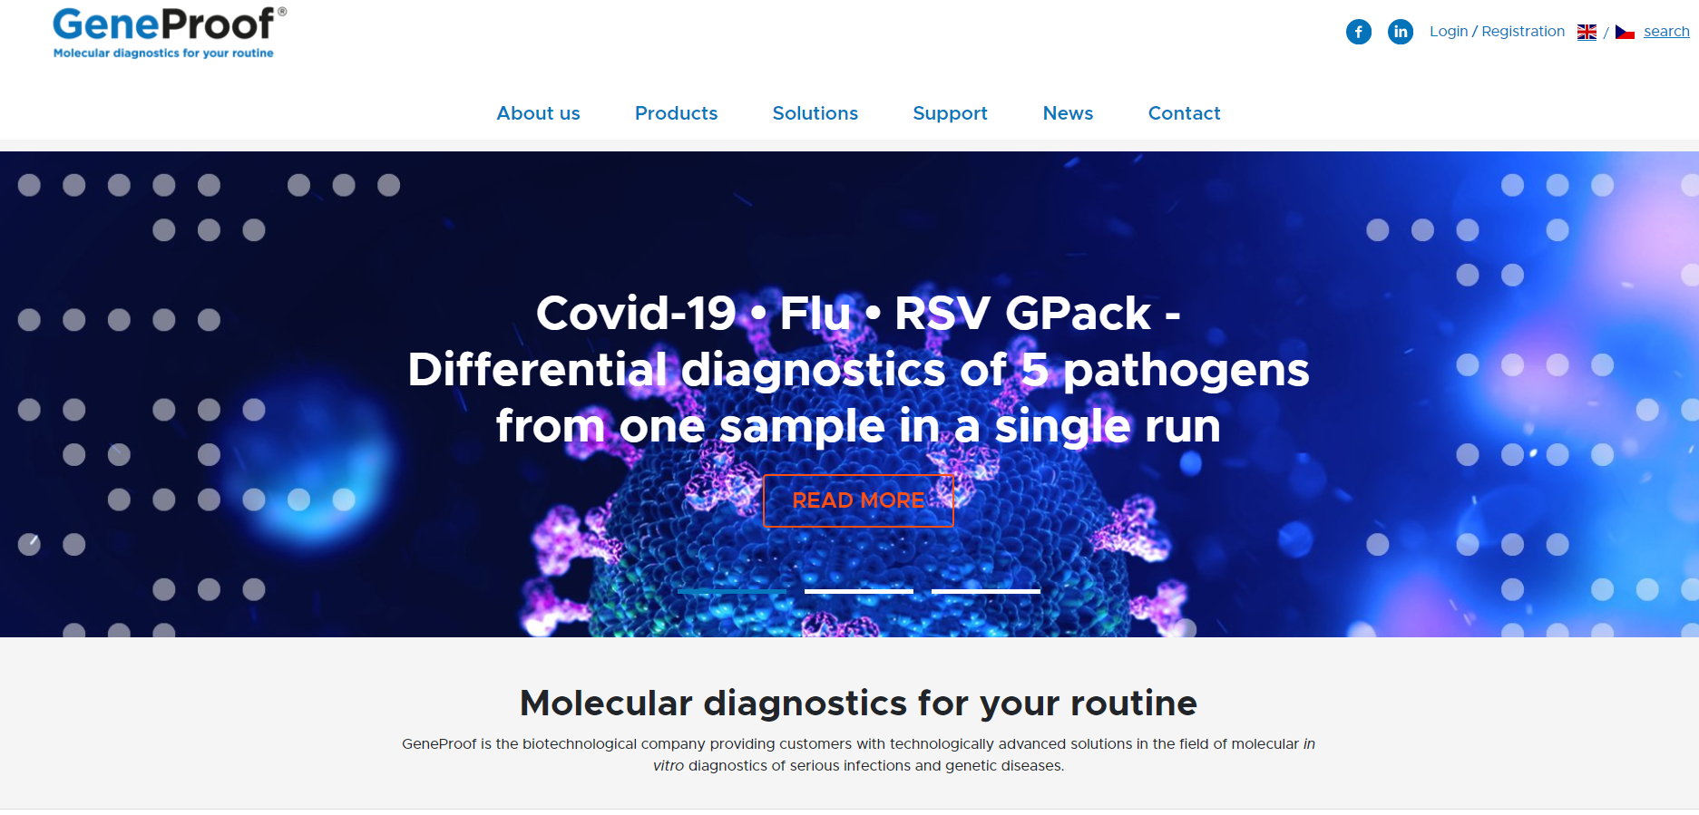
Life after PhD
Lectures series with successful researchers from academia and the private sector who share their experiences
Company Visit
Company presentation
Opportunities for cooperation
The tour company premises

Slide 30
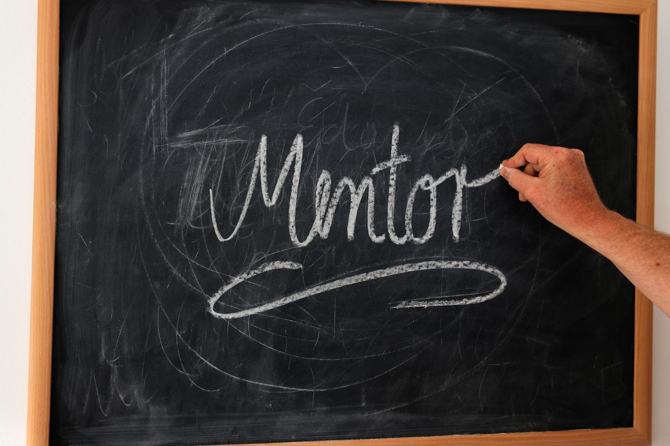
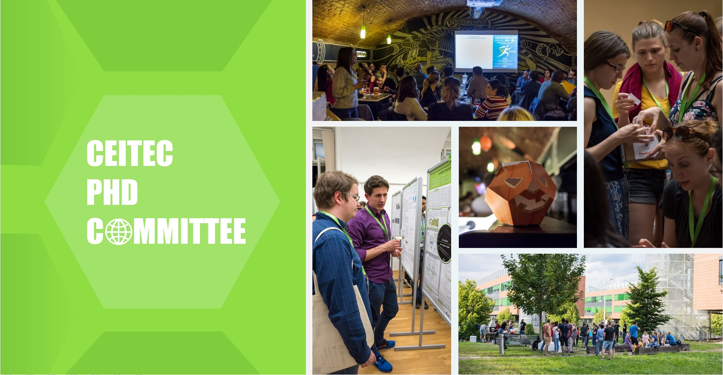
Mentoring
At CEITEC MU, mentoring is a part of the Thesis Advisory Committee (TAC):
  System of individual quality assessment (IQA) of PhD students that led to the successful completion of doctoral studies up to the defense itself
  Every PhD candidate enrolled in a PhD Programme under the CEITEC PhD School must be supervised and mentored during their studies by the TAC
Support of the „peer mentoring“ activities - sharing experiences between mentees:
  Tea time meetings (voluntary and organized by young scientists)
  activities of the CEITEC PhD Student Committee

Slide 31
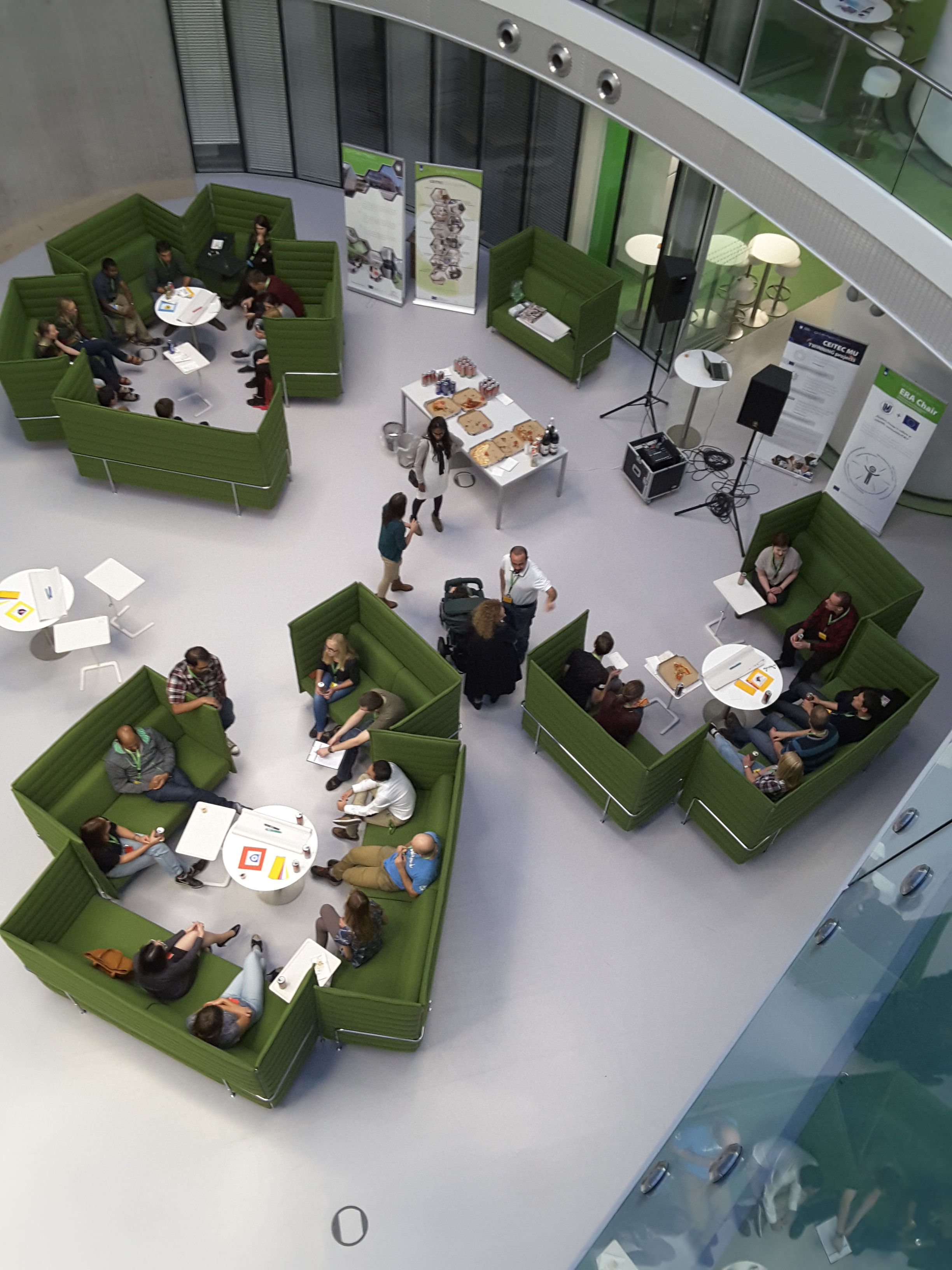
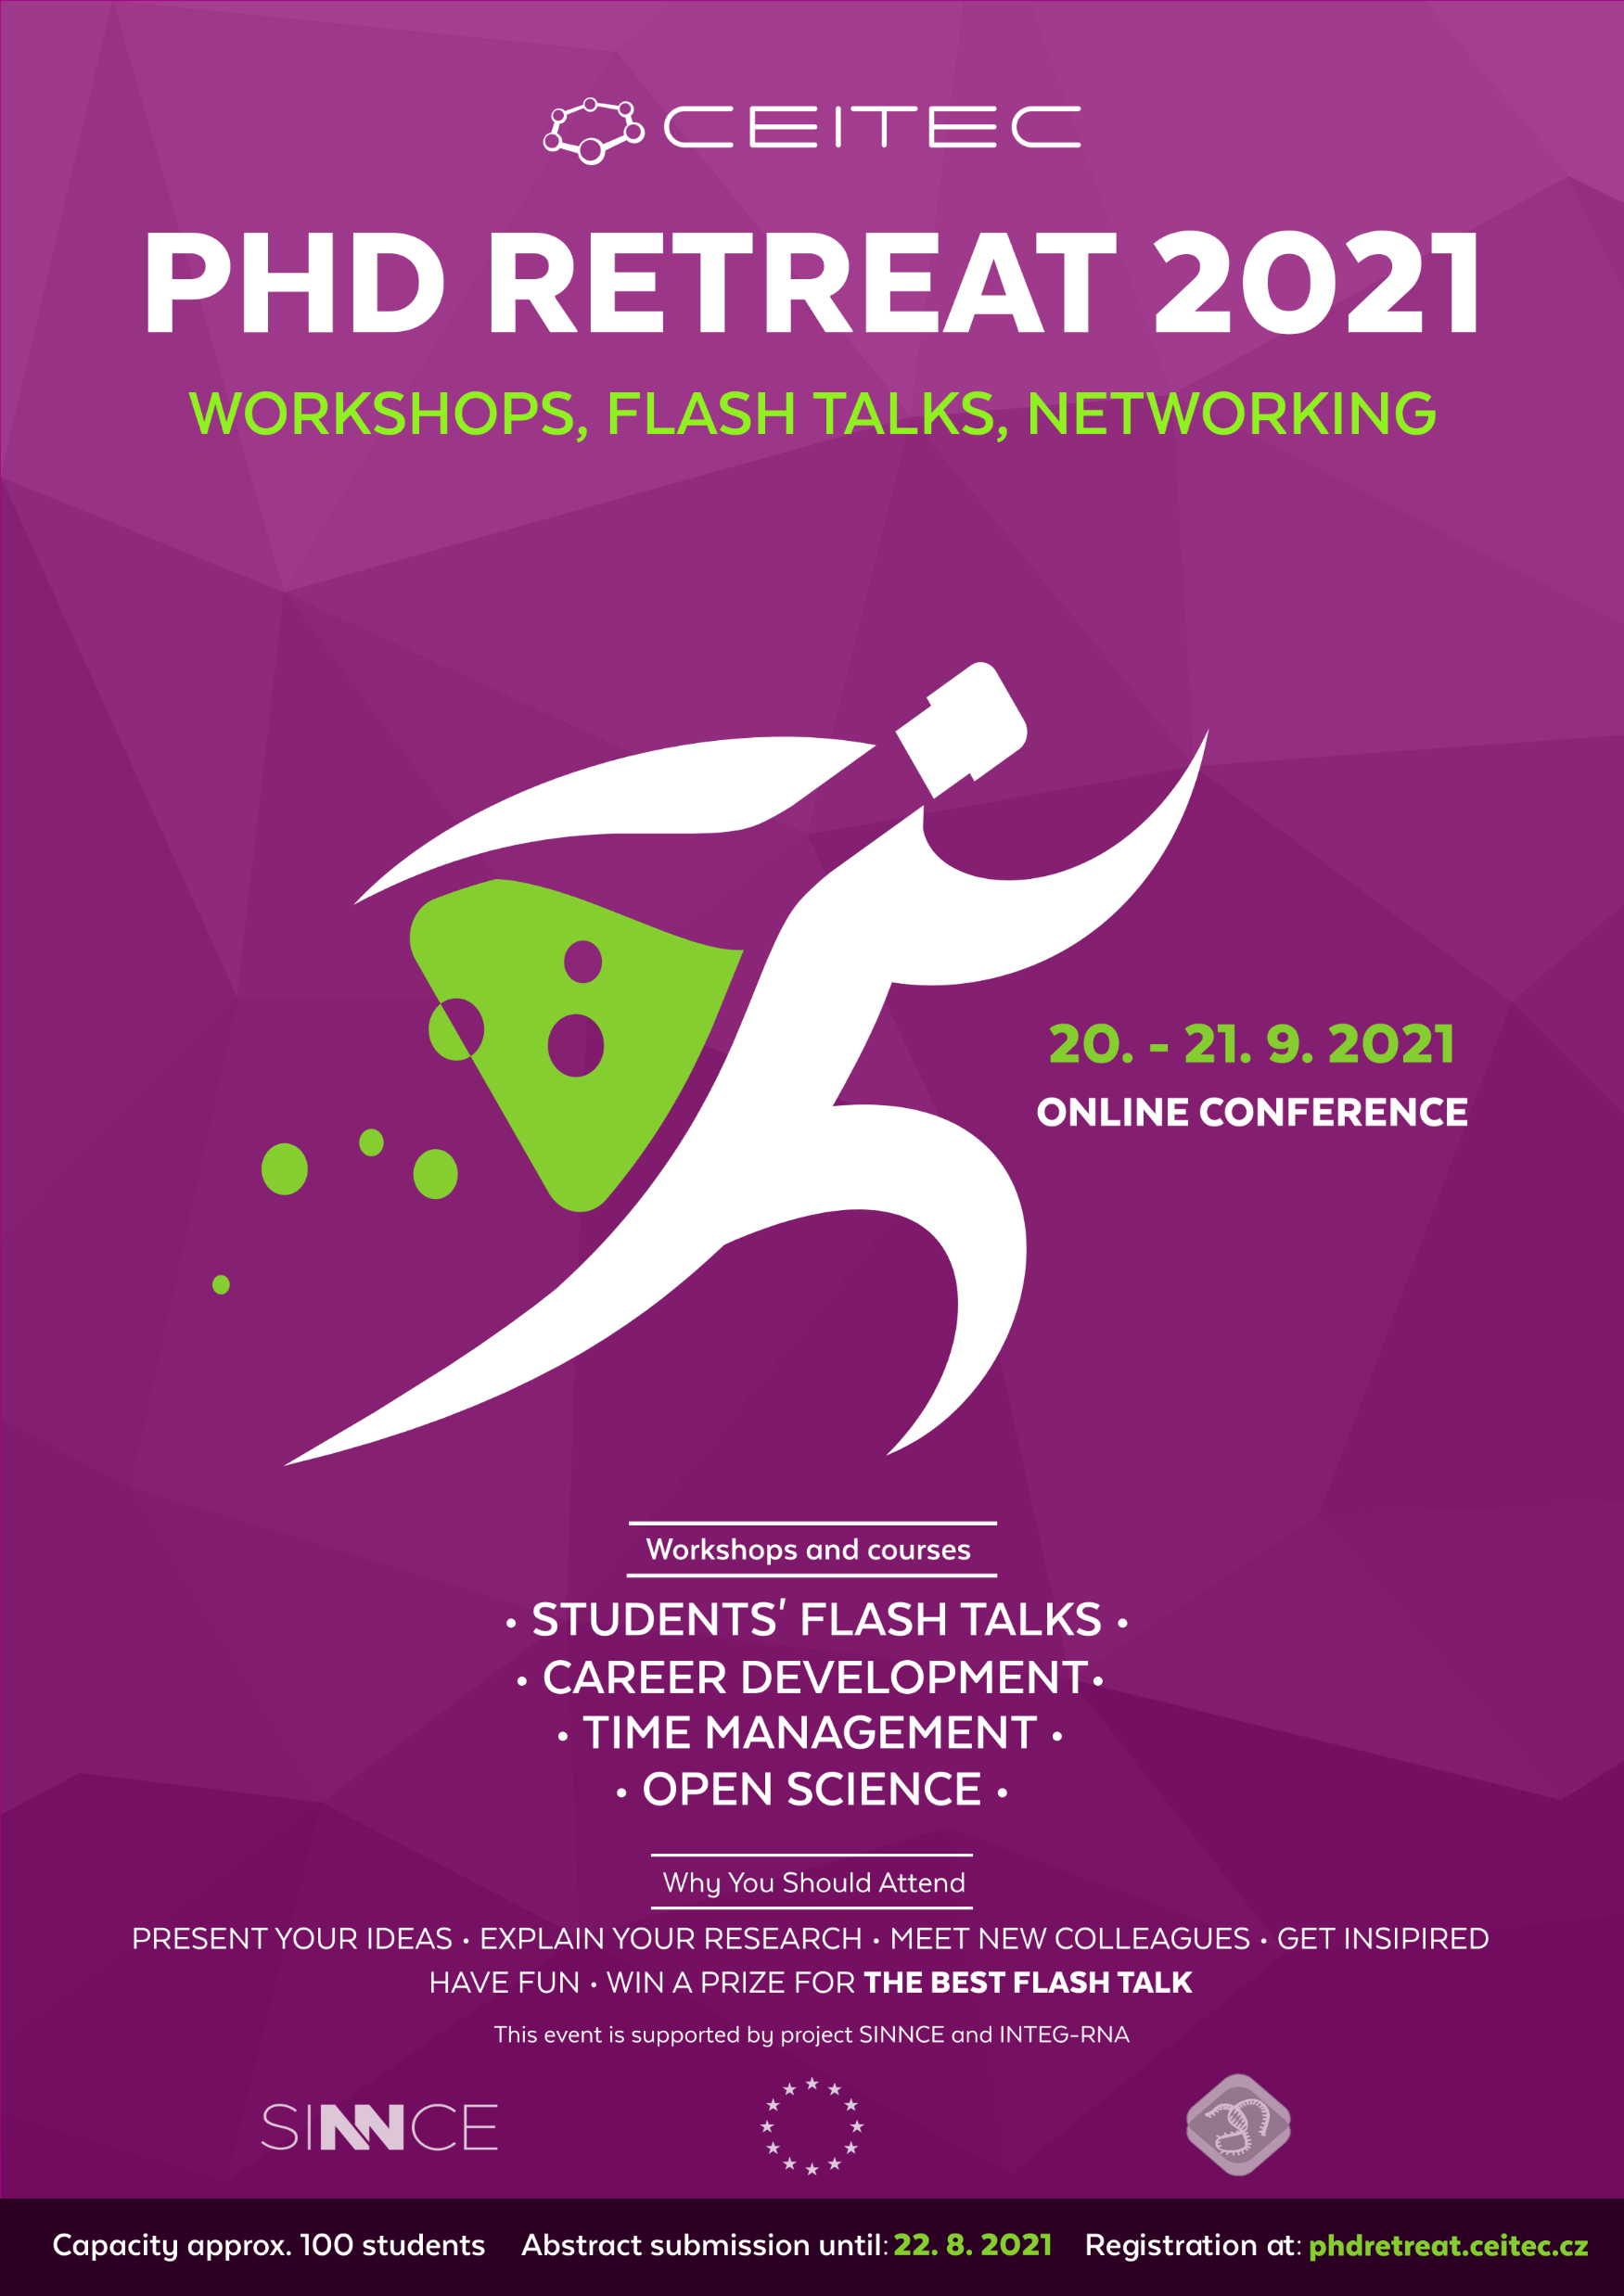
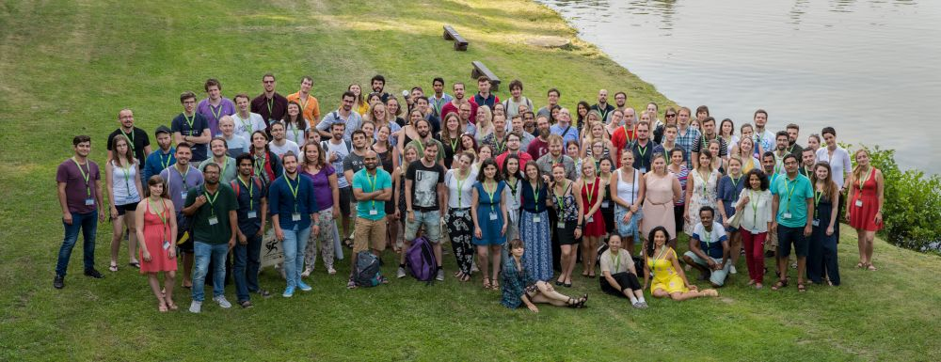
Student’s Activities - PhD Retreats, Tea Times…
PhD Retreat
Event for students from CEITEC
and from other institutes
Networking and sharing good practice
Initiating interdisciplinary cooperation
Opportunity to present research results
and improve presentation skills
CEITEC Tea Time
Informal tea / coffee meetings

Slide 32
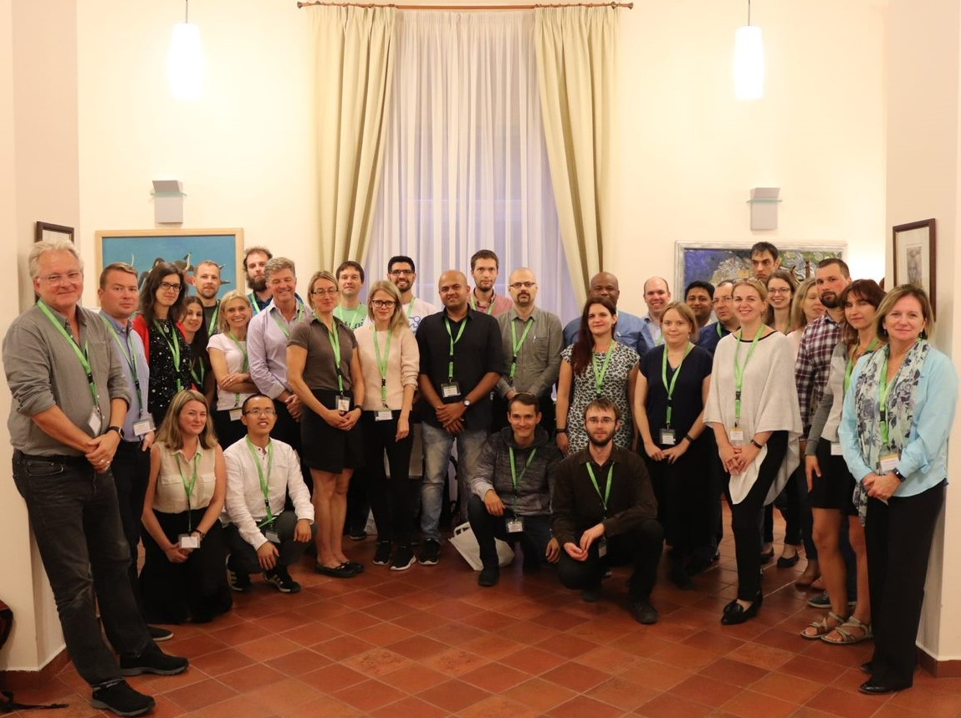
Postdoc Peer Committee
Established in 2019
The goal is to hear the voice of CEITEC MU postdocs, to understand their needs and jointly seek for solutions to problems that we can solve
  Identifies institutional strengths and weaknesses, suggest and jointly with the administration implements solutions that fit the postdoc needs.
Postdocs are drawn to grass-roots activism to create better working conditions for themselves and their peers.
Postdoc Retreats
  Event for postdocs from CEITEC
  and from other institutes
  Networking and sharing good practice
  Initiating interdisciplinary cooperation

Slide 33

Internships at CEITEC MU
Boost your scientific career
Find out if science is right for you
Contact: directly the group leader of a chosen group: www.ceitec.eu/research-groups

Slide 34
Cooperation with Industry
The cooperation with CEITEC brings you the following benefits:
quick access to the latest scientific knowledge, the possibility of expert consultations and to the transfer of know-how,
building a brand on the university grounds with the opportunity to promote your company at professional events of the institute (professional training, workshops, conferences),
access to the most modern equipment in South Moravia (online reservation of equipment on the web https://www.ceitec.eu/core-facilities/) and the possibility of training for your employees,
collaborative research or complete tailor-made services (from project design to data analysis and interpretation),
the possibility of involvement in joint grant projects and national and international research infrastructures,
internships for your employees at CEITEC MU, internships for PhD students in your company, the opportunity to find new employees
more info at: https://www.ceitec.eu/industry-cooperation/
Notes:
Are you an innovative company looking for new challenges in the competitive environment?
Do you want to connect your research with top scientists and use the unique instrumentation of our core facilities?
The cooperation with CEITEC brings you the following benefits:

Slide 35









Examples of cooperation with industry in 2020/2021

Slide 36



Open Science
The CEITEC MU supports the principle of openness to the whole of the research process ranging from research outputs to underlying data as the most effective way in which they can be publicly and freely available to and (re)usable by other researchers and the general public.

Slide 37
CEITEC
@CEITEC_Brno
www.ceitec.eu

