Slide 1
CEITEC MU
Scientific Board Meeting
Jiří Nantl
Brno, 14th March 2019

Slide 2
Research Report 2018

Slide 3
Nature Index (NI)
Institution |  | # results in NI | Proportion of Local Authors According to the NI
1. | Academy of Science of the Czech Republic | 357 | 85.56
2. | Charles University | 253 | 30.22
3. | Masaryk University | 80 | 22.18
4. | Palacký University | 100 | 16.05
5. | CEITEC | 33 | 9.37
6. | University of Chemistry and Technology, Prague | 18 | 8.71
7. | University of South Bohemia | 27 | 6.36
8. | Silesian University in Opava | 12 | 6.23
9. | Czech University of Life Sciences Prague | 14 | 3.26
10. | BIOCEV | 9 | 2.90
 | IST Austria | 51 | 21.62
 | CEITEC | 33 | 9.37

Slide 4
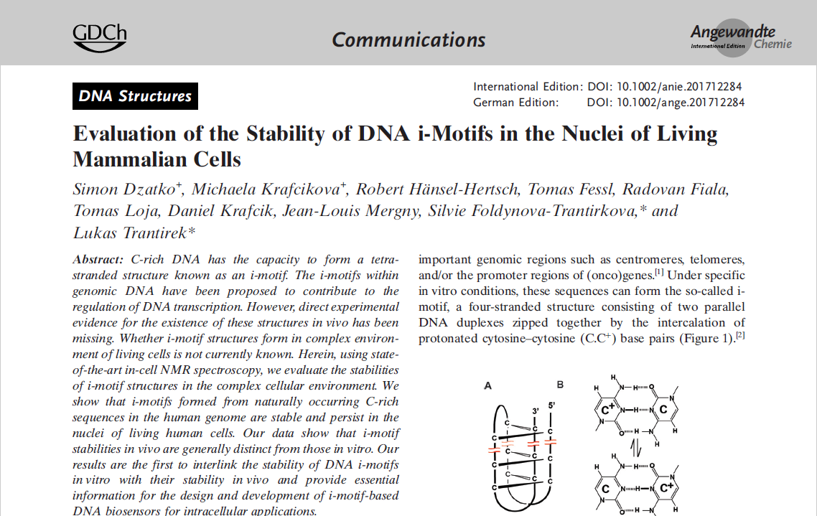
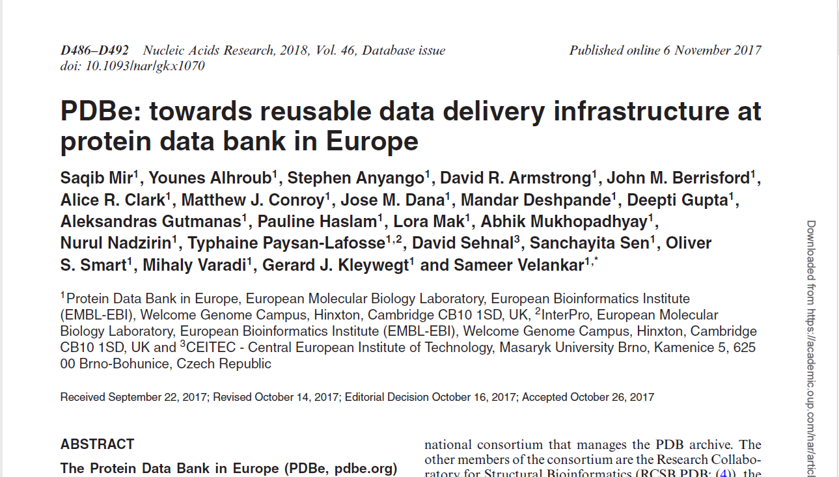
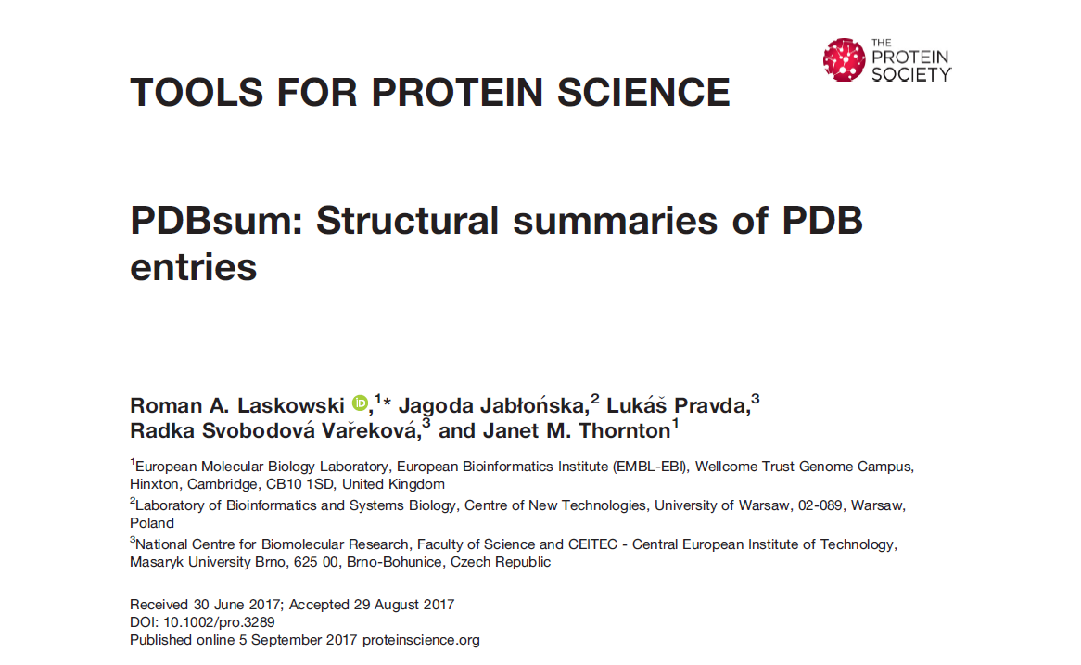

Publications
*Completed data from 2017 will be available in 2Q 2019
Q1 and T5 was determined based on Average JIF Percentile
Notes:
Pozor, data za rok 2018 nejsou kompletní! Tudíž očekáváme změnu počtu publikací a poměry se můžou ještě hýbat.

Slide 5
Publication Analysis 2018
Institution | # of docs at WoS | % of WoS docs in Q1 | Highly cited papers | # of citations of the docs | Average # of citations per doc | % of cited docs | h-index | % Open Access
CEITEC MU | 293 | 51% | 3 | 342 | 1.1 | 45% | 7 | 23%
IOCB AS CR | 295 | 55% | 1 | 295 | 0.9 | 44% | 5 | 18%
IST (AT) | 231 | 66% | 3 | 258 | 1.1 | 38% | 6 | 19%
IMG AS CR | 126 | 47% | 0 | 138 | 1.1 | 41% | 5 | 37%
GMI (AT) | 48 | 80% | 2 | 74 | 1.5 | 44% | 5 | 48%

Slide 6
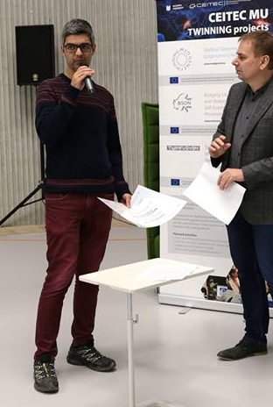
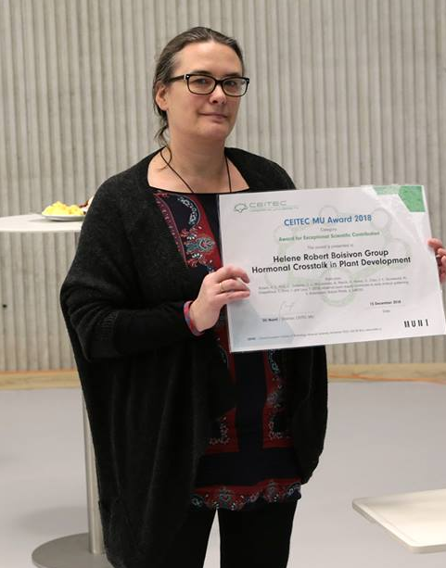
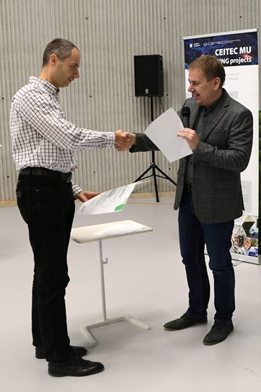
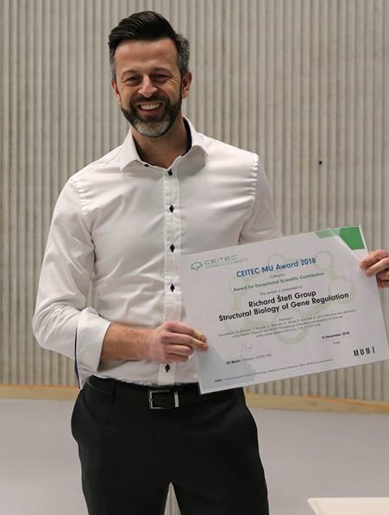
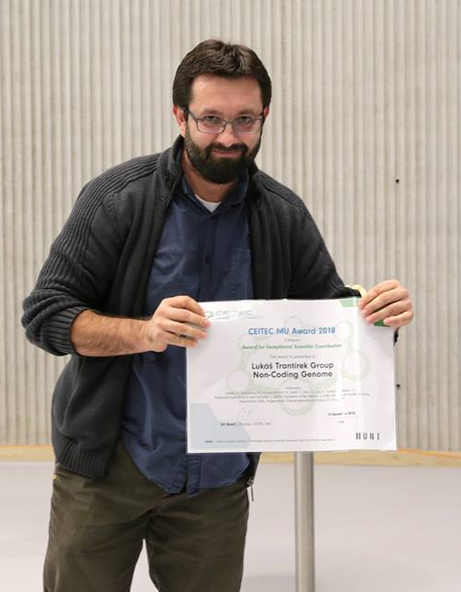
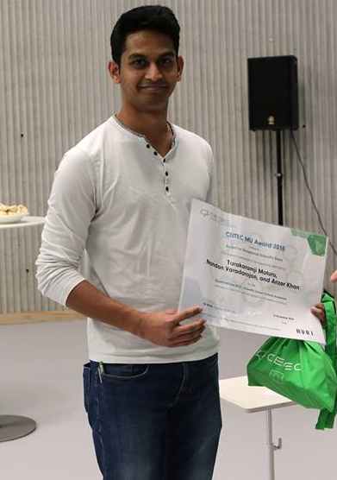

CEITEC MU Awards 2018
Exceptional Scientific Contribution
Kostas Tripsianes
Heléne Robert Boisivon
Pavel Plevka
Richard Štefl
Lukáš Trantírek
Event of the Year
Šárka Pospíšilová

Slide 7
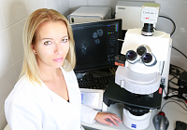
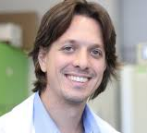
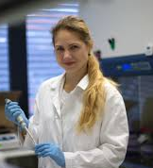
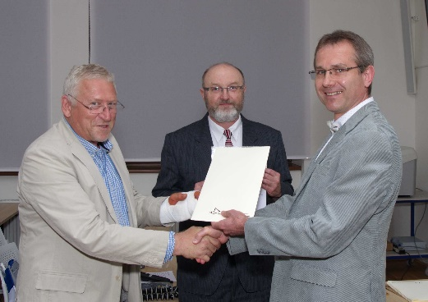
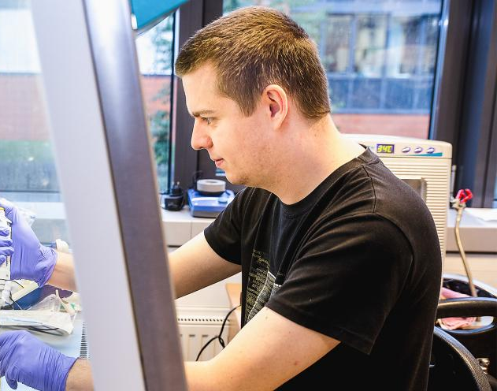
External Awards
Rector's Award
Terezie Mandáková
Neuron Award
Marek Mráz
Discovery Award
Gabriela Pavlasová
T. Mandáková
Marek Mráz
Petr Sedmera Prize
Jan Novotný, Martin Sojka, Marek Nečas and Radek Marek
Jean-Marie Lehn Prize for Chemistry
Zdeněk Farka

Slide 8
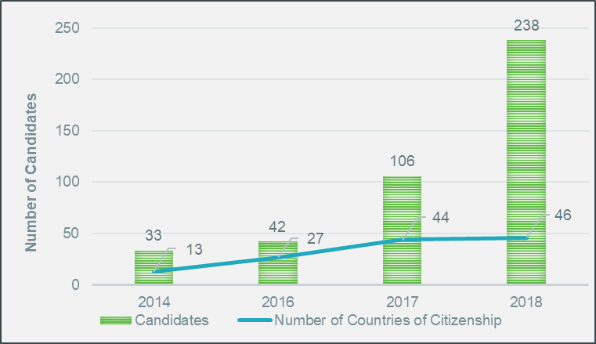

CEITEC PhD School
Major achievements:
Accreditation of PhD Programme - Biomedical Sciences - specialisation Molecular Medicine (Faculty of Medicine) - Dec 2018
Establishment of CEITEC Student Committee - Autumn 2018
BRIDGE Fund - Fund for PhD Student Interdisciplinarity Bridging Life Sciences and Materials Sciences - March 2018
Increasing Number of Candidates
in Admission Process

Slide 9
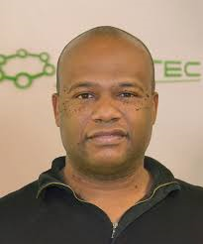
Postdoctoral Programme
List of Courses 2019
Postdoc Peer Committee
  Formed in 2018
  To support postdoctoral community
  To create fit-to-purpose training and events
  To involve the into institutional governance
Chair of the PPC
Michael Christopher Owen
Postdocs at CEITEC MU in Numbers
  47 researchers
  77 % foreigners
  Gender balance: 24F/23M
  16 nationalities

Slide 10
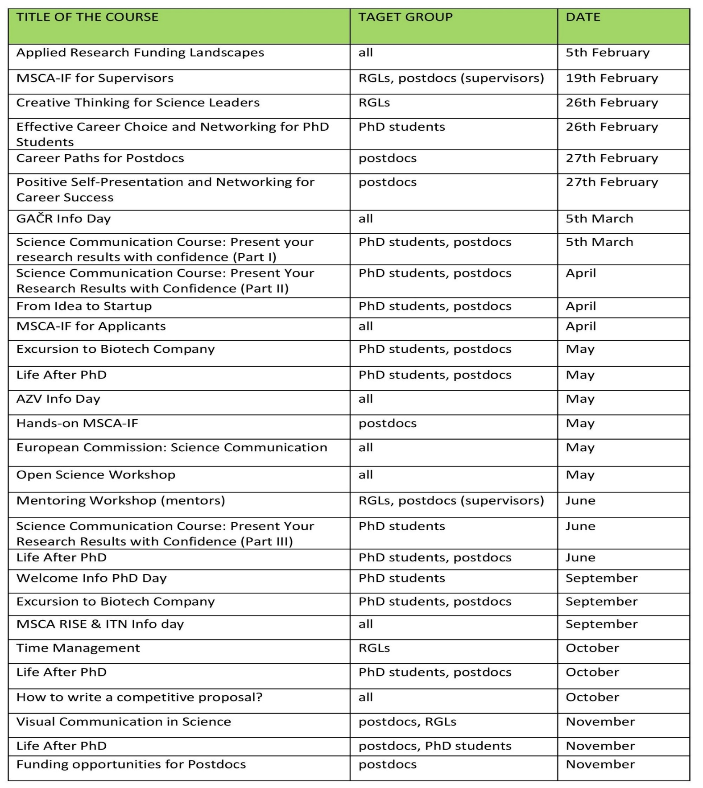
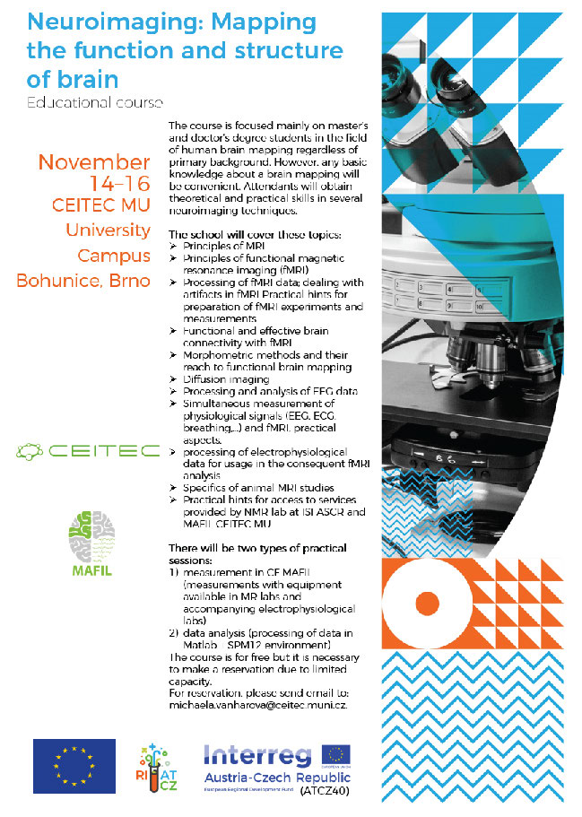
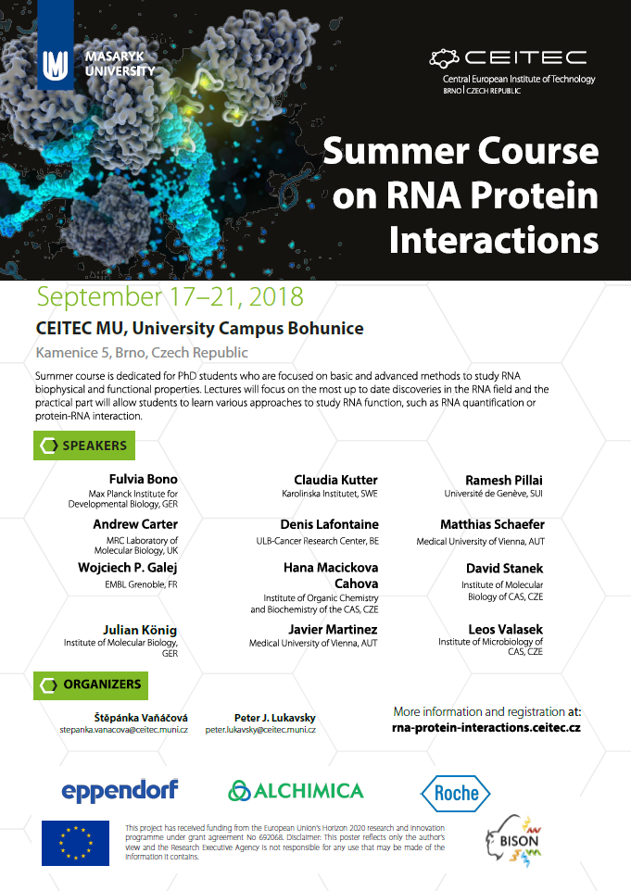

Training and Mentoring
List of Courses 2019
  Expanding training portfolio for researchers in all stages (primarily for early-stage ones)
  Soft skills and transferable skills courses
  Career development events and courses
Plan for 2019

Slide 11

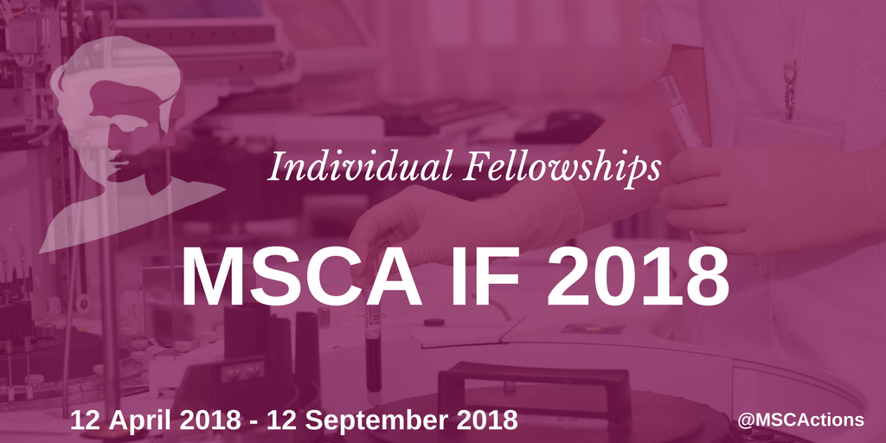


Grants & Funding
New Horizon 2020 Projects:
EUROPEAN RESEARCH COUNCIL
  LeukemiaEnviron, Marek Mráz
WIDENING FELLOWSHIPS
  Panagiotis Alexiou (GL), Jaclyn Quin (O’Connell RG)
MSCA-RISE
RNADIAGON (Ondřej Slabý as coordinator, 6 partners)
HEALTH
MyPal (Šárka Pospíšilová as partner)
RESEARCH INFRASTRUCTURES
  EPIC-XS (Ondřej Slabý as third party)
Notes:
Vedle toho máme další: LIBRA, ORION. Toto jsou novinky roku 2017/2018.

Slide 12
Grants & Funding
National Funding Highlights:
27 approved GAČR grants (43% success rate)
  twice the usual number of awarded projects
  including 2 EXPROs (2 M€ for 5 years): Plevka, Trantírek
2 OP VVV Long-Term Inter-Sector Collaboration Grants awarded
  SINGING PLANT (coordinated by Jan Hejátko, with PSI)
  A-C-G-T (coordinated by Šárka Pospíšilová, with IAB and Genomac)
Strategy:
Individual funding strategies
Clear expectations on international grants
Regular and predictable infodays and trainings
Focus on ERC, MSCA grants
Notes:
Vedle toho máme další: LIBRA, ORION. Toto jsou novinky roku 2017/2018.

Slide 13
Budget Spending 2018
Budget Plan 2019

Slide 14
Budget Spending 2018 + Budget Plan 2019
Financial Results 2018
  Net profit after taxation 7,9 mil. CZK
  Surplus of institutional sources 46,1 mil. CZK
Budget Plan 2019
  Growth of institutional sources by 2,3 %
  Decrease of total planned expenditure in comparison to 2018 spending (lower investment and international grants)
  Stable budgets of research groups
  Lower allocation of NPU-II project by 7,7 % due to decrease of external sources
Notes:
Vedle toho máme další: LIBRA, ORION. Toto jsou novinky roku 2017/2018.

Slide 15
Adjusted Profit and Loss Account
1.1.2018- 31.12.2018

Slide 16
Balance of Funds
1.1.2018- 31.12.2018

Slide 17
Budget Spending 2018 + Budget Plan 2019
Structure of Revenue

Slide 18
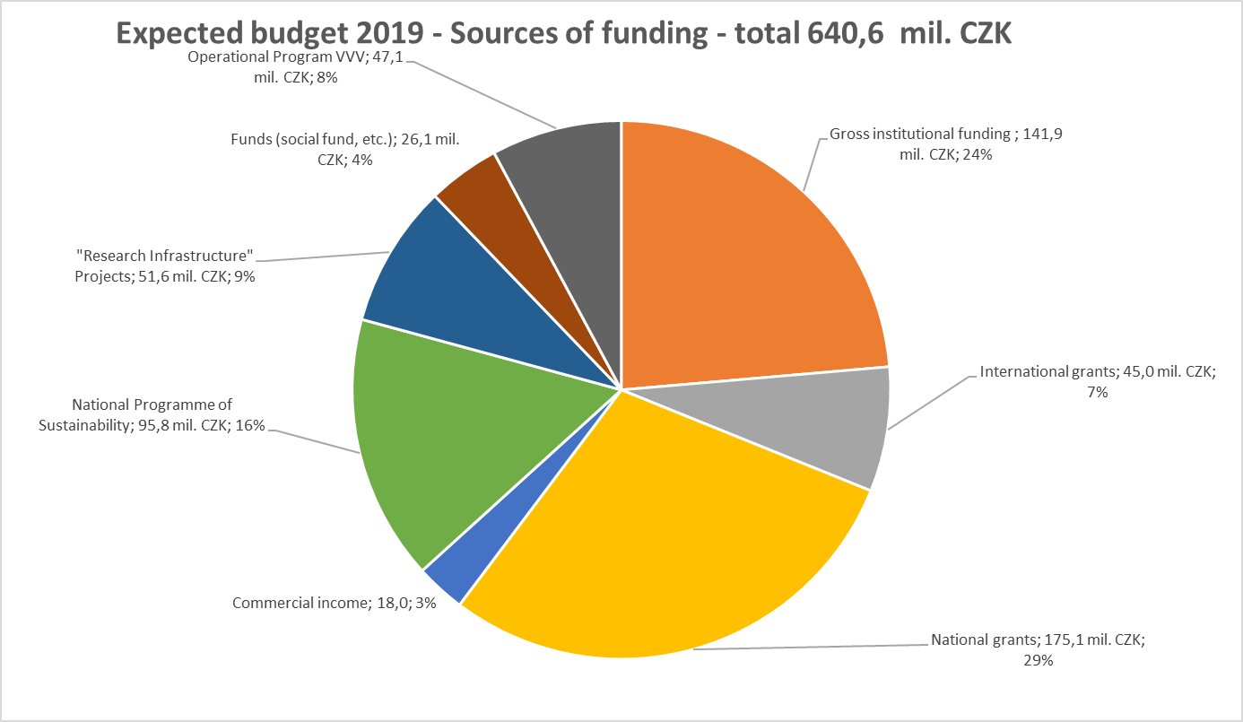

Slide 19
Budget Spending 2018 + Budget Plan 2019
Structure of Expenditure

Slide 20
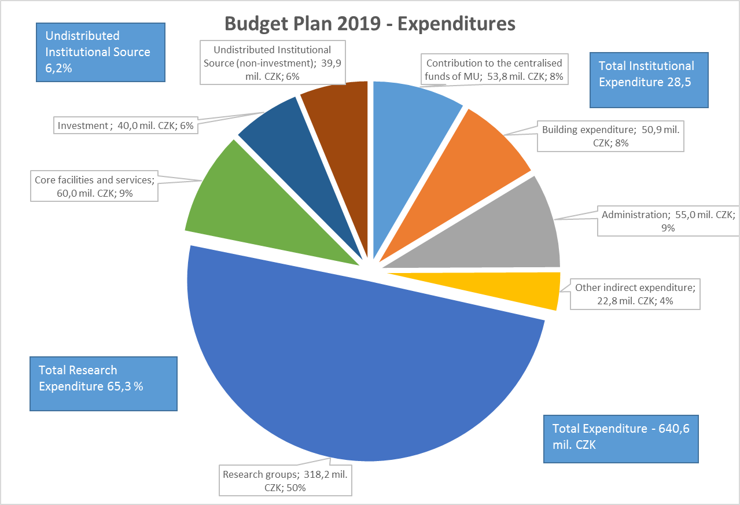

Slide 21
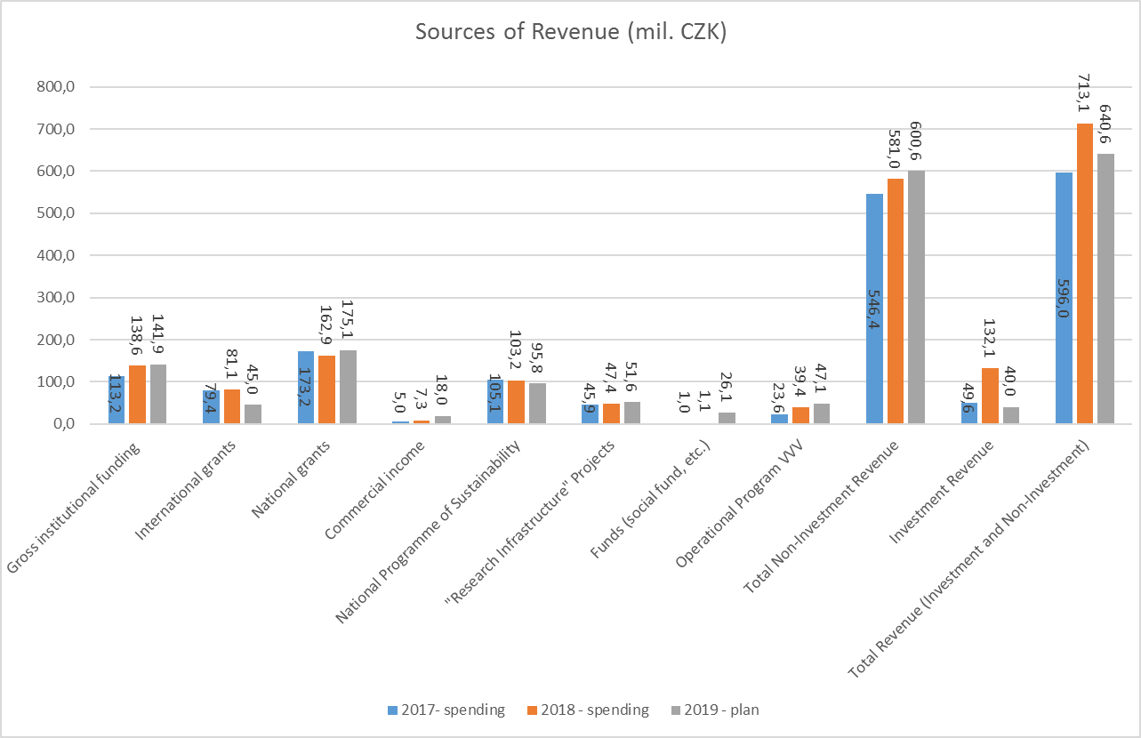

Slide 22
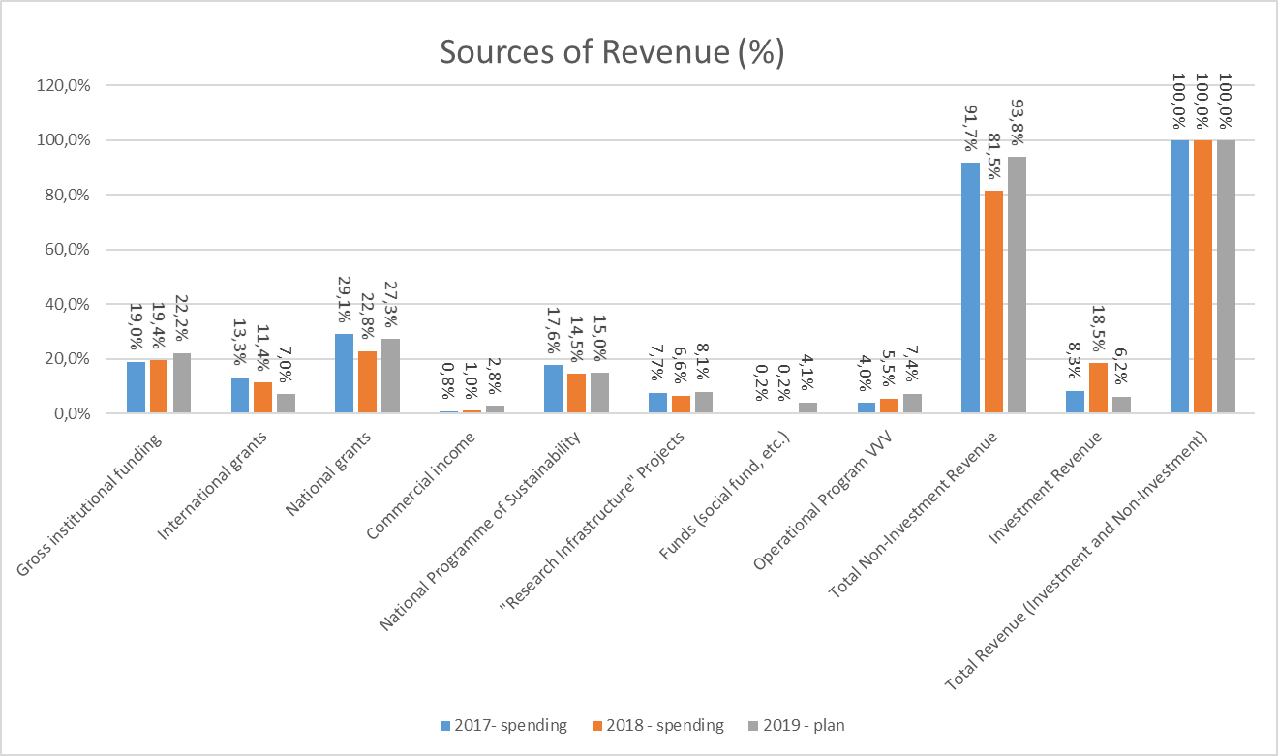

Slide 23
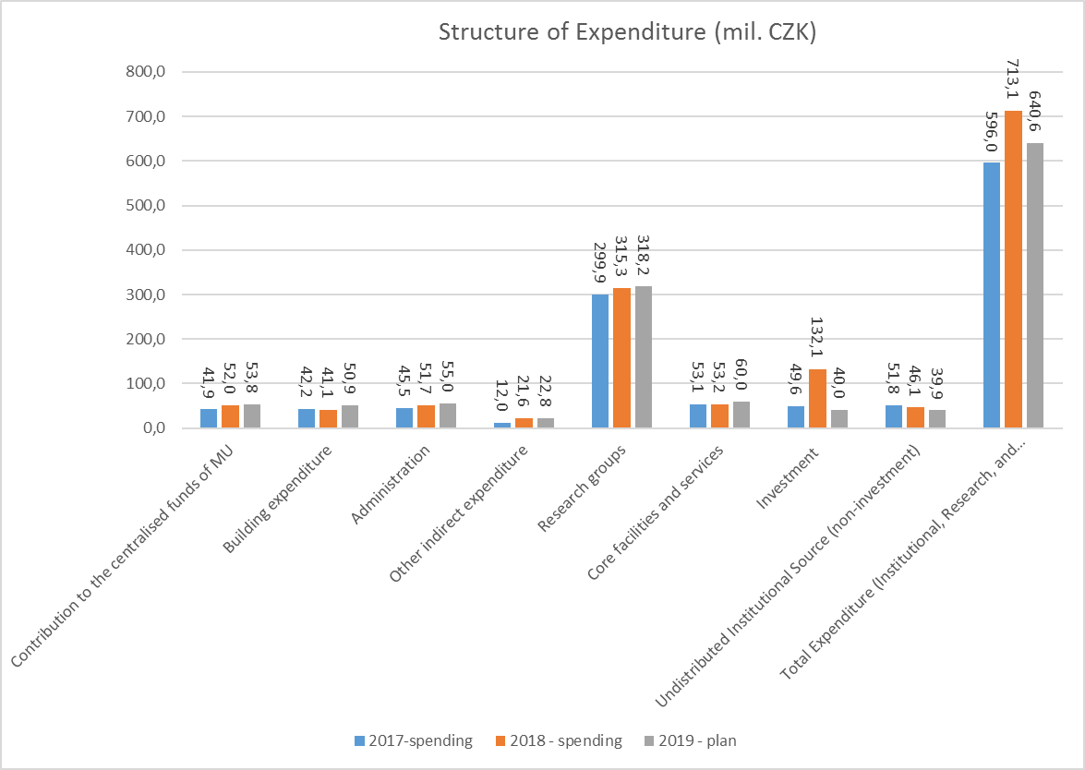

Slide 24
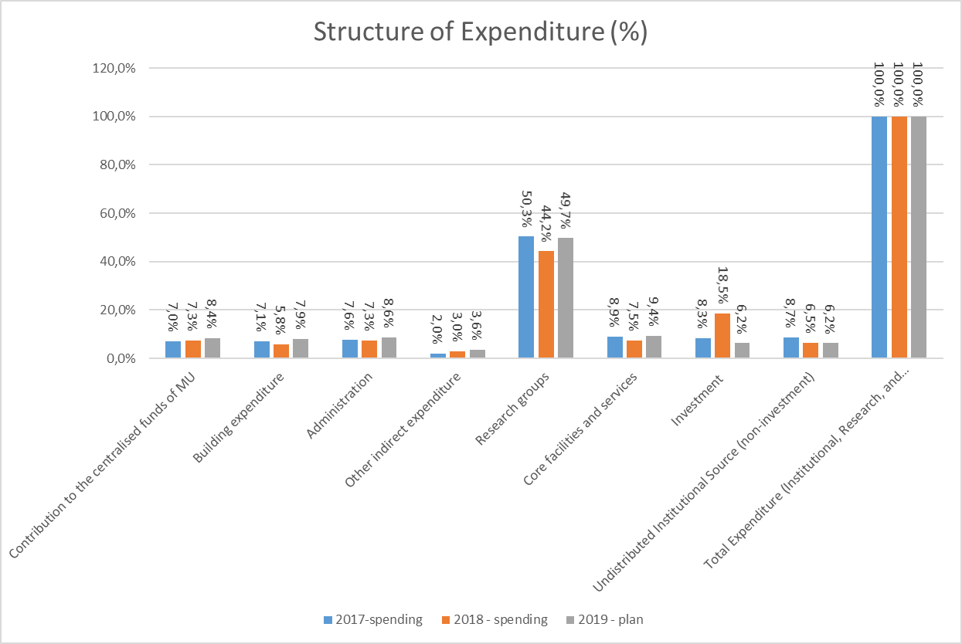

Slide 25
Financial Outlook After 2020
End of sustainability period in 2020.
Discontinuity of funding on national level after 2020 – risk that institutional funding will not match outage of NPU project.
  Uncertain future mechanism of distribution of institutional funds at MU.
  End of funding via NPU project in 2020. Outage of approx. 100 mil. CZK in 2021.
  Institutional fundind probably will not be sufficient to cover the deficit of NPU project in 2020. The total budget deficit may exceed 30 mil. CZK in 2021.
Accumulation of financial reserve exceeding 100 mil. CZK to overlap the transitional period post 2020.
Structural changes of CEITEC MU after 2020 will be necessary.
  Decrease in number of research groups (to be planned over 2019)
Notes:
Vedle toho máme další: LIBRA, ORION. Toto jsou novinky roku 2017/2018.

Slide 26
Thank you for your attention.

