Slide 1
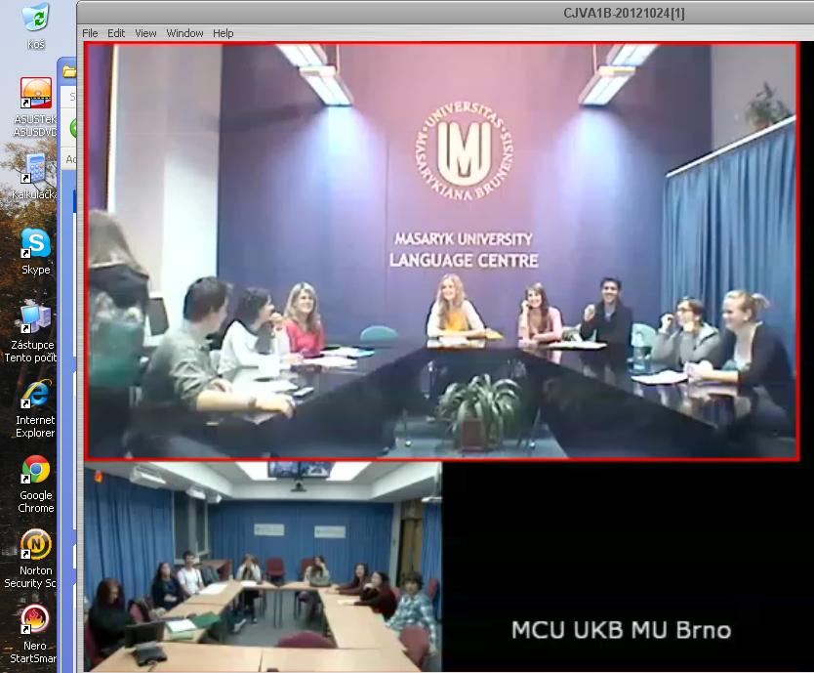



Creativity in EAP:
How far can we go?
Libor Štěpánek
Masaryk University Language Centre
lstep@fss.muni.cz

Slide 2
outline
CJV MU
theory
  creativity
  language learning
  community of practice
- examples

Slide 3
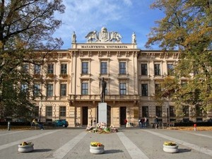

Masaryk University Language Centre
45,000 MU
10,000 LC
100
7
3

Slide 4
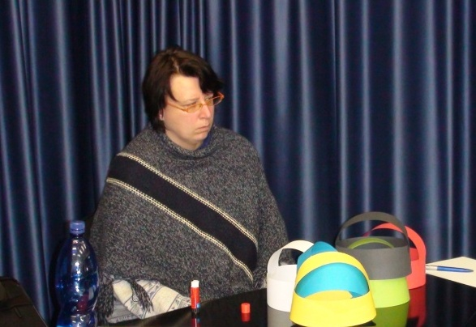
Creativity?

Slide 5
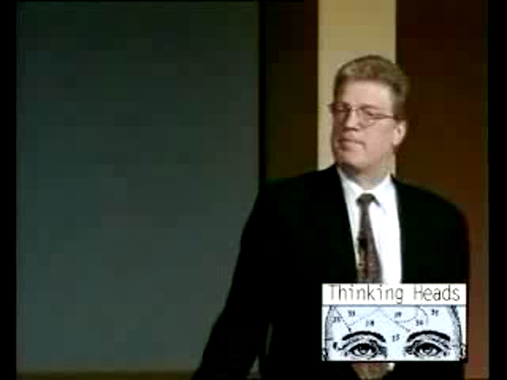
Creativity
is a complex and multi-faceted phenomenon, which prevents promotion of a universally accepted definition; (Treffinger et al., 2002)
is a function of intelligence which takes many forms and draws from different capacities. (Robinosn, K., 2009)
every individual has it to some degree;
(Csikszentmihalyi, 1996)
potential for creativity is innate in individuals;
(Torrance 1970, Runco et al., 2010:362)
has levels, … we can ask ‘how creative’ we are;
(Treffinger et al., 2002)
people cannot be taught creativity but, instead, the right combination of personal characteristics and an encouraging environment could produce it.
(Csikszentmihalyi, 1996; Heindel and Furlong, 2000)
http://www.youtube.com/watch?v=mddD1yGREKQ&feature=related

Slide 6
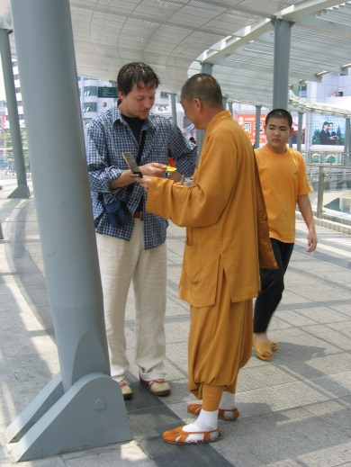
Why creative language learning?
“…the use of any language is inherently creative…”
… we ……. “…re-define, re-create and/or re-produce things
by firstly questioning them, then by looking at them
from a fresher, different angle or perspective, and
finally by formulating and/or producing a renewed,
different alternative of the very thing that is being
looked at…”
(Clarke, 2010: p.2)

Slide 7
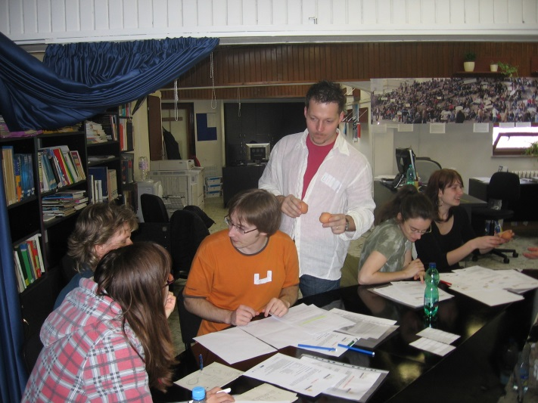
Why community-of-practice?
Discourse communities:
  a top down style within a given hierarchy
Communities of practice:
  a combination of formal patterns of communication with an informal exchange of information within a negotiated learning environment
  (Morgan, 2008: 17)

Slide 8
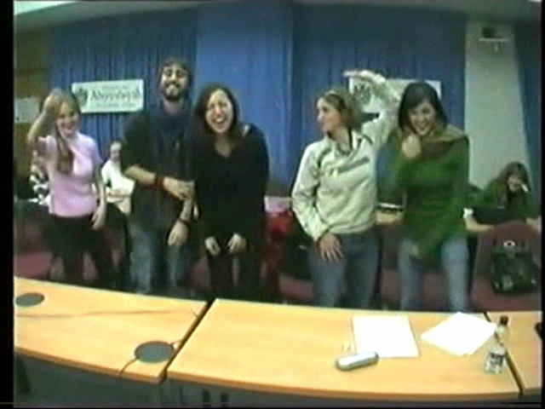
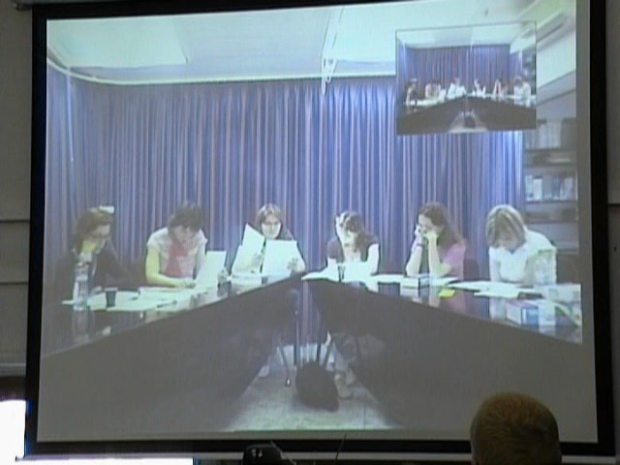
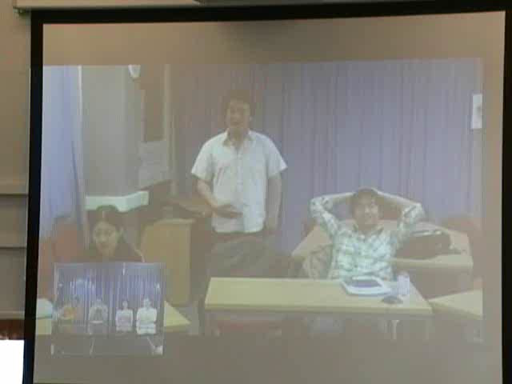
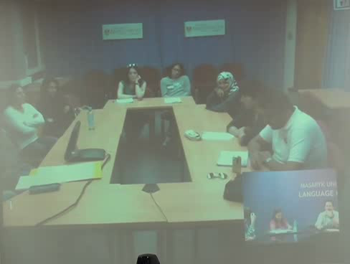
situations

Slide 9
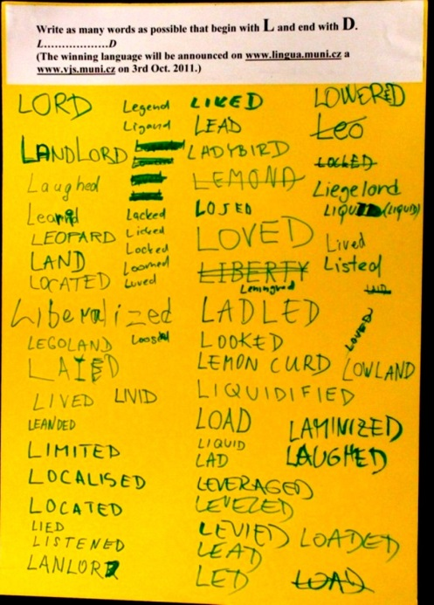
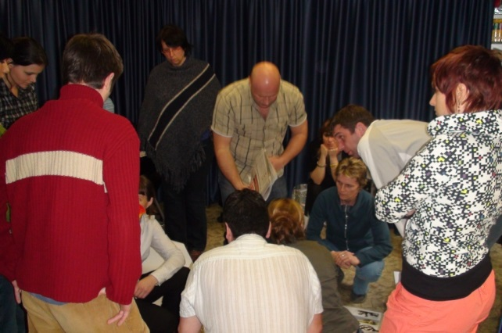
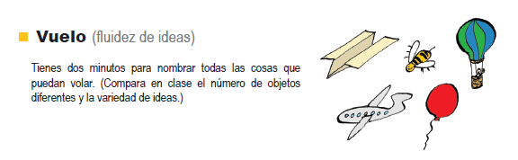
CREATIVE PERSONALITY
J.P. Guilford
areas of development
Prove that this chair does not exist (max. 200 words).
fluency
flexibility
originality
elaboration

Slide 10
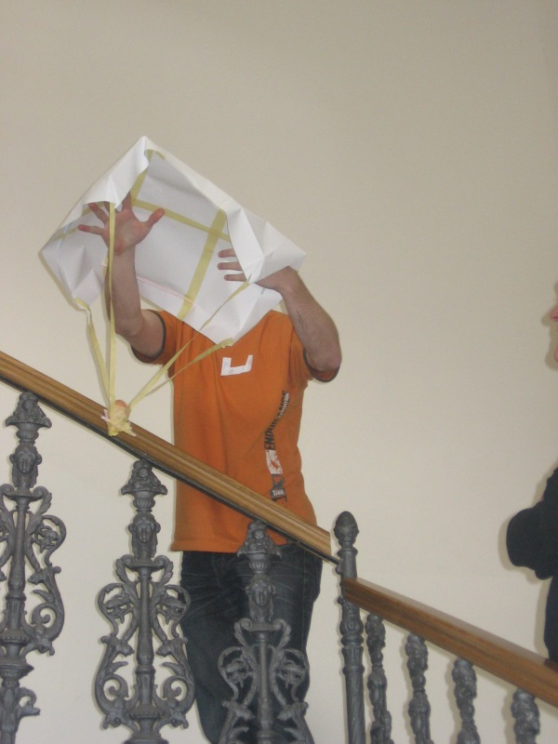
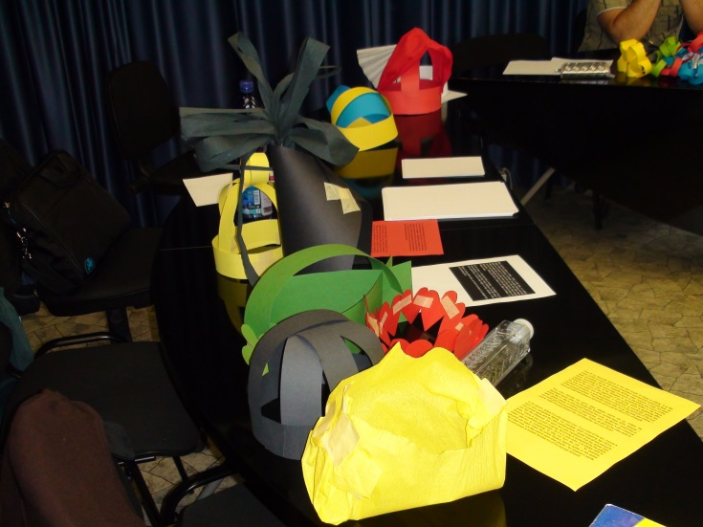
barriers
of
perception
environment
culture
emotions
intellect
expression

Slide 11
…and some activities…

Slide 13
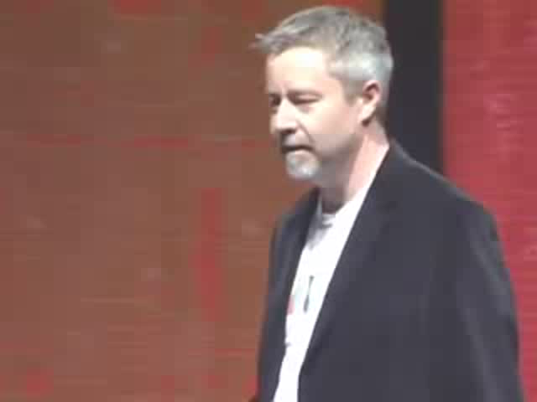

Tim Brown on creativity
Adapted from: http://www.ted.com/talks/tim_brown_on_creativity_and_play.html

Slide 14
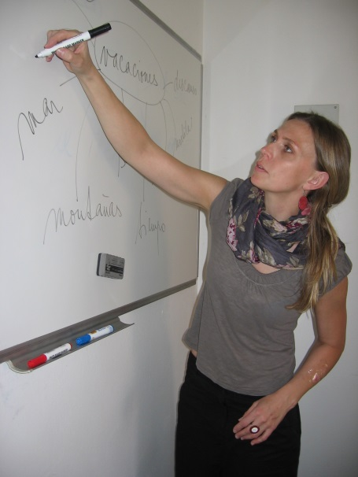
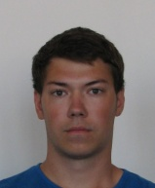
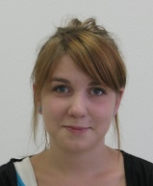

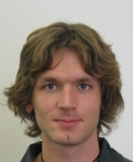
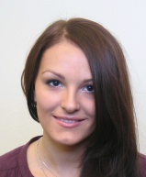


syllabus
+

Slide 15
syllabus
Autumn term 2011
  reading between the lines
  academic writing style
Spring Term 2012
  academic paragraph writing
  panel discussion
Autumn Term 2012
  small talk
  grammar

Slide 16
first session

Slide 17
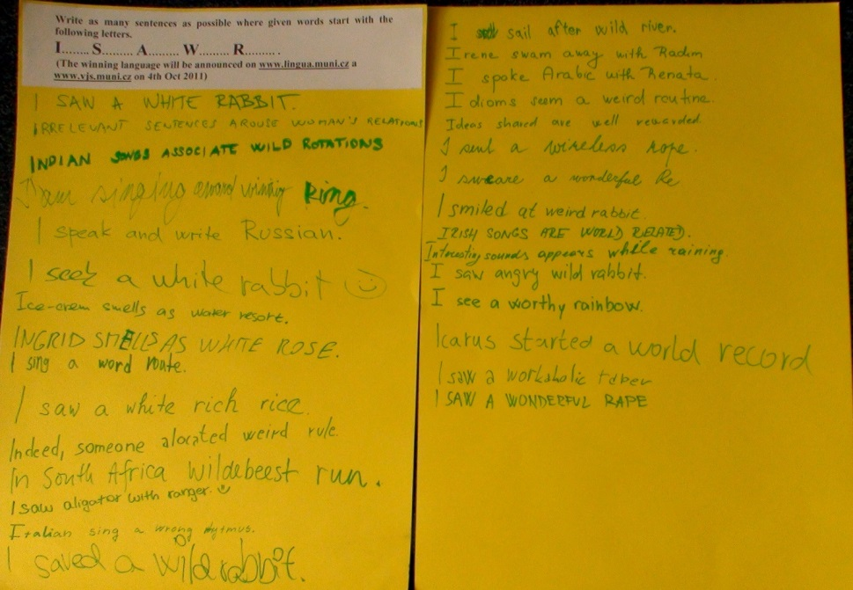
first session
expressional fluency
I…..S…..A……W……R….. .

Slide 18
first session
expressional fluency
barriers:
    “ …it is not academic“
    “ ….it is just a game“
    “ …it is not creative“
    “ …I was not sure about spelling of some words“
    “ …it is not good to use informal words in academic English“
    “ …my grammar is very bad“

Slide 19
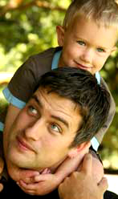
first session
adaptive flexibility
Right now mum is 21 years older than her child. In 6 years her child will be 5 times younger than she.

Slide 20
first session
adaptive flexibility
Right now mum is 21 years older than her child. In 6 years her child will be 5 times younger than she.
Where is daddy?

Slide 21
Answer
If in 6 years the mother will be 21 years older than and 5 times as old as the child, then:
5*(X+6) = (X+6)+21
4*(X+6) = 21
X+6 = 5.25
X = -0.75

Slide 22
Answer
If in 6 years the mother will be 21 years older than and 5 times as old as the child, then:
5*(X+6) = (X+6)+21
4*(X+6) = 21
X+6 = 5.25
X = -0.75
At present the child is:
three quarters of a year before being born.
And three quarters of a year is nine months…

Slide 23
grammar

Slide 24
grammar
Complete the sentences in reported speech.
John said, "I love this town."
John said ____________________________ .
"Do you like soccer ?" He asked me.
He asked me ____________________________ .
"I can't drive a lorry," he said.
He said ____________________________ .
"Don't waste your money" she said.
She told the boys ____________________________ .
"What have you decided to do?" she asked him.
She asked him ____________________________ .
"You should revise your lessons," he said.
He advised the students ____________________________ .
(Adapted from: http://www.myenglishpages.com/site_php_files/grammar-exercise-reported-speech.php)

Slide 25
grammar
Complete the sentences in reported speech.
John said, "I love this town."
John said ____________________________ .
"Do you like soccer ?" He asked me.
He asked me ____________________________ .
"I can't drive a lorry," he said.
He said ____________________________ .
"Don't waste your money" she said.
She told the boys ____________________________ .
"What have you decided to do?" she asked him.
She asked him ____________________________ .
"You should revise your lessons," he said.
He advised the students ____________________________ .
(Adapted from: http://www.myenglishpages.com/site_php_files/grammar-exercise-reported-speech.php)

Slide 26
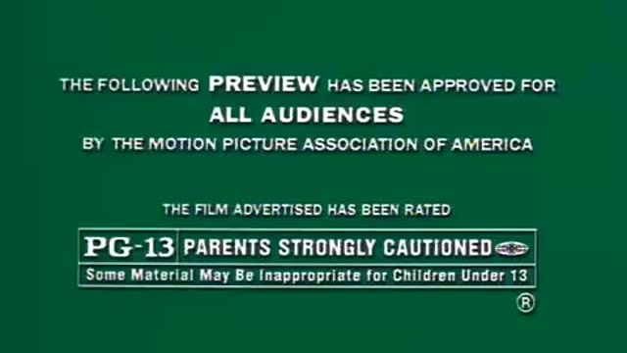
grammar
https://www.youtube.com/watch?v=yMErdpA804Y

Slide 27
grammar
Find similar examples of reported speech in your favourite films or videos and share them with your colleagues.
https://www.youtube.com/watch?v=yMErdpA804Y

Slide 28
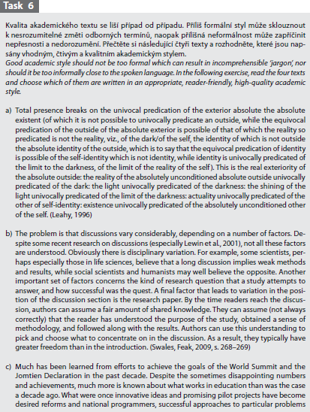
reading

Slide 29
reading

Slide 30
reading
Find a text in your field of study which you believe represents high quality academic writing.

Slide 31
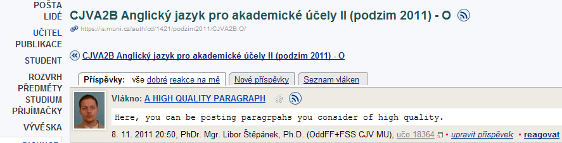
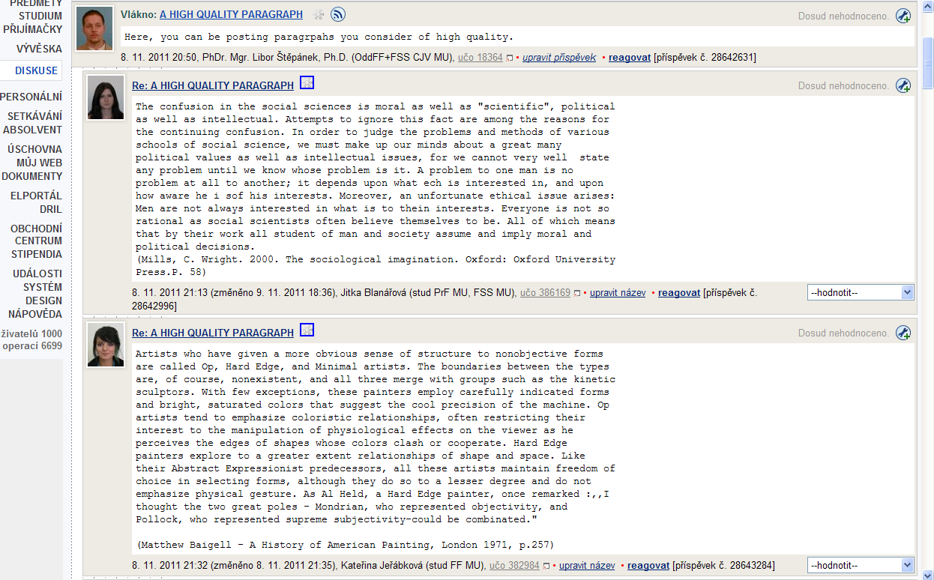
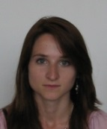
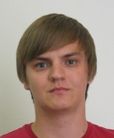
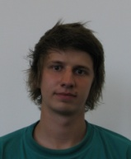
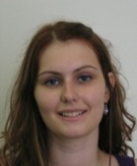
reading
search strategies
text analysis
genre discussion
competition/games
peer-review

Slide 32
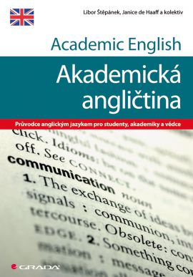
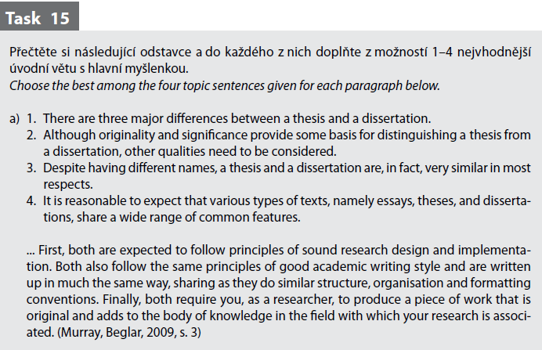
writing

Slide 33
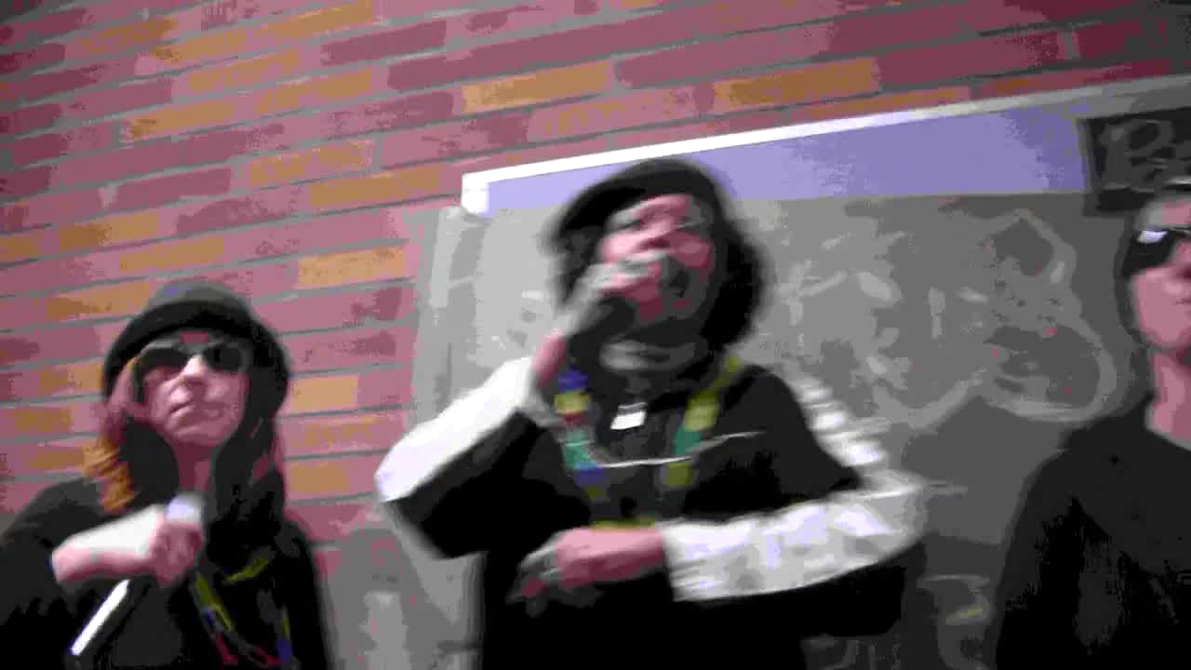
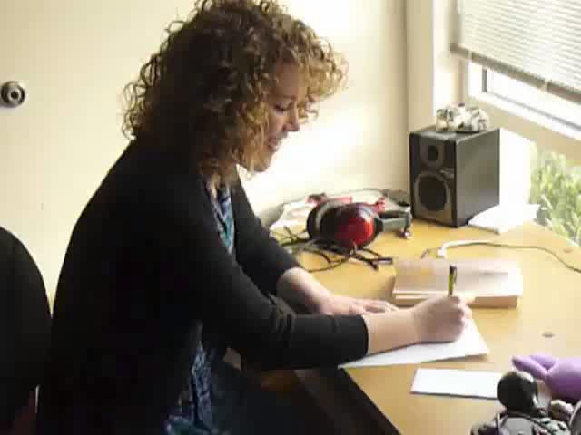
writing webquest
http://www.youtube.com/watch?v=MNsH0RW7lvM
http://www.youtube.com/watch?v=mbxKUBsTWF8

Slide 34
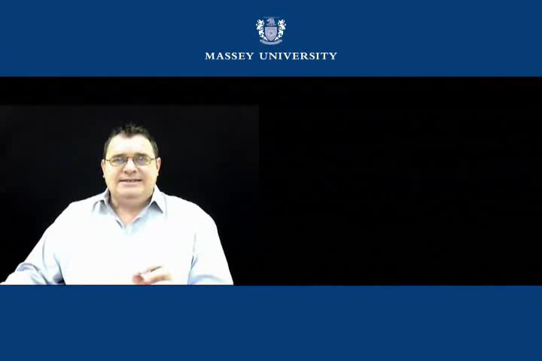
writing on-line lectures
http://www.youtube.com/watch?v=w183qB0KDFg

Slide 35

writing development actitivities
associational fluency
  “The author says …“
  Write as many synonyms to the verb „say“ as possible.
word fluency
  Write as many words as possible you would never use in academic writing.
elaboration
  “This paper presents …“
  Finish the sentence in 5 different ways.

Slide 36
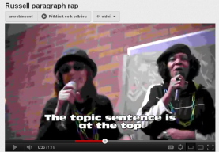
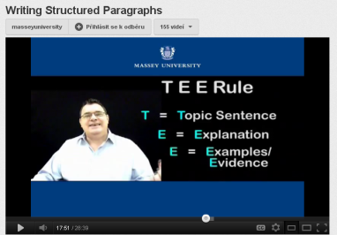
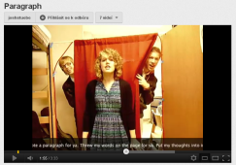
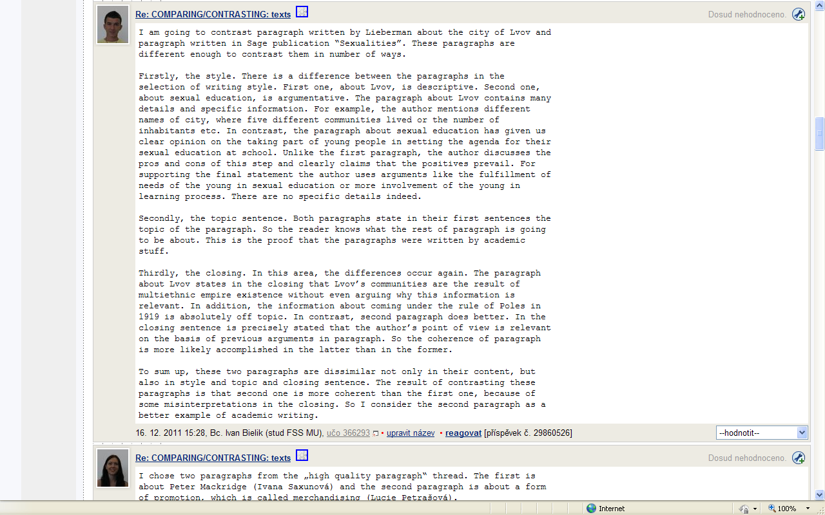
writing production

Slide 37
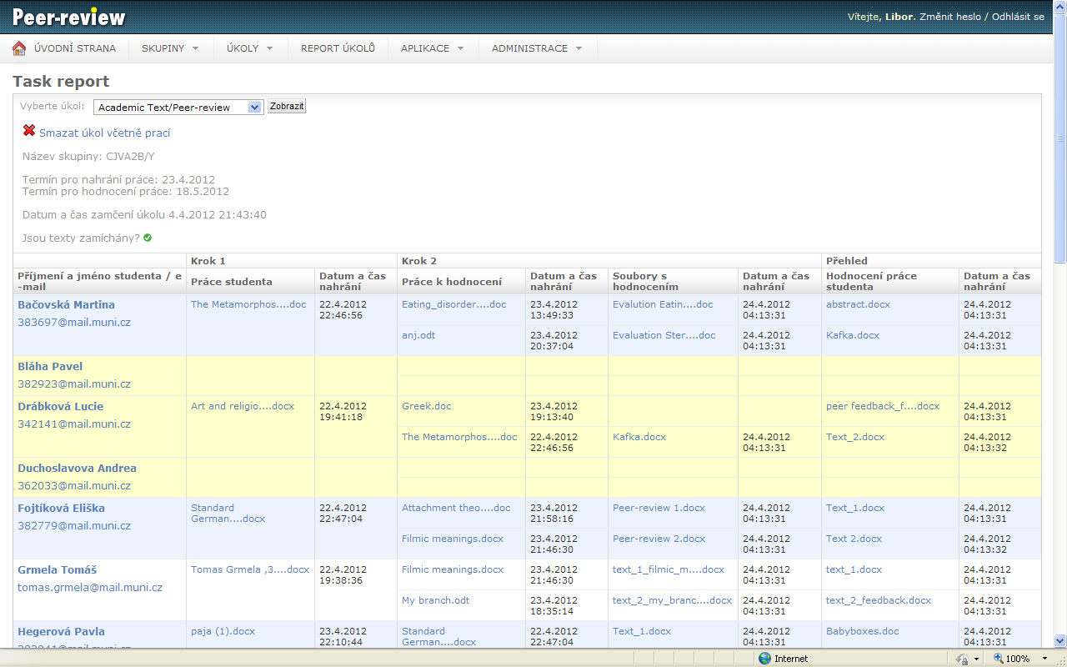
writing peer-review

Slide 38


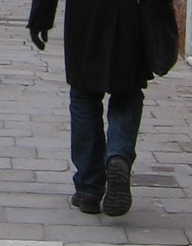
feedback

Slide 39
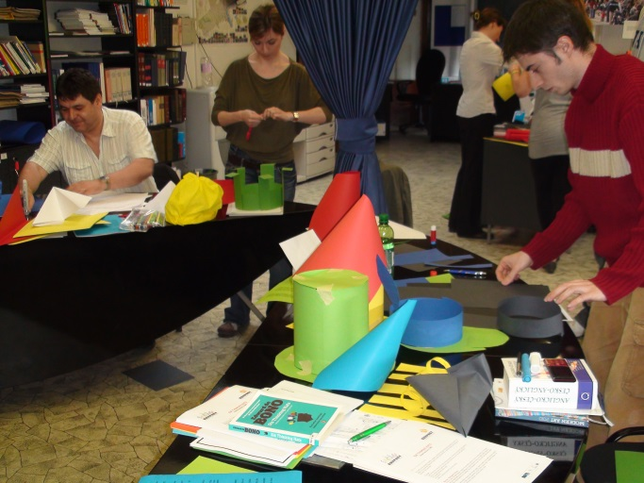
Can we…
create a community of practice?
offer diverse settings and materials for diverse styles of learning?
create real-life-like-situations?
show barriers?
train fluency, flexibility, elaboration and originality, etc.?

Slide 40
