Slide 1
SWAHILI EVENING.
JIONI YA KISWAHILI
Notes:
This presentation demonstrates the new capabilities of PowerPoint and it is best viewed in Slide Show. These slides are designed to give you great ideas for the presentations you’ll create in PowerPoint 2011!
For more sample templates, click the File menu, and then click New From Template. Under Templates, click Presentations.

Slide 2
JAMBO, HABARI, KARIBU SANA

Slide 3
BY CORONA KIMARO ČERMÁK
I WANT YOU TO FEEL RELAXED, ENJOY THE MUSIC, TOUCH THE CLOTH, HEAR THE LANGUAGE, SEE THE PICTURES AND BY ALL THESE YOU WILL UNDERSTAND SWAHILI LANGUAGE AND SWAHILI CULTURE.

Slide 4
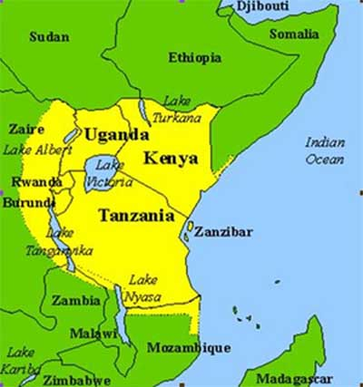
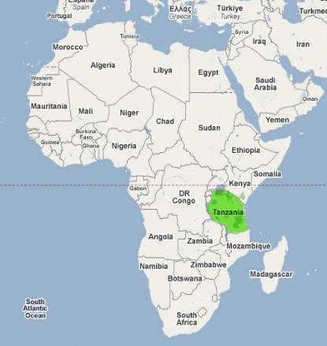

Slide 5
COMPARISON BETWEEN TANZNAIA AND THE CZECH REPUBLIC
TANZANIA IS 12 TIMES BIGGER
ACCORDING TO 2012 CENSUS THERE ARE 49 MILIONS PEOPLE IN TANZANIA.
120 TRIBES
SWAHILI AND ENGLISH ARE BOTH OFFICIAL LANGUAGES.
BORDERED WITH KENYA, UGANDA,DRC CONGO,BURUNDI, MALAWI, ZAMBIA,RWANDA AND MOZAMBIQUE
KILIMANJARO HIGHEST MOUNTAIN IN AFRICA.
LAKE VICTORIA, AFRICAN LARGEST LAKE AND WORLD’S SECOND LARGEST FRESH WATER LAKE. LAKE TANGANYIKA, LAKE NYASA
MANY NATIONAL PARKS SERENGETI, NGORONGORO, MIKUMI
Organize with Sections

Slide 6
THE ORIGIN OF SWAHILI.
IS TRACED FAR BACK FROM 8TH CENTURY DUE TO THE TRADE AT THE COAST OF EAST AFRICA AND LATER SPREAD INTO THE INTERIOR OF AFRICA

Slide 7
SWAHILI IS A MIXTURE OF BANTU AND ARABIC LANGUAGES.
HOWEVER THERE ARE TRACES OF OTHER LANGUAGES SUCH AS ENGLISH, GERMAN, PORTUGUES, HINDUSTAN AND FRENCH.

Slide 8
WHY TO LEARN SWAHILI LANGUAGE OR CULTURE?
Swahili has developed to become a very popular African language, taught in many leading academic institutions in Africa, Europe, America and Asia

Slide 9
It is offered as subject of study in prestigious universities like Harvard, Yale, Stanford, Princeton, the University of Pennsylvania and many others.
It is estimated that close to 100 institutions teach Swahili in the US alone..

Slide 10
It is one of the language which is widely used and growing fast in Africa and the world at large.
Used in media such as BBC, VOA, DW, film and The Lion King theatre.

Slide 11
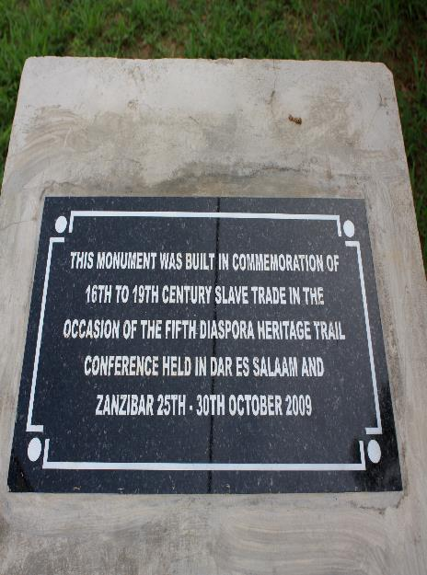
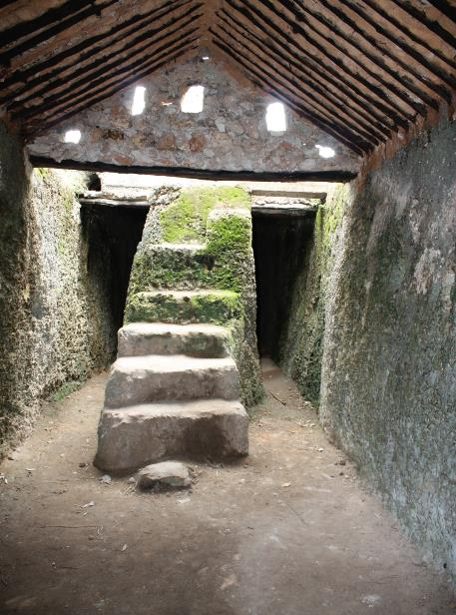

Slide 12
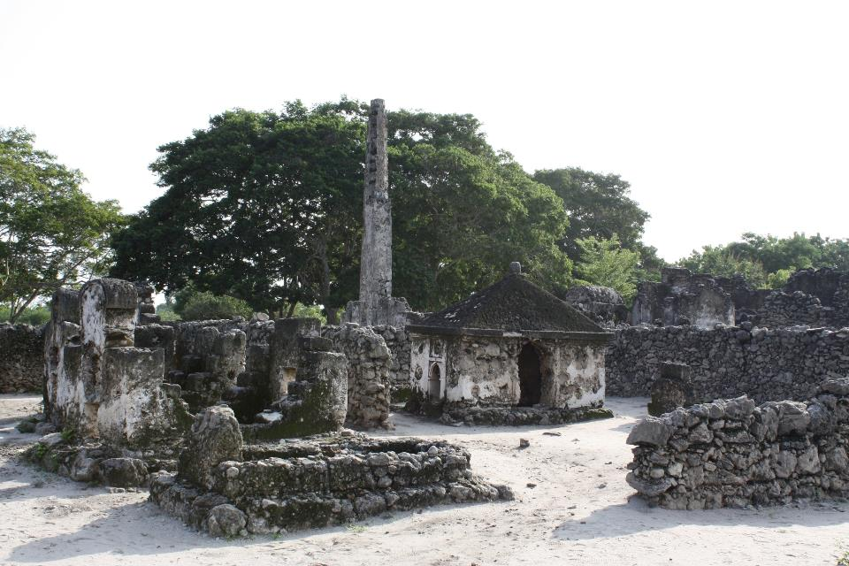

Slide 13
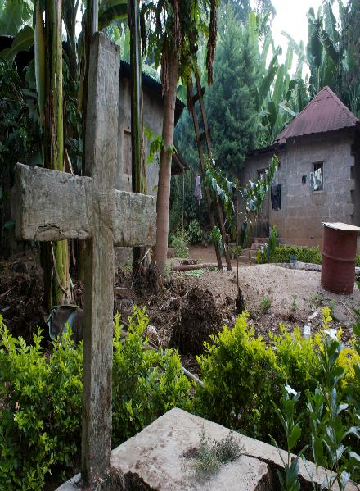
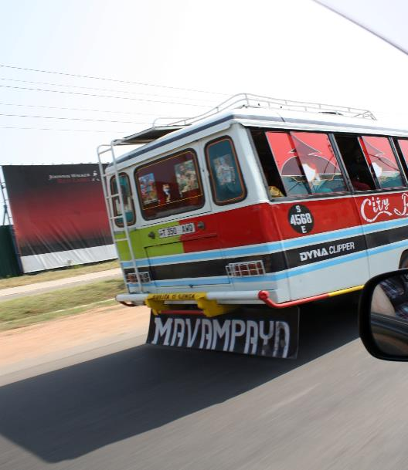

Slide 14
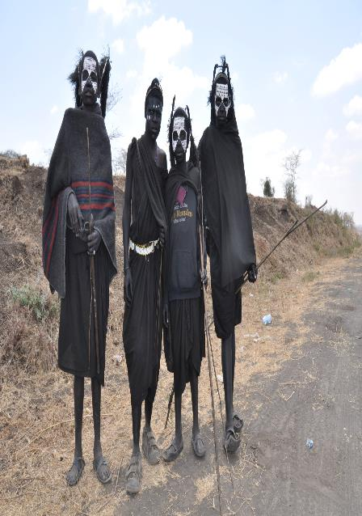
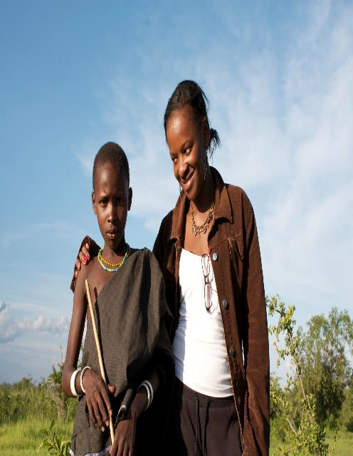

Slide 15
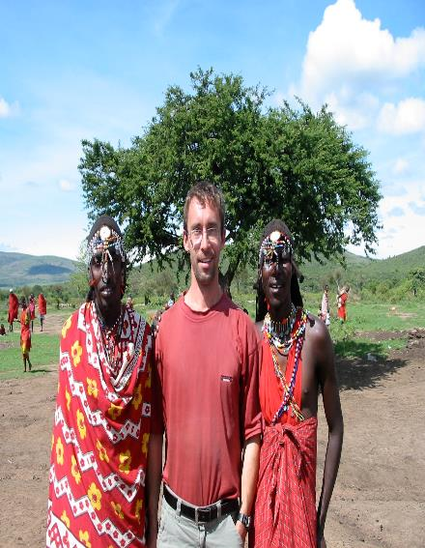
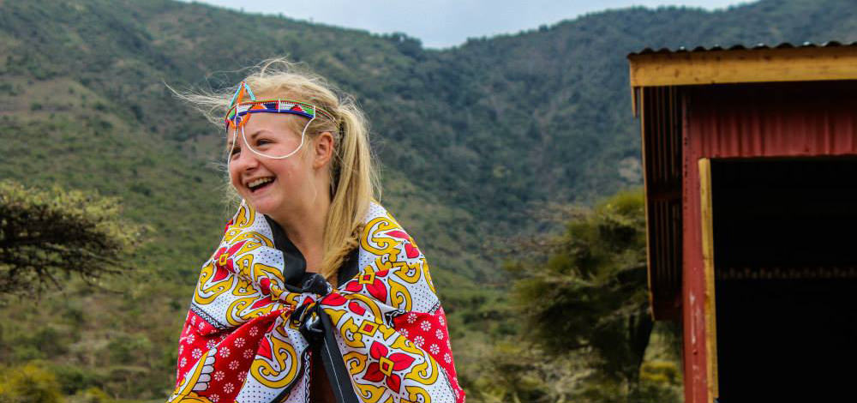
New Picture Effects
Picture Color, Corrections, Artistic Filters,
and Background Removal allow you to customize images for your story

Slide 16
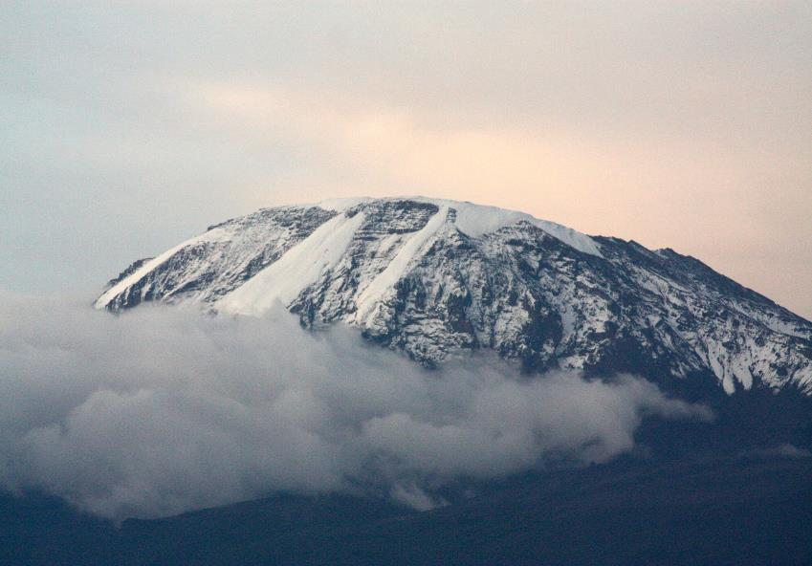

Slide 17
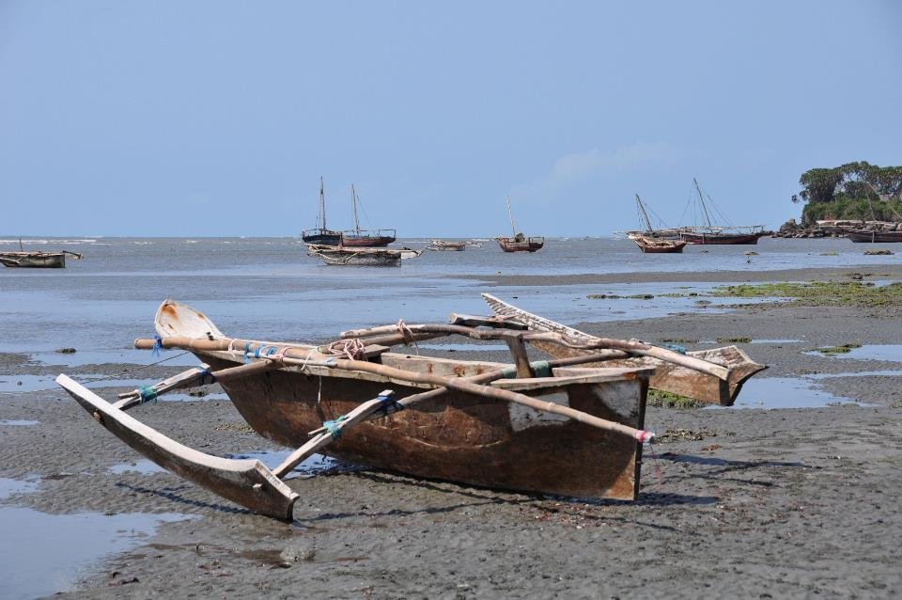

Slide 18
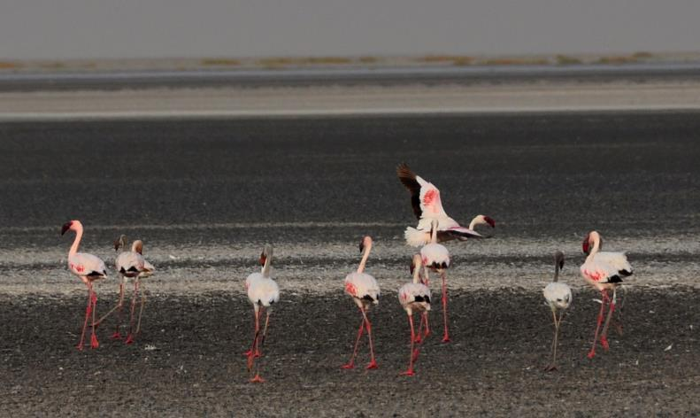

Slide 20
SWAHILI WORDS YOU MAY SAFARI HAKUNA MATATA SIMBA UBONGO

Slide 21
WORDS WHICH SOUND SIMILAR. CHAI SUKARI KAHAWA

Slide 22
Asanteni sana
Nakaribisha maswali.

