Slide 1
English for University Studies: English in Academic Context and Skills Wei-lun Lu Language Center Masaryk University

Slide 2
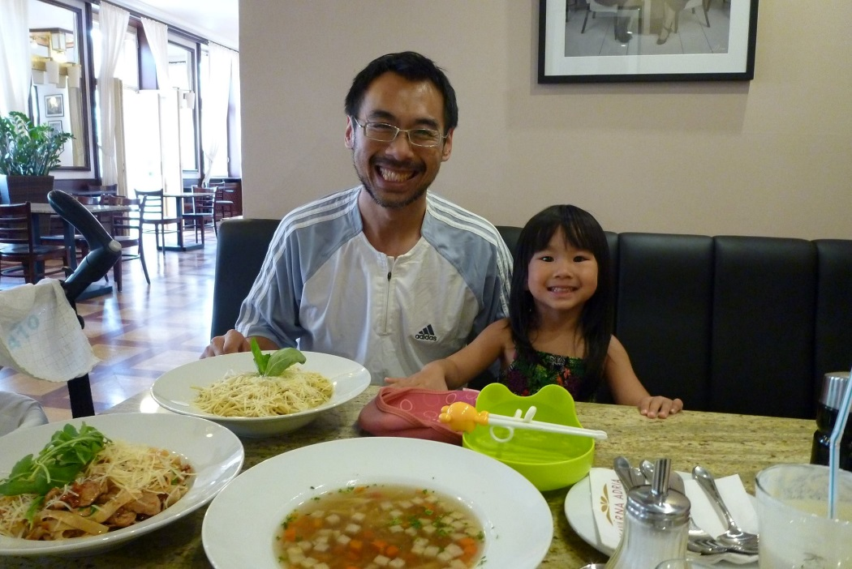
Background of the lecturer
Name: Wei-lun Lu, Ph.D.
Teaching experience: in Taiwan (10 years), in Czechia (5 years).
Professional interests: language, culture and thought.
Personal interests: travel, religion.
Married, 2 kids.
Contact: weilunlu@gmail.com

Slide 3
Your turn (5)
Work in pairs and go over the following questions:
List of questions to go over:
What is your name?
Where are you from?
What language do you speak as your first language?
What is your cultural background?
What brought you to this course?

Slide 4
Question: Why do you need English?
What does it mean “to study in a university” and what is English good for?
Operate in an international environment
People from different cultures
English as the lingua franca/working language
Read texts in English
Introduce your idea in English.
Disagree and let others know.

Slide 5
Pushing it further… (10)
Does the first language you speak give you any problem in learning English?
Does the (learning) culture you are used to give you any problem in communicating internationally?
How do you think I can help you overcome the difficulties?

Slide 6
Course objectives
To improve language skills for university studies
Integrated in nature, developing basic academic skills:
Listening, speaking, reading, writing.

Slide 7
Suggested readings and resources
Books to follow:
Vocabulary: Word Power
EAP Now: English for Academic Purposes
Online resources:
TED talks
CNN student news

Slide 8
Occasions to use English in academic context (15)
On what occasions do you use English in the university?
Lectures
Seminars
Tutorials
Presentations
Interviews
Informal academic discussions
Socializing (with peers)

Slide 9
Dimensions of communication
Formality
Interactivity
Persuasiveness
Informative
Personal/impersonal
Now based on the above criteria, define the nature of the samples of the academic language. Discuss how each sample is different.

Slide 10
Define the occasions
There are samples of English on formal academic occasions. Assess them based on the foregoing criteria:
Sample 1 (1:20- 2:19)
https://www.youtube.com/watch?v=F0USIqEP-MA
Sample 2 (- 2:00)
https://www.youtube.com/watch?v=-8Zo-NiQFtU

Slide 11
Important skill for advanced learning: Shadowing
Listen to the text once—choose a topic that fits your interest/need.
Listen to the text a few more times to try to figure out the rough message through multiple hearings.
Listen to the text while reading the transcript and look up any words you are not confident about.
Listen to the text and repeat with a minimum delay—rinse and repeat until you can read it confidently at the same speed as the recording, then do it a couple of more times.
Now listen to each of the clips again to practice.

Slide 12
Sample 3-4
There are samples of English used in academic seminars. Assess them also based on the foregoing criteria.
Sample 3: Seminar (on poetry) (- 1:55, *2)
https://www.youtube.com/watch?v=omveFR-2hmg
Sample 4: Line game (0:27- 6:18, *1)
https://www.youtube.com/watch?v=eYYf-mUmPqI

Slide 13
Sample 5
You will see a panel discussion in English (Sample 6) and the introduction that precedes it (Sample 5). Assess the language usage based on the foregoing criteria.
Sample 5: Introduction to a panel: (use Chrome; - 5:02)
https://www.youtube.com/watch?v=I8uUjtiaXqE
Listen again. What is the announcement mainly about?

Slide 14
Sample 6-9
The clip presents a panel discussion on learning a new language (16:00-26:30). Analyze the language usage on the foregoing criteria. https://www.youtube.com/watch?v=I8uUjtiaXqE
In the meantime, summarize each speaker’s message:
Maxine:
Lily:
Lera:
John:

Slide 15
Have your own say
How does that correspond to your own experience? Pick up on some points in the clip and prepare a one-minute speech to share with the class.

Slide 16
Summary for Sessions 1-2
Your learning English is all about:
Your language background
Your need (what university English looks like):
Types of occasions where English is used:
Ceremonies
Seminars
Panel discussions
Skill of shadowing as an integrated way of learning
Session 3: Vocabulary

Slide 17
Shadowing Practice 1
Now listen to Sample 1 again. Summarize the message. In the meantime, jot down the words and expressions you are not confident about.
Do the same for Sample 2-5.

Slide 18
More materials for learning new languagues
Lonsdale on mastering a language in six months:
https://www.youtube.com/watch?v=d0yGdNEWdn0
Efromovich on techniques to learn languages
https://www.youtube.com/watch?v=-WLHr1_EVtQ

Slide 19
What is the difference between language in the academic context and outside of it?
Academic language
is more precise, used as a tool to explain our ideas, report the results of research to other people.
It is used to:
explain, describe, define, justify, give examples, sequence, evaluate, be time-specific, signal cause and effect, hypothesize, generalize, compare and contrast, and adopt specialized vocabulary.
Non-academic language is more often used:
to express feelings or concepts and ideas on an everyday basis (greeting others, sharing experiences and personal views, meeting others…).

Slide 20
Read the two paragraphs in your handouts (task 3, page 2). In pairs, discuss the difference in style.
non-academic language uses:
contractions (e.g. can’t, won’t, isn’t)
short forms of words (e.g. cos for because, w8 for wait)
slang (e.g. dude, cash, cool)
imprecise words (e.g. some, a lot, thing)
personal pronouns (e.g. I, my, we)
cliches (e.g. a coin has two sides)

Slide 21
Academic language is:
informed and informative; i.e. has a clear purpose, structure and audience
critical and objective
analytical
rational (not emotional or opinion based)
complex (in terms of grammar and vocabulary)
responsible
hedged (use of cautious language)
non-repetitive
persuasive
formal (neutral in style, precise and accurate)

Slide 22
Ways of achieving formality
right choice of words (colloquial, idiomatic, phrasal verbs)
nominalisation (frequent use of nouns)
avoiding negative forms of verbs if possible
avoiding repetition
scarce use of personal pronouns (I, you, we)
hedging (modifiers, modal verbs, absence of general statements)
cohesion
correct grammar

Slide 23
Formality - word level
formal words are often longer than their informal equivalents. They are single words, not multi-words and they are often of Latin or French origin, unlike the informal ones, which are more often of Anglo-Saxon origin. In formal language, multi-verb words are substituted with a one-word synonym.
Verbs such as get/have/mean/make/do/give/put tend to be substituted with expressions with more precise meaning
Similarly, common adjectives such as big/small /good /bad and adverbs such as sometimes/always/a bit are substituted with expressions with more precise meaning.

Slide 24
examples
Vague meaning | More precise meaning
answer | solution
a way | approach, method, technique
to mean | indicate, imply suggest
to get | obtain, achieve, gain, acquire, attain
to do | conduct, perform, operate, function
big | substantial, considerable, significant
bad | inappropriate, unsuitable, inconvenient
a lot | dramatically, significantly, considerably
fast | rapidly

Slide 25
Analyzing texts to decide level of formality
Read the extracts below and use them as samples of two different styles in terms of formality. Which extract is more academic? How does it differ from the less formal form of language?

Slide 26
Text A
Some writers (but their names aren’t very important) reckon lecturers should tell students what things they want them to do during a course, things like assessment and grading. Lots of students I’ve talked to reckon they don’t know what their lecturers want. Also cos they aren’t native English speakers they need more help than other students. A couple of students have gotten their mates from overseas to check all their essays and other stuff to make sure they were ok. And another guy gets his wife to check everything he writes to check it’s on the right topic and hasn’t got any mistakes.

Slide 27
Text B
Several writers (Samuelowicz 1987; Drury & Webb 1990; Silva 1992) have drawn attention to the need for lecturers to make explicit their expectations for the whole course, including assessment items and grading procedures. A considerable number of participants in the present study reported that they were uncertain of what lecturers expected of them as graduate students. They also perceived that they, as non-native English speakers, needed very explicit directions and much more guidance than English-speaking students. Two participants said that they had to ask international students to proof-read their assignments, overheads and handouts for seminars to ensure they were appropriate. One person reported that his wife proof-read and edited all of his assignments to ensure they were relevant to the topic and error free.

Slide 28
Production practice: Levels of formality
Work in pairs. Pick a topic and give a one-minute talk on the topic chosen. Imagine that your audience is a group of friends.
My trip/live to Brno.
My English learning experience.
The education in my own country.
Now do the same, but imagine your audience is a group of professors.

Slide 29
Raise the level of formality of each of the following sentences by bearing in mind the points discussed previously
1. If you fail the test, you won’t be employed by the company.
2. Ok, what are the causes of low employee morale? Many possibilities exist.
3. You can clearly see the differences between these two processes.
4. A small bit of oxygen is added to the solution gradually.
5. These special tax laws have been approved in some counties in the U.K.: Cumbria, Dorset, Devon, West Midlands, East Anglia, etc.
6. The subjects didn’t have much difficulty with the task.

Slide 30
Sample answers:
1. Should you fail the test, you will not be employed by the company.
2. Let us consider the causes of low employee morale. A significant number can be mentioned.
3. The differences between these two processes is evident.
4. A small amount of oxygen is gradually added to the solution.
5. These special tax laws have been approved in some counties in the U.K. such as Cumbria, Dorset, Devon, West Midlands or East Anglia.
6. The subjects found the task easy to perform.

Slide 31
Task: Rewrite the email (like speaking to a professor).
Hi Jim,
sorry I can’t make it for the match tomorrow. You know, I tore the ligament in my left ankle when I was cycling and the doctor said I should take it easy and not do much for a couple of days, so what can I do. Hey, do you think Mike replace me? Let me know if it’s ok with you and I’ll ask him.
See you,
David

Slide 32
Sample letter
Dear professor Smith,
I am writing to apologize for my absence from the university match tomorrow. Unfortunately, I tore the ligament in my ankle during the PE lesson and I will be unable to participate in the match since the doctor advised me to rest for several days.
I hope I am not complicating the situation too much and I would like to thank you for understanding.
Sincerely,
David Graham

Slide 33
Homework
Write a paragraph which explains your decision to register for the course.
Imagine it is part of your academic assignment, so the language that you use should be formal.

Slide 34
Converter link
https://www.clipconverter.cc/

