Slide 1
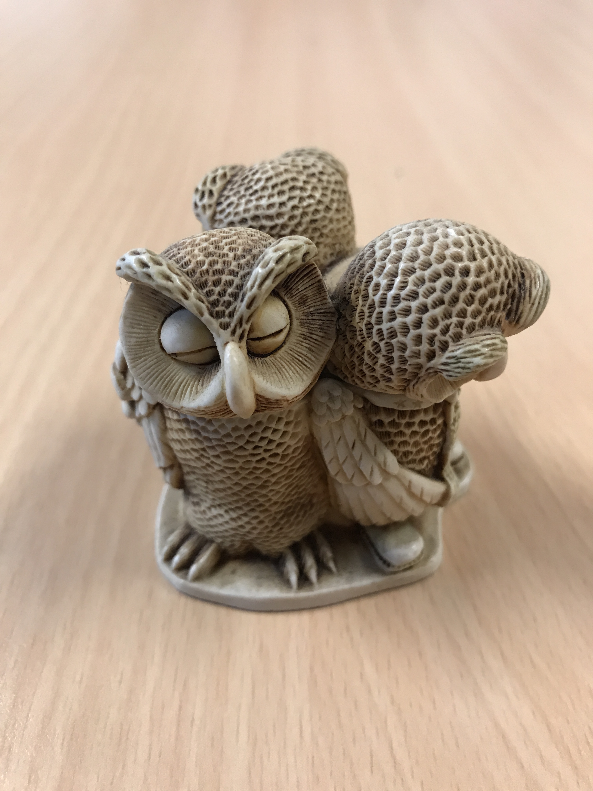
English Language Focus Summer School Masaryk July 2018
Writing Skills:
An interactive Writers’ Workshop

Slide 2
Preliminary Activity
Writing Skills
Please write down 3 sentences about yourself!

Slide 3
In This workshop
Writing Skills
What is Academic Writing in English?
Some useful resources
Formal speaking skills v Formal writing skills
Accuracy or communication?
Sentence construction: a critical aspect
Putting your own skills into practice
Conclusions

Slide 4
What is Academic writing in English (1)
Writing Skills
What do you want from your students when they are writing texts in Czech? Brief discussion in pairs / 3s. Write 5 requirements
and in English?

Slide 5
Activity 1
Writing Skills
The Minister’s
Press Conference

Slide 6
Activity 2
Writing Skills
A time for sharing!

Slide 7
A brief look at sentence construction

Slide 8
There are three basic types of sentences:
1. Simple sentences = one independent clause:
“The economic crisis ended in civil war after a few years.”
2. Compound sentences = two or more independent clauses:
“The population revolted against the government, and the economic crisis ended in civil war.”

Slide 9
There are three basic types of sentences:
3. Complex sentences = one independent clause combined with one or more dependent clauses:
“The economic crisis ended in civil war when the population had finally revolted against the government.”
Sometimes the pronoun is left out:
“The economic crisis caused a lot of unrest, resulting in civil war.”

Slide 10
You can vary sentence openings and endings of longer sentences by …
Starting with the independent clause:
“We added a paragraph to our mission statement because we wanted employees to become more aware of ethical issues.”
Starting with a dependent clause:
“As we wanted employees to become more aware of ethical issues, we added a paragraph to our mission statement.”

Slide 11
You can do a similar things with phrases.

Slide 12
Being concise (1)
How do these two sentences differ?
“The majority of studies which were conducted before this research project did not find negative aspects related to the use of indirect outsourcing.”
“Most previous studies did not find disadvantages of indirect outsourcing.”

Slide 13
Being concise (2)
Descriptive (or verbose) constructions can usually be made more effective when you turn clauses into phrases.
For example,
“studies which were conducted before this research project”
can be replaced by
“previous studies”.

Slide 14
Another way to make a text more concise is to reconstruct phrases.

Slide 15
Sometimes a clause or a phrase can be replaced by a pronoun.
Subject-verb, Phrase: | Subject-verb, Phrase:
The term community networking was coined in the 1980s. Since then, the term has been defined in many different ways. | The term community networking, which was coined in the 1980s, has been defined in many different ways.
Although social networking is possible in person, this process usually takes place online. | Although social networking is possible in person, it usually takes place online.

Slide 16
Activity 3
Writing Skills
The Minister’s Speech Feedback
Look at your article. Make any changes (accuracy, sentences, range) you think are necessary
Peer review
Feedback

Slide 17
Activity 6
Writing Skills
Your sentences: revisited!!

Slide 18
Some useful resources
Writing Skills
Academic Word List (AWL)
http://www.victoria.ac.nz/lals/resources/academicwordlist/
Academic Phrasebank
http://www.phrasebank.manchester.ac.uk/
Purdue Online Writing Lab
https://owl.english.purdue.edu/owl/
Transition words and phrases

Slide 19
What is Academic writing in English (2)
Writing Skills
Principle aspects of English language use
formal language
a wide and appropriate academic vocabulary
correctly structured text (sentence & paragraph level)
use of correct punctuation
avoidance of wordiness (circulocution / clarity)
correct grammar forms
linking ideas (coherence / topic sentences & thesis statement)
Our focus in these workshops is the use of appropriate vocabulary (range)

Slide 20
Formal Speaking v Formal Writing
Writing Skills
Spoken text
Nowadays companies are finding that they have to change the way they do things and they’re finding that human resources planning is really helpful when they have to do this. One reason why it’s helpful is because it can help the companies work out what the issues are and then, when you’ve done that, it can help you make up your mind what you’re going to do about it. Basically, human resource planning is what you do when you’re going through ….
Written text
As companies experience the need for change, they often apply human resource planning to define the relevant issues and develop responses to them. Broadly defined, human resource planning is the process of analysing an organisation’s human resources needs under changing conditions and developing the activities necessary to satisfy those needs.

Slide 21
Accuracy or Communication
Writing Skills
Both!
Who is the audience?
Professor
Seminar group
Journal readers
Family and friends
Wider public
Don’t underestimate punctuation and grammar to enhance meaning.
EATS SHOOTS AND LEAVES

Slide 22
Evaluation
Writing Skills
What can you take from these sessions?

