Slide 1
Introduction to Writing and Speaking Skills in A Business Context

Slide 2
What to Expect from This Course
To Understand Communication in the 21st century
An Introduction to Writing and Speaking
How to Approach the World of Business Writing
To Understand Public Speaking
To Understand What Makes a Successful Presentation

Slide 3
Communication in the 21st Century
Communication in the 21st century—personal or professional—involves less conversation and more electronic sharing of information.
Written communication, therefore, is often the norm.
Sadly, many good business people are very poor writers.
Poor writing in any context leaves a lasting impression, which can be prove detrimental in today’s workplace of enduring email, texts, digital documents and social media.

Slide 4
How to Approach the World of Business Writing
The six tactics below will make you a better writer.
Be clear. Many think that using fancy words and excessive language makes them appear more persuasive, authoritative or intelligent . Effective writing consists of words that are clear and accessible to the audience.
Be concise. Make your points quickly. People in business today are too busy to wade through paragraphs to reach the important points. In fact, after the opening paragraph it is more effective to use bullet points rather than paragraphs.
Be direct. Writing instructors routinely teach that the purpose of the communication be addressed as early in the first paragraph as possible. In email this is even more important.
Have someone else proof important written communication. Spelling errors are unacceptable because they make writers look uneducated and sloppy.
Font size and style. Often corporations will have approved fonts. If not, use a non-serif font such as Arial or Verdana. They are easy on the eye. And, please, DO NOT USE ALL CAPITAL LETTERS IN CORRESPONDENCE.
Maintain business etiquette and tact. Be considerate of both co-workers’ time and points of view. Separate emotion from intellect, and do not be condescending. If you are a manager, set an example and never allow anger to overrule reason.

Slide 5
Effective writing in the workplace is an essential skill
The rules are basically the same for any type of writing, however there are some special issues which arise in the business context.
Know Your Audience: Before you sit down to compose your letter, memo or report, think about the recipient of your document. What are you trying to say to this person?
Be brief : Avoid wordiness and unnecessary large words. Strive for clarity in your writing e.g.
Wordy - The hurricane had the effect of a destructive force on the manufacturing plant.
Precise - The hurricane destroyed the manufacturing plant.
Punctuation and Grammatical Errors: Nothing can kill your credibility in a business setting faster than to have grammatical and/or punctuation errors, especially in a formal report.
Effective Use of Passive Voice: Sometimes the passive voice can be a useful tool for avoiding placing blame or for intentionally making a sentence vague e.g. instead of the memo saying: "Because J. Smith forgot to include the correct budget projections with the bid, we lost the client," try "The correct budget was inadvertently left out of the client packet, which led to the loss of the client."

Slide 6
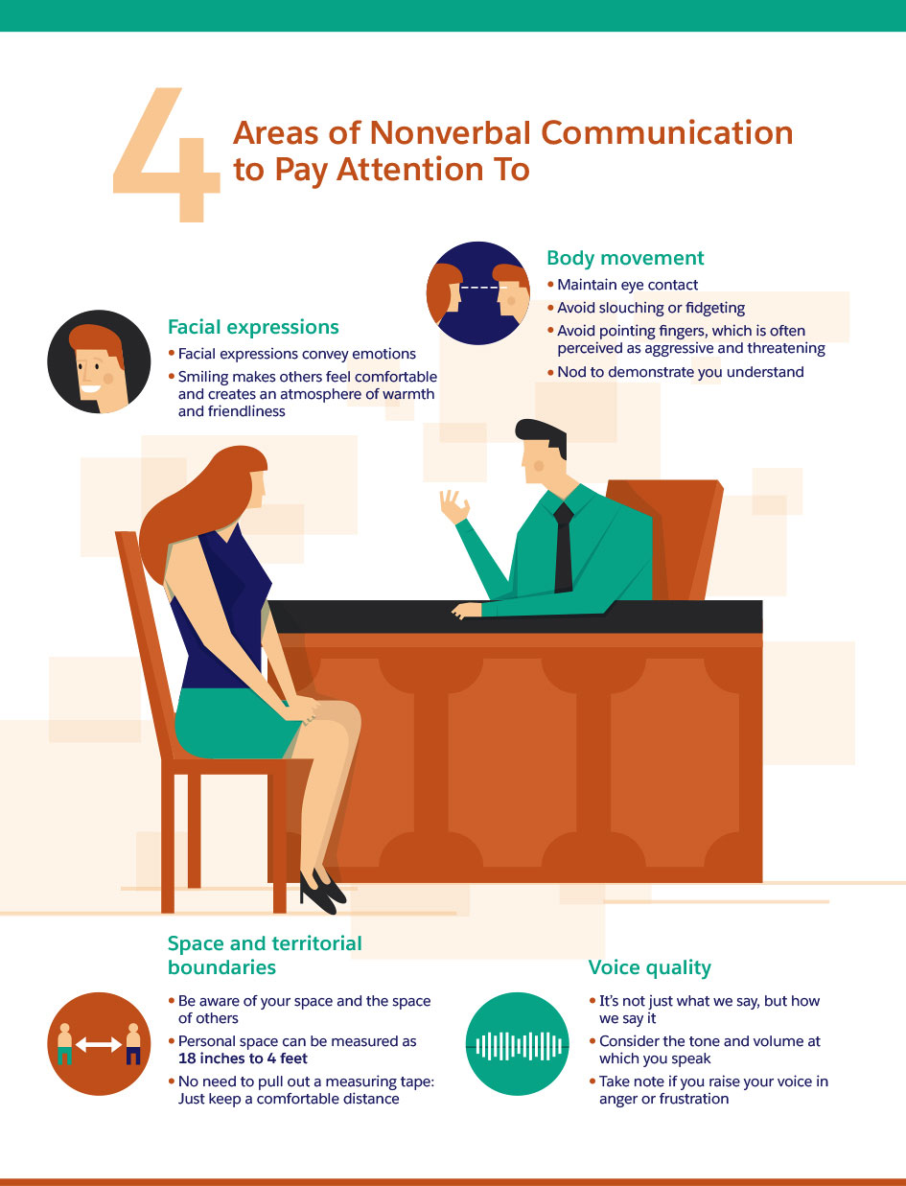
Nonverbal Communication Crucial in Business

Slide 7
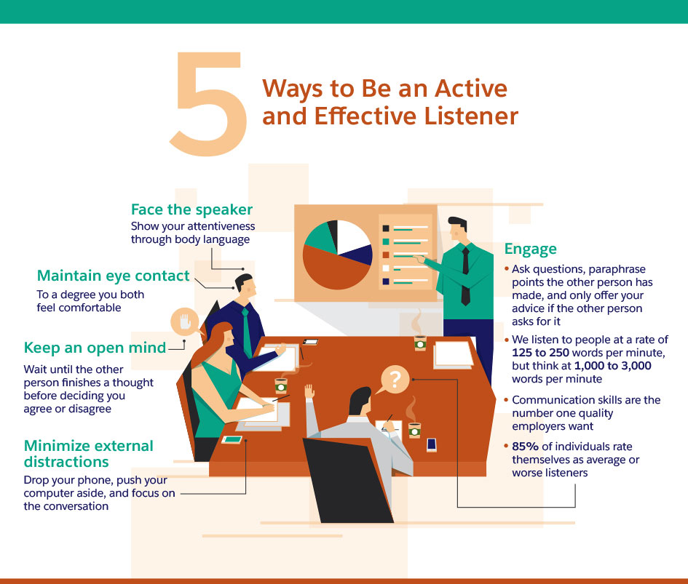
In Business It Pays To Listen

Slide 8
What Is Public Speaking?
Public speaking occurs when you give a speech before a live audience. It differs from other types of speaking, such as videos, which may be recorded.
Public speaking has many advantages, including improving your confidence level and giving you the opportunity to champion a cause you care about.
Public speaking skills can help you find a job. Many jobs, such as an instructor or sales professional, require you to speak in public.
In one survey of 600 employers participants indicated that they felt good communication skills were twice as important as managerial skills.
You may be asking "what makes a good public speaker?" The answer might seem easy: A good public speaker makes use of effective public speaking techniques.

Slide 9
Effective Public Speaking Techniques
Care About Your Topic: Passion goes a long way.
Remember Your Speaking Goal: When developing your speech, identify the reason why you're speaking. Make it a point to stick to this goal.
Support Your Main Points: Every point you make in your speech needs to be supported with either an example, an illustration, or facts.
Tell a Story: This could be
A customer story. The story of how your product or services helped a specific customer.
Your company story. The story of how your company came to be.
A product development story. The story of how you came to offer a new product (or service)
Practice Your Speech: Lack of practise will reduce your chance of success

Slide 10
Effective Public Speaking Techniques C’tnd
Relax!: It's normal to be nervous about public speaking.
Don't Worry About Mistakes: They happen.
Pace Yourself: This is where practising your speech helps immensely.
Add Visual Aids: Humans use their sight more than any other sense.
Dress Comfortably, But Professionally: The general principle is that you want to dress professionally and be well groomed.
Avoid Awkward Fillers: Nothing worse that to listen to "Um," "uh," "like.
Use Gestures (But Don't Overdo): Natural movement during a speech is a sign of an effective public speaker

Slide 11
Presentations As Part of Public Speaking
Here we will look at mistakes to be avoided:
Not Scripting Your Presentation: Presentations don’t “just happened”.
Reading; Not Speaking: When reading your head goes down and you disengage with the audience.
Not Practicing Enough: Repeat from previous slides.
Boring, Unprofessional Design: It takes only a few milliseconds to lose an audience attention. Once loss you will never recover it.
Cluttered, Text-Heavy Slides: It is sometimes difficult to find the balance.

