Slide 1
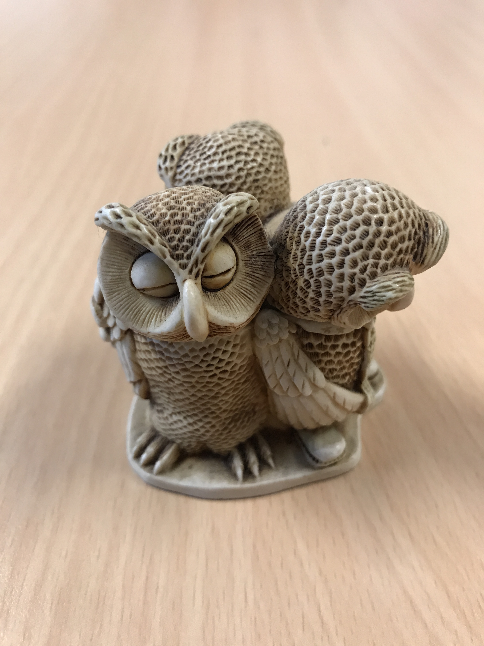
SWEUS Masaryk July 2018
Navigating Through Lectures & Seminars

Slide 2
In this workshop
Navigating Through Lectures & Seminars
Brainstorm
Signposting language
Activity 1: Lecture styles
Handling a Lecture
Seminar Skills
Activity 2: a seminar discussion
Conclusion and evaluation

Slide 3
Brainstorm
Navigating Through Lectures & Seminars
Brief discussion:
Remember some of the lectures or presentations that you have recently attended. What made it easy / difficult to understand the content? How can the speaker help the audience understand the main message of the talk?

Slide 4
Signalling Language
Navigating Through Lectures & Seminars
A focus for attention
Helps to focus on the structure of a lecture
Keeps you alert

Slide 5
Activity 1
Navigating Through Lectures & Seminars
A good or a bad lecture?
https://www.youtube.com/watch?v=7DY1e0Grwtw
What makes this a bad lecture?
https://www.youtube.com/watch?v=YdtLELVhEQg
What makes this a good lecture?

Slide 6
Handling a lecture?
Navigating Through Lectures & Seminars
KEY WORDS (prepare beforehand)
Signalling language
Recording (notes)
Background reading

Slide 7
Note-taking
Navigating Through Lectures & Seminars
https://www.youtube.com/watch?v=UAhRf3U50lM
DISCUSSION:
What works for you?
Notes in first or second language?

Slide 8
Seminar Skills (1)
Navigating Through Lectures & Seminars
How to prepare for a seminar
Give yourself enough time
Read around the subject
Formulate some questions (and the answers you expect)
What could you contribute to the discussion?
Rehearse a possible contribution

Slide 9
Seminar Skills (2)
Navigating Through Lectures & Seminars
During the Seminar
JOIN IN
Listen to others and adapt your opinions – take notes
Don’t interrupt
Use signposting language to give your contribution structure
Don’t talk too much (be concise)

Slide 10
Seminar Skills (3)
Navigating Through Lectures & Seminars
Think about how you are speaking
Look up when you are speaking and focus on who you are talking to – EYE CONTACT
Speak clearly with pauses
Think about the volume of your voice
Think about the tone (don’t be too emotion-led)
Think about the speed
Try and use academic language with accuracy

Slide 11
Activity 2
Navigating Through Lectures & Seminars
A seminar discussion
10 minutes to think of a contribution
10 minutes in small groups
PLENARY DISCUSSION

Slide 12
Topic for discussion
Navigating Through Lectures & Seminars
English should be promoted as the most important global language.

Slide 13
Some final thoughts
Navigating Through Lectures & Seminars
The best initial preparation for a seminar is good lecture attendance.
This means more than just sitting in the lecture theatre...it means active involvement in, and processing of, the lecture
It’s a good idea to briefly but systematically review your lecture notes before the seminar.
You should deliberately think of issues you want to ‘take forward’ from the lecture for clarification during the seminar

Slide 14
Evaluation
Navigating Through Lectures & Seminars
What can you take away from this workshop?

