Slide 1
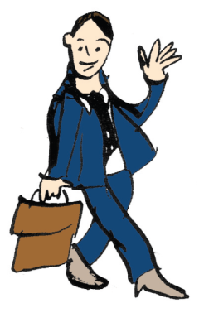
Týden CJV Pátek
Barbora Chovancová

Slide 2
UNIWERSYTET WROCŁAWSKI
Studium Praktycznej Nauki Języków Obcych

Slide 4
Impact Brno – ESP Konference Wroclaw
Ewa Jankowska
Izabela Bojarska
Teaching Foreign Languages and Addressing the Specific Needs of Higher Education Students: New Trends, Challenges, Recommendations

Slide 5
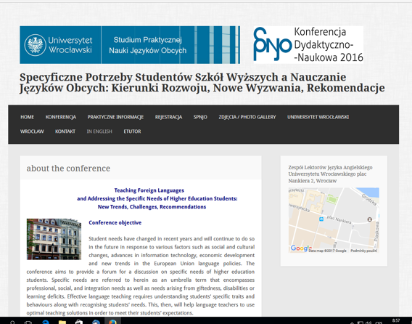

Slide 6
Kredka and Ołówek

Slide 8
Share and Gain 2016

Slide 9
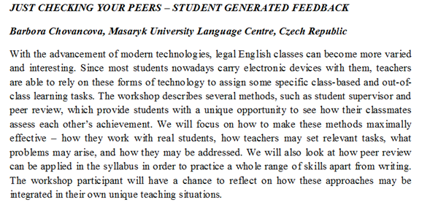

Slide 10
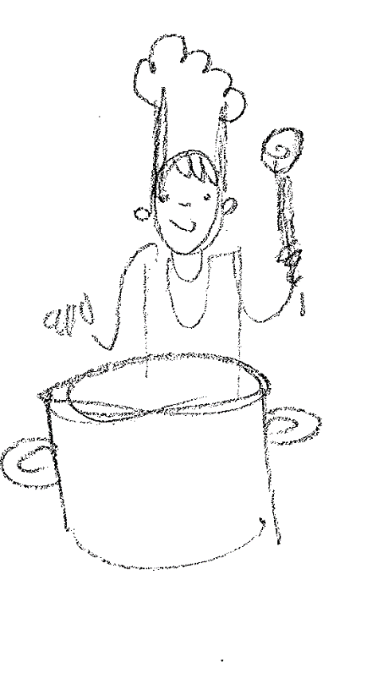
I feel a recipe is only a theme, which an intelligent cook can play each time with a variation. Madam Benoit

Slide 11
Having a go at peer review
Write down one paragraph on the following topic:
Food for thought: why students should feed their brains?
https://www.google.cz/search?q=food+quotes+proverbs+sayings&biw=1280&bih=665&source=lnms&tbm=isch&sa=X&ved=0ahUKEwi-1N6iwfbOAhXKvRoKHbbwDFYQ_AUIBigB#tbm=isch&q=feed+your+brain&imgrc=GYm0k9MsM8BM9M%3A

Slide 12
Give feedback on a text written by your colleague

Slide 13
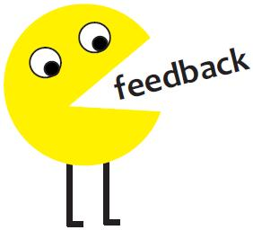
What should be evaluated – and how – and why?

Slide 14
https://www.youtube.com/watch?v=0FqkkW2t1SY

Slide 15
Students need to learn to give feedback
“...no one is born a great cook, one learns by doing.”
Julia Child, My Life in France

Slide 17
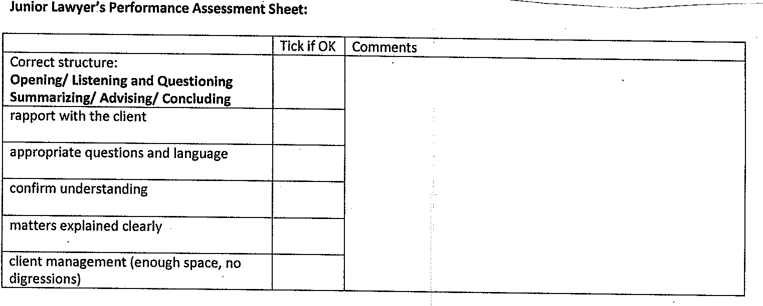
When you finish, the supervisor gives the lawyer feedback.
Be diplomatic and friendly!
Feedback is not only listing mistakes.

Slide 18
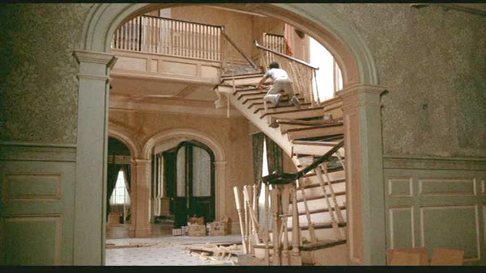
WRITTEN PEER REVIEW
Case Study – Stairs collapse
The name of your client is Bert Simpson. You have already interviewed him. You promised that you will go through the case and you will write an e-mail to Bert with some advice.

Slide 19
Case analysis
Aim: to inform a client about the options he has in a legal case in written form (via a letter)

Slide 20
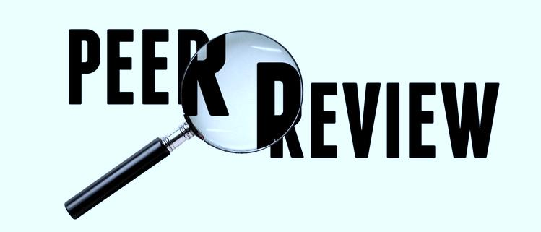
Homework
Choose a letter filed by another group and comment on it (50-70 words).
In your comments consider the following aspects
Content (as a client would you be satisfied with the advice?)
Structure (clear, logical, linking words, …)
Style (appropriate, formal, …)
Vocabulary (range, accuracy, collocations, …)
Grammar (range, accuracy – especially a word order)

Slide 21
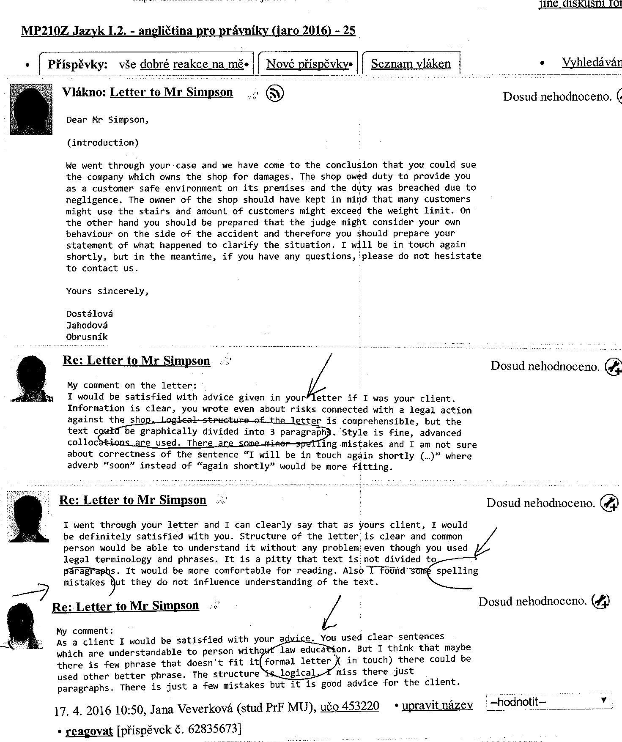
Student generated feedback
Positive stroking:
I would be satisfied with your advice if I was your client.
Information is clear, style is fine, advanced collocations are used.
Highlighting of problem areas:
It is a pity that text is not divided to paragraphs. It would be more comfortable for reading.
There are some minor spelling mistakes, but they do not influence understanding of the text.

Slide 22
Activity analysis?
Group work
Legal topic
Learning legal collocations by practice
Formal writing skills practice
Peer review (by giving the review, students learn how their work will be assessed)
Preparation for
the Seminar assignemt the exam real life

Slide 23
Google Disc – sharing work

Slide 24
Oregon State University: MAKING PEER REVIEW WORK
What's So Good Abour Peer Review?
When you read your peers' papers you can...
Understand the assignment better
See how other writers responded to the assignment
Pick up writing strategies from other writers
Get to know someone better through their writing
When another student reads your paper you can…
Bounce your ideas off another person before they go to the teacher for grading
Step outside yourself to see your own strengths and weaknesses as a writer
Write for an audience larger than just the teacher
Hear where you need to clarify or develop your ideas
http://wic.oregonstate.edu/making-peer-review-work

Slide 25
TIPS for Achieving a Successful Peer Review:
Respond in pencil—you may need to erase.
Ask the writer what he/she would like feedback on: a section they had trouble with, the introduction, conclusion, etc. Tell your reviewer the same.
Read the paper through once without a pencil in your hand, just to get the big picture. Then read it again.
Identify what was done well, what you liked about the paper, not just the problems. If you see a great sentence or idea, say so!
Ask yourself, “What two things would improve this paper most?” Then suggest them to the writer.
Remember that being too nice is not helpful, nor is being too harsh. You can be honest, but always be kind.

Slide 26
“Recipes don’t work unless you use your heart! “ – Dylan Jones
Relevant for your own teaching situation?
Are you going to cook up a storm?

Slide 27
Cookery is not chemistry. It is an art. It requires instinct and taste rather than exact measurements.”
Marcel Boulestin
Thank you for
your
Over to Hanka…

