Slide 1
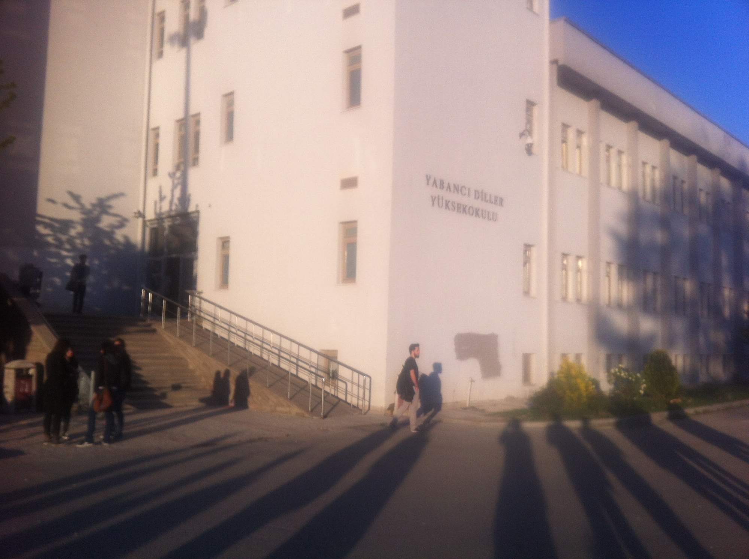
Hacettepe University, Ankara, Turkey: teacher mobility to long-standing partner institution
Notes:
Cooperating since 2009

Slide 2
School of Foreign Languages
cca 150 teachers
- teach and/or work as testers or curriculum officers
cca 2500 students in a 1 year intensive pre-study program (20 lessons/week for Int. level; 25 for pre-int.)
compulsory language preparation providing general English
some specialized elective ESL (e.g.soft-skills) in evening courses
elective prep languages offered (German, French, Russian, etc.)
Dept.of Modern Languages offers Japanese, Arabic,Spanish,etc.
aimed at passing a proficiency test (B2)
class size – about 30 students
student level: A2 (many), B1 (most), B2 (some)
study materials: text books (e.g. English File) and teacher’s own materials

Slide 3
Notes:
School of Foreign Languages

Slide 4
Notes:
Modern campus architecture

Slide 5
Notes:
Meeting area in front of staff offices – decorated with international project “Umbrellas”

Slide 7
Our teaching programs
Interactive Powerpoint presentation “Culture Comparison of Turkey and the Czech Republic”
Hofstede - Onion Model of Culture (symbols, personalities, characteristics, values)
Quiz on Czech Culture
Discussion
Promotion of student mobility programs (Erasmus)

Slide 8
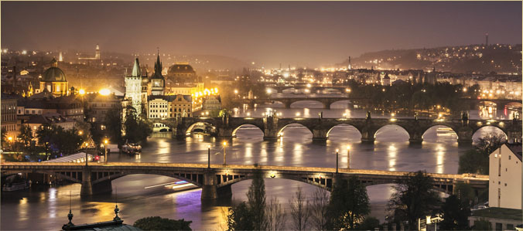
Outline of presentation
Hofstede’s Cultural Model
Symbols and images of the Czech Republic
Cultural figures & traditions

Slide 9
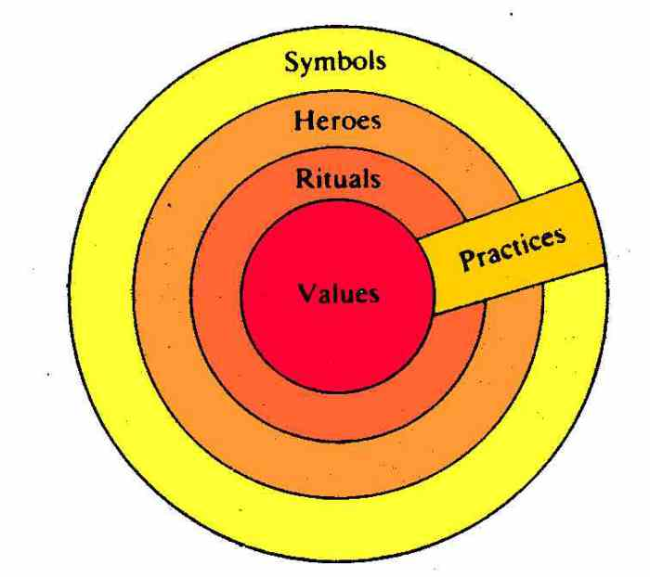
Hofstede’s Model: The Cultural Onion Geert Hofstede (1928), Dutch social psychologist, researches cross-cultural groups & organizations
SYMBOLS: tourist sites (Prague), products &
brands (Budweiser beer, Skoda automobiles)
HEROES: historical figures, scientists,
athletes, artists, even fictious characters,
role-models of society (Havel, Kafka)
RITUALS AND TRADITIONS: holidays (Christmas, Easter), popular activities (sports), body language (shaking hands), hygiene, etiquette, polite manners (“Enjoy your Meal”)
VALUES: influenced by history of culture (working hard, family, atheism, agnocticism, independence, freedom). Even if seemingly outdated, may subconsciously play a role in modern society
PRACTICES: work life, leisure time, holidays, festivals, laws

Slide 10
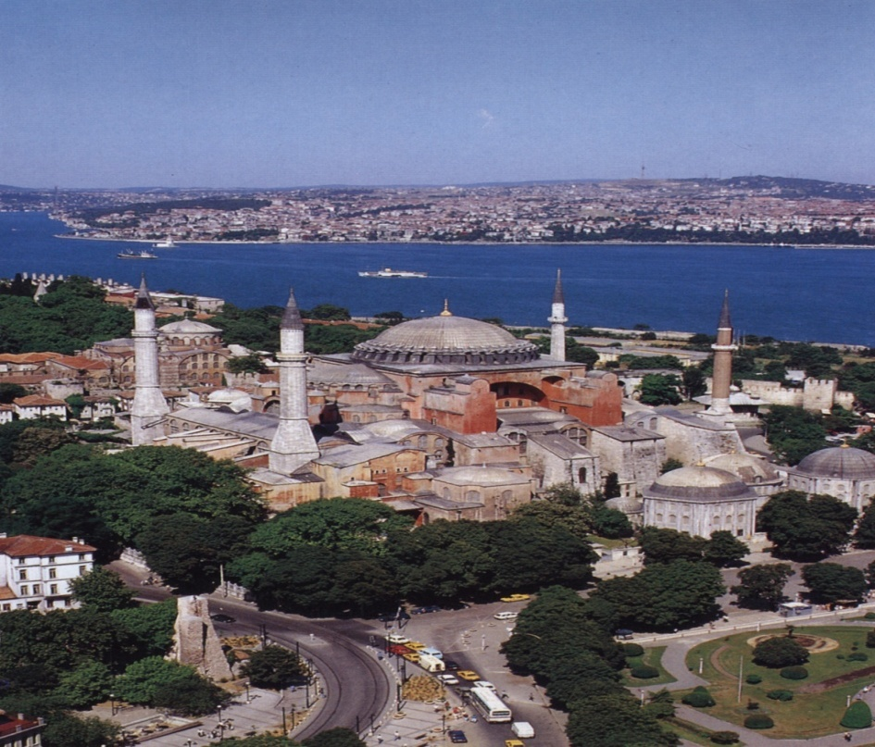
Symbols of Turkey chosen by Czech students
Ankara – capital; Istanbul – divide between Europe & Asia
President Ataturk & Orhan Pamuk
Islam & mosques
Tourist destination
Turkish baths & the sea
Turkish delight & kebab
Turkish coffee & waterpipes
Carpets & crafts
Notes:
Czech student survey

Slide 11
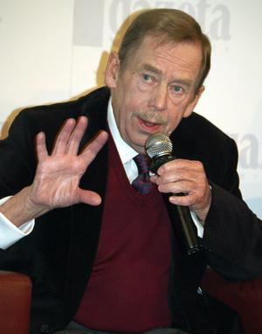
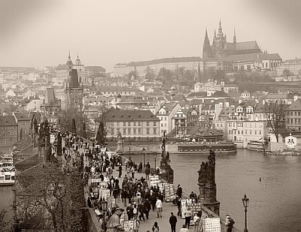
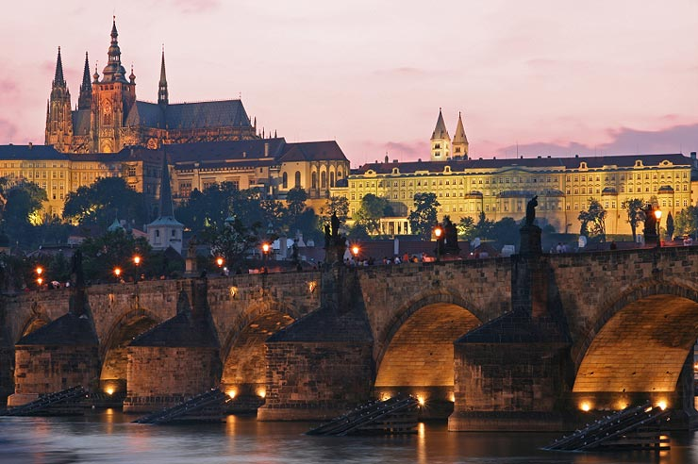
Czech symbols chosen by Turkish students
geography & architecture
history & personalities
events & celebrations
music & dance
amusement & sports
food & drink
http://www.youtube.com/watch?v=SomQT9P1UAg
11
Notes:
Student participation

Slide 12
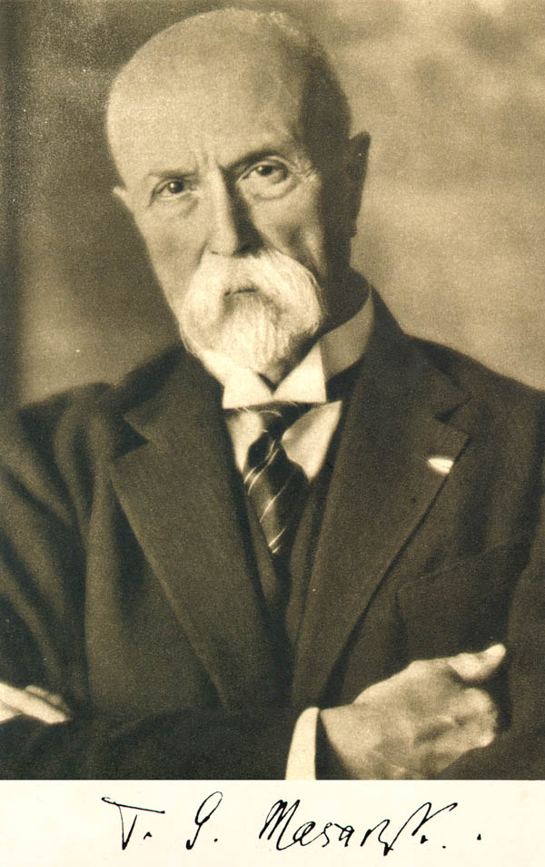
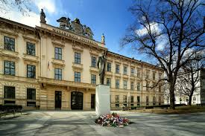
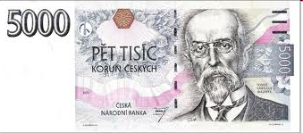
Tomáš Garrigue Masaryk (1850-1937)
1st Czechoslovak president (1918-1935)
philosopher, sociologist,
professor & writer
strong democratic, Christian &
humanist ideas
Masaryk University
12
Notes:
Masaryk compared to Ataturk, new republic after WW1, Ankara as 2nd city to Istanbul like Brno to Prague,

Slide 13
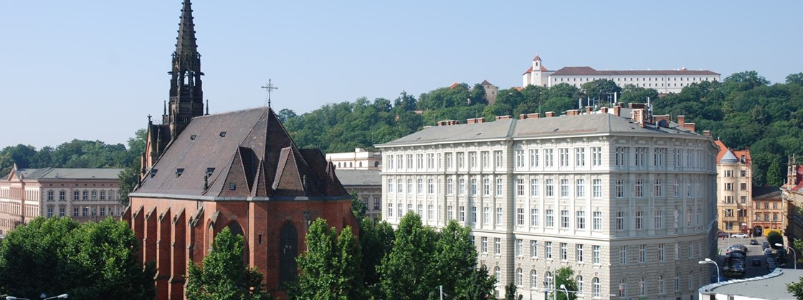
Masaryk University (1919)
2nd largest in CR
42,000 students
9 faculties - Arts, Social Studies, Medicine, Science, Economics, Law, Education, Sports, Informatics
13
Notes:
Compared to Hacettepe

Slide 14
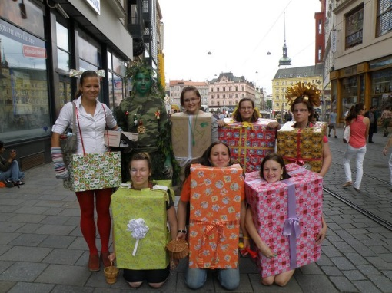
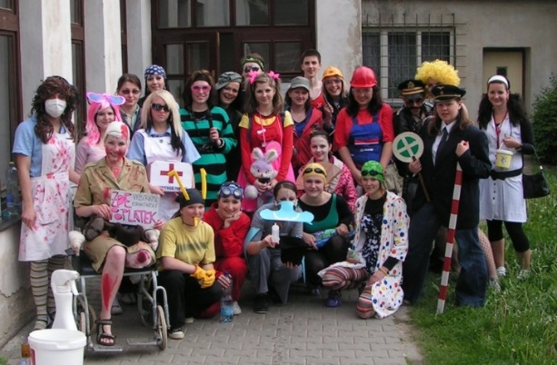
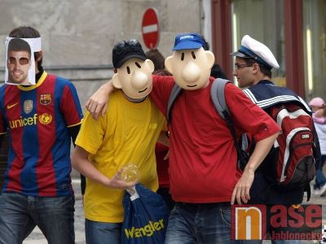
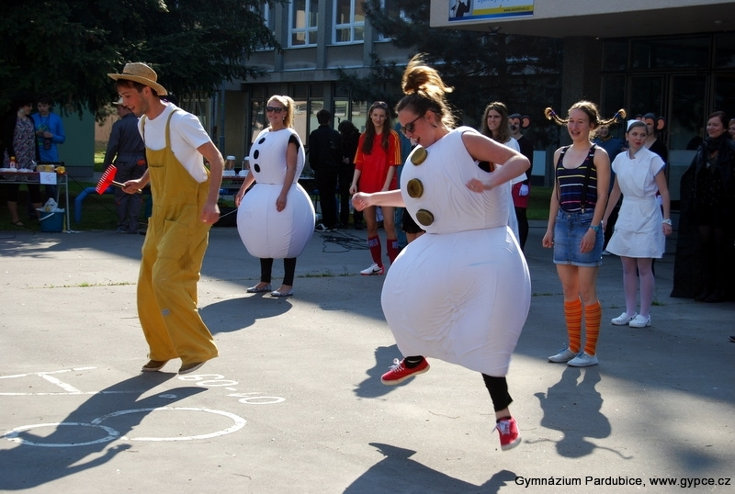
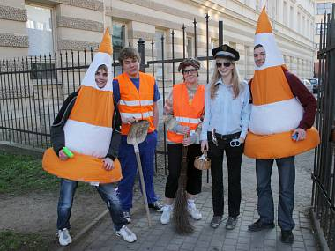
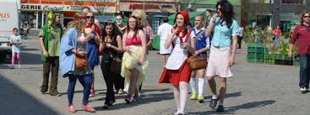
“Last School Bell”– graduating from secondary school
VIDEO

Slide 15
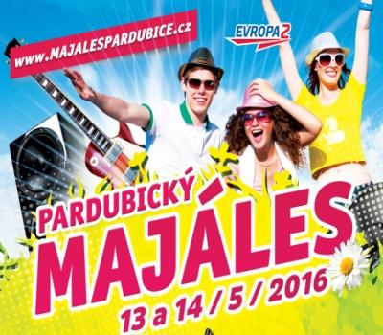
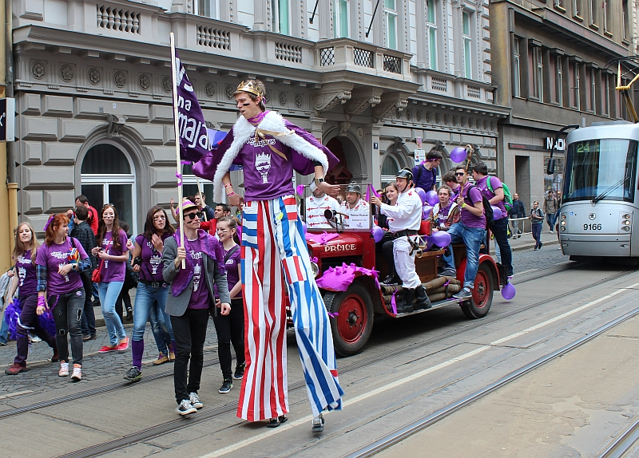
Majales – spring student festivities

Slide 16
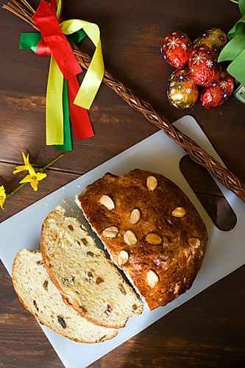
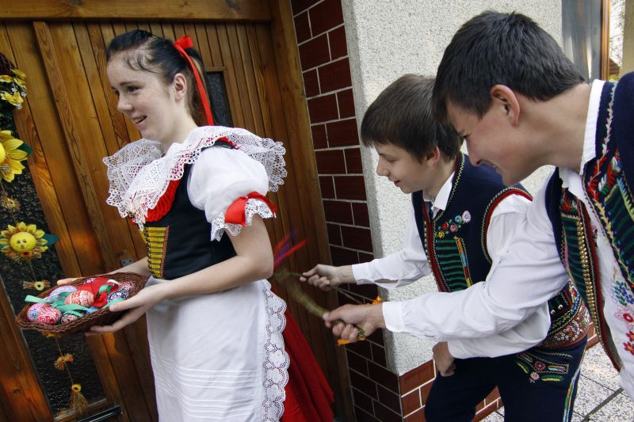
Easter traditions
chase away illness and bad spirits; bring health
boys touch girls lightly on the legs
Easter carol, painted egg or candy, ribbon

Slide 17
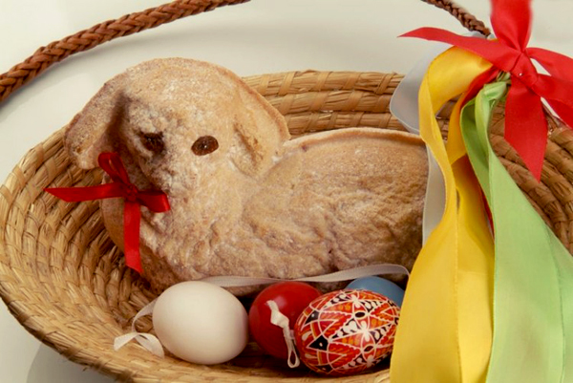
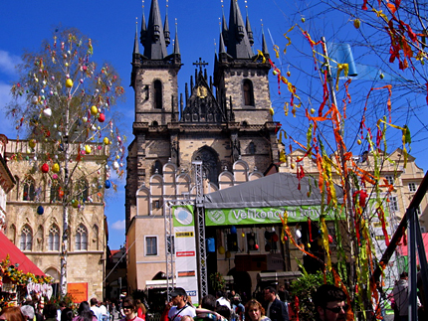
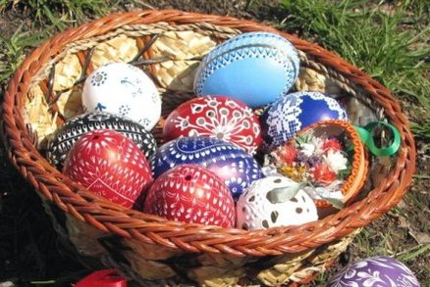

Slide 18
Hofstede’s Model: The Cultural Onion
SYMBOLS: tourist sites (Prague), products &
brands (Budweiser beer, Skoda automobiles)
HEROES: historical figures, scientists,
athletes, artists, even fictious characters,
role-models of society (Havel, Kafka)
RITUALS AND TRADITIONS: holidays (Christmas, Easter); popular activities (cottage culture, mushroom picking, hiking), rituals (Last Bell); body language (shaking hands); hygiene, etiquette, polite manners (“Enjoy your Meal”)
VALUES: influenced by history of culture (working hard, family, atheism, agnocticism, independence, freedom); Even if seemingly outdated, may subconsciously play a role in modern society
PRACTICES: work life, leisure time, holidays, festivals, laws

Slide 19
Quiz on Czech Culture
History
During the 14th century, in what city was the seat of the Holy Roman Emperor, Charles IV?
A) Rome B) Vienna C) Prague
2) What year was Charles University, the oldest university in Central Europe, founded by King Charles IV?
A) 1148 B) 1348 C) 1548
3) In the late 1500s, which city marked the arrival of tulips from Turkey to Europe?
A) Amsterdam B) Paris C) Prague
4) To what empire did the Czech lands belong until the 1st World War?
A) Holy Roman Empire B) Ottoman Empire C) Austro-Hungarian Empire
5) Who was the first president of Czechoslovakia in 1918?
A) Tomáš Garrigue Masaryk B) Karel Čapek C) Václav Havel

Slide 20
Quiz on Czech Culture
History
During the 14th century, in what city was the seat of the Holy Roman Emperor, Charles IV?
A) Rome B) Vienna C) Prague
2) What year was Charles University, the oldest university in Central Europe, founded by King Charles IV?
A) 1148 B) 1348 C) 1548
3) In the late 1500s, which city marked the arrival of tulips from Turkey to Europe?
A) Amsterdam B) Paris C) Prague
4) To what empire did the Czech lands belong until the 1st World War?
A) Holy Roman Empire B) Ottoman Empire C) Austro-Hungarian Empire
5) Who was the first president of Czechoslovakia in 1918?
A) Tomáš Garrigue Masaryk B) Karel Čapek C) Václav Havel
6) When was Czechoslovakia founded?
A) October 1918 B) May 1945 C) August 1968
7) What political event took place in Czechoslovakia in 1968?
A) Invaded by Germany B) Invaded by the USSR C) Start of the cold war
8) What revolution took place in Czechoslovakia a week after the fall of the Berlin Wall in 1989?
A) The October Revolution B) The Velvet Revolution C) The Quiet Revolution
9) Czechoslovakia split into 2 states –Czech Republic and Slovak Republic – in what year?
A) 1989 B) 1993 C) 2004
Science & Industry
10) What is the birthplace of psychologist Sigmund Freud?
A) Příbor, Czech Republic B) Vienna, Austria C) London, United Kingdom
11) In what modern-day city did Gregor Mendel, 19th century ‘Father of Genetics,’ conduct his experiments with pea cultivation and plant breeding?
A) Berlin, Germany B) Berne, Switzerland C) Brno, Czech Republic
12) Which car company was founded in 1895 in the Czech lands?
A) Fiat B) SEAT C) Škoda
13) Who invented the first soft contact lens?
A) Leonardo da Vinci in 1508 B) Otto Wichterle in 1959 C) Kyoichi Tanaka in 1979
Sports
14) In what sports has the Czech Republic never won an Olympic gold medal?
A) hockey B) tennis C)canoeing D) decathlon E)javelin-throwing J) speed skating K) cross-country skiing
15) Which Czech football player is currently playing for a Turkish team?
A) Jan Nedvěd B) Michal Kadlec C) Tomáš Rosický
16) After football, what is the second most popular spectator sport in the Czech Republic?
A) skiing B) tennis C) ice hockey
Lifestyle
17) What percentage of Czechs consider themselves non-religious (that is, not belonging to an official religion)?
A) 5% B) 50% C) 70%
18) What country is the leader in beer consumption per capita in the world?
A) Germany B) Ireland C) Czech Republic
19) What is a typical Czech dish?
A) hamburger B) pork, cabbage & dumplings C) rice and beans
Literature
20) Which writer was nominated for the Nobel Prize in Literature every year from 1932-1938?
A) Vaclav Havel B) Franz Kafka C) Karel Čapek
21) Which word comes from the Czech language?
A) yogurt B) robot C) tulip
Other
22) The population of the Czech Republic is
A) 10 million B) 15 million C) 20 million
23)What is one of the largest medieval castle complexes in the world?
A) Windsor Castle B) Prague Castle C) Buda Castle
24) The Czech Republic is one of the countries with the highest density of _____ in the world.
A) lakes B) hiking trails C) castles
25) What colours does the Czech flag contain?
A) red & white B) red, white & blue C) black, red & gold

Slide 21
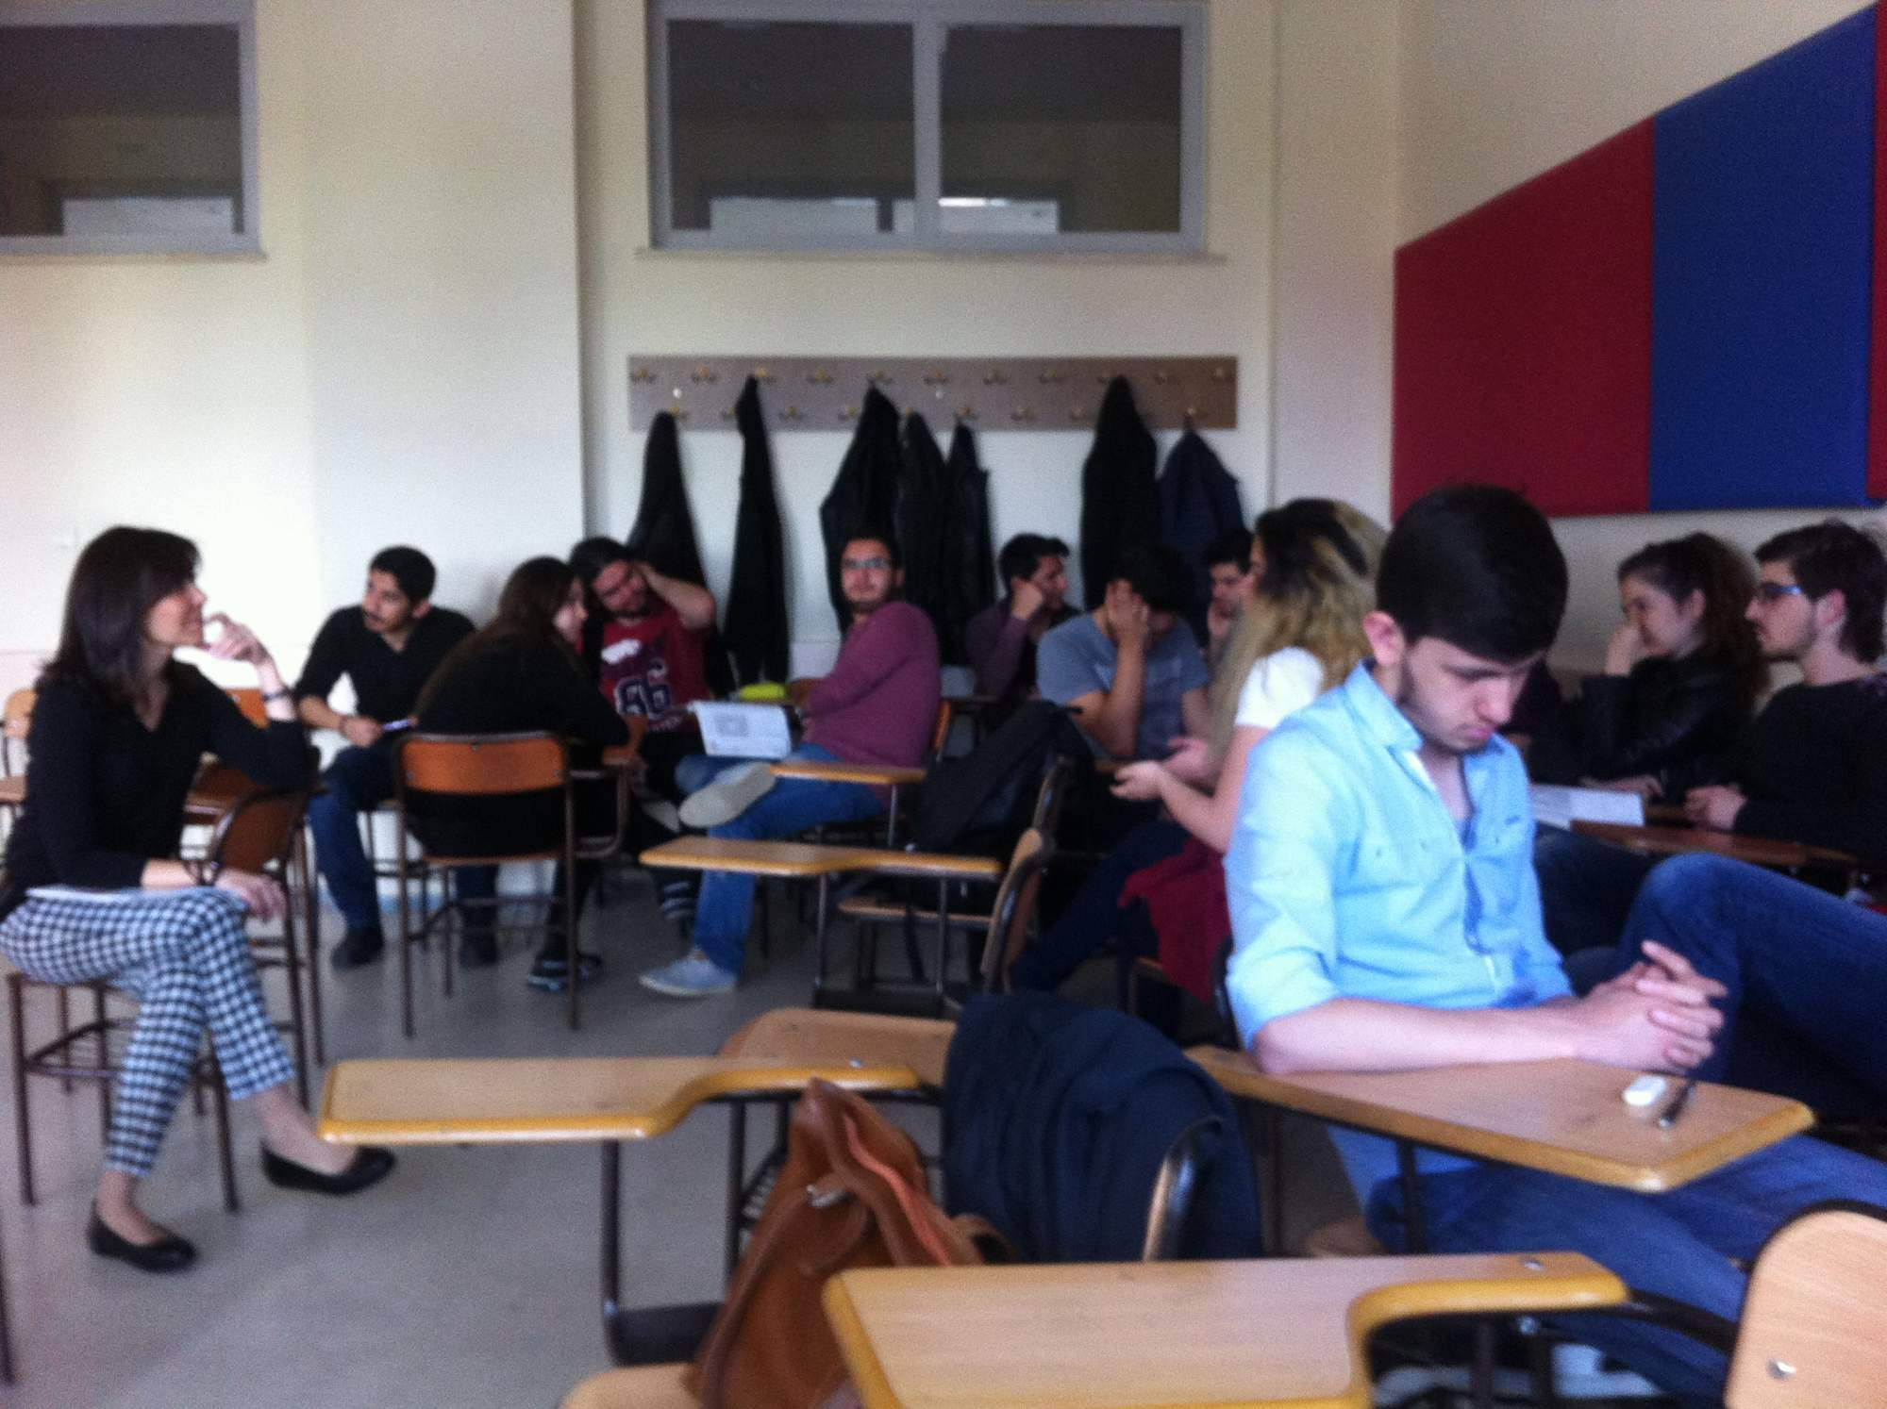
Class observation
Vocabulary based Internet activity using Kahoot.com
Competitive quiz on Contemporary Crime (e.g. internet fraud, theft, social media stalking)
Definition of a word is provided with 4 options
Students choose one through their mobile phones into the application, which times them (to determine the winner of each round)

Slide 23
Notes:
Today, in contrast to previous year when scarves were banned.

Slide 25
Conclusions
Similarities - size of centre
- use of computers, A/V media
- wide range of language ability
Differences - prep year (general non-specialized English)
- large classes, more vocal and less formal students
- younger students (all 0 year, before specialization)
Students and staff appreciative of foreign visit
Good hospitable approach
Notes:
Overall impression was good

Slide 26
Notes:
A special occasion – surprise birthday celebration at the end of the class

Slide 27
Notes:
Staff cafeteria

Slide 28
Notes:
Dinner out with colleagues

