Slide 1
B2, or not B2. That is the question
Anjuli Pandavar

Slide 2
Parental discretion advised. What you are about to hear might be distressing.

Slide 3
B2 Examination does not equal CEFR B2 language proficiency because…

Slide 4
It is an examination.

Slide 5
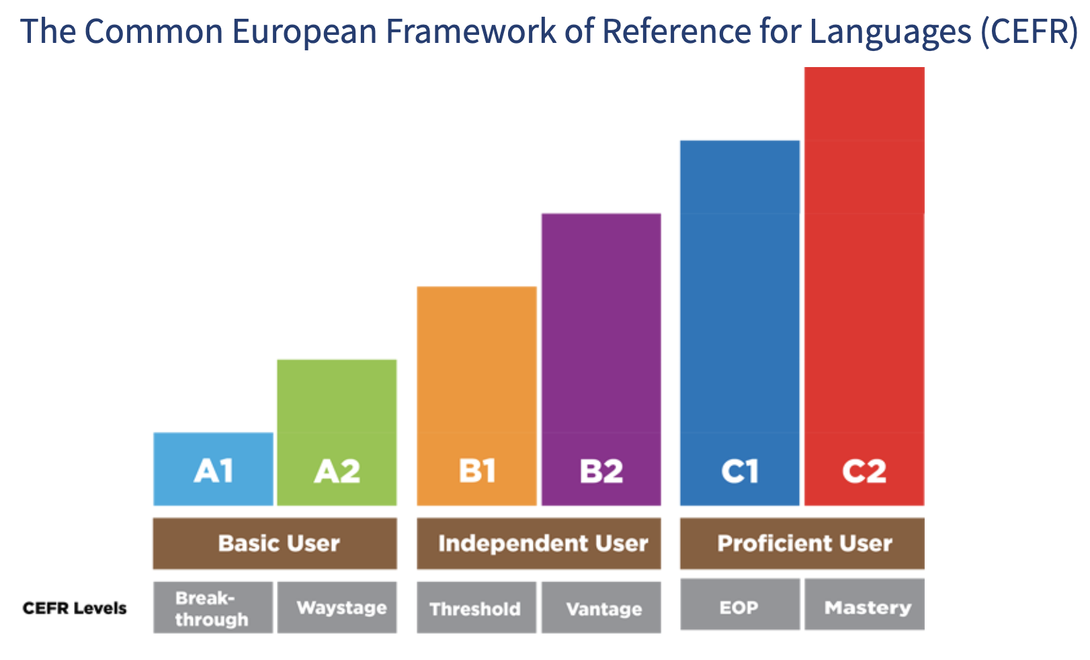
CEFR B2:

Slide 6
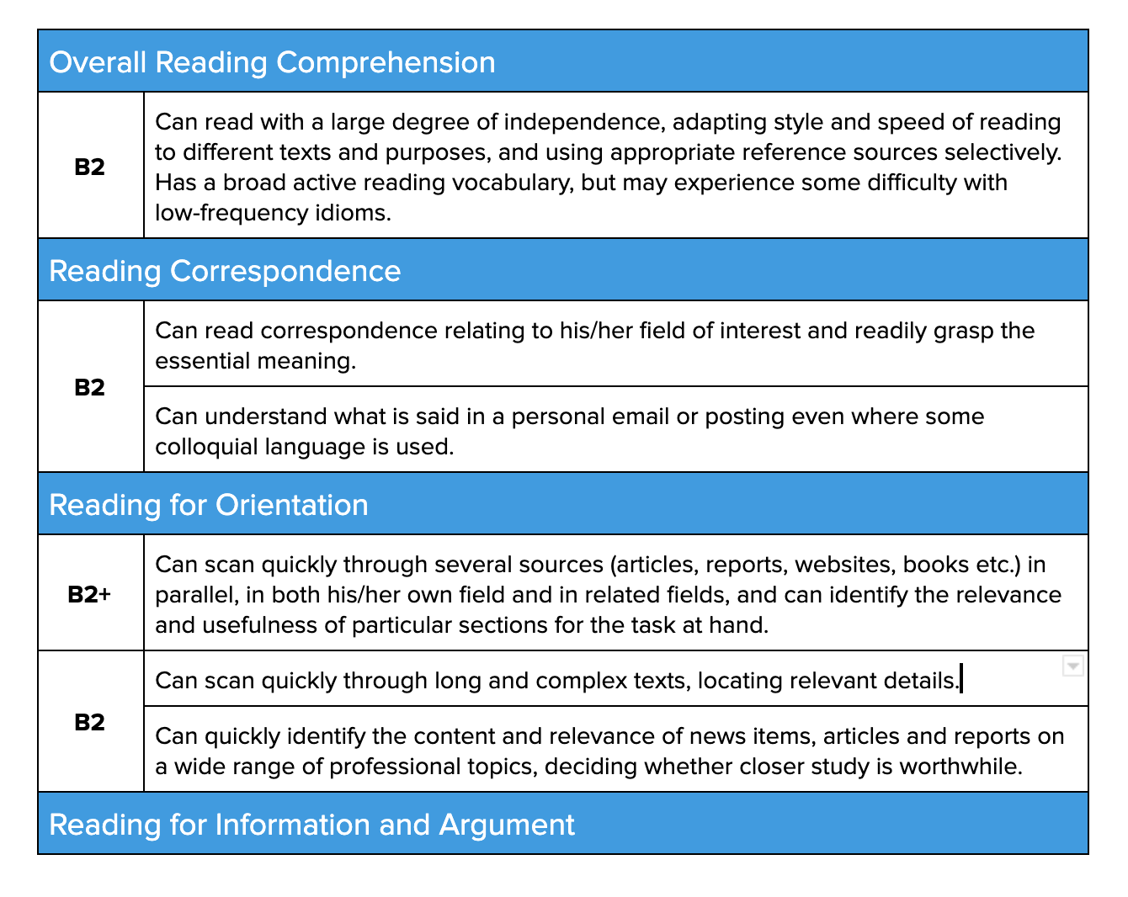
What CEFR B2 actually measures:

Slide 7
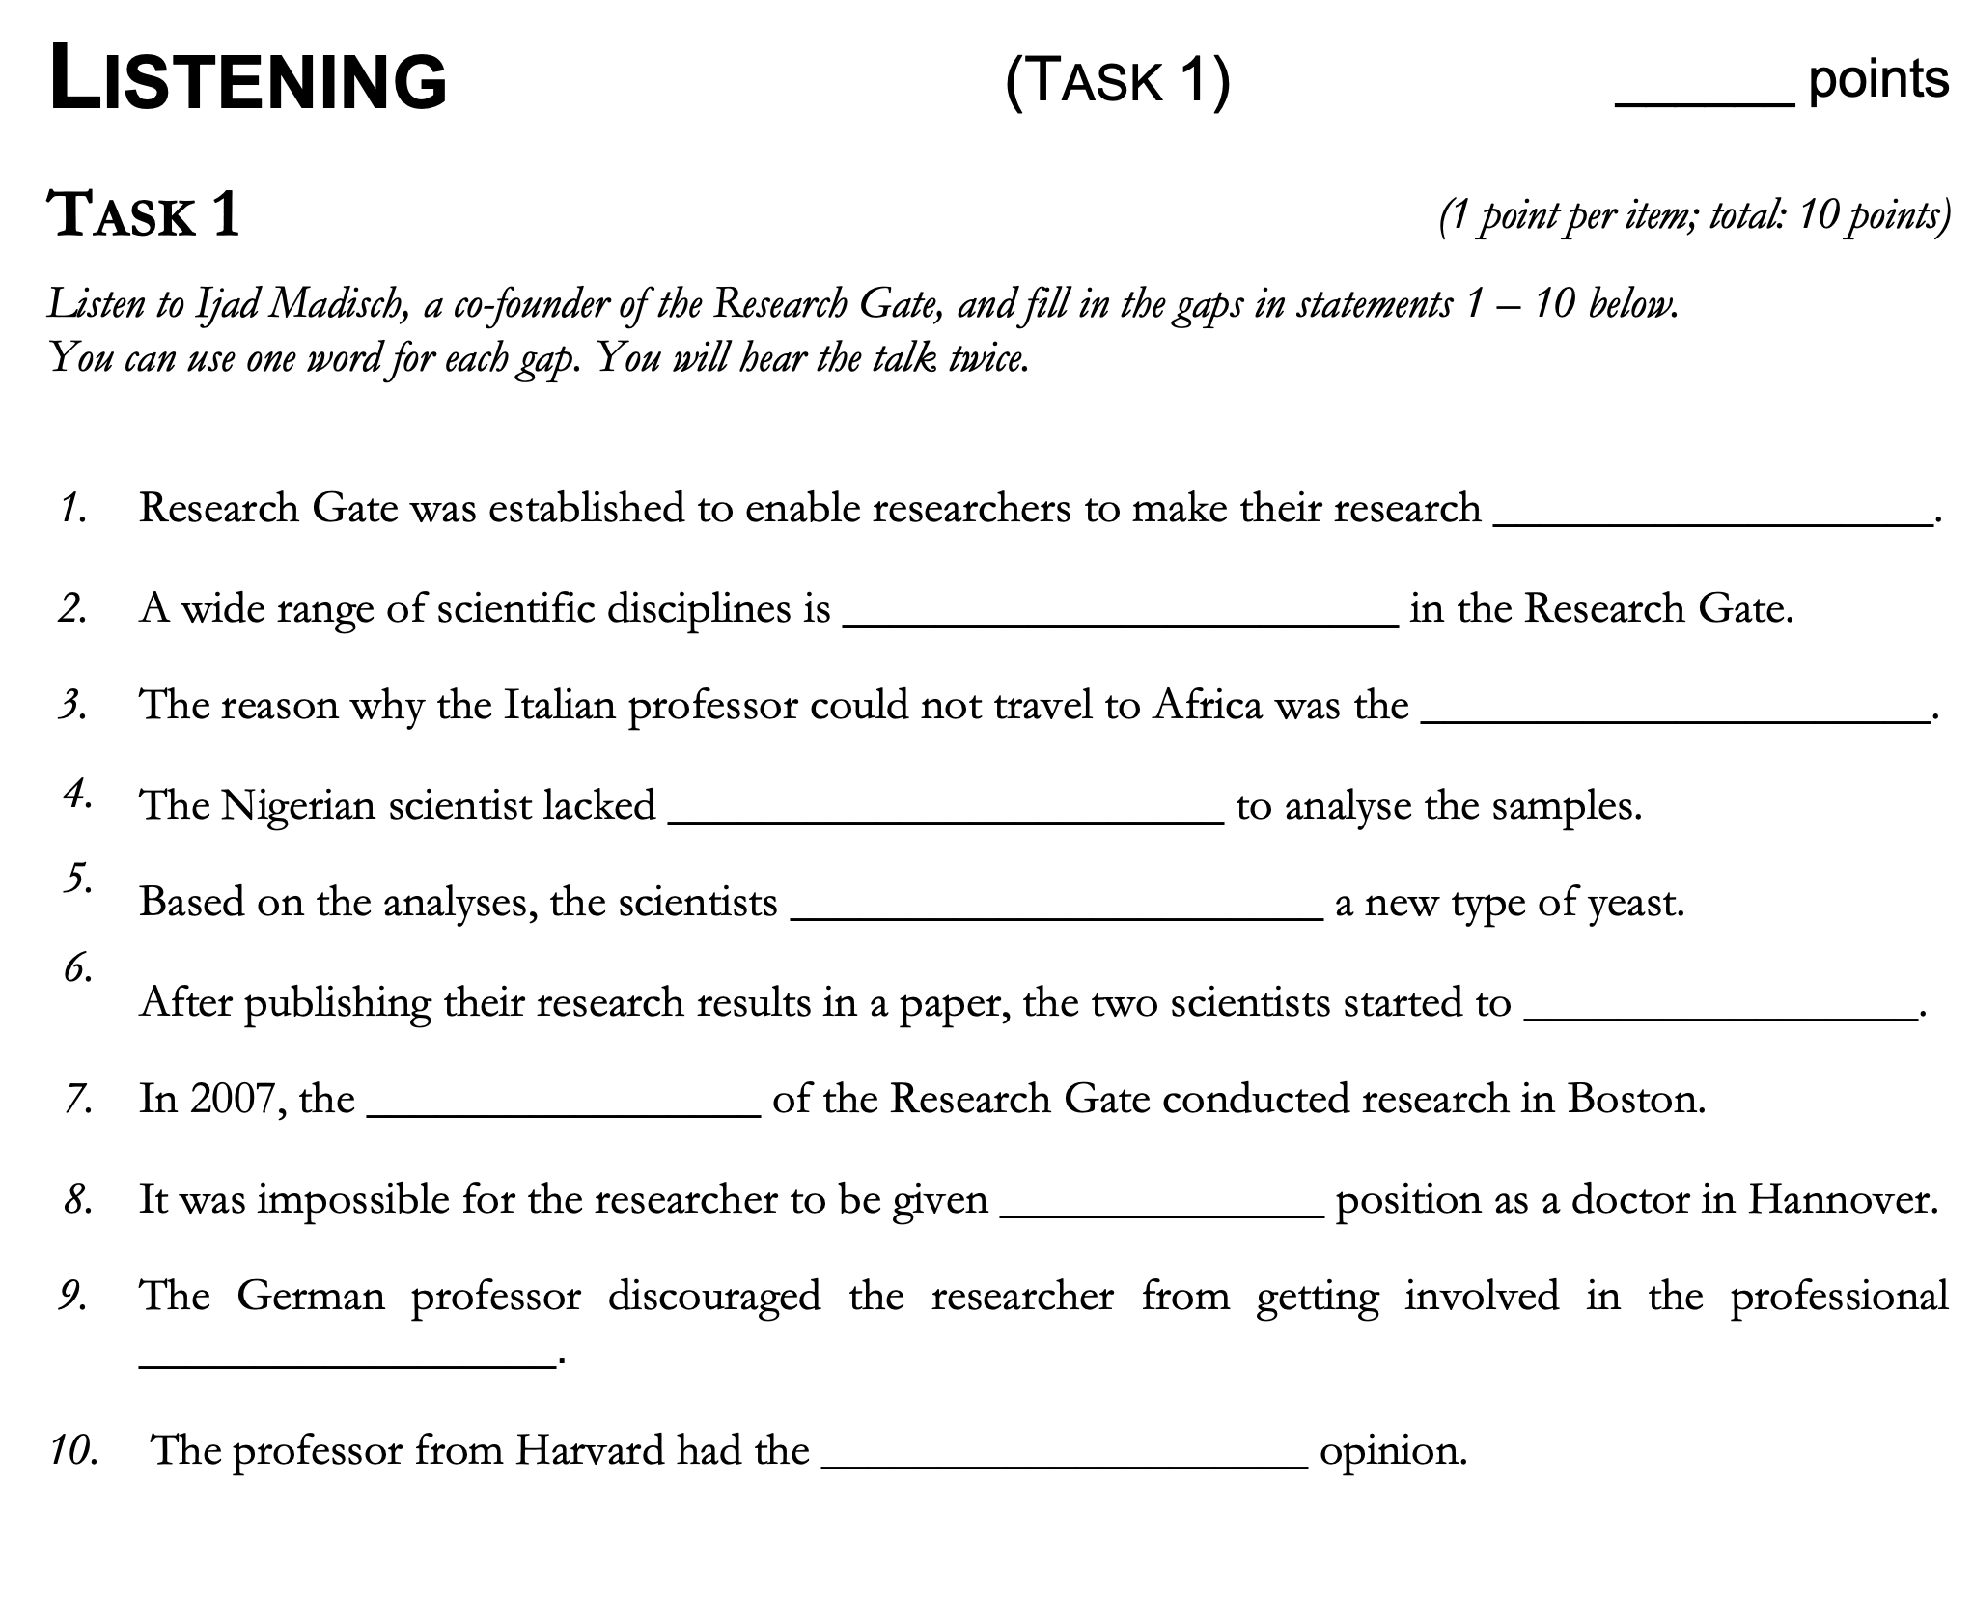
What B2 exam actually tests:

Slide 8
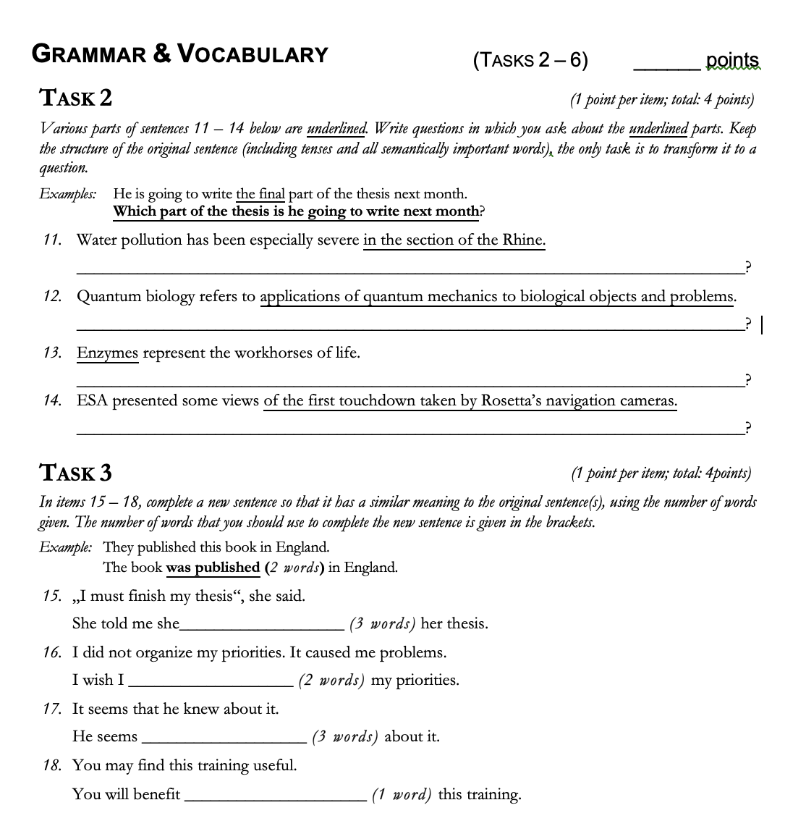
What B2 exam actually tests:

Slide 9
How the B2 exam maps onto CEFR

Slide 10
Comments?

