Slide 1
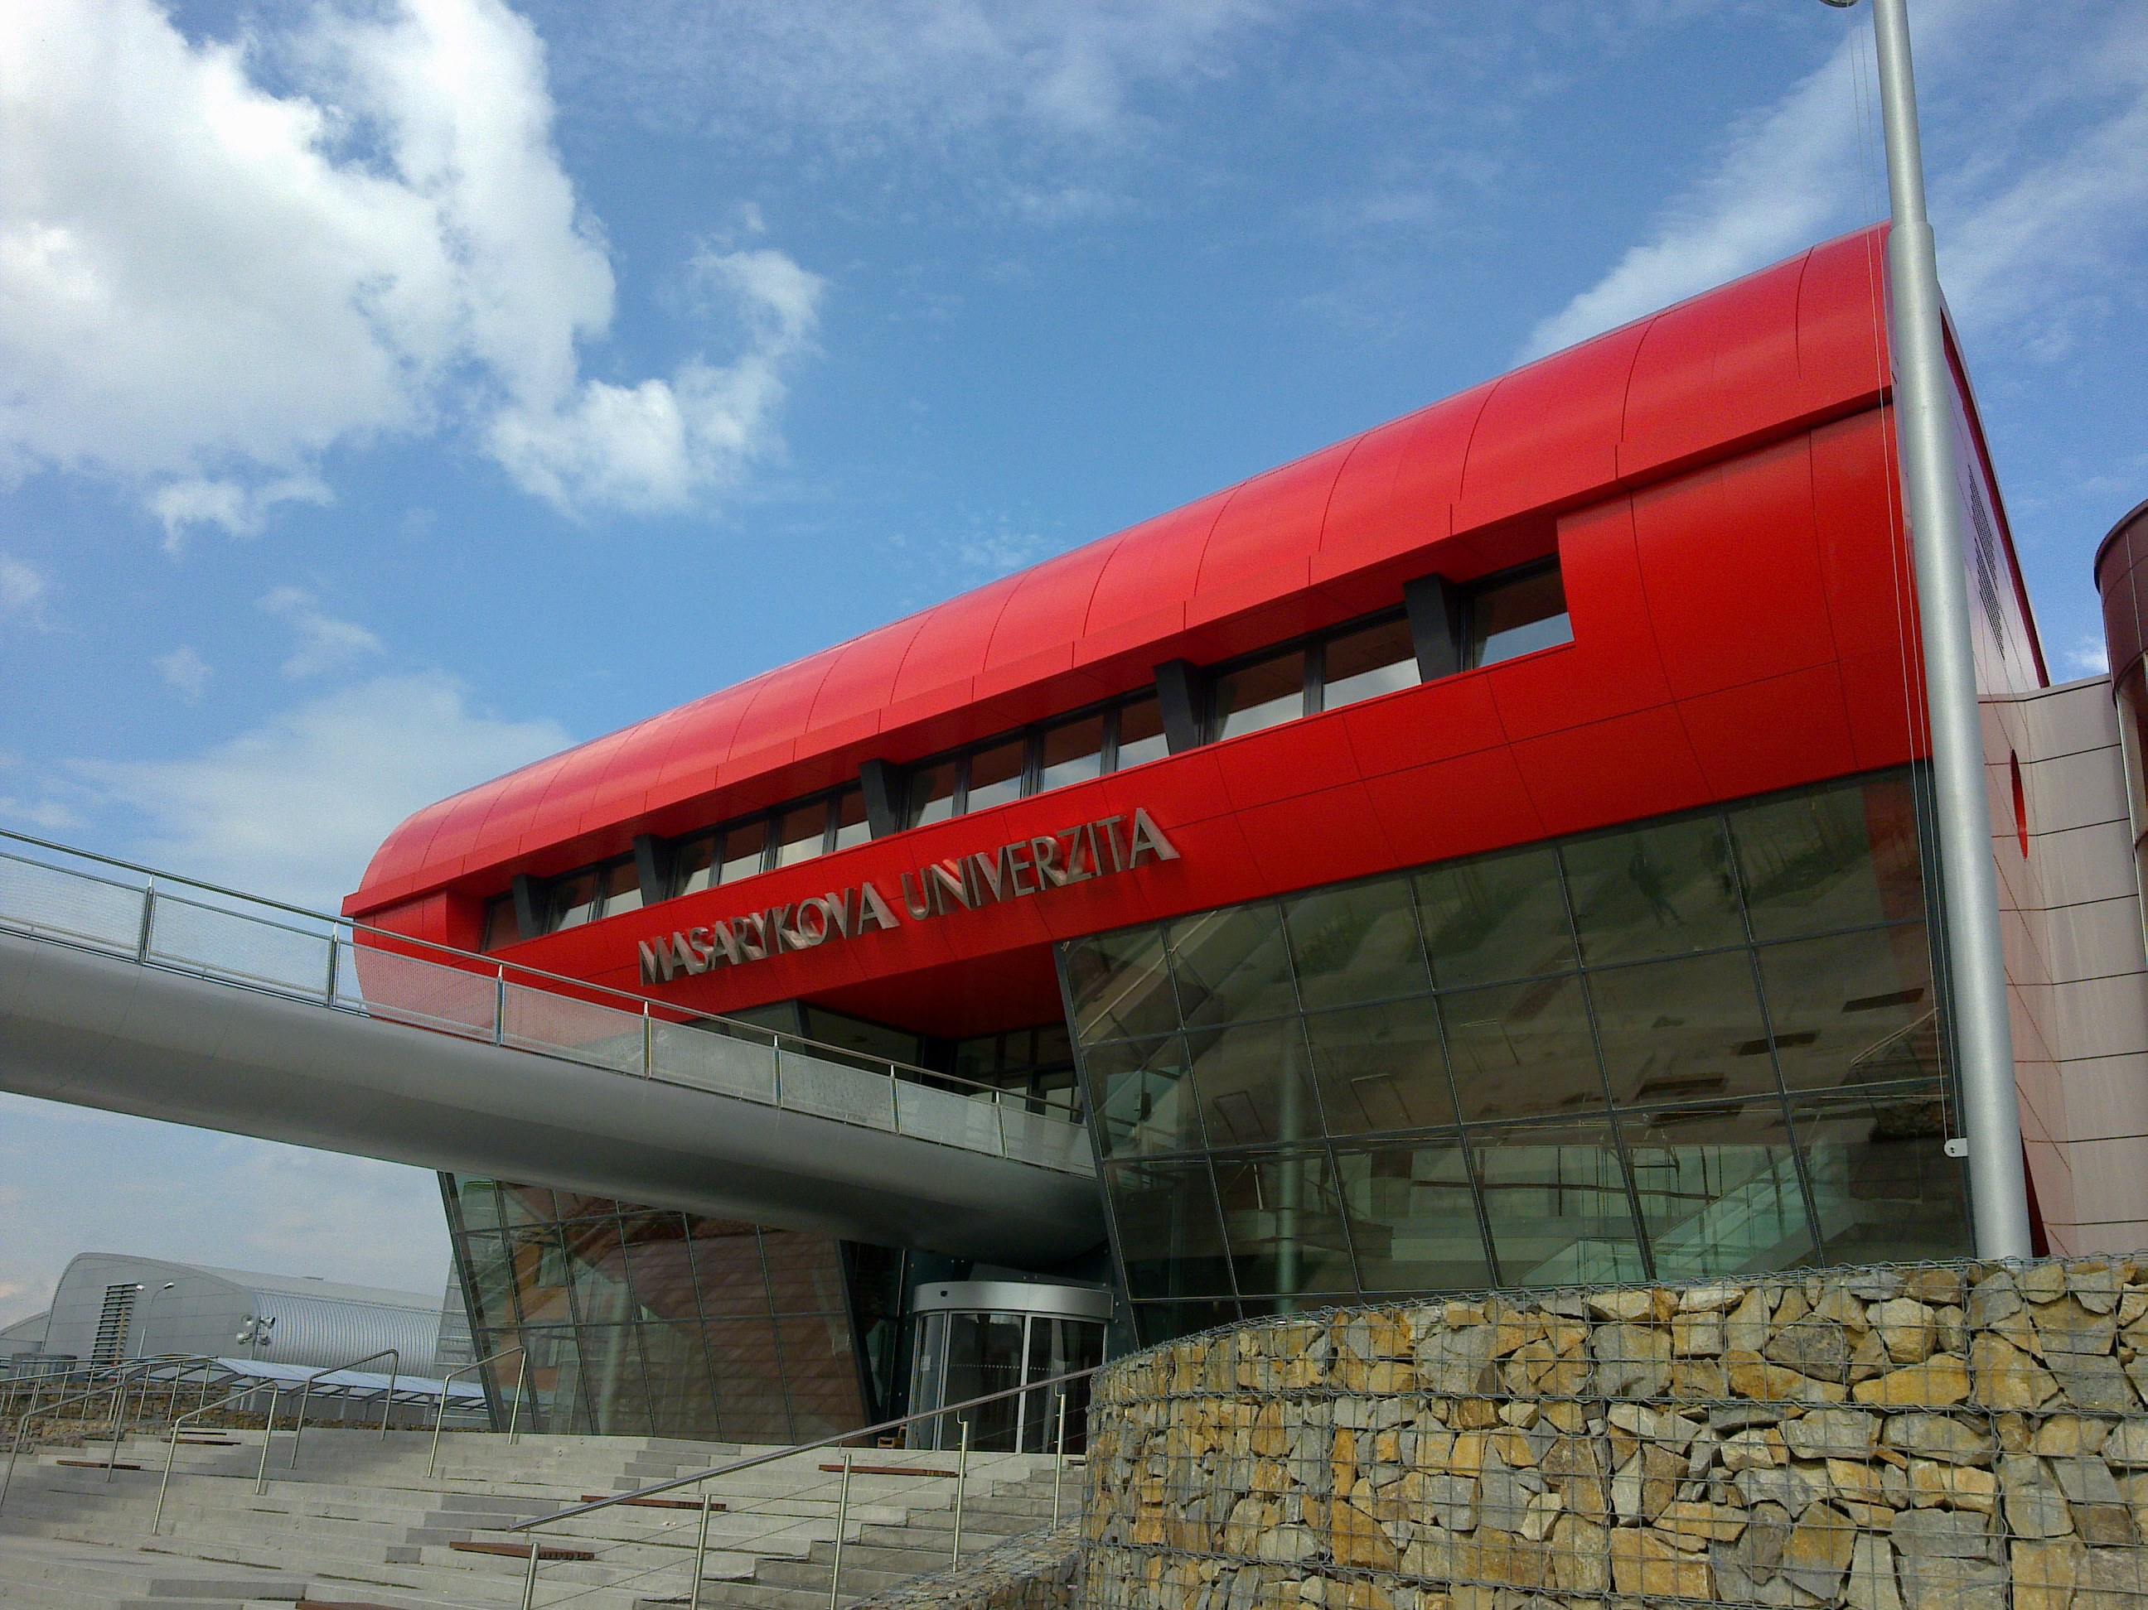
Aligning English Language Courses with Specialized Professions:
Lessons learned from development of an ESP course for Medical Lab Technicians
Tetiana Kibalnikova, Katarína Lexová
22-25 January, 2024
CJV LF MU

Slide 2
Outline
Needs analysis✔️
Goals and objectives ✔️
Methodology ✔️
Material selection ✔️
Study materials development ✔️
Examples of customized lesson materials and activities ✔️
Assessment (work in progress) ⚙️

Slide 3
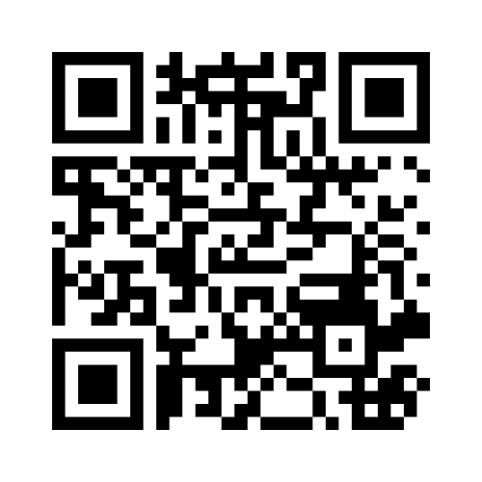
In one or two words, describe the biggest challenge you face when developing English for Specific Purposes courses

Slide 4
COURSE CHARACTERISTICS
Name of the course: English language II
Term: spring 2024 (pilot version)
Number of hours: 2 per week
Type of Completion: zk
The TEAM of COURSE DEVELOPERS
Veronika Dvořáčková ‒ Unit 6, chief editor
Tetiana Kibalnikova ‒ Units 3, 4, 9, 10, 12, 13
Katarína Lexová ‒ Units 3, 5, 8, 11, 13
Jana Klapilová ‒ chief graphic designer

Slide 5
Needs Analysis
Different sources:
a) field guarantor (MUDr. Zdeňka Čermáková, Ph.D.)
b) instructors (MUDr Miroslava Beňovská, doc. MUDr. Milan Dastych, CSc., MBA)
c) students (BLAN 0321)
A variety of complementary methods to gather information for needs analysis (documents analysis, interviews, questionnaires)

Slide 6
2 lab tours:
The University Hospital Brno (January 30, 2023) – MUDr Miroslava Beňovská, doc. MUDr. Milan Dastych, CSc., MBA
Masaryk Memorial Cancer Institute (February 7, 2023) – MUDr. Zdeňka Čermáková, Ph.D.
Document analysis:
Bachelor’s study programmes: Medical Laboratory Technologist (Laboratorní diagnostika ve zdravotnictví), Laboratory Assistant (Zdravotní laborant)
CEFR
- Are students capable to define their needs effectively?

Slide 7
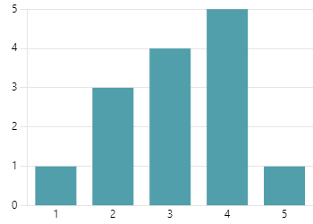
Needs Analysis Questionnaire
BLAN 0312 (14/16 students)
1) How motivated are you to attend the course of English focused on your specialty? (5 stars - very motivated; 1 star - not motivated)
2) What for will you need the knowledge of English for specific purposes (ESP)? You may choose more than 1 option:
- Further education 7
- Work placement in a multinational team 6
- Scientific research 6
- Reading specialized literature for professional 8 development
- Other 0
3) What specific language skills would you like to practise in the ESP course? You may choose more than one option
- Speaking 12
- Listening 10
- Reading 4
- Writing 7
Figure 1
Figure 2
Figure 3
7
7
8
12
4
6
6
10

Slide 8
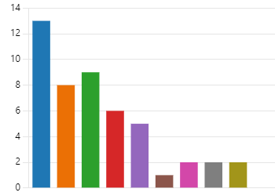
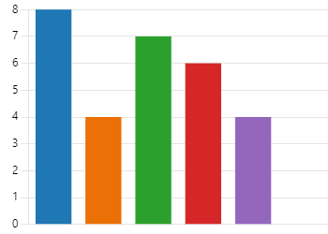
4) Which classroom activities would you prioritize in the ESP course? You may choose more than one option
- learning specialized vocabulary 13
- reading authentic professional texts 8
- watching authentic videos on professional topics 9
- discussing specialized issues in English 6
- revising grammar and doing exercises 5
- doing problem-solving tasks (e.g. case studies) 1
- role playing professional scenarios 2
- creating posters on professional topics 2
- writing reports on professional topics 2
- other 0
5) Which forms of classroom activities would you prioritise in the ESP course? You may choose more than one option
- pair work 8
- team work 4
- individual work 7
- self-study (assigned home task) 6
- interactive activities (e.g. quizzes, posters…) 4
- other 0
Figure 4
Figure 5

Slide 9
6) Are there any specific topics or subjects within your field that you would like the English for Specific Purposes course to cover in detail? Please, list them.
“Microbiology”
“Laboratory”
“Useful vocabulary for lab technicians, for example the methods, instruments etc.”
“All English lessons can be only for our specialization. Not everything for all”
“Special vocabulary”
“Metabolism”……

Slide 10
New ESP Course Syllabus | Curriculum: Laboratorní diagnostika ve zdravotnictví, Zdravotní laborant | CEFR
Unit 3 Medcial Lab Technician Profile |  | Reception: -Can obtain information, ideas and opinions from highly specialised sources within their field.-Can follow the essentials of lectures, talks and reports and other forms of academic/professional presentation which are propositionally and linguistically complex.
Unit 4 Clinical Laboratory and its Automation | Instrument Technology (Year 1)
Unit 5 Laboratory Safety | First Aid (Year 1), Handling Chemical Substances (Year 1), Hygienic Rules in Laboratories (Year 3)
Unit 6 Laboratory Biosecurity to the Outside World | First Aid (Year 1), Handling Chemical Substances (Year 1), Public Health Protection (Year 3) | Production: -Can give clear, detailed descriptions and presentations on a wide range of subjects related to their field of interest, expanding and supporting ideas with subsidiary points and relevant examples. -Can use appropriate technical terminology when discussing their area of specialisation with other specialists.
Unit 7 Oral Exam Training
Unit 8 Quality Control, Analytical Errors and their Prevention | Quality Management in Bioanalytical laboratory(Year 3)
Unit 9 Haematology | Clinical Haematology (Year 2), Immunohaematology and Blood Banking (Year 2)
 |  | Mediation: - Can interpret and describe reliably (in Language B) detailed information contained in complex diagrams, charts and other visually organised information on topics in their fields of interest. -Can formulate questions and give feedback to encourage people to make connections to previous knowledge and experiences.
Unit 10 Urinary System and Urinalysis | Clinical Biochemistry (Year 2),
Unit 11 Microbiology | Biochemistry (year 1), Histology (year 1), Molecular and Cellular Biology (Year 1), Techniques of Molecular biology and genetics (Year 1), Medical Microbiology (Year 2, 3)
Unit 12 Immunology | Clinical Immunology (Year 2, 3) | Linguistic competence: -Has a good range of vocabulary for matters connected to their field and most general topics. -Has a good command of simple language structures and some complex grammatical forms, although they tend to use complex structures rigidly with some inaccuracy.
Unit 13 Diagnostic tests | Molecular and Cellular Biology (Year 1), Techniques of Molecular biology and genetics (Year 1) , Clinical Genetics (Year 2), Clinical Biochemistry (Year 2),

Slide 11
Goals and Objectives of the ESP Course
to enhance the students’ productive (spoken, written), receptive (listening, reading), interactive (spoken, written) and mediative (oral, written) communicative skills at B2 CEFR level
to develop the students critical thinking through problem-solving activities
to boost the students’ specialized vocabulary to communicate effectively in their job environment
to foster practical application of language structures and enhance grammar proficiency at B2 CEFR level

Slide 12
Methodology
Task-based Language Teaching and Content-based Instruction :
focused on the completion of meaningful tasks
problem solving
contextualized language learning
integration of basic language skills within the context of meaningful tasks

Slide 13
Material Selection
Video:
https://www.ted.com/talks
https://study.com
https://www.labmanager.com/calibration-metrology
https://www.youtube.com/@NPSmedicinewise
Professional articles:
https://www.testing.com/articles/
Medical websites:
https://medlineplus.gov/lab-tests/
https://my.clevelandclinic.org/
https://www.mayoclinic.org/
https://www.healthline.com/health
Chat GPT
CJV week, 2024

Slide 14
Study Materials Development
A typical unit framework: 4-5 sections organized around a subject-matter topic
Starter: lead-in discussion session or a set of pictures
Content: authentic texts, videos, form-focused activities
Language: specialized target vocabulary and grammar structures
Task: case studies, role plays, projects (pair / team work)
Incorporation of scaffolding strategies
Unit 4

Slide 15
Customized lesson materials
Unit 4 Clinical Laboratory and its Automation
Specific Objective: to communicate effectively with colleagues regarding laboratory automation, equipment, processes, and technologies.
Lead-in: discussion session about their recent visiting a lab
Activities:
- watching a video, note taking, relaying
- matching definitions
- case study
- labeling pictures
- reading and matching headlines
- grammar practice: Passive Voice
- gap filling, word formation

Slide 16
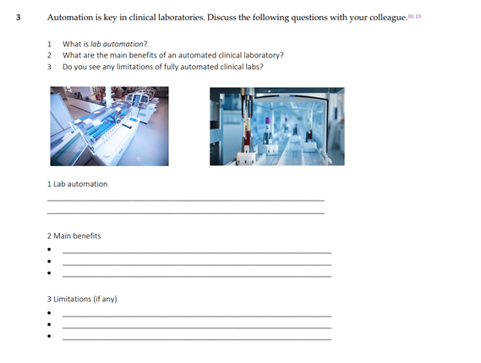
Laboratory Equipment

Slide 17
Grammar Practice: Passive Voice

Slide 18
Unit 5 Safety Control
Specific Objective: to acquire and use a range of specialized vocabulary and grammar structures relevant to safety communication.
Lead-in: Which everyday situations pose risks for people and why?
Activities:
- designing a concept map based on a text
- interpreting diagrams (mediation)
- synonym discrimination exercise (risk vs hazard)
- gapfill
- video (2)

Slide 19
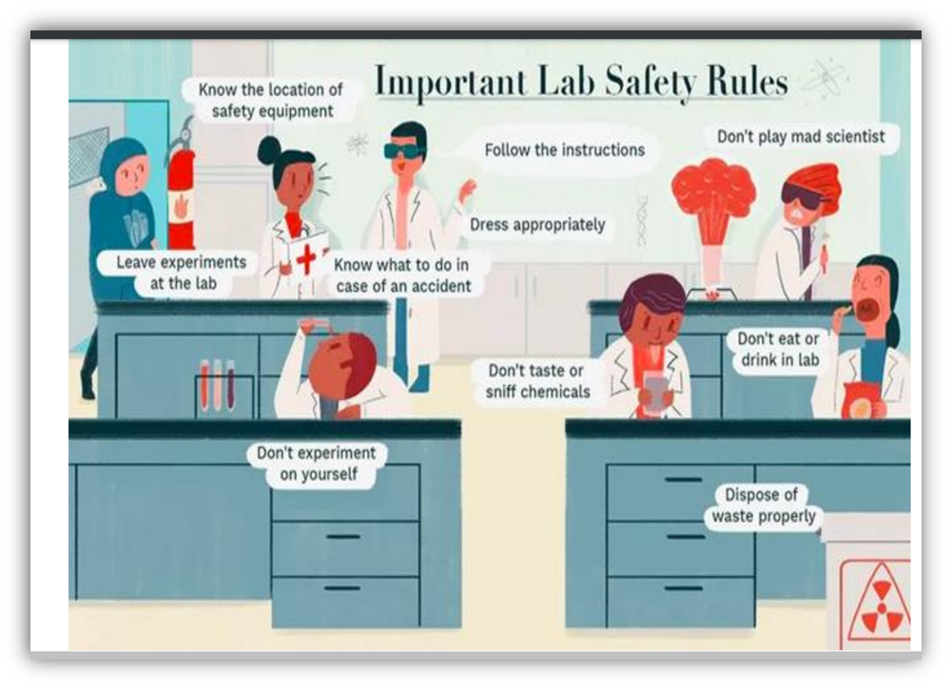
Follow-up Reading activity:
The rules formulated in the bubbles are briefly defined in the following text.
Match the description with the rule identified in the picture:
Key:

Slide 21
Grammar Practice: Modals (prohibition, permission, obligation, rules, regulations and prevention)

Slide 22
Unit 8 Quality Control, Analytical Errors and their Prevention
Specific Objective: to proficiently implement quality control measures, identify various types of analytical errors and implement preventive measures demonstrating mastery of relevant vocabulary and language structures with an emphasis on language of speculation
Lead-in: discussion session about QC in a medical lab
Activities:
- matching definitions
- sentence completion
- interpreting the information in the cartoon and a diagram
- complementing a concept map
- note taking (listening)
- sorting / categorizing terminology
- reading and gap filling
- sequencing paragraphs in the case report
- text relaying (group work)

Slide 23
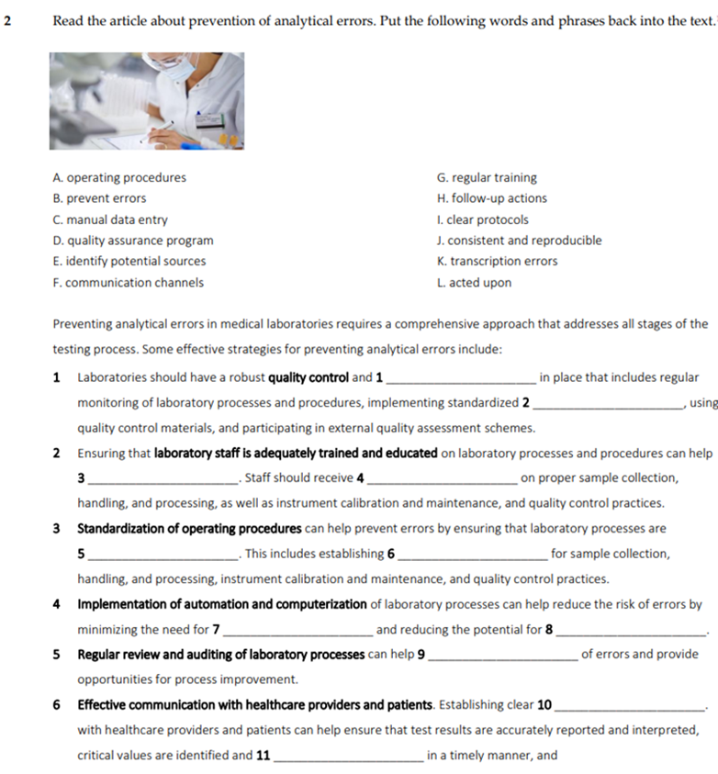

Slide 25
Pronunciation Practice
Units of measurement, numbers
Units of measurement

Slide 26
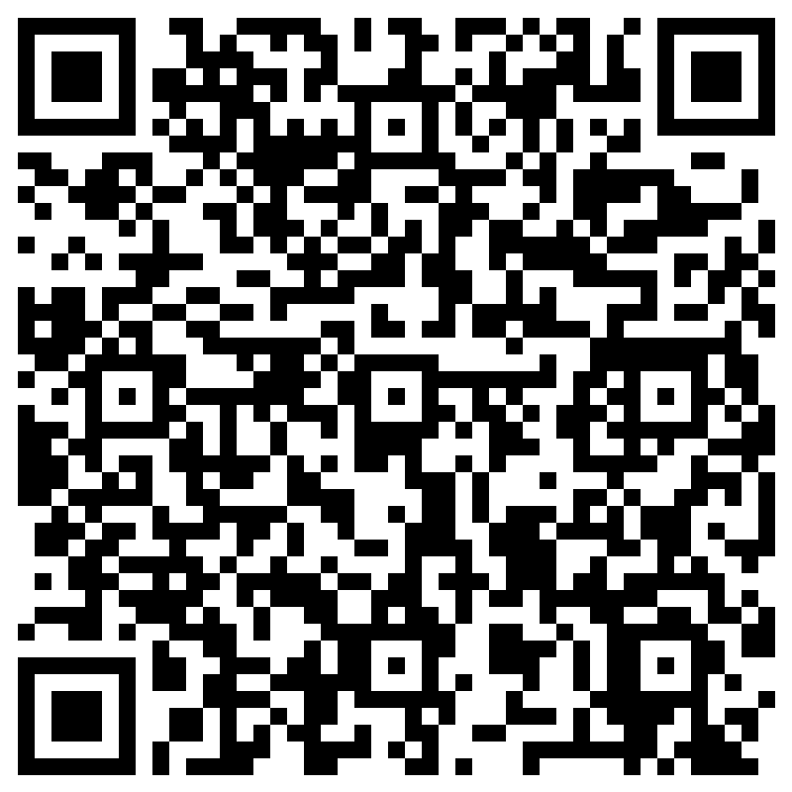
Unit 9 Haematology
Specific objective: to develop proficiency in specialized vocabulary to be able to interpret and communicate information related to blood components, diseases and laboratory techniques.
Lead-in: a Blood quiz “How well do you know what's flowing through your veins?”
Activities:
- reading the text, filling in the gaps and labeling the diagram
- matching definitions
- categorizing / sorting terminology
- listening, notetaking, completing the grid
- case study
- scanning

Slide 27
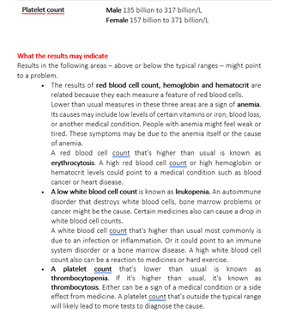
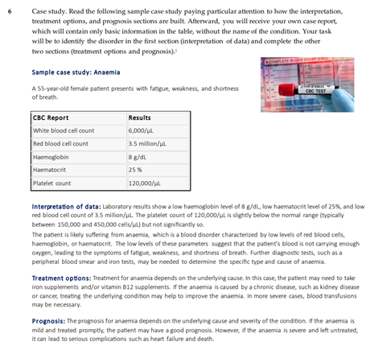
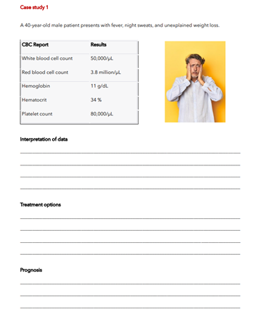
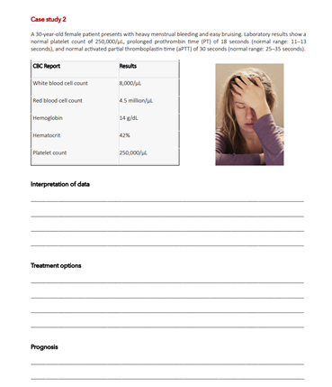

Slide 28
Unit 11 Microbiology
Specific Objective: to employ specialized vocabulary and communication skills to comprehend, analyze, and convey information related to microorganisms, laboratory techniques, and microbial processes.
Lead-in: discussion session about hot topics in microbiology
Activities:
- reading and gap filling
- matching definitions
- listening (watching a video) for gist
- reading for orientation (scanning a website for locating relevant details
- interpreting charts (mediation)
- matching headlines
- grammar practice: noun-forming suffixes
- word formation

Slide 29
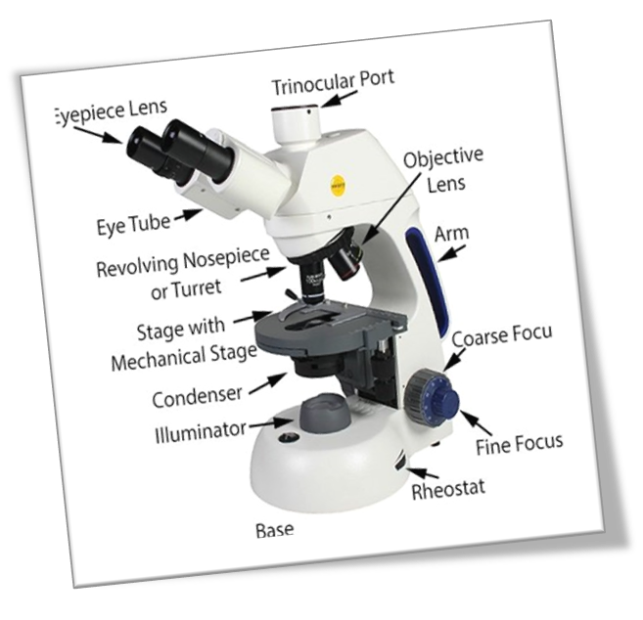
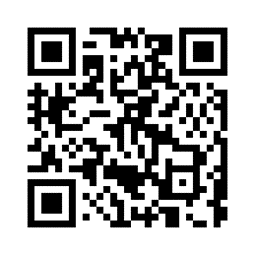
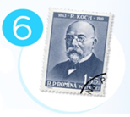
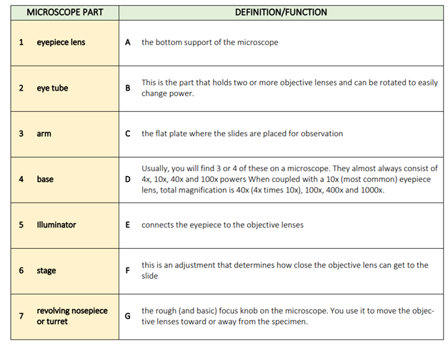
A slideshow Vocabulary practice: Wordwall
Presented below are a series of images showcasing the key milestones
in the history of the microscope, arranged chronologically.
Your task is to figure out the significance of each milestone
based on the provided pictures

Slide 30
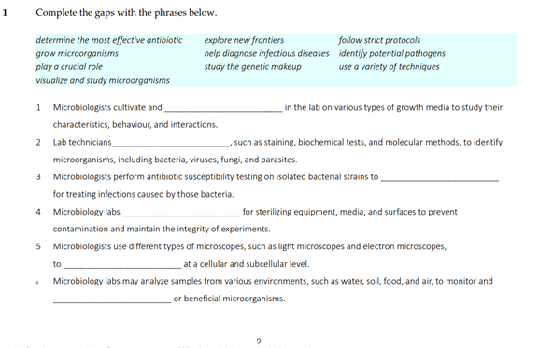
Grammar Practice: Noun-forming Suffixes

Slide 31
Unit 12 Immunology
Specific Objective: demonstrate a comprehensive understanding of fundamental immunological concepts, including immune responses, cell-mediated immunity, laboratory techniques commonly used in immunology
Lead-in: discussion session “How can understanding of immunology help lab technicians in diagnosing and treating diseases?”
Activities:
- listening / watching a video for details
- matching definitions
- inferring meaning of the target vocabulary
- reading for detail
- role play

Slide 32
Grammar Practice: Direct and Indirect Questions

Slide 33
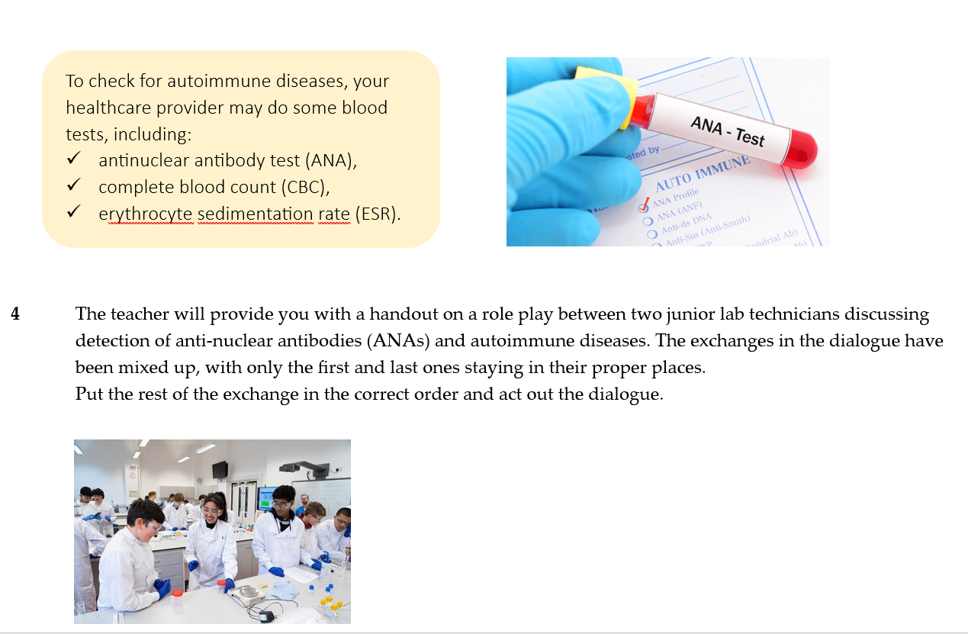
Role Play

Slide 34
Limitations of the new ESP course for MLT
cultural considerations: the new ESP course is not fully relevant for Czech medical laboratory environment
time constrains
language complexity

Slide 35
“If the only tool you have is a hammer, you tend to see every problem as a nail” (A.Maslow)

Slide 36
Resources
Lesiak-Bielawska, E.D. (2015). Key Aspects of ESP Materials Selection and Design. English for Specific Purposes World. Issue 46. https://www.researchgate.net/publication/330656326
Salazar E.U. (2017). Designing and Implementing an ESP Course: Revisiting an Experience: Revista Pensamiento Actual. Vol 17. No. 28. https://revistas.ucr.ac.cr/index.php/pensamiento-actual/issue/view/2436/261
Sufiyandi, M. F. (2020). Some basic principles in designing materials for students of English for specific purposes: IJIERM. Vol 2. No 1. https://journal.yaspim.org/index.php/IJIERM/article/view/19/7
Upton T.A. (2012). LSP at 50: Looking back, looking forward. IBERICA. No 21. 8-28. https://revistaiberica.org/index.php/iberica/article/view/307

