Slide 1

FREELY ACCESSIBLE CLINICAL CASES IN LSP TEACHING
Natália Gachallová
Týden CJV 2024

Slide 2

Synopsis
Introduction & Context
Three examples of implementation in my teaching practice
Follow-up exercises
Search options
Conclusion

Slide 3
Context
two-semester courses of Basic Medical Terminology for international students
obligatory for the students of general medicine, dentistry, and physiotherapy
mostly non-native speakers of the language of instruction, i.e. English
diverse educational and language background
aiming at language proficiency sufficient to comprehend (not only) Latin parts of medical documentation

Slide 4
Methodology
Elder (2015): “establishing authenticity is essential in measuring the language abilities and cognitive processes of language learners to predict their performance in future language use”
teaching materials emphasizing closer contact with the real practice
ethical concerns and implications impeding sharing of authentic medical documentation with students
search for alternative sources of real case records
ULTIMATE GOAL: students‘ ability to extract relevant/important information and pass these on in the form of a structured report

Slide 5

The New England Journal of Medicine
https://www.nejm.org/
research articles, reviews
wide variety of case records from all main specialties
addressed to medical professionals, but adjustable for teaching needs
keyword search
images, test results, progress of disease, diagnostics
FREELY ACCESSIBLE

Slide 6
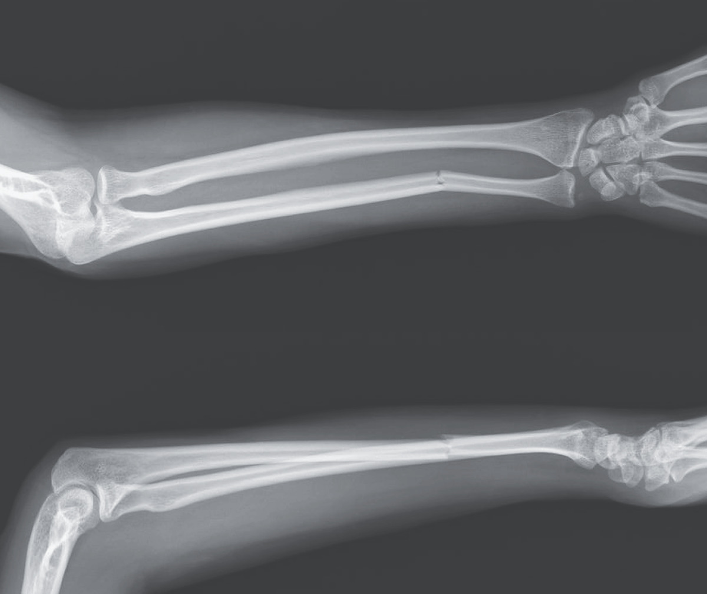
Isolated ulnar
shaft fracture
A 60-year-old left-handed woman presented to the emergency department with pain in her left forearm after having been struck by a baseball bat by her partner. On physical examination, the left forearm was swollen and tender, especially with passive pronation and supination. The overlying skin was intact, and the results of neurovascular examination were normal. No other traumatic injuries were present. Radiographs of the left forearm showed an isolated ulnar shaft fracture (upper image, anteroposterior view; lower image, lateral view). Isolated ulnar shaft fractures, also called “nightstick fractures,” result from blunt force trauma to the forearm. The injury classically occurs when the upper arm is raised in self-defense against an attack to the head or torso, such as in intimate-partner violence, as occurred in this case. Comprehensive assessments of the safety and mental health of the patient were performed, and social services were offered. The patient underwent open reduction and internal fixation of the fracture, followed by splinting, although this type of injury may be managed nonoperatively in some cases. At follow-up 10 weeks later, the patient had regained full function of her arm; she had obtained a restraining order for protection and was receiving assistance from a social worker.
https://www.nejm.org/doi/full/10.1056/NEJMicm2211242

Slide 7
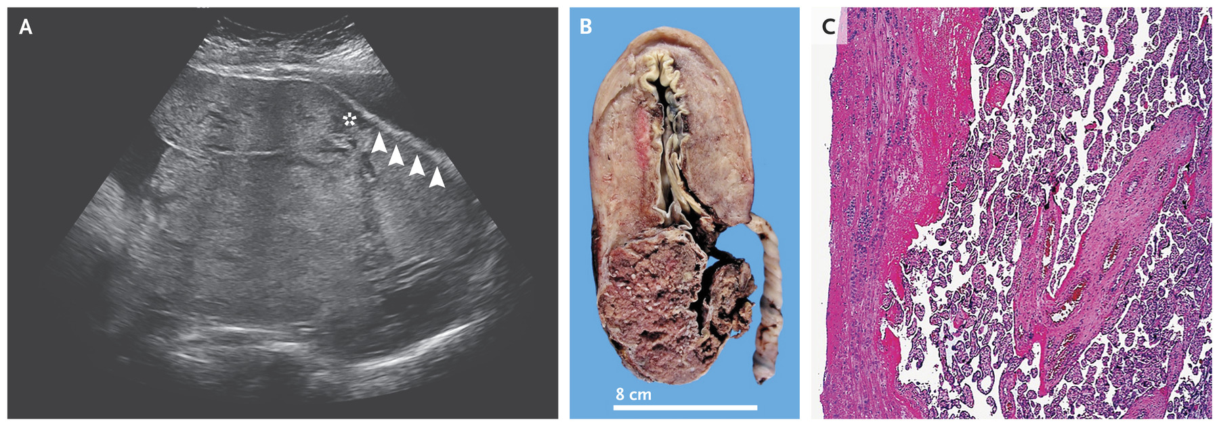
Placenta increta
Latin prefixes in clinical terms
AD- accreta
IN- increta
PER- percreta
Sectio caesarea acuta
St.p. hysterectomiam totalem
A 38-year-old woman who had undergone three low-segment cesarean sections was admitted to the hospital in labor at 36 weeks of gestation. Antenatal ultrasonography suggested placenta accreta (Panel A), with the appearance of irregular vascular spaces (asterisk) and loss of retroplacental hypoechoic stripe (arrowheads), which suggested obliteration of the basal decidua. She underwent an emergency cesarean section, which confirmed the abnormal adherence of the placenta to the myometrium. The placenta was left in situ, and a cesarean hysterectomy was performed to decrease the risk of massive hemorrhage. Gross and histopathological examination (Panels B and C) confirmed the diagnosis of placenta increta, with trophoblastic invasion into the myometrium. There is a spectrum of abnormal placentation: placenta accreta refers to the attachment of the chorionic villi to the myometrium, placenta increta to the invasion of the chorionic villi into the myometrium, and placenta percreta to invasion through the myometrium, with or without involvement of surrounding structures. Abnormal placentation may be suspected on ultrasonography or magnetic resonance imaging but can be diagnosed definitively only on histopathological examination. The patient’s postoperative course was uncomplicated. She was discharged home with her newborn on the fifth postoperative day, and both mother and child remained well at follow-up 12 months after delivery.

Slide 8
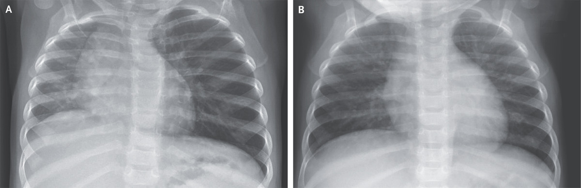
A child inhaling food
https://www.nejm.org/doi/full/10.1056/NEJMicm2115363
Corpus alienum bronchi lateris sinistri
Infans cum tussi et stridore
Status post bronchoscopiam in situ
Extractio corporis alieni
Suspicio obstructionis respiratoriae partialis bronchi lateris sinistri
A healthy 12-month-old girl was brought to the emergency department with a 4-hour history of coughing and stridor. Four hours earlier, she had choked while eating. Her respiratory rate was 38 breaths per minute, and her oxygen saturation was 98% while she was breathing ambient air. On examination, she appeared well. No cough or stridor was observed. Crackles and wheezing were heard in the right lung, and the left lung was clear. A chest radiograph showed opacification and volume loss in the right lung, rightward shift of the mediastinum, and hyperinflation of the left lung (Panel A). Given the abnormal radiographic appearance of the right lung, there was concern about right-airway obstruction. However, during rigid bronchoscopy, a foreign body was removed from the left mainstem bronchus. Partial airway obstruction in the left mainstem bronchus had resulted in hyperinflation on that side, with passive atelectasis and opacification on the right side. Foreign-body aspiration in children is potentially life-threatening. It is important to note that chest radiographs may appear normal when radiolucent objects are aspirated. High clinical suspicion of foreign-body aspiration should prompt bronchoscopy in order to avoid acute and chronic complications. A repeat chest radiograph in this patient was normal (Panel B), but her course was complicated by pneumonia, which abated with antimicrobial treatment.

Slide 9
FOLLOW-UP
EXERCISES
ABBREVIATIONS AND SPECIAL PHRASES: l.sin., susp. st.p., in situ
ANALOGIES between English and Latin:
  -ion ~ io (obstruction, hyperinflation, extraction)
  -scopy ~ -scopia (= visual examination)
ALTERNATIVE WAYS of conveying the same information:
an infant with v. … of an infant
suspicion of obstruction v. suspected obstruction
extraction > state after extraction
PREPOSITIONS AND CLASSIFICATION OF NOUNS into correct declension:
post + Acc: bronchoscopiam
cum + Abl: tussi, stridore
Explanation of new related TERMS AND THEIR CLASSIFICATION:
hyperinflation > -io, ionis, f pattern
atelectasis > -sis, sis, f pattern
Corpus alienum bronchi l.sin. / infans cum obstructione
Infans cum tussi et stridore / tussis et stridor infantis
St.p. bronchoscopiam in situ
Extractio corporis alieni / st.p. extractionem
Obstructio respiratoria partialis bronchi lateris sinistri suspecta

Slide 10
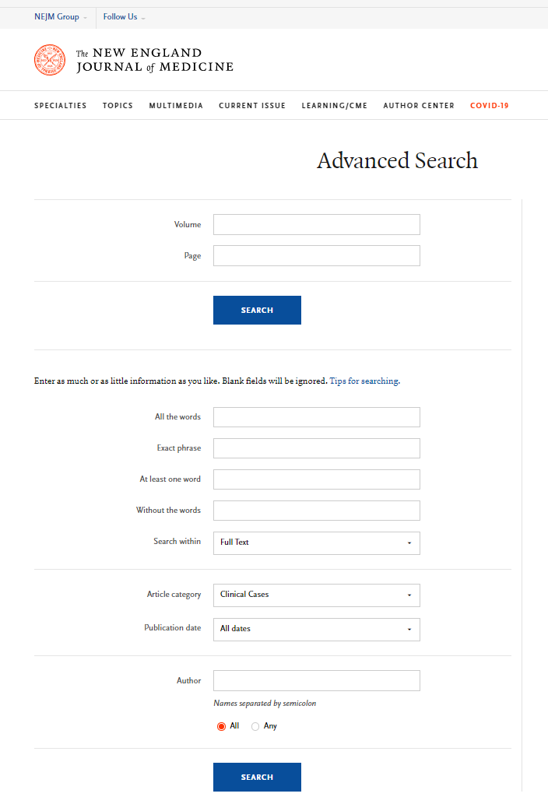
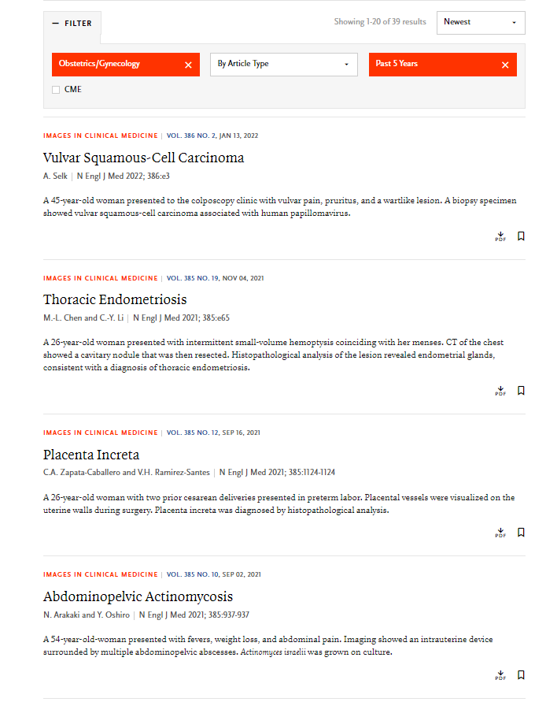
Search
Keyword / phrase:
e.g. open fracture
Article Category:
clinical cases
Specialty:
e.g. surgery
https://www.nejm.org/medical-search
https://www.nejm.org/medical-articles/clinical-cases?query=footer&date=past5Years

Slide 11
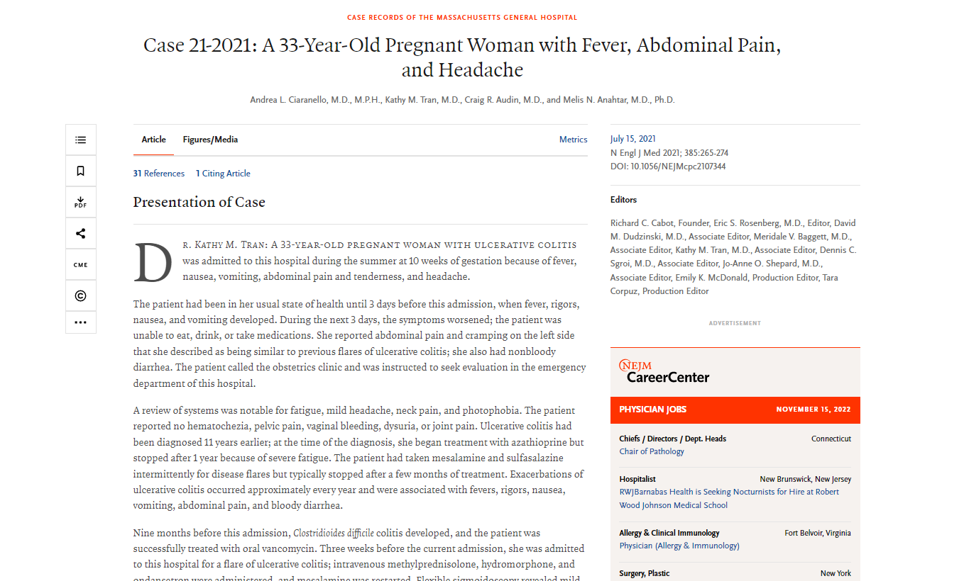
Case 21-2021: A 33-Year-Old Pregnant Woman with Fever, Abdominal Pain, and Headache
Search results
https://www.nejm.org/doi/full/10.1056/NEJMcpc2107344

Slide 12
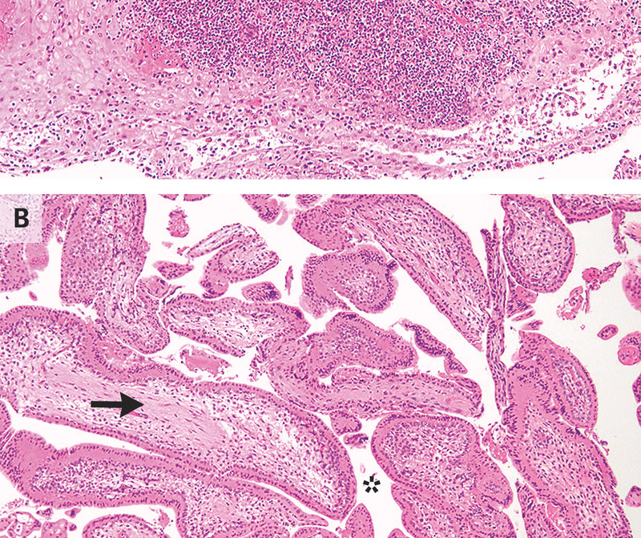
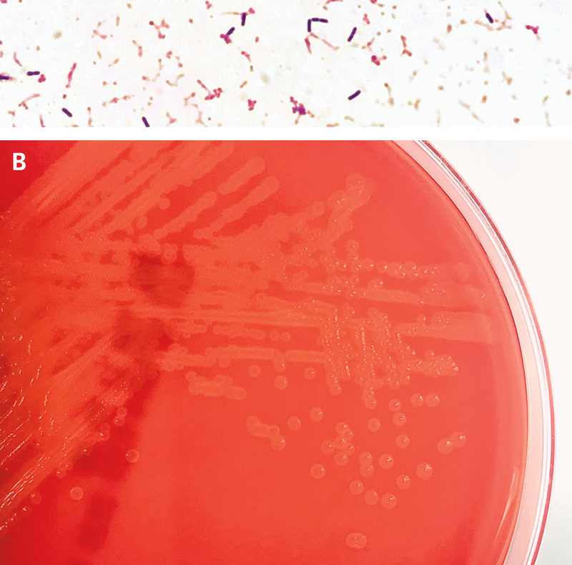
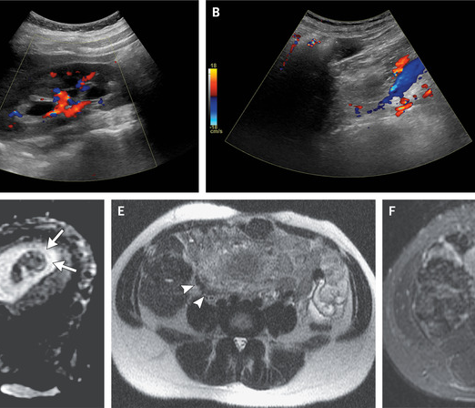
Presentation of the case
A 33-year-old pregnant woman with ulcerative colitis was admitted to this hospital during the summer at 10 weeks of gestation because of fever, nausea, vomiting, abdominal pain and tenderness, and headache. A review of systems was notable for fatigue, mild headache, neck pain, and photophobia. The patient reported no hematochezia, pelvic pain, vaginal bleeding, dysuria, or joint pain. Ulcerative colitis had been diagnosed 11 years earlier […] exacerbations of ulcerative colitis reoccurred approximately every year and were associated with fevers, rigors, nausea, vomiting, abdominal pain, and bloody diarrhea. Doppler ultrasonography of the abdomen revealed mild fullness in the pelvicalyceal system on the right side that is probably a physiologic finding in pregnancy. There was trace fluid in the right lower quadrant; however, the appendix was not visualized.

Slide 13
Implementation
VOCAB & WORD FORMATION
structure of a medical report
what is relevant?
different ways of reporting the same set of information
specific formulae, eponyms, abbreviations
vocabulary & word compounding
contextualizing grammatical phenomena, identification, recognizing and correcting mistakes
matching images with reports
reconstructing context (e.g. male/female?)
febris
nausea
pelvalgia
cephalalgia levis
photophobia
colporrhagia
hematochezia
colitis
exacerbans
recurrens
gravida cum colitide ulcerosa recurrenti
colitis ulcerosa gestationis in anam.
colitis ulcerosa in grav. hebd. 10

Slide 14
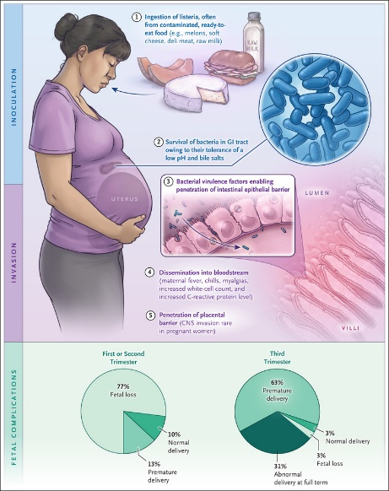
Follow-up context
This patient’s presentation has several key features that are consistent with listeria infection. In an immunocompetent host, ingestion of food contaminated with listeria typically results in asymptomatic infection or mild febrile gastroenteritis. However, this patient is at increased risk for invasive listeria infection because she is pregnant, has an inflammatory bowel disease, and takes immunosuppressive therapy.

Slide 15
References
J. Artimová and L. Švanda, “Latin as a Language for Specific Purposes: Its Development and Current Trends,” Humanising Language Teaching, vol. 18, pp. 1–11, 2016.
J. Artimová, L. Švanda, and K. Pořízková, “Podoby súčasného diagnostického záznamu” in Dimenzie jazykového vzdelávania v nefilologických odboroch (Tradícia a súčasnosť) 1953-2013 (Anna Rollerová ed.), pp. 91–101, Bratislava: Ústav cudzích jazykov LF UK v Bratislave, 2013.
L. F. Bachman and A. S. Palmer, Language Testing in Practice: Designing and Developing Useful Language Tests. Oxford, New York: Oxford University Press, 1996.
C. Elder, “Exploring the Limits of Authenticity in LSP Testing: The Case of a Specific Purpose Language Test for Health Professionals,” Language Testing, vol. 33, No. 2, pp. 147–152, 2015.
K. Fogarasi and P. Schneider, “How the Incorrect Use of a Medical Genre Can Result in Erroneous Legal Judgements,” CASALC Review, vol. 5, No. 1, pp. 121–133, 2015.
K. Fujita, M. Akiyama, K. Park, E. N. Yamaguchi, and H. Furukawa, “Linguistic Analysis of Large-Scale Medical Incident Reports for Patient Safety, Studies in Health Technology and Informatics, vol. 180, pp. 250–4, 2012.
B. Hemzal and M. Votava, Zkratky používané v medicíně. Brno: Neptun, 2005.
D. Lippert, Die lateinische Diagnose in der Unfallchirurgie und ihren Grenzgebieten. Wien: Allgemeine Unfallversicherungsanstalt Wien, 2010.
P. Nečas, “Empirický pohled na výuku latinské lékařské terminologie” in Latinitas medica (E. Marečková, H. Reichová, M. Severová, Dana Svobodová, and František Šimon, eds.), pp. 92–100, Brno: Munipress, 2015.
K. Pořízková, Jozefa Artimová, and Libor Švanda, “Latinská lékařská terminologie ve světle moderních výukových metod,” ACC Journal, vol. 19, No. 3, pp. 134–139, 2013.
K. Pořízková, “Corpus-Based Approaches to Teaching Medical Terminology” in XVIIth CERCLES. The Future of Language Education in an Increasingly Digital World: Embracing Change, Porto 15–17 September, 2022.
K. Pořízková a M. Blahuš, “Korpus autentických klinických diagnóz v prostředí softwaru Sketch Engine” in Latinitas medica (E. Marečková, H. Reichová, M. Severová, Dana Svobodová, and František Šimon, eds.), pp. 31–42, Brno: Munipress, 2015.
K. Pořízková and R. Helán, “Using Tools of Corpus Linguistics for Investigating and Teaching Language ofor Medical Purposes” in Language Studies at a Higher Education Institution, Kaunas 2014.
The New England Journal of Medicine, Accessed 12 November, 2022. Retrieved from https://www.nejm.org/

