Slide 1
English Course for Students of Dentistry
Veronika Dvořáčková, Jana Klapilová, Marie Lahodová Vališová
CJV LF MUNI

Slide 2
Course Creation – Your Experience
When were you last involved in creating from scratch or substantially modifying an English for Specific Purposes (ESP) or Language for Specific Purposes (LSP) course?
What specific approaches did you use during the course development or modification process?
Can you share any obstacles you faced and how you dealt with them?

Slide 3
Outline
Background
Syllabus
Activity types
Hands-on tasks
CJV LF MUNI

Slide 4
Background
Ongoing course differentiation process
English for Medics, Dentists and Embryologists I, II
English for Non-Medical Healthcare Professions I, II
New courses
English for Laboratory Technicians (T. Kibalnikova, K. Lexová)
English for Dentistry (V. Dvořáčková, J. Klapilová, M. Lahodová Vališová)
spring semester, vocabulary/terminology focused, skills
Planned
English for Embryologists
… ?
CJV LF MUNI

Slide 5
Syllabus
Unit 1: Presentation and Oral Exam
Unit 2: Chairside Manner and Medical History Taking
Unit 3: Oral Cavity
Unit 4: Extraoral and Intraoral Examination
Unit 5: Dental Caries
Unit 6: Dental Prophylaxis
Unit 7: Restorative Dentistry
Unit 8: Oral Cancer
Unit 9: Orthodontics
Unit 10: Dental Trauma and Maxillofacial Surgery
Unit 11: Oral Health and Systemic Diseases
Unit 12: Ethics in Dentistry
CJV LF MUNI

Slide 6
Activity Types
item matching
collocation formation
wordformation
gapfills
item ordering
video tasks
… usually combinations of all above
role plays
patient report completion
case discussion task
CJV LF MUNI

Slide 7
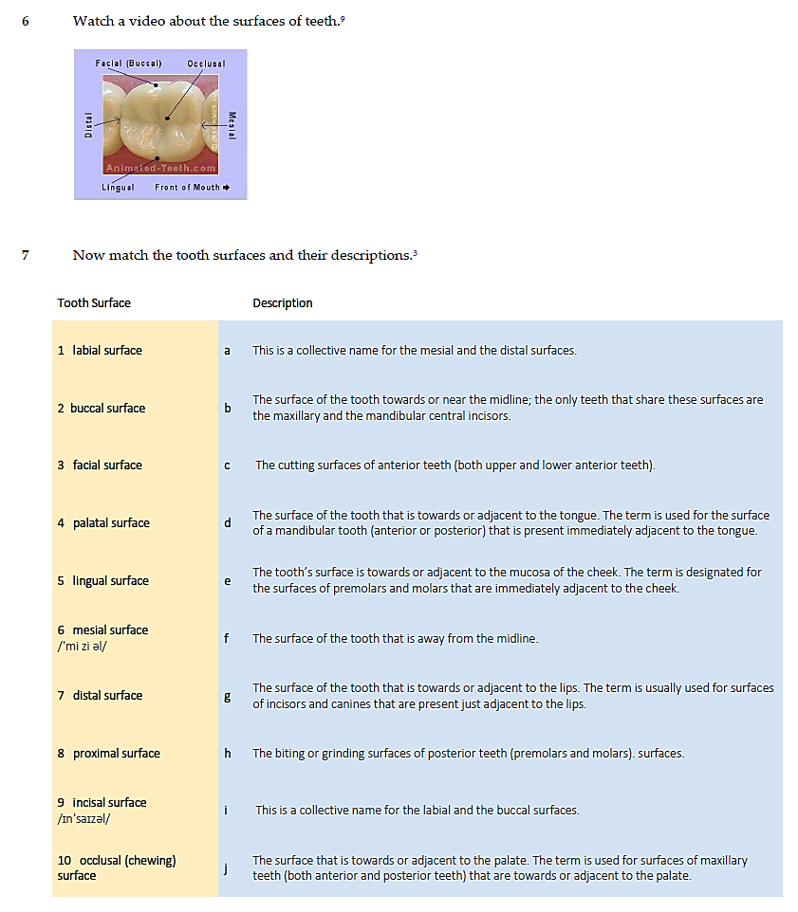
Item Matching
Pictures
Definitions
Unit 5 Dental Caries
TASK Matching
Unit 3 Oral Cavity
CJV LF MUNI

Slide 8
Gapfills
Word Formation
Unit 9 Orthodontics
Unit 4 Extraoral and Intraoral Examination
CJV LF MUNI

Slide 9
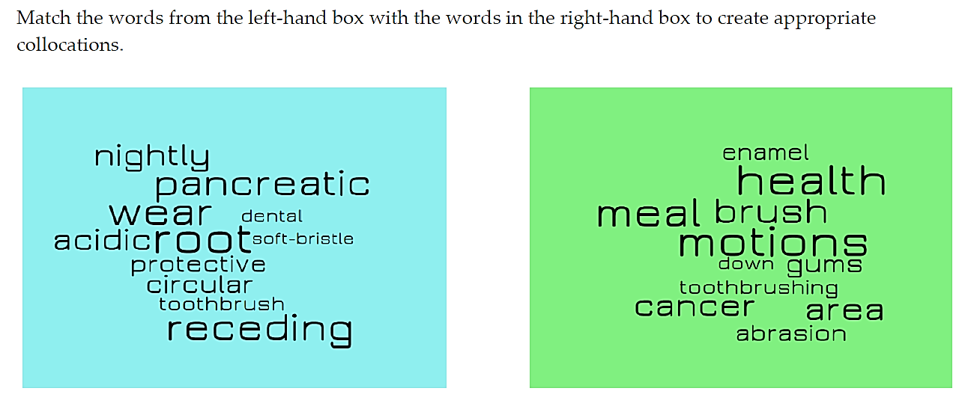
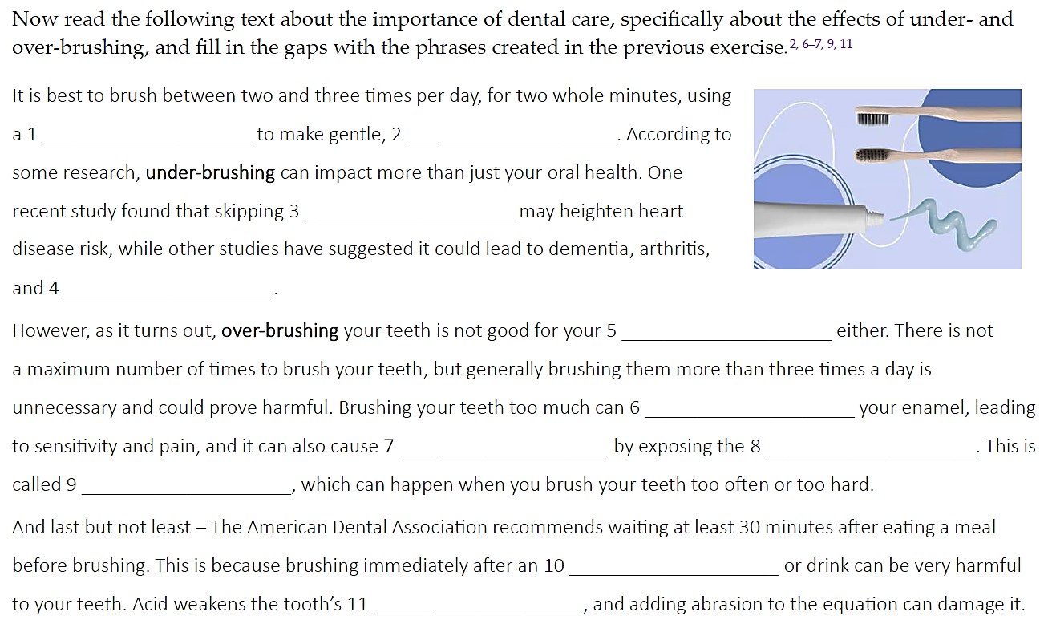
Collocation Formation
Unit 11 Oral Health and Systemic Diseases
Unit 6 Dental Prophylaxis
TASK
Video (or here)

Slide 10
Collocation Formation – Key
heart disease: oral bacteria, inflamed gums, infective endocarditis, susceptible individual, colonize the lining of the heart
diabetes: blood sugar control, oral thrush, dry mouth
pneumonia: compromised patients, bacterial plaque, oral secretions, hospital-acquired pneumonia
nutrition: chewing food, broken teeth, loose teeth, denture loss

Slide 11
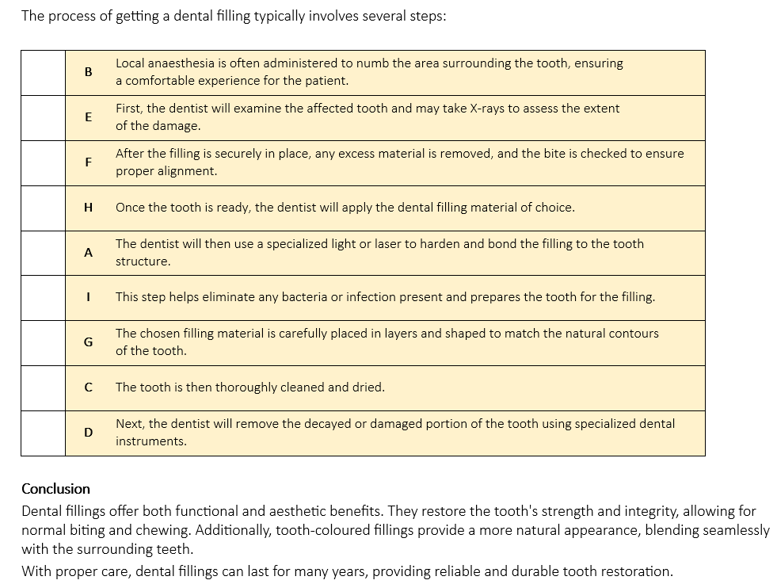
Sorting Out
Ordering
Unit 3 Oral Cavity
Unit 5 Dental Caries

Slide 12
Video Tasks
Unit 7 Restorative Dentistry
Unit 4 Extraoral and Intraoral Examination
CJV LF MUNI

Slide 13
Role Plays
Unit 2 Medical history taking
Unit 6 Dental check-up
Unit 7 Root canal treatment (OET)
Unit 9 Orthodontic consultation
Unit 10 Chipped molar treatment
CJV LF MUNI

Slide 14
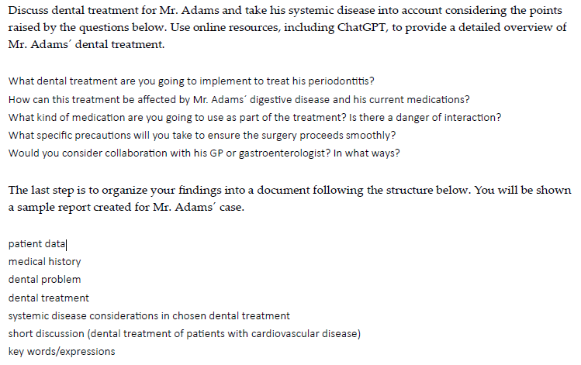
Patient Report Completion
Unit 11 Oral Health and Systemic Diseases
Sample report
Instructions and patient profiles
CJV LF MUNI

Slide 15
Case Discussion
Teacher Notes
The texts, comprehension questions and suggested answers for teachers are available as a separate document.
Step 1 (6 min)
small groups, all participants reading the same case report
glossary of technical terms
three discussion (comprehension) questions
Step 2 (6 min)
groups reshuffled, all three case reports are represented
a bank of 14 questions, students and answer those related to their text, sharing more background with their peers
Unit 8 Oral Cancer
TASK
CJV LF MUNI

Slide 16
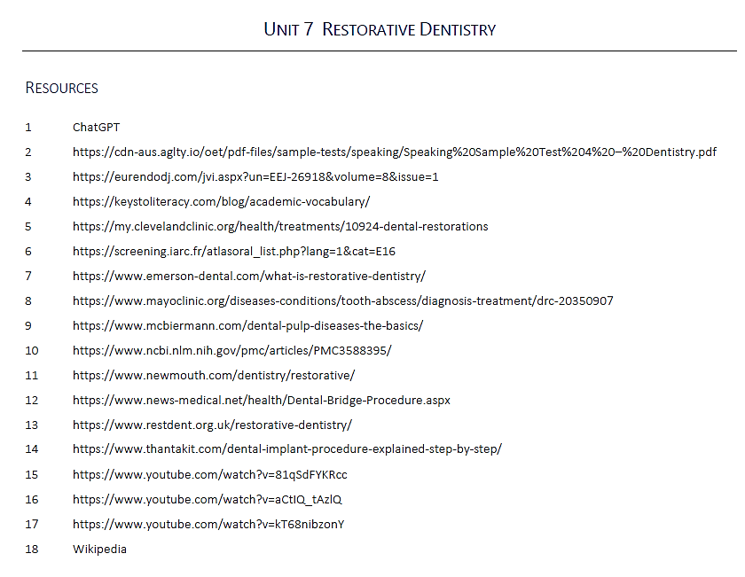
Resources
Multiple…
Quoted at the back of each unit.

Slide 17
CJV LF MUNI

