Slide 1
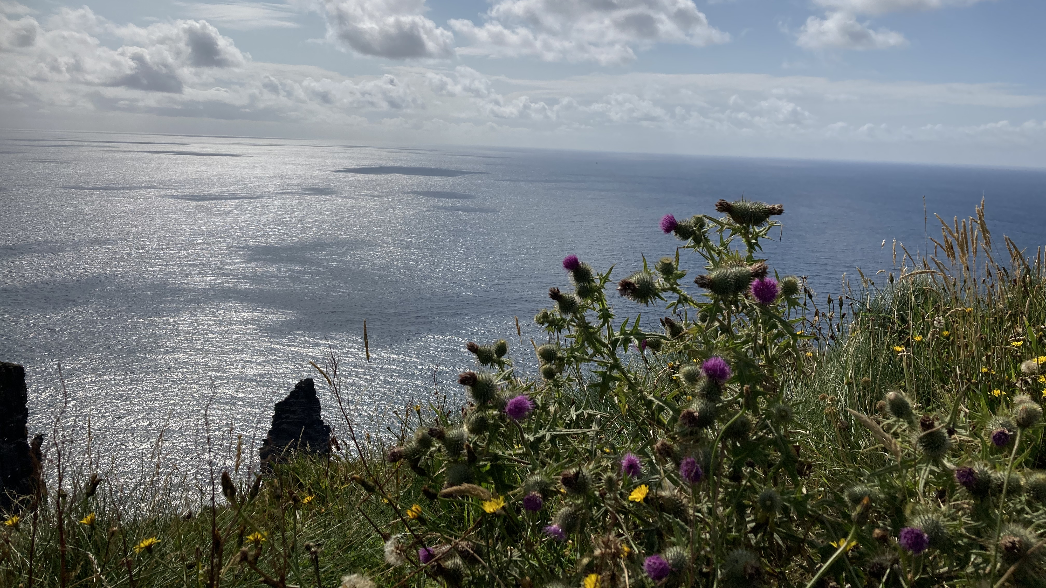
Exploring Mindfulness in Ireland this is not about AI but EI Erika Putnová
Why?
https://www.mentimeter.com/app/presentation/alq4hxgqoaj6e77kzaeipsjftkijbhpn/iumso8zf9gd8/edit

Slide 2
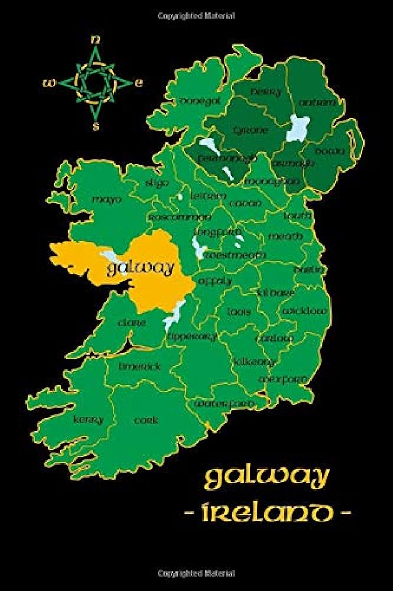
Mindfulness for educators
Atlantic Language School Galway, Ireland – July 2023 – staff mobility Erasmus +

Slide 3
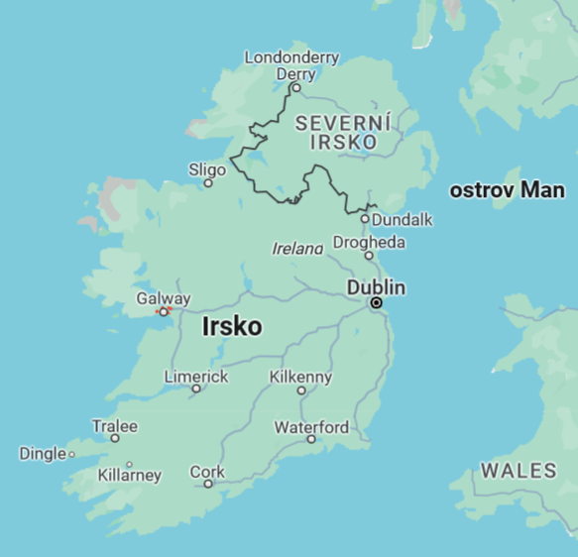

Slide 4
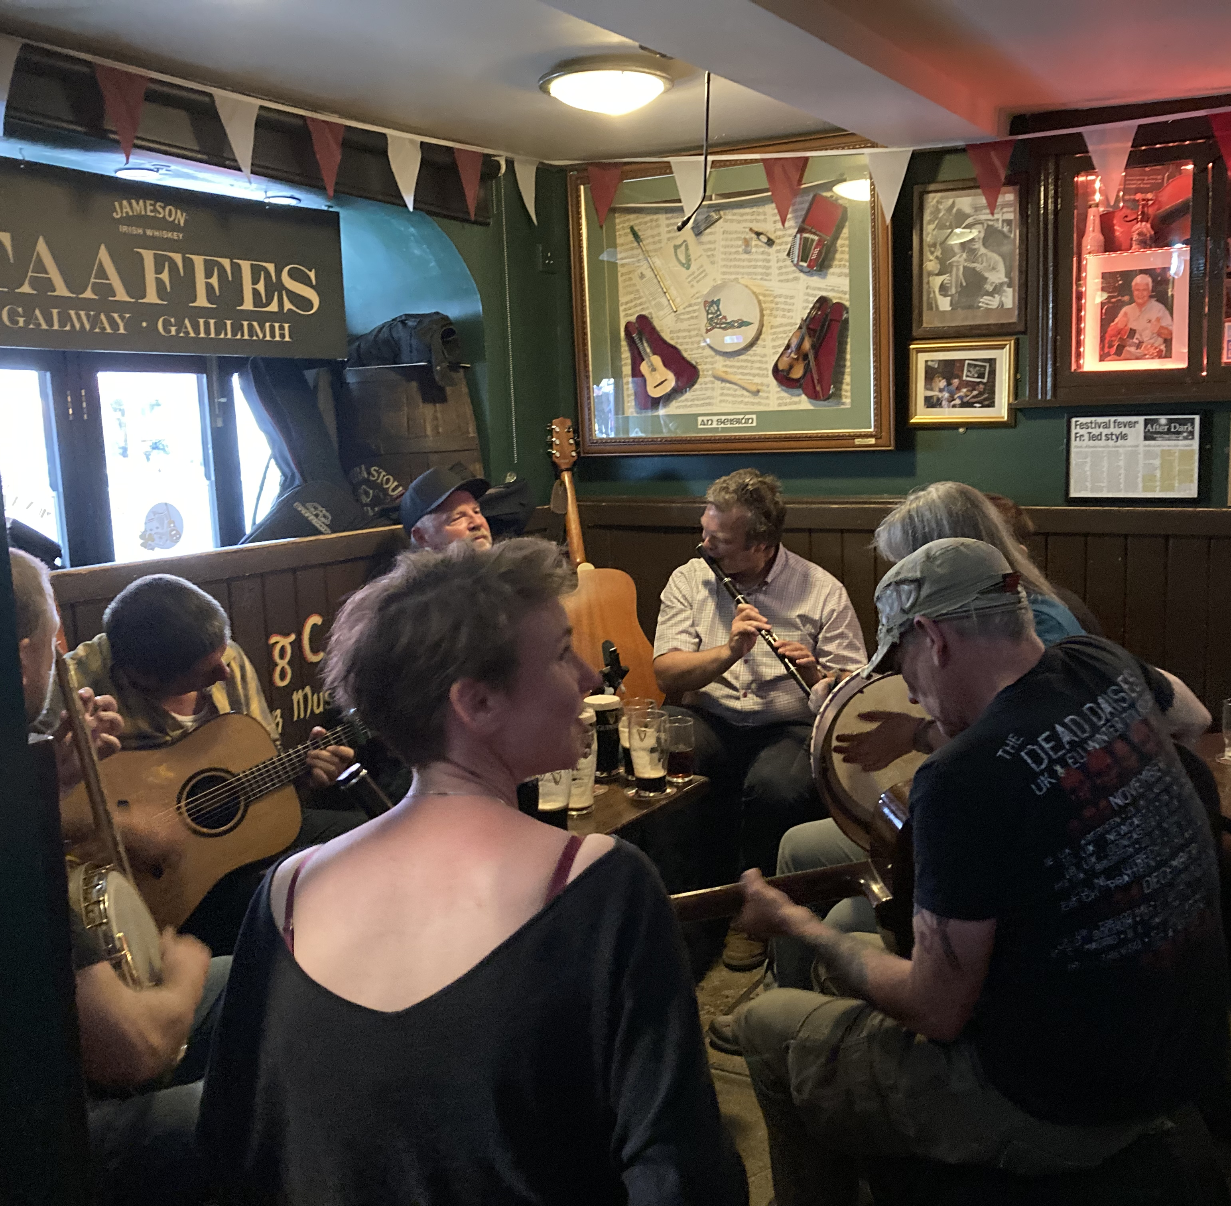
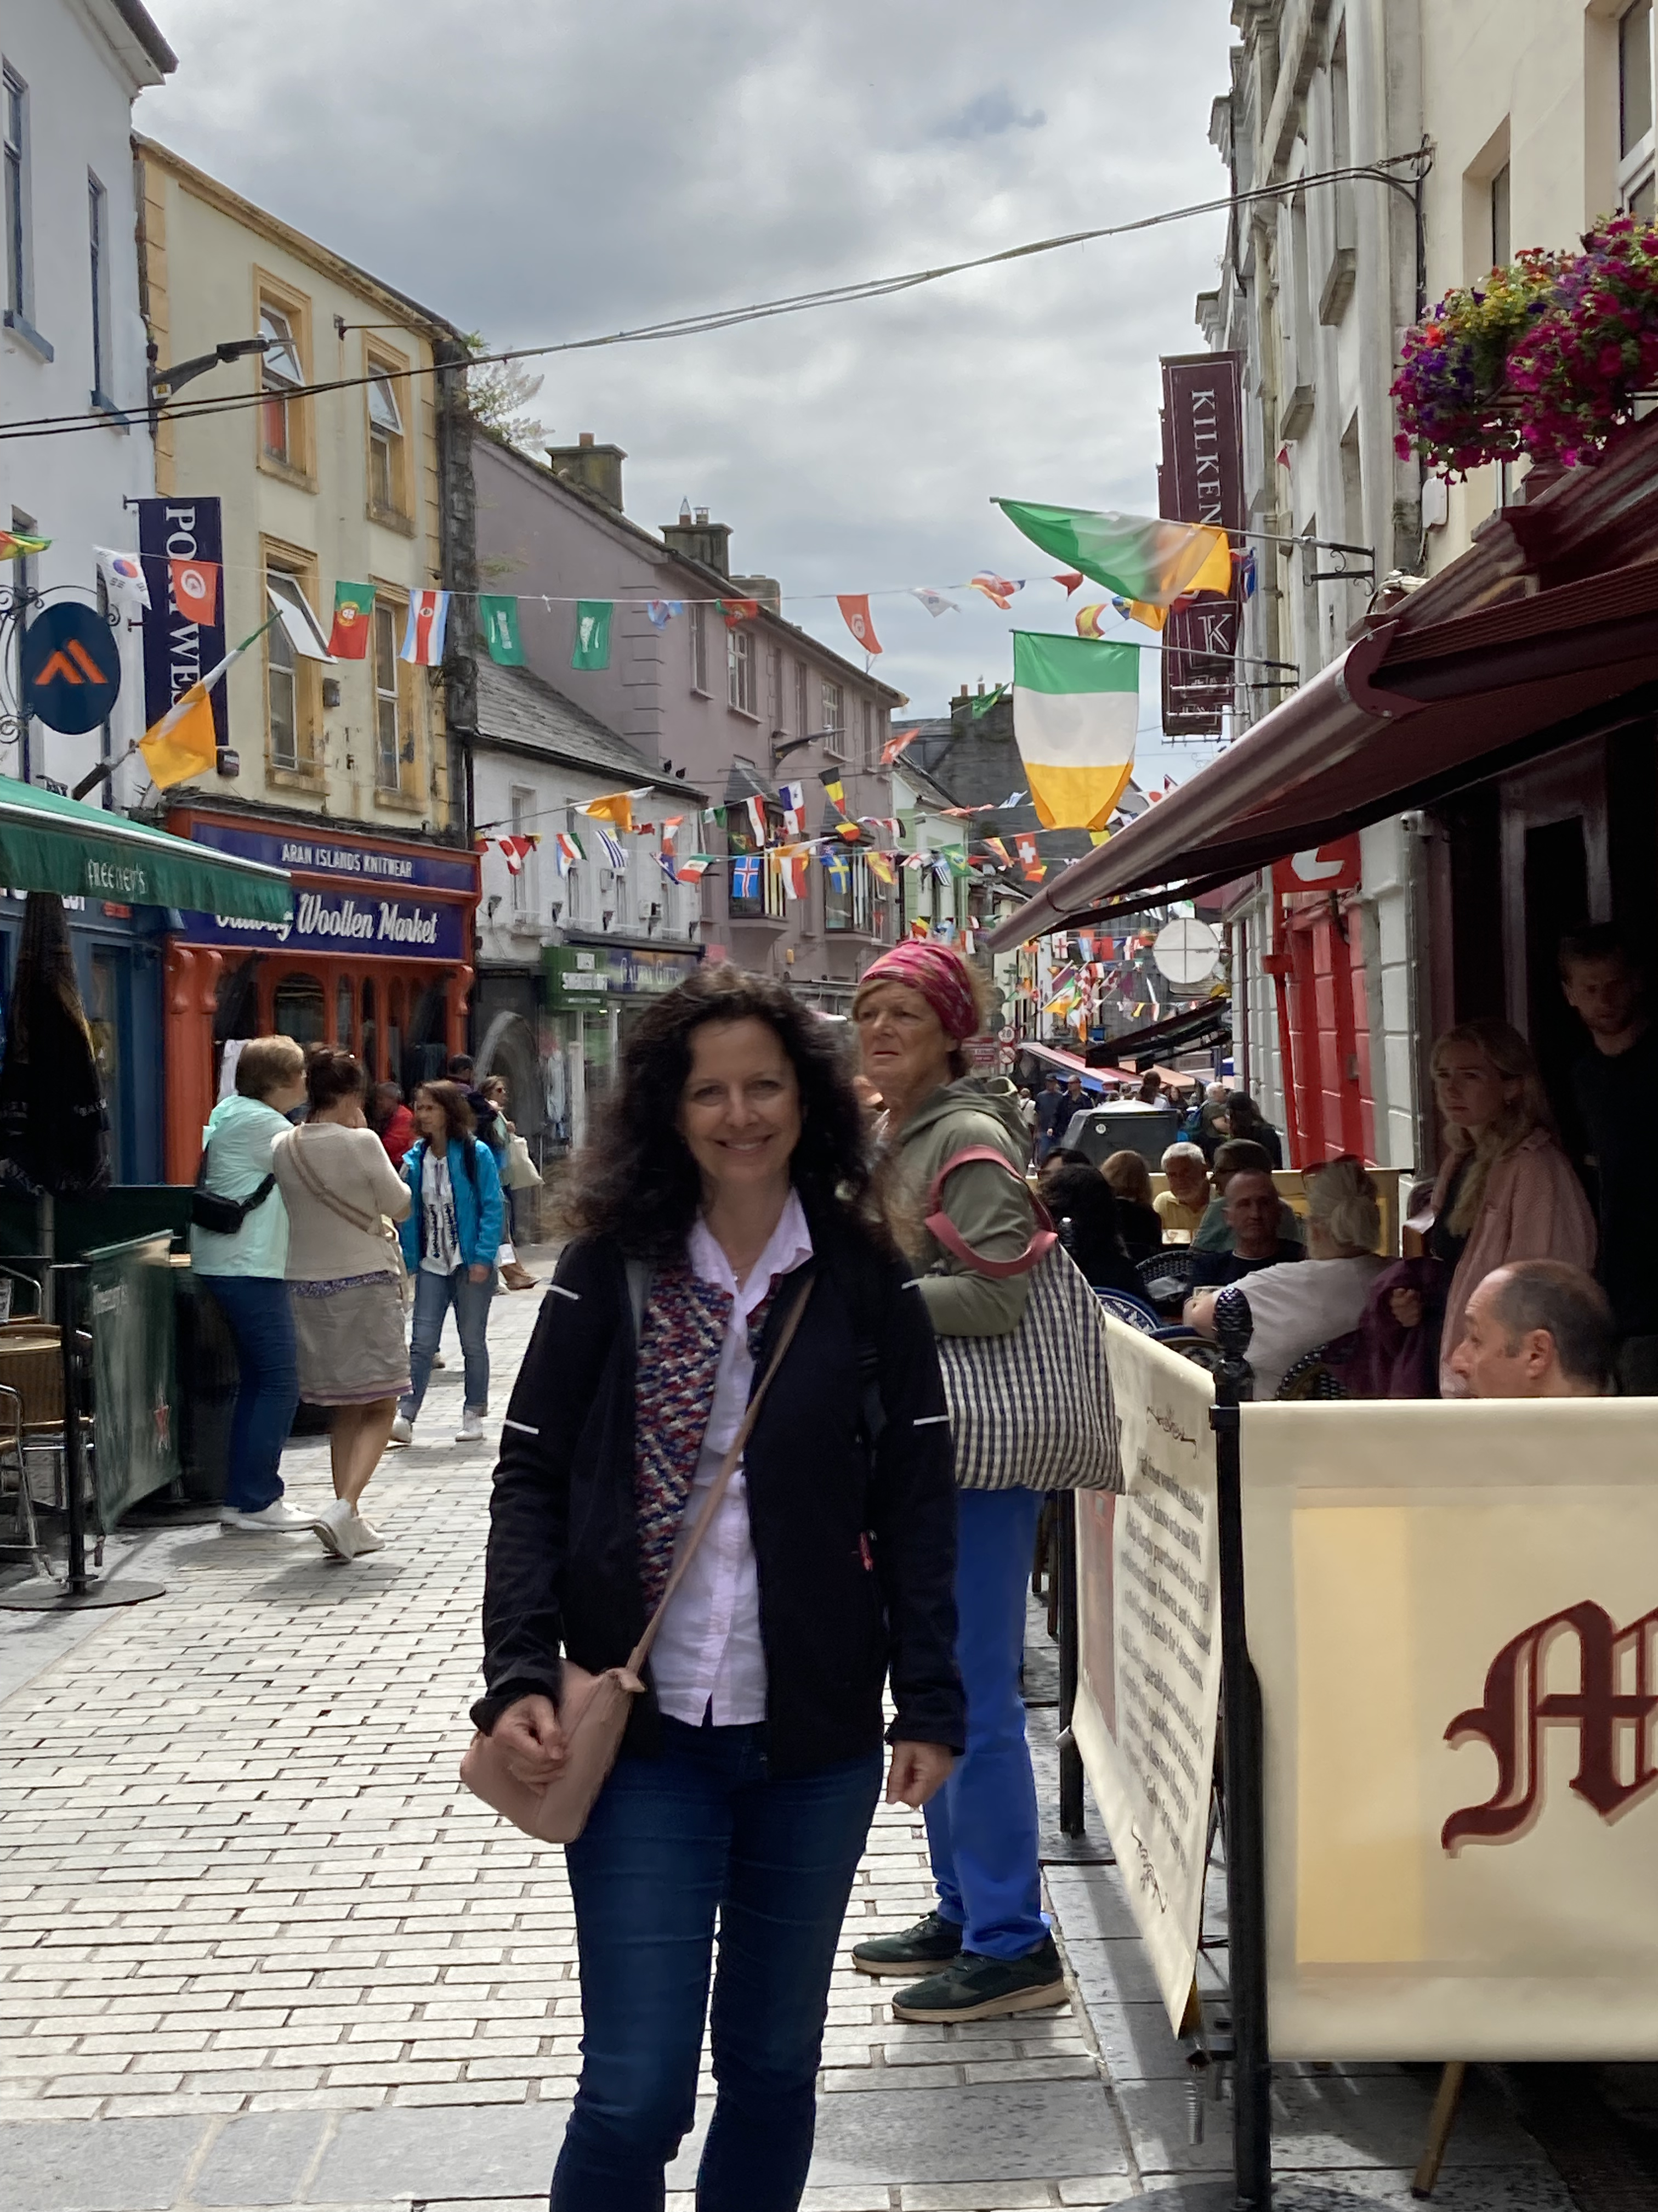
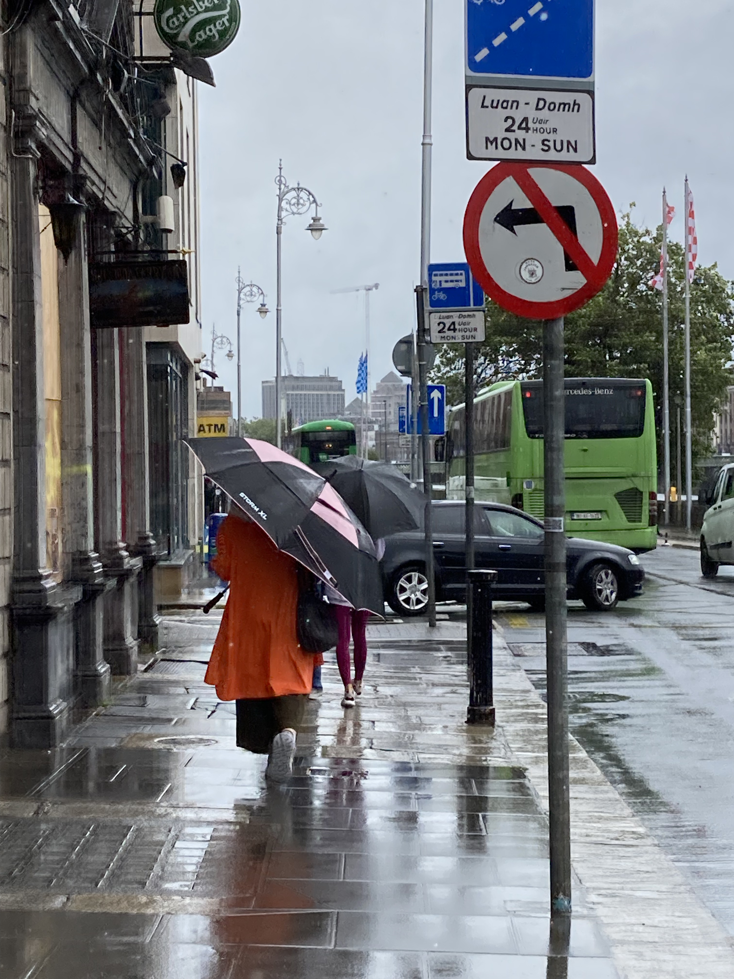
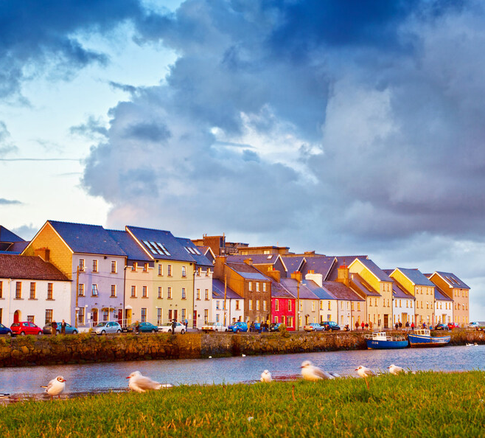

Slide 5
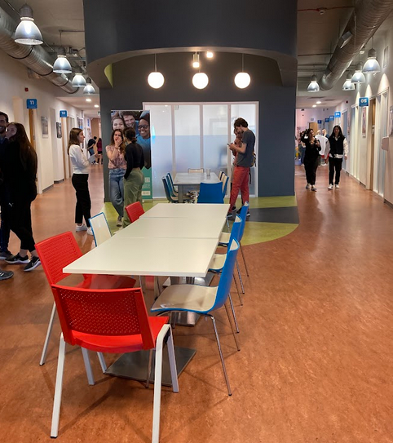
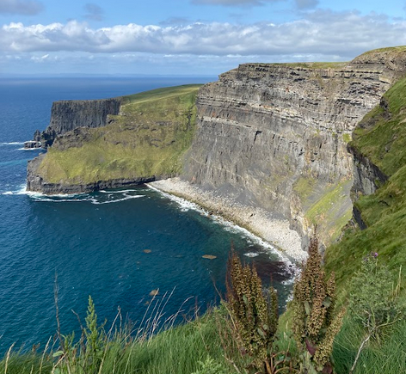
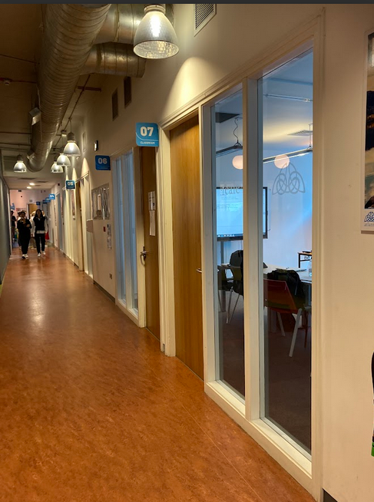
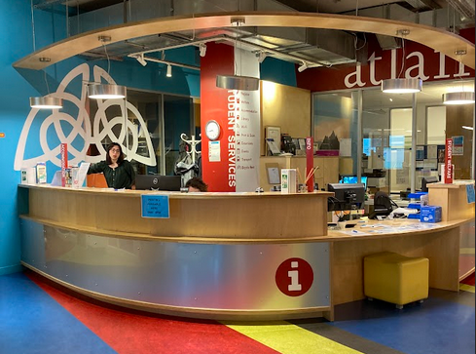
OUTLINE
Why did I choose the course?
Objectives of the course
Classroom sessions: theory + practice
Mindfulness & Emotional intelligence
Activities for developing M&EI (examples)
Mindfulness in the workplace and classroom
My first attempts of Mindfulness in the seminars
Main takeaways
Hokusai says…

Slide 6
OBJECTIVES

Slide 7
ADDED VALUE and ACTIVITIES

Slide 8
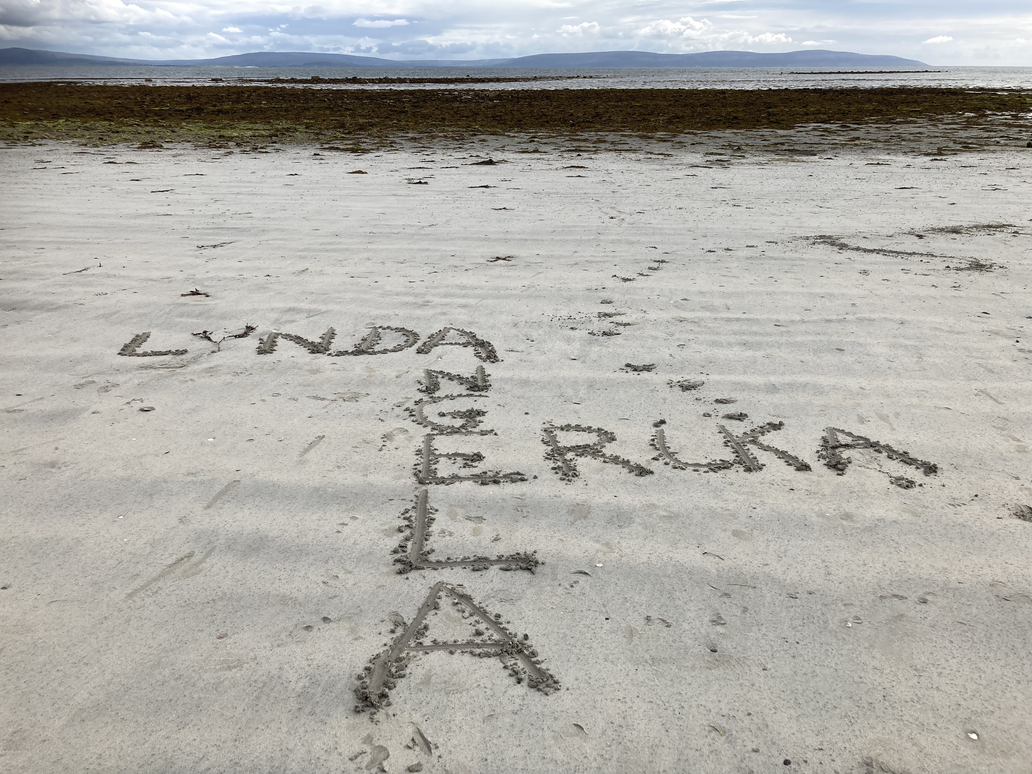
OUTCOMES AND IMPACT

Slide 9
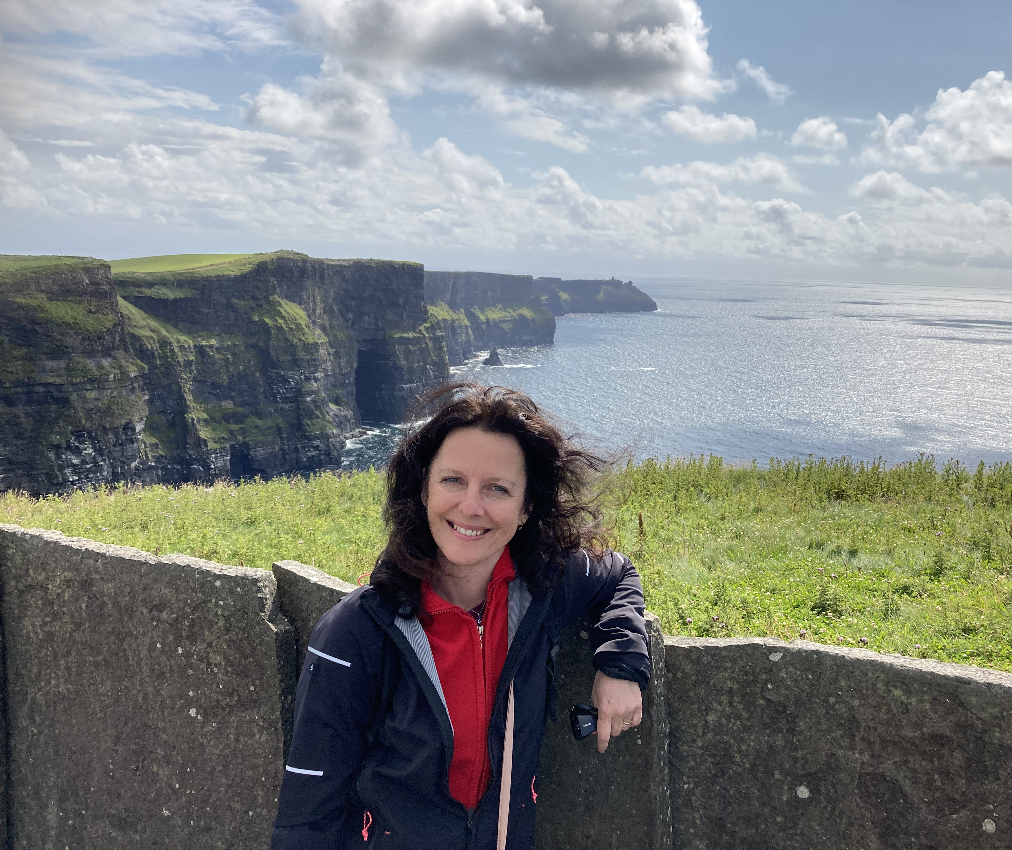
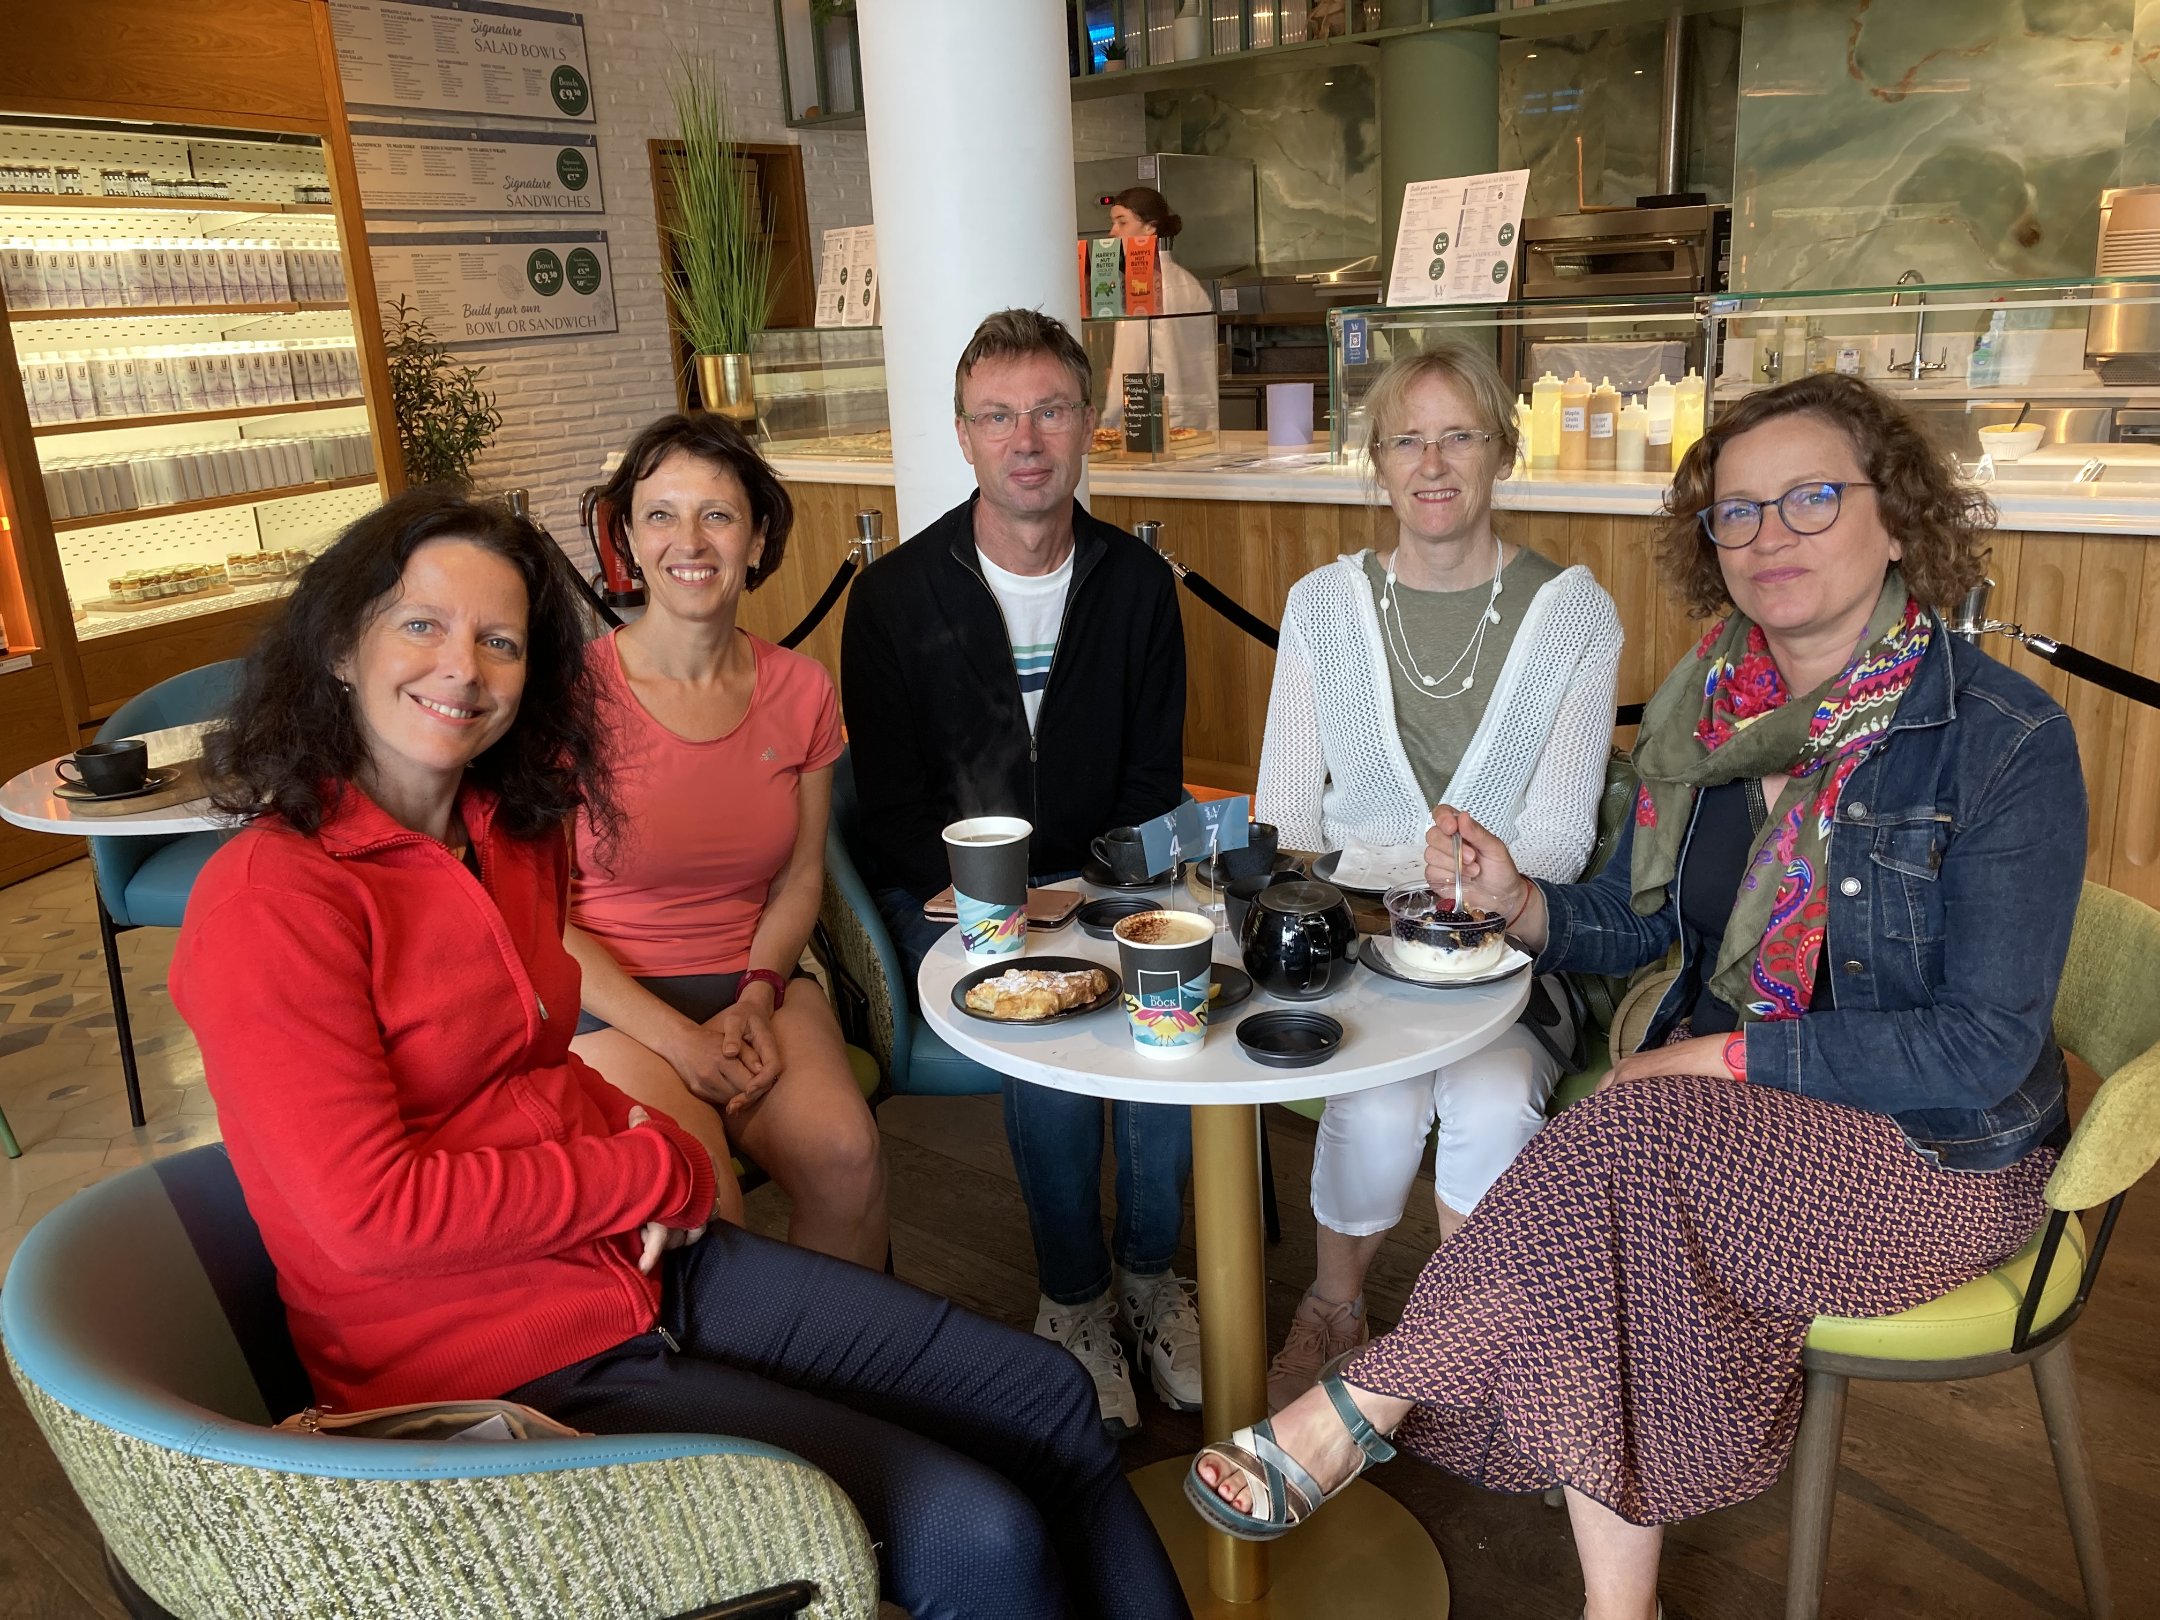
My main objectives
Work life balance
Me-time
Application in the classroom
Meeting new people

Slide 10
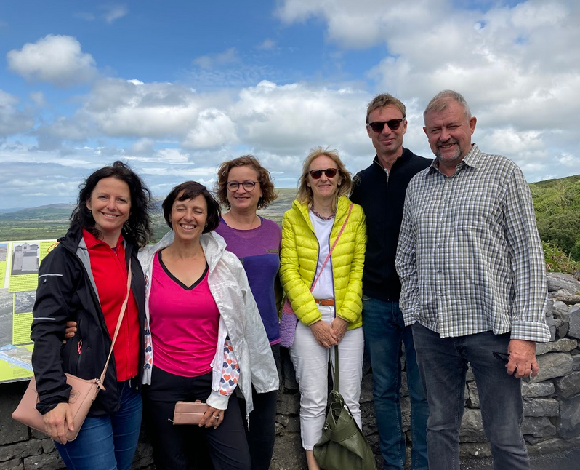
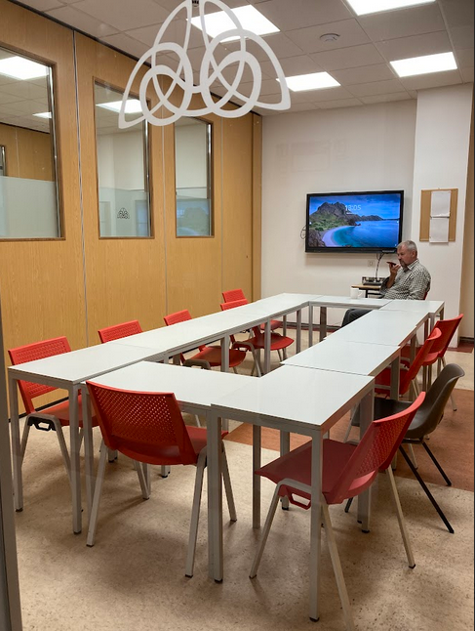
CLASSROOM SESSIONS –
theory and practice
Lawrence Body
English and mindfulness teacher at Malaga University
Lawrence Body has a Master degree in Mindfulness and Emotion management and almost 30 years’ experience as a teacher trainer. He has developed programs for Malaga University, for schools at primary and secondary level supported by the Junta de Andalucia, and for the English Language Centre in Brighton, UK. He also designs courses for business and organizations and provides training online.
https://www.youtube.com/watch?v=rOne1P0TKL8 – mindfulness meditation – 3-minute breathing space

Slide 11
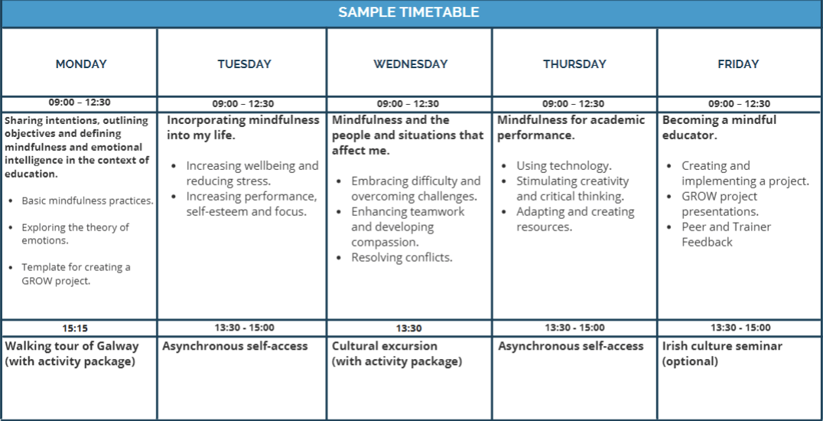
SAMPLE TIMETABLE

Slide 12
DISCUSSION – I - Mindfulness
What is mindfulness?
What activities can you do mindfully? Can they be done in the classroom?
What is FLOW?
What might be the impact of mindfulness?

Slide 13
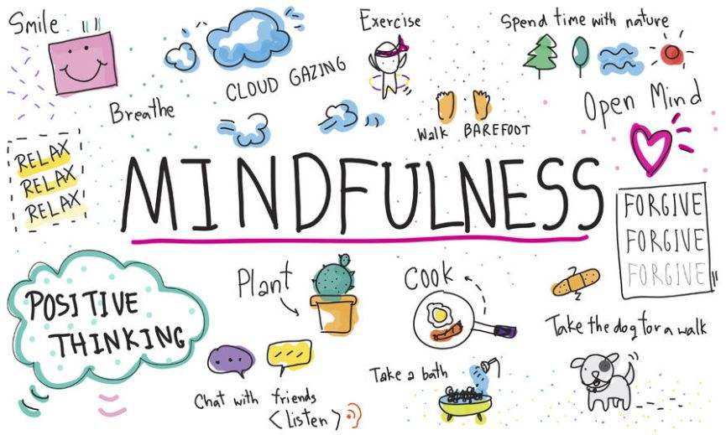
WHAT IS MINDFULNESS?

Slide 14
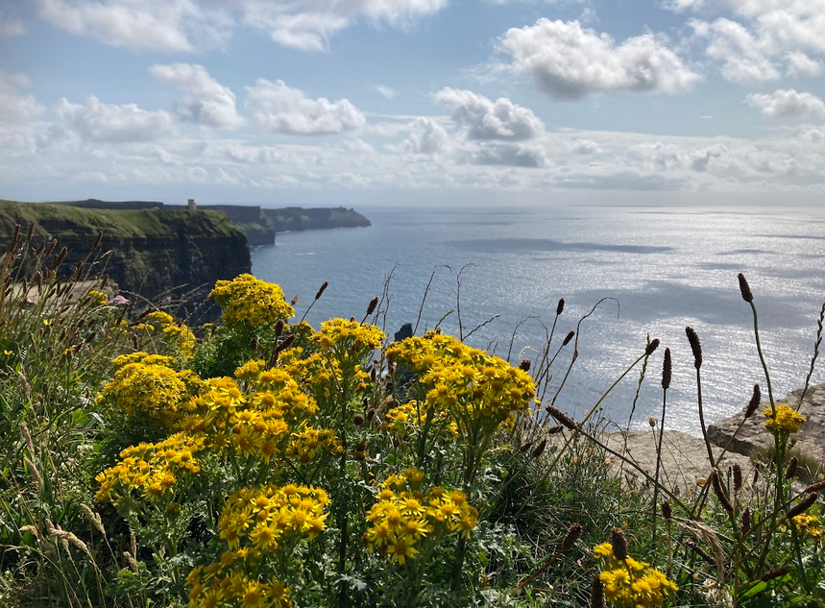
BASIC INGREDIENTS
Experiencing life to the full
Becoming more self-compassionate
Developing wisdom and compassion
Flow
Being vs. doing

Slide 15
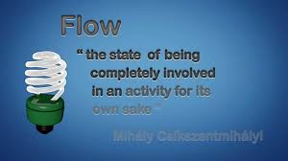
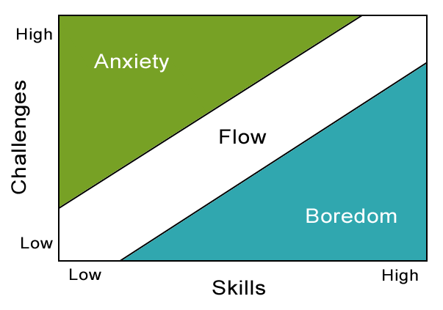
FLOW
energized
growth
joy
fun

Slide 16
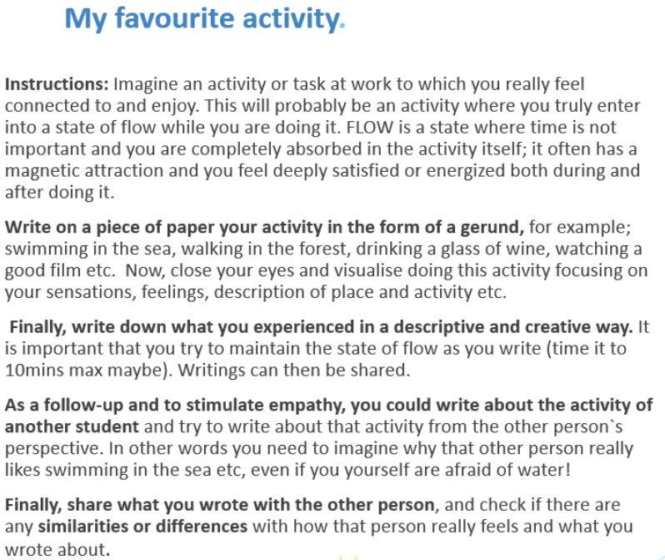
FLOW

Slide 17
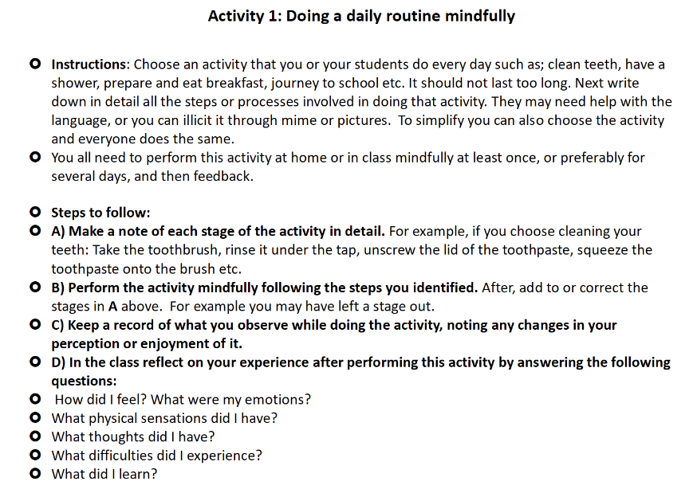
DAILY ROUTINES

Slide 18
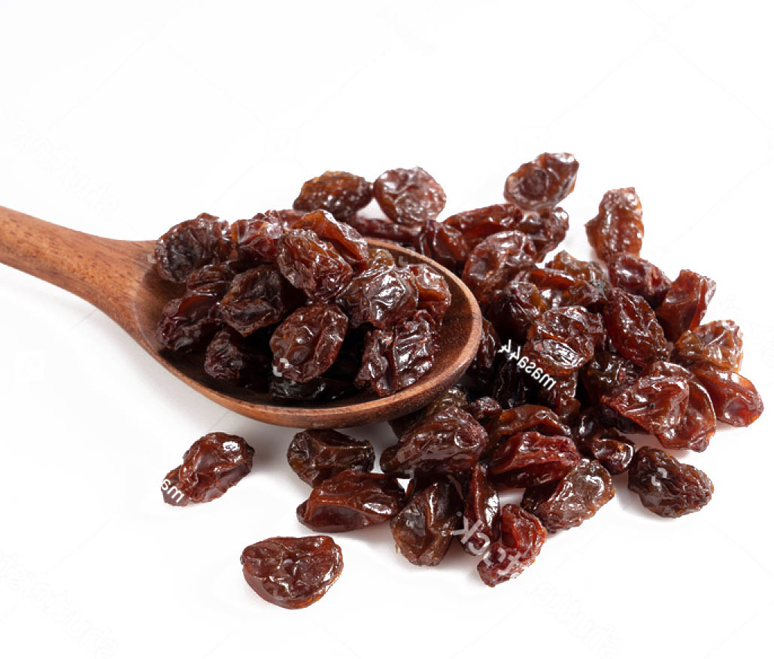
MINDFUL EATING
https://www.youtube.com/watch?v=z2Eo56BLMjM&t=9s
https://www.youtube.com/watch?v=1umGZ8S8tHo

Slide 19
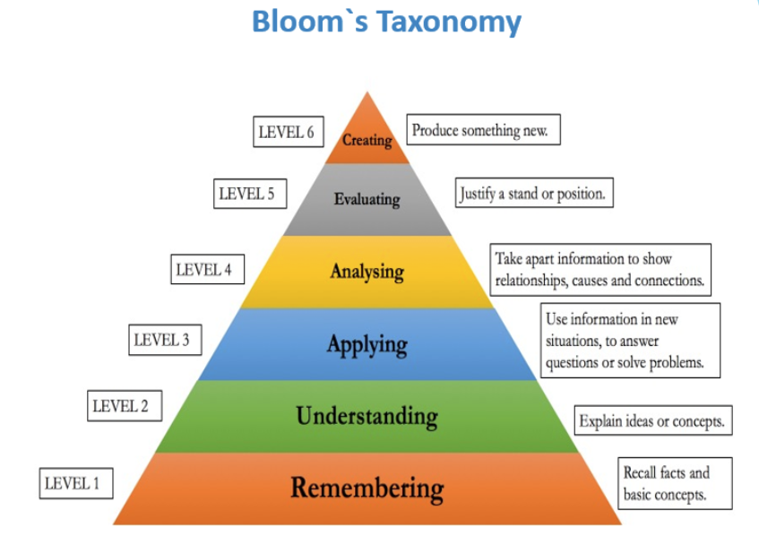
MORE THOUGHTS ABOUT MINDFULNESS AND EI
Gaining perspective
Creativity (finding beauty) – beginner‘s mind
Critical thinking

Slide 20
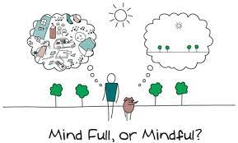
CHANGES THAT MIGHT HAPPEN
Improved mental health; decreased stress, anxiety and depression
Improved attention and concentration
More positive behaviour
Increases in social emotional learning
Growth in empathy and compassion
Enhanced critical thinking and creativity
Real learning and better test scores

Slide 21
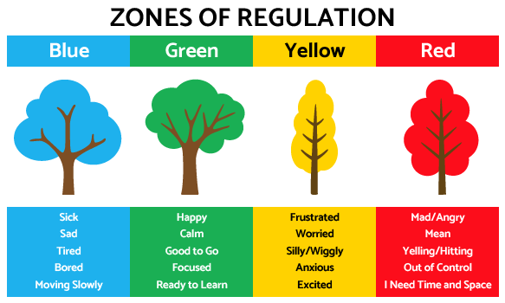
Mindfulness helps you stay in the green zone

Slide 22
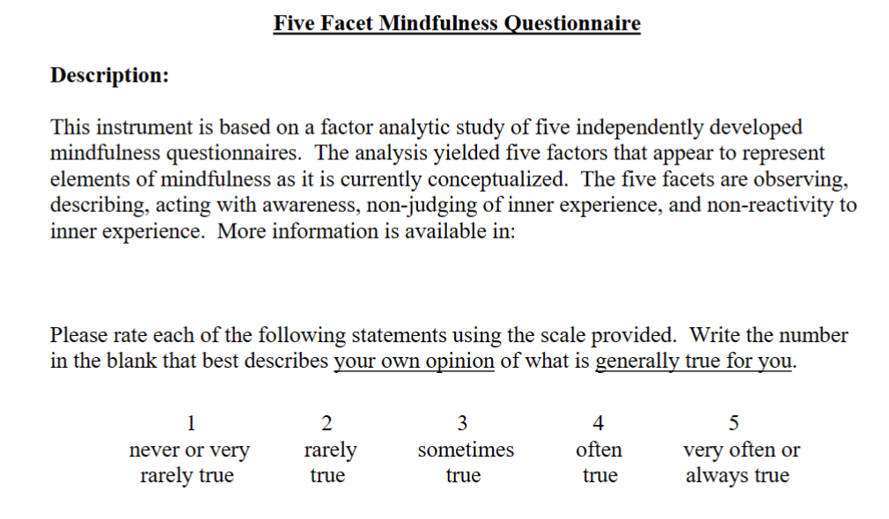

Slide 23
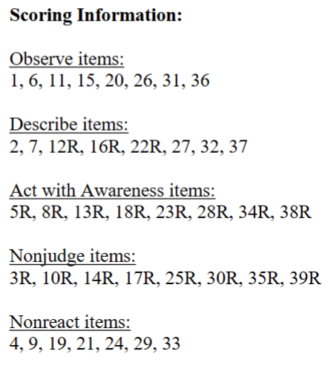

Slide 24
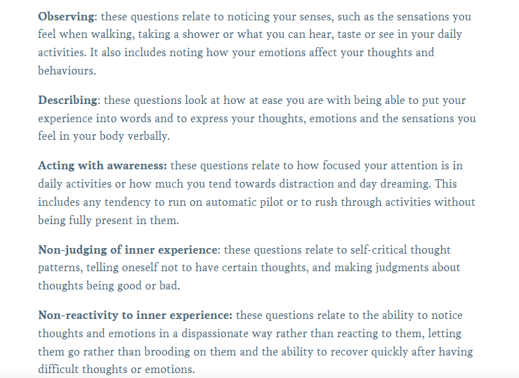
WHAT IS BEHIND?

Slide 25
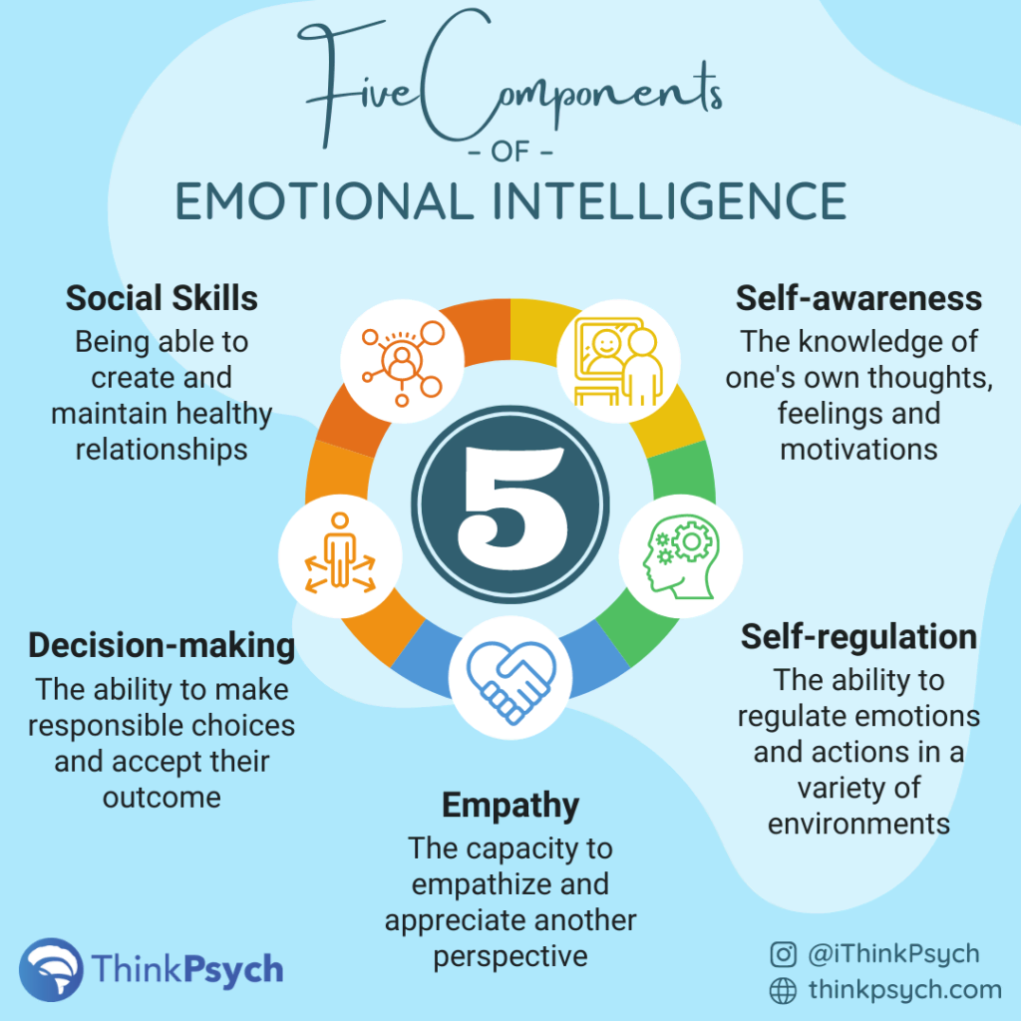
What is emotional intelligence?

Slide 26
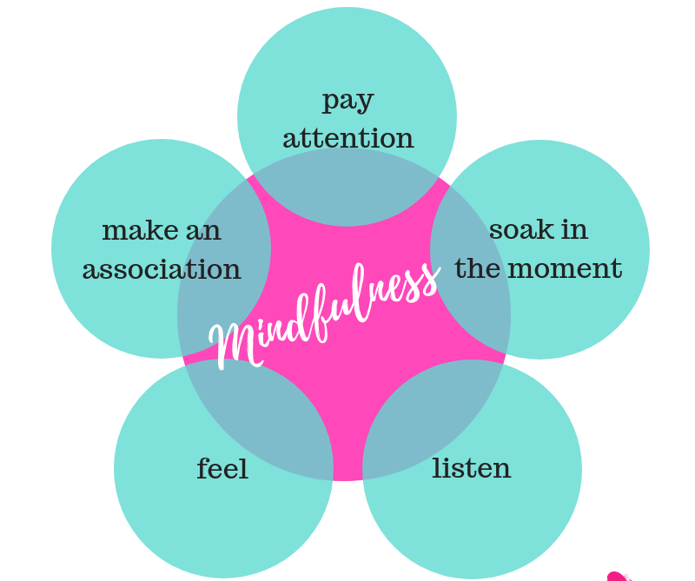
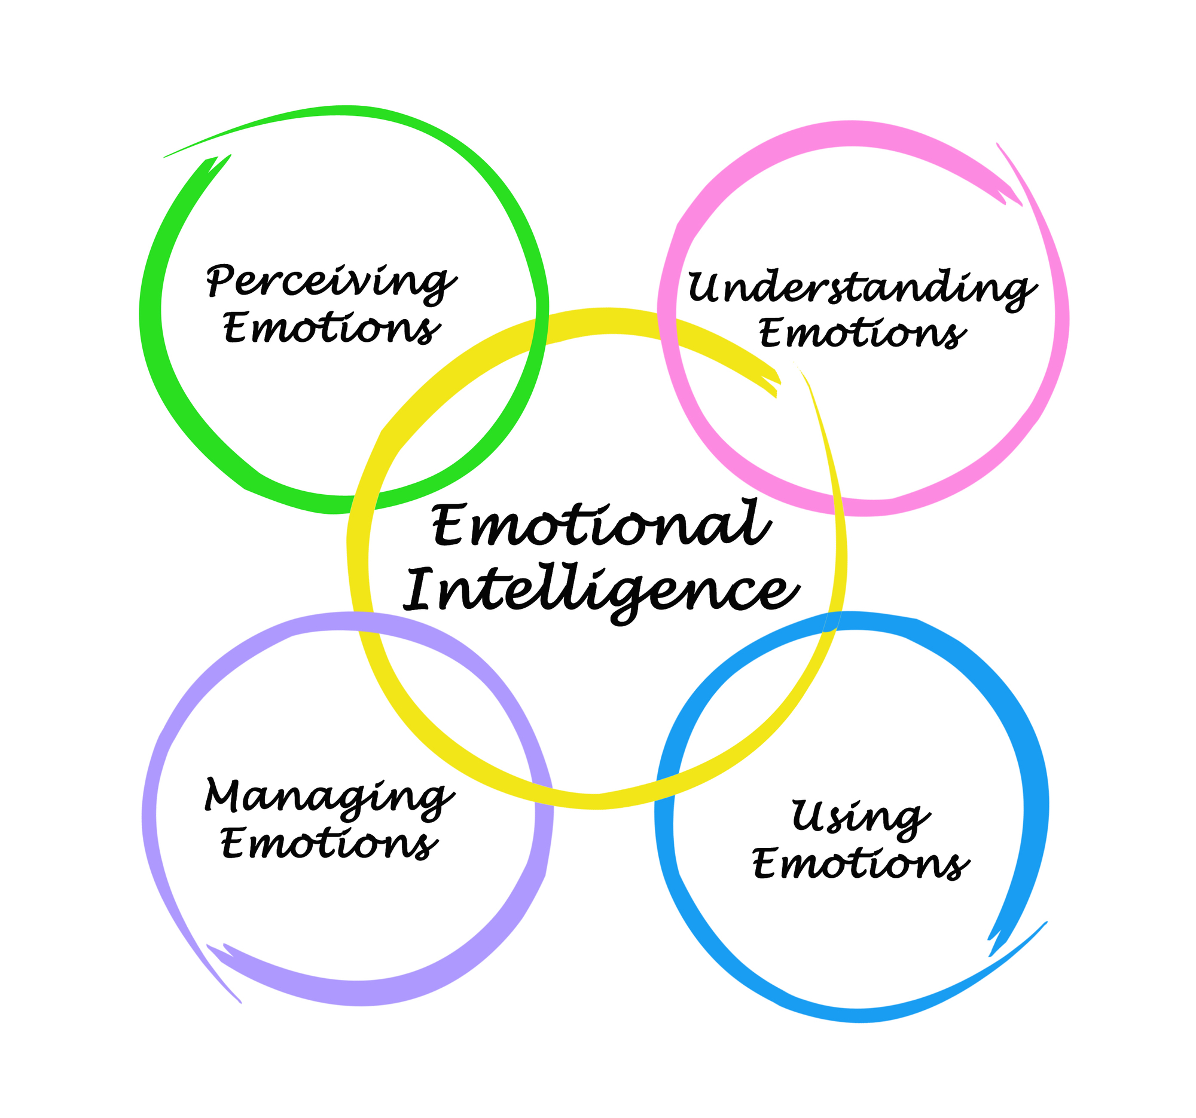
Mindfulness vs. emotional intelligence
helps us understand where we are
helps us manage our emotions

Slide 27
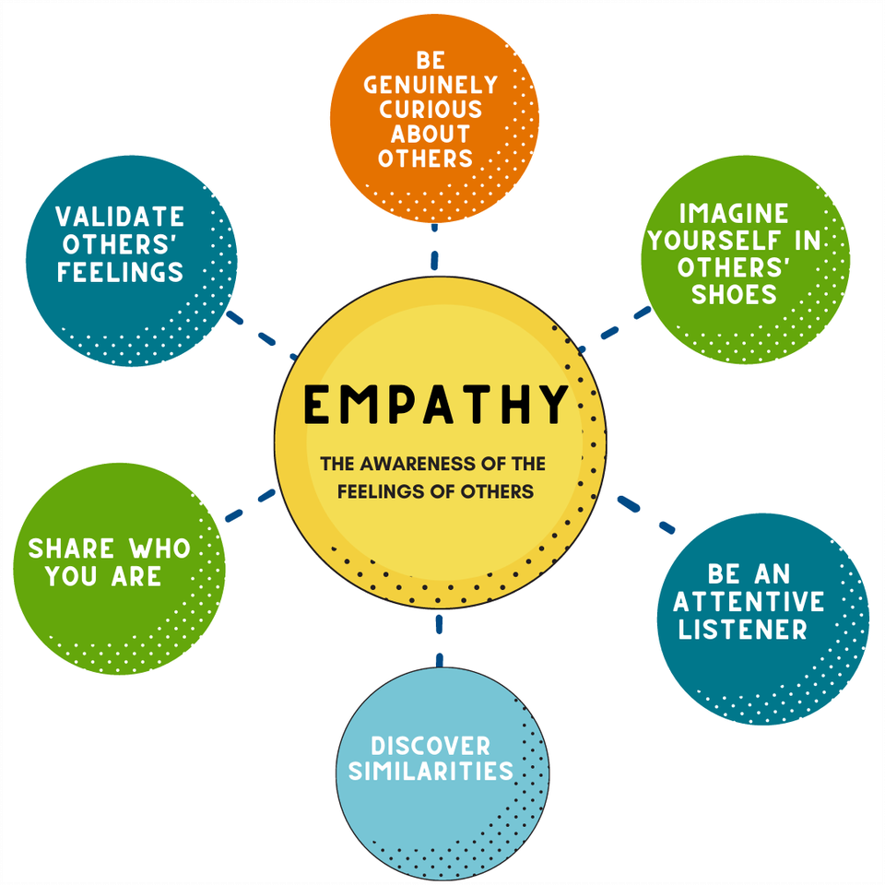
EMPATHY

Slide 28
EMPATHY AND EMOTIONAL AWARENESS

Slide 29
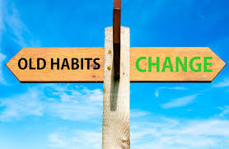
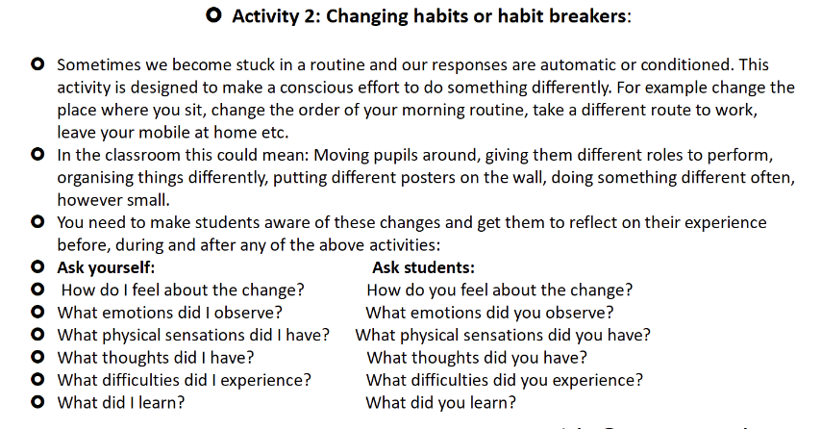
CHANGING HABITS

Slide 30
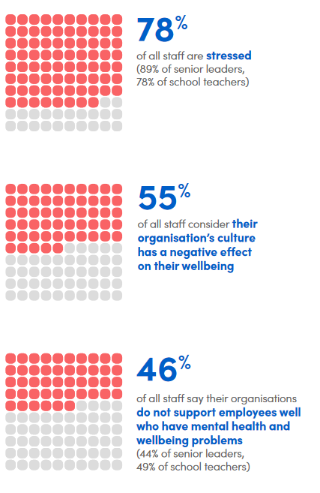
STATISTICS
https://www.educationsupport.org.uk/resources/for-organisations/research/teacher-wellbeing-index/

Slide 31
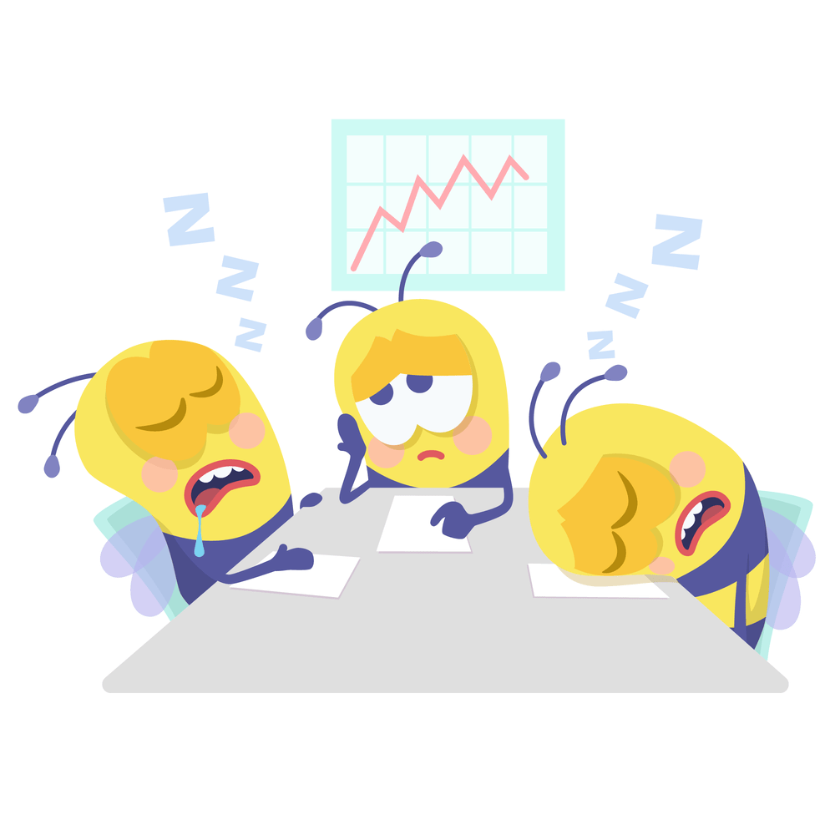
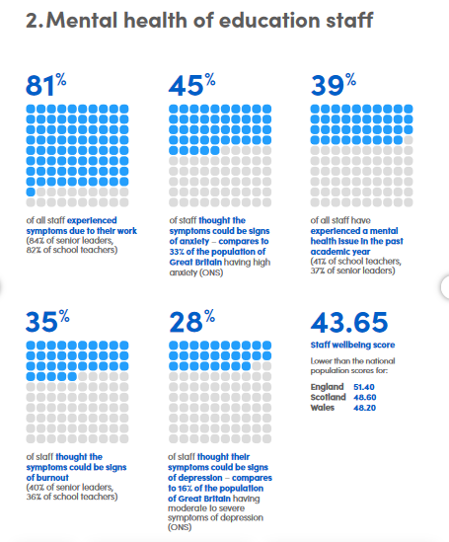
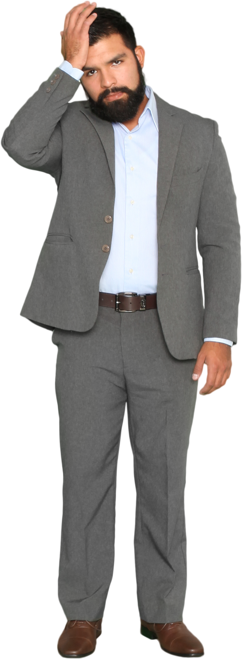
STATISTICS

Slide 32
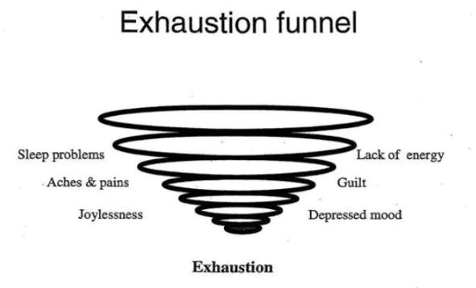
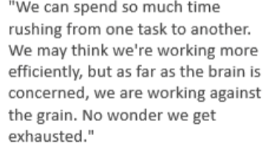
BEING BUSY vs. EFFICIENT

Slide 33
COACHING MODEL WORKSHEET

Slide 34
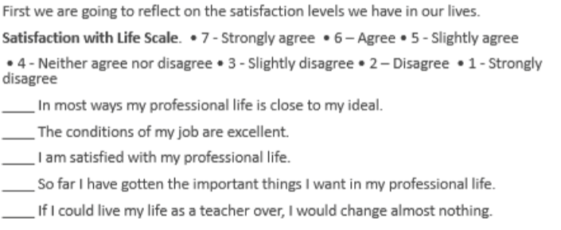
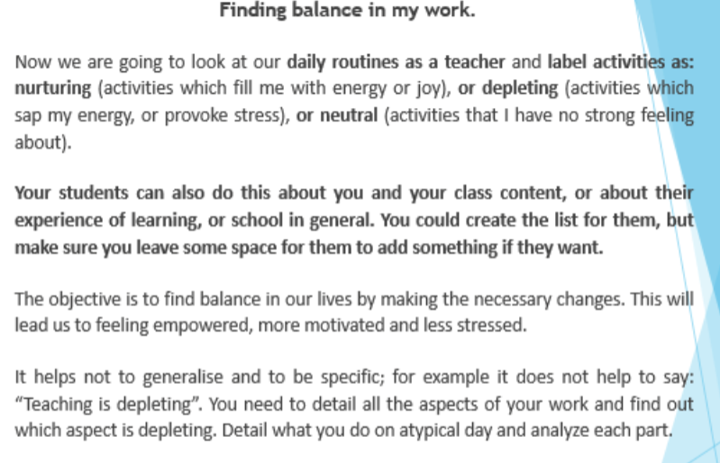
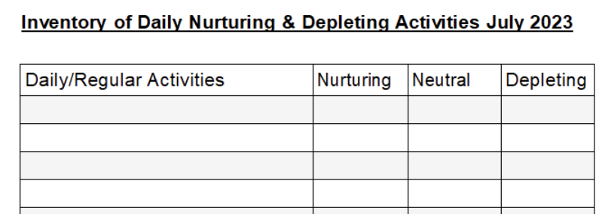
WORKPLACE - reflections
nurturing – depleting- neutral

Slide 35
GROW project: nurturing – depleting- neutral - taking action

Slide 36
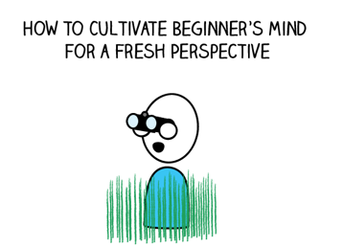
MINDFULNESS GROUNDRULES
critical thinking

Slide 38
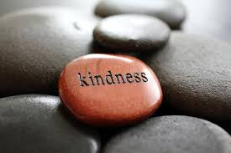

Slide 39
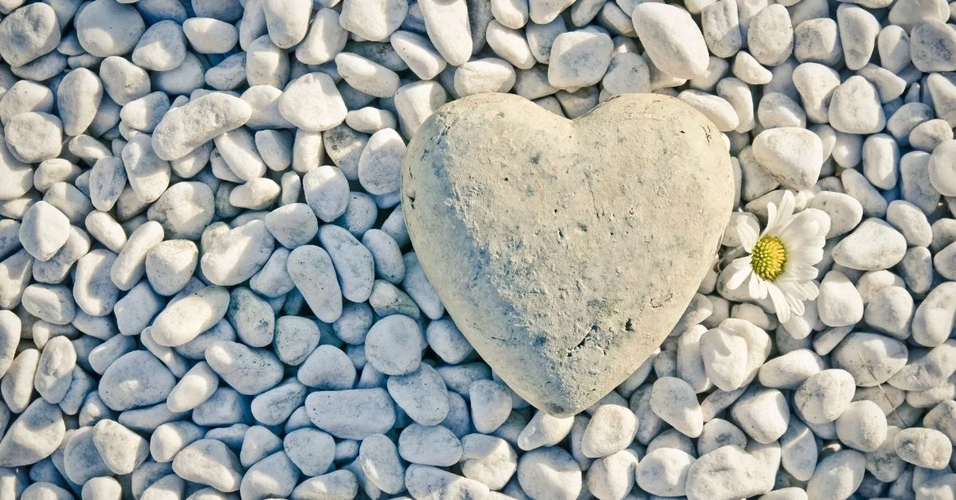
COMPASSION

Slide 40
FEEDBACK ON THE COURSE (ESF MU – 1st year students)
Častejšie by som sa venoval meditácii, ktorá uvoľňuje atmosféru v miestnosti.
Libilo by se mi, kdyby se do hodin zařadila “meditace”, jako jednou; řešení aby tam nechodili další je pravidlo, že buď stihnou přijít do 10:05 nebo ať vejdou až v 10:15, pokud by se tohle pravidlo zavedlo hned od začátku kurzu, tak by to mohlo fungovat.
I loved the "meditations" at the start of the lesson, I think it helped me to focus more on the lesson and my mind didnt wander off so often.
I liked those little meditations in the end of semester and the atmosphere in the class which was friendly and positive.

Slide 41
SOME LINKS to explore more
Everyday mindfulness - YouTube
Anger Management for Kids (and Adults) (youtube.com)
https://www.youtube.com/watch?v=dOkyKyVFnSs – guessing the feelings
https://www.youtube.com/watch?v=GQN6wS753_w – loving kindness
https://www.youtube.com/watch?v=rOne1P0TKL8 – mindful meditation

Slide 42
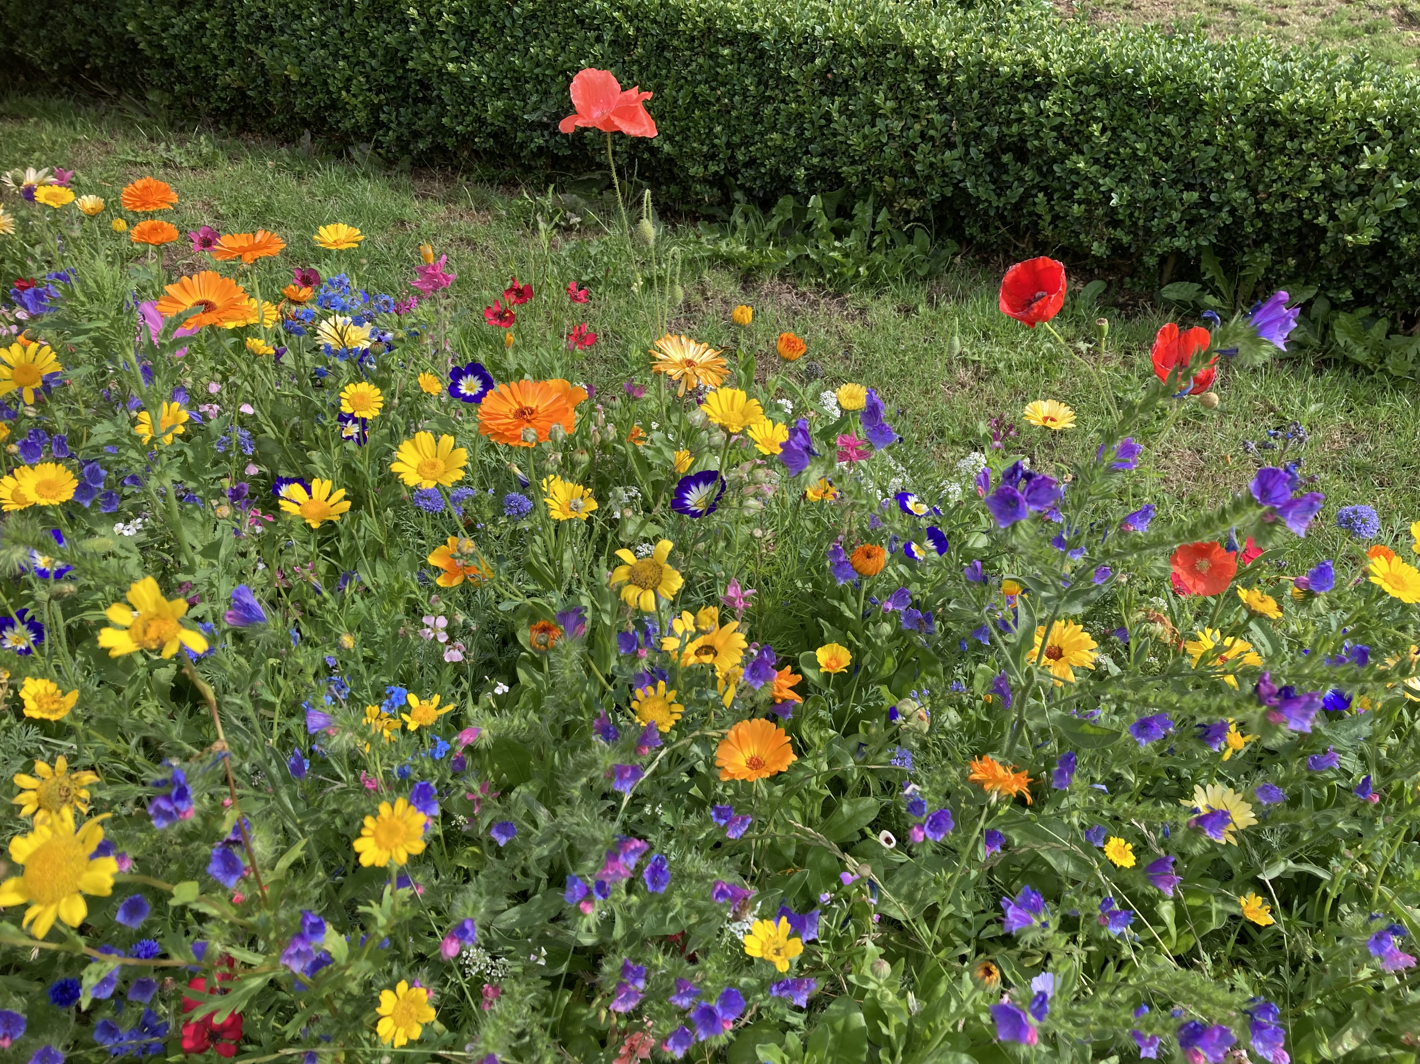
MAIN TAKEAWAYS
DAY BY DAY- What can you do?
Breathe
Meditate
Explore 5 senses
Movement
Perform daily tasks mindfully
Change/break habits when necessary
Be aware of your thoughts and emotions
Formal/informal practice
Try it in your classroom
Read around the subject matter

Slide 43
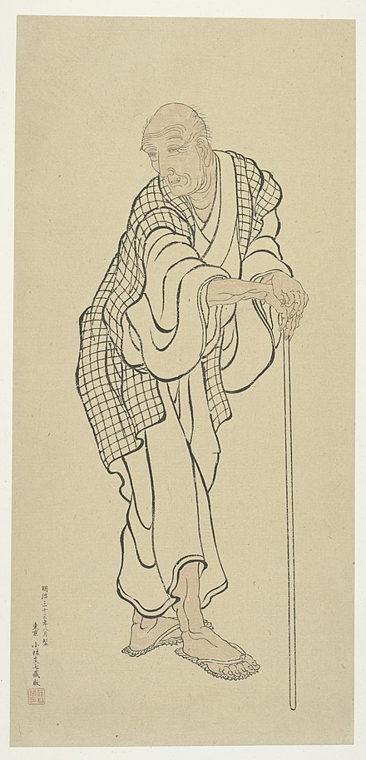
HOKUSAI SAYS…by Roger Keyes
Roger Keyes is an art historian and curator of Japanese art
as well as a poet, and he ‘translated’ what he read in Hokusai’s paintings into this poem.
https://www.youtube.com/watch?v=zkTvAi9UdLw

Slide 45
THANK YOU

