Slide 1
Micropayments and PKI
Vít Bukač

Slide 2
Outline
Micropayments overview
Blacklisting performance
PKI collaboration
Scheme modification(?)

Slide 3
Micropayments
Electronic payment scheme suited for payments with a low nominal value
Cheap
Fast
Anonymous
Online/Offline

Slide 4
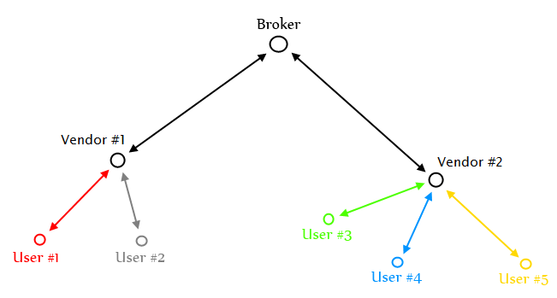
Micropayments scheme

Slide 5
Blacklisting
We require maximum freshness of certificate status while keeping low cost (cost ~= bandwidth)
Issuing of certificate revocation list (CRL) is a potential bottleneck
In micropayments scheme vendor verifies user certificates but user does NOT verify vendors’ certificates
  Bytes transferred: (vendor_count)*(CRL_size)
Each vendor downloads CRL only once in the validity period

Slide 6
Blacklisting
user_count >> vendor_count
  Vendors download CRL very soon after it was issued
  <15 minutes by our estimates
Classical CRL
  Freshness achieved by keeping short validity period
Delta CRL
  High freshness
  High user_count is a disadvantage
Over-issued CRL
  Balances load during validity period
  Lower freshness but good bandwidth

Slide 7
PKI usage
Public Key Infrastructure can hardly replace micropayments
  Slower processing, twice the size of certificates
PKI may be able to supplement micropayments with additional functionality
It is standardized and verified by extensive use
  “Why invent the wheel?”

Slide 8
PKI Usage
Broker – user
  User certificate blacklisting
  Customer objections
Broker – vendor
  Secured transport of broker’s public key to vendor
  CRL authentication
User registration (User possess a qualified certificate either on a chip card or as a file in his computer)

Slide 9
Key pair algorithm identifier
User certificate (274 B)
  ID_{User} (4 B), ID_{Broker} (4 B)
  PublicK_{User} (128 B)
  issued_on (4 B), expires_on (4 B)
  Limit (2 B)
  CertSignature (128 B)
Disadvantages
  Card reader cannot recognize used key pair algorithm
  When the algorithm is considered broken all certificates have to be revoked simultaneously
Add algorithm identifier (0.5 – 1 B) to the certificate?
  Certificates with the new algorithm can be issued while the old algorithm is still in use

Slide 10
Version identifier
User certificate (274 B)
  ID_{User} (4 B), ID_{Broker} (4 B)
  PublicK_{User} (128 B)
  issued_on (4 B), expires_on (4 B)
  Limit (2 B)
  CertSignature (128 B)
Disadvantages
  Any modification to current system must be deployed globally and simultaneously
Add version identifier (0.5 - 1 B)?
  Version identifier can be tied with key pair algorithm identifier (new algorithm/different key length represent a new version)

Slide 11
?

Slide 12

Thank you for your time!

