Slide 1
Eccentric training: theory, application and periodization
Jan Cacek, FSpS MU, Brno, Czech republic
jan.cacek@gmail.com

Slide 2
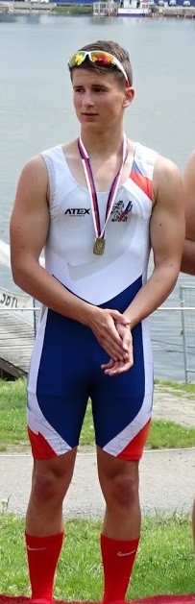
Something about me
Jan Cacek
  my sports career:
    runner 800 a 1500 m, soccer player, ice hockey player
    3 children (17 – 14 – 11 years old)
  Vice dean for research and science FSpS MU
  Chairman of the National Association of Strength and Conditioning Trainers of the Czech Republic
  Head of division of Track and Field FSpS MU
  Study program guarantor „Personal and Strength and Conditioning Trainer“
  Chief editor of the Journal Studia Sportiva
  Member of the Methodological Committee of the Czech Athletic Federation and Rowing federation
  Track and Field and Strength and Conditioning trainer
    Coach of many elite athletes from different sports disciplines

Slide 3
Lecture structure
  Theory:
    History of eccentric training
    Possibilities of using eccentric training
    Benefits of eccentric training
    Risks of eccentric training in preparation

Slide 4
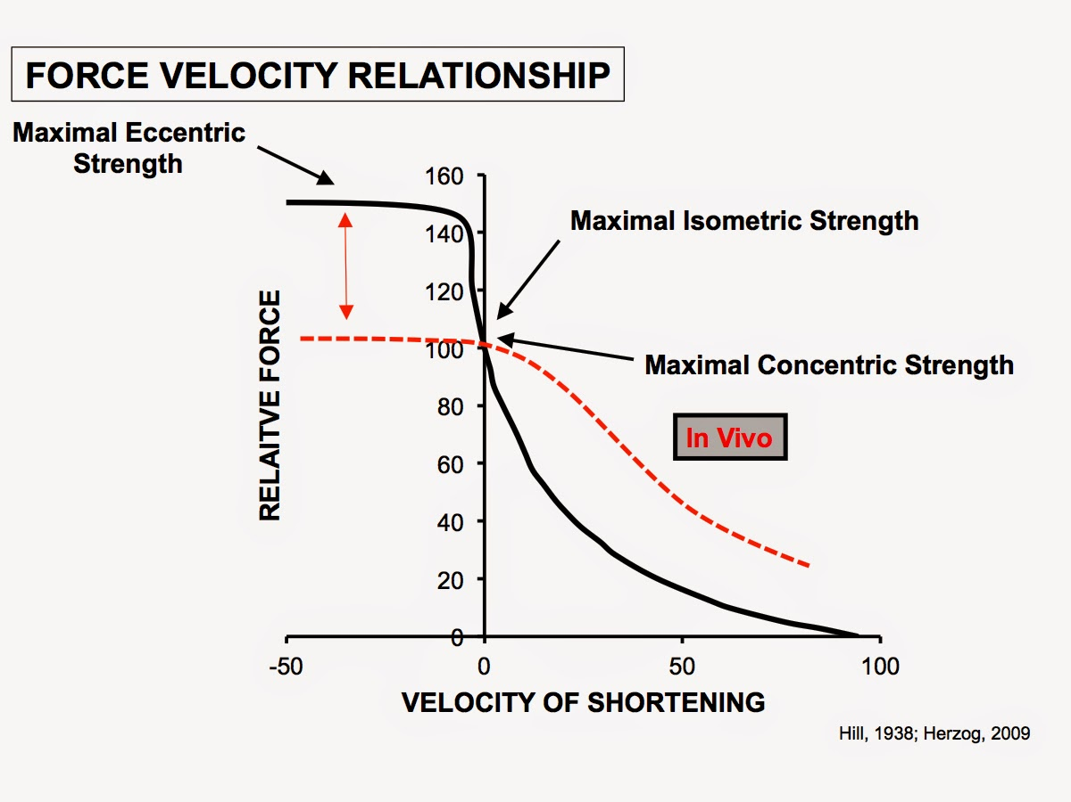
History of eccentric training
1882 - Fick found that the eccentric contraction muscle could produce more strength than concentric muscle contraction.
A.V. Hill - The body has a lower energy consumption in eccentric muscle activity compared to concentric muscle work
1953 - Asmussen introduced the concept of eccentric exercise
The term "eccentric", with "ex" meaning „away from“ and "centric" = exercise away from the center of the muscle
Lindstedt et al. - In eccentric contraction, we talk about negative work.
  function is creating braking force
Mechanical Work in Muscle Activity E = F (-∆L)
F = force
∆L = change in muscle length
Concentric work - the muscle shortens - ∆L is therefore negative and the final work is positive
Eccentric activity - muscle extends, ∆L is positive and resultant work negative (negative)

Slide 5
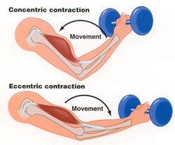
Eccentric contraction
Muscle is prolonged when the muscle load is greater than the force produced (Hamill, Knutzen, 2006).
The reason for the load may be:
  gravitation,
  supramaximal loads with values exceeding 1RM
  antagonist activity
Eccentric contraction load moves downward (in the direction of gravity)
Muscles brake and control movement down, not initiating movement (deceleration)
The eccentric load requires only about 1/6 - 1/7 of the amount of O2 than in concentric mode with the same load (Bigland-Ritchie & Woods in Lastayo et al, 1999)
Eccentric exercise requires a lower level of control
Brady, D., 2012)

Slide 6
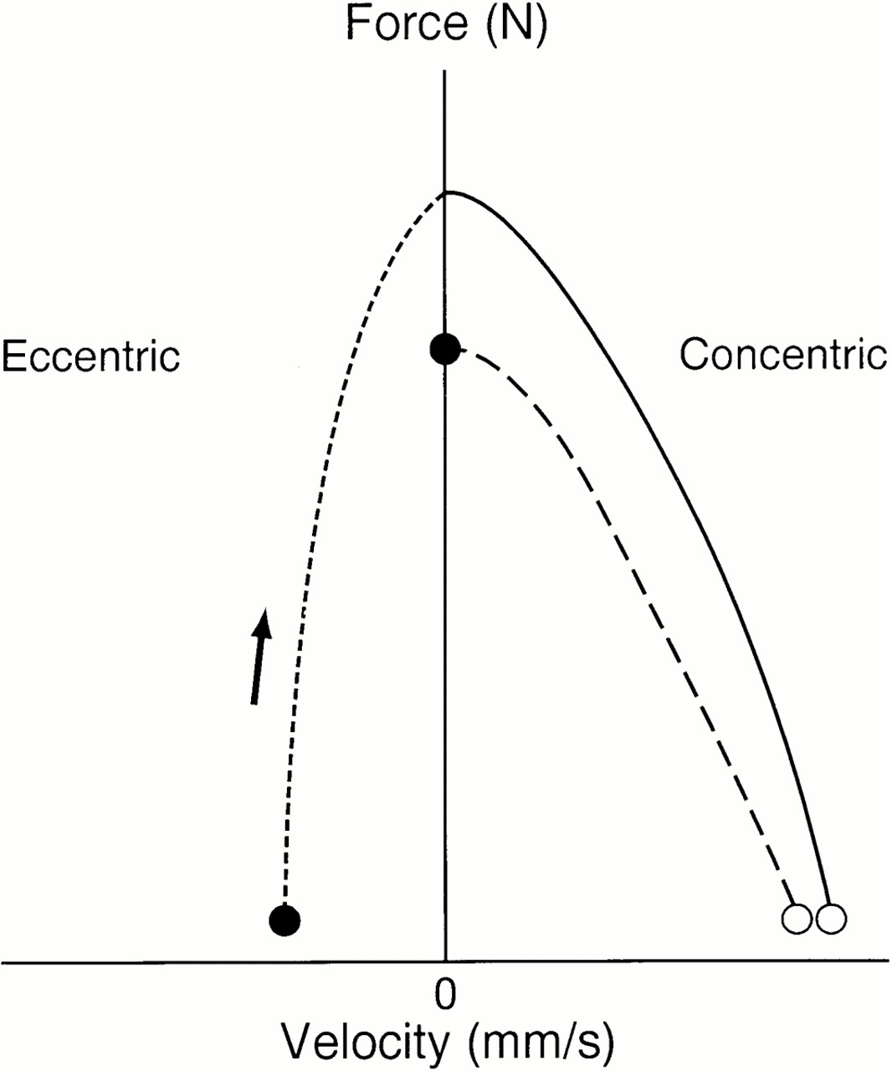
Eccentric contraction
prolonged muscle absorbs mechanical energy which:
  it can be dispensed in the form of heat
  it is temporarily stored as a back energy potential of the so-called deformation (elastic) energy and subsequently used
strech-shortening cycle improves muscle work economy by up to 50% (Hamill, Knutzen, 1995, p. 87-89)
Enoka, 1996)

Slide 7
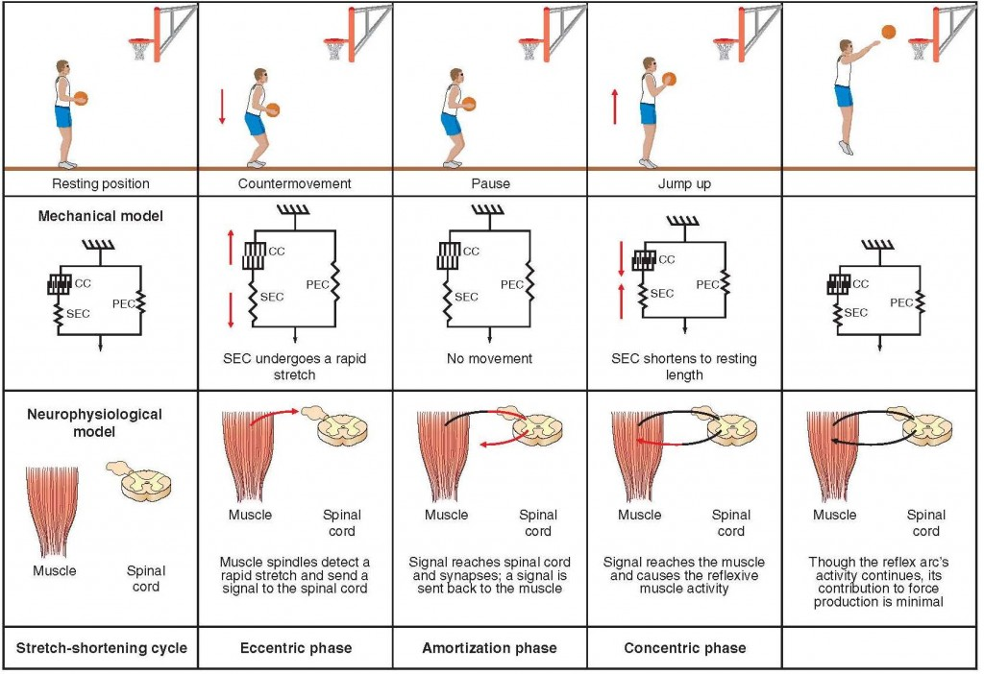
Polach, D.
http://davidpotach.com/stretch-shortening-cycle/

Slide 8
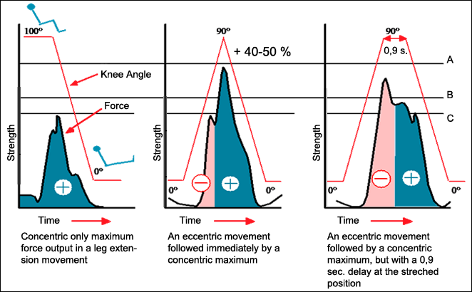
Only concentric movement
SSC
Stretching phase longer than 0.9s - concentric phase = lower power production
Electromyography: Characteristics of Produced Strength of Lower Leg Extrensors in Elite Weightlifters During Isometric, Concentric and Variable SSC Cycle
  Häkkinen K; Komi P V; Kauhanen H., 1989. International journal of sports medicine 1986;7(3):144-51 In: https://www.david.fi/technology/design/effectiveness/

Slide 9
Mechanisms associated with force increase in eccentric contraction
  Exist three theories but they are not explored enough.
  Proprioceptive afferentation (transfer of information to the Brain) the threshold of alpha motoneuron irritation decreases and therefore eccentric contraction is sometimes referred to as the contraction with the most powerful recruitment of motor units
  irritation of both Muscle spindles (muscle lengthens) and Golgi muscle tendon (muscle develops tension and therefore increases tension at the transition of muscle and tendon)
    Concentration contraction does not maintain increased afferentation from both receptor types
  motor unit recruitment is in reverse order to concentric contraction - clearly not proven

Slide 10
Acute Effect of Eccentric Exercise = Structural Damage to Muscle and Reduction of Functionality
At functional level the effect results in:
  Reducing muscle strength
  change the optimal muscle length
  increase in passive muscle tension
  delayed onset of muscular serenses (DOMS)
  increasing serum muscle protein,
  muscle edema
chronology of muscle damage - different, may take several days = reduces performance and increases the risk of movement injury

Slide 11
Benefits of eccentric training for athletes
Increase in muscle strength
Injury prevention - hamstrings
Positive effect on tendons and bone tissue
Minimizing symptoms of delayed onset of muscle pain (DOMS)

Slide 12
Increase in muscle strength Baroni, B. M. et al (2014)
Eccentric Training - Progress of Eccentric Strength 10-60% (0.5% to 3.5% / Training Unit)
Significant better than by concentric training (only half-intervention studies)
The increase in strength depended on:
  Intervention design
  Frequency - there is no difference between 4 training session / week and 2 - 3 session / week
  duration of intervention program (4-8 weeks = 2.16% / TS; 9-12 weeks = 1.49% / TS; greater than 12 weeks = 0.78% / TS).
  volume, intensity - 3 - 5 series, 6 - 10 reps, 2 - 4 times a week
  The angular velocity
  Exercise type - isotonic exercise showing higher progression of strength than isokinetic
  Mobility of joints
  Muscle groups
  Entry level of strength
  Gender (men more than women)
  Ages (young men higher than older men)

Slide 13
Neuromuscular adaptation
increased ability to activation agonist muscles
improving inter-muscle coordination
reduction of antagonist muscle activation - inconsistent conclusions (Stability Of Joints versus Peak torque)
higher capacity for activation of motor units in eccentric contraction (NO for concentric) = specificity for type of contraction

Slide 14

Structural adaptation
First theory
the muscle adapts by changing its resting length
the number of sarcomers increases in series and the muscle is more prolonged (Brockett et al., 2001).
Second theory:
after the first intensive stage of eccentric exercise, the weak fibers are reduced
stronger and more resilient fibers remain and have a protective effect (Armstrong et al. In. LaStayo et al., 2003).
Chronic eccentric load causes more muscle fiber strength. This strength is important in stretching the muscle, where it protects the muscle from excessive damage
Exc. training increases the amount of muscle mass - leads to an increase in muscle fiber cross-section - associated with the growth of both the number and cross-section of myofibrils - the role of satellite cells
It is not yet known what volume of work, exercise intensity and rest intervals are optimal for hypertrophy

Slide 15
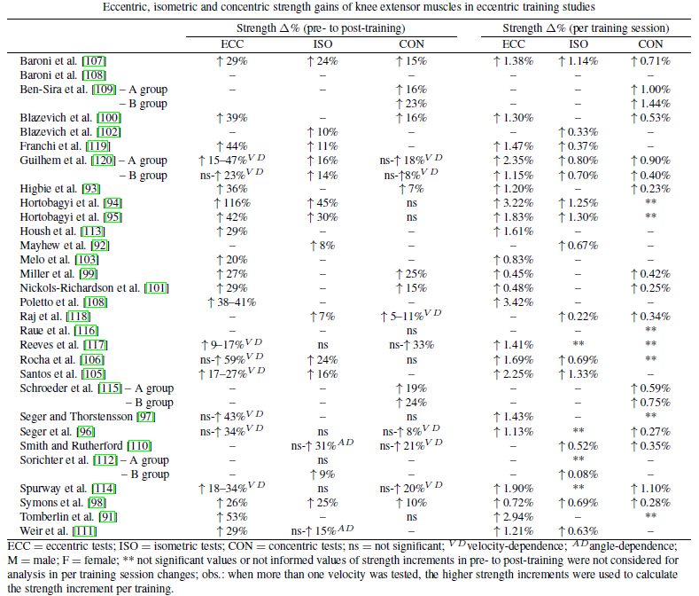
Baroni, B. M. et al (2014)

Slide 16
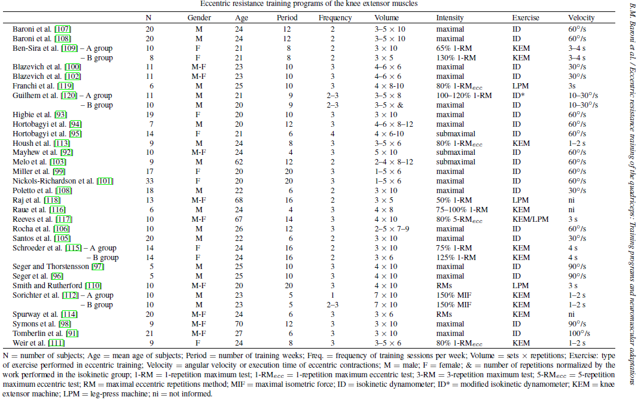
Baroni, B. M. et al (2014)

Slide 17
Effect of eccentric training on speed and explosive power
Cook et al. 2013: Comparison of 4 training programs, (3 weeks, 20 rugby, squats, bench): eccentric, concentric, eccentric + overspeed, concentric + overspeed
  the biggest effect on speed and explosive power = Exc. + overspeed
  Only the eccentric training improved onlythe maximum power
  CONCLUSION: a combination of resistive eccentric training with training in which there are incentives for explosive strength and speed is recommended
Wirth et al. (2015) examined the effects of eccentric training on maximum and explosive strength in untrained (6 weeks, unilateral legpress in eccentric phase)
  31.1% maximum strength improvement
  the improvement in explosive power (jump with counter-motion) was nonsignificant
The Wirth study supports Cook's results
  eccentric training with resistances alone will not cause positive changes in speed and explosive force indicators
  Exc. training with specific exercises in terms of mechanics (speed, angles…)

Slide 18
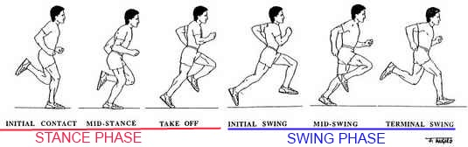
Injury prevention and performance - hamstrings
The most frequent injuries of hamstrings arise at the initial contact with ground (Guex et al, 2016)
The ratio of flexors to knee extensors
  Problem = mostly hamstrings
  especially for sprinters
  Lysholma and Wiklander (1987) report injured hamstrings = 11% of running injuries
  except for muscle injuries, the tendon hamstring is also overloaded
https://www.google.cz/search?q=terminal+swing+phase&client=firefox-b-ab&biw=1540&bih=822&source=lnms&tbm=isch&sa=X&ved=0ahUKEwizh7mLsMLQAhUHBsAKHaxMAEwQ_AUIBigB#imgrc=scF5srkGLW1dGM%3A

Slide 19
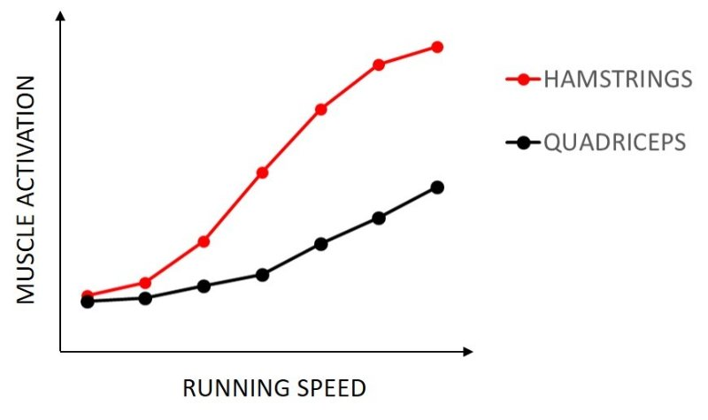
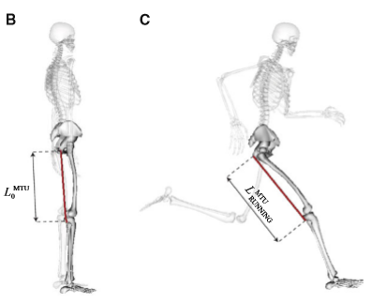
Hamstrings and Performance
Schache et al, 2013
288/5000
As the speed increases, the importance of the ratio between hamstrings and quadriceps increases
H/Q ratio is associated with a good/bad running economy (Sundby and Gorelick, 2014)
it is therefore recommended, in particular for sprinters, to include eccentric hamstring exercises to improve their H/Q ratio

Slide 20
Hamstring injury and eccentric training
Askling, Karlsson and Thorstensson (2002) investigate the effect of an eccentric strength program on the incidence and severity of hamstring injury (n = 30)
  The experimental group realized eccentric hamstring training (1-2 times per week, 10 weeks) using a special devices
Diagnosed
  isokinetic strength of hamstrings before and after the intervention program
  all hamstring injuries 10 months after the end of the intervention.
Results:
  the incidence of hamstring injury was clearly lower in the training group (3/15) vs. the control group (10/15)
  there was a significant increase in strength and speed in the training group

Slide 21
Positive effect on tendons
Eccentric exercise = there is action of large forces on muscle-tendon transition
When the acting force is greater than the muscle itself can create, there is a risk of damage to muscle, tendon, insertion
Eccentric training has a positive effect on muscle and tendon status = treatment of tendopathies
Adaptation to eccentric training
  stimulation by eccentric exercise leads to collagen formation and increased fibroblastic activity - tendon hypertrophy (better muscle-tendon transfer)
  tendon becomes stronger in tension - normalization of glycosaminoglycan levels
  increasing the energy absorbing capacity of the muscle - reducing the risk of excessive stretching

Slide 22
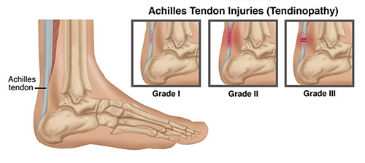
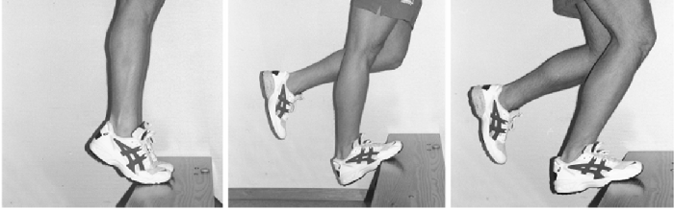
Chronic tendinopathy of Achilles tendon
Painful tendon thickening
Especially for runners due to tendon overload = degenerative process
Symptoms:
increased level of glycosaminoglycans,
irregular structure and arrangement of fibers, no inflammation
morning stiffness
pain limiting movement - the greatest after exercise
new formation of blood vessels
Mumbleau, 2013
Recommendation:
Alfredson's exercise protocol
12 weeks, 3 x 15 reps, 2 times a day
with straight and bent knee
exercise is slow,
we increase intensity when exercise is pain free (Habets et al, 2015)
Cuff, 2014

Slide 23
Langsberg et al. - 12 soccer players (6 healthy controls, 6 with Achilles tendon, 12 weeks eccentric exercise)
  confirmed the effectiveness of this type of treatment - eccentric exercise stimulates the synthesis of type I collagen in the area of ​​the damaged tendon.
  as a result of the improvement of the tendon structure, pain increase and tendon adaptation to the load also occur
Fahlström et al. (2003) combination of eccentric exercise and stretching - application of 12 weeks to patients with pain:
  middle part of the Achilles tendon (78 patients, 101 affected tendons)
  with tendon pain of this tendon (30 patients, 31 affected tendons)
  in the group of middle tendon pain, 89% of them experienced pain relief after treatment, and returned to an earlier stage of activity
  the remaining 11% = women, higher BMI
  In patients with tendon tendon pain - 32% tendons improved
  the difference in the results of this group may be due to the different source of pain (bursa, bone) and not the tendon (Fahlström et al., 2003).

Slide 24
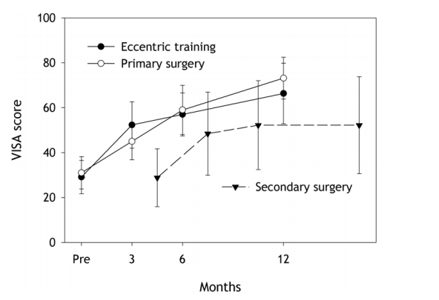
Bahr, et al. (2006) compared the effects of surgical treatment with eccentric training of patellar tendinopathy
  35 patients, divided into two groups
  1. gr. surgical treatment with subsequent rehabilitation
  2. gr. eccentric strength training - squats on 25 ° inclined plate (3x15 - 2x daily, 12 weeks)
The Victorian Institute of Sport Assessment (VISA) - (range 0 - 100), based on questionnaire responses
specially developed for patellar tendinopathy. three, six and twelve months of follow-up
both improvement groups (p <0.001)
the mean VISA score for both groups increased from 30 to 49 (95% CI, 42 to 55) at three months, 58 (95% CI, 51 to 65) at six months, and 70 (95% CI, 62-78) for twelve months
there was no superior efficacy of surgical treatment compared to eccentric strength training

Slide 25
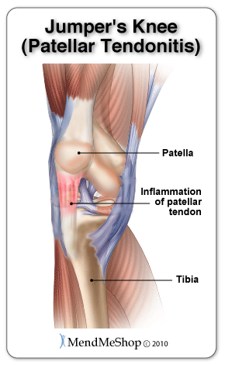
Jumpers knee - Patellar tendinopathy
Typical of jumpers and sprinters - high demands on knee extensors
  Occurrence can be up to 50%
Symptoms
  pain under the paw - especially after exercise (walking up stairs, jumps, squats)
  In the advanced stage of pain, the workload is disabled
  changes in tendon structure and vessel formation,
  inflammatory origin not proven
Cause
  excessive tendon stress (high intensity exercise)
Jonsson and Alfredson (2005) looked at the different efficacy of eccentric and concentric training in 15 patients with long-term ligamentum patelae involvement. Training unit twice a day for 12 weeks)
  Eccentric and concentric training, one exercise, three series, 15 reps
  after 6 weeks the work of the concentric group was interrupted - without positive results
  eccentric training -l relieving pain and allowing a return to previous (pre-trauma) training activity in 90% of patients.
  long-term effect after less than 3 years
http://www.aidmyachilles.com/tendon-muscle-injuries-in-the-leg/tendinitis-of-the-patellar-tendon.php

Slide 26
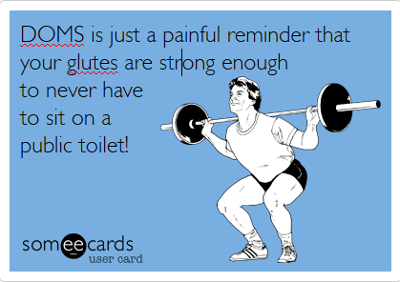
Minimizing symptoms of Delayed onset muscle soreness (DOMS)
Appears when the intensity or volume of an eccentric exercise suddenly increases, or an unusual high intensity movement is performed (Nosaka, Newton, 2002)
  In athletics typically - downhill running, overspeed, endurance runs in the field
  Plyometric training
  Eccentric training for beginners
Cause
  disrupting the sarcomere structure and damaging the excitation-contraction coupling mechanism (Warren et al. in Proske, Morgan, 2001, p. 333)
Typical symptoms
  decreased muscle strength
  increase in serum creatine kinase,
  damage to the muscle fiber structure,
  Inflammation,
  increasing the activity of proteolytic enzymes and pains (Stupka et al., 2001).
minimization = eccentric exercise performed according to the principles of adequacy and sequence (low intensity at the start of stimulation)
symptoms of pain = result of poorly controlled training
http://rbhfitness.blogspot.cz/2015/01/delayed-onset-muscle-soreness-doms.html

Slide 27
RISKS OF ECCENTRIC TRAINING
Acute injury
  Exercise technique = 2/1, jumps
  If the muscle produces the same torque at both concentric and eccentric contractions, fewer motor units are involved in eccentric contraction.
  greater risk of muscle and other connective tissue damage - fewer muscle units produce a given strength, overload and easier injury to muscle (McHugh, 2003).
  More frequent damage = fast muscle fibers (Fridén et al. In McHugh, 2003).
Chronic injuries
  Spine
  Joints
Overload
  DOMS,
  Non-respect of training principles
Overtraining

Slide 28
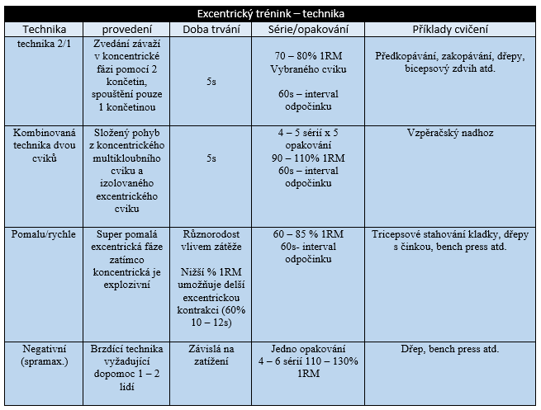
Trends and possibilities of using eccentric training
Types of eccentric training according to Mike, Kerksick a Kravitz In: Horák, (2016)
The recovery time between training sessions should be at least 24-48 hours (Nosaka, Newton, 2002).

Slide 29
The Most Effective Eccentric Exercise For Progress For Athletes =
  Isotonic,
  Less Effective Isokinetic,
  Least Effective Isometric
Bridgeman et al. recommends using SSC exercises for athletes whose performance has SSC character - drop jump
  the length of contact with the pad should correspond optimally with the length of contact in the competition conditions during the exercises

Slide 30
Conclusion
significant physiological adaptations due to eccentric loading are manifested in both concentric and eccentric muscle activities
for sprinters to combine with training speed or supramaximal speed
Specific performance requires specific adaptation and that specific stimulus = mechanics, energy, coordination
Eccentric training increases tendon strength and positively stimulates skeletal minerals
Exc. Training acts as a prevention of hamstring injury, reduction of DOMS manifestations, therapeutic effects on patellar tendinopathy and tendonopathy of Achilles tendon.
Eccentric Exercises are recommended to include - the prerequisite for the application of eccentric training is excellent strength preparation (concentric 1RM training), technical level and part of the RTC

