Slide 1
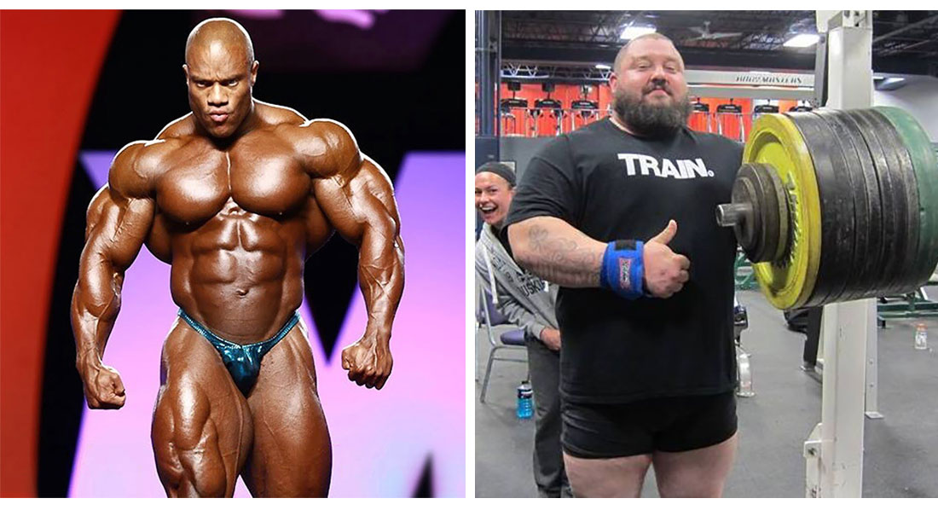
Muscle hypertrophy: theory, application and periodization

Slide 2
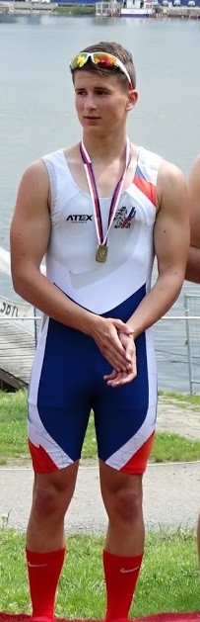
Something about me
Jan Cacek, PhD
  my sports career:
    runner 800 a 1500 m, soccer player, ice hockey player
    3 children (17 – 14 – 11 years old)
  Vice dean for research and science FSpS MU
  Chairman of the National Association of Strength and Conditioning Trainers of the Czech Republic
  Head of division of Track and Field FSpS MU
  Study program guarantor „Personal and Strength and Conditioning Trainer“
  Chief editor of the Journal Studia Sportiva
  Member of the Methodological Committee of the Czech Athletic Federation and Rowing federation
  Track and Field and Strength and Conditioning trainer
    Coach of many elite athletes from different sports disciplines

Slide 3
Determinants of strength and power
total amount and composition of muscle fibers
muscular architecture
hormonal profile
polymorphism
neuromuscular factors

Slide 4
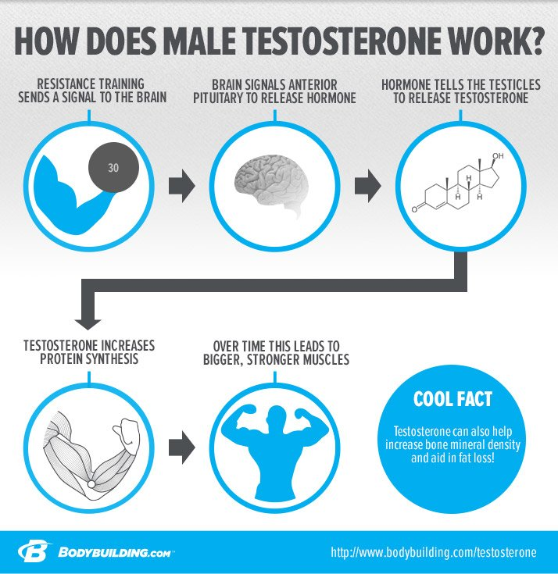
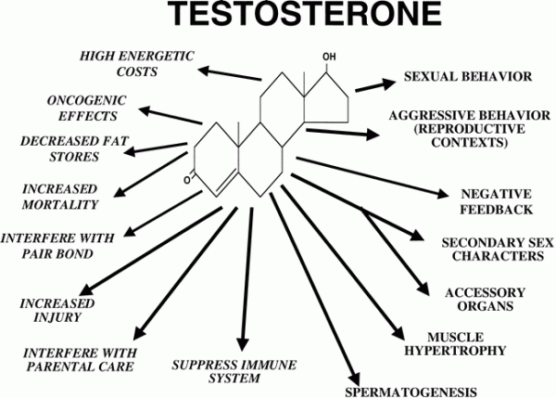
stimulates GH secretion and increases the presence of neurotransmitters on muscle fibers
helps activate muscle tissue growth
leads to protein synthesis.
https://www.precisionnutrition.com/anabolic-hormones-and-muscle
https://trmorrisnd.com/2013/11/11/a-recent-va-study-published-in-jama-indi/

Slide 5
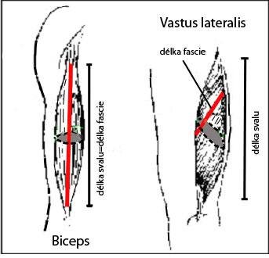
Muscle architecture
Fusiform muscle (biceps)
X
Penniform muscles (vastus lateralis)

Slide 6
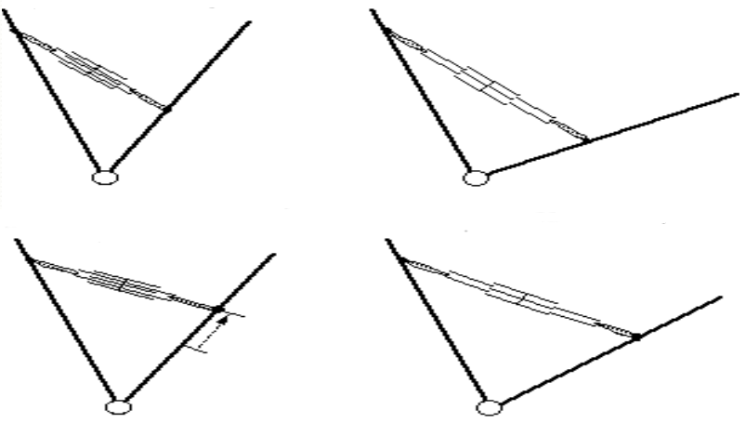
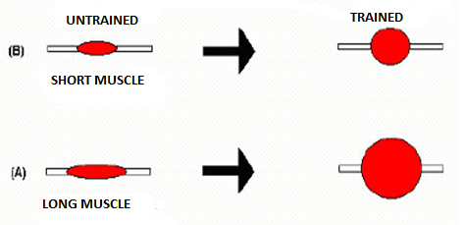
potential for muscle hypertrophy - limited by muscle length

Slide 7
Polymorphism
Interleukin 6 (IL-6) gene -174 G / C
  studies demonstrate a pivotal role in post-exercise hypertrophy processes (Ruiz, 2010)
  power athletes had a higher incidence of G.
Gene for hypoxia-induced factor 1α (HIF1A) - Pro582Ser
  detection of HIF1A variant - Pro582Ser in Russian power athletes (weightlifters, wrestlers) at regional and national level vs control group
Gene for creatine kinase muscle isoform (CKM) - rs8111989 A / G
  Alea G is associated with power output. Significant incidence was found in power-oriented athletes (Chen, 2017).
Angiotensinogen Gene (AGT) - Met235Thr
  The AG2 polymorphism of the Met235Thr gene can be considered a genetic determinant of strength, as evidenced in several investigations, for example, in jumpers, sprinters, or weightlifters, where more significant Met235Thr was observed (Zarębska et al., 2016).
Nitric oxide synthase gene (NOS3) -786 T / C
  T allele is associated with power output (Drozdovska, 2013). Drozdovska (2013)
  significantly higher T allele frequencies in 53 Spanish elite power athletes (jumpers, sprinters)

Slide 8
Neuromuscular factors determining muscle strength (FRY a kol.1994)
  Recruiting motor units
  Rate coding
  Intramuscular activation
  Inter-muscle activation
  Use elastic energy and reflexes
  Neural inhibition
  Type of motor units
  Biomechanical and anthropometric factors
  Hypertrophy

Slide 9
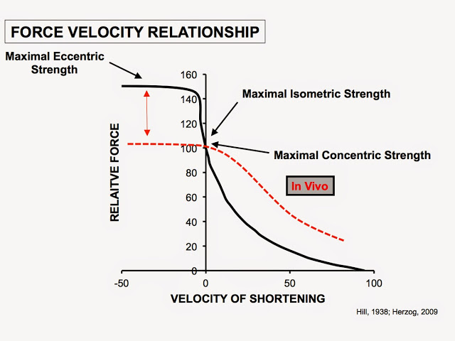
The relationship of force and velocity shortening
http://www.mcmillanspeed.com/2015/05/a-coaches-guide-to-strength-development.html

Slide 10
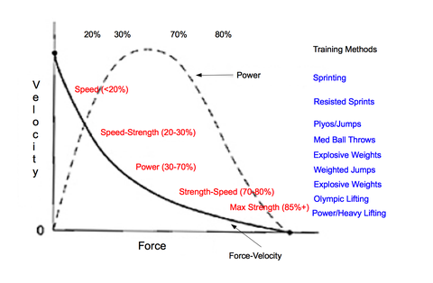
Cooper, 2018 (https://www.12amlabs.com/blogs/news/shock-method-plyometric-training-for-elite-athleticism)

Slide 11
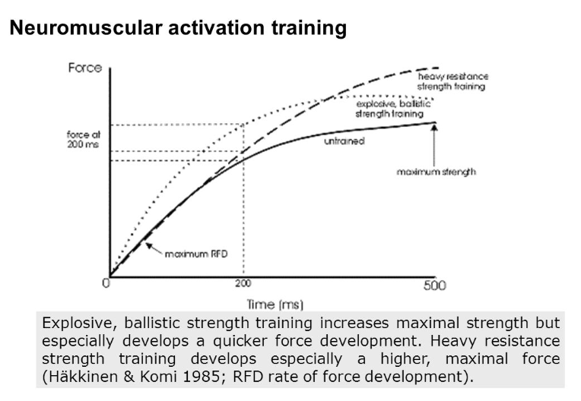

Slide 12
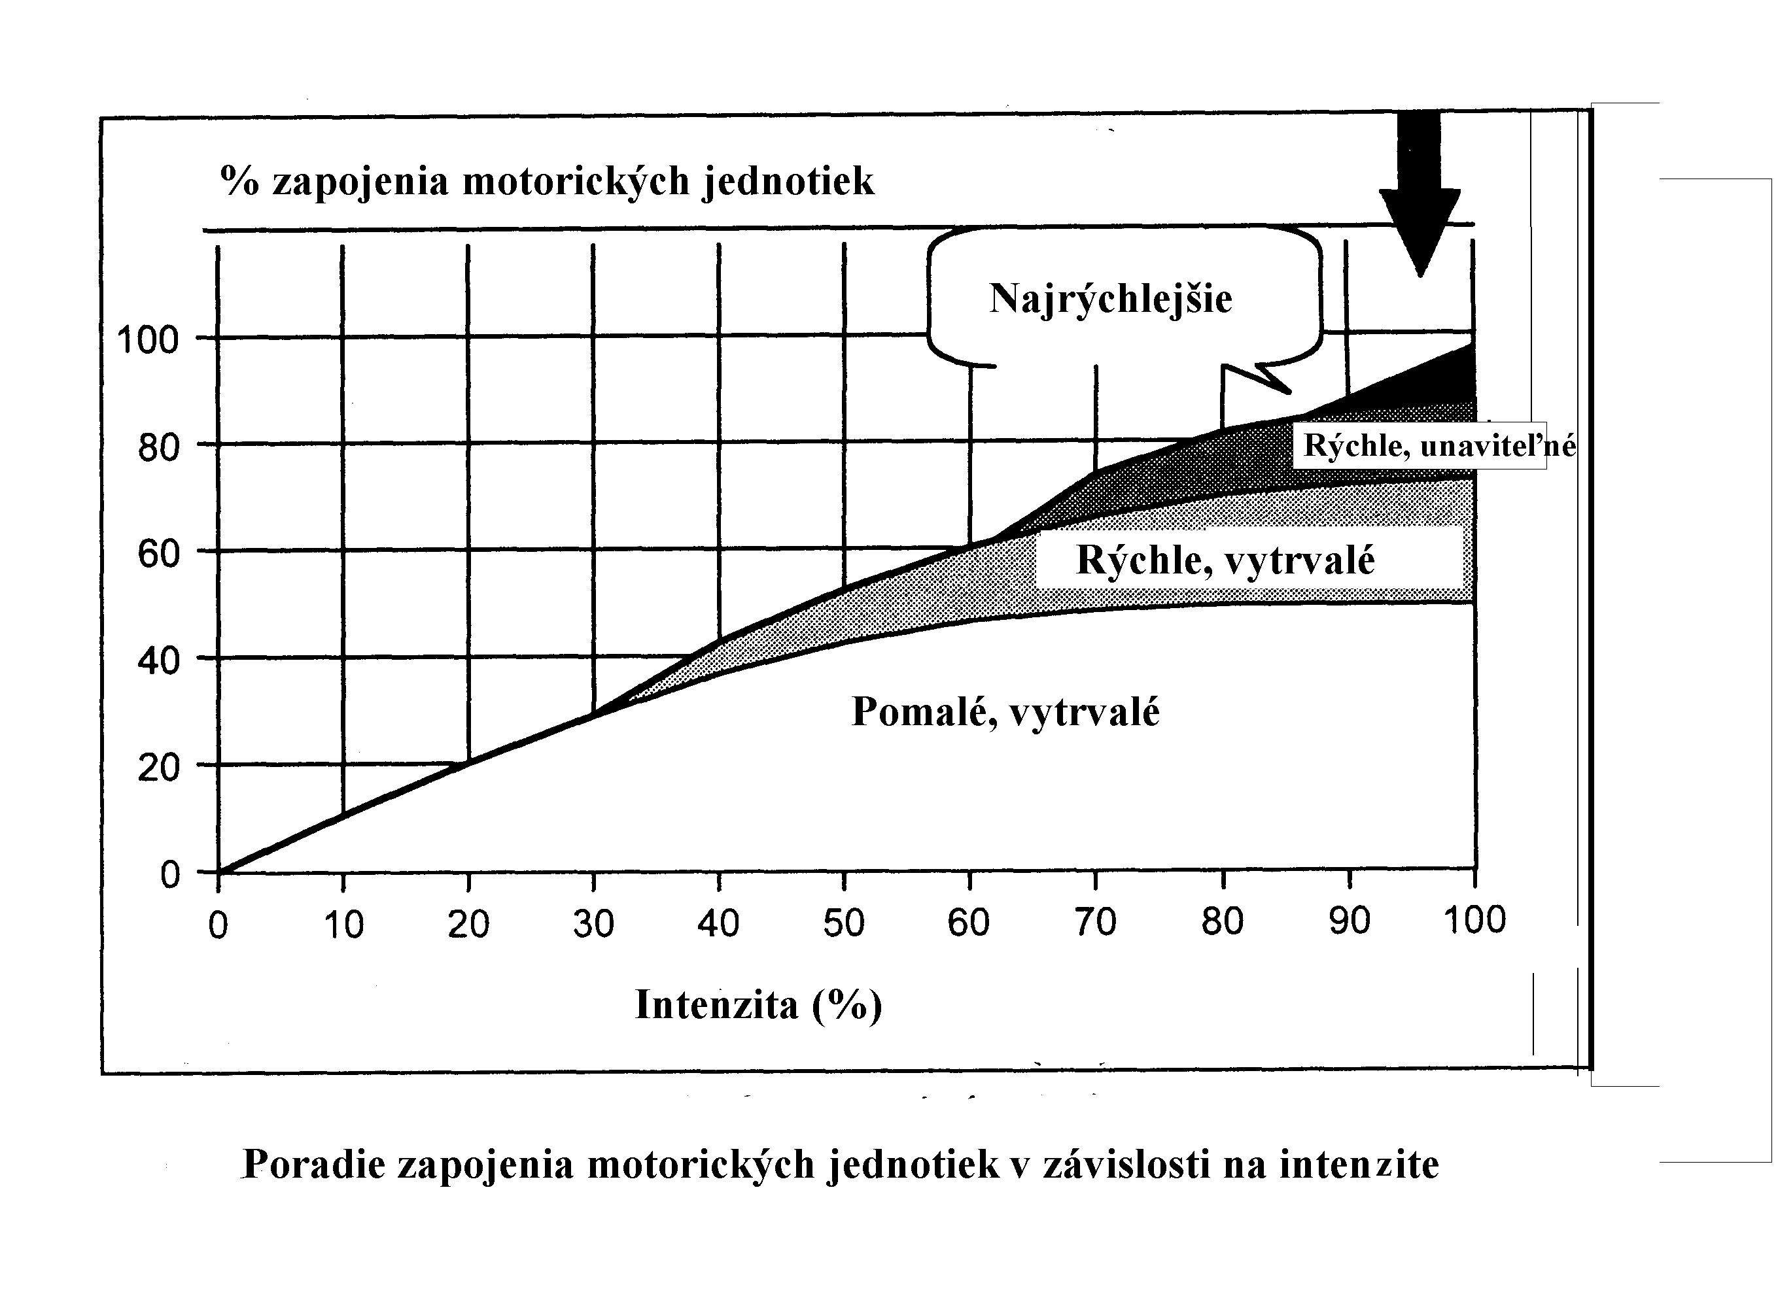
Henneman's principle of size

Slide 13
Hypertrophy
Definition - increasing the cross-section of muscle fibers
Sarcoplasmic and Myofibrillary
Zatsiorsky (5 - 60s)
https://andersnedergaard.dk/en/kropblog/sarcoplasmic-hypertrophy/

Slide 14
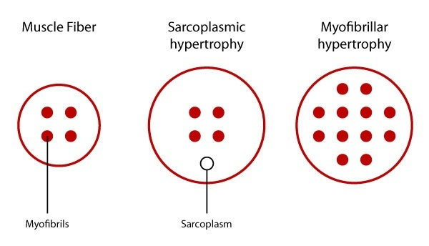
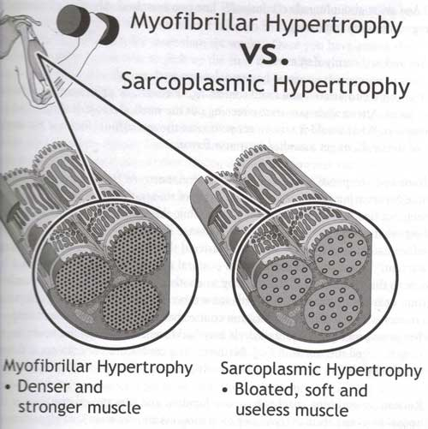
?????
hypertrophic progress over 100 %
Fares D. Alahmar, 2015
muscle fibers composed of:
myofibrils - 85-90%
residue
extracellular connective tissue
blood vessels
mitochondria,
glycogen 5-10% 15-20%
membrane invagination - serves for propagation of electrical signals
Sarkoplasma 0.5-2%
  (Macdougall et al., 1982)

Slide 15
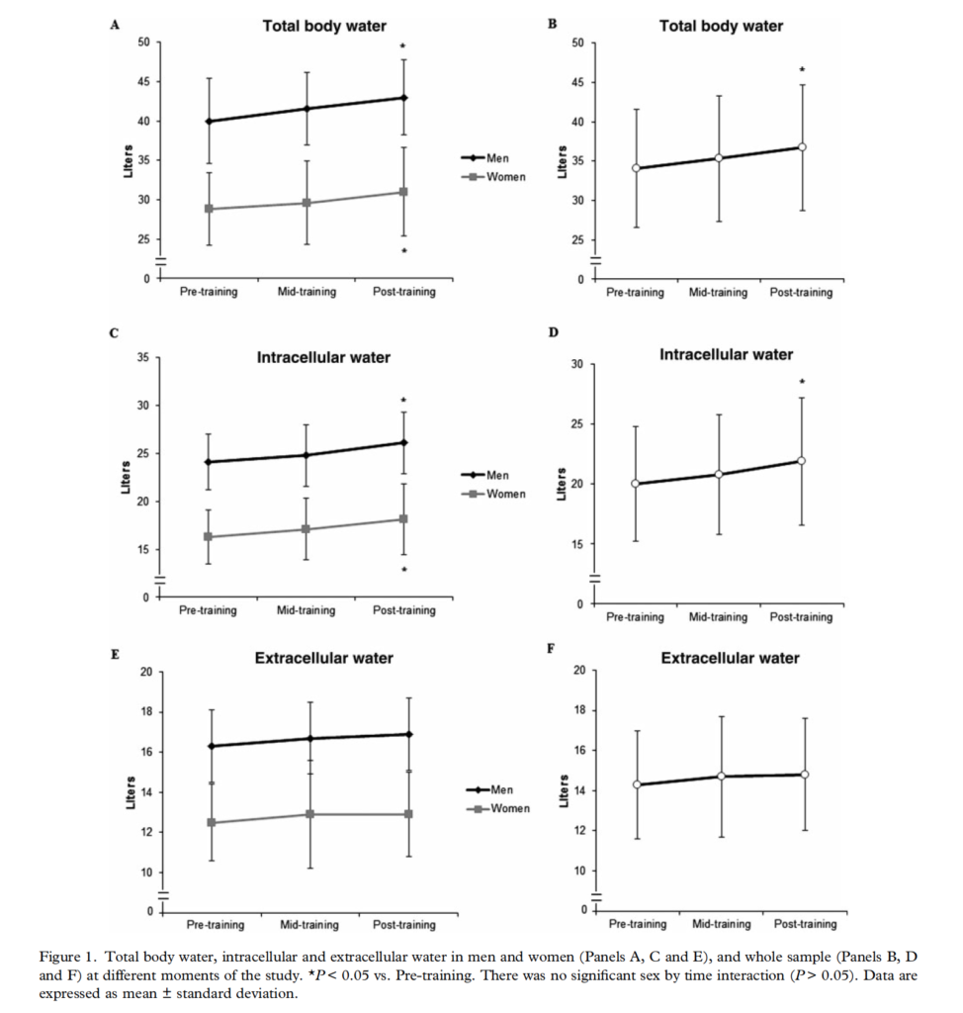
Sarkoplas. hypertrophy?
Research shows TBW increase of about 3 l / 12 weeks (beginners)
Intracelular = about 1 kg (in sarkoplasma)
muscles increase only 4% in 12 weeks
But in the body up to 3 liters of fluid outside the extra muscles - where are they?
Ribeiro et al. 2014

Slide 16
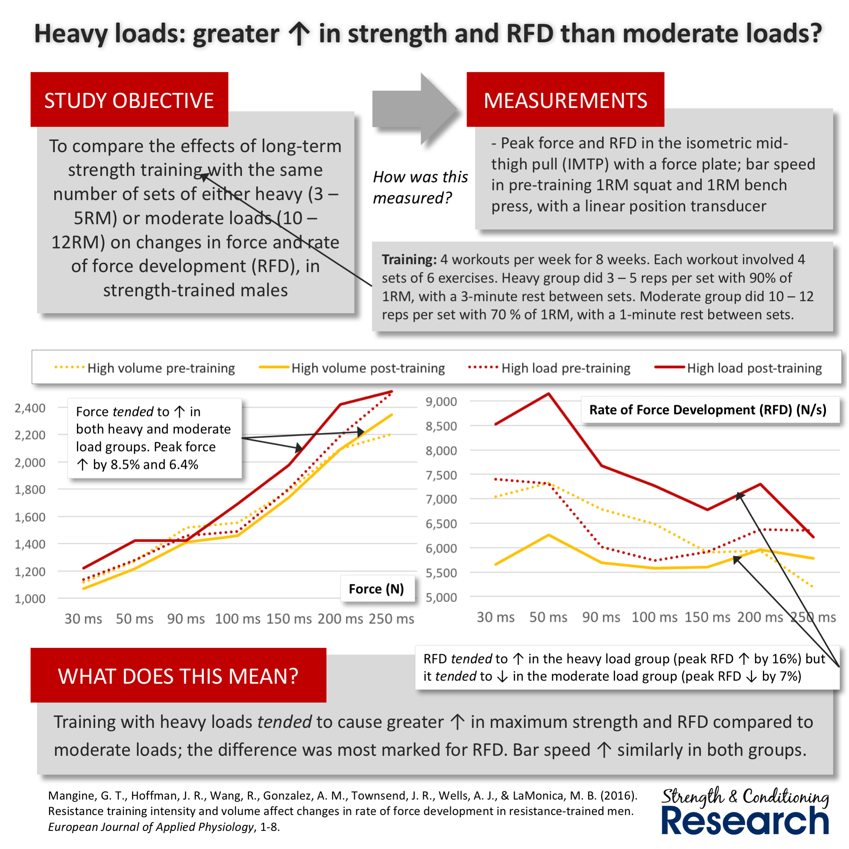
Effect of different forms of strength training on Fmax and RDF
https://www.strengthandconditioningresearch.com/perspectives/strength-training-sprinting/
Hypertrophy or maximum strength
3RM vs 10RM

Slide 17
HYPERTROFICAL TRAINING

Slide 18
Manipulable Variables - Influence on Hypertrophic Processes
the weight of resistence - the load
number of repetitions
number of sets
rest time between sets
exercise velocity
type of rest

Slide 19
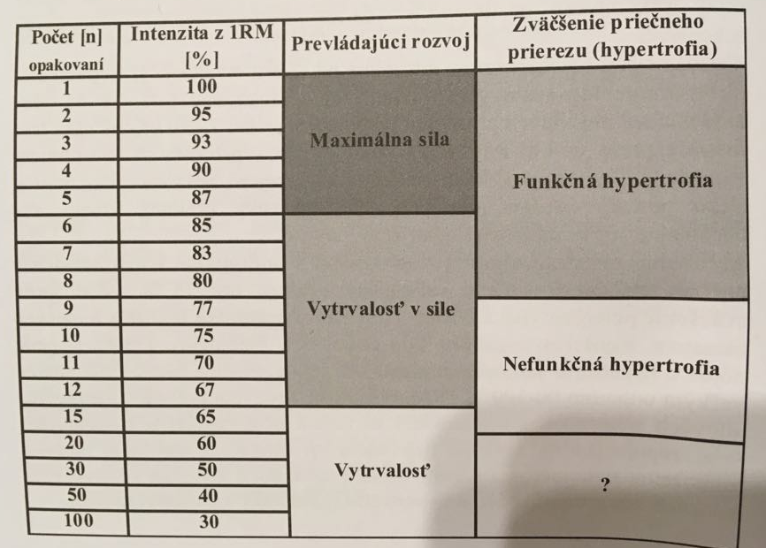
Functional hypertrophy
Vanderka (2016)
(2016)

Slide 20
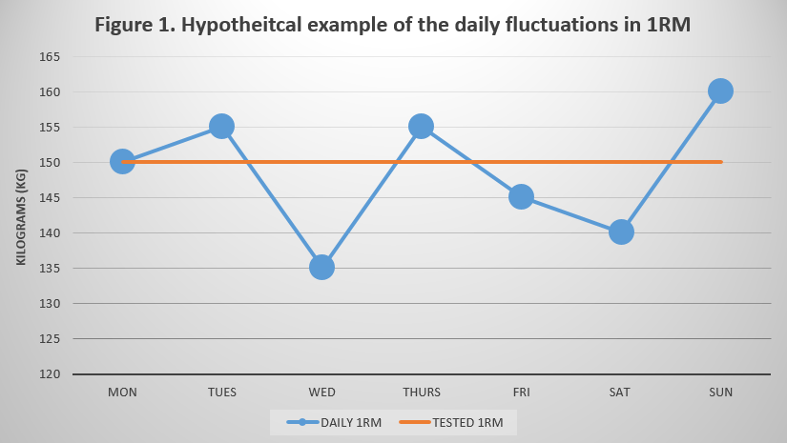
Assessment of exercise intensity
by calculating the training volume
calculating training intensity
  Intensity vs Effort
  Background 1 RM

Slide 21
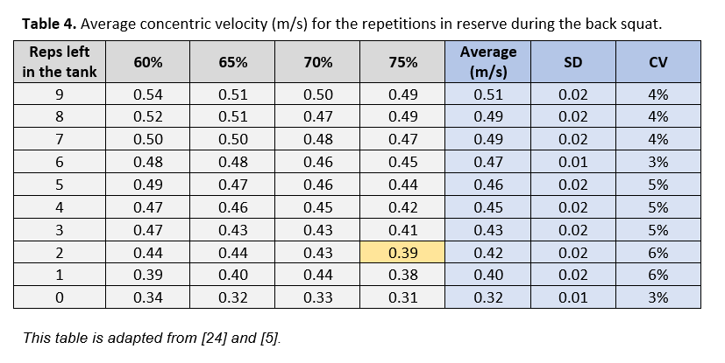
Intensity and velocity when exercise to failure
Decrease in intensity
  decrease in repetition rate in series
  reducing the amount of resistance between sets at the same number of times
  reducing the number of repetitions between sets with the same resistance
https://www.scienceforsport.com/velocity-based-training/?fbclid=IwAR2sIYHLNdDEQ4F2dqXS64BaMtN4Zbz1pU6RnONzBlkKt72xL0O76l8XjlU

Slide 22
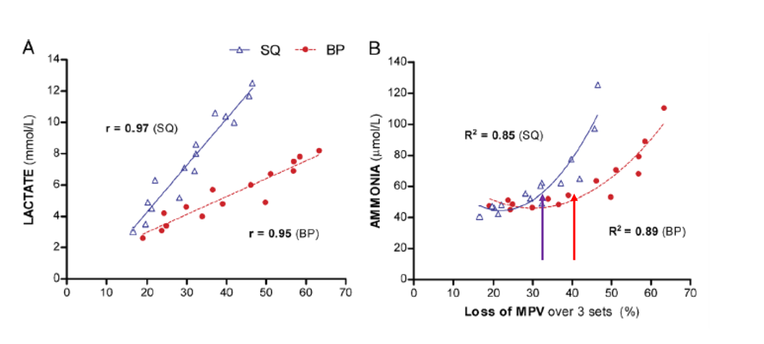
Metabolic Fatigue (LA - increases linearly)
Neuromuscular fatigue (increases in the shape of a curve)
  To increase muscle mass (not necessarily related to body fluid)
    it is not necessary to practice to failure, on the contrary,
    it is necessary to exercise in large volume.
  ??? Is this also true for bodybuilders ???? = "Sarcoplasmic hypertrophy"
https://www.scienceforsport.com/velocity-based-training/?fbclid=IwAR2sIYHLNdDEQ4F2dqXS64BaMtN4Zbz1pU6RnONzBlkKt72xL0O76l8XjlU

Slide 23
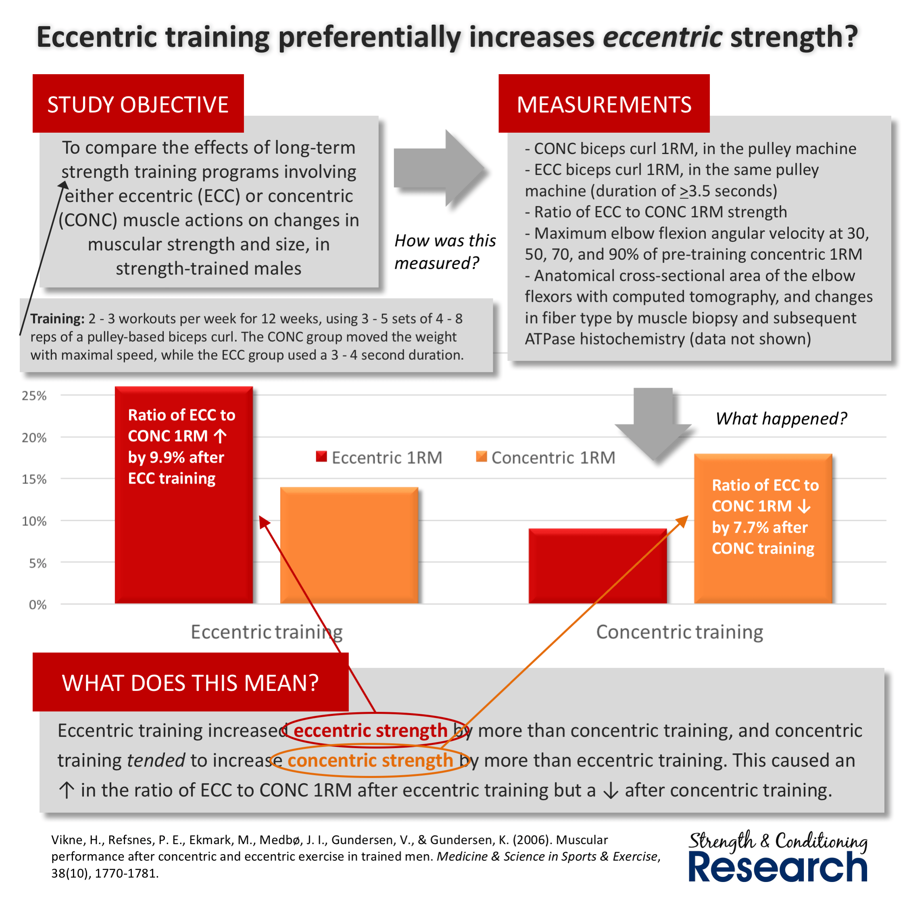
Concentric versus eccentric training
Concentric and eccentric strength
Do we develop both components?
Do we know how to develop this types of strength?
Absence of research!
https://www.strengthandconditioningresearch.com/perspectives/strength-training-sprinting/

Slide 24
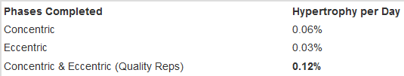
Structural adaptation
Eccentric training increases the amount of muscle mass
  causes an increase in the cross-section of muscle fibers - associated with the growth of the number and cross-section of myofibrils - the role of satellite cells
It is not yet known what volume of work, exercise intensity and rest intervals are optimal for hypertrophy
    Wernbom et al., In. Brady 2012

Slide 25
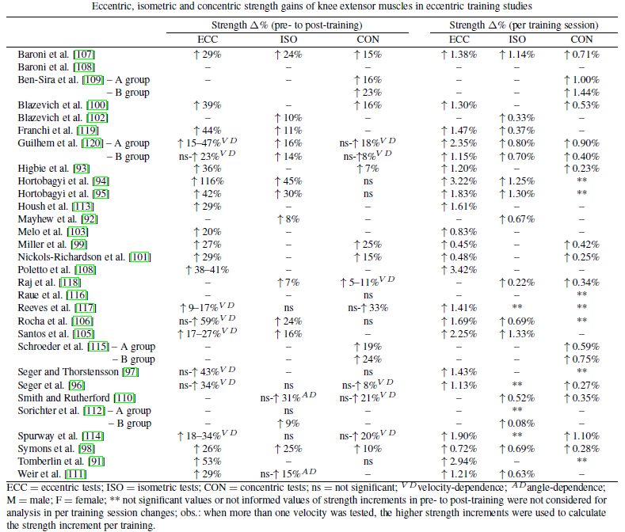
Baroni, B. M. et al (2014)

Slide 26
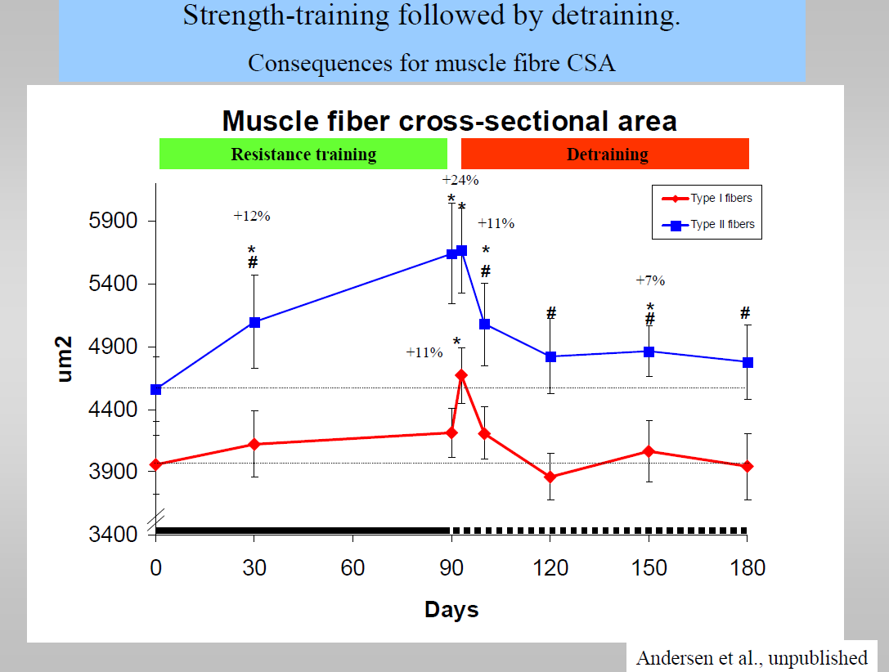
Perodization of strength development
Planning an annual training plan - basic principles
continuity
sequence
adequacy
individualization
specificity
(Andersen, přednáška)
ZVÝŠENÉ RIZIKO PORANĚNÍ
SNÍŽENÝ VÝKONNOSTNÍ POTENCIÁL

Slide 27
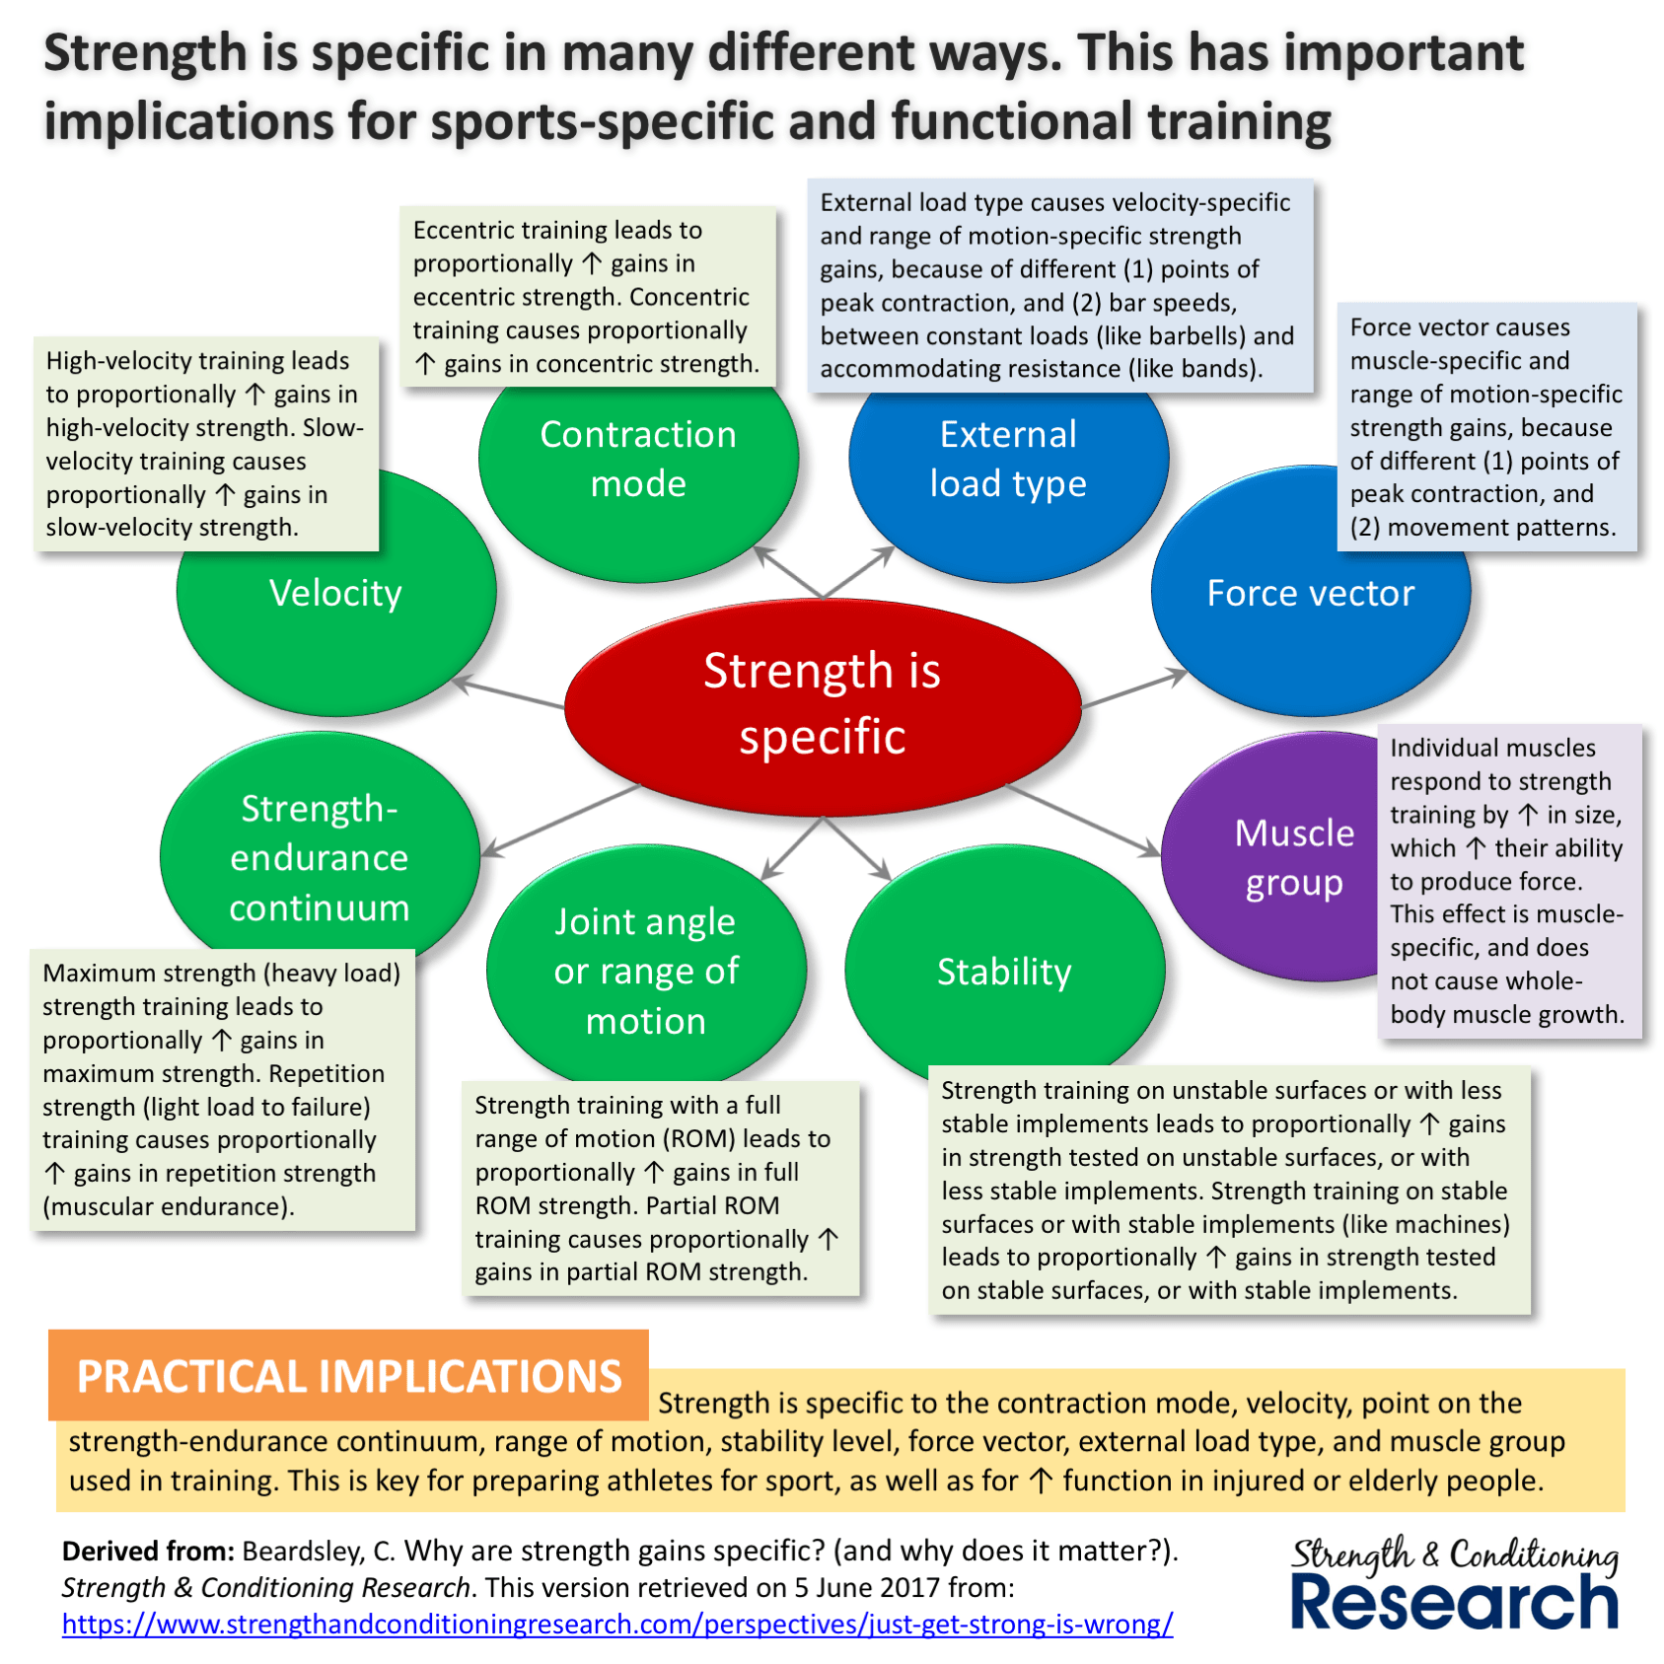
Specificity
Structure of strength performance
Velocity
Type of contraction
Force vector
Muscle group
Power peak in relation to range of motion (angle) and speed
Stability (groud)
Range of motion
Metabolic coverage
One vs multi-joint exercise
https://www.strengthandconditioningresearch.com/perspectives/strength-training-sprinting/

Slide 28
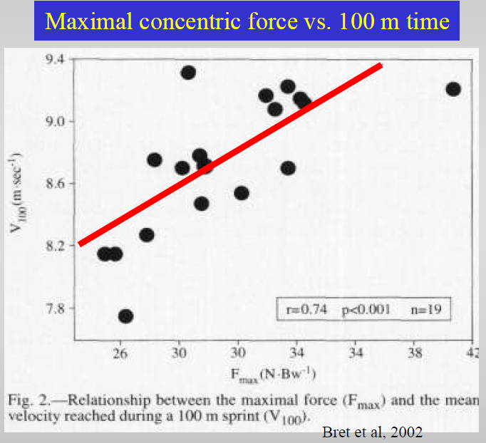
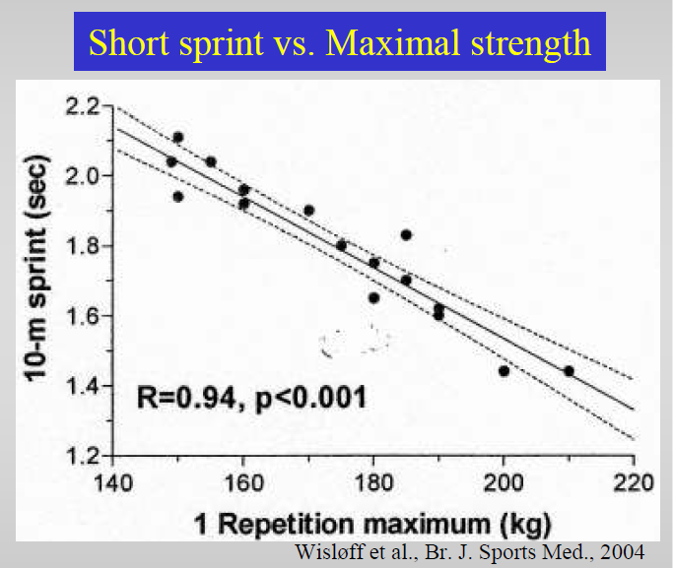
Fmax and speed

Slide 29
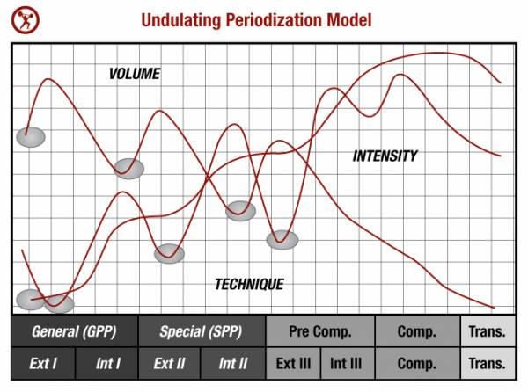
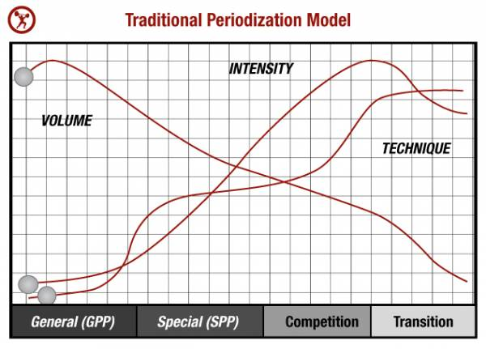
Type of periodization
https://breakingmuscle.com/fitness/a-simple-guide-to-periodization-for-strength-training

Slide 30
Thank you for your attention

