Slide 1
Research in Faculty of Sports Studies Labs
Martin Zvonař
the Dean of the Faculty of Sports Studies

Slide 2
Lab specialization
Exercise Stress Testing
Nutrition and healthy lifestyle
Biomotor Abilities
Gait analysis

Slide 3
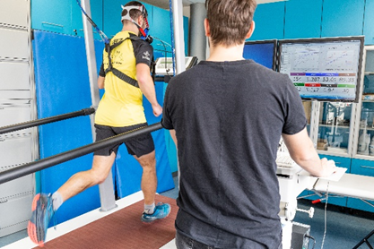
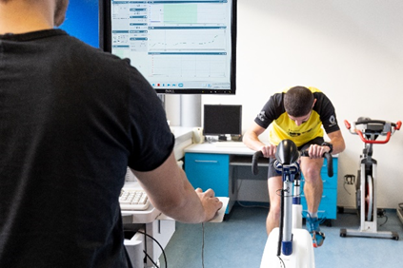
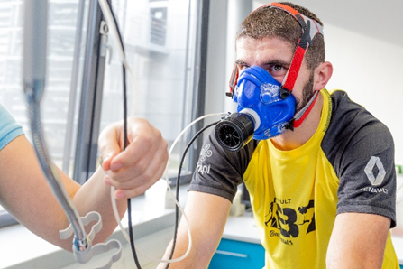
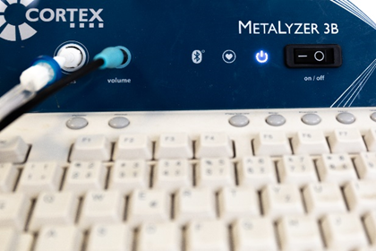
Exercise Stress Testing
Physiological and sports medical tests of human responses to physical load:
energy intensity of movement,
physical fitness,
determination of aerobic capacity,
anaerobic threshold,
training zones,
fat utilization during exercise,
for setting guidelines for training or rehabilitation,
or to discover any malfunctions of the body during exercise
Ergometers:
• Treadmill: LODE Katana, SAPILO Warulu (for spiroergometry)
• Bicycle ergometer: LODE Excalibur Sport (for spiroergometry, Wingate test and Pedal Force Measuring)
Stress Test:
• Spiroergometry (aerobic capacity: VO2 max, ventilator threshold (VT) economy of running)
• Wingate test (anaerobic capacity)
• Fat utilization during exercise

Slide 4
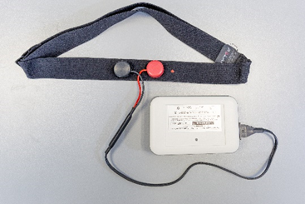
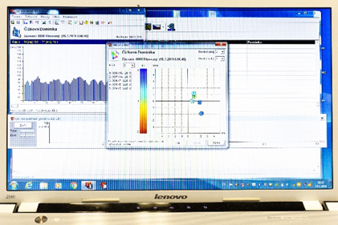
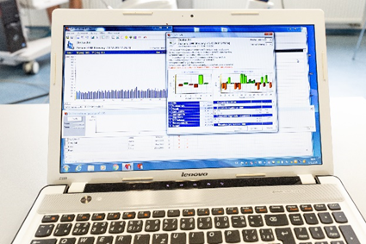
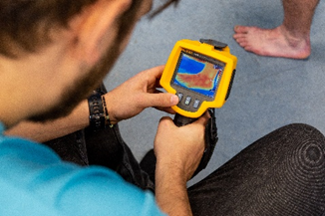
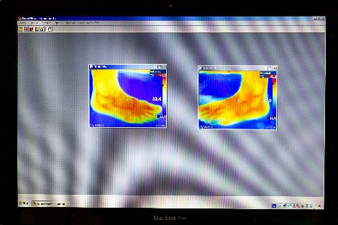
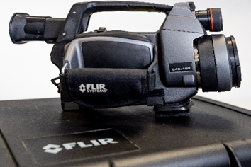
Exercise Stress Testing
SPECTRAL ANALYSYS OF HEART RATE VARIABILITY
Examination of the state of autonomic regulation for assessing the fatigue of the body of athletes in the prevention and diagnosis of overtraining.
Analysers of heart rate variability:
TF4 DiANS PF8/4
using MySASY system
Pulmonary function testing (spirometry)
Basal and resting metabolic rate
INFRARED THERMOGRAPHY
Musculoskeletal examination to detect poor circulation or damage from overloading  inflammation of muscles, tendons, ligaments, etc.
Thermographic camera:
• FLUKE TiR
• Thermographic camera: FLIR, SC 260

Slide 5
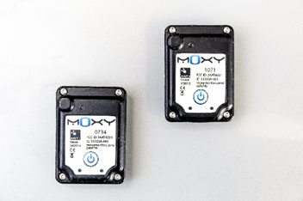
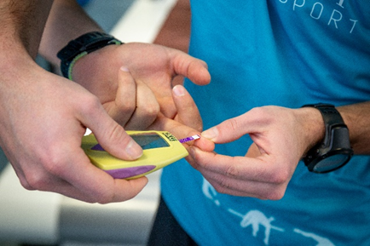
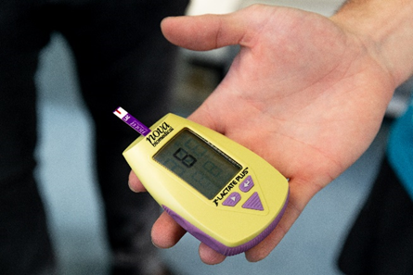
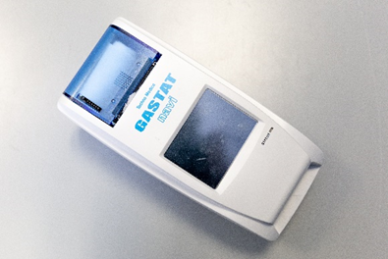
Exercise Stress Testing
MONITORING OF OXYGEN LEVELS IN MUSCLES
while athletes exercise.
• Model MOXY 3 (wearable sensor)
BLOOD ANALYSIS
• Blood Lactat Measurement: Lactate Plus Meter (Nova Biomedical)
• Blood gas analyser: GASTAT-navi (hand type)

Slide 6
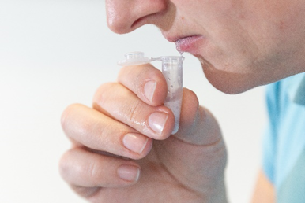
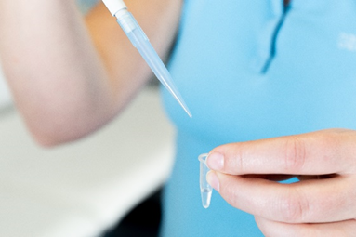
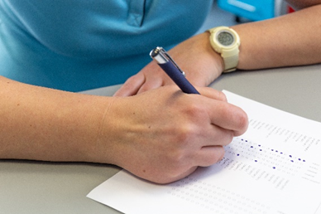
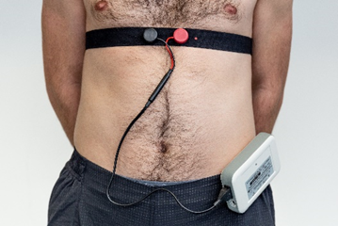
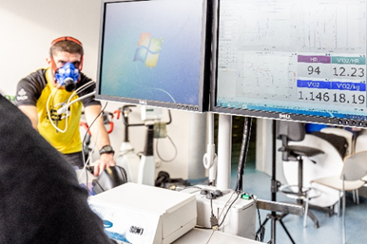
Exercise Stress Testing – research 1
The creation of mobile-friendly app for screening and diagnosis of fatigue at young athletes
PSYCHOLOGY (questionnaires) | BIOLOGY | IMUNOLOGY
Faculty of Arts (in cooperation) | Faculty of Sports Studies | Faculty of Science (in cooperation)
POMS | HRV | Analysis of saliva
Sleeping | Body composition | Blood capillary analysis
Aim:
early diagnosis of fatigue,
mobile app. will categorize athletes at risk of fatigue further steps in the management of fatigue
to find the relations between the selected variables characteristic for the internal and external training load of adolescent athletes.

Slide 7
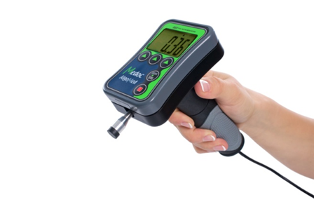
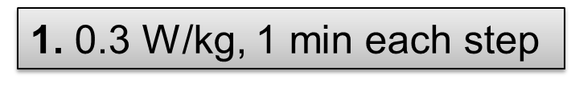
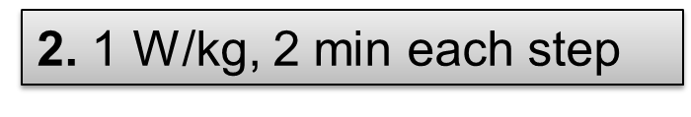
Exercise Stress Testing - research 2
The effect of testing protocol design for maximum oxygen consumption
Aim:
to assess an incremental exercise test protocols to volitional exhaustion
to assess the criteria of validity (plateau in oxygen consumption, maximum heart rate, Borg scale)
Methods:
35 participants
the participants visited the laboratory on 3 occasions each separated by at least 7 days
each participant undertook an incremental cycling test protocol until exhaustion.

Slide 8
Nutrition and healthy lifestyle – research 1
Effect of Respiratory Intervention and Movement Training in the Group of Hematooncological Patients
monitoring the influence of the respiratory and locomotor programs on selected parameters in hematooncological patients during remission.
These parameters are: interview with the client, spirometric examination (VC, FBE, FEV1, FEV1 / FVC), spiroergometric examination to vita maxima, spectral analysis VSF, handgrip, body composition using bioelectric impedance, frequency nutritional questionnaire and quality of life test.
The inclusion of respiratory training - patient's faster return to everyday activities, or even to leisure activities
respiratory training as a pre-treatment for the following cardiac training

Slide 9
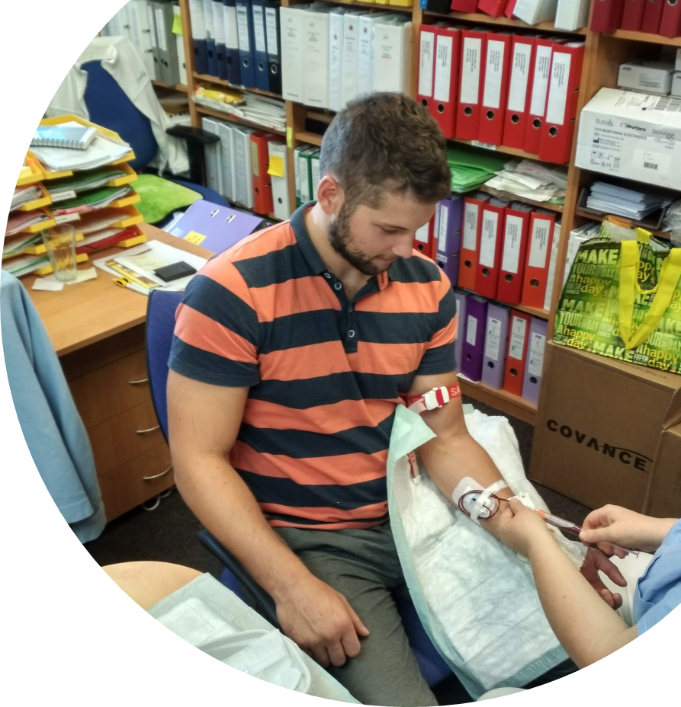
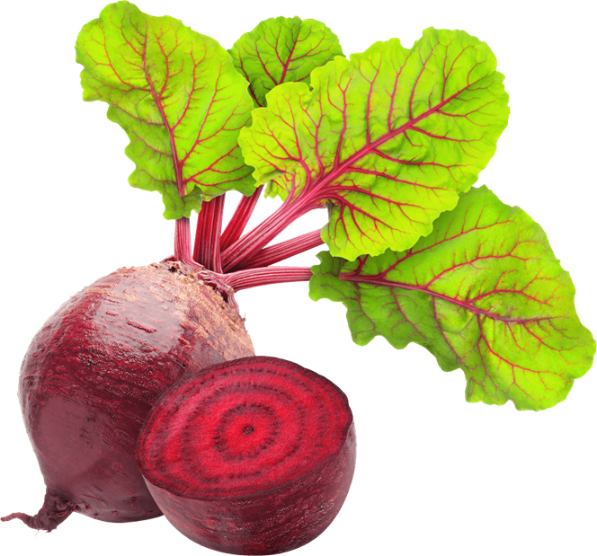
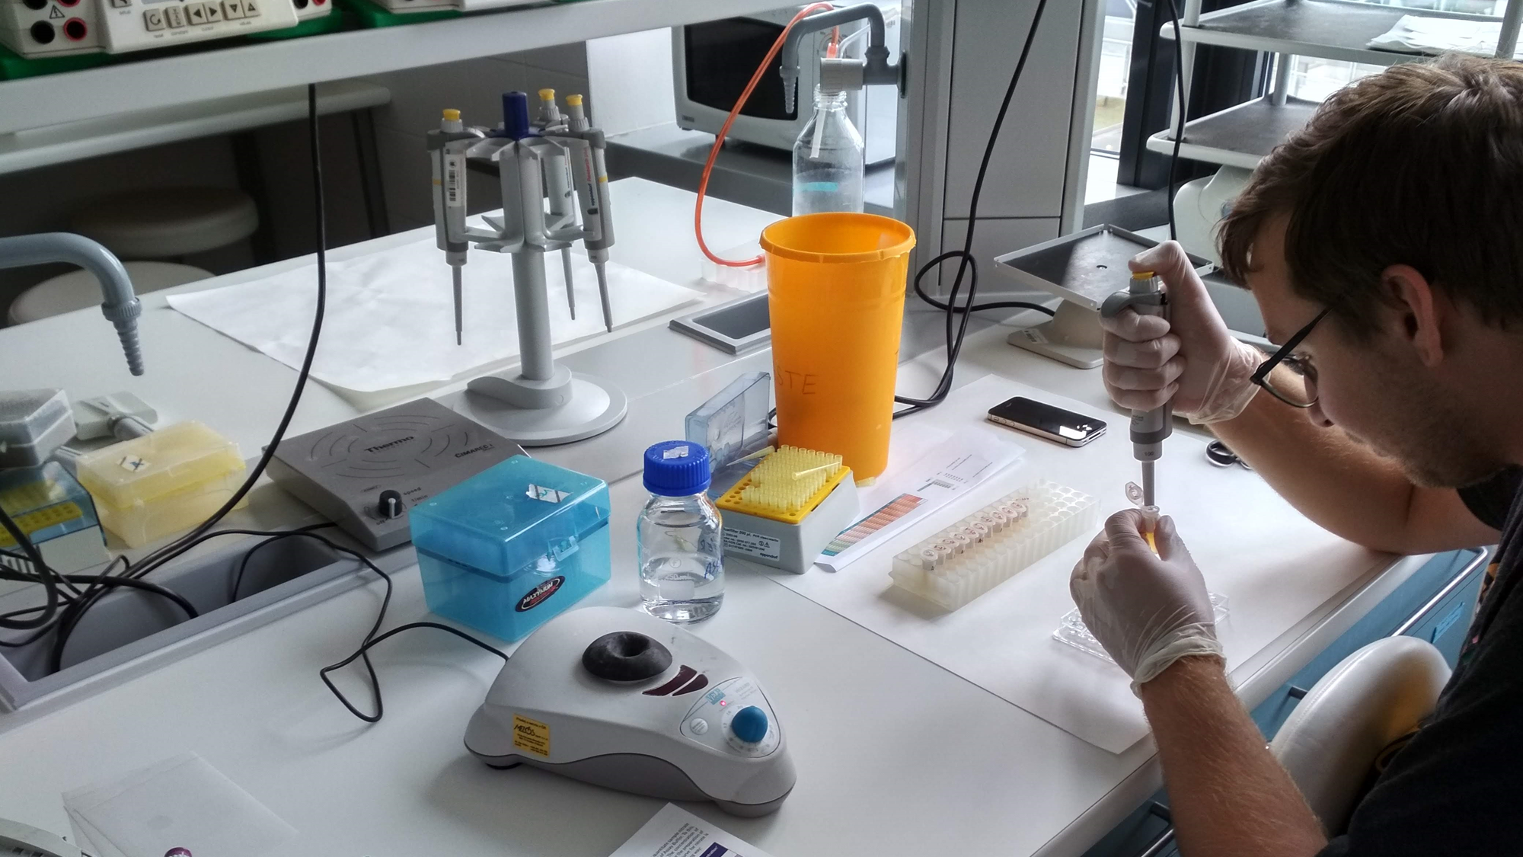
Nutrition and healthy lifestyle – research 2
Nitrate/nitrite blood dynamics after beetroot juice concentrate intake
Aim of research was to determine time-to-peak values of blood nitrates/nitrites after beetroot juice concentrate (BJ) intake (70 ml or 140 ml; 400 mg or 800 mg of dietary nitrates).
Group of 4 healthy men recreational athletes underwent two situations lasting 5 days (70 ml and 140 ml of BJ). Each day whole blood was collected and on the fifth day another 6 samples were taken each hour after BJ intake. One additional sample was collected 24 hours after intake as wash-out period.
Commercially available supplements and biochemical kits were used for the purposes of the study.
Gathered data are also crucial for setting the proper methods in main research with focus on increasing athlete‘s muscle work efficiency and therefore performance during submaximal cycling test.

Slide 10
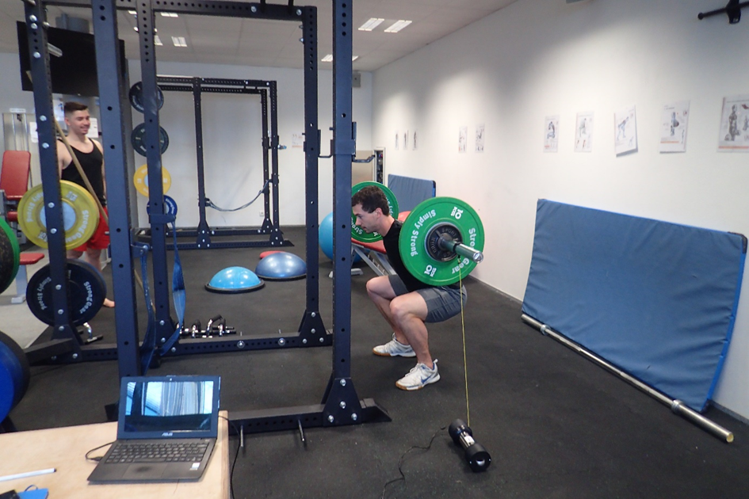
Biomotor Abilities – research 1
The influence of length of rest interval and age on change dynamic in strength parameters
Aim: to find out whether children will be able to achieve the required performances with a shorter rest interval than adults?
shorten the total time of the strength intervention and provide more space for the development of necessary technical and tactical skills, or create an oportunity to use strength training in normal physical education classes.
20 children (10 girls, 10 boys) and 20 adults (10 men and 10 women). Children and adults perform 3 series of 10 RM free-weight squats (resistence chosen on safety basis for children) in six not consecutive days (combination of 2 types of rest - active, passive and 3 rest intervals (IC), IC: 3min, IC: 2min, IO: 1min). The order of combinations is random for each person.
The ability to produce strength (repetition rate, execution speed, muscle strength, and work) is recorded using the instrument FytroDyne.
record the heart rate using sporttest and analysis of respiratory parameters by CORTEX.

Slide 11
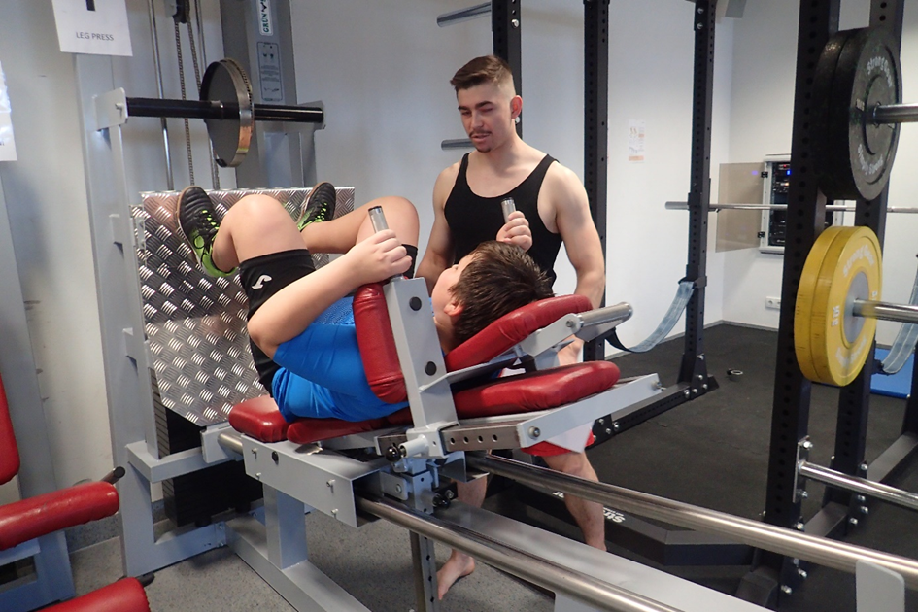
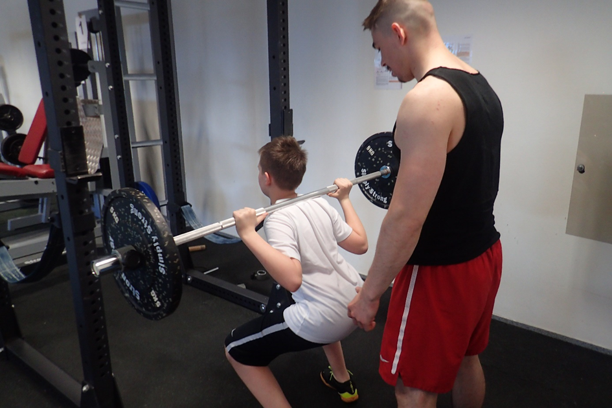
Biomotor Abilities – research 2
Effect of strength training on child obesity reduction
studies suggests that strength training can improve body structure and basal metabolism.
The aim of the study is to analyze the effect of strength training on the reduction of body fat in children.
18 children aged 8-13 (mean 11 ± 1.45 y) were involved in the research. Children exercise twice a week for 11 weeks
The exercise lasts 60 minutes in a range of 2 training units per week (15 min warm up and stretching, 40 min exercise, 5 min stretching).
Exercise is focused to practicing large muscle groups (squat, leg press, bench press, pull-ups with expander, abdomen exercise).
Resistance increases during the weeks from 12Rm to 8Rm. The effectiveness of the exercise will be evaluated by comparing the input and output InBody.

Slide 12
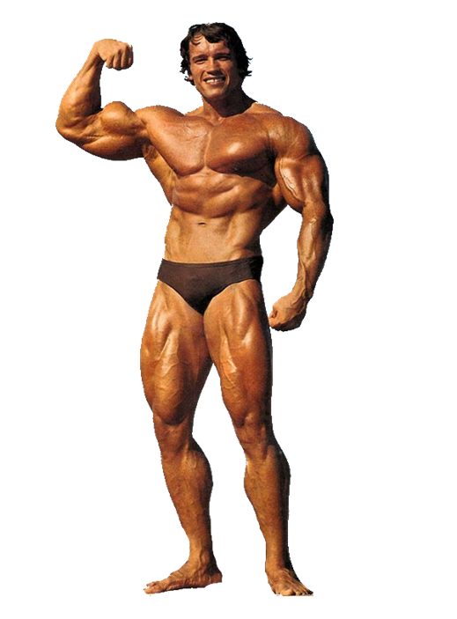
Biomotor Abilities - research 3
Changes and differences in body composition and strength of fitness and bodybuilding athletes at different rest intervals
changes in body composition (specifically, body fat, muscle mass, bone mass) and changes in force displacement measured on the dynamometer (elbow flexors and knee extensors) using 30, 60, 120 second rest intervals and retained training volume.
3 athletes - men aged 23-29 with a strength training experience of more than 5 years and experience of at least 2 competition seasons with the highest performance class in the c category
Measurement Methods:
calibrated electro-impedance instrument InBody 230
Training diary - volume of aerobic and strength work

Slide 13
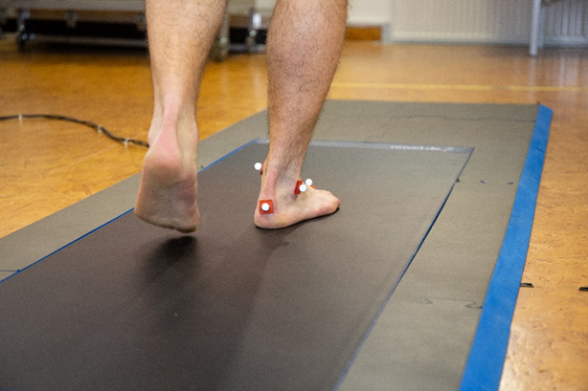
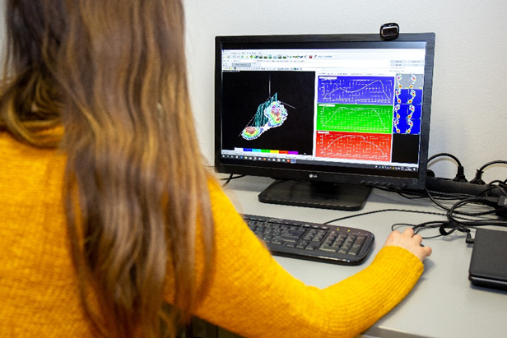
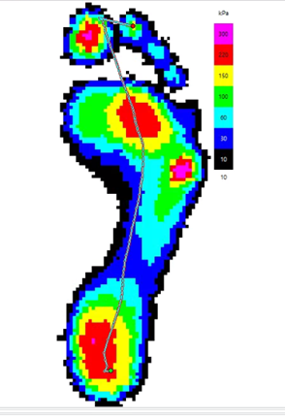
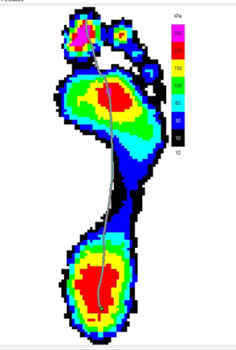
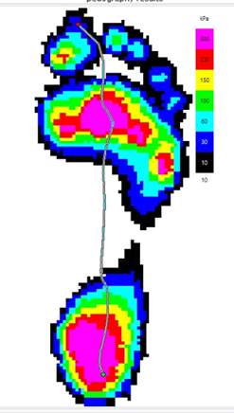
Gait analysis lab
Emed-at platform (Novel GmbH, Germany)
Evaluation of the longitudinal and transverse foot arch
Right and left foot asymmetries
Morphological changes of the foot
Assessment of the areas with increased peak pressure
Plantar pressure, contact time, contact area, mean force normalized to body mass, foot progression angle etc. analysis
FLAT
NORMAL
HIGH ARCH

Slide 14
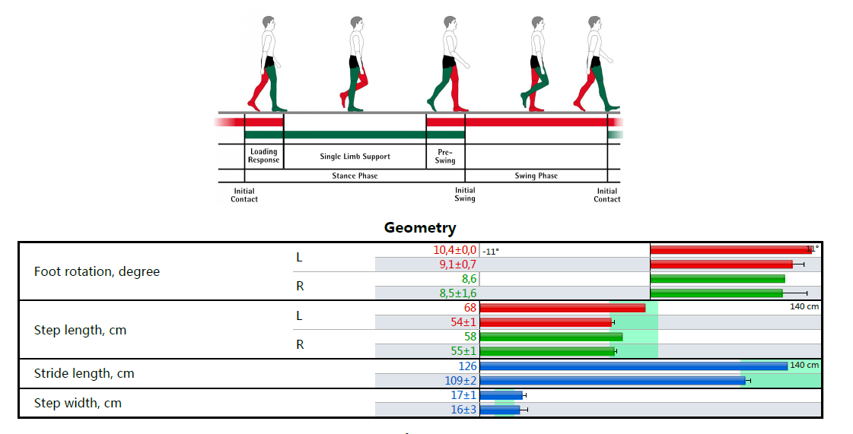
Gait analysis lab
Zebris (Medical GmbH, Germany)
Right and left foot asymmetries of plantar pressure, contact area, contact time
Step length
Step width
Cadence
Speed

Slide 15
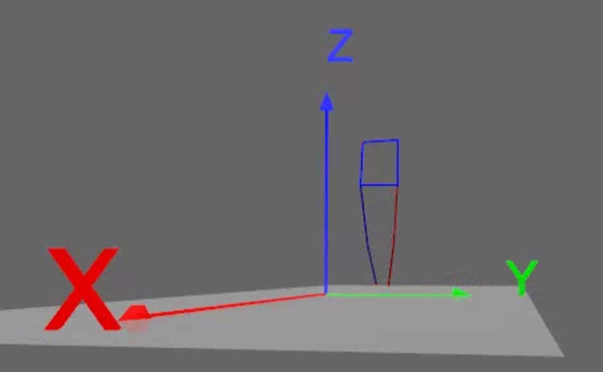
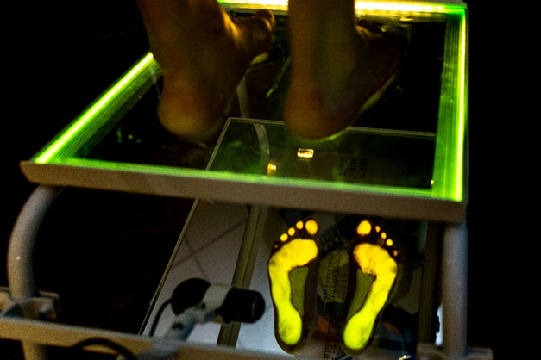
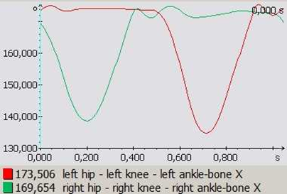
Gait analysis lab
Podocam
Evaluation of the longitudinal and transverse
foot arch when standing
Simi Motion
3D kinematic analysis (8 cameras)
Evaluation of the movement through
  Velocity
  Acceleration
  Side asymmetries
  Joints angles
  Comparison of the performance in different persons,
  or before and after an intervention
3D model stick diagram
Knee joint angle changes of the left and right lower limb during one step cycle

Slide 16
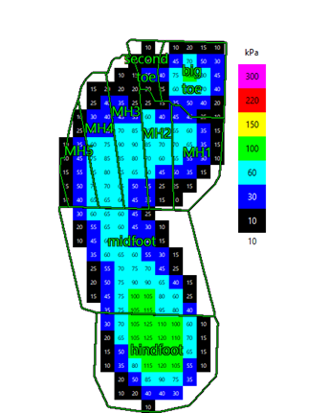
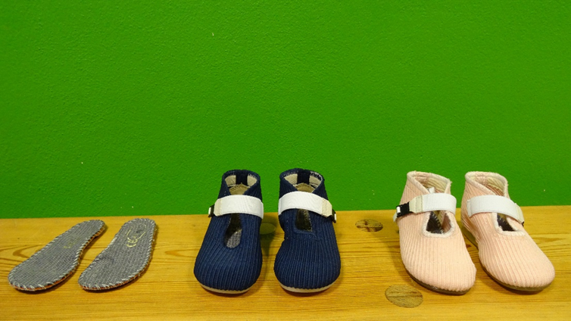
Gait analysis - research
First steps: gait analysis in healthy toddlers and toddlers with calcaneus valgus diagnosis (CVD) and the effect of special footwear
analyze the effect of tested shoes on gait parameters
assess differences in the gait pattern of healthy and CVD toddlers
three groups will be compared: a group of healthy toddlers, toddlers with CVD with a conservative treatment, and toddlers with CVD using tested shoes
tested shoes were designed to correct the valgus position of the calcaneus in two prototypes and will be added to the conservative treatment.
after 7 months assessment of the effect of tested shoes on the calcaneus valgus position.
a unique information to the shoe company that will allow adjusting the product to maximize the effectiveness of the tested shoes.

