Slide 1
Czech Republic
Choose your own path.

Slide 2
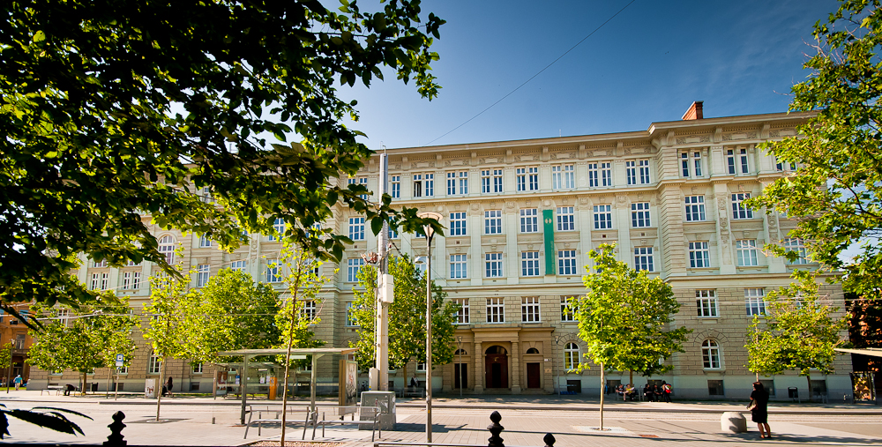
Faculty of Social Studies
Faculty of Social Studies was founded in 1998 (Masaryk University established in 1919 with social science teaching tradition dating back to 1921)
Faculty of Social Studies walk-through
approx. 3000 students, 400+ international students, 45+ countries represented
18 degree programs in English = 3 BA programs, 6 MA programs 2 MA joint/double degree programs, and 7 PhD programs.
comprehensive library, several computer labs, specialized desktop publishing studios and multimedia rooms, student clubs, radio r …

Slide 3
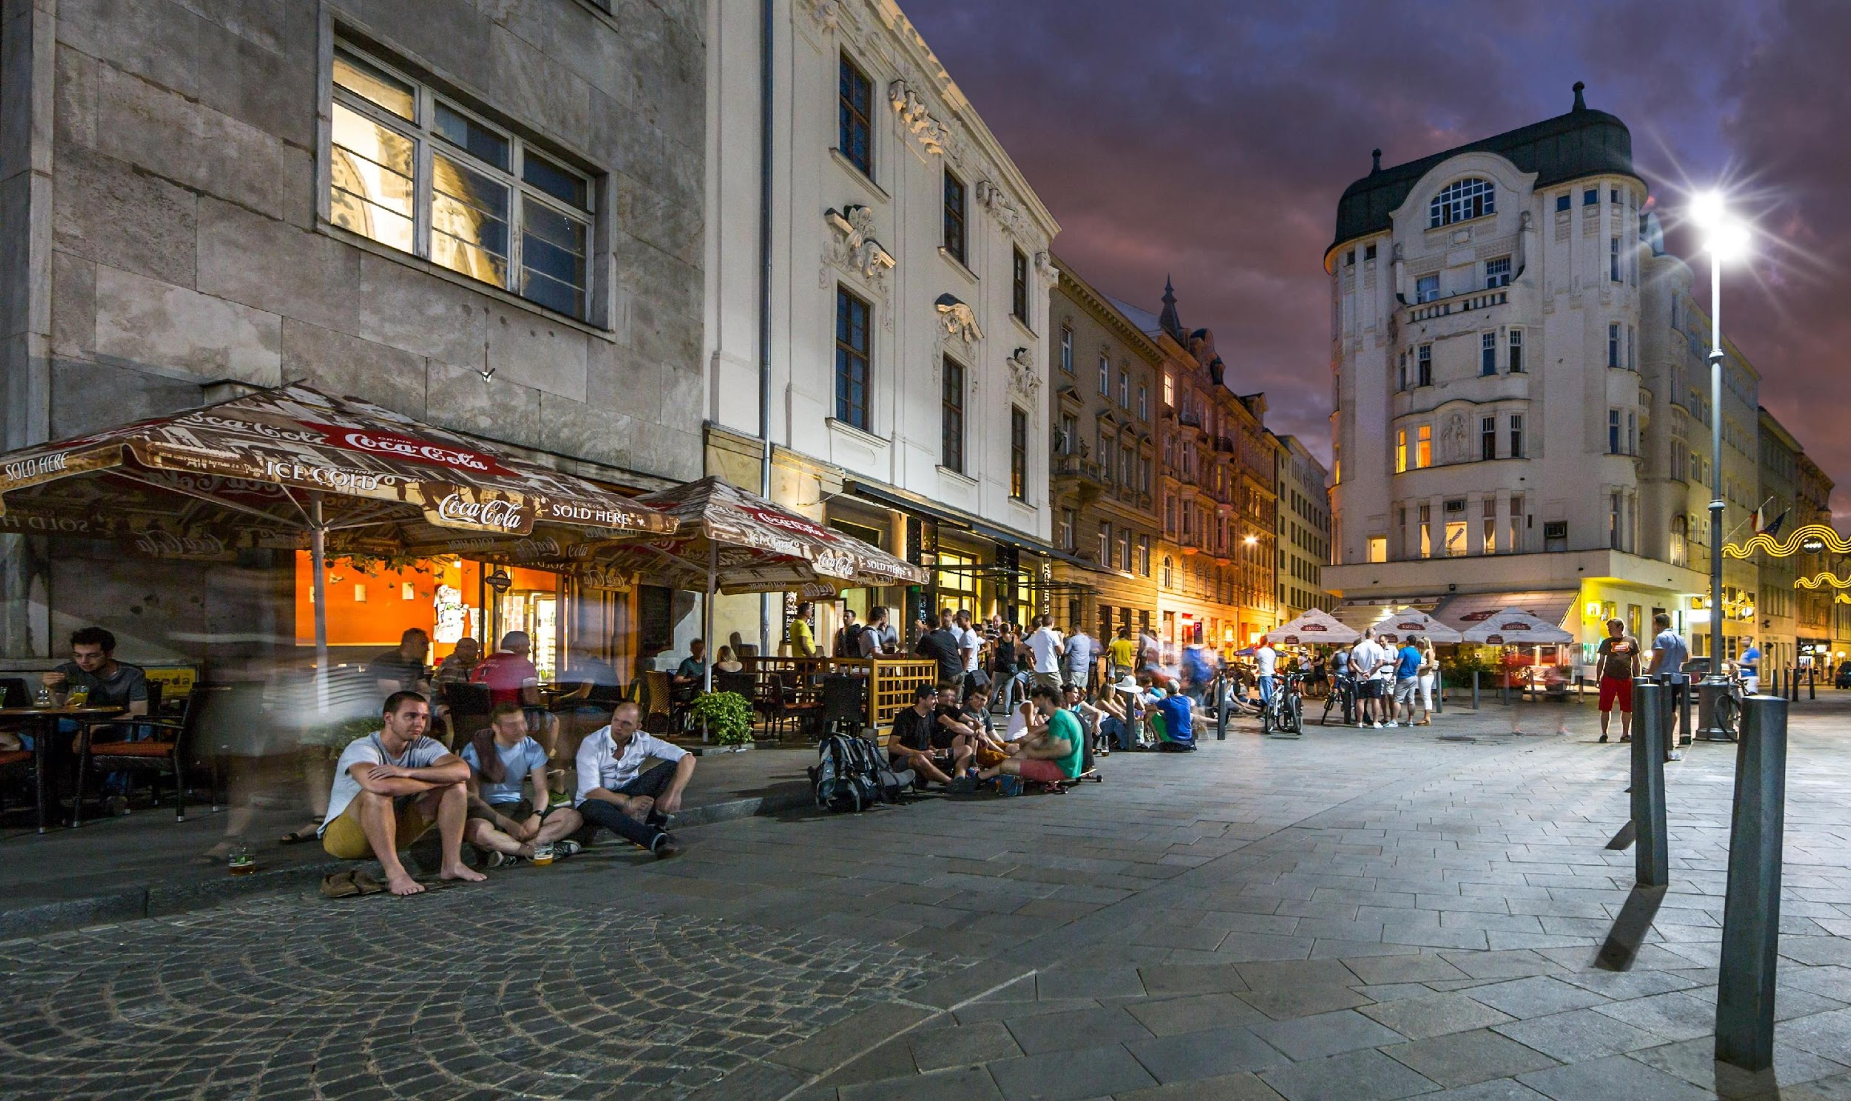
The City of Brno
350,000 inhabitants, approx. 60,000 students
Famous for its coffee culture, electron microscopes, functionalist architecture, music and theatre, the video games industry and much more
The Czech Republic is the 11th safest country in the world

Slide 4
Exchange students
55 incoming exchange and guest students in the autumn semester of 2023.
Erasmus+ in Europe, bilateral agreements, governmental scholarships, international university networks,
200+ courses taught in English
Choose courses freely across the Faculty (with respect to the rules of your home university and to the conditions given by the teacher at FSS)
How to choose English-taught courses?
Course catalog - English-taught course (you can specify Faculty of Social Studies and particular Department/Unit)
Contact the Department Coordinators at FSS and discuss your options
Details HERE
Information for students incoming at Masaryk University (Erasmus+ program)
International Students Guide

Slide 5
Study programs in English
Bachelors – details HERE
International Relations and European Politics
Global Challenges: Society, Politics, Environment
Politics, Media and Communication
Masters – details HERE
Sociology
Cultural Sociology
International Relations and European Politics
Energy Policy Studies
Conflict and Democracy Studies
Public and Social Policy and Human Resources
Masters Joint/ Double Degree programs
European Governance
Double degree program with Utrecht University, 1st year at Masaryk University, 2nd year at Utrecht.
Europe from the Visegrad Perspective
Jagiellonian University Krakow (PL) (home university and the project coordinator) - MU Brno (CZ) - Pécs (HU) - Banská Bystrica (SK), students spend one semester at each partner university.
Energy Policy Studies (new since 2024)
Double degree program with University of Trento (IT), 1st year at MUNI, 2nd year at Uni Trento

Slide 6
PhD Programs in English
Clinical Psychology
Psychology
Developmental Psychology
Educational Psychology
General Psychology
Social Psychology
Work Psychology
International Relations and European Politics
Media and Journalism Studies (only full-time mode)
Political Science
Political Science (single subject program)
Security and Strategic Studies
Social Policy and Social Work
Sociology
Sociology (single subject program)
Population studies specialization
Details HERE

Slide 7
Department of Social Policy and Social Work

Slide 8
Department of Social Policy and Social Work Courses for Autumn 2023
PUPn4403 Economics
PUPn4405 Evaluation research
PUPn4419 Contemporary problems in European welfare states
PUPn4513 Public Policy Process
PUPn4568 Multivariable Statistics
SPRb1126 Policy Engagement of Social Workers
SPRb1130 Human Behavior and the Violence
SPRn4482 Social Inclusion and Disability
SWDn4477 Social Work Institutionalisation and Organisation
VPLb1155 European Union Public Policy
VPLn4461 Contemporary Social Policy in EU

Slide 9
Department of Social Policy and Social Work Courses for Spring 2023
PUPn4402 Employment and labour market policy: European perspective
PUPn4455 Globalization and its phases: History, economy and migration flows
PUPn4457 Gender and labour market in different European contexts
PUPn4468 Statistics and Social Research
PUPn4999 Governance, Agency and Problems of Public Administration
VPLn4461 Contemporary Social policy in EU
SPRb1161 Social Work and Intimate Partner Violence
SPRb1228 Drug Interventions
VPLb1155 European Union Public Policy

Slide 10
Brief Research Profile
The research of Department covers a broad range of topics in social work, social policy and social services.
In social work a special focus is on problems and interventions related to children and families, disability and ageing, professionalisation and social, cultural and organisational conditions of social work practice.
In social and employment policy a special focus is on comparative research, evaluation research and intersections of family policies, employment policies and social inclusion.

Slide 11
Erasmus+ Departmental Coordinators
Daniela Jaklová Střihavková
E-mail: djs@fss.muni.cz
Tel: 549 49 48 20
Office hours: on request (via email)

