Slide 1

Choose your own path.

Slide 2
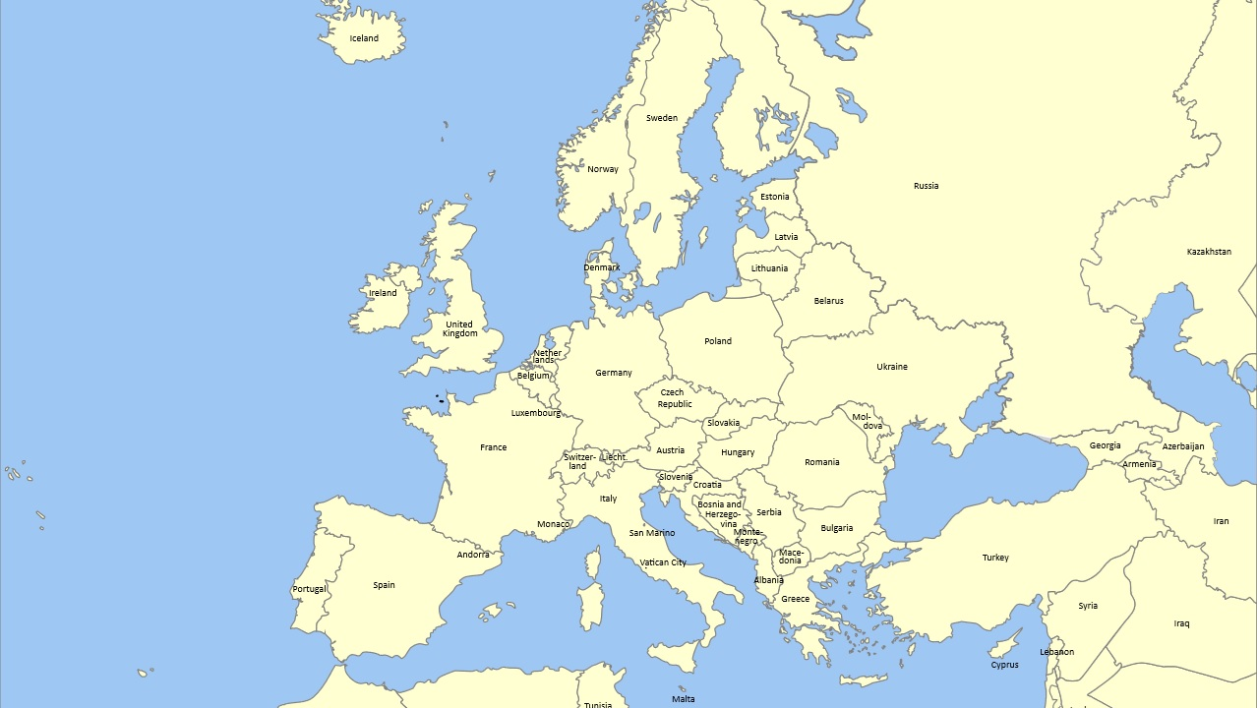

Slide 3
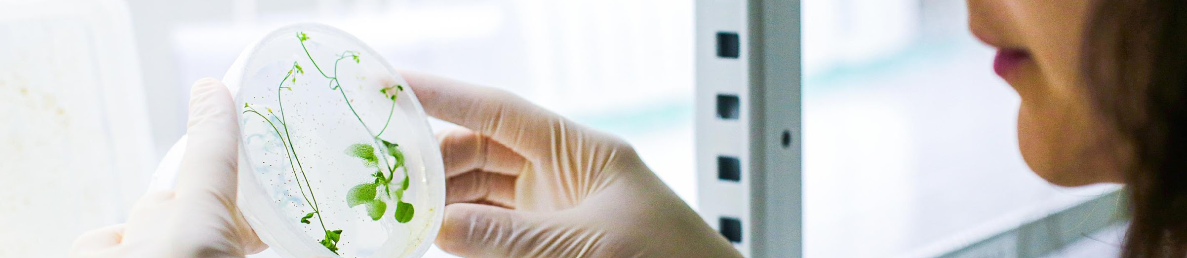
Czech Republic in general
10,5 million inhabitants
Located in Central Europe, rich history and culture since the middle ages
Very friendly cost of living
11th safest country in the world
Cradle of genetics, contact lenses, water turbine, blood types, nanofibers and many more (including sugar cubes and lager beer).

Slide 4
Education at
Masaryk University

Slide 5
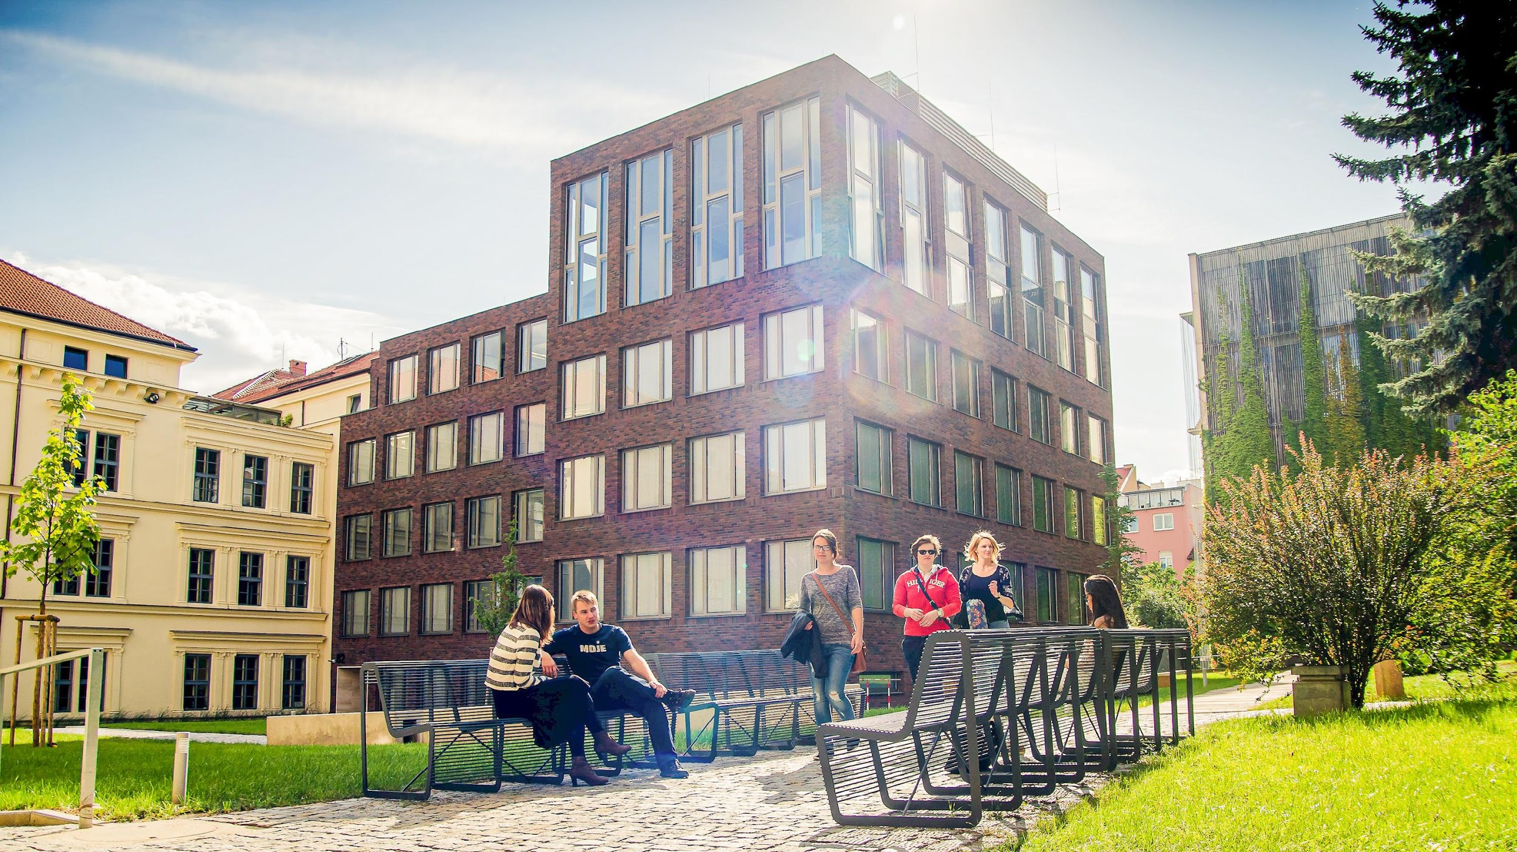
Student-oriented approach

Slide 6
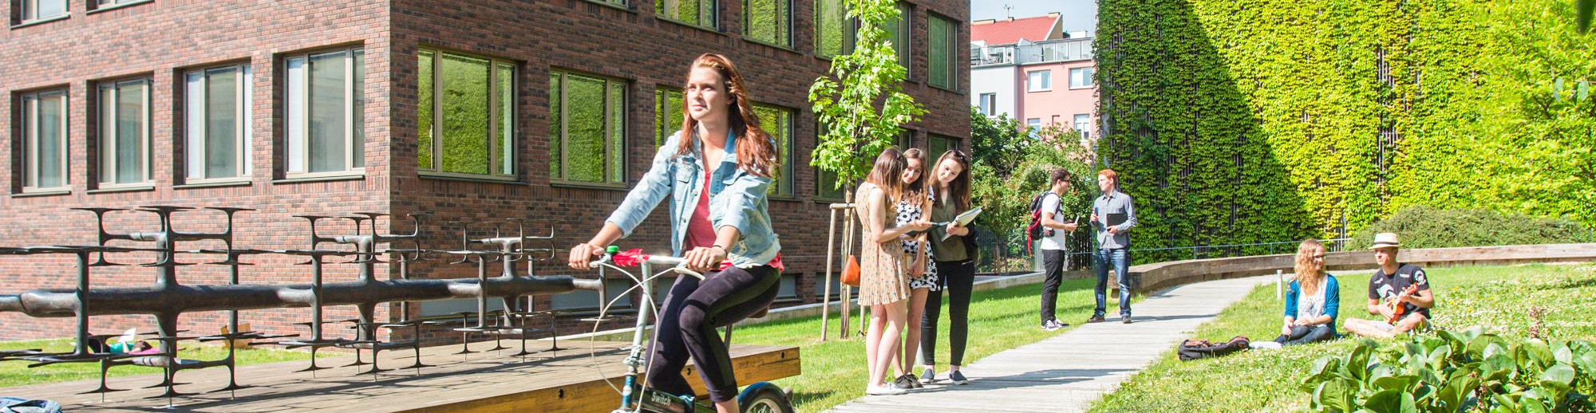
Basic facts and figures
10 faculties, more than 200 departments
21 % international students
approx. 30,000 students
Founded in 1919

Slide 7
Faculties
Law
Medicine
Science
Arts
Education
Economics and Administration
Informatics
Social Studies
Sports Studies
Pharmacy

Slide 8
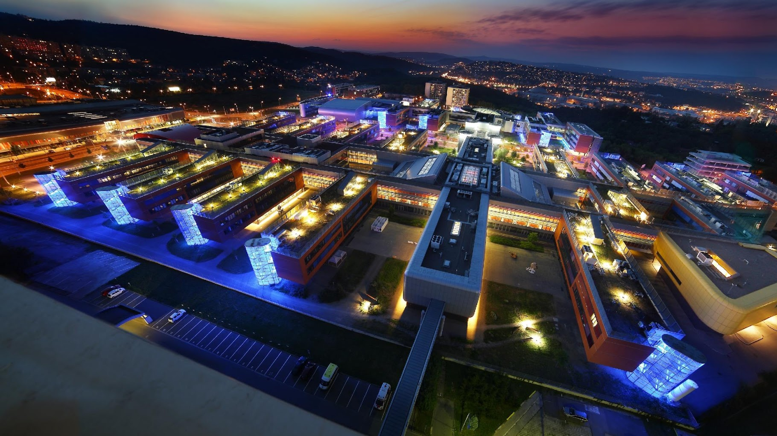
Modern and international

Slide 9

What to know about us
Personal approach to students – more and more selective approach
98 % of students find work easily
International environment
Around 500 disabled students – a special university department Teiresias
Strong emphasis on research – CEITEC centre, MA students participating in research, cooperation with corporate partners
American federal student aid (FAFSA) accreditation

Slide 10
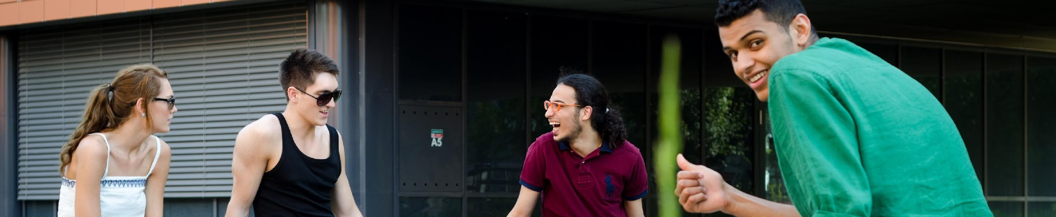
Internationalisation
21 % of international students
1670 incoming exchange students in 2022
Strong support for international students – Erasmus Student Network Brno, the Centre for International Cooperation, Language Centre, accomodation at dorms available
Member of the EDUC alliance
Extensive possibilities of mobilities even for international degree students

Slide 11
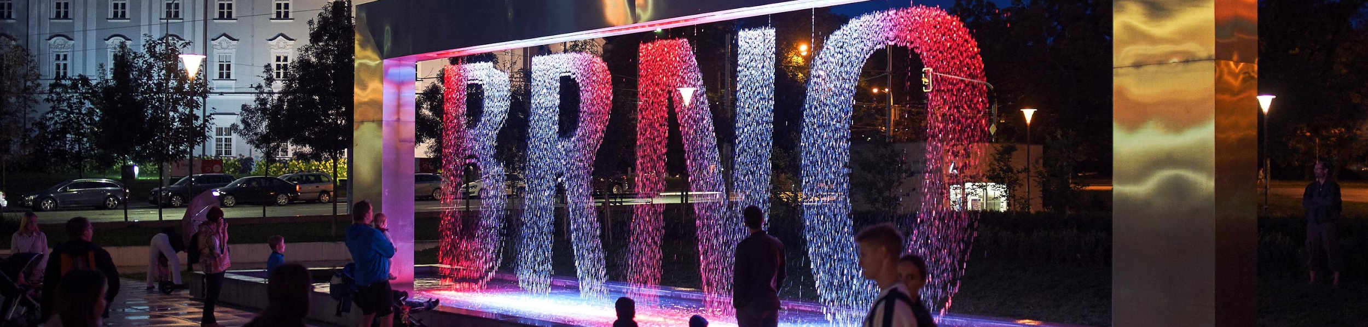
The City of Brno
350,000 inhabitants, approx. 60,000 students
Famous for its coffee culture, electron microscopes, functionalist architecture, music and theatre, video games industry and much more
Ideal point for exploring Europe

Slide 12
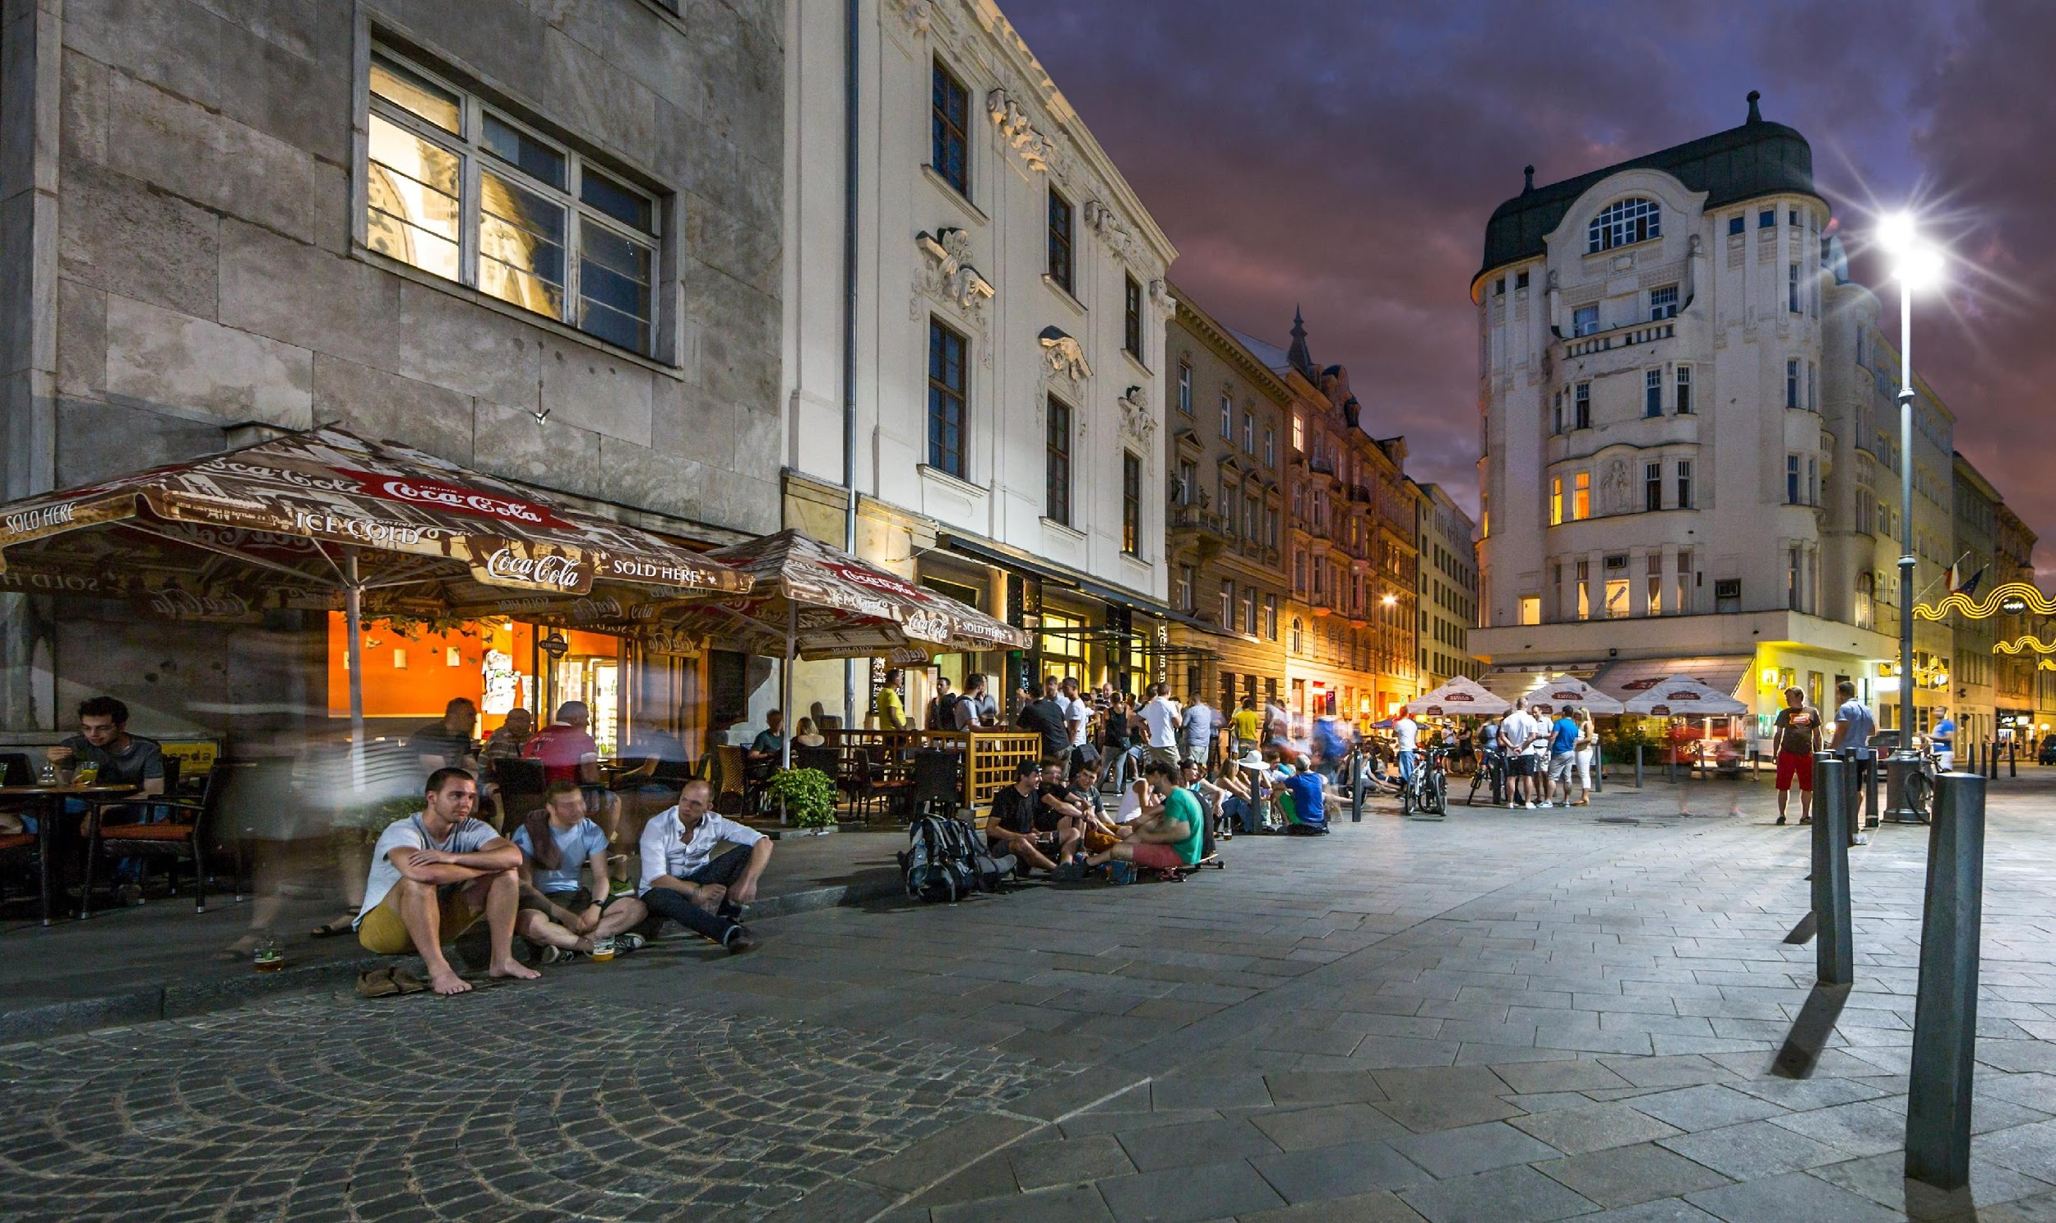
Brno – a student city

Slide 13
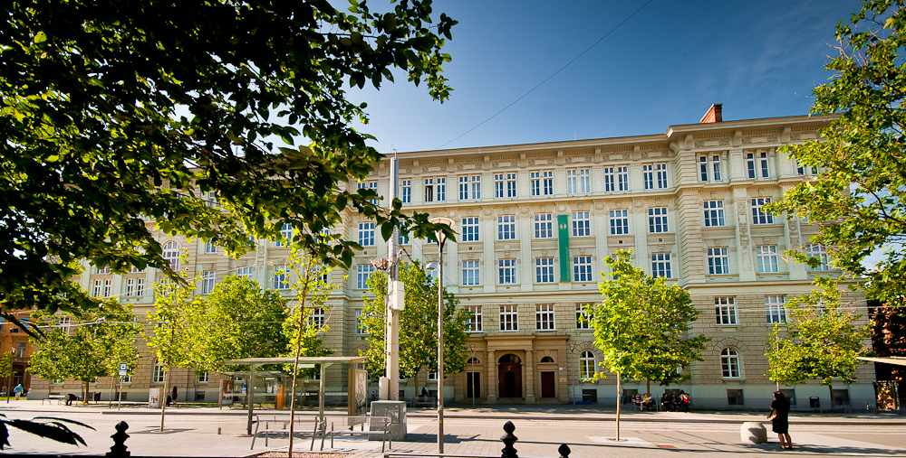
Faculty of Social Studies
7 departments, 3 research institutes
approx. 3000 students
Founded in 1998, by1997: social sciences had been developing within the Faculty of Arts
https://www.youtube.com/watch?v=kDXsqZPFTQU

Slide 14
Thank you for your attention

