Slide 1
Masaryk University IT services
Břetislav (Bruce) Regner
regner@ics.muni.cz
Institute of Computer Science

Slide 2
Service hierarchy
CESNET (Czech Education and Scientific Network), CR
Institute of Computer Science, MU/Brno
IT departments, faculties
Emploees (lab technicians, PhD students…) at departmens

Slide 3
CESNET
Assotiation of Czech Universities and the Czech Academy of Sciences
National (academic) IT services
      Networking
      Computing&storage
      Collaboration/communication support
      Security (CSIRT)
      Identity and digital certificates

Slide 4
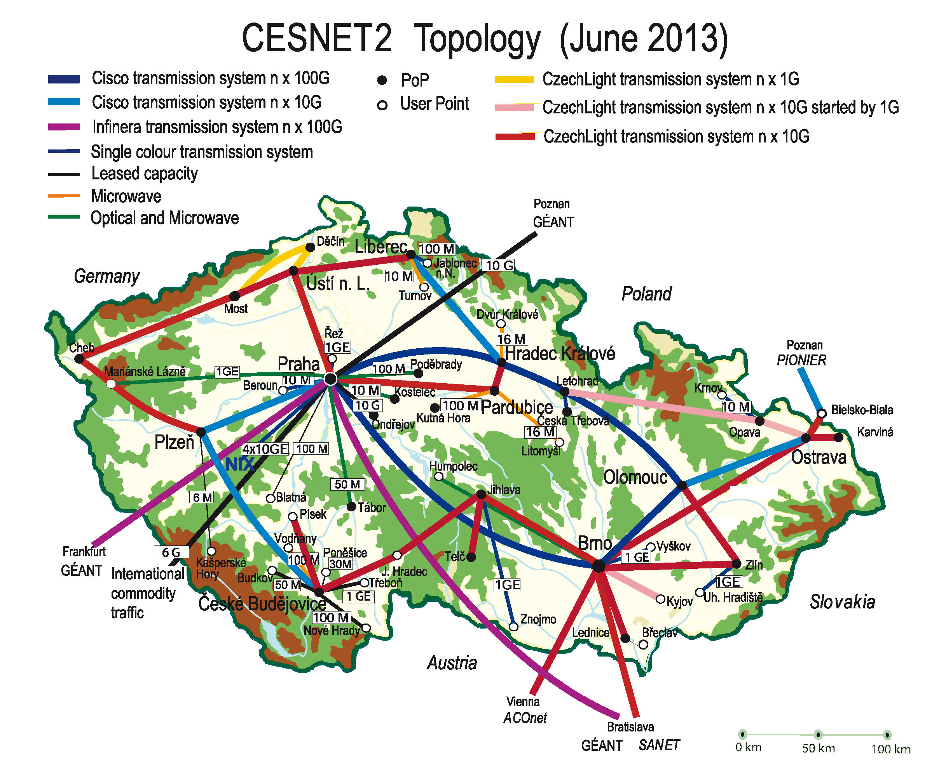

Slide 5
Storage & Computing
16 PB storage (including tapes)
Coordinator of MetaCentrum (NGI, part of EGI)
National e-infrastructure coordination (IT support for R&D)

Slide 6
Collaboration support
Video - and webconferencing
National (academic) installation of Adobe Connect (MUST, Friday Afternoon)
IP telephony (free telephony within CESNET, IP connection abroad)

Slide 7
Identity and certificates
eduID.cz federation (Shibboleth)
TERENA certificates (personal and server)

Slide 8
Institute of Computer Sciences
IT Service provider for MU (and Brno)
Central MU facilities
Close cooperation with CESNET
      Common projects

Slide 9
Faculties
IT departments
      Local IT support (installations, repairs)
      Local mail/webservers, local networks, …
Technicians at Departments
      Lowest-level IT Support or Specialized Services

Slide 10
Identity management
UČO
Primary and Secondary Password
Identity Cards

Slide 11
Information systems
MU Intranet (INET) (MUST, Thursday Morning)
      Developed by ICS
      Economics, accounting
      HR, personal data
      Project management
      Financial control
      …

Slide 12
Information systems
MU Information System (IS MU) (MUST, Thursday Afternoon)
      developed by FI
      Study administration (enrollment, exams, e-learning, timetables)
      Discussion forums, e-votes, document server
      … and much more

Slide 13
Libraries
(MUST, Wednesday Afternoon)
Support for library services (ALEPH system)
Information resources – e-magazines, scientific publications (Wiley, Springer, Elsevier…)

Slide 14
Networking
Brno’s Academic Computer Network (BAPS) – 150 km of optical cables
10 Gbps Core Network
Customers: Courts, Schools, T-Mobile
WiFi AP – Eduroam and MUNI (captive portal)
VPN
MU network management and monitoring

Slide 15
Telephony – internal phone system
      free calls within the MU (and other Universities in CR and Slovakia over CESNET)
      Cheap calls abroad (VoIP to peers, over CESNET )
      Currently preparing new Phone System (?? Including Instant Messaging, Videocalls)

Slide 16
Data Storage
“standard” – small (20 GB/emploee), fast, reliable
      Samba, SCP
      Every Emploee
      Students/Partners on Demand
      Self-Service, Web Interface
“middle” – 100s of GB – best effort
BIG – 10s to 100s of TBs (CERIT SC in cooperation with CESNET) (MUST, Wednesday Morning)

Slide 17
(Super)computing
CERIT SC (MUST, Wednesday Morning)
      project/national storage and computing center, part of national e-infrastructure
      3,5 PB storage (incl. Tapes)
      3500 processor cores
      Scheduling, job planning, resource allocation

Slide 18
Hosting and Virtualization
Webhosting (CMS Umbraco) (MUST, Thursday Morning)
Linux hosting (Linux Account, OpenVZ containers)
VMWare virtualization system (100 cores)
Virtual machines on CERIT “cloud” – Open Nebula over KVM/Xen/VMWare)

Slide 19
Audio/Video
(MUST, Friday Afternoon)
Lecture recording support, transcoding, publishing
Videoconferencing (Adobe Connect, Tandberg/Polycom)
UltraGrid – support for Ultra-High Definition low-latency video – up to 4k, algorithm development

Slide 20
Central Computer Management
(MUST, Tuesday Afternoon)
Deployment – OPSI system
Management - Active Directory

Slide 21
Software
Campus-wide licences
      Servant Salamander
      Statistica, SPSS, SAS
      ArcGIS
      ASPI (juridicial SW)
      Matlab 5

Slide 22
Software
Concurrent licences
      Maple
      Matlab
MS Software - MS Select
Adobe - Adobe contract (Creative Cloud coming soon☹)
Antivir – NOD/AVG

Slide 23
Computer rooms
(MUST, Tuesday Afternoon)
About 1000 computers accessible for students
University computer centre – 130 computers available 24/7 at Komenskeho square
Printing/scanning

Slide 24
IT Security
(MUST, Friday Afternoon)
      Network Traffic Monitoring
      Incident Handling
      Research, Cooperation with Industry
      Cooperation with National Security Authority and Police

Slide 25
Others
Large-format prints (up to A0)
Identity cards printing

Slide 26
ICS structure
Divisions:
  Communication infrastructure
  Computational and Storage infrastructure
  Information Systems
  User Support

Slide 27
  Q&A?
Jméno Příjmení
jmeno@ics.muni.cz
http://www.ics.muni.cz/~jmeno

