Slide 1
Masaryk University
Web Presentations
(the centralized ones)
Pavel Budík
budik@ics.muni.cz
http://www.ics.muni.cz/~budik

Slide 2
What is this talk about?
How many of you take care of a web?
MU has hundreds of web presentations, which ones?
Centralized web presentations
    The ones ICS takes full care of
    About 50 presentations

Slide 3
What we‘ll see?
50 web presentations… Are you serious?
MU official presentation
Housing.muni.cz
What‘s behind?

Slide 4
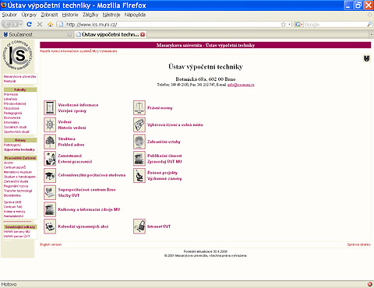
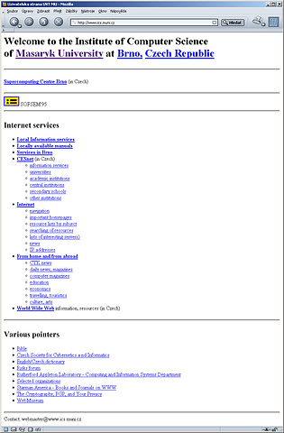
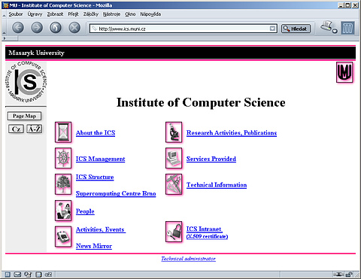
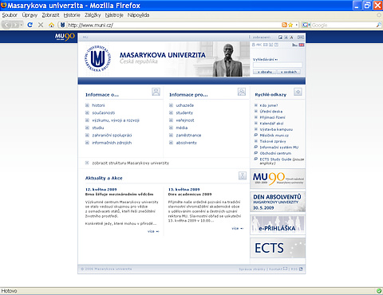
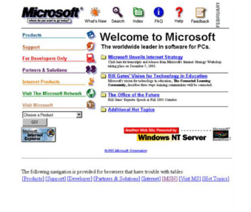
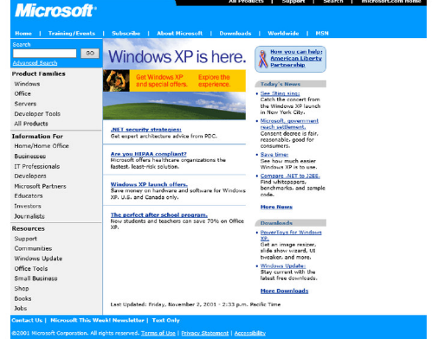
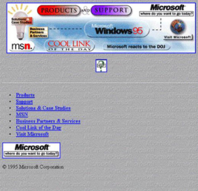
MU official presentation
Came on-line in 1996
Had 3 major versions
New version underway
    Web has stalled, need to upgrade
    Still the same problems as before
www.muni.cz

Slide 5
Housing.muni.cz
Came on-line in 2003
Original version had to be rebuilt in 2013
    Simple, minimalistic
Housing.muni.cz
Current statistics
    50 active advertisements
    1200 registered users, 1000 MU students, 200 advertisers

Slide 6
What‘s behind the scenes
www.muni.cz
    Custom solution, not much of a data input UI
Platform powering Housing.muni.cz
    Appeared later, uses open source CMS Umbraco
webcentrum.muni.cz/umbraco

