Slide 1
Early Warning Scores (EWS)
Clinical Sessions 2011
By Bhavin Doshi

Slide 2
What is EWS?
After qualifying, junior doctors are expected to distinguish between the moderately sick patients who can be managed in the ward and patients who are so sick that they need admission to the high dependency unit
Early warning scoring systems are in place to determine whether a patient is critically sick.
It does not require expensive, sophisticated equipment
It is reproducible

Slide 3
Who is it used for?
EWS can be used to monitor medical, pre and postoperative surgical, and Accident and Emergency patients.
Early warning scores are sometimes also referred to as:
Patient at Risk scores (PARS) or
Modified Early Warning Scores (MEWS).
Surgical specialties use modified versions - POSSUMS (physiological and operative severity score for the enumeration of mortality and morbidity)

Slide 4
How do you calculate an Early Warning Score?
An EWS is calculated for a patient using simple physiological parameters.
Mental response,
respiratory rate,
pulse rate,
systolic blood pressure,
Temperature,
(Oxygen saturation),
(Urine output)

Slide 6
How is it useful?
The idea is that small changes in these parameters will be seen earlier using EWS than waiting for obvious changes in individual parameters such as a marked drop in systolic blood pressure which is often a pre-terminal event.
Of all the parameters, respiratory rate is the most important for assessing the clinical state of a patient, but it is the one that is least recorded.
Respiratory rate is thought to be the most sensitive indicatory of a patients physiological well being.
This is logical because respiratory rate reflects not only respiratory function as in hypoxia or hypercapnia, but cardiovascular status as in pulmonary oedema, and metabolic imbalance such as that seen in diabetic ketoacidosis (DKA).

Slide 7
When and why to use an Early Warning Score?
An EWS score should be calculated for any patient that nursing staff are concerned about.
It gives a reproducible measure of how "at risk" a patient is.
Patients who have suffered major trauma, or have undergone major surgery.
Repeated measurements can track the patient's improvement with simple interventions such as oxygen or fluid therapy or further deterioration.
Serial EWS readings are more informative than isolated readings as they give a picture of the patient's clinical progress over time.

Slide 8
And then……
Once an unwell patient has been identified, with an EWS score of 3 or more, this should stimulate a rapid assessment of the patient by a ward doctor or, if available, the intensive care unit (ICU) team.
The result of the review should be the modification of patient management to prevent further deterioration.
If deteriorating patients are identified early enough, simple interventions such as oxygen, or fluid therapy, may prevent further deterioration and imminent collapse.
The use of EWS has been shown to be effective in reducing mortality and morbidity of deteriorating patients as well as preventing ICU admissions

Slide 9
What should happen if a patient has an EWS of 3 or more?
Urgent attention!
The level of response is dependent on the facilities available.
In many UK hospitals a score of 3 triggers an immediate review by a ward doctor.
If no improvement is seen the most senior ward nurse can then call a senior doctor.
This gives the ward nursing staff the authority to refer upwards to more senior members of staff if a patient's clinical situation is not improving.
Some UK hospitals have gone further and a score of 3 results in an immediate call, by the nursing staff, directly to the Intensive care unit registrar for a ward review.
Other hospitals have been more cautious and use a score of 4 or even 5 as a call out trigger.

Slide 10
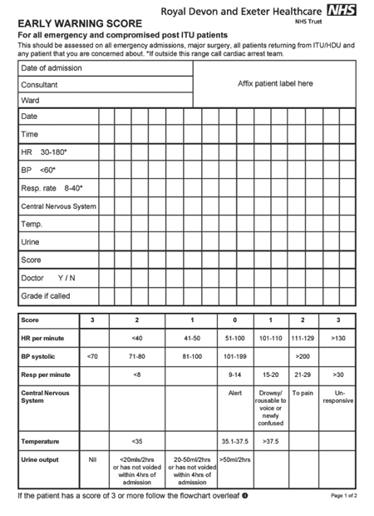

Slide 11
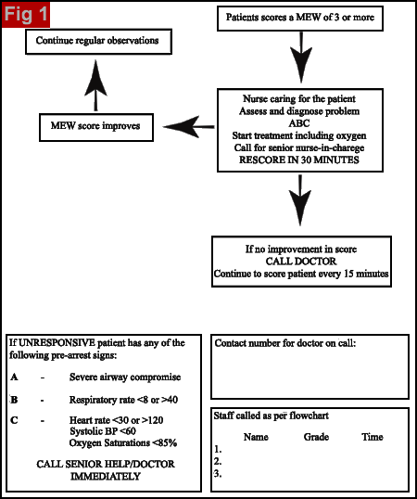

Slide 13
Case 1
A 60-year-old man arrived in hospital with increasing shortness of breath. He had no chest pain. He had a past history of a myocardial infarction and was awaiting coronary artery bypass surgery; he was also a known asthmatic. On arrival in hospital he was alert with a respiratory rate of 30, a pulse rate of 130 and a blood pressure of 108/60, his temperature was 38.5°C. He therefore had an EWS score of 5. He was assessed by the emergency doctors. A salbutamol nebuliser and oxygen therapy were given. After 15 minutes, on clinical observation, he looked better. His respiratory rate had dropped to 24, his pulse rate was 124 bpm, temperature remained the same but his blood pressure had dropped to 95/55mmHg. Therefore despite looking better his EWS score had risen to 6, suggesting he was still deteriorating. The intensive care team were called and he was admitted to the high dependency unit for observation and treatment. He was found to be septic from a chest infection. This case shows that subjective judgements made on appearance only can be misleading. More objective judgements are often made on the basis of physiological parameters

Slide 14
A 72 year old patient arrived in recovery after a Whipple's resection of his pancreas for a pancreatic tumour. He had lost 3 litres of blood intra-operatively and was receiving a blood transfusion in recovery. Initially in recovery he was alert with a heart rate of 70bpm, a respiratory rate of 15, a blood pressure of 110/70mmHg, and a urine output of 20ml/hr. His EWS was 1. Over the next 3 hours in recovery he became more tachycardic and hypotensive. He was alert with a heart rate of 105, a respiratory rate of 20, a blood pressure of 95/50 and a UO of 10ml/hr. His temp. was not recorded. Therefore his EWS can be calculated as having risen to 4. Despite this a doctor did not review him, and he was sent back to the ward. By midnight he was drowsy, had a respiratory rate of 30, temp. of 38.5°C, HR of 120bpm, BP of 90/50mmHg and his urine output was negligible. This made his EWS 11. He was finally reviewed, resuscitated and taken immediately back to theatre for an exploratory laparotomy. Two litres of blood and clot were found in his abdomen from a bleeding artery. He was in hypovolaemic shock. He was sent intubated to the intensive care unit and remained there overnight. If the EWS protocol had been followed this patient should have never left recovery. All the signs were there from a very early stage that he was deteriorating. Early intervention would have prevented the development of hypovolaemic shock and possibly an ICU admission

