Slide 1
Cerebellum
MIMSA’s Anatomy sessions 2013

Slide 2
cerebellum
Motor part of the brain
  Coordination of movement
  Regulation of muscle tone
  Maintenance of equilibrium
  Ensures that there is contraction of the proper muscle at the appropriate time and with the correct force

Slide 3
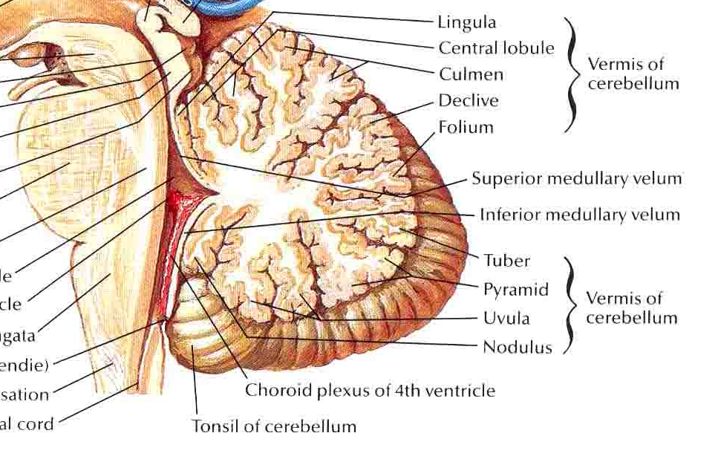
Posterior cranial fossa
Separated from the occipital lobes by the tentorium cerebellum
Falx cerebelli placed deeply in the posterior cerebellar fissure
Fastigium constitutes the roof of the 4th ventricle

Slide 4
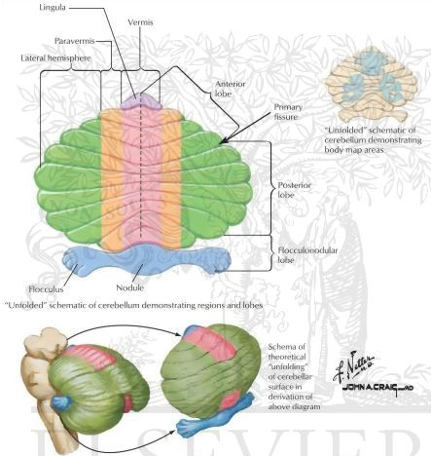
Longitudinally: 2 large bilateral hemispheres with vermis between them
Transversally:
  Floccolonodular: at the edge of inferior surface; composed of paired irregular-shaped masses – flocula- joined medially by the nodulus (part of the vermis)
  Anterior: rostral to the primary fissure. ATTENTION!2nd fissure to develop
  posterior lobe: between primary and posterolateral fissures
Posterolateral fissure – between flocculonodular and posterior lobes. 1st fissure to develop

Slide 5
Gray and white matter
Gray matter: cortex + 4 types of nuclei in each side
White matter: medullary center + paired inferior, middle and superior cerebellar peduncles composed of afferent and efferent nerve fibers which connect the cerebellum with the medulla, pons and midbrain respectively

Slide 6
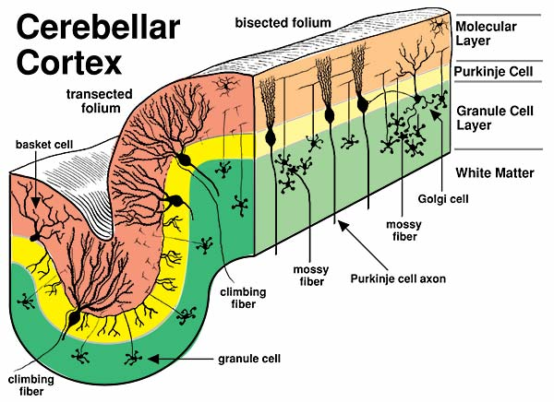
Cerebellar cortex
Folia cerebelli
3 layers:
  Molecular (stellate +basket)
  Ganglionar (purkyne)
  Granular (golgi cells + granular cells)
Layers have 5 types of cells:
  Stellate
  Basket
  Purkyne
  Golgi
  granule

Slide 7
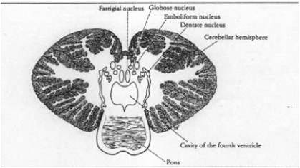
Cerebellar nuclei
Transmit all output from the cerebellum
Fastigial: close to the midline in contact with the fastigium
globulose: 2 or 3 masses in each side
Emboliform: oval shape
Dentate: most proeminent

Slide 8
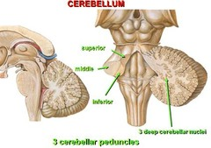
White matter
All the afferent (sensory) and efferent (motor) pathways pass through the peduncles.
Inferior cerebellar peduncle
  Fibers entering the cerebellum with predominant origin in the inferior olivary complex – olivocerebelar tract;
Middle cerebellar peduncle
  Fibers originating in the nuclei pontis / ponto cerebellar tract
Superior cerebellar peduncles
  Fibers from globulose, emboliform and dentate nuclei.
  Afferent fibers: superior spinocerebellar + rubrocerebellar tracts

Slide 9
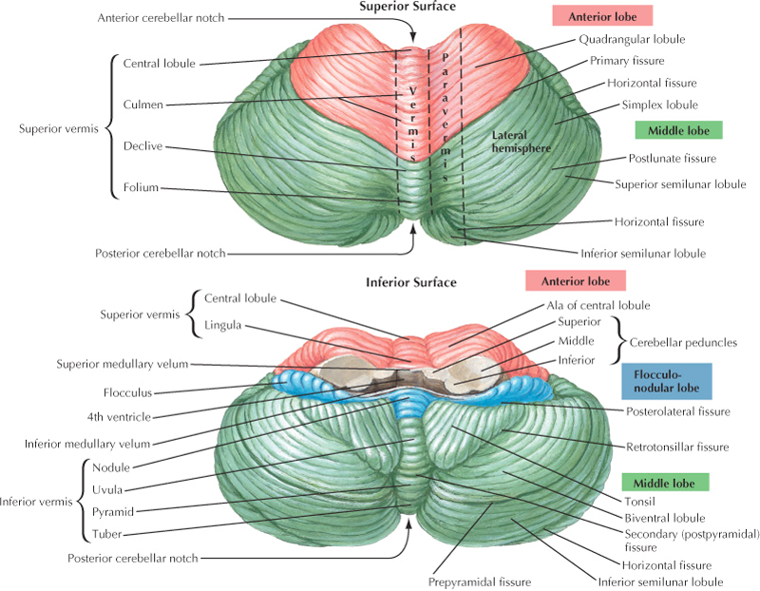
Phylogenetical development
Archicerebellum – flocculonodular lobe: vestibular nuclei (major connection); function: posture and eye movement
Paleocerebellum – superior vermis in the anterior lobe + part of inferior vermis in the posterior lobe; spinal cord (major connection); function: progressive movement
Neocerebellum – ceberellar hemispheres + vermis in posterior lobe; cerebral cortex via ncl pontis (major connection); funtion: manipulative movement and speech

