Slide 1
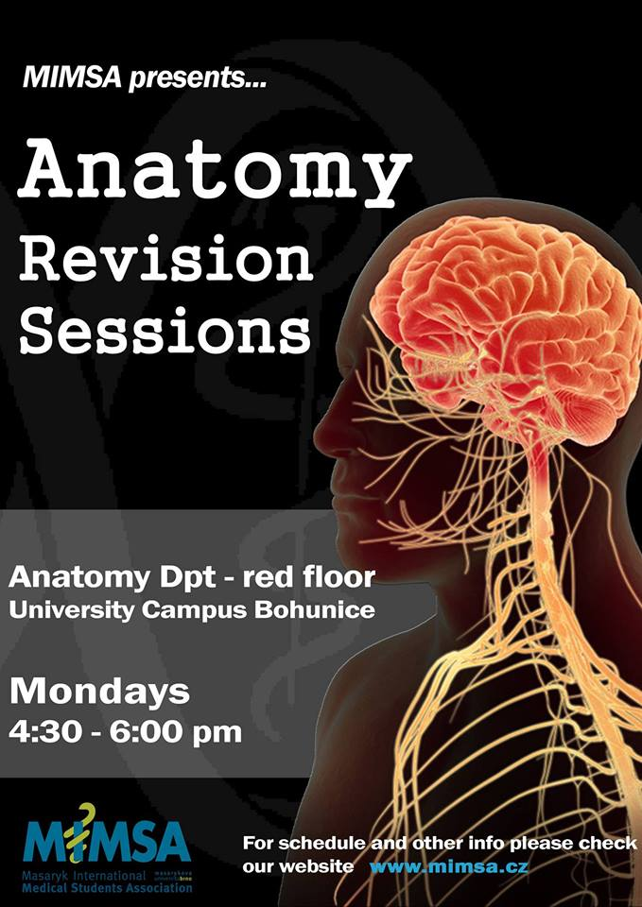
MENINGES AND CEREBROSPINAL FLUID
Konstantinos Choulakis
Konstantinos Choulakis

Slide 2
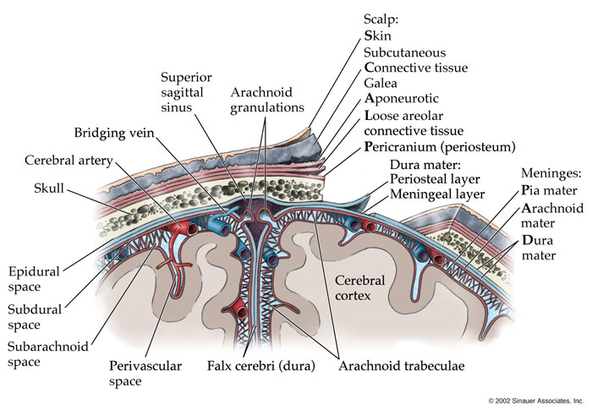
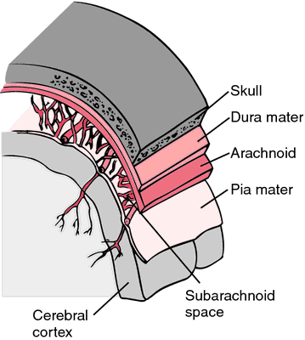
Meninges
Dura Mater
Aracnoid Mater
Pia Mater

Slide 3
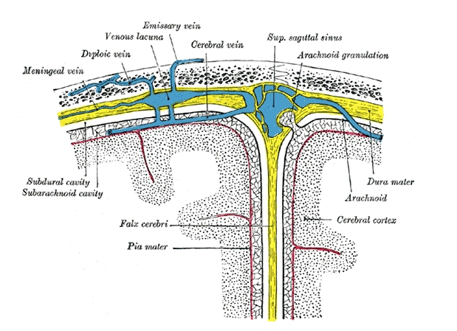
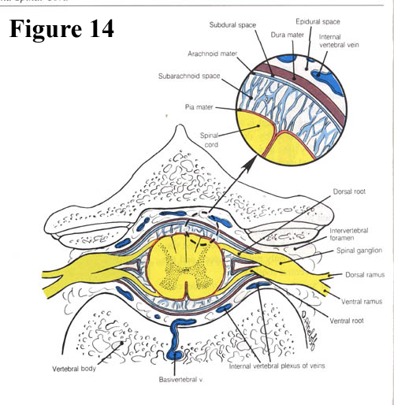
Dura Mater
Spinal Dura mater
It forms a tube (saccus durrae matris spinalis) which start from foramen magnus and extends to second segment of the sacrum. It is pierced by spinal nerve roots. The spinal canal wall is coverd by periostium, then there is dura mater. Between dura mater and periostium there is a , so called epidural space, which is filled with adipose tissue and a venous plexus , the plexus venosi vertebrales interni
Cranial Dura mater
It is firmly attached to the periostium of the skull from which it receives small blood vessels, branches of meningeal vessels (inappropriate name)
which occur in periostium.
The cranial dura mater has several features of importance especially, especially the dural reflections (derivatives) and the dural venous sinuses(see blood supply)
Dura mater is attached to avascular arachnoid mater. Between them there is a potential space, so called subdural space which contains a small amount of interstitial fluid. Enables arachnoid mater to slide against dura mater.

Slide 4
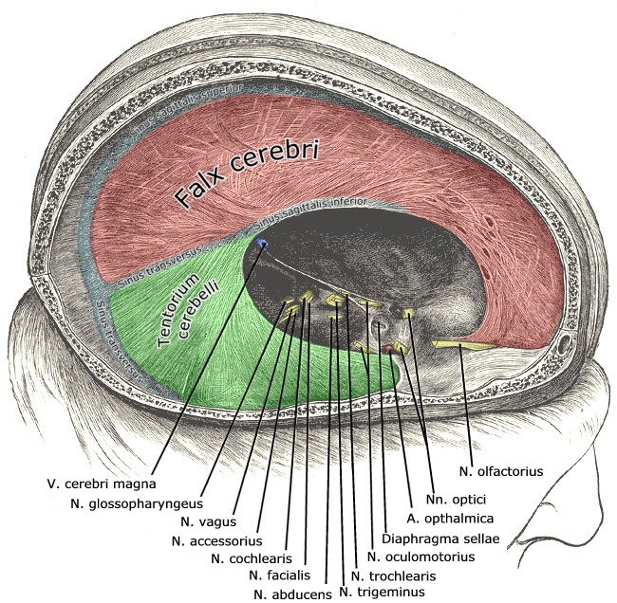
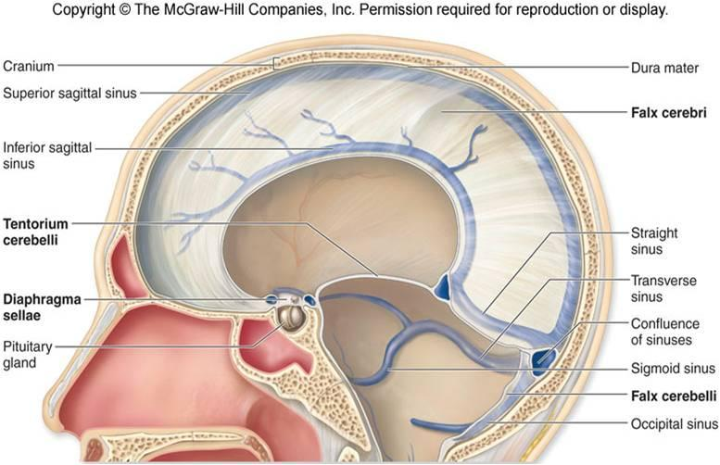
Dural Reflections
The dura separates into two layers at dural reflections (also known as dural folds), places where the inner dural layer is reflected as sheet-like protrusions into the cranial cavity. There are two main dural reflections:
The tentorium cerebelli exists between and separates the cerebellum and brainstem from the occipital lobes of the cerebrum. The peripheral border of tentorium is attached to the upper edges of the petrous bones and to the margins of the sulcus sinus transversi on the occipital bone. The free edge forms the tentorial notch which surrounds the midbrain
The falx cerebri, which separates the two hemispheres of the brain, is located in the longitudinal cerebral fissure between the hemispheres. Its free edge is close to corpus calosum. It is attached to crista galli of ethmoid bone in the front , in the midline of sulcus sinus saggitalis superior as far as back to internal occipital protuberance where it merges into tentorium cerebelli that extends to both sides

Slide 5
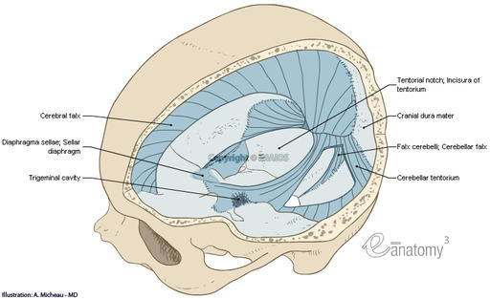
Two other dural inholdings are the cerebellar falx , the sellar diaphragm and the Trigeminal Cave of Meckel :
The cerebellar falx (or falx cerebelli) is a vertical dural infolding that lies inferior to the cerebellar tentorium in the posterior part of the posterior cranial fossa. It partially separates the cerebellar hemispheres. It extends between tentorium cerebelli and occipital crest
The sellar diaphragm is the smallest dural infolding and is a circular sheet of dura that is suspended between the clinoid processes, forming a partial roof over the hypophysial fossa. The sellar diaphgram covers the pituitary gland in this fossa and has an aperture for passage of the infundibulum (pituitary stalk) and hypophysial veins.
On the anterior surface and at the apex of the petrous bone , the trigeminal ganglion is enclosed in a dural pocket, the trigeminal cave of Meckel

Slide 6
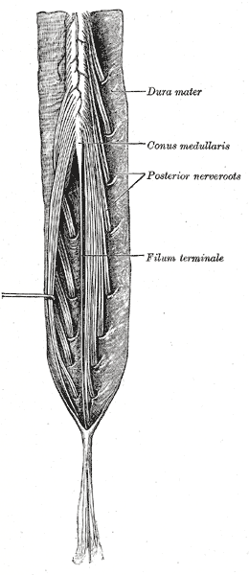
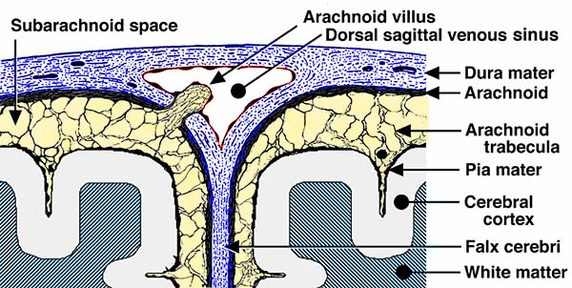
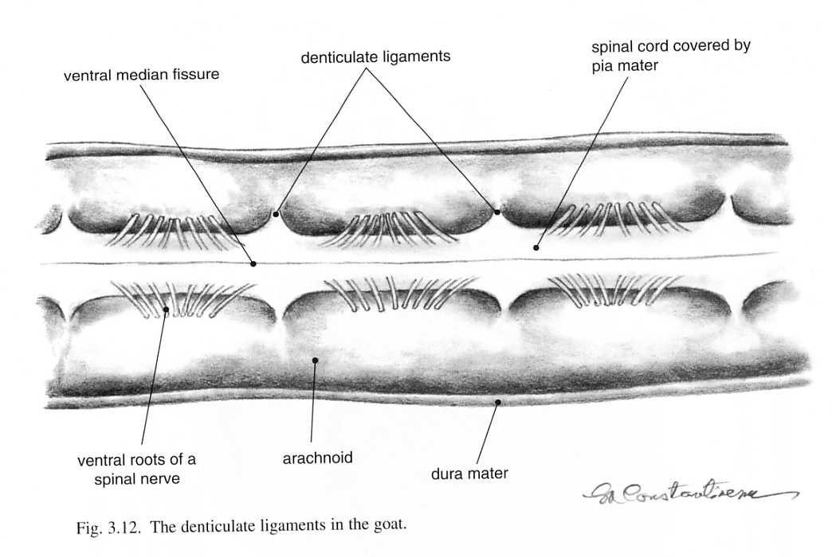
Arachnoid Mater
The avascular arachnoid mater adheres closely to dura mater. Pedunculated, mushroom-like protrusion of the arachnoid project into principal venous sinuses as the arachnoid villi or the arachnoid granulations. They consist of an arachnoid network covered by the mesothelium. The dura which still encloses them is reduced to a thin layer. The majority of arachnoid villi are present around the superior sagittal sinus, in the lateral lacunae and less commonly at the points of exits of the spinal nerves. CSF enters the venous circulation through the arachnoid villi. In older people villi may penetrate the bone ( foveolae granulares) and invaginate into the diploic veins. The arachnoid connects to pia mater via small hair like processes, the arachnoid trabeculae. The space between arachnoid and pia mater is called subarachnoid space.
Pia Mater
It is vascularized ,connective tissue membrane containing a network of fine blood vessels. It adheres to the surface of the brain and spinal cord following all their contours.
The cranial pia mater invests the entire surface of the brain , dipping into the fissure and sulci of the cerebral and cerebella hemisphres. It forms the tela choroidea of the third ventricle and fourth ventricle and it combines with ependymal cells to form choroid plexus of third fourth and lateral ventricles.
The spinal pia mater is thicker, firmer and less vascular . It consists of two layers. The inner layer is intimately adhers to the entire surface of the spinal cord and sends septum into anterior median fissure. The collagen fibres of the outer layer are concentrated to form along each side denticulate ligament. At the caudal end of the spinal cord , the pia mater is prolonged into the filum terminale which unites with the dura mater at the second sacral vertebra and continues caudally and fuses with periostium of coccyx.
Subarachnoid Space
The subarachnoid space varies because the arachnoid rests on dura mater but the pia mater follows the contours of the brain. The subarachnoid space is filled with CSF . Regions of enlarged arachnoid space are called subarachnoid cisterns

Slide 7
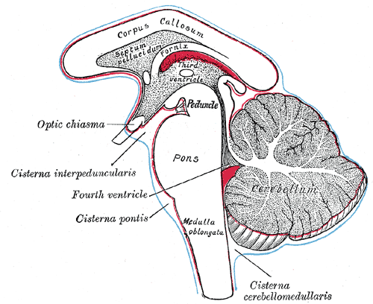
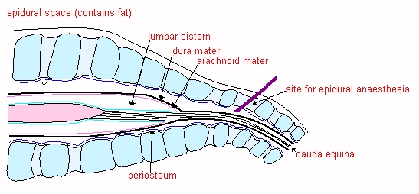
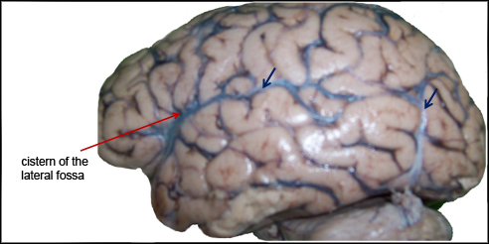
Cisternae
Cisterna magna (cerebellomedullaris). It is located between medulla oblongata and cerebellum and receives CSF through the median aperture from the fourth ventricle
Cisternae basalis are located between the brain stem and diencephalon, include the pontine and interpencular cisterns and the cistern of the optic chiasma
Cisternae fossae lateralis occupies the space where the arachnoid bridges the lateral sulcus, it contains the lateral cerebral arteries
Lumbar cistern extends from 2nd lumbar vertebra to second segment of sacrum. It contains the cauda equina

Slide 8
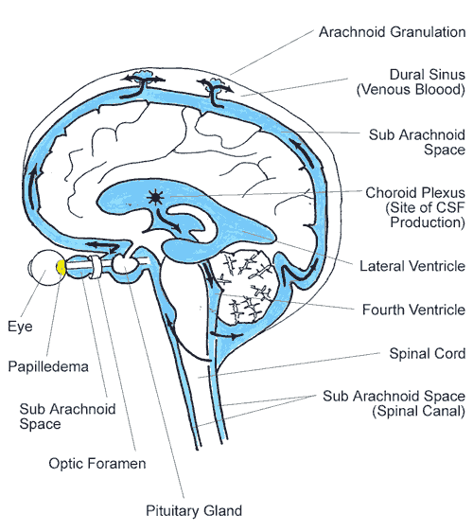
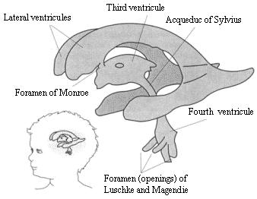
Cerebrospinal Fluid
The cerebrospinal fluid is clear colorless fluid, contains a low amount of cells mainly lymphocytes. It is produced mainly by the choroid plexuses of the lateral ventricles, a small amount by the third and fourth ventricle. The total volume of the CSF in the ventricle system and the subarachnoid space varies from 80-150 mL, but the ventricular system alone contains 15-40 ml . Approx. 500 mL are produced during a 24 h period.
  Produced in the lateral ventricle
Interventricular foramen of Monroe
third ventricle
Aqueduct of Sylvius
1.Median aperture (foramen of Magendie)
2,3. lateral apererture (foramina Luschka)
Fourth ventricle
2 1 3
Subaracnhoid space
Cerebellomedullary and pontine cisterns
lateral surfaces to the region of the superior saggital sinus
Absorbed into venous system through the arachnoid villi
Basal Cisterns→

Slide 9
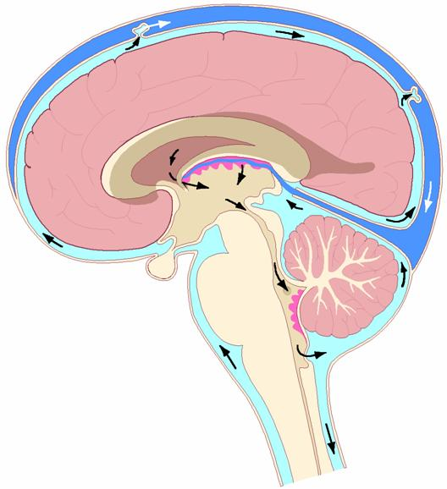

Slide 10
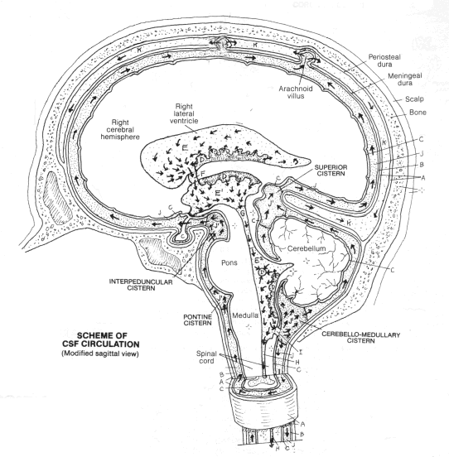

Slide 11
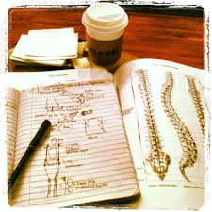
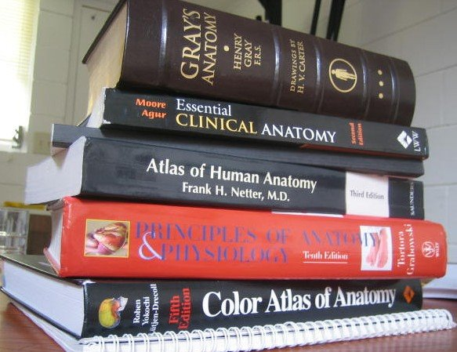

Thank you for attention
GOOD LUCK FOR YOUR EXAMS
Do not forget that anatomy is completely doable exam.
The written is the difficult part in my opinion, it is stressful you have to be
Concetrated as soon you pass the written and you have studied you
will manage to pass the oral also.
P.S.:Just relax because in the end everyone will…………

Slide 12
DIE

Slide 13

Good luck!
Don’t forget to study the pituuehjdbndjry gland

