Slide 1
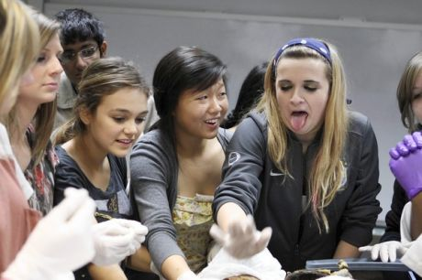
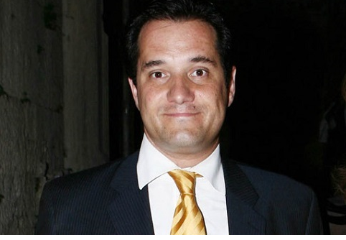
Mimsa Dissection 2 Session
Konstantinos Choulakis

Slide 2
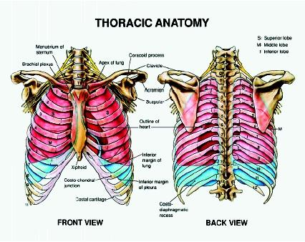
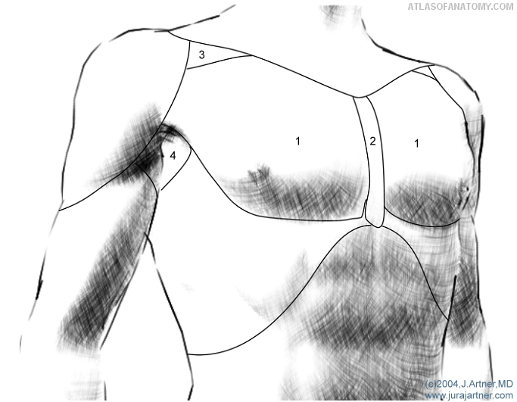
Thorax
Borders:
Superiorly: jugular fossa – clavicles – acromion – 7th cervical vertebra
Inferiorly: xiphoid process – ribs – spinous process of 12th thoracic vertebra
Superior thoracic aperture: 1st thoracic vertebra – first ribs – superior margin of sternum
Inferior thoracic aperture: 12th thoracic vertebra – last ribs – distal costal arches
Regions:
Deltoid
Inflaclavicular ( =clavipectoral= deltopectoral)
Pectoral
Presternal
Axillary
Mammary
Inframammary
2
1
3
3
3
4
5
6
6
7
7

Slide 3
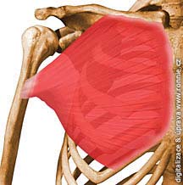
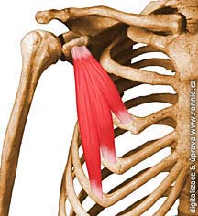
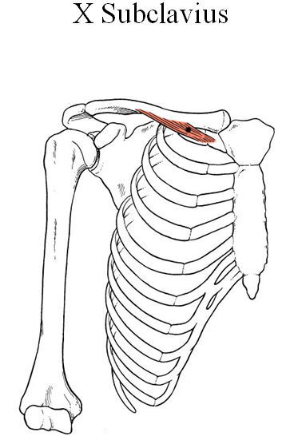
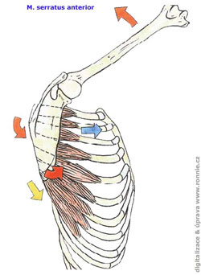
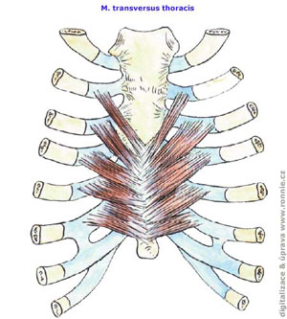
Muscles:
M. Pectoralis Major | M. Pectoralis Minor | M. Subclavius | M. Transversus Thoracis | M. Serratus anterior
O:
I:
Inn:
F:

Slide 4
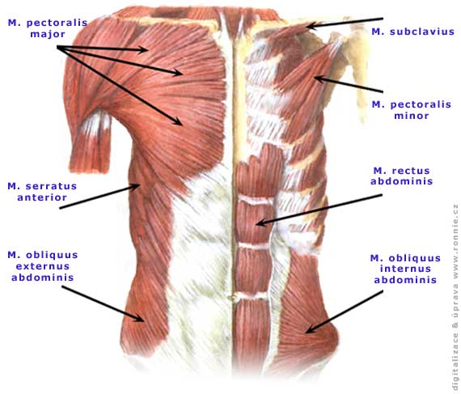
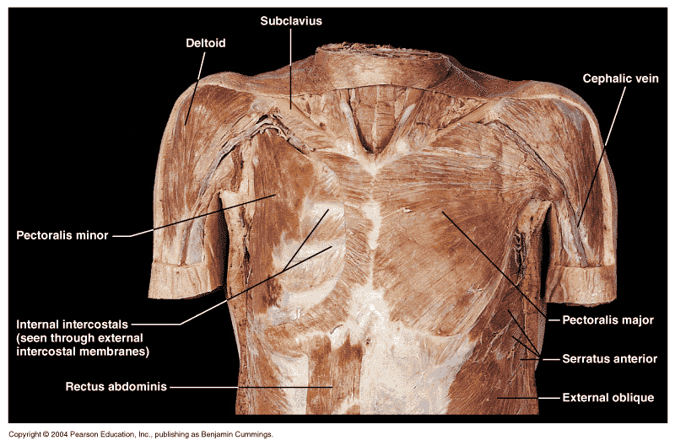

Slide 5
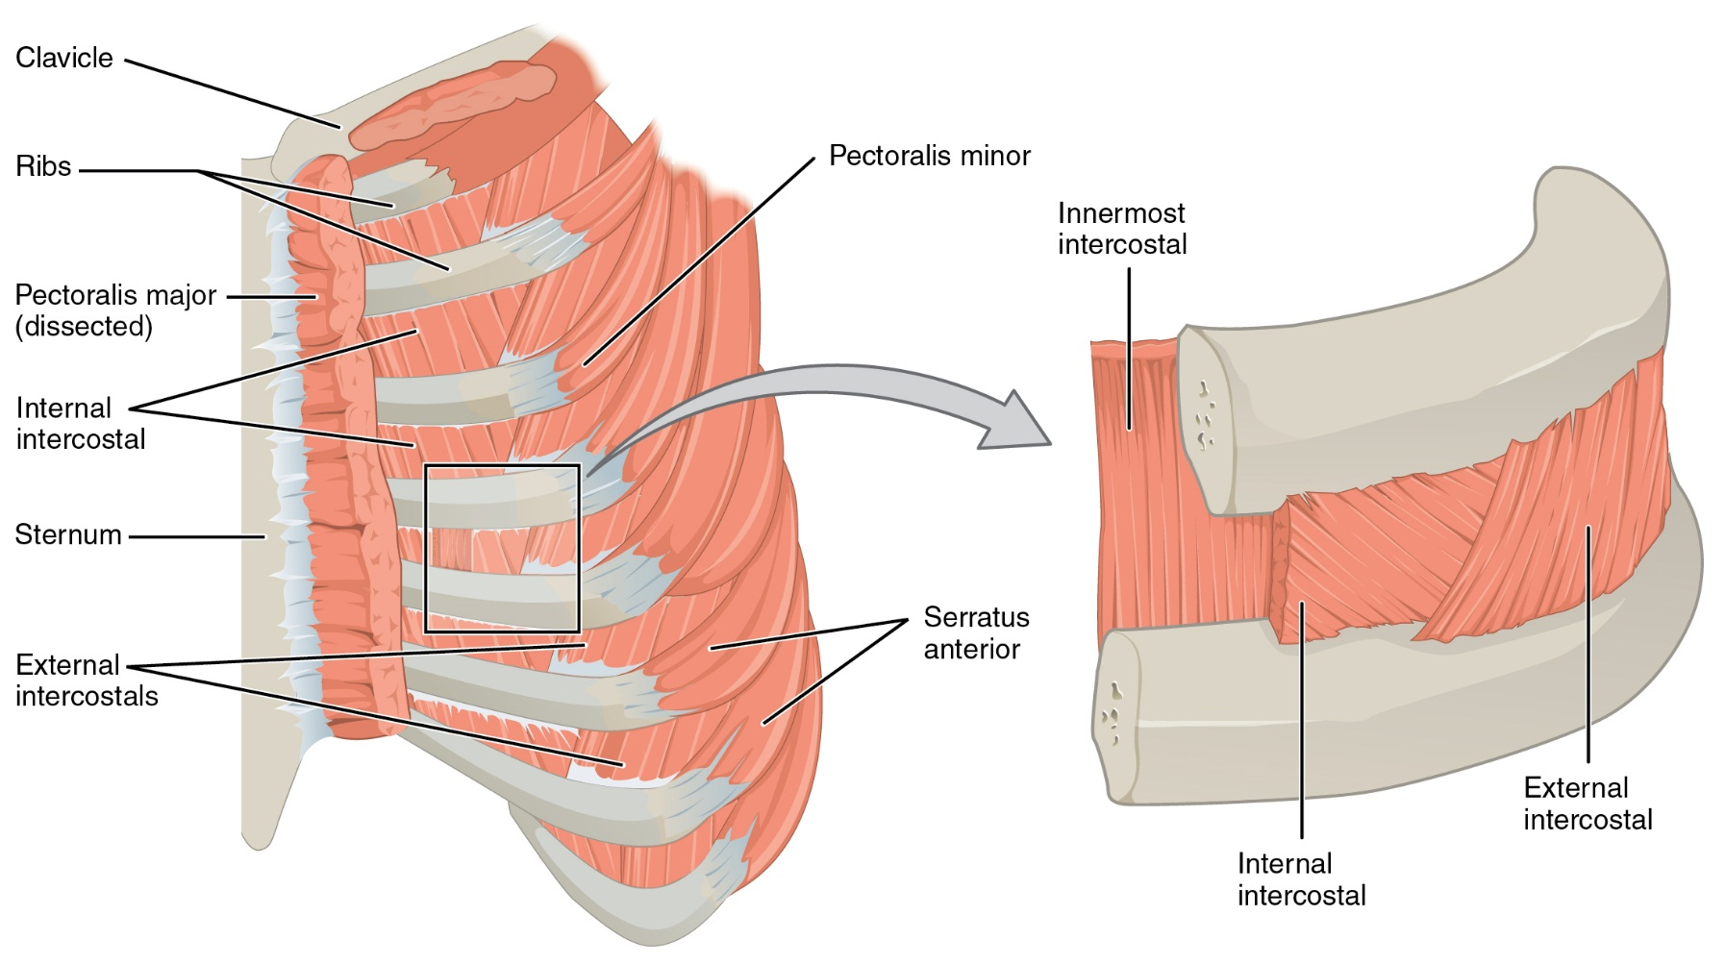
M. Externus Intercostalis | M. Internus Intercostalis | M. Innermost Intercostal
I
O
Origin
Insertion
I
O

Slide 6
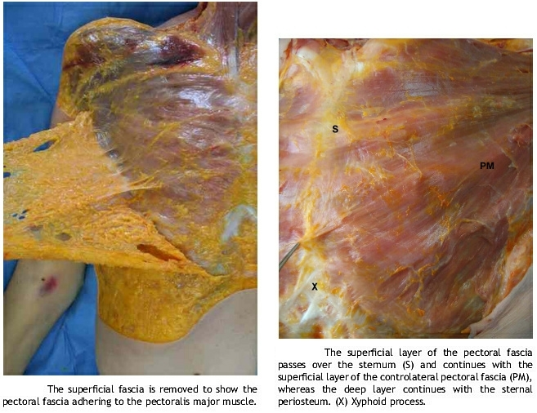
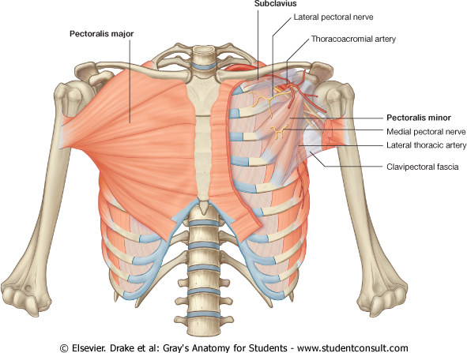
Fasciae
Superficial thoracic fascia: Underneath the skin.
Pectoral fascia: The pectoral fascia is a thin lamina, covering the surface of the pectoralis major, and sending numerous prolongations between its fasciculi: it is attached, in the middle line, to the front of the sternum; above, to the clavicle; laterally and below it is continuous with the fascia of the shoulder, axilla
Clavipectoral fascia: It occupies the interval between the pectoralis minor and Subclavius , and protects the axillary vessels and nerves. Traced upward, it splits to enclose the Subclavius , and its two layers are attached to the clavicle, one in front of and the other behind the muscle; the latter layer fuses with the deep cervical fascia and with the sheath of the axillary vessels. Medially, it blends with the fascia covering the first two intercostal spaces, and is attached also to the first rib medial to the origin of the Subclavius . Laterally, it is very thick and dense, and is attached to the coracoid process. The portion extending from the first rib to the coracoid process is called the costocoracoid ligament.
Endothoracic fascia: Endothoracic fascia is the layer of loose connective
tissue deep to the intercostal spaces and ribs, separating these structures
from the underlying pleura

Slide 7
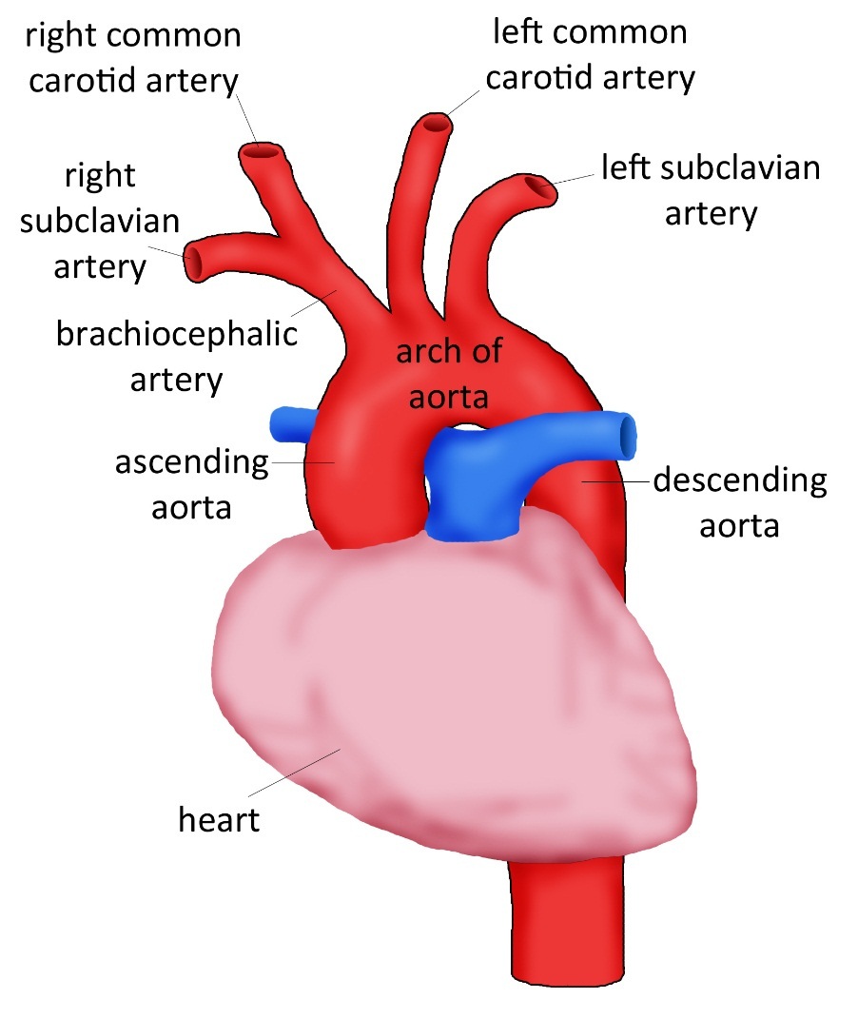
Arteries
Aorta
Brachiocephalic Artery
– Right Common Carotid. – Right Subclavian.
Left subclavian artery
Left common carotid artery

Slide 8
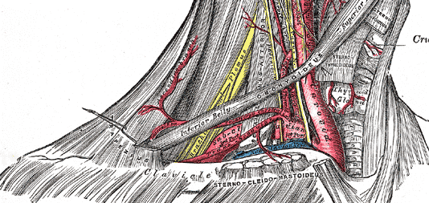
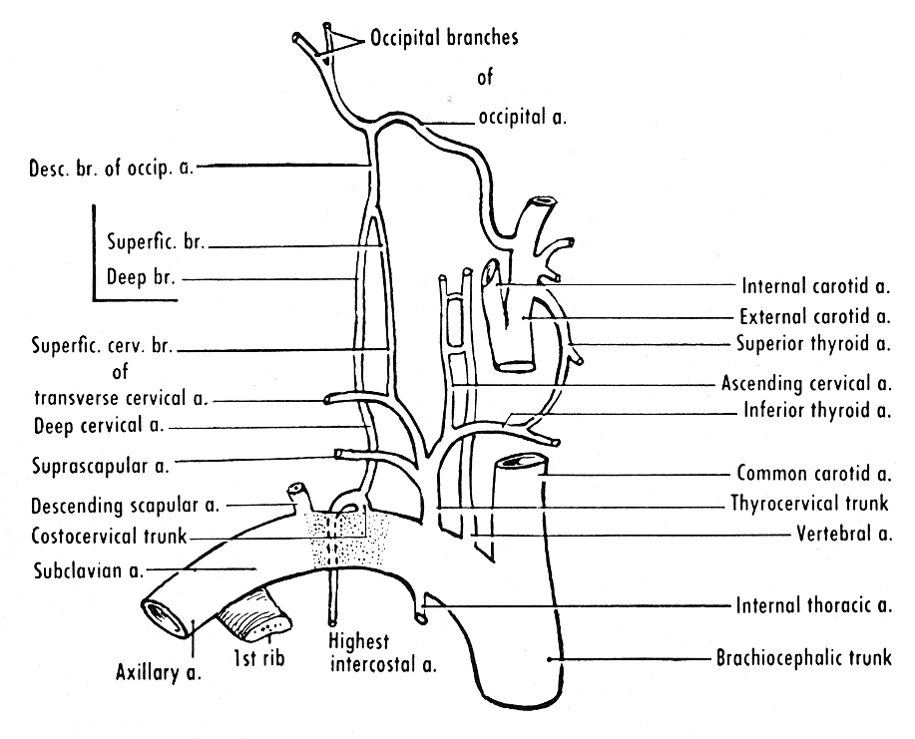
SUBCLAVIAN ARTERY. Mnemonic for branches VITamin C
It passes ventrocaudally from brachial plexus . Enters the fissure between anterior and middle scalene muscles. It lies on groove for subclavian artery of first rib passes bellow clavicle and enter axillary fossa where changes name to Axillary a..
Branches
Vertebral A. It has intracranial and extracranial branches
Internal Thoracic A.. Enters the thoracic cavity through sup. thoracic aperture. It descends on the internal side of thoracic cage, 1 cm away from the margin of sternum till the level of 6th intercostal fissure where it gives the terminal bracnhes: musculophrenic a., superior epigastric a.. Branches: a)mediastinal b)pericardiophrenic c)perforating d) anterior intercostal e)musculophrenic f)superior epigastric
Thyrocervical trunk. Arises from subclavian artery by the the medial margin of anterior scalene muscle. Branches: a)inferior thyroid b)ascending cervical c)superficial cervical d)suprascapular
Costocervical trunk. Rises from posterior side of subclavian artery and after a short run towards 1st rib’s neck it divides to a)deep cervical b)supreme intercostal
(Transverse cervical)

Slide 9
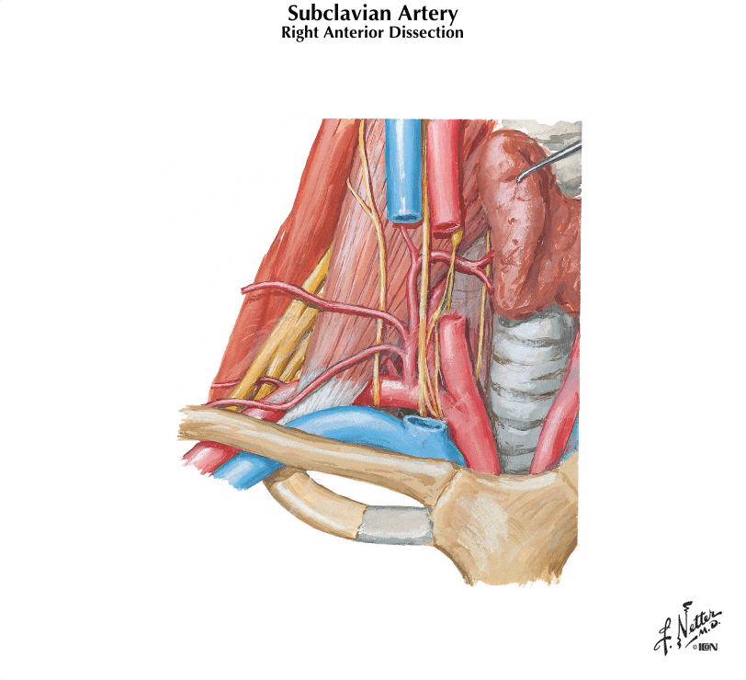
Branches:
Vertebral A.
Internal thoracic A.
a)Pericardial. Supply pericardial sac
b) Pericardiophrenic. Supply pericardium and diaphragm, it is accompanied by phrenic nerve
c)Perforating. Passing through thoracic wall and supply anterior thorax
d)Anterior intercostal enter to the 6 upper intercostal spaces and anastomose with the posterior intercostal arteries (<thoracic aorta)
e)Musculophrenic a. . Descend from the 7th rib along the insertion of diaphragm and gives off intercostal arteries for the 5 caudal intercostal spacies
f)Superior epigastric a. Passes through sternocostal fissure of diaphragm and it descends caudall on posterior side of rectus abdominis.
Thyrocervical trunk
a)Inferior thyroid a. passes up at the level C6 it turns medially crosses the big cervical vessels and nerves and enters thyroid gland. It anastomoses with thyroid superior (< external carotid). It gives off branches: inf laryngeal, tracheal, oesophageal, and pharyngeal.
b)Ascending cervical a. Ascends to anterior surface of scalenus anterior. It gives off muscular branches for the surrounding muscles and spinal branches for supply of spinal cord ( these branches pass through intervertebral foraminae)
c)Superficial cervical a (transverse cervical). Passes over ant. Scalene muscle and supplies trapezius. Can also arise form transverse cervical
d)Suprascapular a. Passes above transverse scapular ligament and enters to supraspinous fossa then passes below the acromion and enters infraspinous fossa and supplies the posterior muscles of scapula. It anastomoses with circumflex scapular a. (<subscapular a. < Axillary a.)
Costocervical trunk
a)Deep cervical. Ascends between transverse process of C7 and Th1. Supplies surrounding muscles and vertebral collumn
b)Supreme intercostal. It gives off branches posterior intercostal for the upper two intercostal spaces
(Transverse cervical) It is often a branch of thyrocervical trunk. It branches of subclavian artery after scalene muscles. It gives off ascending branch for levator scapulae and descending branch for rhomboid and trapezius muscle.

Slide 10
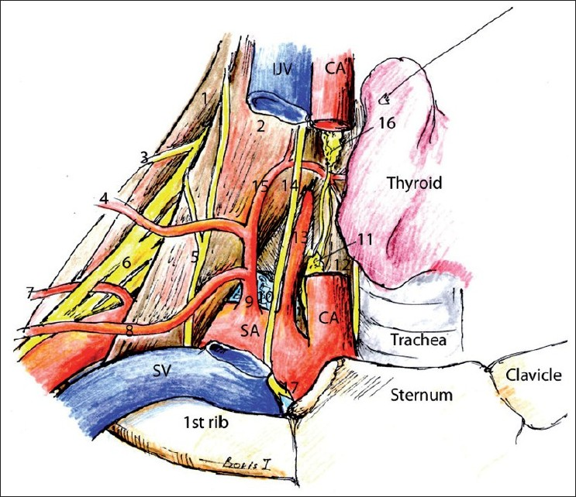

(1) Middle scalene muscle, (2) anterior scalene muscle, (3) dorsal scapular nerve, (4) transverse cervical artery, (5) phrenic nerve, (6) brachial plexus, (7) descending scapular artery, (8) suprascapular artery, (9) thyrocervical artery, (10) lung, (11) inferior cervical sympathetic ganglion, (12) longus colli muscle, (13) vertebral artery, (14) vagus, (15) inferior thyroid artery, (16) middle cervical sympathetic ganglion, (17) recurrent laryngeal nerve

Slide 11
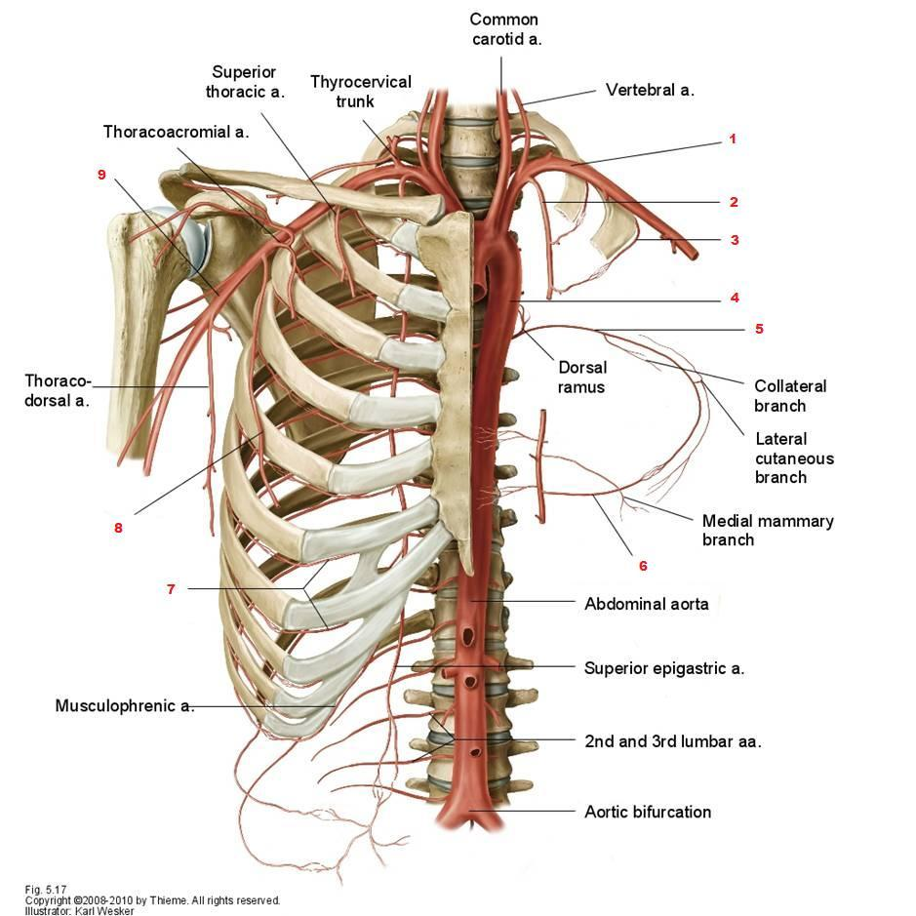
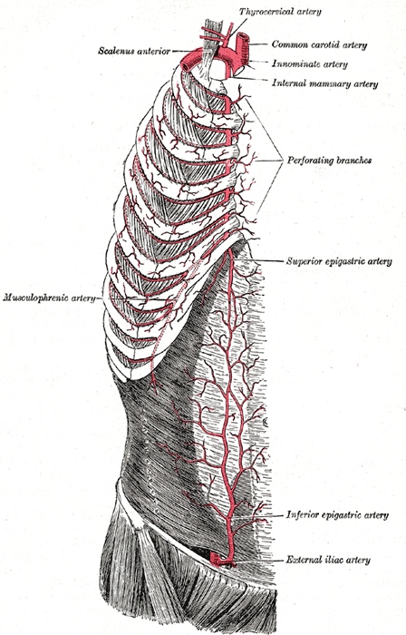
Internal thoracic

Slide 12
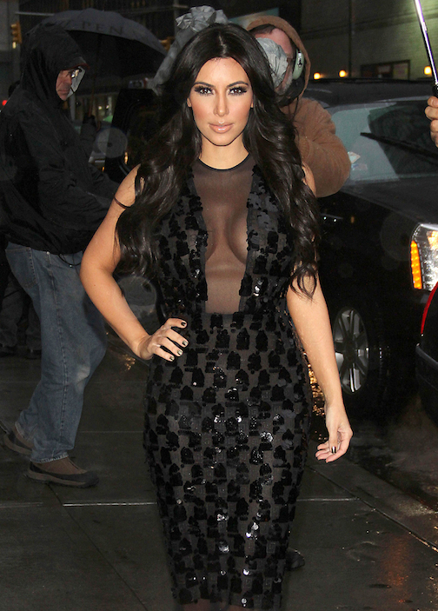

Slide 13
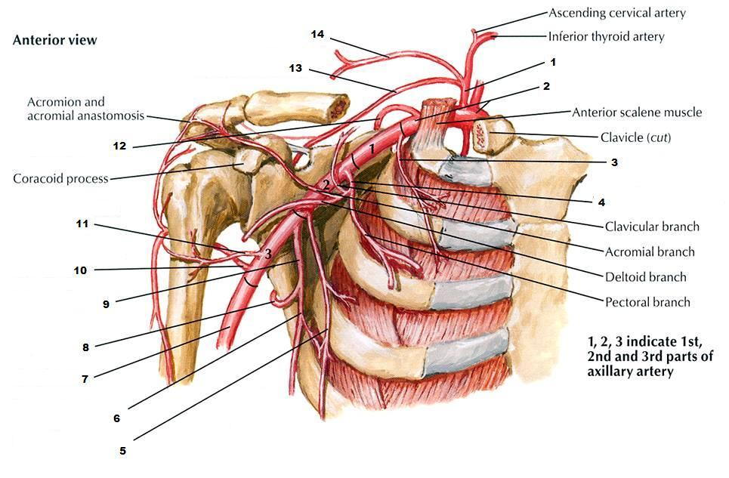
1. thyrocervical trunk
2. subclavian artery
3. superior thoracic artery
4. thoracoacromial artery
5. lateral thoracic artery
6. thoracodorsal artery
7. brachial artery
8. circumflex scapular artery
9. subscapular artery
10. posterior circumflex humeral artery
11. anterior circumflex humeral artery
12. dorsal scapular artery
13. suprascapular artery
14. transverse cervical artery

Slide 14
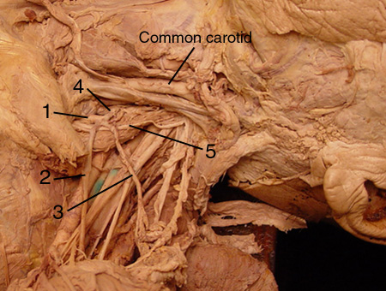
1 = thyrocervical trunk; 2 = suprascapular artery; 3 = transverse cervical artery( superficial cervical); 4 = inferior thyroid artery; 5 = phrenic nerve on the anterior scalene muscle.

Slide 15
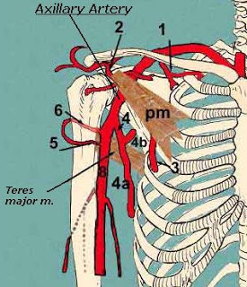
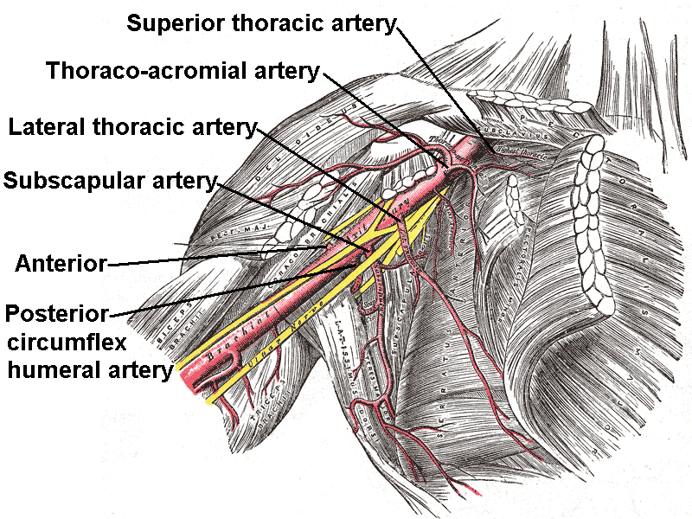
Axillary artery is a direct continuation of subclavian artery into the axilla. The border between both arteries is located by the inferior margin of first rib. It descends through the armpit caudally and at the level of surgical neck of Humerus it passes to brachial artery. It gives off several branches:
Branches to subscapular muscle
Supreme thoracic a. supplies the pectoral and intercostal muscles
Thoracoacromial a. enters the Clavipectoral triangle and gives several branches as acromial, deltoidal for the muscle and pectoral for the homonymic muscles.
Lateral thoracic supplies serratus anerior and gives off lateral mammary branches for the mammary gland (women)
Subscapular a. gives early two branches
Circumflex scapulae a. which passes from foramen omotricipitale into infraspinous fossa and supply the muscles on posterior side of scapula, it anastomoses with suprascapular a. ( <thyrocervical a. <subclavian a.)
Thoracodorsal a. supply m. latissimus dorsi
Anterior circumflex humeri supply deltoid muscle and nourishes glenohumeral joint
Posterior circumflex humeri is bigger than the anterior . It passes from humetricipitale triangle and supply deltoid and nourishes glenohumeral joint
1) superior thoracic artery; 2) thoracoacromial; 3) lateral thoracic; 4) subscapular; 5) anterior humeral circumflex; and 6) posterior humeral circumflex artery.

Slide 16
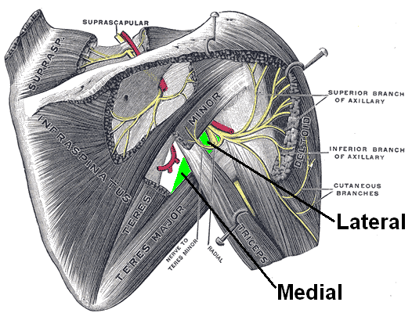
Suprascapular a.
Humerotricipitale
Circumflex humeri a.
Axillary nerve
Omotricipitale
Circumflex scapulae a.

Slide 17
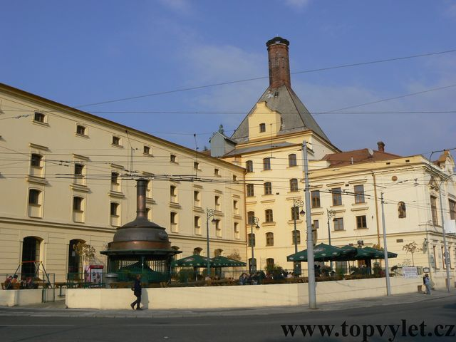

Slide 18
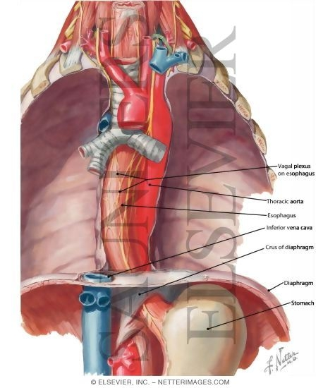
Thoracic Aorta
It begins at the lower border of the fourth thoracic vertebra where it is continuous with the aortic arch, and ends in front of the lower border of the twelfth thoracic vertebra, at the aortic hiatus in the diaphragm where it becomes the abdominal aorta.
At its commencement, it is situated on the left of the vertebral column; it approaches the median line as it descends; and, at its termination, lies directly in front of the column.
It is in relation, anteriorly, from above downward, with the root of the left lung, the pericardium, the esophagus, and the diaphragm; posteriorly, with the vertebral column and the azygos vein; on the right side, with the hemiazygos veins and thoracic duct; on the left side, with the left pleura and lung.
The esophagus, with its accompanying plexus of nerves, lies on the right side of the aorta above; but at the lower part of the thorax it is placed in front of the aorta, and, close to the diaphragm, is situated on its left side.

Slide 19
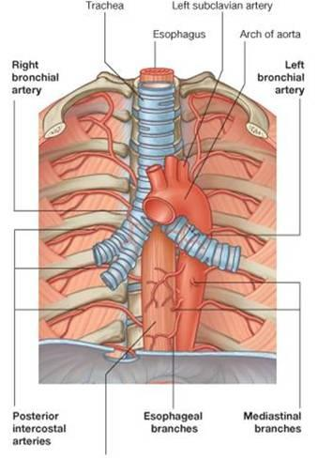
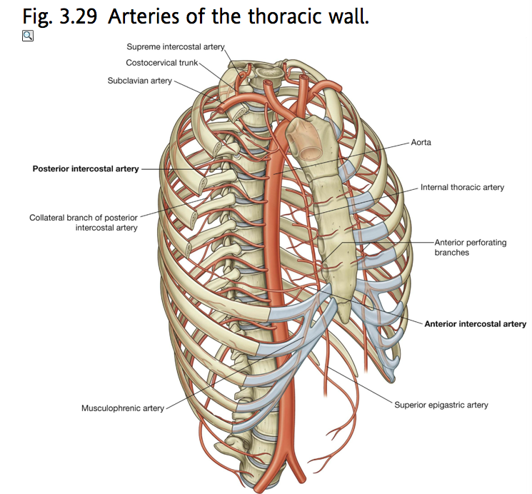
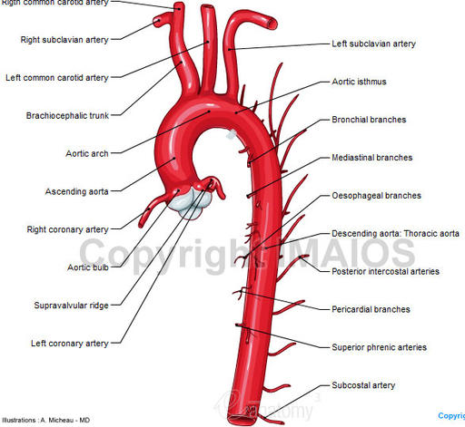
Descending Aorta
The parietal branches
Posterior intercostal arteries enter the 3rd till 11th intercostal space pass within costal groove of superior rib. They anastomose with anterior intercostal arteries.
Subcostal artery passes below 12th rib
posterior intercostal arteries gives off branches:
Dorsal: muscular (back muscles), spinal and cutaneous branches
Muscular: for thoracic muscles
Collateral: runs on superior margin of caudal rib
Lateral cutaneous: supply lateral thoracic wall and mammary gland ( in women- lateral mammary a. )
Superior phrenic: supplies the cranial part of diaphragm
The visceral branches
Bronchial arteries
Oesophagial arteries
Pericardial- Mediastinal arteries

Slide 20
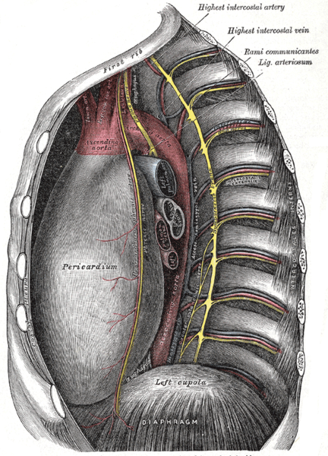
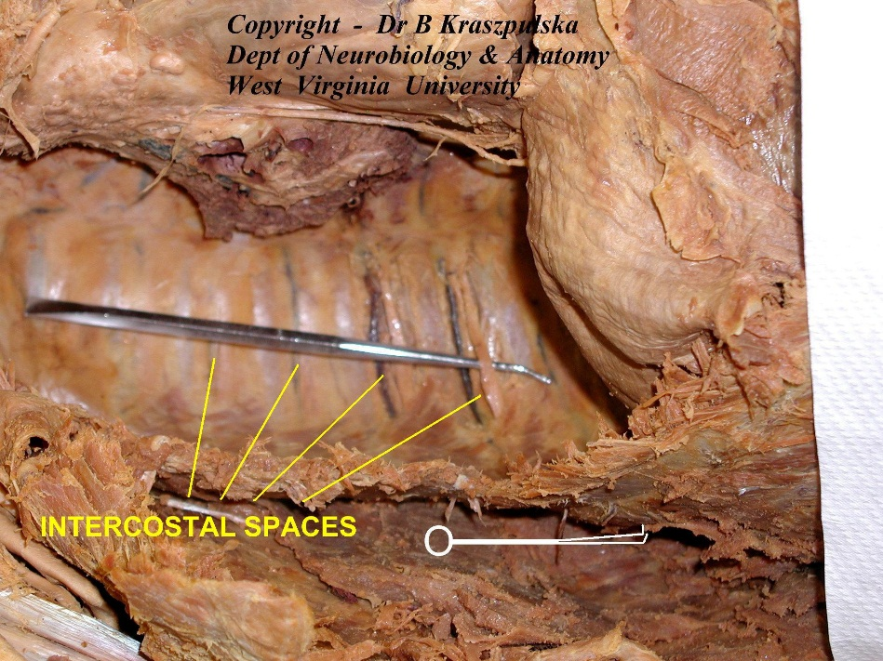
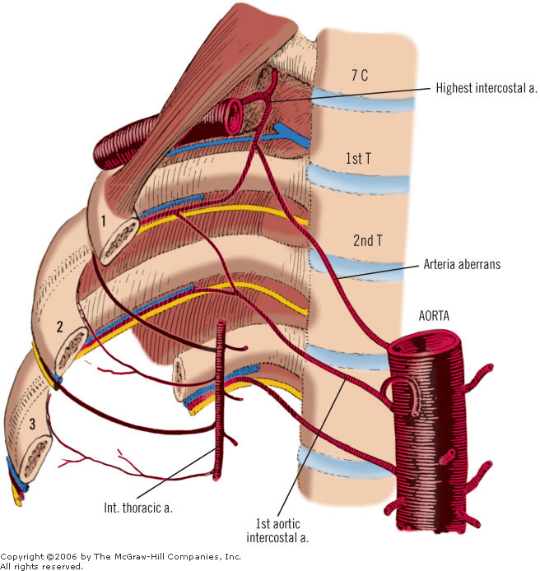
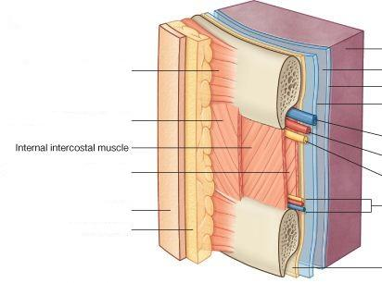
Anterior Intercostal Arteries originate from
Internal thoracic for upper 6 intercostal spaces
Musculophrenic (terminal branch of internal thoracic) for caudal 5 intercostal spaces
Posterior Intercostal Arteries originate from
The 1st and 2nd posterior intercostal arteries arise from the supreme intercostal artery, a branch of the costocervical trunk of the subclavian artery.
The lower nine arteries are the aortic intercostals, so called because they arise from the back of the thoracic aorta.

Slide 21
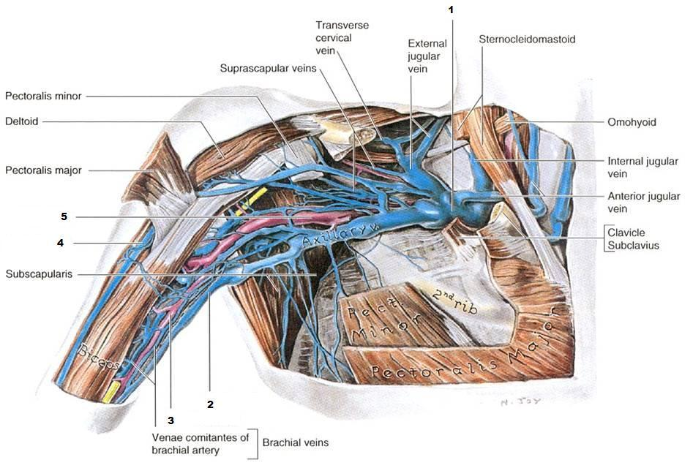
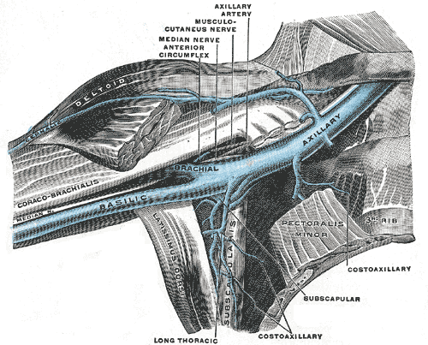
Veins
V. SUBCLAVIA
v. transversa colli
v. suprascapularis
V. AXILLARIS
vv. thoracoepigastricae – vv. subcutaneae abdominis
v. thoracica lat.
vv. costoaxillares
v. cephalica

Slide 22
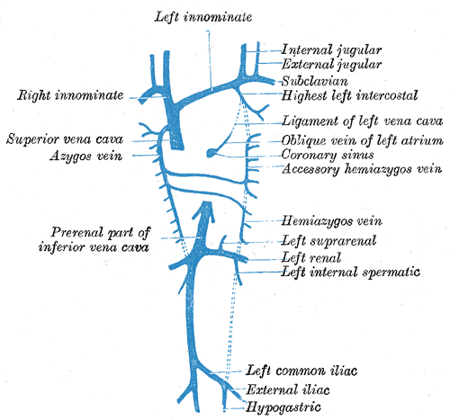
Vena cava
It is formed by the union of the ascending lumbar veins with the right subcostal veins at the level of the 12th thoracic vertebra. A major tributary is the hemiazygos vein, a similar structure on the opposite side of the vertebral column. Other tributaries include the bronchial veins, pericardial veins, and posterior right intercostal veins. It communicates with the vertebral venous plexuses.
The hemiazygos vein and the accessory hemiazygos vein, when taken together, essentially serve as the left-sided equivalent of the azygos vein. That is, the azygos vein serves to drain most of the posterior intercostal veins on the right side of the body, and the hemiazygos vein and the accessory hemiazygos vein drain most of the posterior intercostal veins on the left side of the body. Specifically, the hemiazygos vein mirrors the bottom part of the azygos vein. It usually begins in the left ascending lumbar vein or renal vein, and passes upward through the left crus of the diaphragm to enter the thorax. It continues ascending on the left side of the vertebral column, and around the level of the ninth thoracic vertebra, it passes rightward across the column, behind the aorta, esophagus, and thoracic duct, to end in the azygos vein.
The accessory hemiazygos vein is a vein on the left side of the vertebral column that generally drains the fifth through eighth intercostal spaces on the left side of the body.

Slide 23
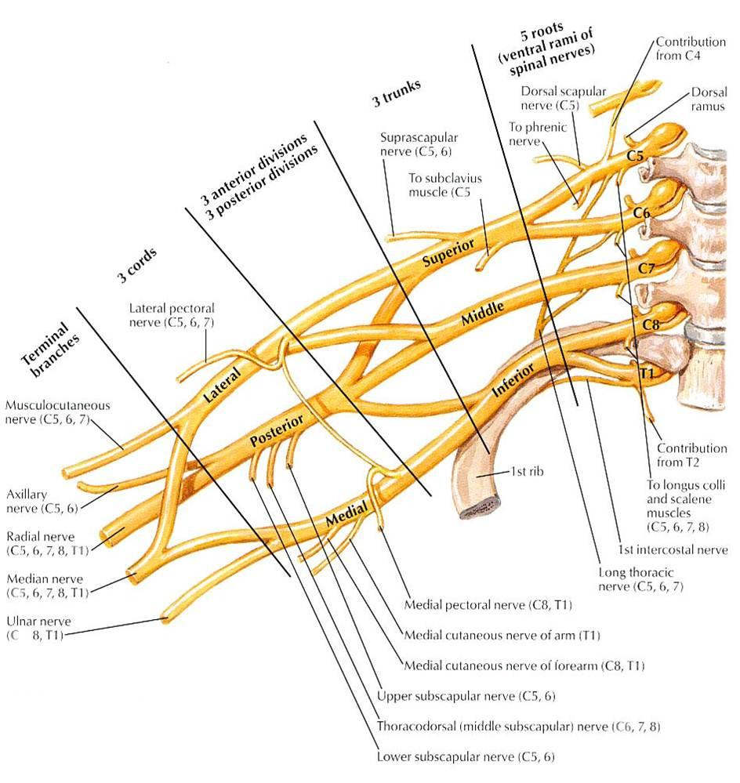
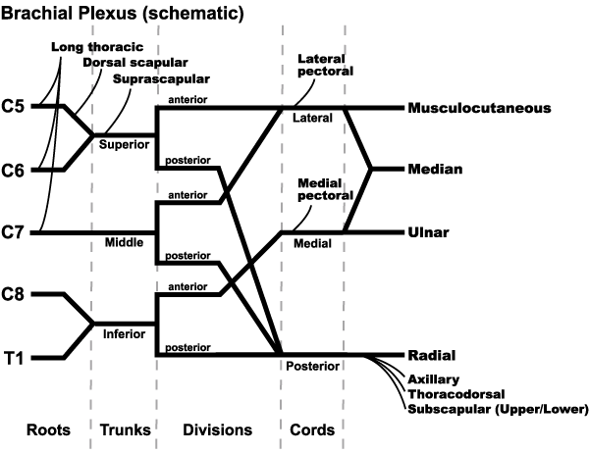
Nerves

Slide 24
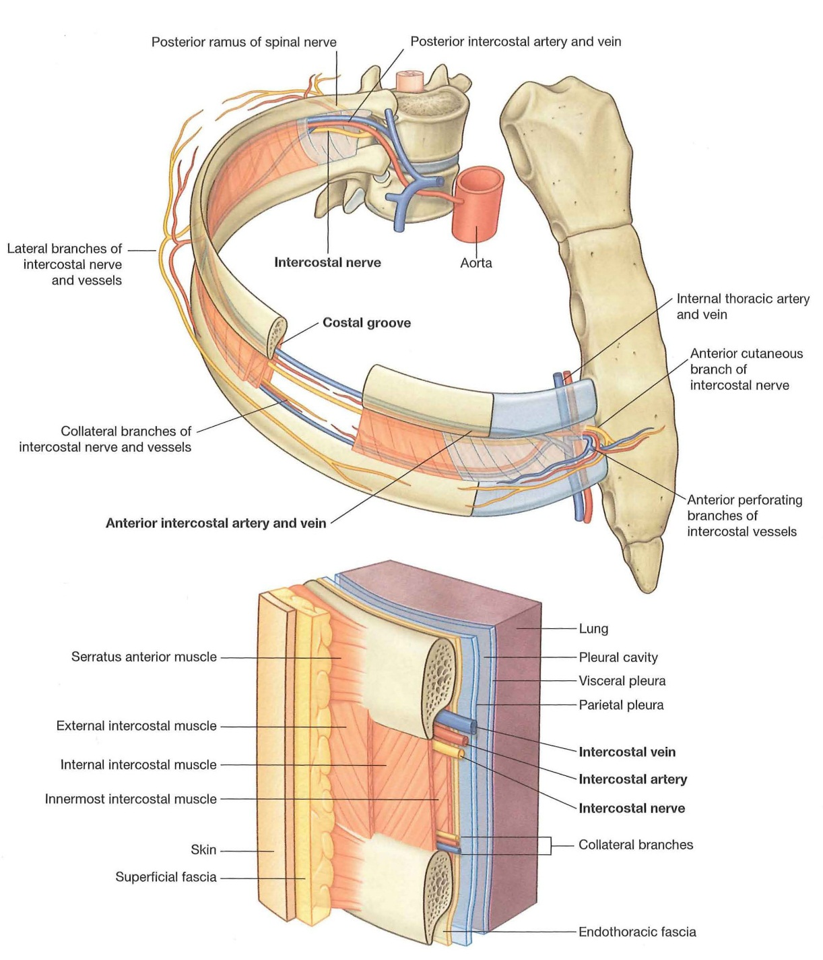
Intercostal Nerves arise from spinal nerves they contain sensory (cutaneous) and motor fibers

Slide 25


Slide 26
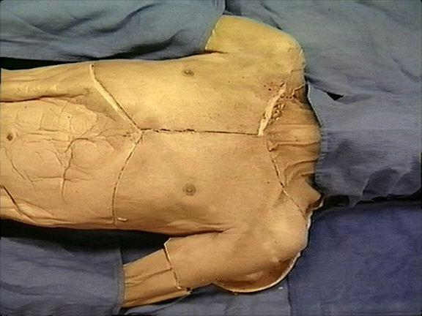
Dissection
1st Step
Incisions
Skin layer

Slide 27
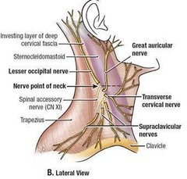
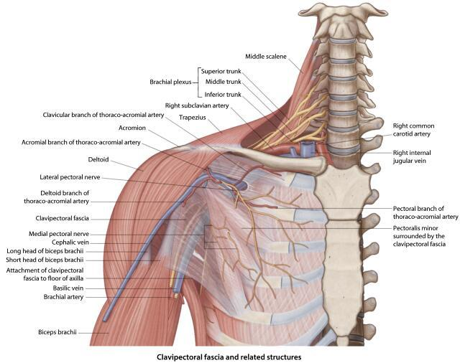

Step 2
Subcutaneous Layer
Supraclavicular Nerves
Cephalic vein
(Thoracoacromial Artery)

Slide 28
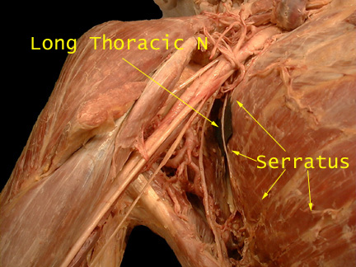
Step 3
Clean The surface of pectoralis major and deltoid muscle
Cut the pectoralis major 4 cm from the arm and reflect it. Take care to preserve the pectoral nerves and vessels.
Find and clean the pectoralis minor m. and subclavious and clean the Clavipectoral fascia
Cut the Pectoralis minor m.
Find and clean axillary artery and its branches at the lateral thoracic wall (Lateral thoracic and Subcapular arteries)
Identify and clean axillary vein and its tributaries at the lateral thoracic wall (vv. Thoracoepigastricae, vv.costoaxillares, v. thoracica lat.)
Identify and clean Long thoracic nerve

Slide 29
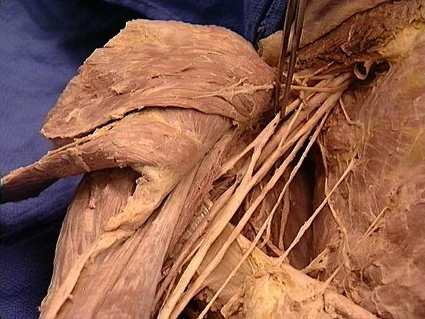
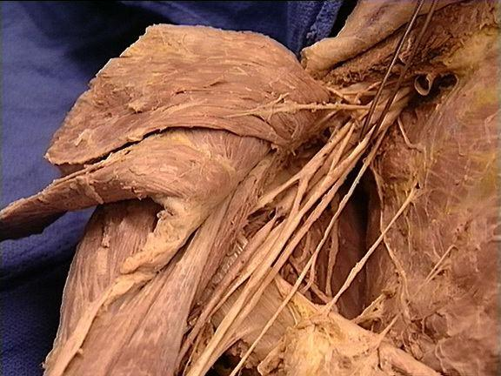
Step 4
Identify and clean the brachial Plexus
Lateral cord
Medial cord
Median n.
Branches:
Ulnar
Medial Pectoral
Medial root of Median nerve
Medial cutaneous of arm
Medial cutaneous of forearm
Branches:
Musculocutaneous
Lateral Pectoral
Lateral root of Median nerve
Intercostobrachial nerve

Slide 30
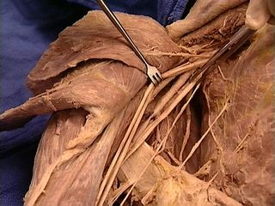
Posterior cord
Branches:
Upper and lower Subscapular
Thoracodorsal
Axillary
Radial

Slide 31
Step 5
Find and clean the vessels and nerves that pass from the
Omotricipitale
Humerotricipitale
Suprascapular a.
Humerotricipitale
Circumflex humeri a.
Axillary nerve
Omotricipitale
Circumflex scapulae a.

Slide 32
Step 6
Intercostal spaces

Slide 33
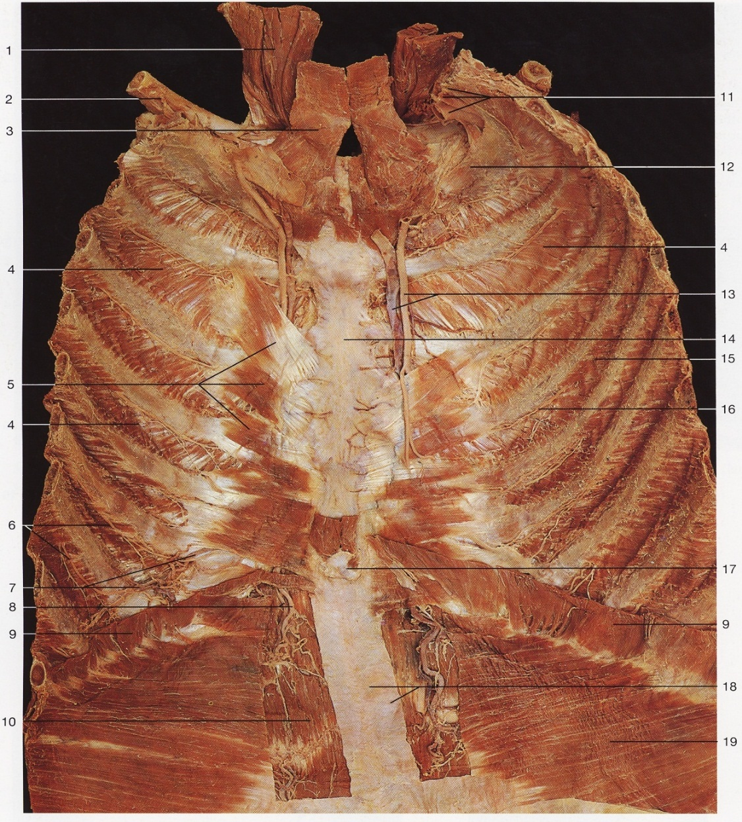
Step 7
Open the rib cage by cutting the ribs and removing the anterior thoracic wall
Find and clean the Internal Thoracic vessels and the Transversus thoracis muscle

Slide 34



Internal Organs
Structures within the thoracic cavity include
structures of the cardiovascular system, including the heart and great vessels, which include the thoracic aorta, the pulmonary artery and all its branches, the superior and inferior vena cava, the pulmonary veins, and the azygos vein
structures of the respiratory system, including the trachea, bronchi and lungs
structures of the digestive system, including the esophagus,
endocrine glands, including the thymus gland,
structures of the nervous system including the paired vagus nerves, and the paired sympathetic chains,
lymphatics including the thoracic duct.
It contains three potential spaces lined with mesothelium: the paired pleural cavities and the pericardial cavity. The mediastinum comprises those organs which lie in the center of the chest between the lungs.

Slide 35

The mediastinum lies between the right and left pleura in and near the median sagittal plane of the chest. It extends from the sternum in front to the vertebral column behind, and contains all the thoracic viscera except the lungs. It may be divided for purposes of description into two parts:
an upper portion, above the upper level of the pericardium, which is named the superior mediastinum with its superior limit at the superior thoracic aperture and its inferior limit at the plane from the sternal angle to the disc of T4-T5 (Plane of Ludwig at Angle of Louis);
and a lower portion, below the upper level of the pericardium. This lower portion is subdivided into three parts:
that in front of the pericardium, the anterior mediastinum;
that containing the pericardium and its contents, the middle mediastinum;
and that behind the pericardium, the posterior mediastinum.
It is surrounded by the chest wall anteriorly, the lungs laterally and the spine posteriorly. It is continuous with the loose connective tissue of the neck, and extends inferiorly onto the diaphragm.

Slide 36


Contents of Superior Mediastinum
Cross section through the thorax at vertebra T2 This section cuts through the superior mediastinum above the aortic arch.
aortic arch
brachiocephalic artery
thoracic portions of the left common carotid and the left subclavian
brachiocephalic veins and
upper half of the superior vena cava
left highest intercostal vein
vagus nerve
cardiac nerve
superficial and deep cardiac plexuses
phrenic nerve
left recurrent laryngeal nerve
trachea
esophagus
thoracic duct
remains of the thymus
Cross section through the thorax at vertebra T3. This section is also through the superior mediastinum but a little lower than the one above. You are looking up and into the aortic arch

Slide 37


Contents of Anterior Mediastinum
A quantity of loose areolar tissue
Dome lymphatic vessels which ascend from the convex surface of the liver
Two or three anterior mediastinal lymph nodes
The small mediastinal branches of the internal thoracic artery
Thymus (involuted in adults)
Cross section through the thorax at vertebra T5.
Contents of Middle Mediastinum
the heart enclosed in the pericardium
the ascending aorta
the lower half of the superior vena cava with the azygos vein opening into it
the bifurcation of the trachea and the two bronchi
the pulmonary artery dividing into its two branches
the right and left pulmonary veins
the phrenic nerves
pericardiocophrenic vessels
Cross section through the thorax at vertebra T8
Contents of posterior Mediastinum
thoracic part of the descending aorta
azygos vein
the hemiazygos vein and the accessory hemiazygos vein
vagus nerve
splanchnic nerves
esophagus
thoracic duct
Sympathetic ganglia
Cross section through the thorax at vertebra T5. This section cuts through the anterior, middle and posterior mediastina.
You now see the ascending and descending aortae as well as the pulmonary trunk.

Slide 38


Trachea
The trachea connects to the larynx at the C6 vertebral level. It continues caudally and enters the mediastinum through superior thoracic aperture. At the Th4-Th5 vertebral level it divides (tracheal bifurcation) into two principal bronchi ( at this point there is located sagitally a structure called carina). By the passing through the superior thoracic aperture, the trachea is topographically divided into pars cervicalis and pars thoracica. The underlay of the tracheal wall is created with 15-20 C-shaped, hyaline cartilages, which are connected to each other by fibrous connective tissue (annular ligaments). The posterior cartilaginous portion is substituted by fibrous connective tissue and smooth muscle tissue (pars membranaceus). The whole set of smooth muscle is called m.trachealis. The mucosa of trachea is consists of pseuodostratified cilated collumnr epithelium and in the submucosa there are numerous seromucous glands, the tracheal glands

Slide 39


The right principal bronchus is shorter wider and it runs more steeply in comparison to the left which is longer, narrower and passes more horizontally .

Slide 40

Right lung
upper lobe
lower lobe
middle lobe
oblique fissure
horizontal fissure
Left lung
upper lobe
lingula
lower lobe
oblique fissure
Each lung is surrounded by a pleural cavity, which consists of two pleurae. The parietal pleura lies against the rib cage, and the visceral pleura lies on the surface of the lungs. In between the pleura is pleural fluid. The pleural cavity helps to lubricate the lungs, as well as providing surface tension to keep the lung surface in contact with the rib cage.

Slide 41


Impressions of organs on the left lung:
The lungs
Left lung- Mnemonic :LABV
Hilum→Left
1.(pulmonary) Artery
2.Bronchus
3.(pulmonary) Veins
Pulmonary ligament

Slide 42


Right lung-mnemonic: RBAV
Bronchus
(pulmonary) artery
(pulmonary) vein
The Right Lung has an oblique and a horizontal fissure
Impressions of organs on the right lung:
Heart
impression

Slide 43



Left Vagus N.: Recurrent Laryngial, Cardiac branches
Phrenic nerve

Slide 44

Pericardium
There are two layers to the pericardial sac: the outermost fibrous pericardium and the inner serous pericardium. The serous pericardium, in turn, is divided into two layers, the parietal pericardium, which is fused to and inseparable from the fibrous pericardium, and the visceral pericardium, which is part of the epicardium. The epicardium is the layer immediately outside of the heart muscle proper (the myocardium)
The lines of reflection between visceral and parietal pericardium form two pericardial sinuses, the transverse pericardial sinus and the oblique pericardial sinus. The transverse pericardial sinus lies anterior to the superior vena cava and posterior to the ascending aorta and pulmonary trunk. Place your finger in the transverse pericardial sinus and examine the relationships of the structures.

Slide 45


The heart
The human heart has four chambers, two superior atria and two inferior ventricles. The atria are the receiving chambers and the ventricles are the discharging chambers. Deoxygenated blood from the body flows via the venae cavae into the right atrium, which pumps it through the tricuspid valve into the right ventricle, whose subsequent contraction forces it out through the pulmonary valve into the pulmonary arteries leading to the lungs. Meanwhile, oxygenated blood returns from the lungs through the pulmonary veins into the left atrium, which pumps it through the mitral valve into the left ventricle, whose subsequent strong contraction forces it out through the aortic valve to the aorta leading to the systemic circulation.

Slide 46



Special features
Atrioventricular valves
Papillary muscles
Chordae tendinae
Semilunar valves
Fossa Ovale
Anterior Interventricular sulcus
Posterior Interventricular sulcus
Atrioventricular groove
Conduction system of the heart

Slide 47




Arterial Blood supply of the heart
Left Coronary artery Anterior Interventricular artery Left circumflex artery
Left Marginal artery

Slide 48



Right coronary artery Right Marginal artery Posterior Interventricular vein

Slide 49





Coronary sinus
Great cardiac vein
(with ant. Interventricular artery)
Middle cardiac vein
( with post.Interventricular artery)
Small cardiac vein
(with Right marginal artery)
Anterior cardiac vein
Empty to right atrium

Slide 50



Heart

Slide 51

Oesophagus
The oesophagus is 23 till 28 cm long tube , which connects the pharynx (C6 level) to stomach. It enters the thorax through superior thoracic aperture and it passes into the abdominal cavity through the hiatus for oesophagus of diaphragm and on the left side of T11-T12 it joins the stomach. The place that Oesophagus joins the stomach is called Cardia. The beginning of oesophagus is 15 cm away from the anterior teeth and the cardia is 40 cm away ( important for oesophagoscopy and gastroscopy). The diameter of oesophagus is 1,5 cm but during swallowing its diameter can be double.
In the course of oesophagus we observe three short physiological constrictions
The Upper constriction (15 cm away from incisors) is located in the pharyngo-oesophageal junction. The constriction is due to arrangement of the circular muscles of the lower pharyngeal constrictor and also the submucosal venous plexus participates in it.
The middle constriction (24 cm away from incisors )is in the plane of tracheal bifurcation. At this plane the oesophagus is located between the aorta, the trachea and the left bronchus.
The lower contriction (40cm way form incisors) is positioned in the place where oesophagus passes through the diaphragm

Slide 52

The Cervical Portion (pars cervicalis) is approximately 6 cm long and comes up to the lower margin sternum. It lies in front of the vertebral column and it is movable against it . In front of oesophagus the trachea passes . Inside the groove between the oesophagus and the trachea the recurrent laryngeal nerve imbedded.
The Thoracic Portion (pars thoracicis) is 16 till 20 cm long . At the beginning (retro-tracheal part) it lies in front of vertebral column and caudally it draws apart from the spine . In front of the oesophagus at the beginning the trachea is situated and at the level T4-T5 the trachea bifurcates. Below this level (retro-pericardiac part) the oesophagus passes behind the heart stored in pericardial sac. At the level of T3 the beginning of thoracic aorta attaches to oesophagus. Caudally the thoracic aorta passes in the midsagittal plane and behind oesophagus. On the oesophagus is lying the anterior and posterior vagal trunk which is formed by the Left and Right Vagus Nerves respectively.
The Abdominal Portion (pars abdominalis) is 1 till 2 cm long and passes below the diaphragm towards the cardia. In front of it the left hepatic lobe is located . This part of oesophagus is covered by the peritoneum.

Slide 53



