Slide 1
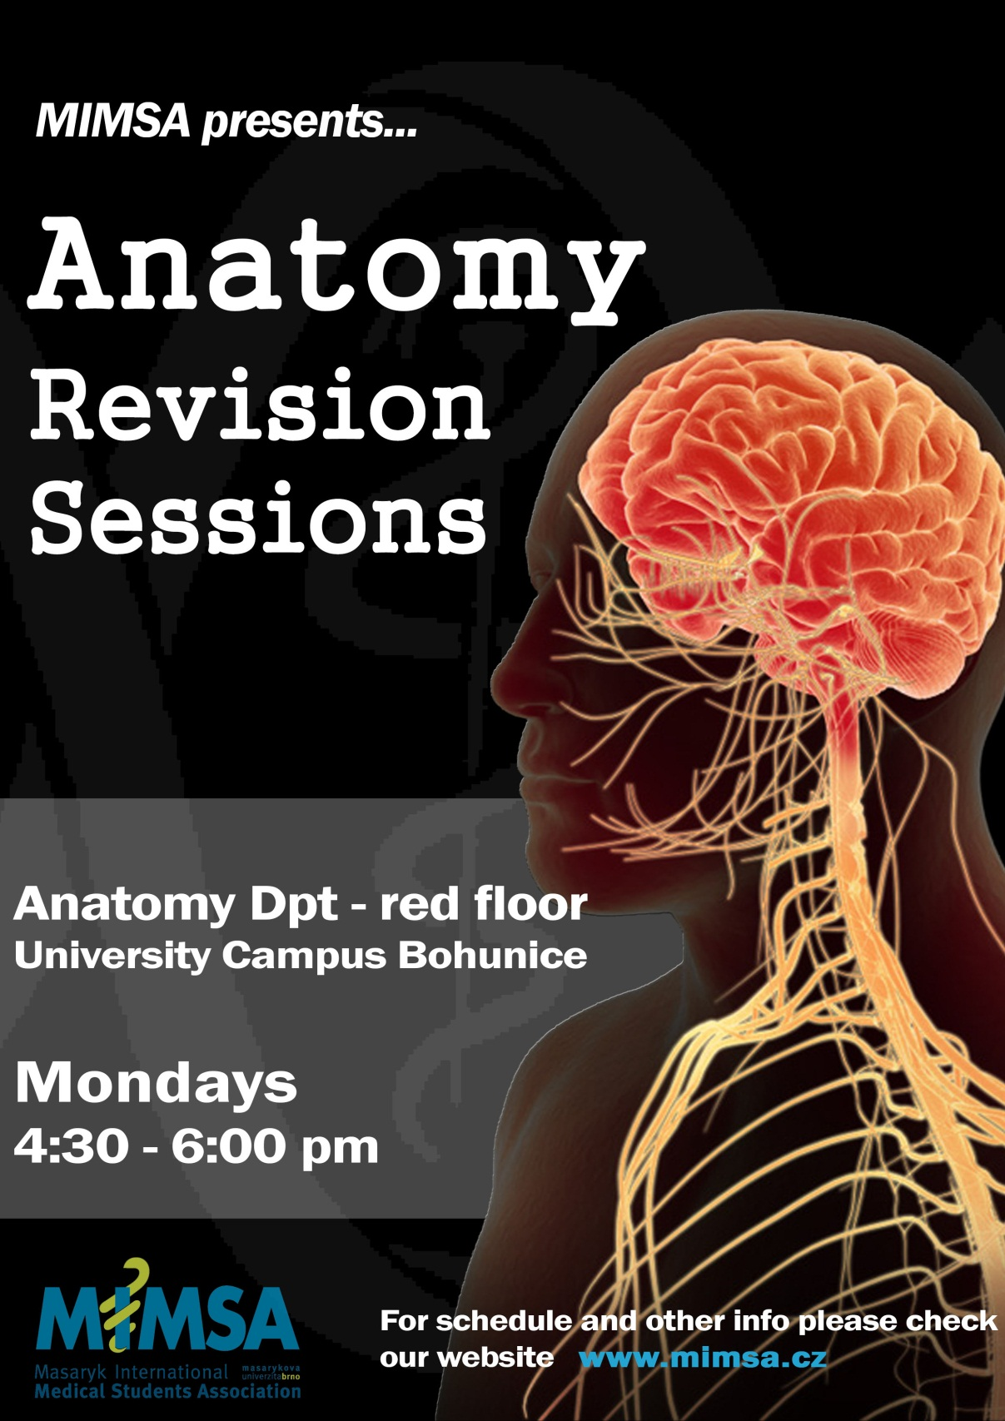

Slide 2
Program of sessions:
7/10 - Spinal Cord
14/10 - Brainsteam and cerebellum
21/10 - Diencephalon
28/10 - Telencephalon
4/11 - Blood Supply, Meninges and Cerebrospinal fluid
11/11 - Cranial nerves (III-VII, IX-XII)
18/11 - Eye
25/11 - Ear and VIIIth cranial nerve.

Slide 3


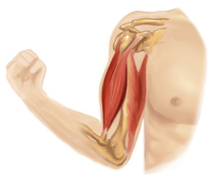
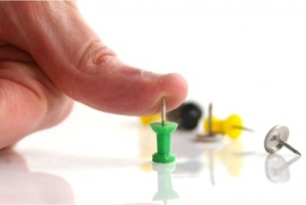
Thalamus
Cerebellum
Brainstem
Cerebral Cortex
Receptor
Afferent neuron
Effector organ
Efferent neuron
Ascending Pathway
Descending Pathway

Slide 4
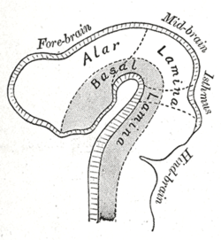
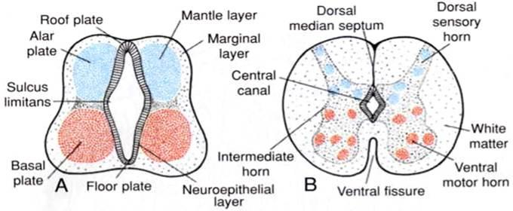

Slide 5
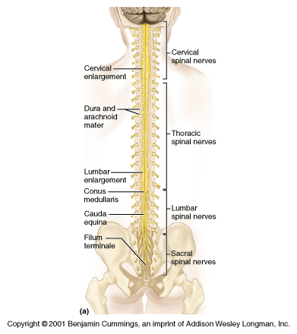
Surface description of spinal cord
Diameter: 2 cm
Length: 42-45 cm (from medulla oblongata or decussation pyramids to L2 vertebra)
It has 2 enlargements:
Cervical/upper enlargement – C4-Th1
Lumbar/lower enlargement - Th9-Th12
Expansions of gray matter providing nerves for upper and lower limb.
Conus medullaris: conical portion of spinal cord (L1-L2)
Filum terminale: Extension of pia matter that attaches spinal cord to the first segment of coccyx.

Slide 6
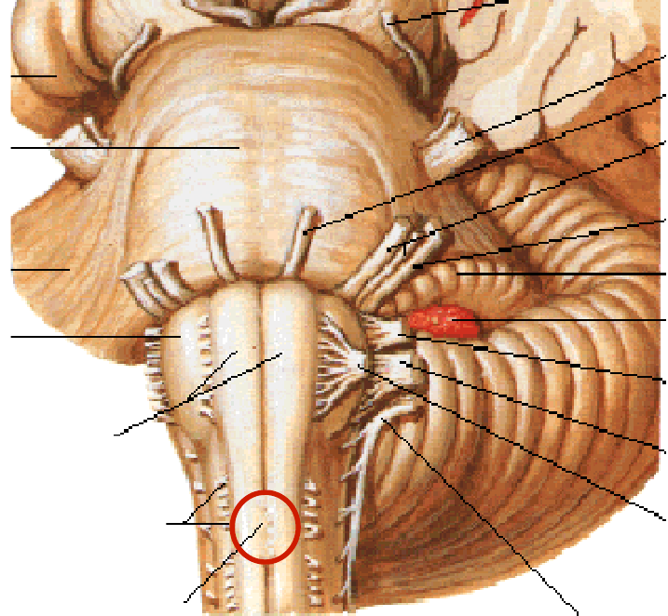
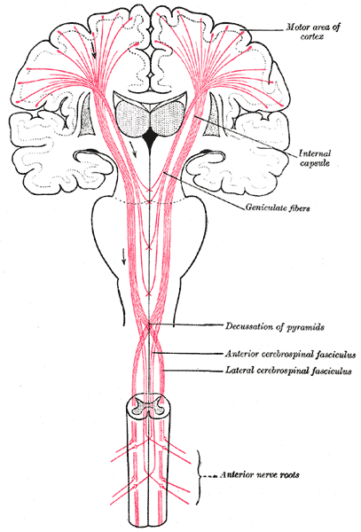
Decussatio pyramidalis

Slide 7
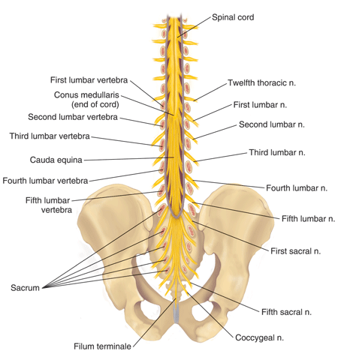
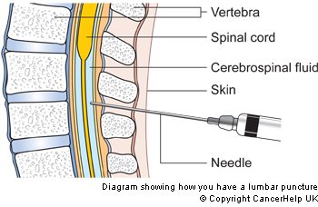
Originally, the spinal cord and vertebral cana have the same length.
Vertebral column grows faster.
The more caudal the spinal nerve, the more oblique it is.
Caudal end of spinal cord:
In newborn: L2-L3
In adult: L1-L2
Lumbar puncture:
Performed between L3-L4 or L4-L5 (below lowest portion of spinal cord – safe acess)

Slide 8
Spinal nerves
31 pairs:
8 cervical
12 thoracic
5 lumbar
5 sacral
1 coccygeal
Anterior Ramus:
Plexus
Costal nn.
Posterior Ramus:
Muscles and Sensation of the Back

Slide 9
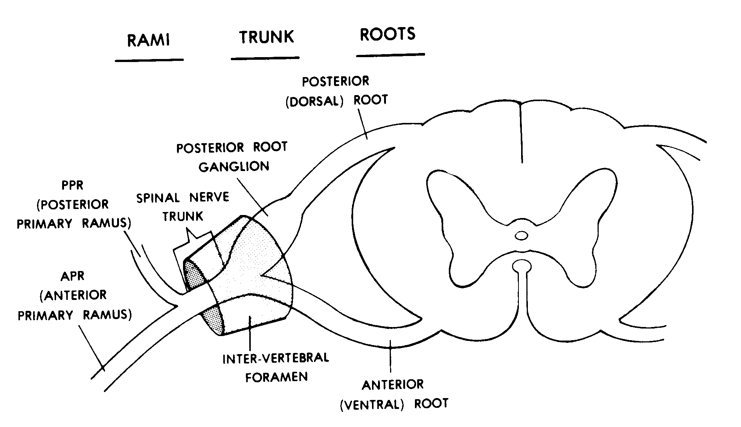

Slide 10
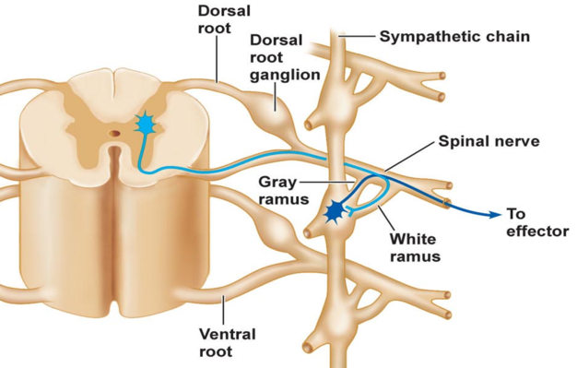
Posterior horn
Lateral horn
Anterior root

Slide 11
Grey Matter
Nucleus - Mass of neurons which give rise to axons with a common path, termination and function.
White Matter
Fasciculus – Bundles of axons of neurons from various sources and targets
Tract – Bundles of axons with the same origin and target.

Slide 12
White Matter
Posterior Funiculus – White matter between the posteromedian sulcus and each dorsolateral sulcus.
Anterolateral Funiculus - White matter between posterolateral sulcus and anterior median fissure

Slide 13
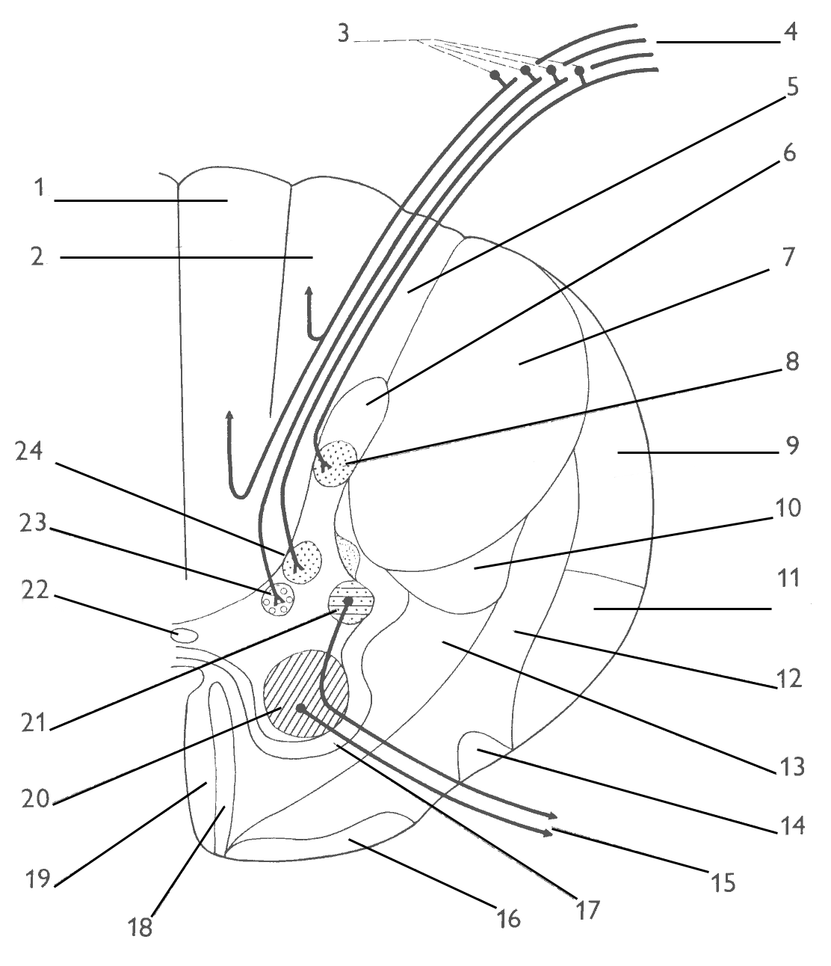
Posteromedian sulcus
Posteromedian sulcus
Fasciculus Gracilis
Dorsolateral sulcus
Fasciculus Cuneatus
Ventrolateral sulcus
(ventral roots exit)
Anterior Median Fissure
Page 20

Slide 14
Dorsal root afferents and tracts of dorsal funiculus
2nd order neuron
Receptor
Pseudounipolar
1st order for all ascending tracts
Convey information from visceral and somatosensory receptors
Synapse with 2nd order neurons in the posterior horn or in brainstem

Slide 15
Pseudounipolar neurons
Dorsal Root
Tr. dorsolateralis Lissaueri
Ncl. posteromarginalis +
Subst. gelatinosa Rolandi
Fasc. gracilis
Tr. spinobulbaris
Fasc. cuneatus
Nucleus proprius
Ncl. thoracicus
(Dorsal nlc. of Clarke)
Tr. spinocerebellaris ant.
Ncl. intermediomedialis
Tr. spinocerebellaris post.
Tr. spino-thalamicus,
-reticularis, -tectalis
Tr. spino-olivaris
Tr. olivo-spinalis

Slide 16
Fasciculus gracilis: From sacral, lumbar and lower six thoracic segments.
Fasciculus cuneatus: From upper six thoracic and all cervical segments.
Generally speaking:
Fasciculus gracilis: Sensation of lower limb
Fasciculus cuneatus: Sensation of upper limb

Slide 17
Tr. corticospinalis lat.
Tr. rubrospinalis
Tr. reticulospinalis
Tr. olivospinalis
Tr. tectospinalis
Tr. corticospinalis ant.
Tr. vestibulospinalis

Slide 18


