Slide 1
Czechoslovakia during the interwar period
Ww ii in central europe liberation of the central europe
Jana Hrabcova

Slide 2
czechoslovakia
the First Czechoslovak republic was proclaimed on October 28, 1918 in Prague
consisted of: Bohemia, Moravia, Silesia, Slovakia and Carpathian Ruthenia
1920 – the constitution - plural parliament democracy
in 1920 – Tomas Garrigue Masaryk (1850–1937) was elected the first President (reelected in 1925 and 1929, served till 1935), he was a philosopher and politician, very influential personality, lived in exile during the WW I – Geneve, Paris, London, USA, his wife was American – Charlotte Garrigue, their son Jan Masaryk served later as Czechoslovak Foreign Minister
most important and most influential political party - Republican Party of Agricultural and Smallholder People - Peasant party, they ussually had a Prime Minister – Antonín Švehla in 1920s, Jan Malypetr and Milan Hodža in 1930s

Slide 3
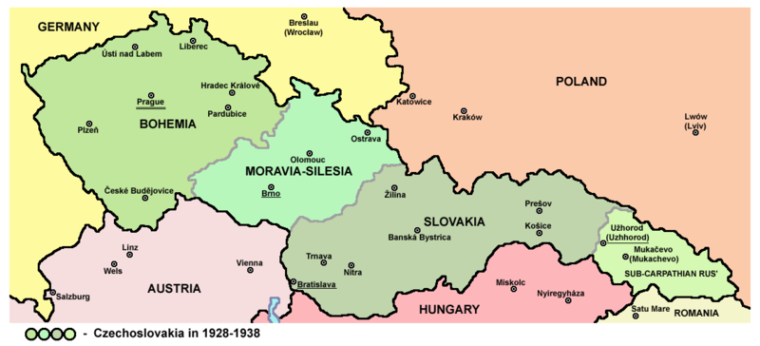
czechoslovakia
The first Czechoslovak republic consisted of: Bohemia, Moravia, Silesia, Slovakia and Carpathian Ruthenia (Sub-Carpathian Rus)

Slide 4
czechoslovakia
foreign policy – led by Minister Edvard Beneš from 1918 to 1935 – one of the most important European diplomats during the interwar period, in 1936 he was elected second President of Czechoslovakia
1921 – the Little Entente was formed – an alliance of Czechoslovakia, Kingdom of Serbs, Croats and Slovenes and Romania – against Hungary and its revanchism and against restoration of Habsburgs, Little Entente was supported by France (1924 – Czechoslovak-French Agreement)
the Little Entente was an idea of Czechoslovak Foreign Minister Edvard Beneš
since 1925 – economic growth, cultural development
the great depression since 1930
since 1933 – Czechoslovakia was threatened by Nazi Germany
Border fortification

Slide 5
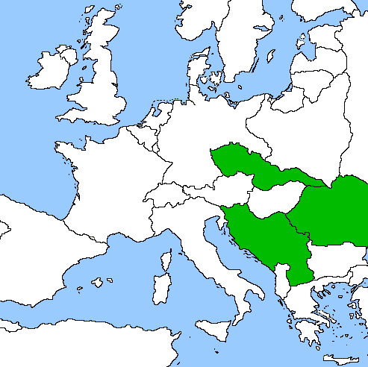
Little entente
Czechoslovakia + Yugoslavia + Rumania

Slide 6
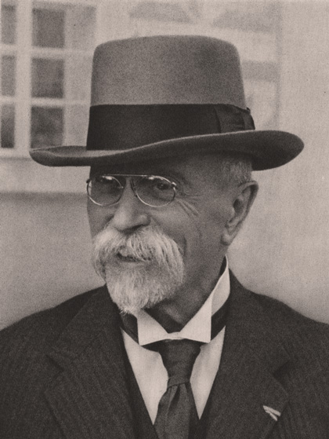
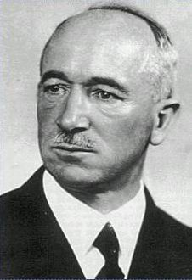
czechoslovakia
Tomaš Garrigue Masaryk
Edvard Beneš

Slide 7
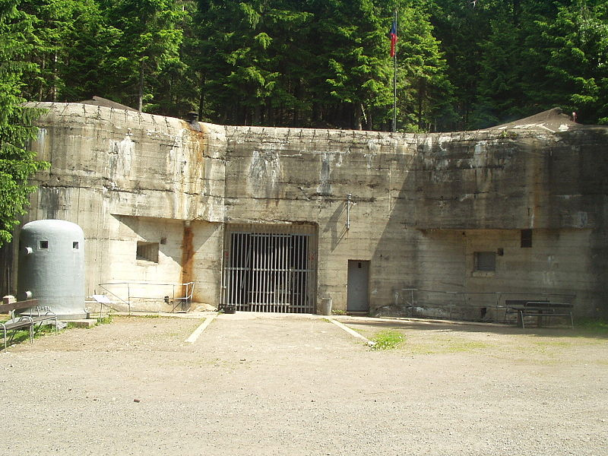
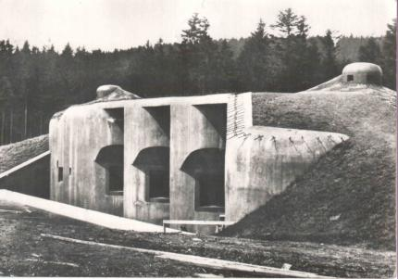
czechoslovakia
Czechoslovak fortification – Hanička
http://www.hanicka.cz/
Czechoslovak fortification – Bouda
http://www.boudamuseum.com/

Slide 8
czechoslovakia
national minorities – more than 3 million of ethnic Germans were living in Bohemian lands, they were called Sudeten Germans
The German minority living in Sudetenland demanded autonomy from the Czech government, claiming they were suppressed and repressed by the Czech government
In the 1935 Parliamentary elections, the newly founded Sudeten German Party under leadership of Konrad Henlein, financed with Nazi money, won an upset victory, securing over 2/3 of the Sudeten German vote, which worsened the diplomatic relations between the Germans and the Czechs
since 1937 – isolation of Czechoslovakia in internatioanl polititics
policy of appeasement – the Great powers did not want to risk world peace for Czachoslovakia
1938 - this policy resulted in Munich Agreement

Slide 9
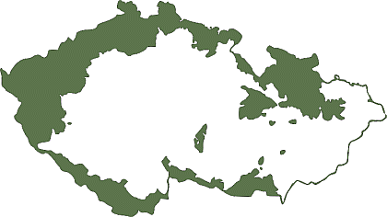
czechoslovakia
Sudetenland – the areas inhabited by Germans in Bohemia, Moravia and Silesia

Slide 10
czechoslovakia
Readings:
TUMA, Oldrich – JINDRA, Jiri (eds.): Czechoslovakia and Romania in the Versailles System. Prague 2006.
LUKES, Igor: Czechoslovakia Between Stalin and Hitler: The Diplomacy of Edvard Beneš in the 1930s. New York1996.
LUKES, Igor – GOLSTEIN, Erich (eds.): The Munich Crisis, 1938: Prelude to WWII. London 1999.

Slide 11
Central Europe at the beginning of WW II
Germany
the Third Reich – Adolf Hitler as a Führer (Leader) – all the power centralized in his hands, nazism, Gestapo (secret police – Heinrich Himmler) – persecuting of Jews, liberals, Socialist, and Communist opposition – concentrations camps, propaganda (Minister Joseph Goebbels), economical prosperity again – preparations for the war, in 1935 – Germany began to re-arm, 1936 – remilitarization of Rhineland, axis with Italy and later also with Japan …
attack on Poland in September 1939, attack on France in spring 1940, autumn 1940 – the battle of Britain, June 1942 – operation Barbarossa – attack on USSR – from September 1942 to February 1943 – the battle of Stalingrad – crucial point of the war, the Soviets won and launched great offensive
1944 – crisis of Nazi regime
January 1945 – Germans stopped by French and American troops at western front

Slide 12
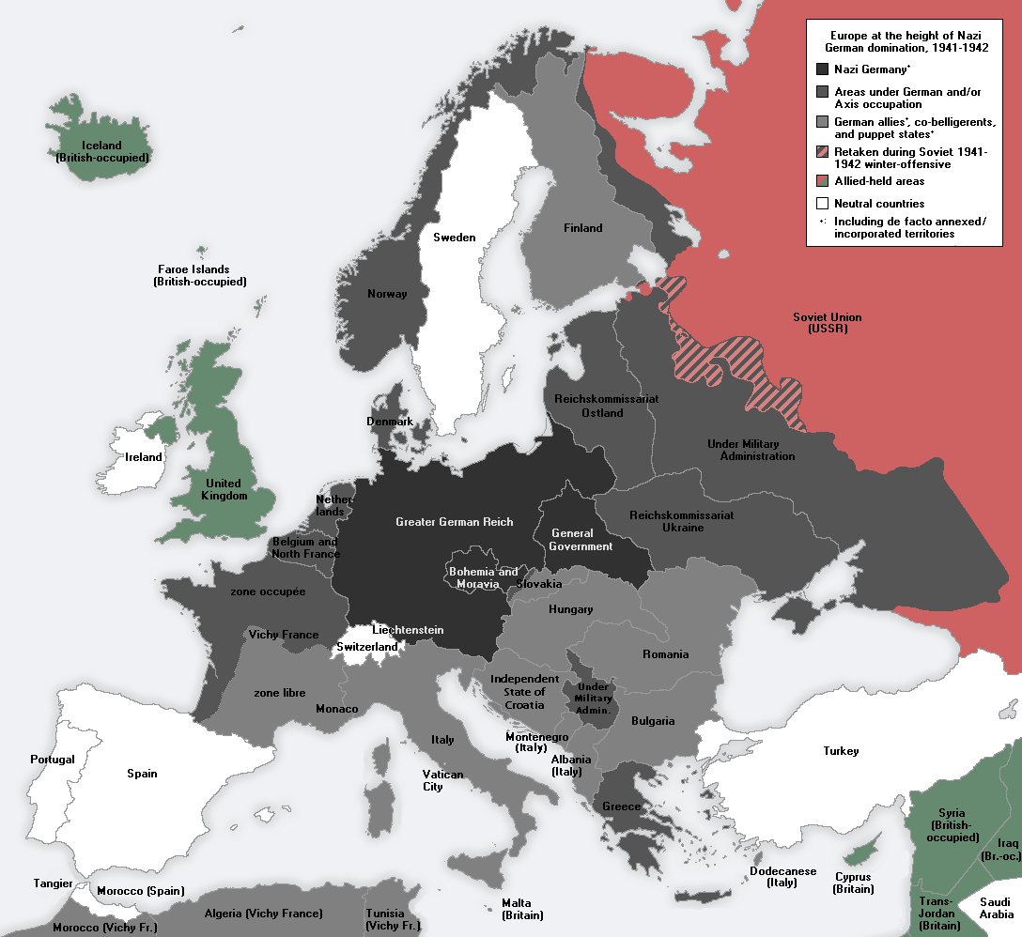
Europe under Nazi domination

Slide 13
Central Europe at the beginning of WW II
Austria
after Anschluss in March 1938 (Fall Otto) Austria became a part of German territory
in April a plebiscite that confirmed annexation of Austria into Nazi Germany

Slide 14
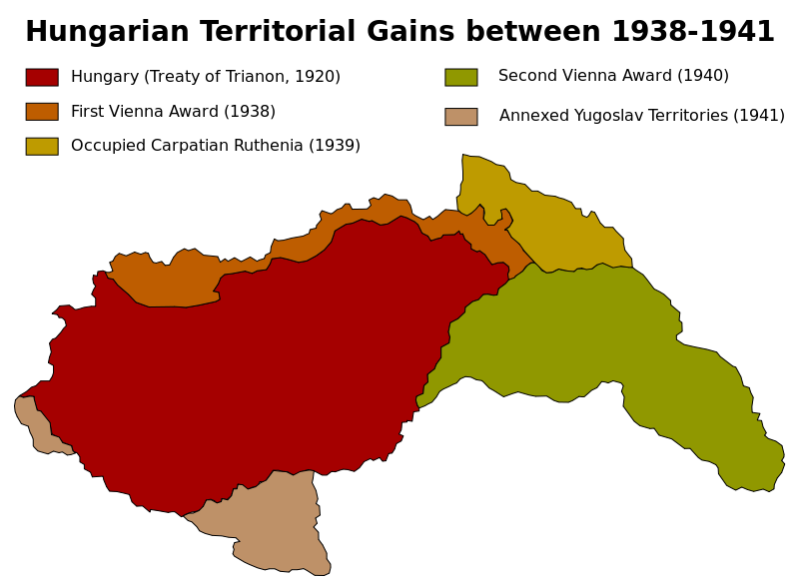
Central Europe at the beginning of WW II
Hungary
territorial gains – from Czechoslovakia, Rumania and Yugoslavia
hungarian nazism
1940 - joined Axis Berlin – Rome – Tokyo
Participated on the invasions of Yugoslavia and of the Soviet Union

Slide 15
Central Europe at the beginning of WW II
Poland
endangered by Germany but also by Soviet Union
attacked by Nazi Germany on 1st September 1939 without declaring war on Poland
17th September – USSR attacked Poland and occupied eastern part of Poland
so called New Partition of Poland – western part under German Reich, central part – General Gouvernement (with the capital city of Krakow) – the head Hans Frank, eastern part – occupied by USSR
many concentration camps in Poland – Auschwitz, Majdanek, Sobibor, Treblinka ...
segregation of Jews – a big ghetto in Warsaw – from April to May 1943 – Warsaw Ghetto Uprising
of Poland's prewar Jewish population of 3 million, only about 369,000 survived the war
Polish resistance movement – Polish goverment in exile with Władysław Sikorski as Prime Minister, in Poland the Home Army (Armia Krajowa) and the Peoples Army (Armia Ludowa)

Slide 16
Central Europe at the beginning of WW II
Czechoslovakia
in Czechoslovakia numerous German minortity, Sudeten German Party with the leader Konrad Henlein
April 1938 – Carlsbad Decrees demanding the authonomy for Sudeten Germans and the freedom to profess Nazi ideology, Sudeten Germans expected that President Beneš will refuse their exaggerated requirments
Czechoslovak government was forced to coclude an agreement with Henlein but he refused all their suggestions according to Hitler´s instructions
several negotiations on Czechoslovakia between Hitler and British Prime Minister Neville Chamberlain during September 1938:

Slide 17
Central Europe at the beginning of WW II
15th September – Berchtesgaden – Great powers were putting pressure on Czechoslovak government to accept Hilter´s requirments – he wanted Sudeten, firstly Czechoslovak government refused British and French pressure but on 21st September was forced to accept Hitler´s requirments
22nd September – Bad Godesberg – new Hitler´s requirments – he wanted to occupy Czechoslovak fortification and some border areas for Poland and Hungary
Hitler announced that he will attack Czechoslvoakia on 28th September (according to the Fall Grün prepared already in April 1938)
change of the government in Czechoslovakia – Prime Minister General Syrový
23rd September – general mobilization in Czechoslovakia

Slide 18
Central Europe at the beginning of WW II
29th to 30th September – Negotioations of four Great powers in Munich (Germany – Hitler, Italy – Mussolini, Great Britain – Chamberlain, France – Daladier) – about Czechoslovak frontiers and German requirments but without Czechoslovakia – France and Great Britain were Czechoslovak allies but they signed the agreement with the enemy:
the Munich Agreement, Czechoslovakia(Czechoslovak troops) had to evacuate Sudeten and cede it to Germany,
the USSR did not reply for the Czechoslovak application for the help
from 1st to 10th October Czechoslovak borderland was occupied by German troops and annexed to Germany, Poland got the area around Těšín and Spiš, Hungary got Carpathian Ruthenia and southern parts of Slovakia
Czechoslovakia lost 1/3 of its area, 1/3 of light industry, in southern Slovakia fertile soil important for agriculture was lost
the First Czechoslovak republic was dissoluted, so called Second Czecho-Slovak Republic till March 1939 – President Emil Hácha, no parliamentary democracy anymore
7th October – autonomy of Slovakia was proclaimed – Czecho–Slovakia

Slide 19
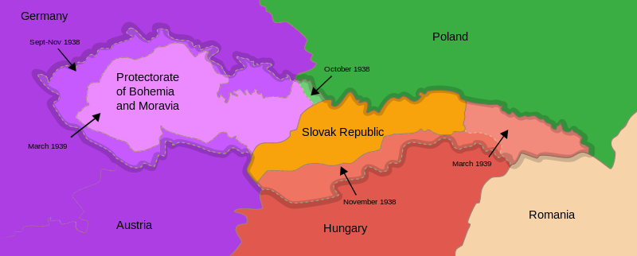
Munich agreement
September 1938 – Munich Agreement – lost of Sudetenland
March 1939 – establishing of Protectorate Bohemia and Moravia
March 1939 – Slovak State

Slide 20
Central Europe at the beginning of WW II
13th March 1939 – Slovak Prime Minister Jozef Tiso was invited into Berlin – he was made to enforce the separation of Slovakia
14th March 1939 – Slovak State was proclaimed, dependent on Germany
14th March 1939 – President Hácha and Foreign Minister Chvalkovský invited to Berlin – Hitler threatened with bombing of Prague – they were forced to sign the document asking Germany for protection what was in fact forced capitulations
15th March 1939 – German army occupied Bohemia and Moravia – dissolution of Second Czechoslovak Republic
16th March 1939 – the occupants proclaimed Protectorate of Bohemia and Moravia – it was part of German Reich, formaly autonomous state with so called State President Emil Hácha and Prime Minister Rudolf Beran but the real power was in hands of Reichsprotektor Konstantin von Neurath and later Reinhard Heydrich

Slide 21
Central Europe at the beginning of WW II
Jews were dismissed from the civil service and placed in an extralegal position,
the Czechs launched secret resistance movement to Nazi occupation, Czechoslovak Government in exile in London
mass demonstrations in October 1939 – the anniversary of establishing of Czechoslovakia – one student Vojtěch Sedláček was shot to death and the second one – Jan Opletal was seriously injured and died later, his funeral on 15th November became a new mass manifestation
the Nazis started an intervention against students on 17th November 1939 – 9 students were executed, 1200 of them deported into concentration camp in Sachsenhausen, all the Universities in Protectorate were closed (→ International Students´ Day)

Slide 22
Readings
Seton-Watson, Hugh: Eastern Europe 1918 – 1941. Hamden 1962.
Rotschild, Joseph: East Central Europe between the Wars. Seattle 1974.
Voráček, Emil and others: The Disintegration of Czechoslovakia in the end of 1930s. Policy in Central Europe. Prague 2009.
http://www.holocaustresearchproject.org/toc.html

Slide 23
Liberation of central europe
The Soviet Red Army
since March 1943 to May 1944 – the territories in the Ukraine were liberated
August 1944 – Nazi regime in Romania was overthrown
September 1944 – also Bulgaria became a member of anti-Nazi alliance
Yugoslavia – strong resistance movement – communists (Partisans) under the leadership of Josip Broz Tito, in October 1944 – Belgrade was liberated with the help of Red Army, the rest of Yugoslavia liberated mostly by Partisans
from October 1944 till February 1945 – fights in Hungary, siege of Budapest

Slide 24
Liberation of central europe
in April 1945 German-Hungarian forces finaly pushed from Hungary to Austria
February 1945 Poland (17th February – liberation of Warsaw)
in January 1945 – the Provisional Governement in Poland – with Soviet support
members of anti-German resistance movement that remained loyal to London exile government were arrested by the Soviets, many of them exiled
The conflict in Poland continued – since 1943 – Polish-Ukrainian War

Slide 25
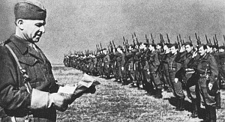
Liberation of central europe
from 29th August 1944 till the end of October 1944 – the Slovak National Uprising – the Partizans and members of so called First Czechoslovak Army against German occupation
September to November 1944 – Red Army crossed border mountains after cruel fights and entered Slovakia (Battle of the Dukla Pass – 22,000 soldiers of Red Army were killed)
then the Red Army advanced throw Slovakia towards Vienna, during this advance Bratislava was liberated (4th April 1945), then Brno (26th April) and Ostrava (30th April)
General Ludvik Svoboda, Commander in Chef of the First Czechoslovak Army

Slide 26
Liberation of central europe
western part of Bohemia was liberated by American troops under the command of general George S. Patton but the Soviets asked Americans to stop in Pilsen and not to continue to Prague
5th May 1945 – the May Uprising of Bohemian People in Prague and then in the whole country
Soviet Generals refused an offer of General Eisehower – he wanted to send American troops to help the uprising but the Soviets wanted to liberate Prague themselves
8th May 1945 – liberation of Prague and the end of the WW II in Europe

Slide 27
Liberation of central europe
30th April – Hitler committed suicide
2nd May – Fall of Berlin
7th May – capitulation of Germany – confirmed again at night from 8th to 9th May
in July 1945 – the Allied leaders met in Potsdam, Germany – this conferrence confirmed earlier agreements about Germany – so called Programme of four D (denazification, demilitarization, democratization and decartelization)
also the resettlement of German minority from Czechoslovakia, Poland, Hungary and Yugoslavia
August 1945 – International Trial in Nüremberg – after almost one year of trial 12 prominent Nazis sentenced to death

Slide 28
Liberation of central europe
Germany divided into four ocuppation zones – French in the southwest, British in the northwest, United States in the south, and Soviet in the east, also Berlin, which was situated in the Soviet zone, was divided into four occupation zones
all the territorries that Germany had occupied (Austria, Czechoslovakia …) were detached
Germany lost some territories for Poland and Russia, new Polish frontiers on the Oder-Niesse line
millions of ethnic Germans expelled from Czechoslovakia, Poland and Hungary returned to Germany

Slide 29
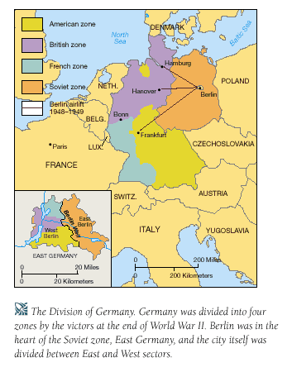
Liberation of central europe
Occupations zones in Germany and Berlin

