Slide 1
National awakening and the long 19th century in Central Europe
Richard Turcsanyi

Slide 2
Revision: questions
What are the reasons for belated development of Central Europe before 19th century?
What was the high historical point of national histories?
What were the biggest historical tragedies for CE nations?

Slide 3
Historic memory
PL: Lech, Mieszko I., Boleslaw I., Casimir III., Jadwiga, Wladislaw I. Jagiello, Czarniecki, Dabrowski, Bonaparte, Constitution of 1791,
CZ: Grandfather Czech, C+M, Saint Wenceslaus, Premysl Ottokar, Saint Agnes of Bohemia, Charles IV., Jan Hus, Jan Amos Comenius
HU: Turul, Hun, Arpad, Stephen I., Mongols, Charles Robert, Matthias Corvinus, Turks, Gabor Bethlen, Francis II. Rakoczy,
SK: Pribina, Svatopluk, C+M

Slide 4
Nation and nationalism
Nation: modern inventions vs. ancient group?
Enlightenment (France v. UK v. Poland v. Austria v. Russia)
French revolution
Romanticism (Herder)
Imagined community (Anderson)
Economic and political development
Def: a group of people sharing language, culture, history, religion, ethnicity etc – different to other groups
-- Central Europe v. Western Europe (v Asia?)

Slide 5
History of the long 19th century
1772 – 1795: Partition of Poland
1815: Congress of Vienna
1848: Spring of nations
1867: Austro-Hungarian compromise
1871: German “Second” Reich
1914-1918: WWI
Three periods of national revivals
  Intellectuall movement
  Higher middle classes
  Mass movements

Slide 6
National awakening
PL: Dabrowski, Kosciuszko, Mickiewicz, Pilsiudski
CZ: Frantisek Palacky, T. G. Masaryk
HU: Lajos Kossuth, Istvan Szechenyi
SK: Jan Kollar, Ludovit Stur
Levels of national development:
  1. Poland and Hungary
  2. Czech Republic
  3. Slovakia

Slide 7
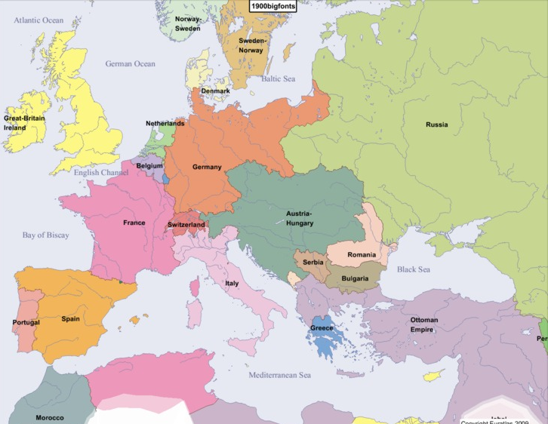

Slide 8
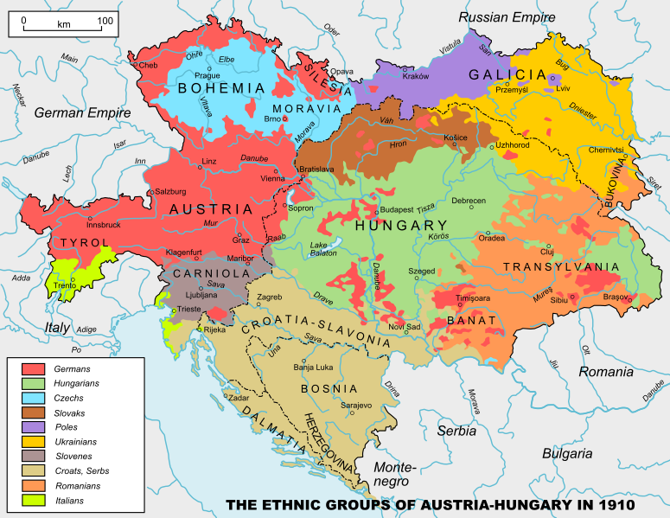

Slide 9
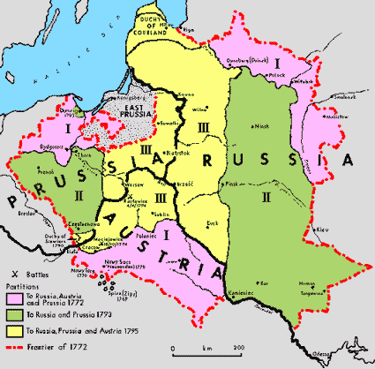

Slide 10
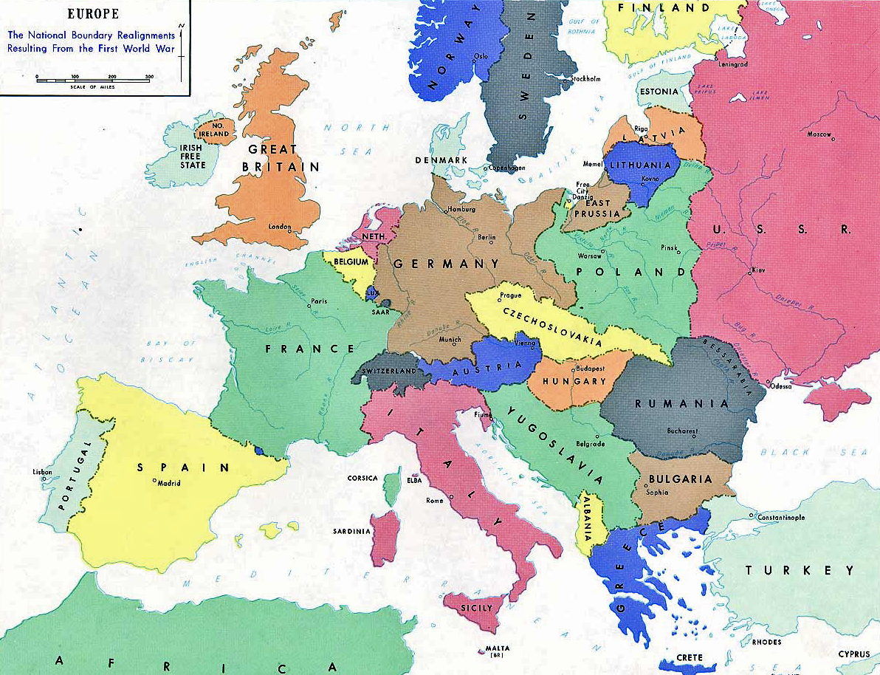

Slide 11
