Slide 1
Security situation in the Central Europe after 1989
Richard Turcsanyi

Slide 2
What is Security?
Security
sécurité
Sicherheit
seguridad
Bezpečnost
Безопасность
安全
सुरक्षा
أمن
…

Slide 3
Security is…
→ the condition/state of affairs of…
…the absence of threats to acquired values (Wolfers)
…a low probability of damage to acquired values (Baldwin)

Slide 4
Security dimensions (Baldwin)
Security for whom?
Security for which values?
How much security?
From what threats?
By what means?
At what cost?
In what time period?

Slide 5
What security studies?
Political Science
International Relations
Security Studies
Strategic Studies
Military Studies

Slide 6
Security studies: driving forces
Events
Distribution of power
Technology
Academic debate

Slide 7
Post Cold War
Lost of credit of the whole discipline…
International relations – relative rise of importance for IPE
Strategic Studies = useless?
Security Studies
  Leave as it is (i.e. = strategic studies)
  Small reform
  Large reform
Richard Betts’ circles

Slide 8
Broadening and deepening of security studies
Reference object / type of threat | Military | Military/Non-military
States | National security | Comprehensive security (Environmental, economic, health, food threats)
Societies, Groups, and Individuals | Intrastate security (civil wars, ethnic conflicts) | Human security

Slide 9
Realism: “Bad people in anarchical world”
Human nature = bad, international system = anarchy
State = the (internal and external) protector of the values (i.e. provider of security)
Struggle for security + international anarchy → power of the state → security dilemma
Security = state security = state power
Thucydides, Machiavelli, Richelieu, Carr, Morgenthau, Kissinger, Waltz…
How to solve the security dilemma
  Balance of power (deterrence)
  Hegemony

Slide 10
Liberalism: Ability to conquer the war
Human nature = good
International system = anarchy, but cooperation possible
War = the failure
  Power to people, security for people
To prevent security dilemma
  Liberal internationalism (Kant)
  Idealism (Wilson)
  liberal institutionalism (Mitrany, Haas, Keohane)
Neoliberal variants (neoliberal institutionalism)
  Absolute gains
  Complex interdependence
  International regimes

Slide 11
(neo)Marxist approaches
Economy at the basic of the conflicts
Classes not states are the main actors
  International system based on (imperial) states will always cause conflicts → proletariat revolution
Hegemony and exploitation
Examples:
  Dependency theories, core v. periphery models (Wallerstein’s world-systems approach)

Slide 12
Constructivism: What is a threat and how it becomes one?
Wendt: “Anarchy is what states make out of it”
Security studies:
  Rational approaches – there are objective threats to security
Constructivism – we don’t know what the threats are until they become so → perception of threat is crucial
Copenhagen school – securitization
  Philosophical approach – discourse
  Sociological approach – practical action

Slide 13
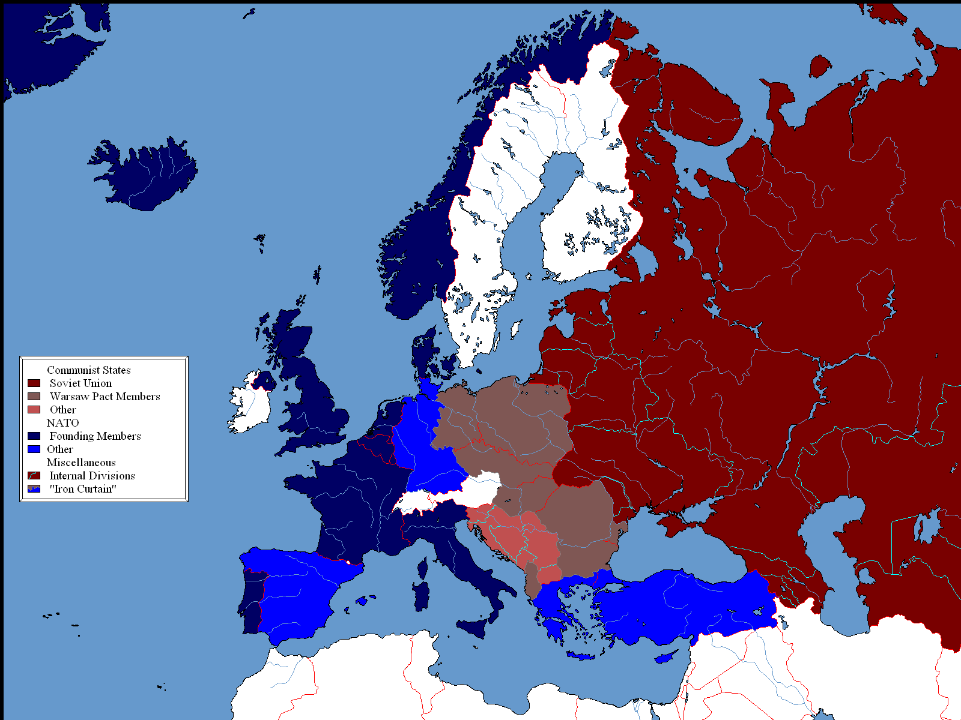

Slide 14
Central Europe: Now what?
Neutral area, security guaranteed mutually by West (NATO) and East (Russia)
Separate Central European organizations – “NATO-bis”, “EU-bis”, enhanced CSCE
Integration with the West (NATO & EU) → 1991

Slide 15
NATO: Now what?
NATO = useless?
  M. Thatcher – „you don’t cancel your insurance policy just because there have been fewer burglaries on your street in the last twelve months.“
Doctrinal shift: containment → enlargement
Key player – the USA
1993: Bill Clinton – “it’s economy, stupid”
  Development of the position that security of Central Europe is absolutely vital for security of Europe and NATO
  Problem: Russia (and Congress)

Slide 16
NATO enlargement
1991 NACC (North Atlantic Cooperation Council)
1994 Partnership for Peace
1997 NACC → EAPC (Euro-Atlantic Partnership Council)
1997 Madrid summit – invitation to join NATO (CZ, PL, HU)
1997 NATO-Russia Permanent Joint Council
1999 First enlargement
2002 NATO Russia Council
2004 Second enlargement
2009 Third enlargement

Slide 17
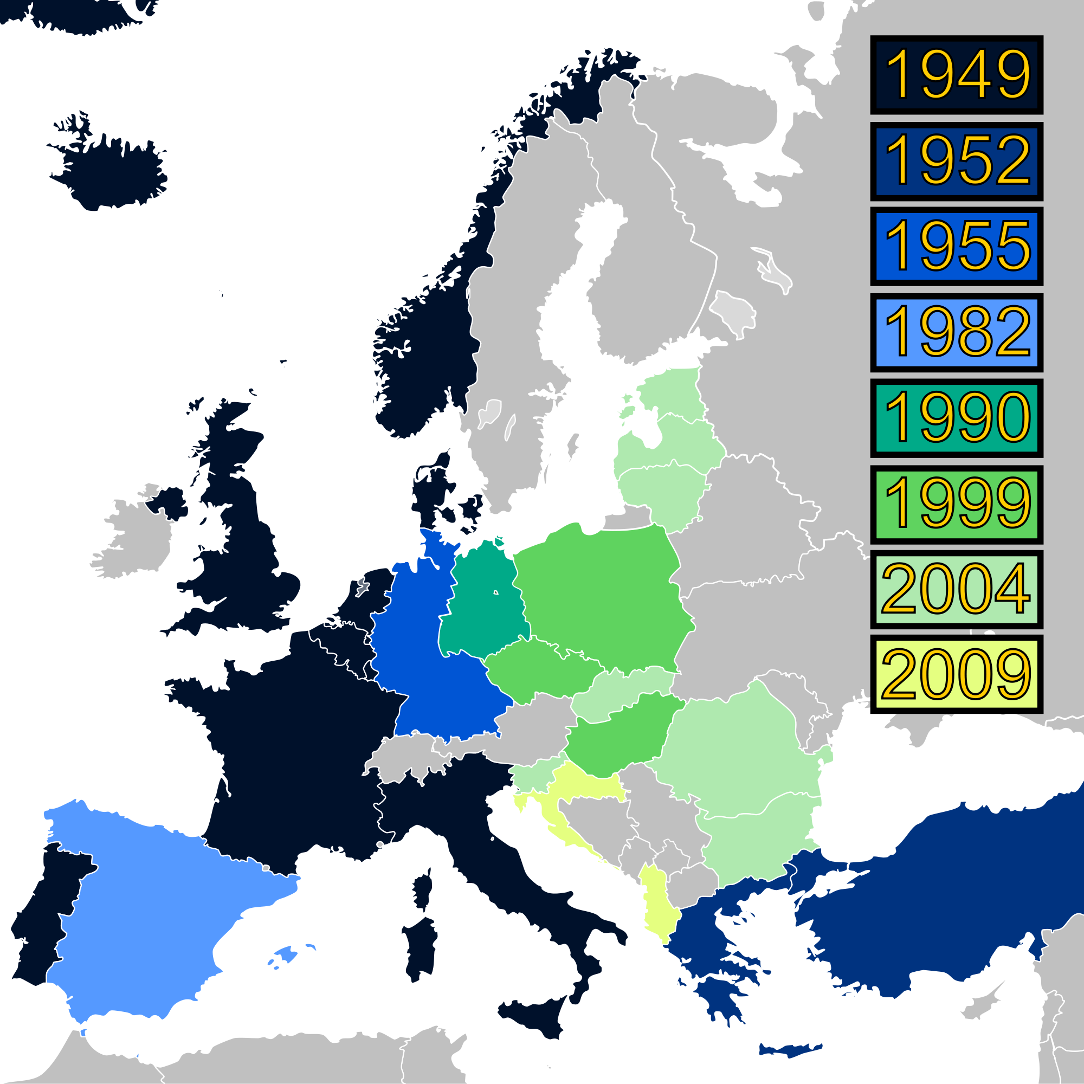

Slide 18
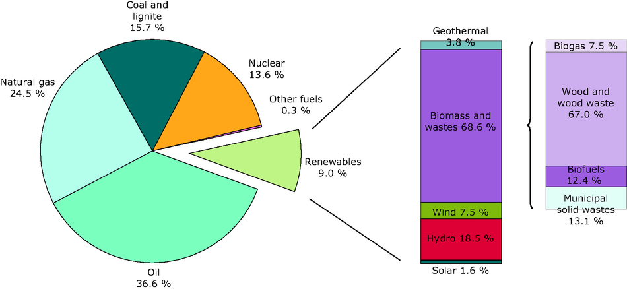
EU energy sources, 2009

Slide 19
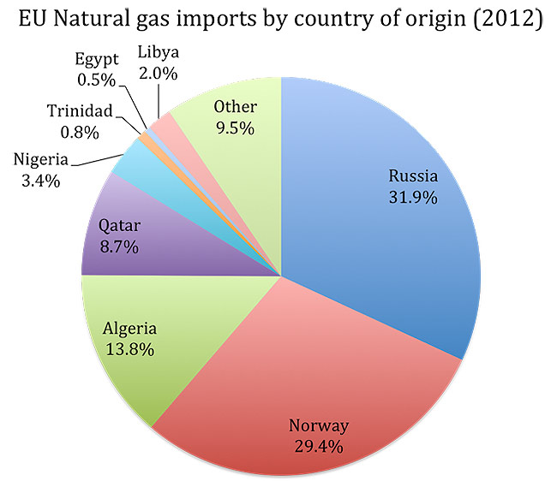

Slide 20
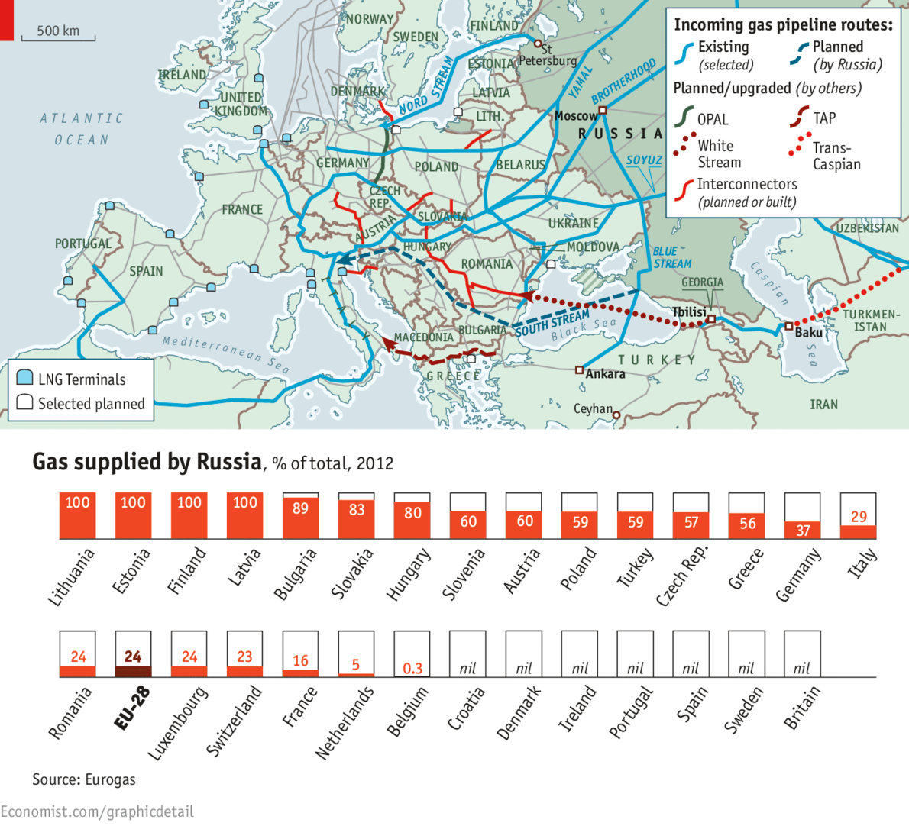

Slide 21
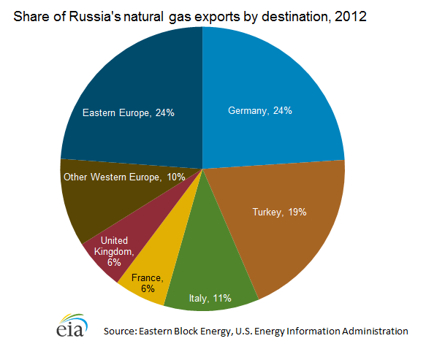

Slide 22
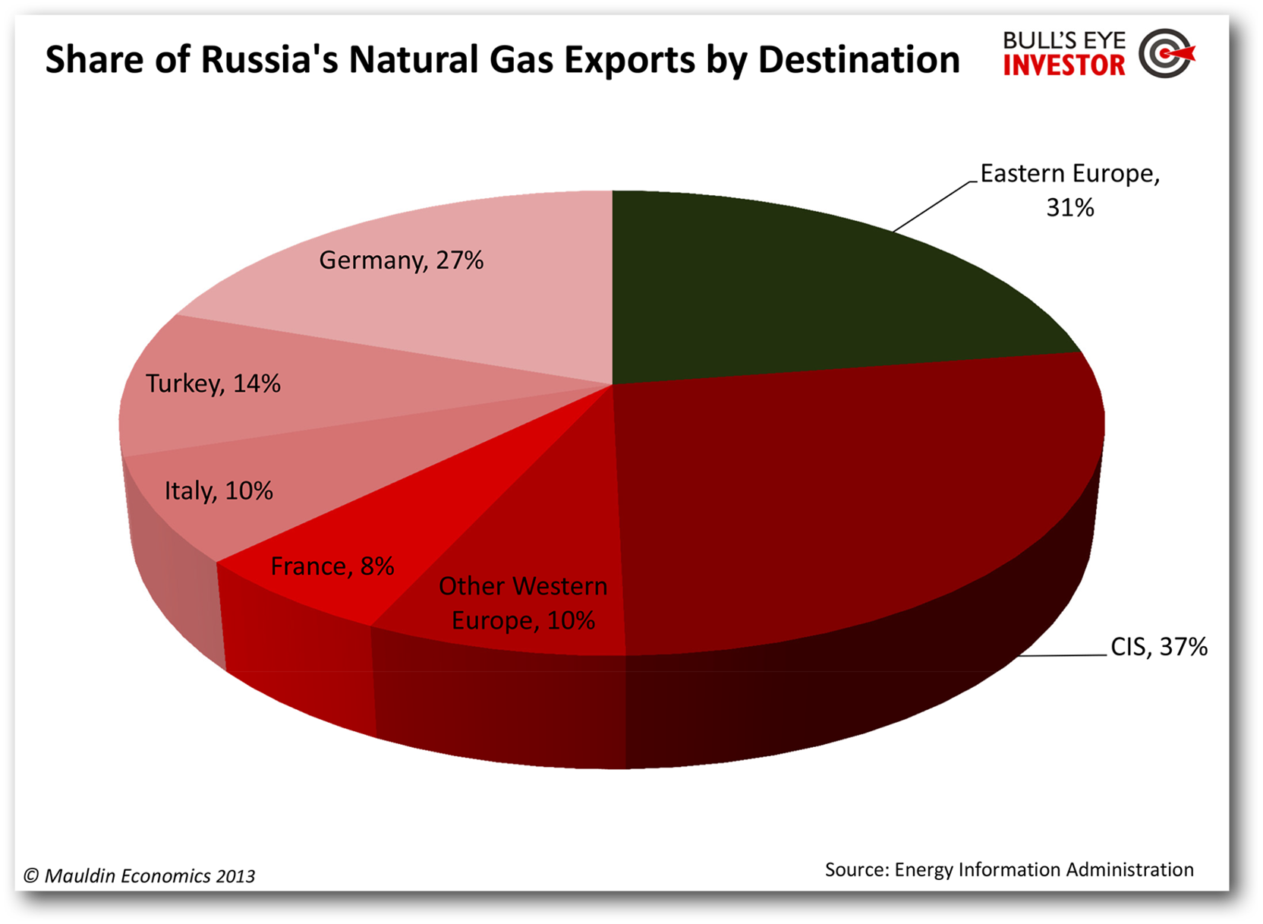

Slide 23
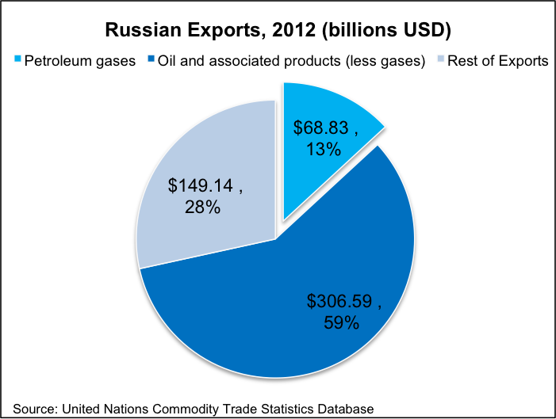

Slide 24
