Slide 1
Student motivation

Slide 2
What motivates you, personally?
TASK: Think about what motivates you in life and in learning, and as a teacher… write it down

Slide 3
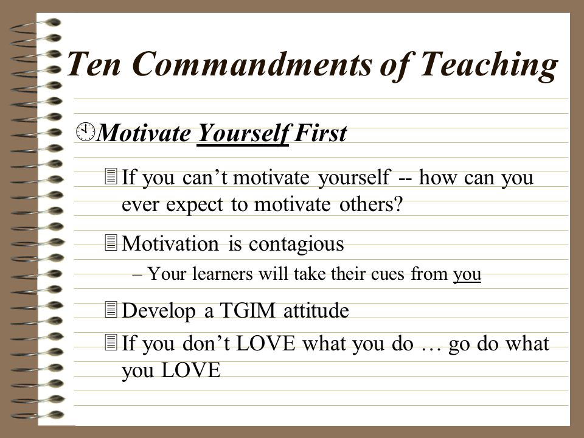
http://images.slideplayer.com/10/2896222/slides/slide_2.jpg
Notes:
Thank God It´s Monday

Slide 4
MOTIVATION, the BIG word
    TASK: Brainstorm, in groups, other words and concepts connected to motivation, your group can assign a spy to spy on other groups ☺
Notes:
Growth vs. Fixed mindset, awareness, will, determination, goal, purpose, authenticity, relevance,

Slide 5
What do you think motivates your students?
Think, Pair, Share…

Slide 6
Ten Commandments of Motivating Learners – Z. Dörnyei
1 Set a personal example with your own behavior.
2 Create a pleasant, relaxed atmosphere in the classroom.
3 Present the tasks properly.
4 Develop a good relationship with the learners.
5 Increase the learner’s linguistic self-confidence.
6 Make the classes interesting.
7 Promote learner autonomy.
8 Personalize the learning process.
9 Increase the learners’ goal-orientedness.
10 Familiarize learners with the target language culture

Slide 7
My bit to add
Talk to Them about Their Motivation…
- their ups and downs
- their successes and how to use them
- their doubts
- the need to reality-check
TASK: Write a letter to yourself what exactly you are going to change in your teaching regarding students´ motivation… think big!

Slide 8
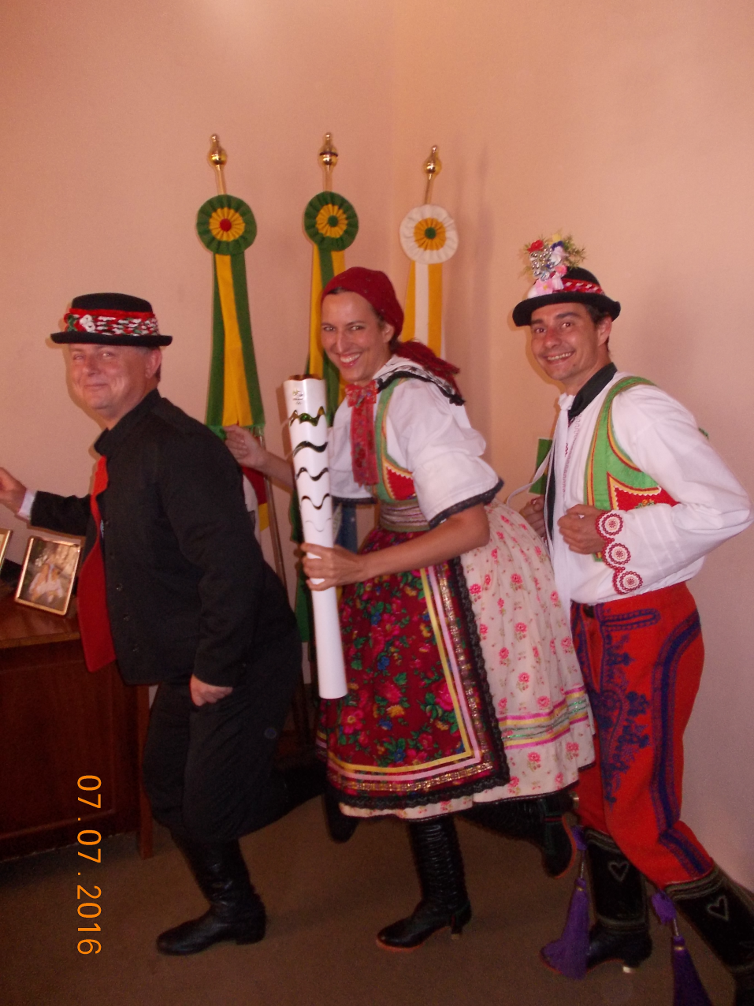
THANK YOU
    FOR YOUR ATTENTION

