Slide 1
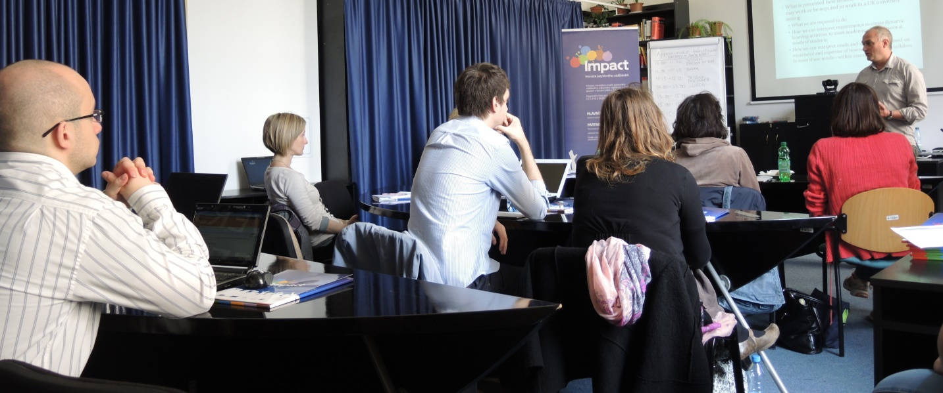

ACADEMIC SKILLS IN ENGLISH
Summer School
Masaryk University Language Centre
Monday 18th July to Friday 22nd July 2016
Brno
Notes:
1

Slide 2
tutors
Marc Grollman
Štěpánka Bilová
Alena Hradilová
Eva Trumpešová-Rudolfová
Libor Štěpánek

Slide 3
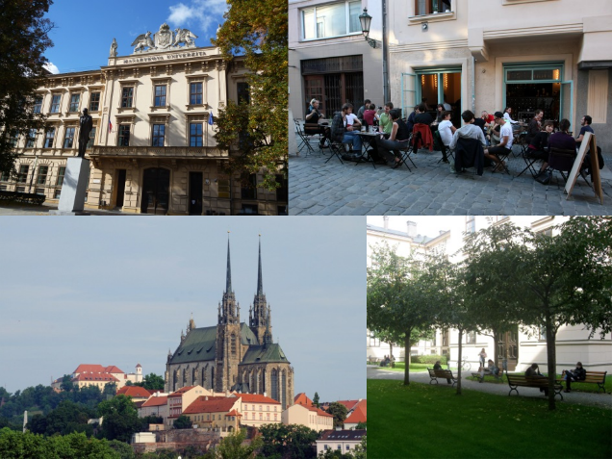
Timetable (Monday to Friday)
09:00-10:30 Workshops
10:30-11:00 Coffee Break
11:00-12:30 Workshops
12:30-14:00 Lunch Break
14:00-15:30 Workshops

Slide 4
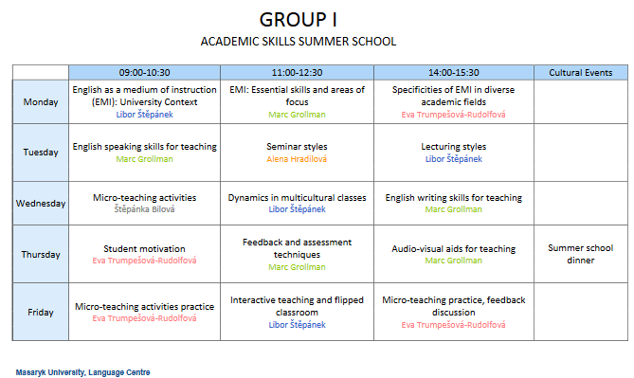

Slide 5
?

Slide 6
introduction

Slide 7
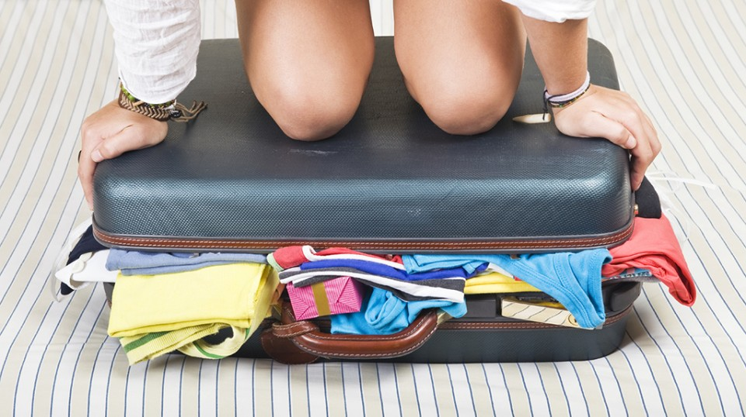

Slide 8
Lines of interest / confidence/ approach
teaching
English
communication with students
EMI

Slide 9

questionnaires

Slide 10
We wish you
a happy summer school!
The Organisational Team
Notes:
10

