Slide 1
Dynamics in multicultural classes

Slide 2
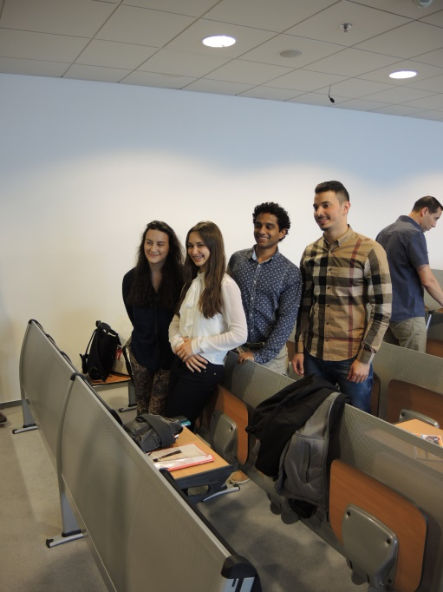
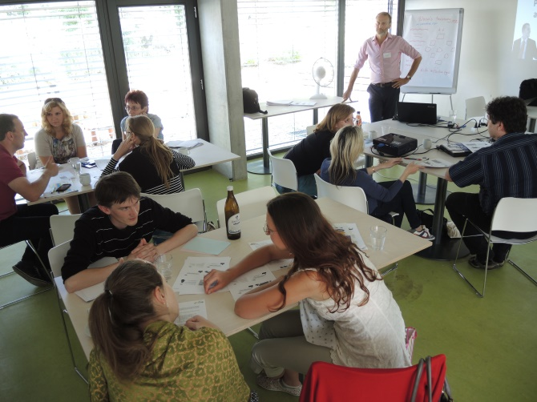
agenda
meeting a student
thinking as a student
theories & tools

Slide 3
…meeting a student

Slide 4
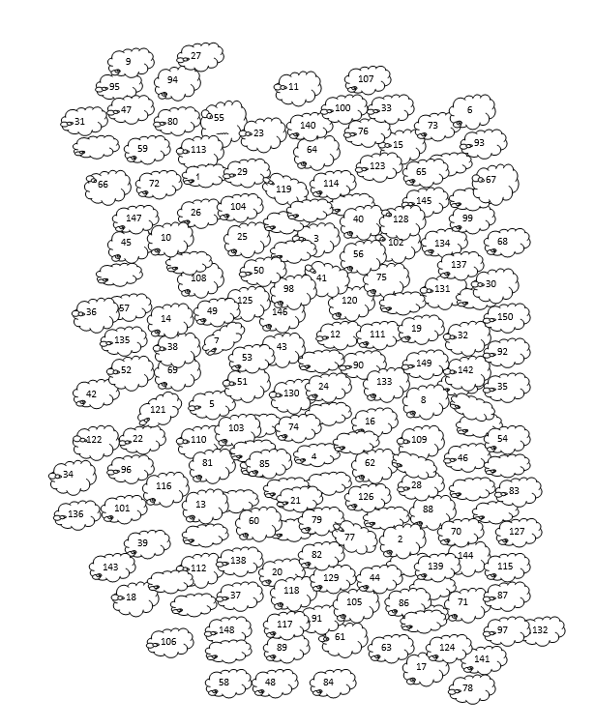
…pecore

Slide 5
… and cricket?
Most people are really surprised the first time they try a cricket.
Cricket can symbolize good luck and protection.
Cricket often appears in literature.

Slide 6
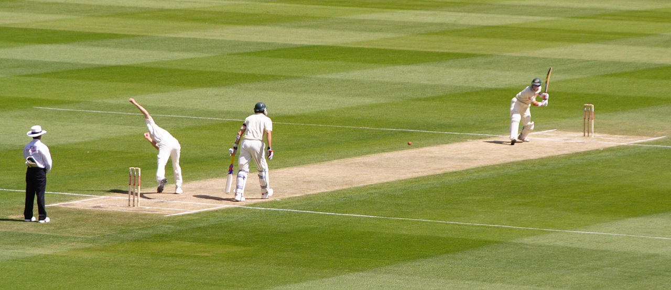

Slide 7


Slide 8


Slide 9
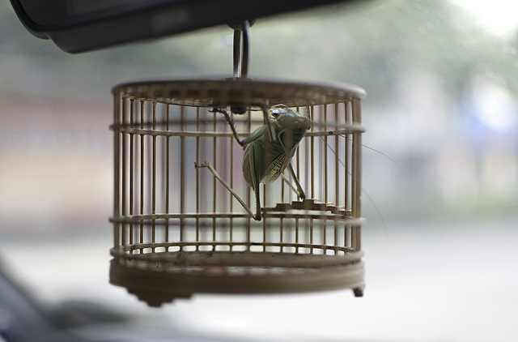
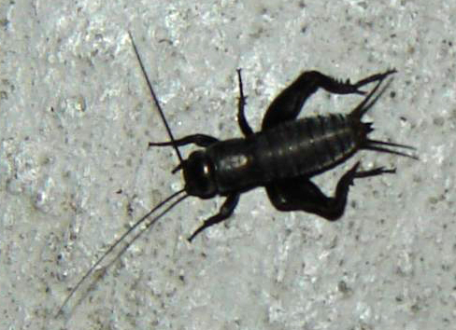

Slide 10


Notes:
10

Slide 11
…theories and tools

Slide 12
Culture: Two Paradigms
Essentialist view
Non-essentialist view

Slide 13
Culture: Two Paradigms
Essentialist view
Non-essentialist view
Adrian Holliday’s Small Cultures
This suggests that ‘culture’ is a movable concept used by different people at different times to suit purposes of identity, politics and science.

Slide 14
Culture: Two Paradigms
The essentialist view (Geert Hofstede)
This suggests that ‘culture’ is a concrete social phenomenon which represents the essential character of a particular nation.

Slide 15
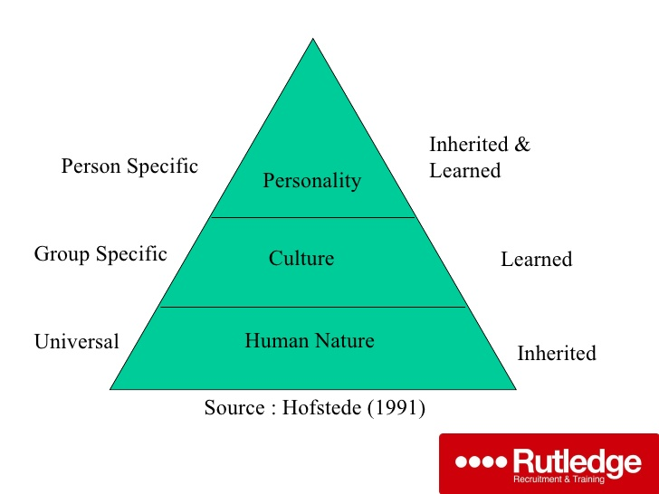

Slide 16
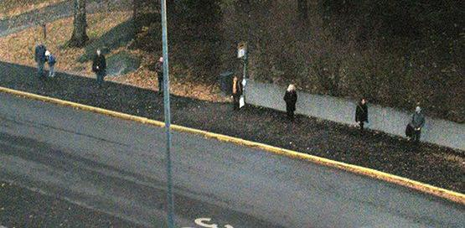
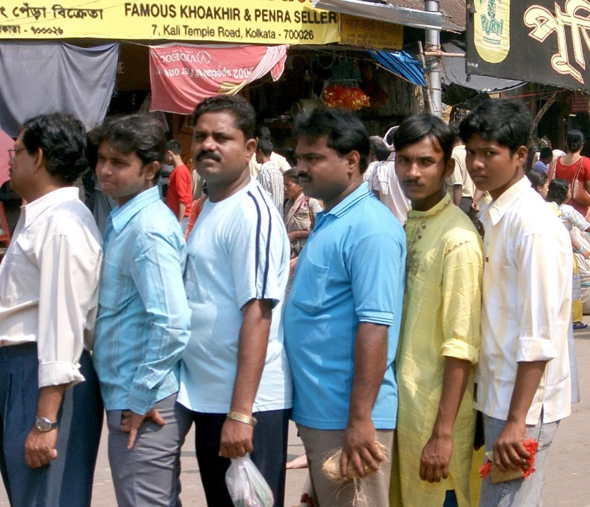

Slide 17

Notes:
17
17

Slide 18

Notes:
18
18

Slide 19

Notes:
19
19

Slide 20
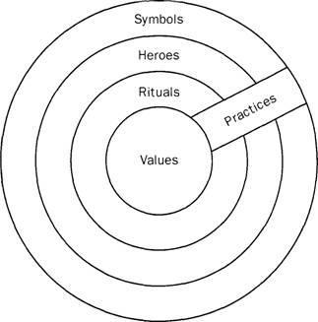

Slide 21
sources and links
Rupert Beinhauer (2013): Diversity Management in Education, seminar, https://impact.cjv.muni.cz/publikace-a-vystupy/materialy/ (Podpora jazykových soft-skills dovedností u akademických pracovníků (klíčová aktivita 5)
Janice de Haaff (2013): Intercultural Teaching, seminar, https://impact.cjv.muni.cz/publikace-a-vystupy/materialy/ (Podpora jazykových soft-skills dovedností u akademických pracovníků (klíčová aktivita 5)
Geert Hofstede (1991). Cultures and Organisations: software of the mind. Maidenhead: McGraw-Hill
Geert Hofstede : https://www.geert-hofstede.com/cultural-dimensions.html
Adrian Holliday (1999): Small cultures, Applied Linguistics 20/2, http://adrianholliday.com/wp-content/uploads/2016/06/holliday-99-smal-cultures.pdf
Pellegrino Riccardi (2014): Cross cultural communication, TEDxBergen, https://www.youtube.com/watch?v=YMyofREc5Jk
Notes:
21

