Slide 1
Lecturing styles

Slide 2
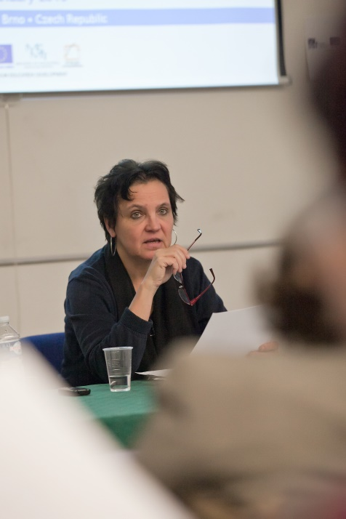
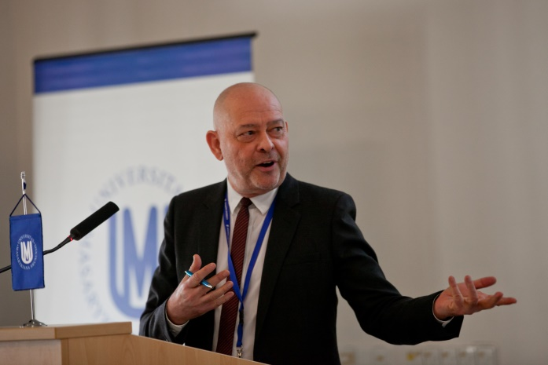
agenda
defining the term
improving the practice
examples to discuss

Slide 3
The lecture
From “legere” in Latin meaning to read …….
What is a lecture today?

Slide 4
The lecture
From “legere” in Latin meaning to read …….
What is a lecture today?
Why do we give them?

Slide 5
cover a certain disciplinary terrain
amplify and contextualize the readings
give your research and your point of view (from informed inquiry and opinion)
give you an opportunity to model certain reasoning processes and discourses
hear a full-participant or relative expert talk about the subject at length
students see and hear a performance

Slide 6
What similarities does a lecture have with a
- text?
- conversation?

Slide 7
…similarities with a text:
high informational load
planned discourse
content high with academic prose (eg nominalisations)

Slide 8
…similarities with a conversation:
you/I/we register.
use of the present tense
some unplanned discourse
some interaction – sharing of time and space

Slide 9
Where would you place your style of a lecture on an oral/literate continuum?
oral _______________________ literate

Slide 10
examples
example 1
example 2
example 3

Slide 11
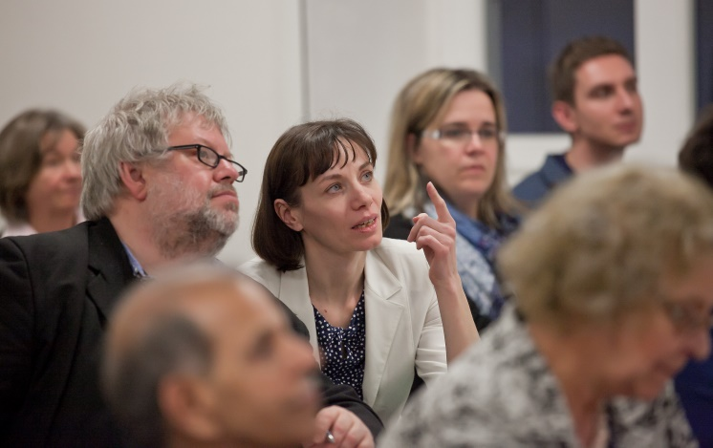
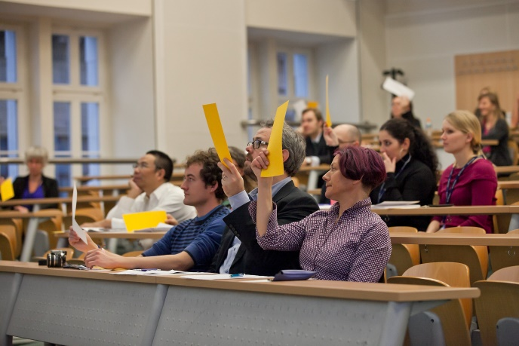
Better Lectures?
delivery
organization
form
content
engaging students

Slide 12
Sources and links:
Joanne Eastlake (2013): Speaking Skills in the Academci Context, seminar, https://impact.cjv.muni.cz/publikace-a-vystupy/materialy/ (Podpora jazykových soft-skills dovedností u akademických pracovníků (klíčová aktivita 5)
Edward de Chazal (2014): Jurassic Academic, http://www.jurassicacademic.com/
Emma Lay (2013): Speaking Skills for Academic Purposes, seminar, https://impact.cjv.muni.cz/publikace-a-vystupy/materialy/ (Podpora jazykových soft-skills dovedností u akademických pracovníků (klíčová aktivita 5)
TED TALKS: https://www.ted.com/
HARVARD YOUTUBE CHANNEL: https://www.youtube.com/user/Harvard
OXFORD YOUTUBE CHANNEL: https://www.youtube.com/user/oxford

