Slide 1
History of Central Europe
Jana Musilová, PhD
87562@mail.muni.cz

Slide 2
Lecture 1
Organization of the course
Definition of the concept of Central Europe and the Introduction to the History of Central Europe in the Middle Ages

Slide 3
Organization
Introduction
Jana Musilová 87562@mail.muni.cz
Attendance – allowed one unexcused lecture
midterm test (6. 4. 2017) and final test (18. 5. 2017) 50 – 46 A; 45 – 41 B; 40 – 36 C; 35 – 31 – D; 30 – 25 - E
Reading

Slide 4
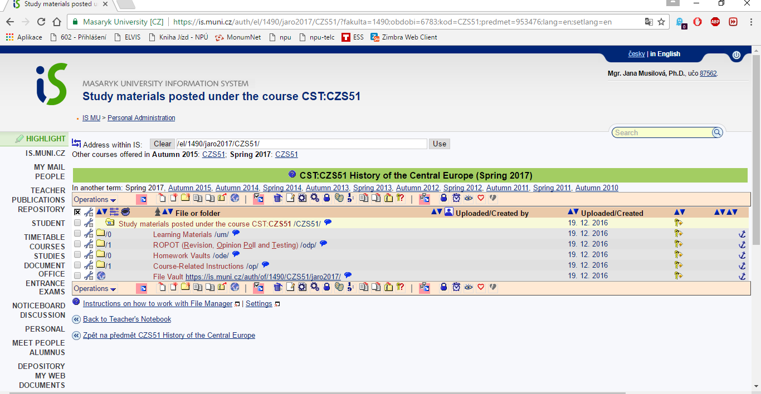
Materials

Slide 5
Central Europe
What is the definition of “CENTRAL EUROPE“?
Or
Where is “CENTRAL EUROPE“?

Slide 6
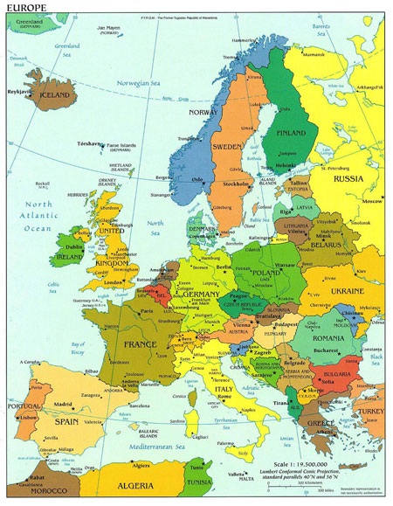

Slide 7
Central Europe
Demarcation of CE:
Geographical
Historical and political development, CE as a cultural unit
Religion
Political and economical development
A Yearbook of Central European Culture characterizes Central Europe "as an abandoned West or a place where East and West collide
Germany's Constant Committee for Geographical Names defines Central Europe both as a distinct cultural area and a political region. George Schöpflin and others argue that Central Europe is defined by being "a part of Western Christianity", while Samuel P. Huntington places the region firmly within Western culture

Slide 8
Geographical demarcation of CE
Germany, Poland, Hungary, Czech Republic, Slovakia, Austria, Switzerland, Liechtenstein (last 3 – Alpine countries)
Earlier publication – CE includes also Belgium, the Netherlands, Luxemburg and Romania (1935)
x
Slovenia, Croatia (new concept)
climate, water – shed, mountains

Slide 9
Historical development of CE
CE – direct influence of „Germany“ (Holy Roman Empire, The Habsburg Monarchy)
Division of CE – capitalistic bloc x Soviet Bloc

Slide 10
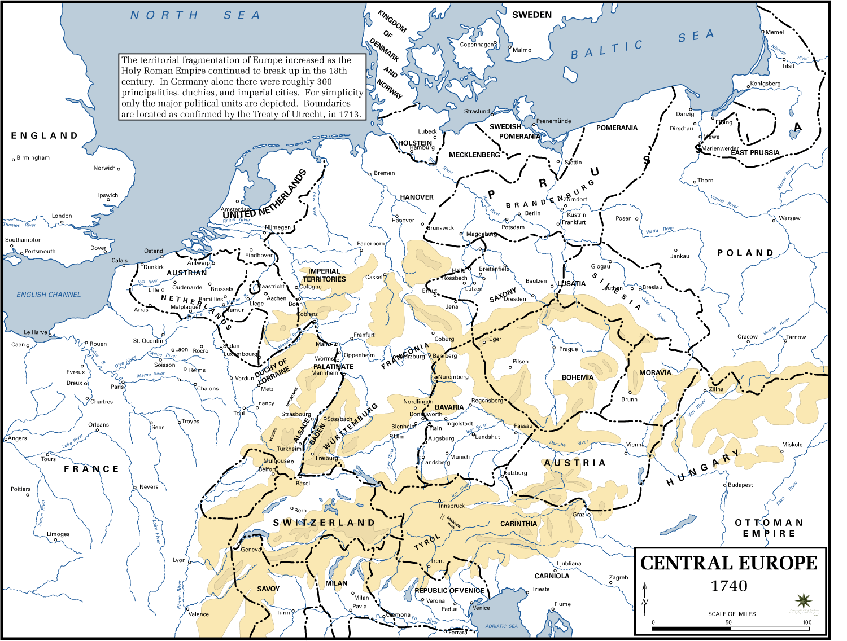

Slide 11
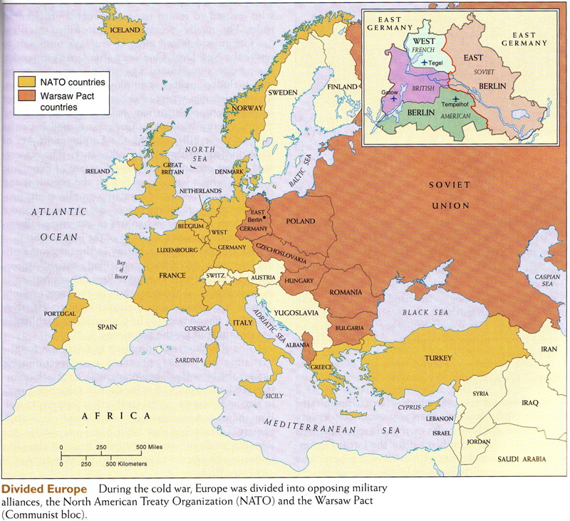

Slide 12
CE as a cultural unit?
CE as a cultural unit?
Cultural concept of CE – till 1795 (disitengration of Poland) – The Habsburg Monarchy, Poland, Lithuania, part of Bavaria (this region had many common interests: politics, literature, architecture, fear of Russian Empire, Osman Empire, Swedes and Prussians)
1867 – emergence of Austria - Hungary and CE as a cultural unit: Czech part, Austria, Slovakia, part of Poland part of Ukraine, Hungary, Transylvania, western Romania, Vojvodina, Croatia, Slovenia, South Tyrol and Bavaria

Slide 13
CE - Mitteleuropa
Mitteleuropa meaning Middle Europe, is one of the German terms for CE The term has acquired diverse cultural, political and historical connotation
The Prussian vision of Mitteleuropa was a pan-Germanist state-centric imperium, an idea that was later adopted in a modified form by National Socialist geopoliticians
Friedrich Naumann’s Mitteleuropa (1915) was a liberal voice in the largely illiberal German discussion on the future of East Central and South East Europe. His reasoning, based on principles of free trade and voluntary cooperation, did not dominate this debate, which, in consequence, centered upon German territorial annexations
Plus other visions of CE eg. Jörg Brechtefeld “…The term Mitteleuropa never has been merely a geographical term; it is also a political one, much as Europe, East and West, are terms that political scientists employ as synonyms for political ideas or concepts. Traditionally, Mitteleuropa has been that part of Europa between East and West. As profane as this may sound, this is probably the most precise definition of Mitteleuropa available…“

Slide 14
CE
1904 in Berlin Central European Economic Association (economic integration of Germany and Austria–Hungary with eventual extension to Switzerland, Belgium and the Netherlands)
T. G. Masaryk – CE space between Germany and Russia

Slide 15
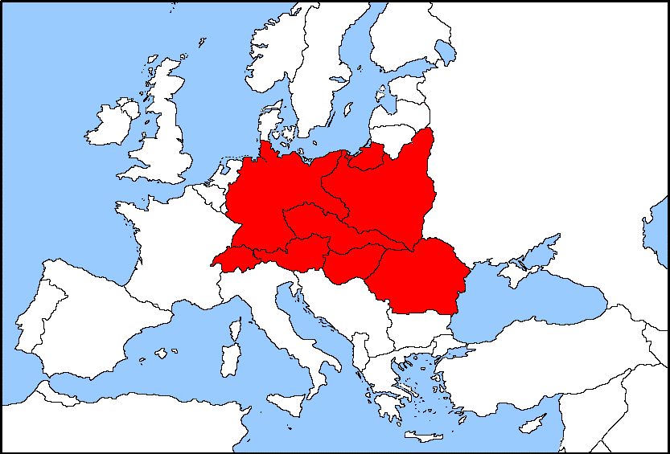
CE: Interwar period
Emmanuel de Martonne (Germany, Switzerland, Austria, Poland, Czechoslovakia, Hungary and Romania)

Slide 16
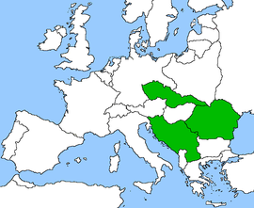
CE: Interwar period
Little Entente

Slide 17
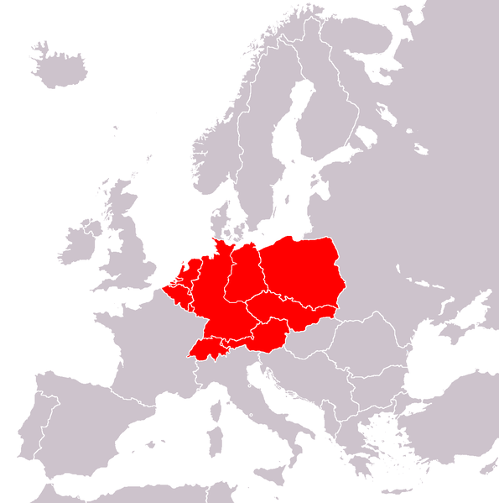
CE after WWII
As a part of the Eastern Bloc – East Germany, Poland, Czechoslovakia and Hungary
E. Schenk (1950)

Slide 18
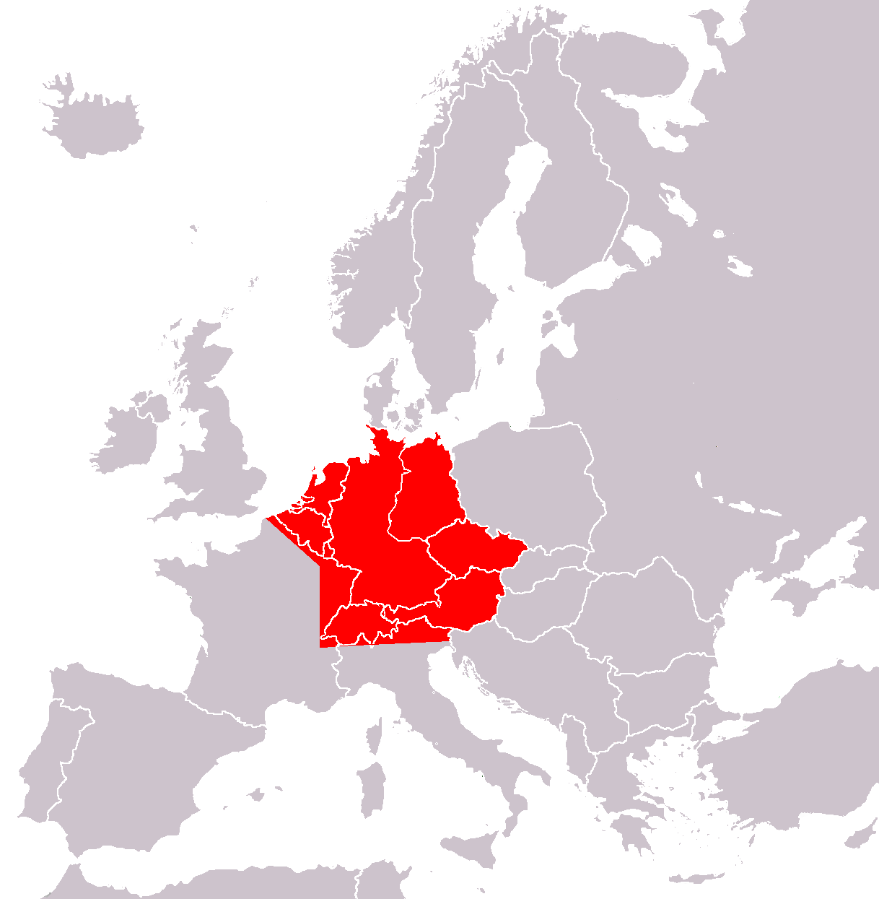
CE: after WWII
A. F. A. Mutton (1961)

Slide 19
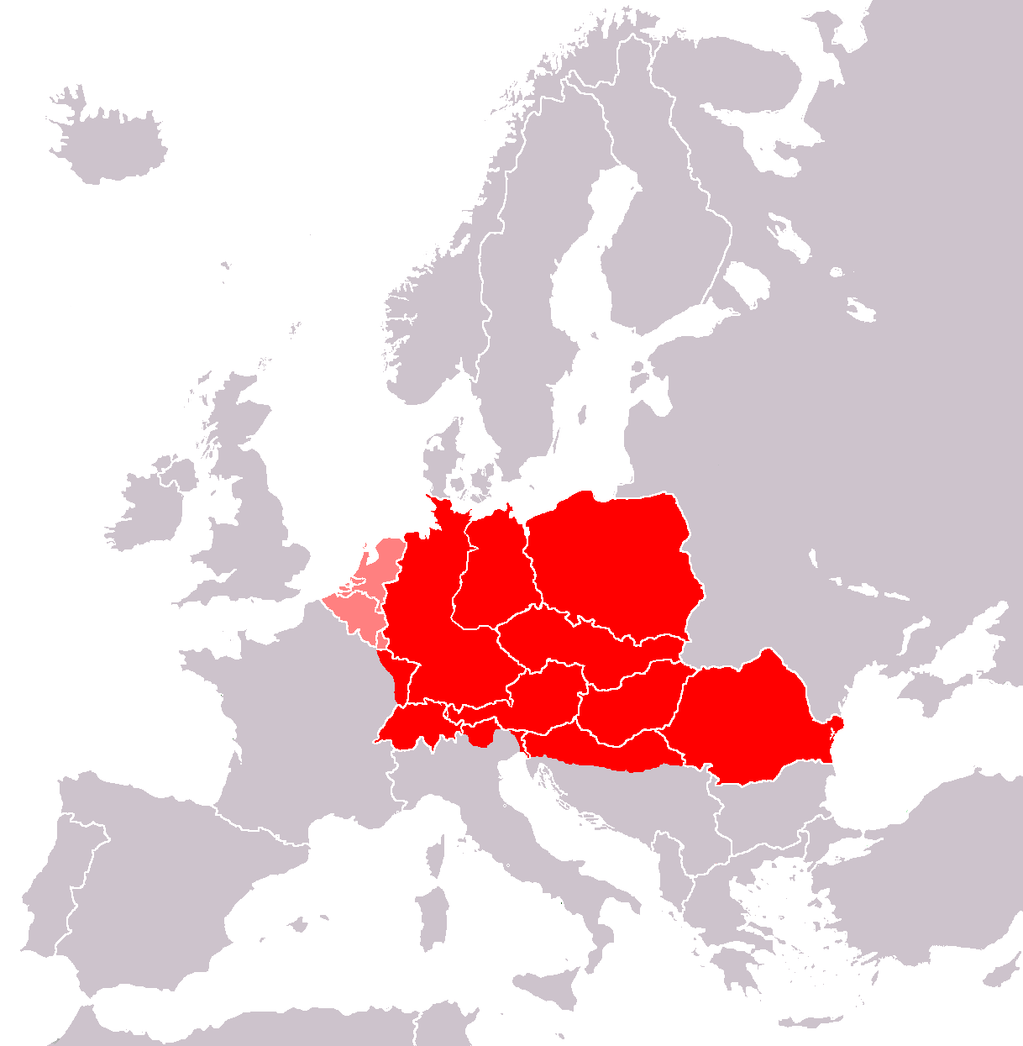
CE: after WWII
Meyers Encyclopedia (1980)

Slide 20
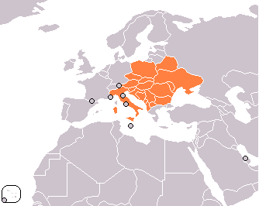
CE 1989
Central European Initiative - forum of regional cooperation Albania, Austria, Belarus, Bosnia and Herzegovina, Bulgaria, Croatia, the Czech Republic, Hungary, Italy, Macedonia, Moldova, Montenegro, Poland, Romania, Serbia, Slovakia, Slovenia and Ukraine; founders were Italy, Austria, Hungary and the former Yugolavia

Slide 21
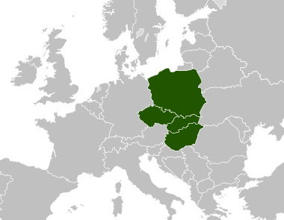
CE after 1989
Visegrád Group: http://www.visegradgroup.eu/about

Slide 22
CE after 1989
CEFTA
Former parties are Bulgaria, Czech Republic, Hungary, Poland, Romania, Slovakia and Slovenia. Their CEFTA membership ended when they joined the EU. Croatia is set to join the EU in 2013
of 1 May 2007, the parties of the CEFTA agreement are: Albania, Bosnia and Herzegovina, Croatia, Macedonia, Moldova, Montenegro, Serbia and UNMIK on behalf of Kosovo

Slide 23
ERDF (CENTRAL EUROPE PROGRAM)
Operational Program “Central Europe“
Program under the European territorial co-funded by European Regional Development Fund (ERDF)
Czech Republic, Germany, Italy, Hungary, Austria, Poland, Slovenia, Slovakia

Slide 24
CE
CE – Visegrad group, in a broad sense - Austria, Slovinia, Lithuania and sometimes Estonia + Latvia, + Germany
Hugh Seton-Watson, Ivan Bérend a György Ránki – CE: Czechoslovakia, Poland, Hungary and Balkans – Eastern Europe
Oskar Halecki – 2 macro regions (west and east), region of 2 CEs – important transition zone between West and East x Friedrich Naumann´s Mitteleuropa – alliance between German Empire and Austria – Hungary

Slide 25
CE: Lonnie R. Johnson
“…religious frontiers between the Roman Catholic West and the Orthodox East…“

Slide 26
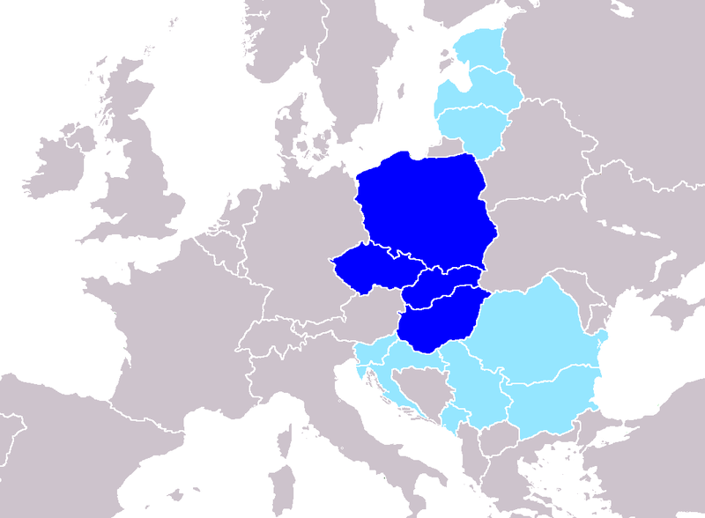
CE: Peter J. Katzenstein
“…V4 and cuncontestable way to decide whether they are parts of Central Europe or not…“

Slide 27
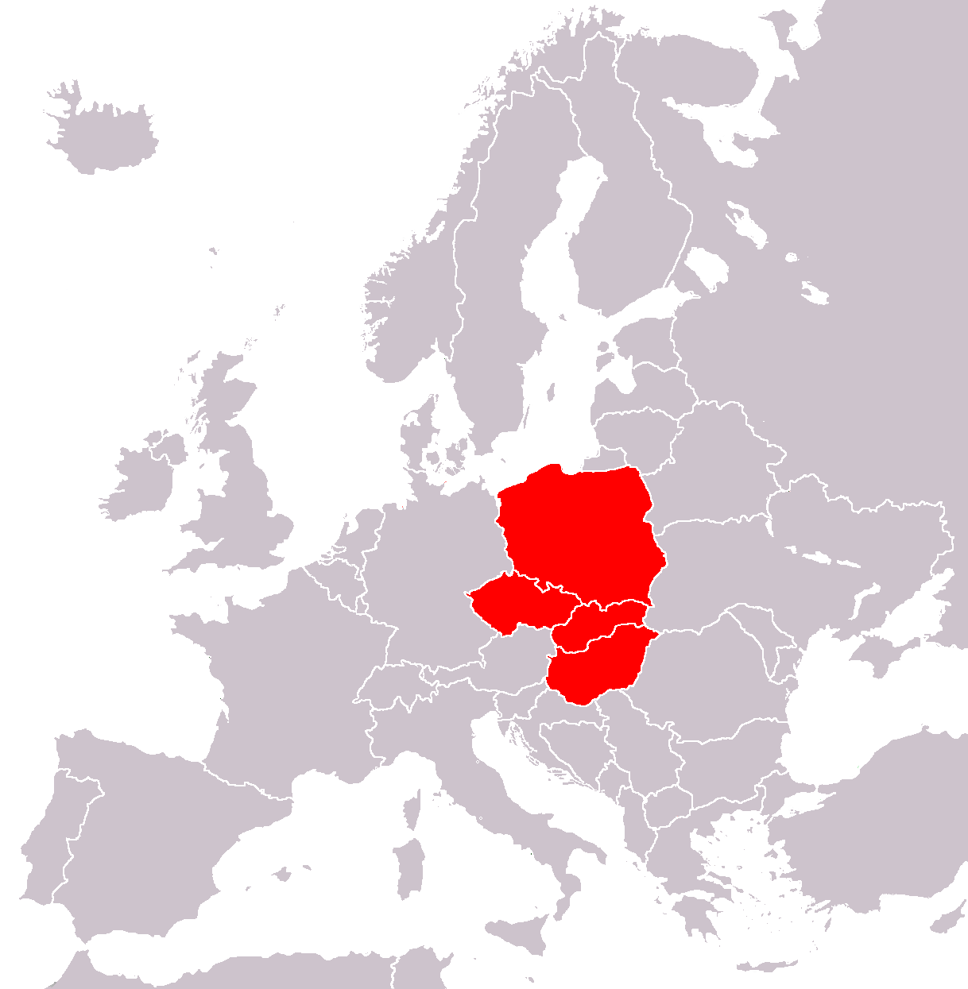
CE: Ronald Tiersky
“…V4…“

Slide 28
References
Johnson, Lonnie (1996): Where is Central Europe. In.: Central Europe: Enemies, Neighbors, Friends. Oxford University Press, pp. 3 – 12.
Tiersky, Ronald (2004). Europe today. Rowman & Littlefield.

Slide 29
Central Europe and the Czech Lands in the Middle Ages
Jana Musilová, PhD

Slide 30
Middle Ages
Elements of unity for Western and Central Europe were Roman Catholicism and Latin
Eastern Europe, which remained Eastern Orthodox Christian, was the area of Byzantine cultural influence; after the schism (1054), it developed cultural unity and resistance to the Western world (Catholic and Protestant) within the framework of Slavonic language and the Cyrillic alphabet

Slide 31
Great Moravia
Was the first major state that was predominantly Slavonic
Emerge in the area of Central Europe
The core of Great Moravia was established, according to legend, in the early 830´s, when Prince Mojmír I crossed the Morava and conquered the principality of Nitra (present-day western Slovakia)
Moravia reached its largest territorial extent under Svatopluk I, who ruled from 870 to 894, and who was occasionally styled as king in contemporaneous sources

Slide 32
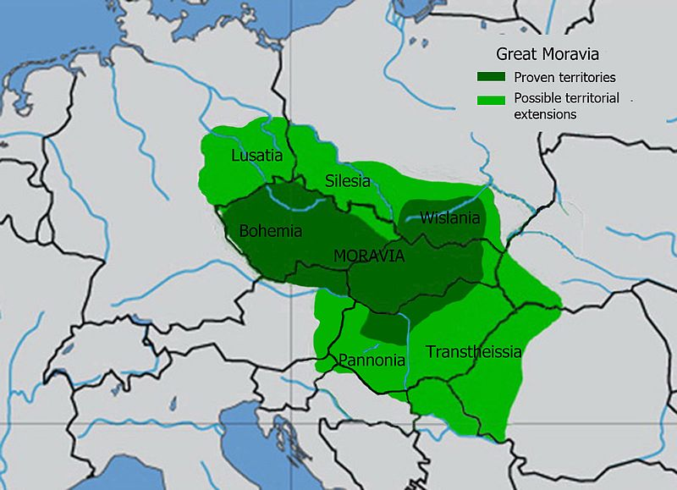
Map of Great Moravia

Slide 33
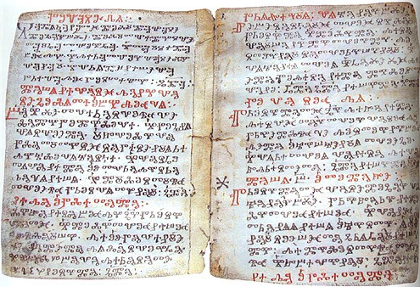
Great Moravia – cultural development
Significant cultural development under Rastislav
863 of the mission of Cyril and Methodius (Rastislav had asked the Byzantine emperor to send a "teacher" to introduce literacy and a legal system to Great Moravia)
Brothers Cyril and Methodius introduced a system of writing (the Glagolitic alphabet) and Slavonic liturgy, the latter formally approved by Pope Adrian

Slide 34
Collaps of Great Moravia
Separatism and internal conflicts emerging after Svatopluk's death contributed to the fall of Great Moravia, which was overrun by the Hungarians. The exact date of Moravia's collapse is unknown, but it occurred between 902 and 907
https://www.youtube.com/watch?v=hIhAm0mq-Ss

Slide 35
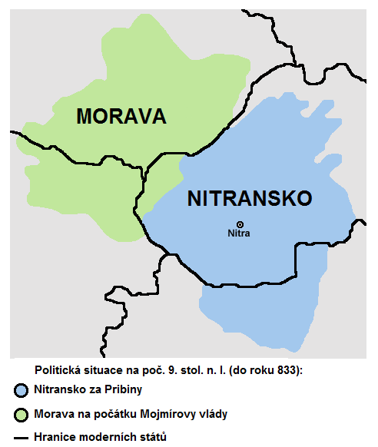
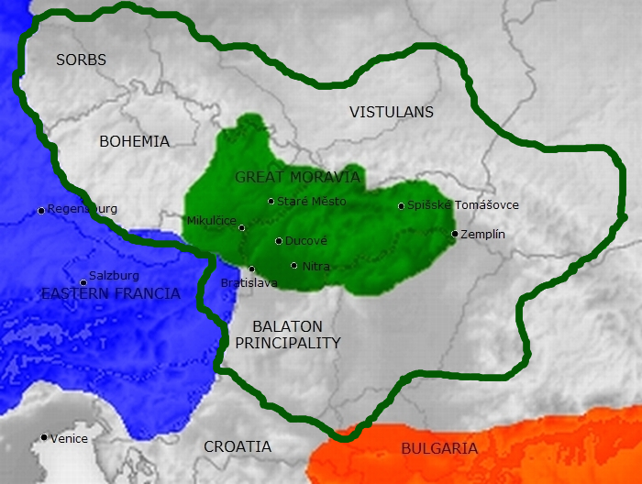
Great Moravia: territorial changes
Mojmír I
Rastislav

Slide 36
Central Europe in 10th and 11th century
The Great Moravia collapesed (Hungarian tribes)
The territory inhabited by Slovaks became a part of newly created Kingdom of Hungary – the House of Arpád
1000 – Stephen I of Hungary (?*969–1038) was crowned a king, christianization – saint patron of Hungary
Ladislaus I of Hungary (*1046–1095) – expansion – 1091 – King of Croatia
Poland – the Piast dynasty – Duke Mieszko (?*935–992) – 966 – conversion to christianity → 1000 – Poland recognized by Pope and by the Holy Roman Empire as a state
1025 – Duke Boleslaus I the Brave was crowned a King – strong ruler – expansion – 1002–1003 – Duke of Bohemia (his mother was from House of Přemyslid)
After his death – the decline of Polish empire – renewed and unified by the King Ladislaus I the Elbow-High (*1261–1333)

Slide 37
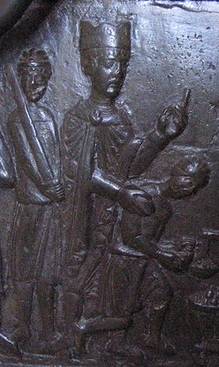
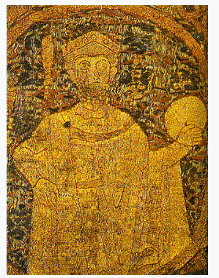
Rulers
Stephen I of Hungary
Boleslaus I the Brave

Slide 38
Bohemia from 9th century till 1306
Centre moved to Bohemia – The Duchy of Bohemia, dependent on Holy Roman Empire
Prague - capital city
The Přemyslid dynasty - ruling
883 – Duke Bořivoj and his wife Ludmila were baptised by Methodius
10th century – duke Wenceslaus – vasal of the German Empire
Wenceslaus was assassinated by his brother → Saint Wenceslaus – the saint patron of the Czech lands
973 – the Prague Bishopric was established (2nd bishop Adalbert – St. Vojtěch - apostolic mission to Poland)
Přemyslids eliminated other strong noble families who were competing with them (massarcing of two noble clans in 10/11th century )
Duchy of Bohemia was a part of Holy Roman Empire

Slide 39
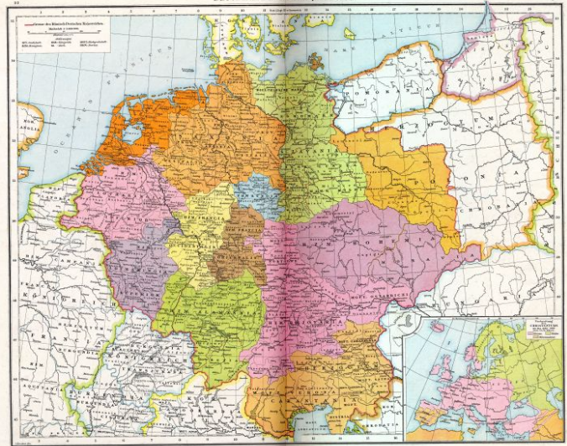
CE around the year 1000

Slide 40
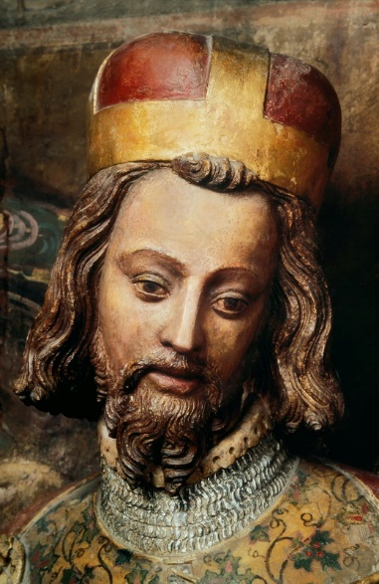
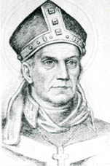
St. Wenceslaus
St. Vojtěch (Adalbert) – 2nd Bishop of Prague

Slide 41
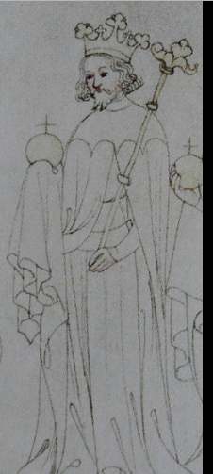
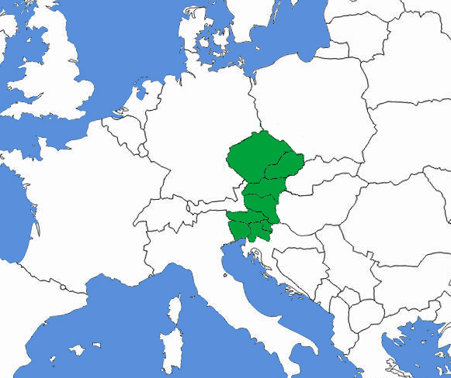
The Kingdom of Bohemia
Bohemian kings were members of College of Electors of the German Empire
Ottokar I (*?1155/1167–1230)
1212 – Golden Bull of Sicily – a decree issued by the Holy Roman Emperor Frederik II in basel that confirmed the royal hereditary title for Ottokar
Wenceslaus I (*1205–1253)
Ottokar II (*?1233–1278, Přemysl Otakar II) – The Iron and Golden King , the rise of the power of Bohemia – his kingdom from the Krkonoše mountains to the Adriatic sea
1255 - a crusade to Prussia – founded the city of Königsberg (Kaliningrad today)
1278 – died in a war with his rival, the Roman king Rudolph Habsburg
Ottokar II and his kingdom

Slide 42
The Kingdom of Bohemia
Wenceslaus II of Bohemia (*1271–1305) – King of Bohemia, King of Poland
Wenceslaus III (*1289–1306) – King of Bohemia, Poland and Hungary, assassinated without heirs – the Přemyslid dynasty died out in the male tail
After four years of struggles for the throne – the new dynasty of Luxembourg scame to Bohemia and the Polish throne returned to the dynasty of Piasts

Slide 43
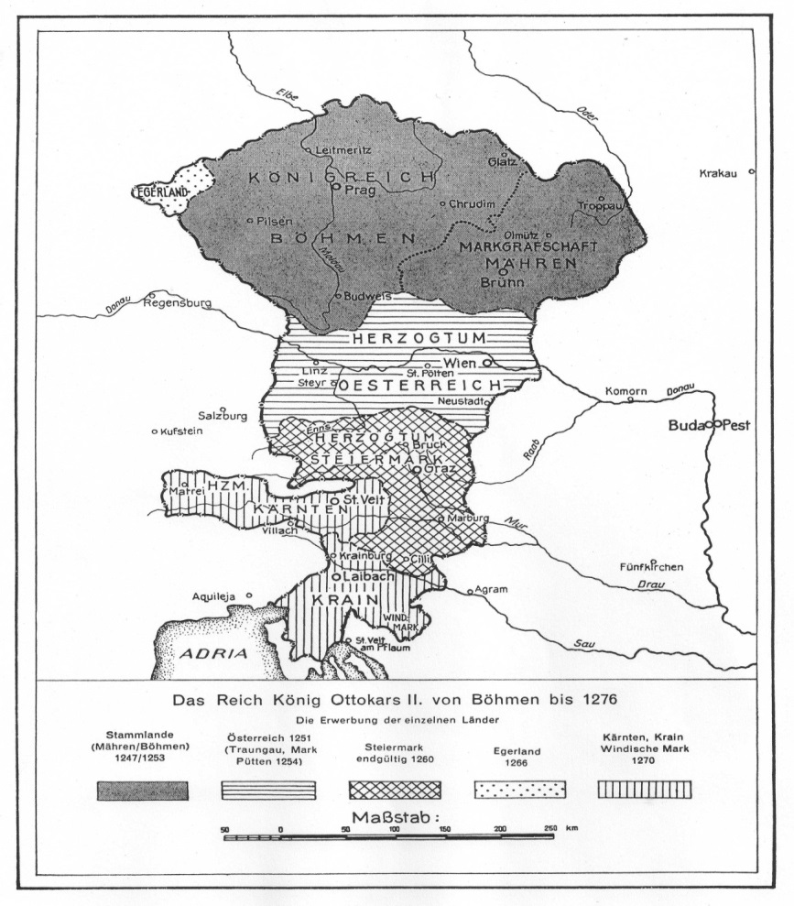
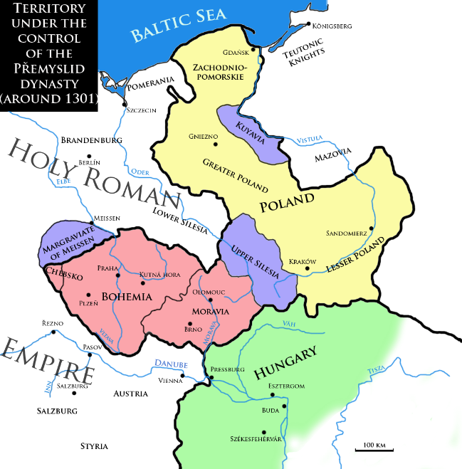
Maps of Bohemian Kingdom
The Kingdom of Ottokar II
around 1270
The Hingdom of Wenceslaus II around 1301

Slide 44
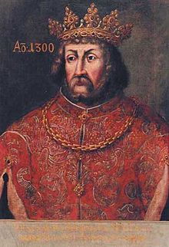
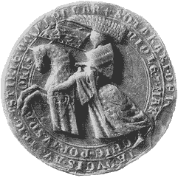
The House of Přemyslids
Seal of King Ottokar II of Bohemia
King Wenceslaus II

Slide 45
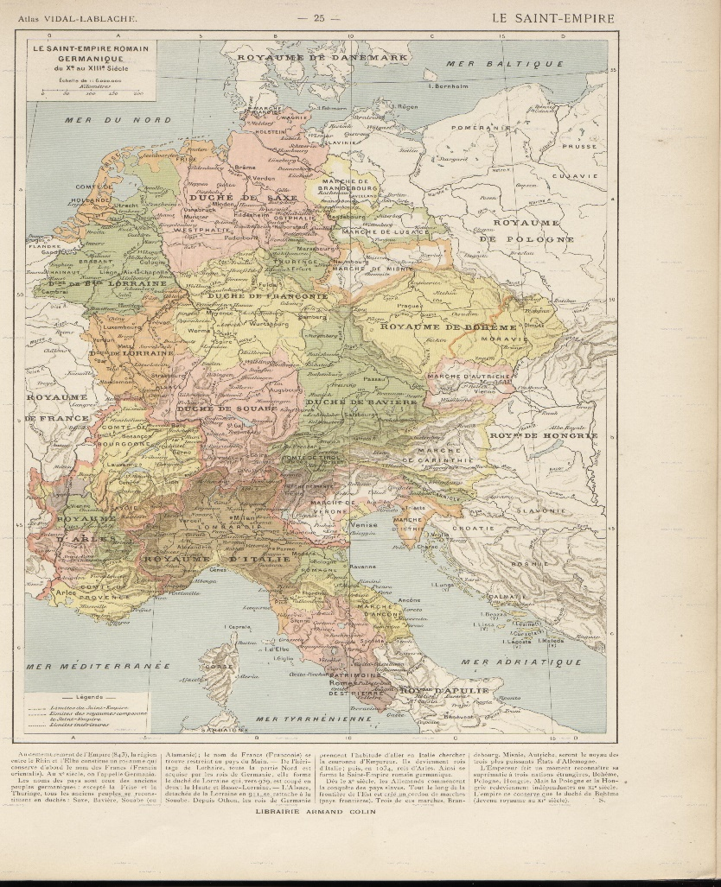
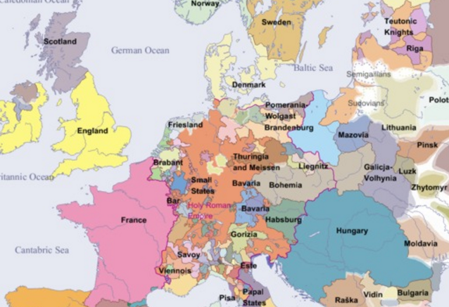
Holy Roman Empire
10th – 13th century
Around the year 1300

Slide 46
Arts

Slide 47
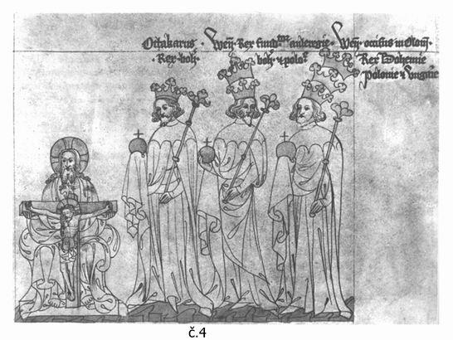
The Bohemian Kings – Otokar II, Wenceslaus II, Wenceslaus III
Chronicle of Zbraslav

Slide 48
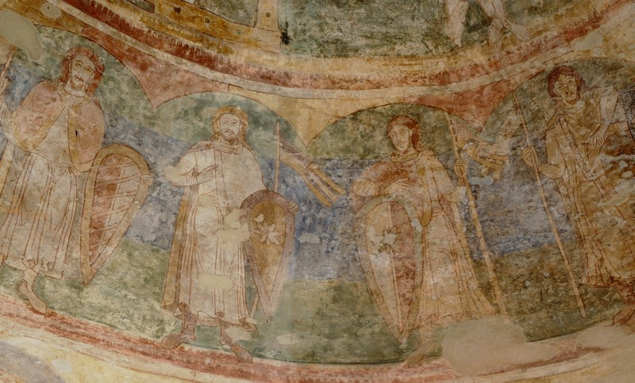
St. Catherine Rotunda in znojmo
The oldest fresco OF THE MEMBERS OF PŘEMYSLID DYNASTY: Rotunda of St. Catherine in Znojmo

Slide 49
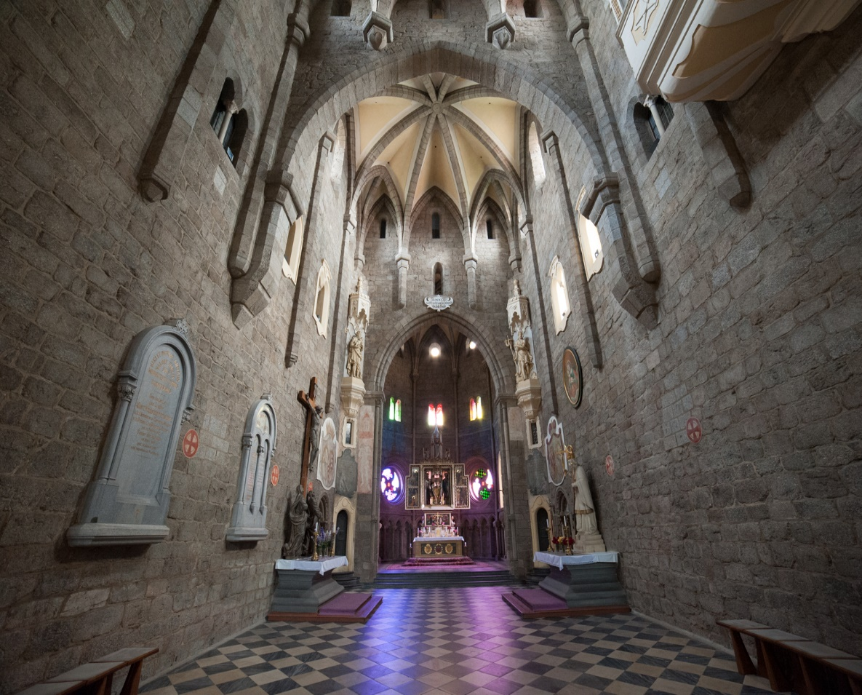
Early Gothic Art
St. Prokopius’ Basilica (abbey church) in Třebíč, bulit around 1101 – 1104, between romanesque and gothic

Slide 50
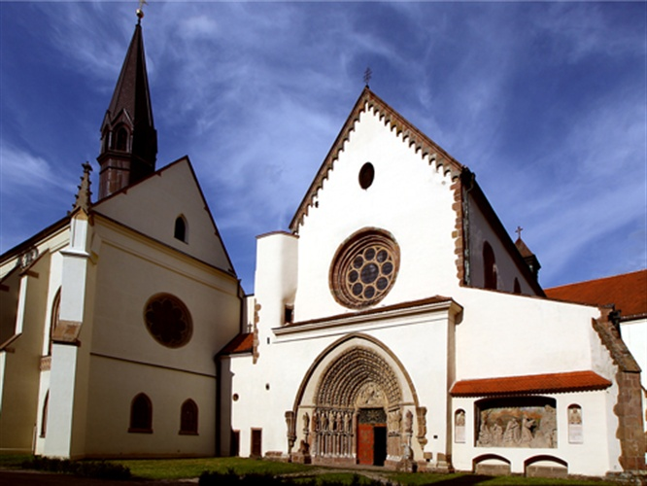
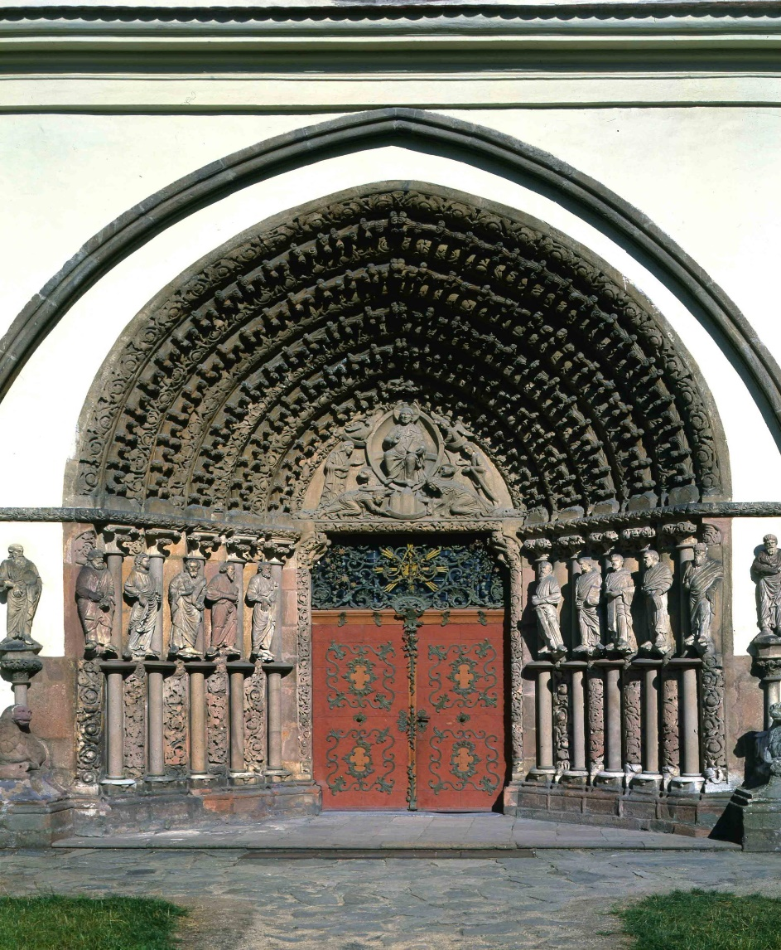
Early Gothic Art (1230 – 14th C)
Předklášteří u Tišnova
Předklášteří u Tišnova

Slide 51
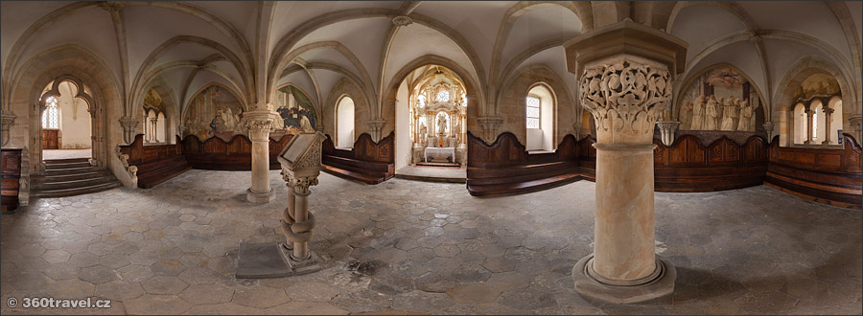
Early gothic art
Osek - Burgundian Gothic monastery, close to Teplice

Slide 52
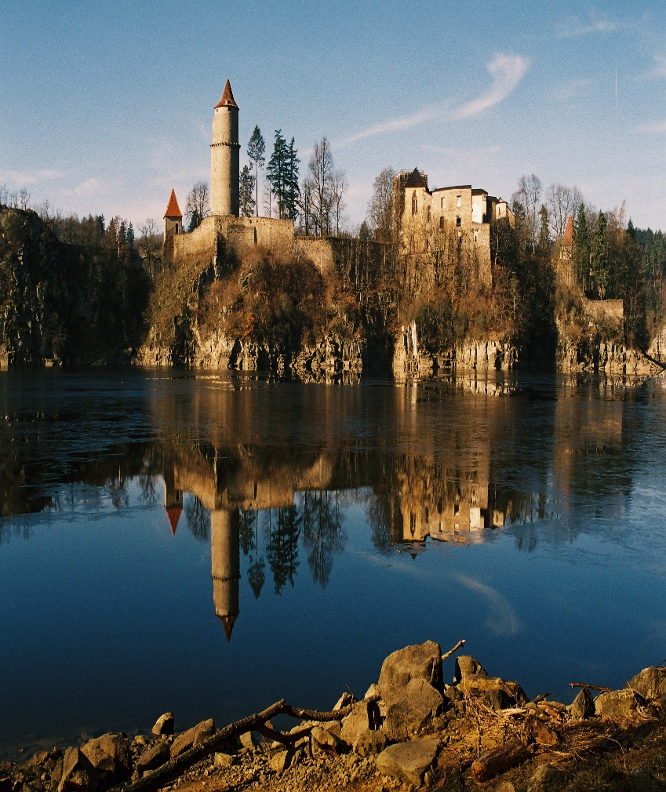
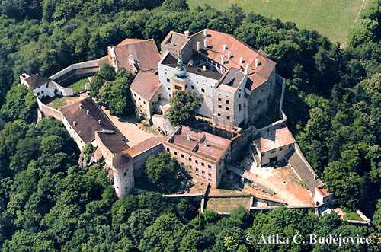
Early gothic art
Castles Zvíkov and Buchlov

Slide 53
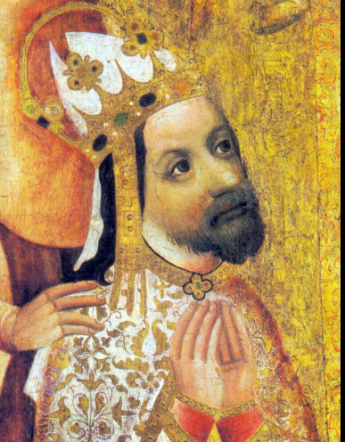
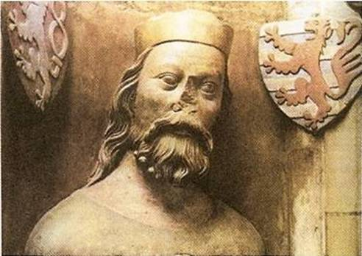
The House of Luxembourgs
John of Luxembourg
Charles IV

Slide 54
The House of Luxembourgs (1310–1437)
John of Bohemia/John of Luxembourg (*1310 – †1346, John the Blind)
Married Eliška Přemyslovna → a new dynasty – the House of Luxembourgs
Succesfull European diplomat and warrior, but in Bohemia was unpopular – needed lots of money for his campains, was very often abroad so the country was without a ruler → the power of nobility strenghten
† in the Battle of Crécy
Charles IV (*1316 – †1378)
Son of John of Bohemia
King of Bohemia (1346–1378) and Holy Roman Empire King (1346–1355), Holy Roman Emperor (1355–1378)
4 wives and many children but was waiting for male descendant for very long so his oldest son Wencelaus (*1361–†1419) - bad ruler

Slide 55
Charles IV
The most important and the best known Bohemian king –Pater Patriae (Father of the Country), his reign = Golden age of Bohemia
Prague became the capital of the Holy Roman Empire, most important city in the Central Europe
Charles IV rebuilt the city on the model of Paris, in Gothic style
Founder of the New Town of Prague, Charles Bridge, Charles Square, St. Vitus Cathedral, rebuilt the Prague Castle …
1346 – the elevation of the Prague bishopric to an archbishopric
1348 – he founded the University of Prague, later named after him, the very first university in Central Europe; Prague became intellectual centre of the CE
The Karlštejn Castle – a place for safekeeping the Imperial Regalia and Bohemian Crown Jewels
Named after him (abroad): Montecarlo (Charles' Mountain) fort and village in Italy

Slide 56
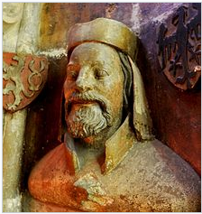
Bust of Charles IV in St. Vitus Cathedral, 1370s, Prague
He promulgated the Golden Bull of 1356 whereby the succession to the imperial title was laid down, which held for the next four centuries
Patronage of culture and the arts
Vita Caroli – his own CV

Slide 57
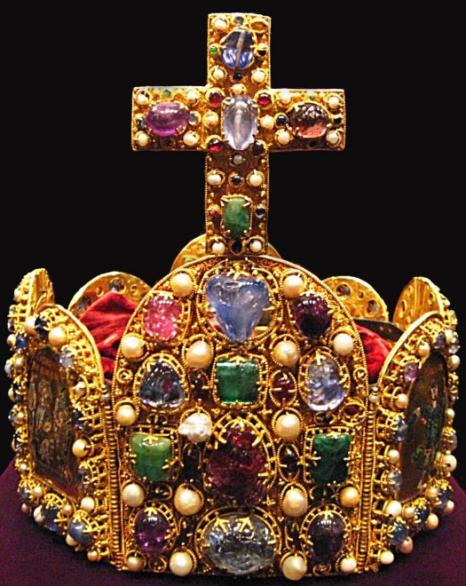
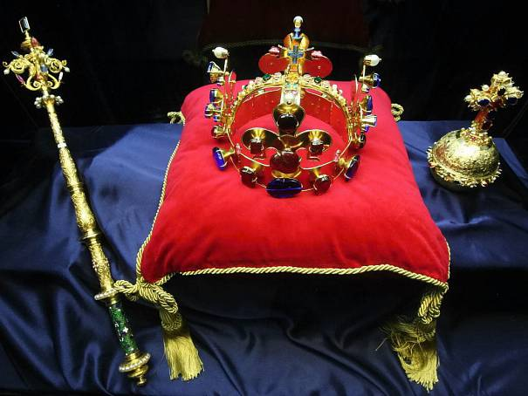
Regalia
Part of Bohemian Crown Jewels
Part of Imperial Regalia

Slide 58
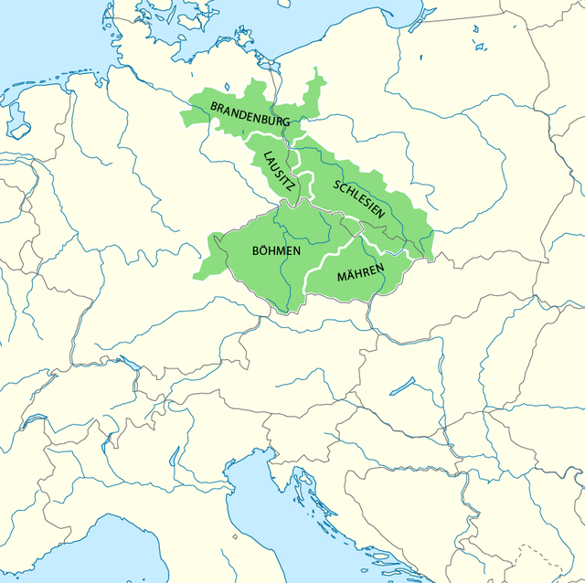
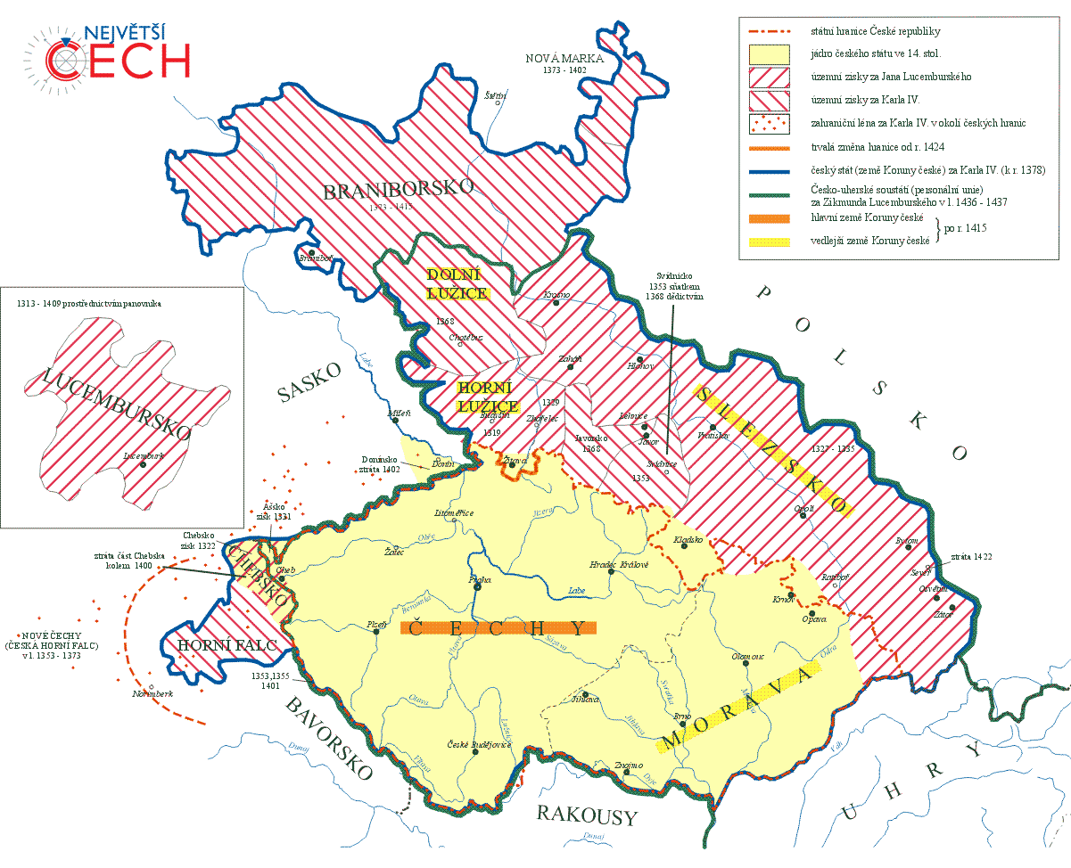
Map of the Kingdom of Bohemia during the reign of Charles IV

Slide 59
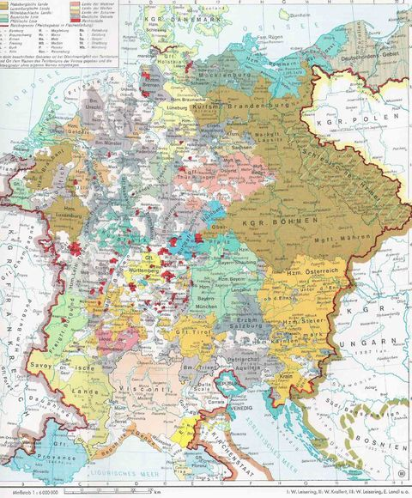
Holy Roman Empire under the reign of Charles IV

Slide 60
High Gothic Art
St. Vitus Cathedral
Castles Karlštejn, Kost, Kašperk
Prague´s Old Town and New Town Hall

Slide 61
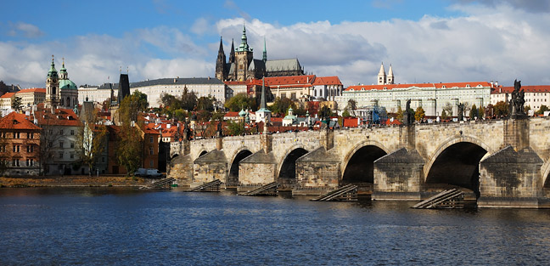
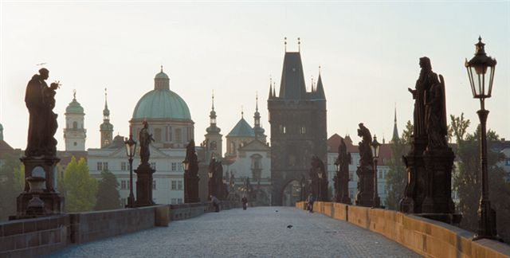
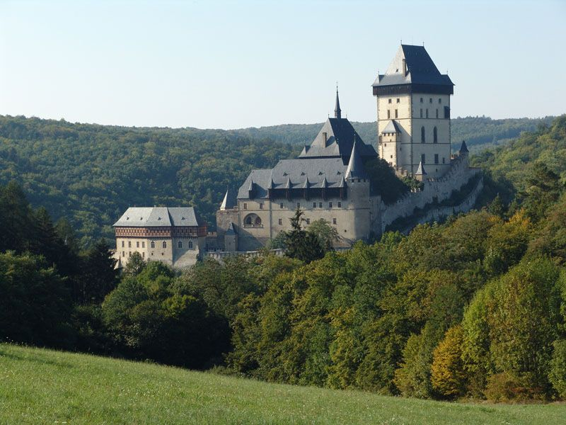

Slide 62
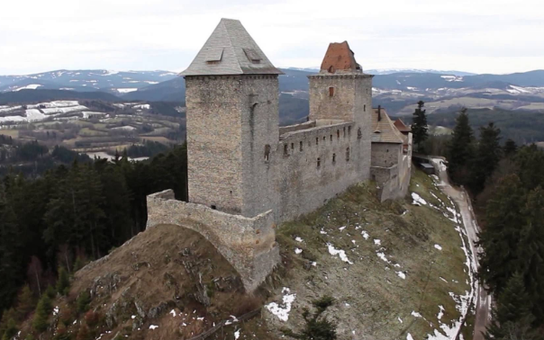

Kašperk
Kost

Slide 63



Prague´sNew Town Hall
Prague´s Old Town Hall
Golden Mosaic at St. Vitus Cathedral (Prague Castle)

Slide 64
The Holy Roman Empire during 14th - 15th century
1273 – Rudolf the Habsburg elected the king of the Roman Empire – unimportant dynasty from Austria, elected because the dukes didn’t want powerful Bohemian king Otakar II on the Roman throne
14th century – the house of Luxembourgs – Henry VII (*1275/76–1313), after his unexpected death the struggle for the throne began – Louis IV of Wittlesbach (*1282/7–1346) from Bavaria won
Charles IV (*1316–1378) of Luxembourg
1346 – Holy Roman King, 1355 – crowned the Holy Roman Emperor
1356 - The Golden Bull – the basic law of the Holy Roman Empire
Wenceslaus IV (*1361–1419) – a son of Charles IV, King of HRE (1378–1411) – weak ruler
Sigismund of Luxembourg (*1368–1437) – Wenceslaus’ brother, son of Charles IV, 1378 – King of Hungary and Croatia (married Mary of Hungary), 1411 – King of HRE, 1419 – King of Bohemia, 1431 - King of Italy, 1433 – HRE

Slide 65

The Holy Roman Empire around 1400

Slide 66
The church in 14th and 15th century
The crisis of Papacy
14th century - Great Papal Schism – two Popes – one in Rome (Italy) and one in Avignon (France)
1409 – the council of Pisa elected a new pope → three popes
1410 – indulgences were authorized by one of the Popes (John XXIII) who wanted to get money for the crusade against his rival Pope Gregory XII and his protector king Ladislaus of Naples
1414 – the Council of Constance was called – the main purpose was to finish the papal schism
1417 – a new pope – Martin V was recognized by the entire Europe - the schism was ended

Slide 67

The schism caused aslo diplomatic crisis in Europe – each secular ruler had to choose which Pope he would had supported

Slide 68
The Hussite Revolution (1419 - 1436)
Master Jan Hus – became one of the forerunners of the Protestant Reformation , was inspired and influenced by British thinker John Wyclif (†1384)
Scholar, clergyman, preacher at the Betlehem Chapel in Prague and Professor of Prague University, 1402 – Rector of Prague University
Wanted to reform certain practices of the Roman Catholic Church
He was protesting against clerical abuses, especially the sale of indulgences (paying for forgivness of the sins during the confession)
Declared that the clergy should live according to the Bible, in poverty, without property and without a secular power
Proclaimed that the believers should understand the Holy Writ so it should be proclaimed in the national languages, not in latine
1410 – Hus was excomunicated from the church by Pope Alexander V
https://www.youtube.com/watch?v=N9gjzpM01Gc

Slide 69

Master Jan Hus
Jan Hus was invited to the Council of Constance to defend himself and explain his theories
The King of Holy Roman Empire Sigismund guaranteed to Jan Hus a safe passage through the HRE but he didn’t have any jurisdiction at the Council of Constance → Hus was imprisoned in Constance for 8 months
Master Jan Hus was condemned by the Council at Constance as a heretic and was sentenced to death.
6th July1415 – he was burnt to death at the stake.
Jan Hus at the stake.
https://www.youtube.com/watch?v=0Vr04TNrbt4

Slide 70
The Hussites
The Bohemian people blamed Emperor Sigismund for Hus’ death so they did not want him to become the king of Bohemia after Wenceslaus’ death in 1419
Hus’ followers launched powerful religious movement, they called themselves the Hussites; ( or the Men of the Chalice - the symbol of Hussites movement)
Principles:
Freedom to preach the Word of God
Celebration of the Lord's Supper in both kinds (bread and wine to priests and laity alike
No secular power for the clergy.
Punishment for the mortal sins.
1420 - after his corronation in 1420 the Hussite uprising in Bohemia → the so called Hussite wars started
Catholics against Hussites
Sigismund organized five crusade campains against Hussites but all the campains were unsuccesfull (due to the outstanding military leader of Hussites – Jan Žižka who became a hero in the Czech tradition)
https://www.youtube.com/watch?v=AOcUVplxVOo

Slide 71
Almost 15 years of religious struggles and civil wars – the country was destroyed and plundered: the ecomonical consequences: starvation, stagnation of the bussiness, destroyed buildings
Hussite movement split into two fractions: the moderate and the radical: Moderate Hussites wanted to finish the warfare so they united with Catholics and destroyed the radical Hussites at the battle of Lipany in May 1434
The Catholic and the Hussite became legal in Bohemia and two churches were established
1436 – Sigismund was accepted as the King of Bohemia, but he died just one year later
Sigismund had to fight not only against the Hussites but also against the Ottoman Empire who spread into Europe from Asia Minor at the end of the 14th century – firstly they attacked the Balkan Peninsula and later – in 15th century – they threatened Hungary

Slide 72
The Hussites
After two weak kings from the house of Habsburgs a Bohemian nobleman and the leader of the Hussites George of Kunštát and Poděbrady (1458–1471) was elected - Bohemian king
He suggested something what could be considered as a proposal of todays European Union
He tried to prevent isolation of hussite Bohemia in catholic Europe, so he proposed a treaty among all Christian powers, the member states should pledge to settle all differences by exclusively peaceful means and fight altogether against Ottoman Empire who was threatening Central Europe
1464 the new Pope Paul II asked George to leave hussite church and join the Catholic Church, but George refused → the Pope proclaimed George a heretic and excomunicated him
He had also enemies among Bohemian catholic noblemen – they allied with Matthias Corvinus of Hungary (*1443–1490)
Matthias conquered a large part of Moravia, and in 1469 was crowned King of Bohemia by the papal party in the Moravian ecclesiastical metropolis Olomouc
1470 – an agreement – Mathias was rulling over Moravia and George over Bohemia

Slide 73

Kingdom of Bohemia during the Hussite Wars

Slide 74
The House of Jaggiellonians
After George’s death a new dynasty from Poland (originally from Lithuania) came to the Kingdom of Bohemia – Jaggiellonians
Vladislaus II (*1456–1516)
A conflict between Bohemian and Hungarian King succeded – 1471 – the Peace of Olomouc, which allowed both Vladislaus and Matthias Corvinus to use the title "King of Bohemia„ (Vladislaus would reign in Bohemia and Matthias gained Moravia, Silesia, and the two Lusatias)
1491 – Mathias died → a personal union between Bohemia, Poland and Hungary – Vladislaus moved his capital to Buda (Hungary)
Vladislaus was weak ruler and didn’ like conflicts
1500 – Czech Council adopted a new municipal constitution that limited royal power and Vladislaus signed it in 1502 (hence it is known as Vladislav municipal constitution)
1515 – his daughter Anna married Ferdinand of Austria from the House of Habsburgs

Slide 75
The House of Jaggiellonians
During their reign Hungary was under consistent border pressure from the Ottoman Empire
Louis (Ludwig) II (*1506–1526)
Only 10 years old when his Father died
1526 – died at the battle of Mohács - his troops were defeated by the Ottoman Empire – Sultan Suleyman the Magnificent
The Ottoman victory led to the partition of Hungary for several centuries among the Ottoman Empire, the Habsburg Monarchy, and the Principality of Transylvania
Because Louis II died without having any children, his succesor became his sister’s husband Ferdinad of Austria

Slide 76


Map of Hungary before and after 1526
Before 1526
After 1526

Slide 77


The House of Jaggiellonians
Vladislaus II
Louis (Ludwig) II

Slide 78

Late gothic art (Jagiellonian Gothic)
Vladislav Hall, Prague Castle

Slide 79

Late gothic art (Jagiellonian Gothic)
Church of Our Lady before Týn, Prague

Slide 80
Kingdom of Bohemia during the Middle Ages. a map.
https://www.youtube.com/watch?v=-SK7YmwuVak

Slide 81
Readings
Sedlar, Jean (1994): W. East Central Europe in the Middle Ages, 1000-1500. Seattle: University of Washington Press.
Kalhous, David (2012). Anatomy of a duchy: the political and ecclesiastical structures of early Přemyslid Bohemia. Leiden: Brill.
Doležalová, Eva – Pánek, Jaroslav (2011): Confession and nation in the era of reformations: Central Europe in comparative Perspective). Prague: Academy of Sciences of the Czech Republic.
Kejř, Jiří (1964). The universal peace organization of king George of Bohemia a fifteenth century plan for world peace 1462/1464 ; Václav Vaněček ; edition of the document Jiří Kejř ; english translation Ivo Dvořák. Prague: Czechoslovak Academy of Sciences.
Odložilík, Otakar (1965). The Hussite king: Bohemia in European affairs 1440-1471. New Brunswick: Rutgers University Press.
http://husitstvi.cz/en/

