Slide 1
Czechoslovakia during the Interwar Period WWII in Central Europe Liberation of the Central Europe

Slide 2
Czechoslovakia
The First Czechoslovak Republic was proclaimed on October 28, 1918 in Prague
Consisted of: Bohemia, Moravia, Silesia, Slovakia and Carpathian Ruthenia
1920 – the constitution - plural parliament democracy
1920 – Tomas Garrigue Masaryk (1850–1937) was elected the first President (reelected in 1925 and 1929, served till 1935), he was a philosopher and politician, very influential personality, lived in exile during the WW I – Geneve, Paris, London, USA, his wife was American – Charlotte Garrigue, their son Jan Masaryk served later as Czechoslovak Foreign Minister
Most important and most influential political party - Republican Party of Agricultural and Smallholder People - Peasant party, they ussually had a Prime Minister – Antonín Švehla in 1920s, Jan Malypetr and Milan Hodža in 1930s

Slide 3
Czechoslovakia
The First Czechoslovak Republic consisted of: Bohemia, Moravia, Silesia, Slovakia and Carpathian Ruthenia (Sub-Carpathian Rus)

Slide 4
Czechoslovakia
Foreign policy – led by Minister Edvard Beneš from 1918 to 1935 – one of the most important European diplomats during the interwar period, in 1936 he was elected second President of Czechoslovakia
1921 – The Little Entente was formed – an alliance of Czechoslovakia, Kingdom of Serbs, Croats and Slovenes and Romania – against Hungary and its revanchism and against restoration of Habsburgs, Little Entente was supported by France (1924 – Czechoslovak-French Agreement); the Little Entente was an idea of Czechoslovak Foreign Minister Edvard Beneš; dissolved 1938
Since 1925 – economic growth, cultural development
The great depression since 1930
Since 1933 – Czechoslovakia was threatened by Nazi Germany
Border fortification

Slide 5
Little Entente
Czechoslovakia + Yugoslavia + Romania

Slide 6
Czechoslovakia
Tomaš Garrigue Masaryk
Edvard Beneš

Slide 7
Czechoslovakia
Czechoslovak fortification – Hanička
http://www.hanicka.cz/
Czechoslovak fortification – Bouda
http://www.boudamuseum.com/

Slide 8
Czechoslovakia
National minorities – more than 3 million of ethnic Germans were living in Bohemian lands, they were called Sudeten Germans
The German minority living in Sudetenland demanded autonomy from the Czech government, claiming they were suppressed and repressed by the Czech government.
In the 1935 Parliamentary elections, the newly founded Sudeten German Party under leadership of Konrad Henlein, financed with Nazi money, won an upset victory, securing over 2/3 of the Sudeten German vote, which worsened the diplomatic relations between the Germans and the Czechs
Since 1937 – isolation of Czechoslovakia in internatioanl polititics
Policy of appeasement – the Great Powers did not want to risk world peace for Czechoslovakia
1938 - this policy resulted in Munich Agreement

Slide 9
Czechoslovakia
Sudetenland – the areas inhabited by Germans in Bohemia, Moravia and Silesia

Slide 10
Central Europe at the beginning of WW II
Germany
The Third Reich – Adolf Hitler as a Führer (Leader) – all the power centralized in his hands, nazism, Gestapo (secret police – Heinrich Himmler) – persecuting of Jews, liberals, Socialist, and Communist opposition – concentrations camps, propaganda (Minister Joseph Goebbels), economical prosperity again – preparations for the war, in 1935 – Germany began to re-arm, 1936 – remilitarization of Rhineland, Axis with Italy and later also with Japan …
Attack on Poland in September 1939, attack on France in spring 1940, autumn 1940 – the battle of Britain, June 1942 – operation Barbarossa – attack on USSR – from September 1942 to February 1943 – the battle of Stalingrad – crucial point of the war, the Soviets won and launched great offensive
1944 – crisis of Nazi regime
January 1945 – Germans stopped by French and American troops at Western front

Slide 11
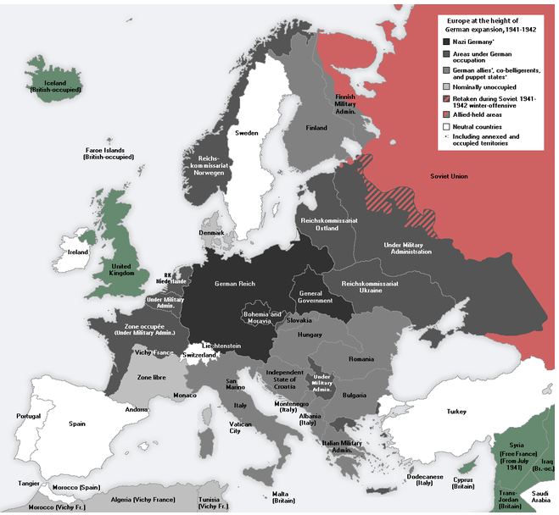
Europe under Nazi domination

Slide 12
Central Europe at the beginning of WW II
Austria
After Anschluss in March 1938 (Fall Otto) Austria became a part of German territory
In April a plebiscite that confirmed annexation of Austria into Nazi Germany

Slide 13
Central Europe at the beginning of WW II
Hungary
Territorial gains – from Czechoslovakia, Rumania and Yugoslavia
Hungarian nazism
1940 - joined Axis Berlin – Rome – Tokyo
Participated on the invasions of Yugoslavia and of the Soviet Union

Slide 14
Central Europe at the beginning of WW II
Poland
Endangered by Germany but also by Soviet Union
Attacked by Nazi Germany on 1st September 1939 without declaring war on Poland
17th September – USSR attacked Poland and occupied eastern part of Poland
So called “ New Partition of Poland“ – western part under German Reich, central part – General Gouvernement (with the capital city of Krakow) – the head Hans Frank, eastern part – occupied by USSR
Many concentration camps in Poland – Auschwitz, Majdanek, Sobibor, Treblinka ...
Segregation of Jews – a big ghetto in Warsaw – from April to May 1943 – Warsaw Ghetto Uprising
Out of Poland's prewar Jewish population of 3 million, only about 369,000 survived
Polish resistance movement – Polish goverment in exile with Władysław Sikorski as Prime Minister, in Poland the Home Army (Armia Krajowa) and the Peoples Army (Armia Ludowa)

Slide 15
Map of New Partition of Poland
1939 - 1941
After 1941

Slide 16
Central Europe at the beginning of WW II
Czechoslovakia
In Czechoslovakia numerous German minortity, Sudeten German Party, leader Konrad Henlein
April 1938 – Carlsbad Decrees demanding the authonomy for Sudeten Germans and the freedom to profess Nazi ideology, Sudeten Germans expected that President Beneš will refuse their exaggerated requirments
Czechoslovak government was forced to coclude an agreement with Henlein but he refused all their suggestions according to Hitler´s instructions
Several negotiations on Czechoslovakia between Adolf Hitler and British Prime Minister Neville Chamberlain during September 1938

Slide 17
Central Europe at the beginning of WW II
15th September – Berchtesgaden – Great Powers were putting pressure on Czechoslovak government to accept Hilter´s requirments – he wanted Sudeten, firstly Czechoslovak government refused British and French pressure but on 21st September was forced to accept Hitler´s requirments
22nd September – Bad Godesberg – new Hitler´s requirments – he wanted to occupy Czechoslovak fortification and some border areas for Poland and Hungary
Hitler announced that he will attack Czechoslvoakia on 28th September (according to the Fall Grün prepared already in April 1938)
Change of the government in Czechoslovakia – Prime Minister General Syrový
23rd September – general mobilization in Czechoslovakia

Slide 18
Central Europe at the beginning of WW II
29th to 30th September – Negotioations of Great Powers in Munich (Germany – Hitler, Italy – Mussolini, Great Britain – Chamberlain, France – Daladier) – about Czechoslovak frontiers and German requirments but without Czechoslovakia – France and Great Britain were Czechoslovak allies but they signed the agreement with the enemy:
Munich Agreement, Czechoslovakia (Czechoslovak troops) had to evacuate Sudeten and cede it to Germany
The USSR did not reply for the Czechoslovak application for the help
From 1st to 10th October Czechoslovak borderland was occupied by German troops and annexed to Germany, Poland got the area around Těšín and Spiš, Hungary got Carpathian Ruthenia and southern parts of Slovakia
Czechoslovakia lost 1/3 of its area, 1/3 of light industry, in southern Slovakia fertile soil important for agriculture was lost
The First Czechoslovak Republic was dissoluted, so called Second Czecho-Slovak Republic till March 1939 – President Emil Hácha, no parliamentary democracy anymore
7th October – autonomy of Slovakia was proclaimed – Czecho–Slovakia

Slide 19
Munich Agreement
September 1938 – Munich Agreement – lost of Sudetenland
March 1939 – establishing of Protectorate Bohemia and Moravia
March 1939 – Slovak State

Slide 20
Central Europe at the beginning of WW II
13th March 1939 – Slovak Prime Minister Jozef Tiso was invited into Berlin – he was made to enforce the separation of Slovakia
14th March 1939 – Slovak State was proclaimed, dependent on Germany
14th March 1939 – President Emil Hácha and Foreign Minister František Chvalkovský invited to Berlin – Hitler threatened with bombing of Prague – they were forced to sign the document asking Germany for protection what was in fact forced capitulations
15th March 1939 – German army occupied Bohemia and Moravia – dissolution of Second Czechoslovak Republic
16th March 1939 – the occupants proclaimed Protectorate of Bohemia and Moravia – it was part of German Reich, formaly autonomous state with so called State President Emil Hácha and Prime Minister Rudolf Beran but the real power was in hands of Reichsprotektor Konstantin von Neurath and later Reinhard Heydrich

Slide 21
Central Europe at the beginning of WW II
Jews were dismissed from the civil service and placed in an extralegal position
The Czechs launched secret resistance movement to Nazi occupation, Czechoslovak Government in exile in London
Mass demonstrations in October 1939 – the anniversary of establishing of Czechoslovakia – one student Vojtěch Sedláček was shot to death and the second one – Jan Opletal was seriously injured and died later, his funeral on 15th November became a new mass manifestation
The Nazis started an intervention against students on 17th November 1939 – 9 students were executed, 1200 of them deported into concentration camp in Sachsenhausen, all the Universities in Protectorate were closed (→ International Students´ Day)

Slide 22
Readings
Seton-Watson, Hugh: Eastern Europe 1918 – 1941. Hamden 1962.
Rotschild, Joseph: East Central Europe between the Wars. Seattle 1974.
Voráček, Emil and others: The Disintegration of Czechoslovakia in the end of 1930s. Policy in Central Europe. Prague 2009.
http://www.holocaustresearchproject.org/toc.html

Slide 23
Growing power of the Soviet political system in these states
Policy of these states should had been directly under the control of Soviet Union
1946 – 1948 emergency of the bloc of the states with so called Democratic People's Republic of…
Out of direct sphere of influence – Greece, since 1955 Austria and Finland
1947 establishment of Infobyro – organization, Soviet government was able to control and lead the other communistic parties
Growing leftist governments in West Europe

Slide 24
Liberation of Central Europe
The Soviet Red Army
Since March 1943 to May 1944 – the territories in the Ukraine were liberated
August 1944 – Nazi regime in Romania was overthrown
September 1944 – also Bulgaria became a member of anti-Nazi alliance
Yugoslavia – strong resistance movement – communists (Partisans) under the leadership of Josip Broz Tito, in October 1944 – Belgrade was liberated with the help of Red Army, the rest of Yugoslavia liberated mostly by Partisans
From October 1944 till February 1945 – fights in Hungary, siege of Budapest

Slide 25
Liberation of Central Europe
In April 1945 German-Hungarian forces finaly pushed from Hungary to Austria
February 1945 Poland (17th February – liberation of Warsaw)
In January 1945 – the Provisional Governement in Poland – with Soviet support
Members of anti-German resistance movement that remained loyal to London exile government were arrested by the Soviets, many of them exiled
The conflict in Poland continued – since 1943 – Polish-Ukrainian War

Slide 26
Liberation of Central Europe
From 29th August 1944 till the end of October 1944 – the Slovak National Uprising – the Partizans and members of so called First Czechoslovak Army against German occupation
September to November 1944 – Red Army crossed border mountains after cruel fights and entered Slovakia (Battle of the Dukla Pass – 22,000 soldiers of Red Army were killed)
Then the Red Army advanced throw Slovakia towards Vienna, during this advance Bratislava was liberated (4th April 1945), then Brno (26th April) and Ostrava (30th April)
General Ludvik Svoboda, Commander in Chef of the First Czechoslovak Army

Slide 27
Red army x American army

Slide 28
Liberation of Central Europe
Western part of Bohemia was liberated by American troops under the command of general George S. Patton but the Soviets asked Americans to stop in Pilsen and not to continue to Prague
5th May 1945 – the May Uprising of Bohemian People in Prague and then in the whole country
Soviet Generals refused an offer of General Eisehower – he wanted to send American troops to help the uprising but the Soviets wanted to liberate Prague themselves
8th May 1945 – liberation of Prague and the end of the WW II in Europe

Slide 29
Liberation
States of Central and Southeast Europe were liberalized mainly by Red Army
From Czechoslovakia and Yugoslavia Red Army left immediately, but in Romania, Hungary, Poland, Finland and in occupied zones (Austria, Germany) stayed

Slide 30
Liberation of Central Europe
30th April – Hitler committed suicide
2nd May – Fall of Berlin
7th May – capitulation of Germany – confirmed again at night from 8th to 9th May
July 1945 – the Allied leaders met in Potsdam, Germany – this conferrence confirmed earlier agreements about Germany – so called “Programme of four D“ (denazification, demilitarization, democratization and decartelization)
Also the resettlement of German minority from Czechoslovakia, Poland, Hungary and Yugoslavia
August 1945 – International Trial in Nüremberg – after almost one year of trial 12 prominent Nazis sentenced to death

Slide 31
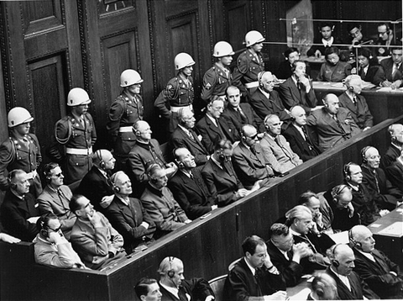
Nuremberg Trial
November 1945 – October 1946
24 Nazi functionaries were accused of crimes against peace and humanity
12 executed
http://www.youtube.com/watch?v=kWR2I5Q9d9U

Slide 32
Summer 1945, Potsdam
J.V. Stalin, H. Truman, W. Churchill /C. Attlee

Slide 33
Conference - Potsdam
Main goals: 1. united Germany – 4 occupation zones only temporary
Plan 4 “D” – demilitarization, democratization, denazification, decartelization
New boards – polish boards
Expulsion of Germans from Poland, Czechoslovakia, Hungary
War reparations - products and raw materials
Punishment of war criminals

Slide 34
Liberation of Central Europe
Germany divided into four ocuppation zones – French in the southwest, British in the northwest, United States in the south, and Soviet in the east, also Berlin, which was situated in the Soviet zone, was divided into four occupation zones
All the territorries that Germany had occupied (Austria, Czechoslovakia …) were detached
Germany lost some territories for Poland and Russia, new Polish frontiers on the Oder-Niesse line
Millions of ethnic Germans expelled from Czechoslovakia, Poland and Hungary returned to Germany

Slide 35
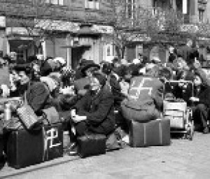
expulsion of the German population
May 1945 – wild expulsion (15,000 – 30, 000)!! - displacement and expulsion of German populations, Saxon, Austria – 660, 000
http://www.youtube.com/watch?v=g6IFfQdM7EI&feature=related

Slide 36
Potsdam Conference and expulsion
August 1945 – transfer of German populatin form Czechoslovakia and Poland, expulsion of Hungarian population was not agreed
Related President´s Decrees - revoke citizenship, National Administration of firms, confiscation of land
Immovable property, valuables
Personal luggage 30 – 50 kilos
Organized transfer – 1946 - Allied Control council. 2, 256,000
1947 – 48 - Additional transfer - family reunification – 80, 000

Slide 37
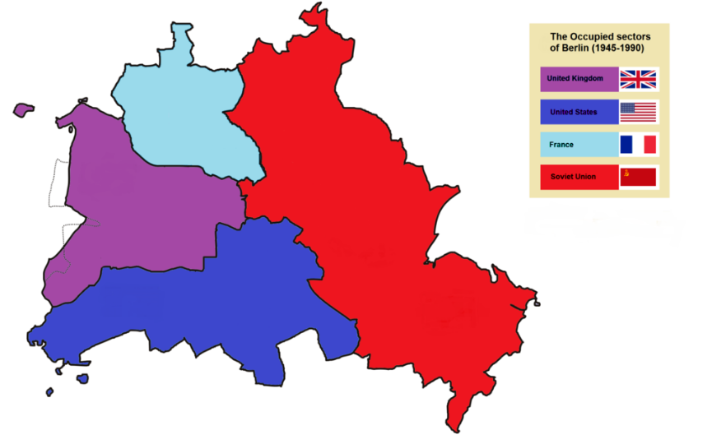
Liberation of Central Europe
Occupations zones in Berlin

Slide 38
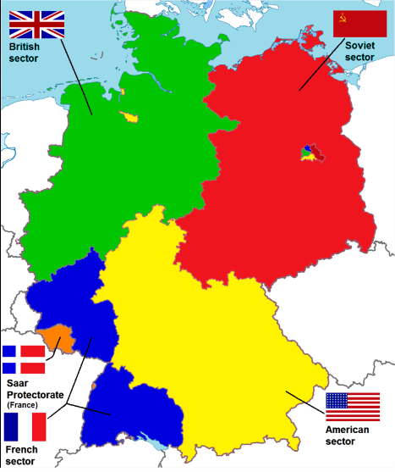
Liberation of Central Europe
Occupations zones in Germany

Slide 39
Peace Treaties
February 1947 Paris – Bulgaria, Finland, Italy, Hungary, Romania
With Germany and Japan – NEVER signed (conference in Moscow - contradictions between the powers – how should be Germany organized – centralized x federated)

Slide 40
Central Europe after WW II
WW II lasted for 2.194 days
30 states, operations – 40 states
110 millions of men and women (army)
Neutral – Ireland, Portugal, Spain, Sweden and Swiss
Soviet Union – 27 millions, China – 10 millions, Germany – 6 millions, Poland – 6 millions, Japan – 2.5 millions,…
Germany - the principle of collective guilt

Slide 41
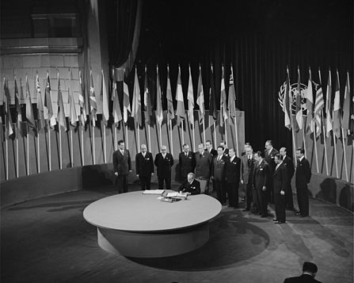
WW II and new world order
New superpowers: US and Soviet Union (defeated Nazi Germany), in Asia – growing China
New trend in European policy – left
US – the strongest world economy
April 1945 – OSN - United Nations charter, Security Council, General Assembly (50 states, today more then 193, international law, international security, economic development, social progress, human rights, and achievement of world peace, replaced the League of Nations, to stop wars between countries, and to provide a platform for dialogue. It contains multiple subsidiary organizations to carry out its missions)

Slide 42
US x Soviet Union
After the common enemy was defeated – relation between US and Soviet Union became worse and slowly the rivalry began
US – better economy, atomic bomb, technically better equipped army
Soviet Union – huge material lost, but still very powerful army – aroused American respect
After Japan was defeated – H. Truman – stop supplying – first step: from alliance to enemies (Lend-Lease aid)

Slide 43
Beginning of the Cold War
1947 - H. Truman – Doctrine against Communism
http://www.history.com/speeches/the-truman-doctrine
1946 – W. Churchill – Iron Curtain
http://www.youtube.com/watch?v=jvax5VUvjWQ
1946 – G. Marshall – Marshall Plan, Czechoslovakia and Poland had to refuse – definitive line between East and West
http://www.oecd.org/general/themarshallplanspeechatharvarduniversity5june1947.htm

Slide 44
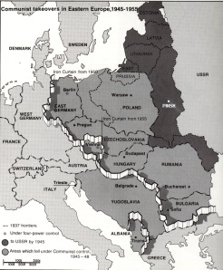
Cold War
No open military conflict
Rivalry: policy, economy, science, culture and sport,…very dangerous phenomenon of the conflict East and West was armaments

Slide 45
Emergency of 2 German states
Soviet Union x West Bloc
In western occupation zones – 4 political parties, election, institutions under the occupation power gave the political power to new local governments
In soviet zone – one party (communists and social democrats), land reform, nationalization of some factories and denacification (schools, offices)
June 1948 - 3 zones – monetary reform, reparation was cancelled, Marshall Plan

Slide 46
Germany and Berlin

Slide 47
Germany
Extreme poverty
The black market - American cigarettes
Rationing is the controlled distribution of scarce resources, goods, or services. Rationing controls the size of the ration, one's allotted portion of the resources being distributed on a particular day or at a particular time.
US and GB – 1. 1. 1947 – Bizone and April 1948 Trizone
June 1948 – decision to establish Germany (3 zones) – Soviet reaction – occupation of western ways to Berlin - collapse in supplying the city- Berlin Crises

Slide 48
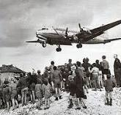
Common control of Germany was finished
J.V. Stalin – to oust western army from Berlin – centre of the soviet zone
June 1948 Soviet army started to block Berlin
Berlin crises (http://www.trumanlibrary.org/whistlestop/BERLIN_A/PAGE_11.HTM)
September 1949 – Federal Republic of Germany, Konrad Adenauer, Independent position – West Berlin
October 1949 - GDR

Slide 49
GDR
President W. Pieck
Soviet control
Establishing - two German states - completed struggling for the post-war order in Europe

Slide 50
Soviet bloc – general info
J.V. Stalin – new wave of terror, no criticism, labor camp
http://www.google.cz/search?q=soviet+working+camps&hl=cs&prmd=imvns&source=lnms&tbm=isch&sa=X&ei=pR2ZUMrwCIjEswaM8oHIBA&ved=0CAcQ_AUoAQ&biw=1008&bih=619
extreme poverty x extreme investment – army
Crises of agriculture, 1946 - crop failure
Soviet policy - Soviet-bloc countries were subordinate Moscow, Soviet advisers in Security forces
1949 - Council for Mutual Economic Assistance

Slide 51
1949 Council for Mutual Economic Assistance - Soviet Union – economical power – control over the national economies, members: Soviet Union, Albania, Bulgaria, Romania, Czechoslovakia, Poland, Hungary, East Germany,…Cuba, Mongolia and Vietnam
Political (Show)trials – ag. Communist and non – communists - accused of subversive activities, effort to find the culprit responsible for economic problems and effort to discourage people from disagreeing with the regime
50´s Hungary, Bulgaria, Czechoslovakia,…
Milada Horaková

Slide 52
Nationalization of industry, prohibitions and restrictions on private enterprise and the peasants were forced to join the collective farm
Hardest enforcement - Soviet interests ended in 1953
http://www.youtube.com/watch?v=T-EwVVm89og

