Slide 1
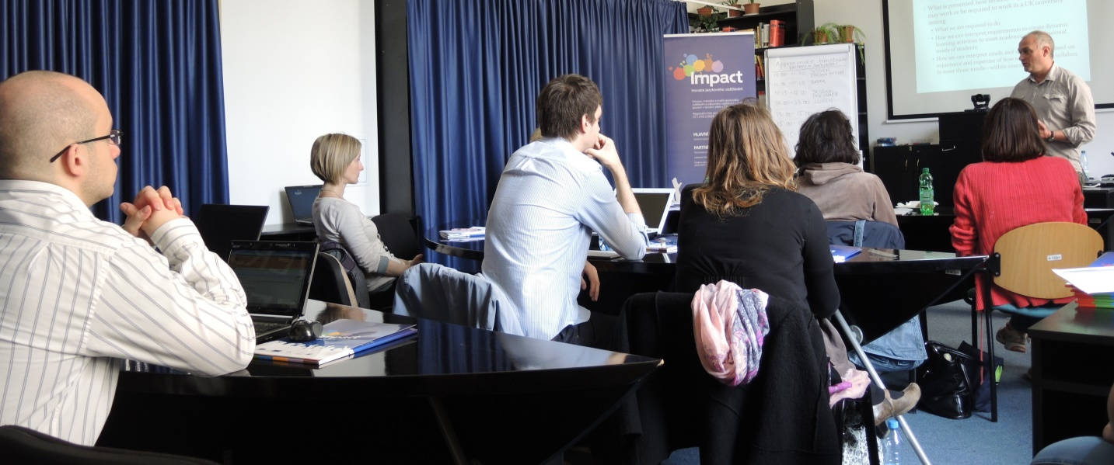


ACADEMIC SKILLS IN ENGLISH
Summer School
Masaryk University Language Centre
Monday 10th July to Friday 14th July 2017
Brno
Notes:
1

Slide 2
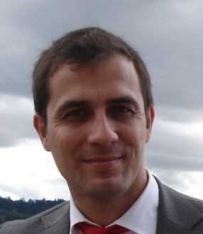
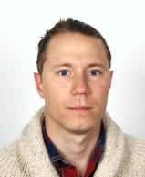
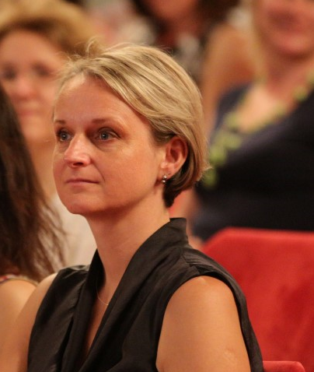
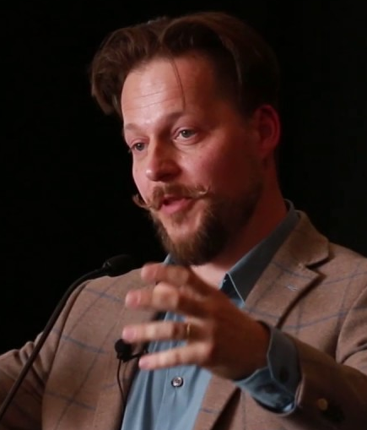
Tutors
Paul van Hooft
Colin Kimbrell
Alena Hradilová
Libor Štěpánek

Slide 3
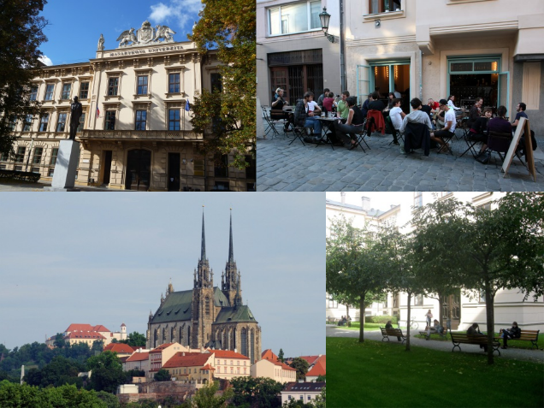
Timetable (Monday to Friday)
08:30 - 09:00 Morning Coffee
(in front of the classroom 206)
09:00-10:30 Workshops
10:30-11:00 Coffee Break
(in front of the classroom 206)
11:00-12:30 Workshops
12:30-14:00 Lunch Break
14:00-15:30 Workshops

Slide 4
ACADEMIC SKILLS IN ENGLISH
Summer School 2017
 | 09:00-10:30 | 11:00-12:30 | 14:00-15:30 | Cultural Events
Monday | Introduction to the school: English as a Medium of Instruction (EMI) Libor Štěpánek | EMI: Essential skills and areas of focus Colin Kimbrell | Specificities of EMI in diverse academic fields Alena Hradilová
Tuesday | Micro-teaching activities Alena Hradilová | English speaking skills for seminar discussions Paul van Hooft | English speaking skills for lectures Alena Hradilová
Wednesday | Theses supervision Paul van Hooft | Audio-visual aids for teaching; Interactive teaching and flipped classroom Libor Štěpánek | Feedback and assessment techniques Paul van Hooft
Thursday | English writing skills for teaching Colin Kimbrell | Micro-teaching activities Alena Hradilová | Dynamics in multicultural classes Libor Štěpánek | Summer School Dinner
Friday | Micro-teaching practice Alena Hradilová Colin Kimbrell | Micro-teaching practice Alena Hradilová Colin Kimbrell | Feedback discussion Alena Hradilová Libor Štěpánek

Slide 5
?

Slide 6
Introduction

Slide 7
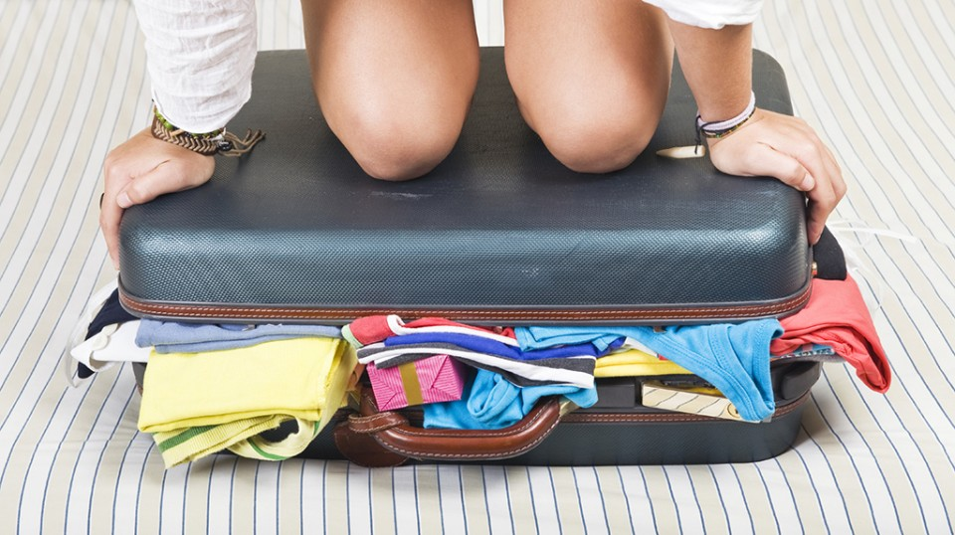

Slide 8
Lines of attitude / interest / confidence/
teaching

Slide 9
Lines of attitude / interest / confidence/
teaching
English

Slide 10
Lines of attitude / interest / confidence/
teaching
English
communication with students

Slide 11
Lines of attitude / interest / confidence/
teaching
English
communication with students
EMI

Slide 12
questionnaires
A
AB
AC
ABC
B
C
BC

Slide 13
We wish you
a happy summer school!
The Organisational Team
Notes:
13

